Slide 1
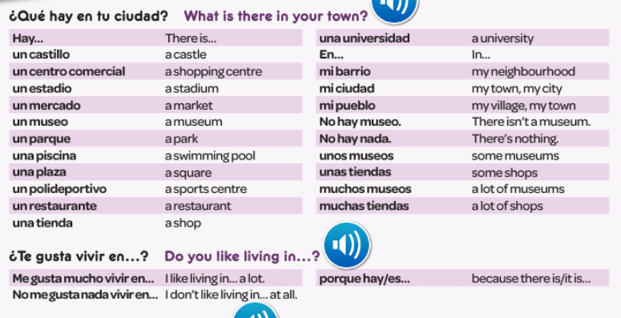
Spanish yr8. This week is assessment week so spend time revising the vocabulary we have learned this term.
The vocabulary for the whole unit is on this powerpoint. Please go through it and make a revision poster/flashcards to help you learn it.
Contact your MFL teacher for the assessment papers if you know you will be away for the lesson when the tests are taking place.

Slide 2
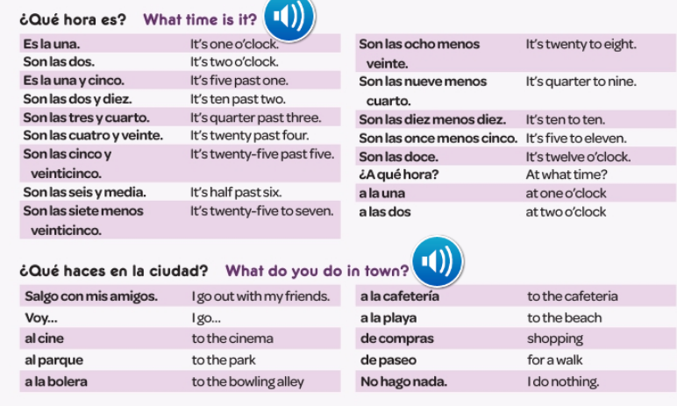

Slide 3
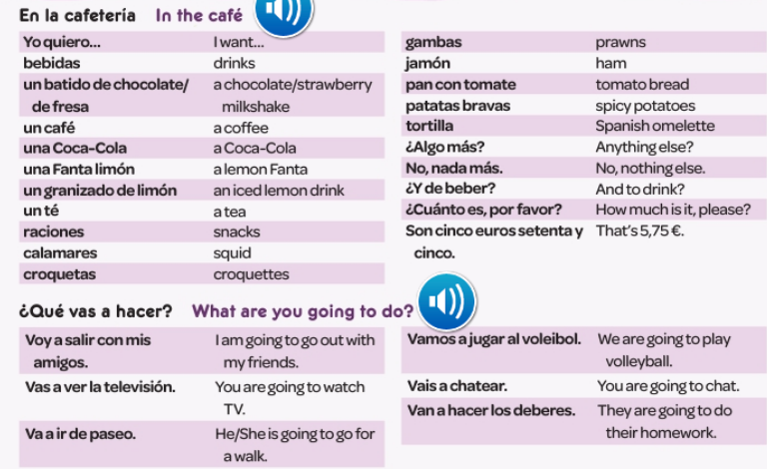

Slide 4
