Slide 1
German yr8. Work through as many of the activities as you can.
Task 1 –Listen to the track and read along. Who is in the photo? Look up any new words you don’t know and add them to your orange book

Slide 2
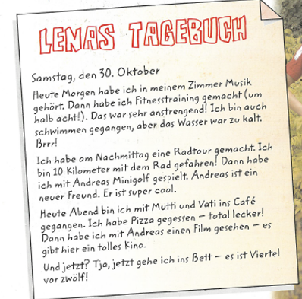
Task 2. Read the text again and put the pictures below in the order they took place, example b,….

Slide 3
TASK 3 – Read the text again and complete the sentences

Slide 4
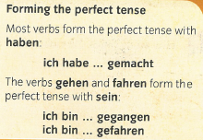
TASK 4. Read the information about forming the perfect tense (past tense). Note that with the verbs gehen and fahren you don’t use ich habe you use ich bin. They both mean I went. Gefahren implies transport was used.

Slide 5
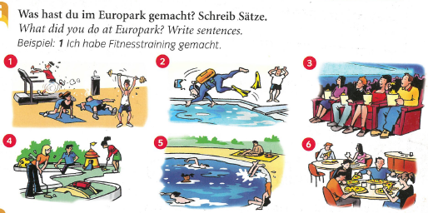
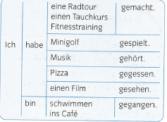
TASK 5 – Using the table to help, and your vocab sheet, write sentences for the 6 pictures. Look at the example ‘Beispiel’ to help you

