Slide 1
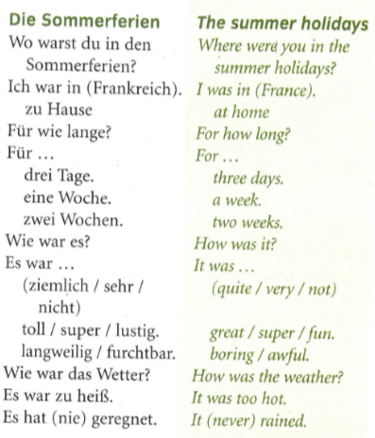
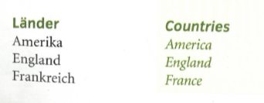
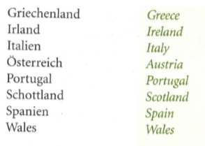
German yr8. Work through as many of the activities as you can.
Task 1 -Read through this week’s vocab. Try and learn the countries and summer holiday words

Slide 2
Task 2. Match up the postcards with the countries written in the cloud.

Slide 3
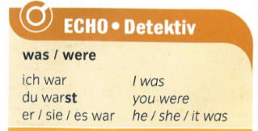
TASK 3 – Listen to the people talk. Where did they go and how long were they there for?
TASK 4 – Copy out this grammar in to your books and learn it. It is very important

Slide 4
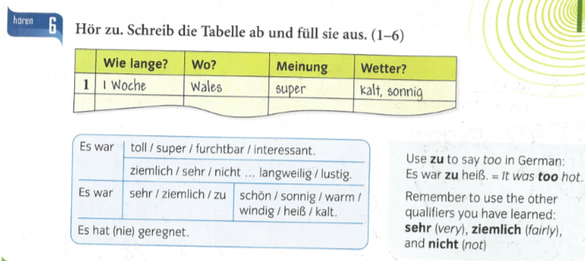
TASK 5. Write down 1-6 in the back of your books Copy out the table and fill it in.
Wie lange? How long? Wo? where? Meinung opinion Wetter? Weather?

Slide 5
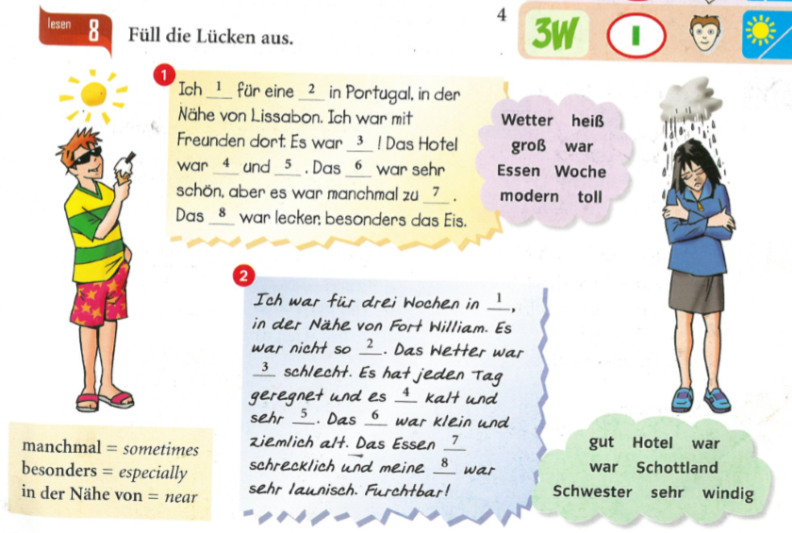
TASK 6. Fill in the gaps with the missing words. The choices are in the clouds

Slide 6
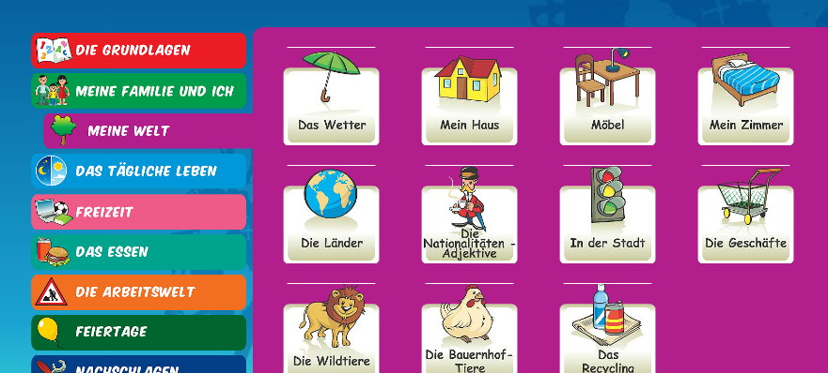
Log in to Linguascope. Username is Kingshill Password is bonjour123
Practise the vocab for the countries in the beginner section.

