Slide 1
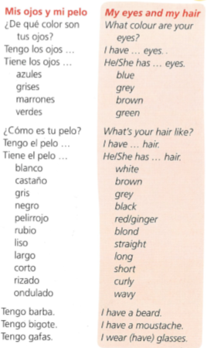
Spanish yr7. Work through as many of the activities as you can.
Task 1 -Read through this week’s vocab. Try and learn the descriptions of hair and eyes

Slide 2
Task 2. Write down 1-5 in the back of your book. Listen to the track and the description of their eyes. Which person is being described?

Slide 3
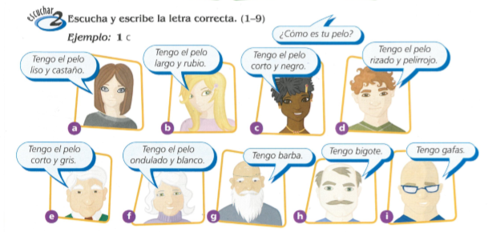
TASK 3 – Write down 1-9 in the back of your book. Listen to the track and the description of their hair. Which person is being described?

Slide 4
TASK 4. Write down a short description of what you look like

Slide 5
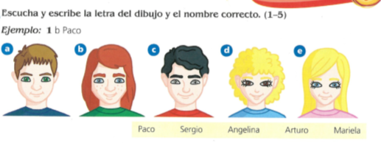
TASK 5 – Write down 1-5. Which person is being described and what is their name?

Slide 6
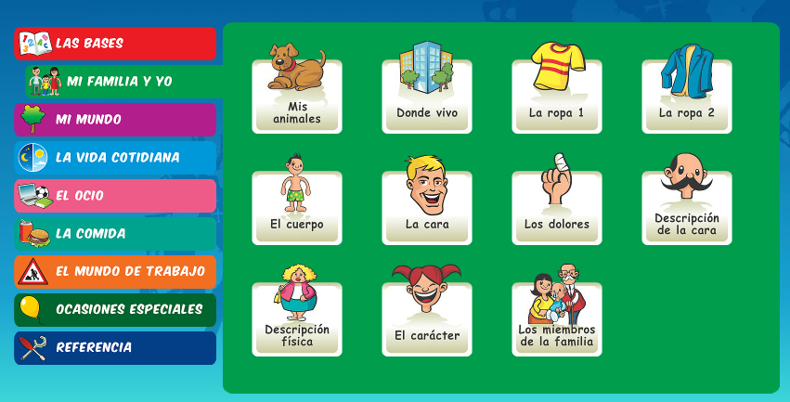
Log in to Linguascope. Username is Kingshill Password is bonjour123
Practise the vocab for describing faces in the beginner section.

