Slide 1
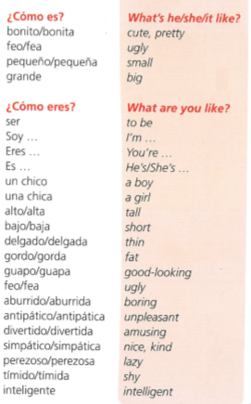
Spanish yr7. Work through as many of the activities as you can.
Task 1 -Read through this week’s vocab. Try and learn the adjectives
Notice that adjectives sometimes have different endings in Spanish depending on whether you are describing something masculine or feminine

Slide 2
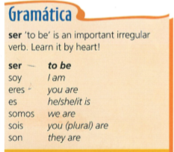
Task 2. Read through the grammar and copy it down

Slide 3
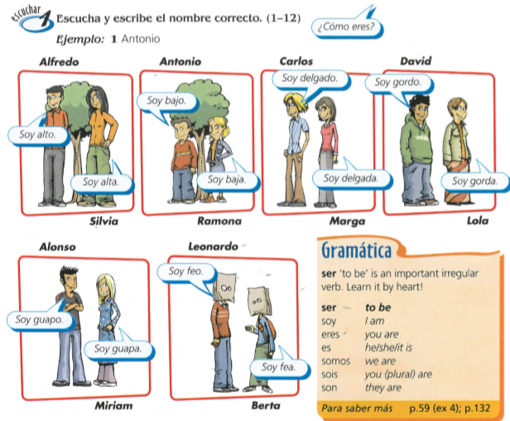
Task 3. Write down 1-12 in the back of your book. Listen to the description. Which person is being described? Write down the name of the person who is being described.

Slide 4
TASK 4 – Write sentences describing 3 members of your family. Make sure the adjective ending matches the gender of the person you are describing
Example…

Slide 5
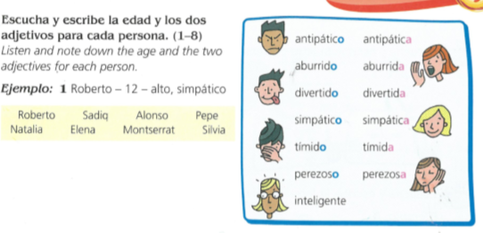
TASK 5. Write down 1-8 in the back of your book. Listen to the track. Write down the age and two adjectives for each person in Spanish.

Slide 6
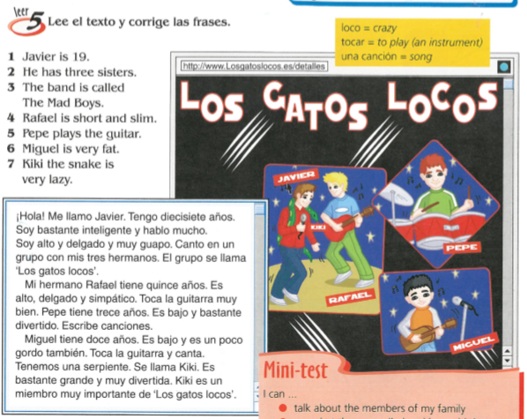
TASK 6 – Read the passage and then correct the 7 sentences.

