Slide 1
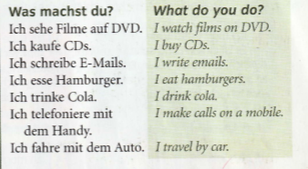
Year 9 German term 5 week 5
Spend some time learning the vocab for this week.

Slide 2
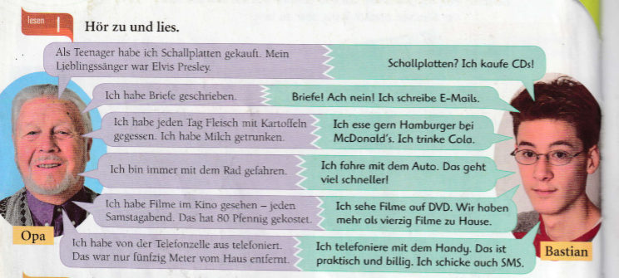
Read through the sentences about how Bastian lives now compared with how his grandad lived as a teenager. Look up any words you don’t know. You can listen to them talk as well.

Slide 3
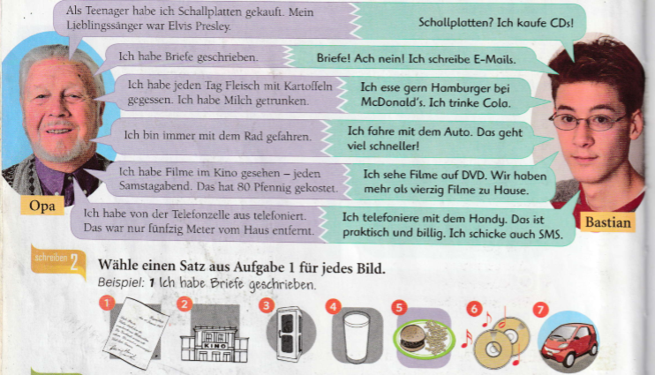
Write a sentence for each of the 7 pictures below.
Choose the sentences from the texts about Opa and Bastian.

Slide 4
Read through the sentences below as a reminder of the difference between present tense on the left and the past tense on the right.

Slide 5
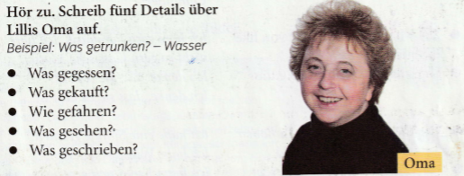
Listen to the track. Write 5 key details about Lilli’s granny in German.
gegessen (ate)
gekauft (bought)
gefahren (went/travelled to)
gesehen (saw)
geschrieben (wrote)

Slide 6
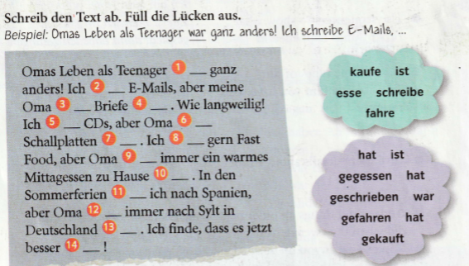
Fill in the gaps in the text from words at the right hand side of the slide in the clouds.

