Slide 1
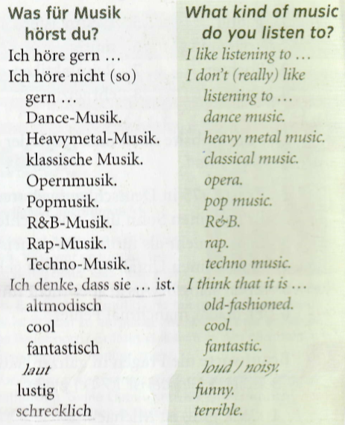
Year 9 German term 5 week 2
Spend some time learning the vocab for this week.

Slide 2
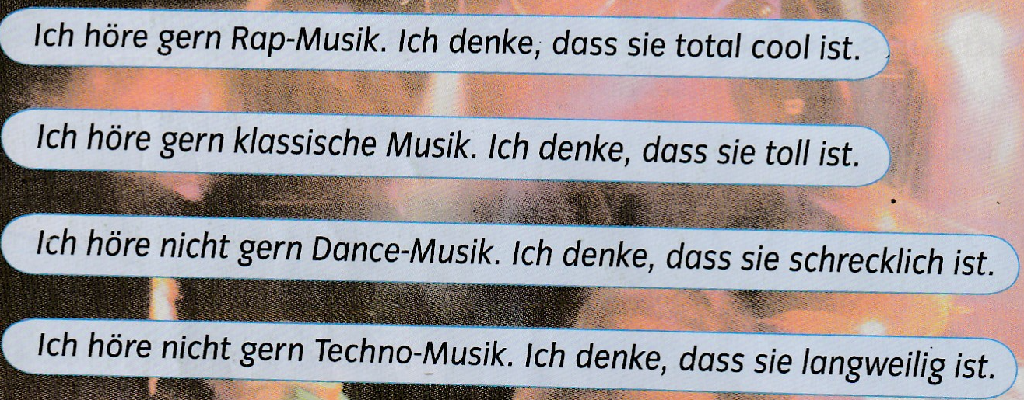
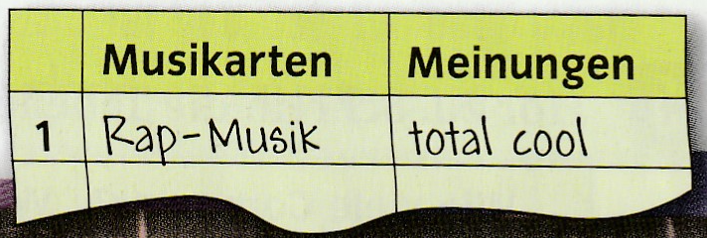
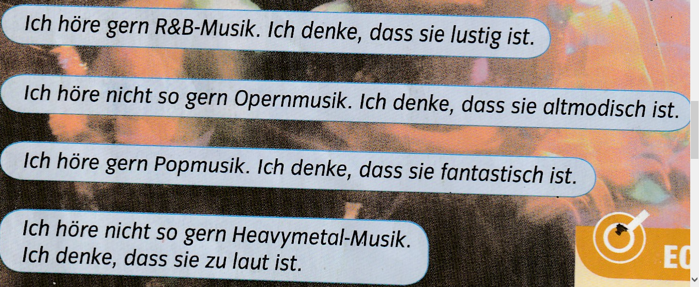
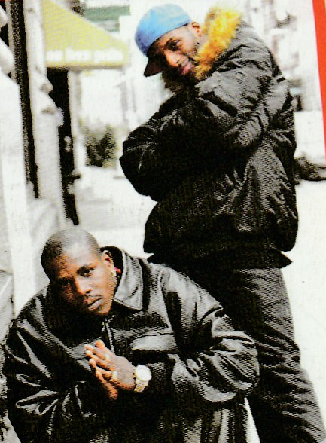
Read the sentences below. Copy out the table and fill it in (in German). Musikarten=type of music Meinungen=opinions

Slide 3
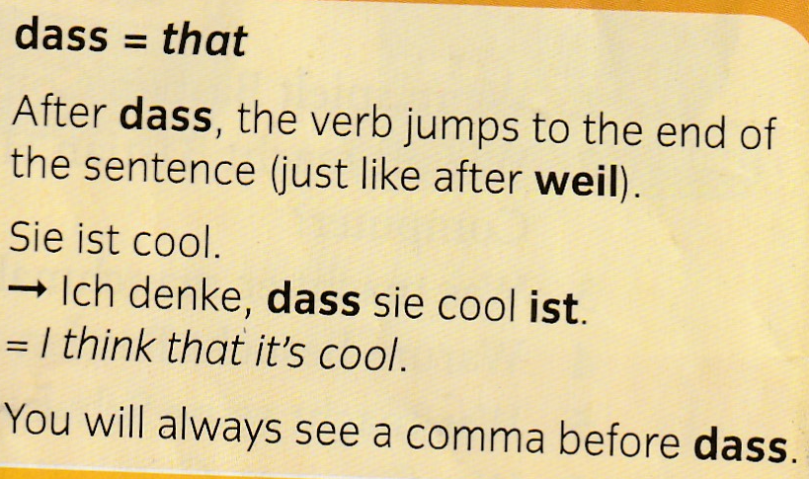
Copy out these grammar notes and learn them.

Slide 4
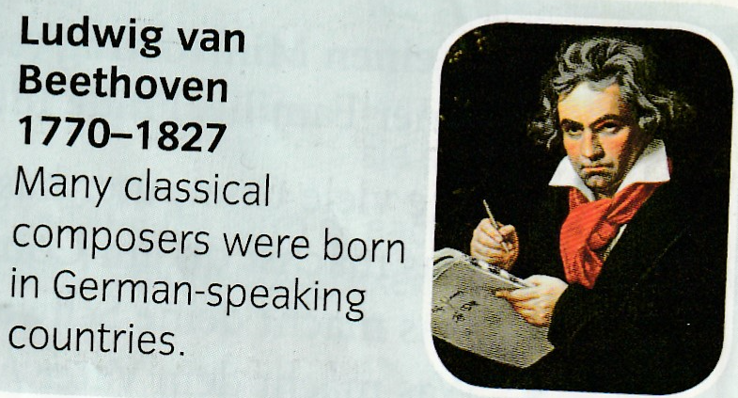
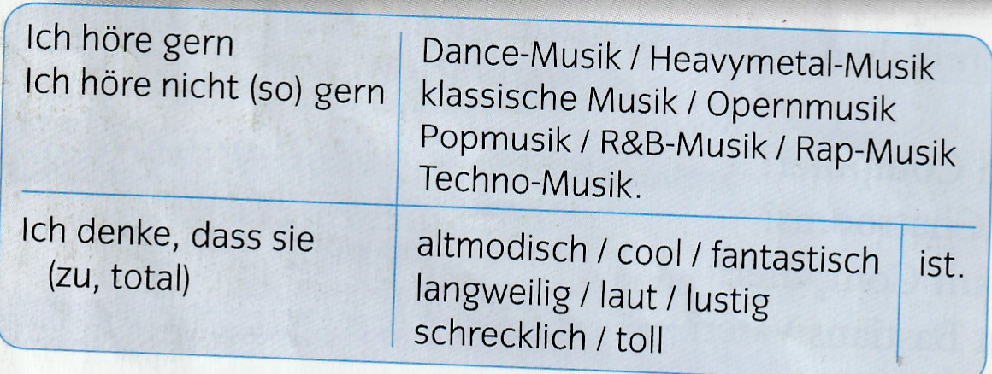
Write out some sentences in German giving your opinion on music. Use the example below and the table to help you.

Slide 5
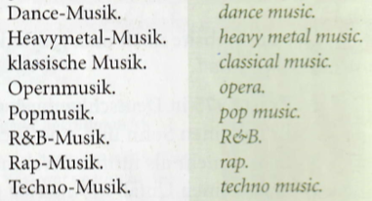
Write down 1-8 in the back of your book and a listening symbol. Listen to the tracks. What kind of music do you hear? Write your answer in German. The first one is done for you below as an example.

Slide 6
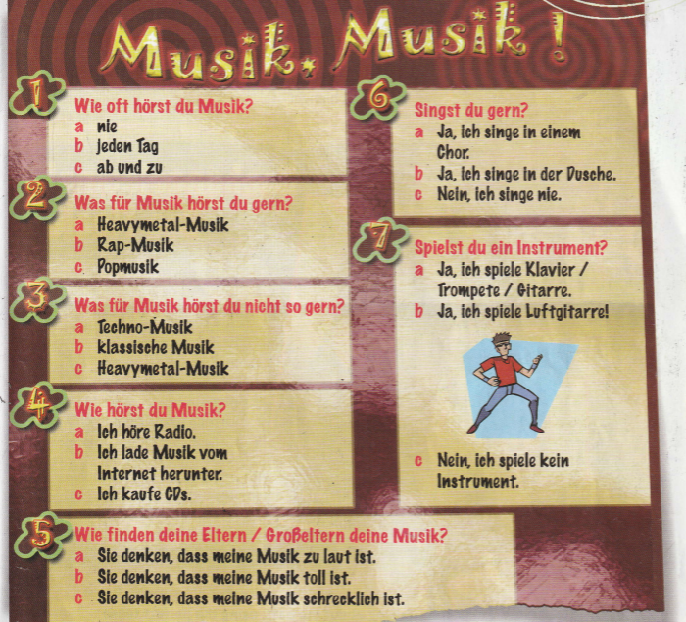
Write down 1-7 in the back of your book and a listening symbol. Listen to the track. Write down the answers Jakob gives to the questions below.
Example 1b

