Slide 1
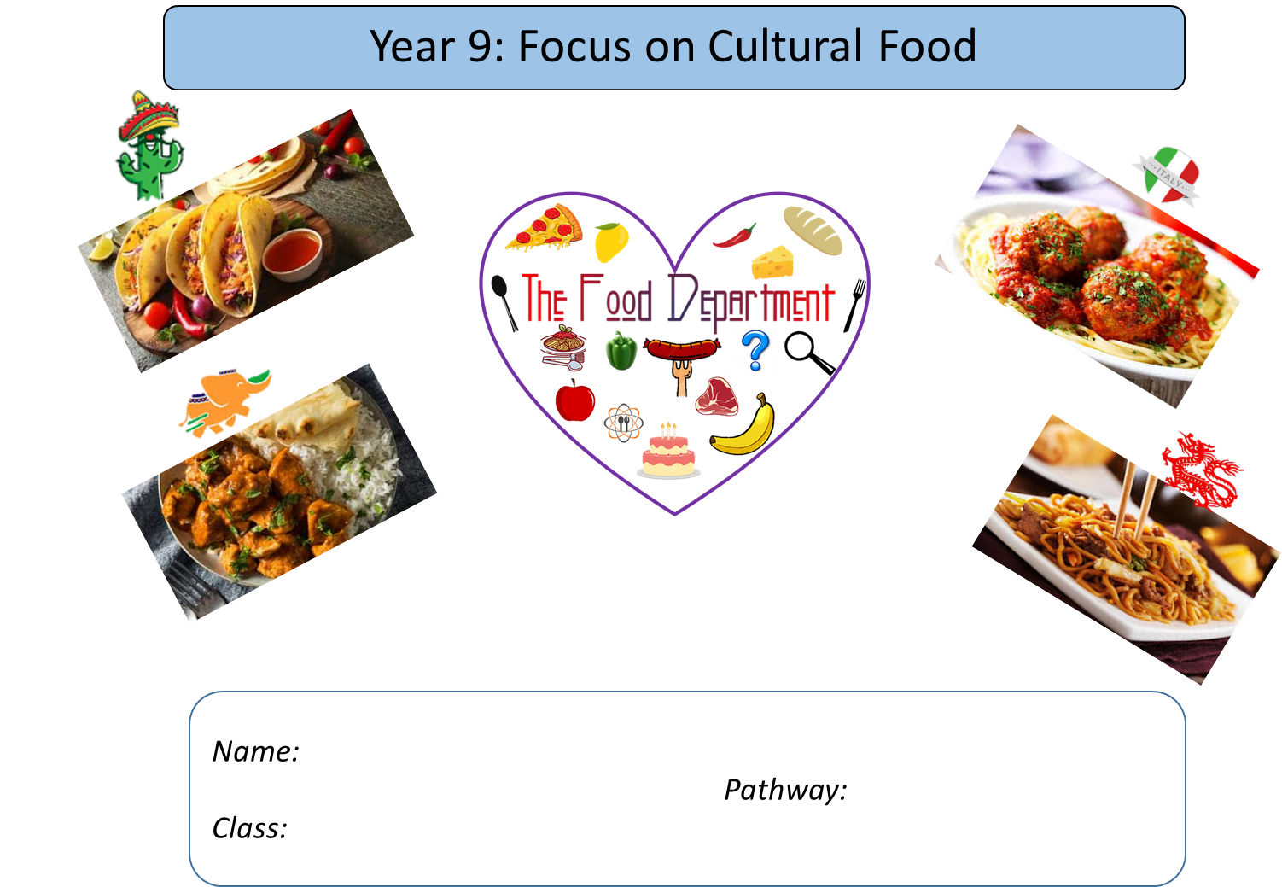

Slide 2
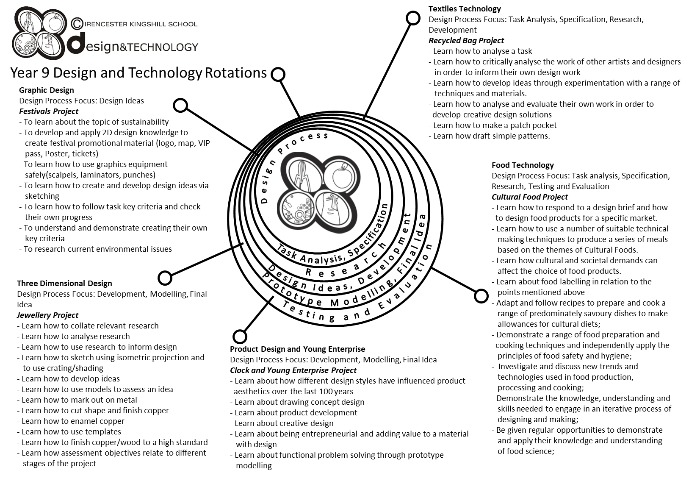

Slide 3
Year 9 pathways criteria – written work
Year 9 Foundation | Year 9 Secure | Year 9 Confident | Year 9 Exceptional
A title page showing the following from your chosen country: a flag, a map, main language spoken and famous people/chefs from that country. | All criteria met from the previous pathway, plus the population and main religions of that country. | All criteria met from previous pathway, with a discussion on at least three areas (e.g. religion, staple foods etc.) | All criteria met from previous pathway, with a discussion on at least five areas (e.g. religion, staple foods etc.)
A map of your chosen country stating the capital and three famous dishes from that country. | A map of your chosen country stating the capital and three famous dishes from that country, names of famous cities and landmarks. | A map of your chosen country stating the capital and three famous dishes from that country, names of famous cities, landmarks, and staple foods grown and produced in that country. | All criteria met from the previous pathway with a discussion on the sustainability on staple foods grown and produced in that country.
You have chosen your dish and have adapted a recipe from the book stating what new flavours you are choosing from your chosen country. | All criteria met from the previous pathway with one alternative dish you have also adapted that is influenced from your chosen country. | All criteria met from the previous pathway with two alternative dish you have also adapted that is influenced from your chosen country. | All criteria has been achieved with reference made to Social, Moral and Ethical issues (cost, religious influences etc.)
You have written your plan of making showing a start and finish time. | You have written your plan of making showing a start and finish time and some timings throughout. | You have written your plan of making showing a start and finish time, and some timings throughout. You have made reference to at least three control points. | You have written your plan of making showing a start and finish time, and some timings throughout. You have detailed control points.

Slide 4
Year 9 pathways criteria – practical work
Year 9 Foundation | Year 9 Secure | Year 9 Confident | Year 9 Exceptional
Some ingredients and equipment handled with reasonable control. | Most ingredients and equipment handled with co-ordination. | Most ingredients and equipment handled with excellent competence and co-ordination. | All ingredients and equipment handled with excellent competence and co-ordination.
Needed a little assistance. | Mostly independent – a little assistance. | Completely independent. Demonstrating good organisation. | Completely independent. Demonstrating a high level of organisation.
Mostly worked in a hygienic and safe manner. | Worked in a hygienic and safe manner. | Consistently worked in a hygienic and safe manner. | Consistently worked in a hygienic and safe manner.
Finished practical dish. | Finished on time. Sink and equipment cleaned and finished product packed away. | Finished well within the time limit. All equipment cleaned and finished product packed away, and extension work completed. | Finished well within the time limit. All equipment cleaned and finished product packed away, and extension work completed to a high standard.
Acceptable finish on end product. | Good finish to end product. | High quality product with excellent finish. | High quality product with excellent finish. Demonstrating good garnishing/decorating skills to finished product.

Slide 5


Food Technology – essential information
What to bring to school:
For each Food Technology lesson, you will need:
Your pencil case
Your planner
Your work booklet
When you have your practical lessons, you must also bring:
Your ingredients – weighed and measured
A lidded container to take your food home in, clearly marked with your name
For some practical lessons you may also need a dish/tin to cook the food in.
If you do not bring in ingredients – you will NOT cook
When you get to school
On the days that you have practical lessons, you must take your ingredients to the food room BEFORE registration.
Place your high-risk ingredients (meat, dairy, fish) in the fridge and your dry ingredients in the Cool Room.
After your practical lesson you must leave your food in the cool room and collect after afternoon registration.
Think about the environment. Try not to use too many plastic bags for your ingredients Try to reuse
plastic pots and bags. Use old margarine tubs/sweet tins instead.
It is essential that you leave your unit drawers and cupboards CLEAN and TIDY, ready for the next class.
Please sign to show that you have read and understood the essential information set out below.
Name………………………………………………… Signature………………………………………….. Date…………………………….

Slide 6
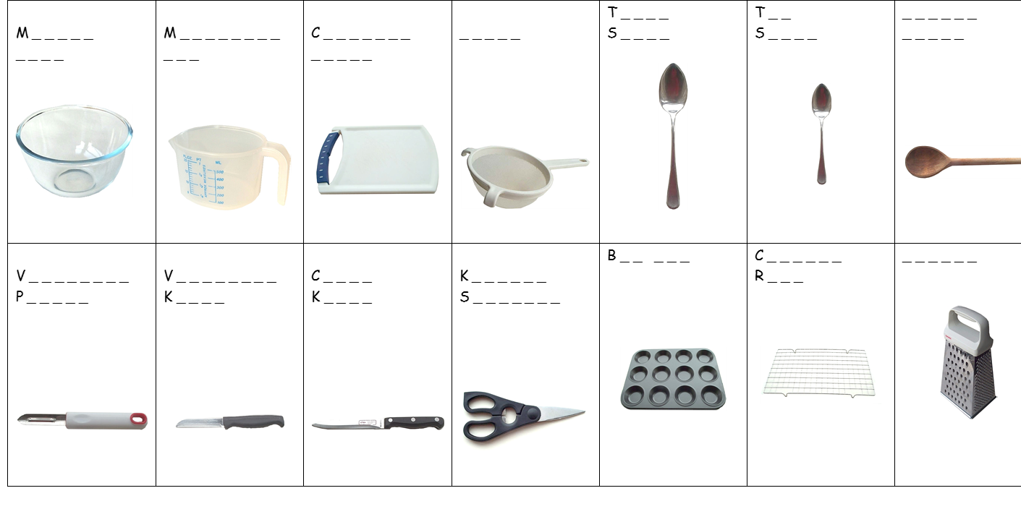
FOOD EQUIPMENT - SPELLING TEST
Identify the following pieces of equipment.

Slide 7
Health and Safety in the kitchen
The Food Technology classroom is one of the most dangerous rooms in the school. During the practical lessons, you will be using a range of equipment, such as sharp knives, ovens, hobs and electrical equipment. It is therefore really important that you follow strict health, safety and hygiene rules to reduce the risk of accidents and injuries.
Write down 10 Food Room Rules and give a brief explanation of why they are important.
1.
2.
3.
4.
5.
6.
7.
8.
9.
10.

Slide 8
Food Safety Quiz
Use your knowledge of Food Hygiene to answer the following questions. The following keywords will help you.
No | Diarrhoea | Warmth | Chilling | 5° - 63° | Cooking | Moisture | 75°
Food | Acidic | 72°+ | Nausea | Time | Salty | Vomiting | Bacteria
Red | Cleaning | 0° - 5° | Sugary | Once | Stomach cramps | 18° | Cross-contamination
 | Question | Answer
1. | What is the main cause of food poisoning?
2. | State 4 symptoms of food poisoning. | 1 2 3 4
3 | What conditions do bacteria need to multiply? | 1 2 3 4
4. | Name 3 conditions in which bacteria find it difficult to multiply. | S_ _ _ _ _ S_ _ _ _ _ A _ _ _ _ _
5. | What temperatures constitute the danger zone? Explain why.
6. | When cooked, what should the core temperature of food be?
7. | What temperature are most bacteria destroyed?
8. | What temperature should your fridge be kept at?
9. | What colour board should be used for raw meat? Explain why?
10. | What are the 4 C’s of Food Hygiene? | 1 2 3 4
11. | How many times can you reheat food?
12. | What temperature should your freezer be?

Slide 9
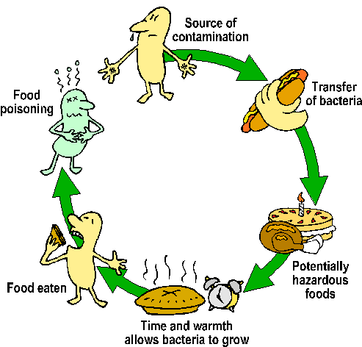
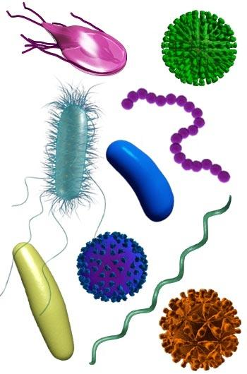
Food Contamination
FOOD SAFETY is the protection of consumer health and well being by safeguarding
food from anything that could cause harm
Food companies have a legal duty to produce food that is “safe to eat”.
Food should be protected from “Field to Fork”. FOOD CONTAMINATION is the
presence in food of any harmful or objectionable substance or object.
Hazards in food are anything that could cause illness, injury or discomfort.
There are 3 types of hazard
  Physical 2. Chemical 3. Biological
Place these contaminants under the correct heading
Plaster Viruses Fly spray Salmonella fungi
Sanitiser E.coli String Hair finger nail
Metal Bolt Yeast Pesticides Bleach soil
Physical | Chemical | Biological

Slide 10
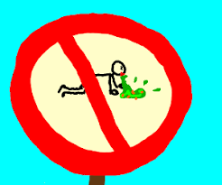
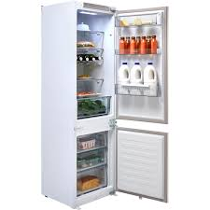
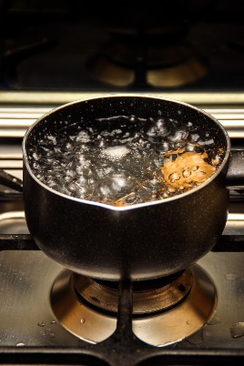
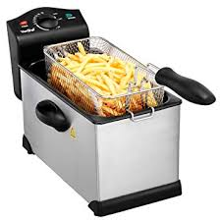
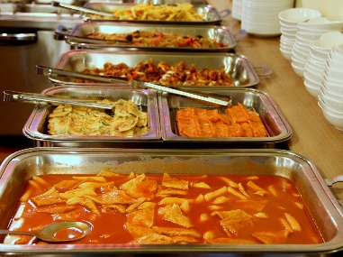

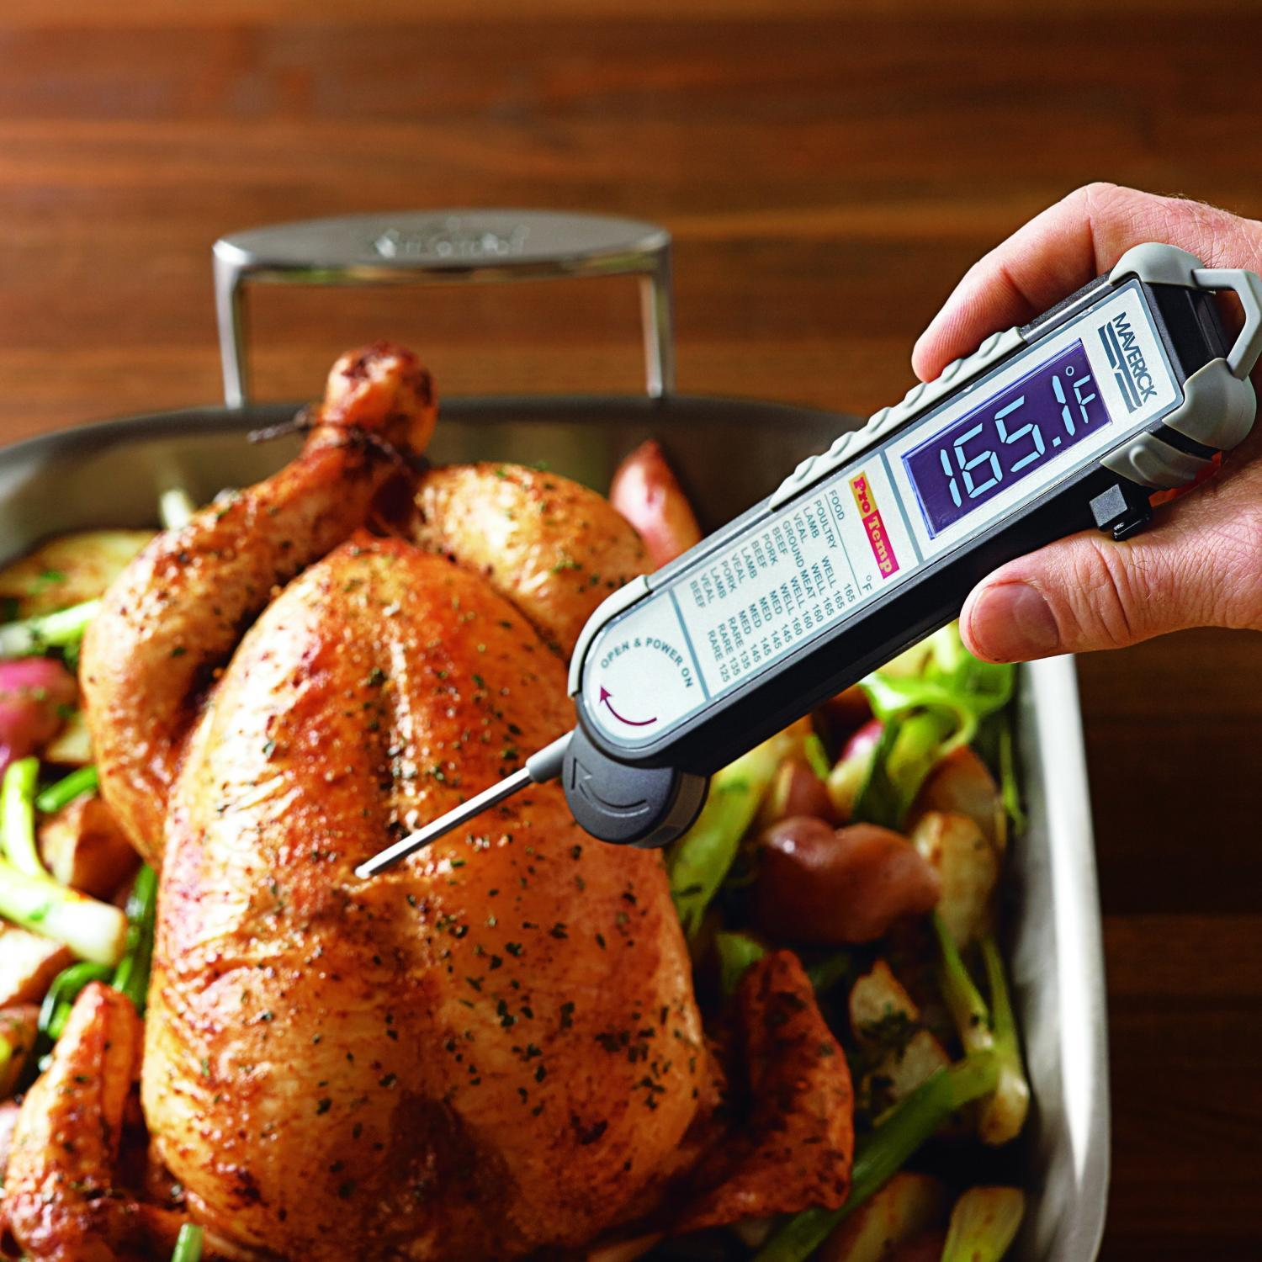
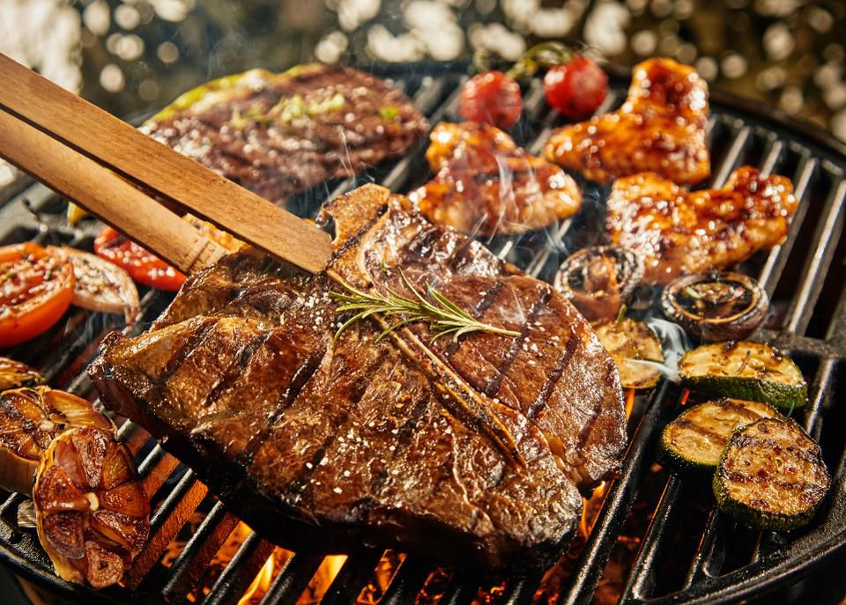
Fridge temperature should be:
The temperature of boiling water is:
water is…..
Freezer temperature should be:
Important food temperatures
Temperature of oil in a deep fat fryer should be:
The Danger Zone where bacteria multiply is between
The holding temperature and the temperature that cooked should be served at is:
The core temperature of cooked food should be:
To check the internal temperature of foods use a:
The core temperature of reheated food should be:

Slide 11
Implementing Dietary Goals
To improve the health of the nation, the government has set a range of dietary guidelines. We know that it is what we eat over a period of time rather than on any particular day that will affect our future health. To avoid illness and try to improve our general state of health we should follow the guidelines below
To reduce Fat, especially animal fat.
To reduce Sugary Foods
To reduce Salt
To increase Dietary Fibre.
As a nation we suffer from a range of Dietary Related Diseases.
Obesity, Heart Disease, Strokes, Tooth Decay, Gum Disease, Diabetes, High Blood Pressure, Constipation, Diverticular Disease, Cancer of Colon.
Use the above words to link the health problem with the dietary goal.
Dietary goal | Dietary related diseases | How to implement
Too much Fat, especially saturated fat, causes
Too much Sugar causes
Too much Salt causes
Not enough Dietary Fibre, fruit and vegetables causes

Slide 12
Nutrition – nourishment or energy obtained from food
A balanced diet has all the essential nutrients found in our food in the correct amounts
Nutrient | Types | Source of nutrient | Function
Protein | Animal
 | Plant
Carbohydrate | Starches
 | Sugars
Fats | Animal
 | Plant
Vitamins | Vitamin A
 | Vitamin B
 | Vitamin C
 | Vitamin D
Minerals | Iron
 | Calcium

Slide 13
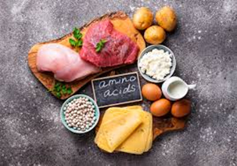
NUTRITION
Macro & Micro Nutrients
Protein
Protein is a ‘Macronutrient’ – which means it is needed by the body in large amounts.
1. Complete the word gap task
Animal Pulses Nut Repair Growth
Proteins assist with ______________ and ___________ of the body.
Proteins are found in __________________ products like meat, fish, cheese, milk and eggs. Vegetable sources include soya bean products, _______________ and _______________.
2. a) What do protein-rich foods have to contain to make them High Biological Value (HBV)?_____________________________________________________________
b) Which types of protein are typically HBV? ____________________________

Slide 14
3. Complete the table. Classify the following protein foods as ‘animal’ or ‘plant’ based protein.
NUTRITION
N.B. There is one plant-based protein that is HBV – name this plant-based protein………………..
Nuts | Dairy | Pork | Cereals | Cod | Poultry
Cheese | Kidney beans | Grains | Beef | Eggs | Milk
Animal (high biological value HBV) | Plant (low biological value LBV)
What is Quorn?
What are the benefits of eating Quorn instead of meat?

Slide 15
NUTRITION
Carbohydrates are also classed as ‘Macronutrients’ – what does this mean?
______________________________________________________________
Complete the word gap task:
Starch Cereals Sugar Energy Fruit
Carbohydrates are needed to give the body ______________. There are two types
of Carbohydrate - _____________ and ______________.
Starch is found in ____________, cornflour, potatoes, pasta and flour.
Sugar is found in ______________, vegetables, honey, milk and processed foods.
2. When might the body need fast release (sugary) carbohydrates?
____________________________________________________________________
3. When might the body need slow release (starchy) carbohydrates?
____________________________________________________________________

Slide 16
4. Complete the table using the list of foods below. Classify them as fast or slow release carbohydrates.
NUTRITION
Fast release (sugary ) carbohydrates | Slow release (starchy) carbohydrates
Fruit | Jam | Vegetables | Sugary Cereals | Oats | Lentils
Honey | Potatoes | Peas | Energy drinks | Rice | Milk
Extension task
Which type of foods contain gluten?
If you were gluten intolerant (coeliac) which foods could you get your carbohydrates from?

Slide 17
NUTRITION
Fats are also ‘Macronutrients’.
Complete the word gap task:
butter insulate saturated energy plant
Fats help to provide concentrated sources of ____________ and help to _______________ the body in cold weather. There are two main types:
_________________________ fats are usually obtained from animal sources, for example _____________ and lard. Unsaturated fats come from ____________ sources, such as sunflower oil.
2. Complete the table using the lists of foods below. Classify them as saturated or unsaturated fats.
Saturated Fats | Unsaturated Fats
Meat | Olive oil | Eggs | Butter
Nuts | Cream | Vegetable oil | Oily fish

Slide 18
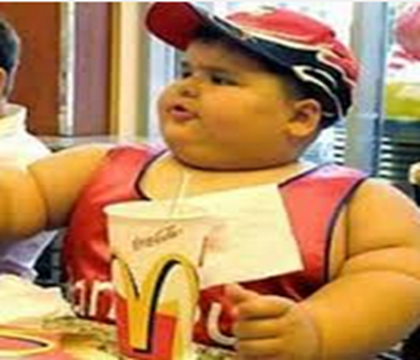
Extension Task
Extension task – consider all dietary goals to help you improve the health of this young man.
Write your answers here:
Health risks:
Changes to diet:
Look at this
What health risks does this boy face?
If you were his parent, how would you change his diet?

Slide 19
NTURITION
Vitamins are needed in very small amounts for growth and health therefore they are
Micronutrients’. The main vitamins are vitamin A, the B complex of vitamins (including thiamine and folic acid), vitamin C, vitamin D, vitamin E & vitamin K.
Match the vitamins to their function (job role in the body).
Give 3 examples of foods you would find each vitamin in.
A B C D E K
Fat Soluble | Function | Food Sources
e.g. Vitamin A | I’m important for growth, healthy skin and hair and I can help you see better at night. | Yellow peppers, carrots, dairy e.g. milk
 | You need me for healthy bones and teeth.
 | I help protect cells. I also help your immune system and repair DNA!
 | I help to clot your blood.
Water soluble | Function | Food Sources
 | We help with cell repair, digestion and energy release from carbohydrates.
 | I help you repair wounds and absorb iron to carry oxygenated red blood cells.

Slide 20
Packaging | Advantages | Disadvantages
Paper and card
Glass
Metal
Plastic and polystyrene
FOOD PACKAGING
Packaging
Looking after the environment is really important to prevent global warming. Remember the 3 ‘R’s R_ _ _ _ _, R_ _ _ _ & R_ _ _ _ _ .
How can we reduce the amount of waste within the home?

Slide 21
FOOD PACKAGING
Why do we package food? List as many reason as you can think of.
Make a list of 5 foods that are suitable for composting?
1.
2.
3.
4.
5.

Slide 22
Understanding recycling symbols
1 | Organic | 4 | Irradiation | 7 | Freezer | 10 | Vegetarian | 13 | Microwave
2 | British Farm Standards | 5 | Traffic Light Labelling | 8 | Barcode | 11 | Compostable packaging | 14 | 5 a Day
3 | Fairtrade | 6 | Litterman | 9 | Gluten Free | 12 | Freedom Food | 15 | Recyclable

Slide 23
Produce a poster to promote recycling in the home
Make your work eye-catching – use bold designs, bright colours, a slogan and a border

Slide 24
FOOD LABELLING
What does the label tell us?
Food labelling has to follow strict guidelines. This is a legal requirement and helps to protect the consumer and allows them to make informed choices.
Look at the label and find the following information. This information has to be visible on the label by law.
1 | Name of product
2 | Name and address of manufacturer
3 | List of ingredients
4 | Weight of product
5 | Date marking
6 | Storage instructions
7 | Instructions for use
8 | Place of origin
9 | Food Allergy information

Slide 25
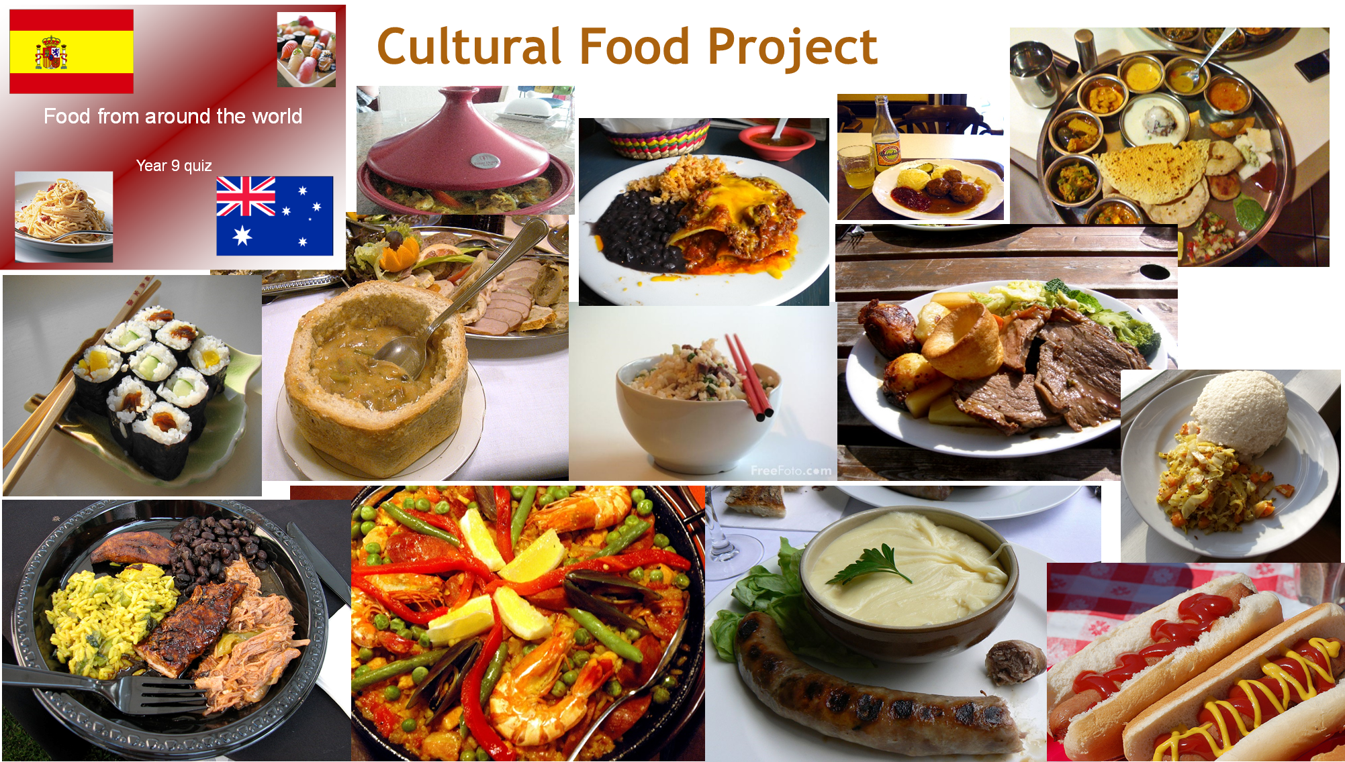
CULTURAL FOOD PROJECT
Your project during Year 9 is to research, plan and cook a dish based on a particular chosen country. You will use the influences of this country to develop a recipe that you have previously used from our school recipe books.
Your project can be produced as a Word document, a PowerPoint or hand-written. As well as cooking the dish, you will be expected to evaluate your cooked dish against a set criteria. You will need to complete a sensory analysis profile and suggest ways in which you could improve your dish if you were to cook it again.
Use the following codes to check the criteria against your pathway – F S C E – see page 27. Tick the check box to show you have completed the tasks.

Slide 26
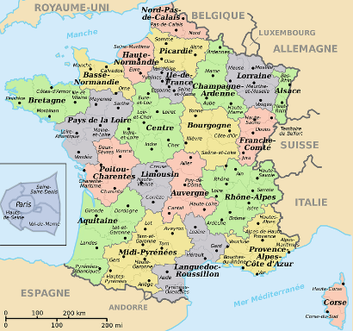
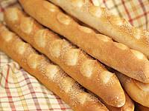
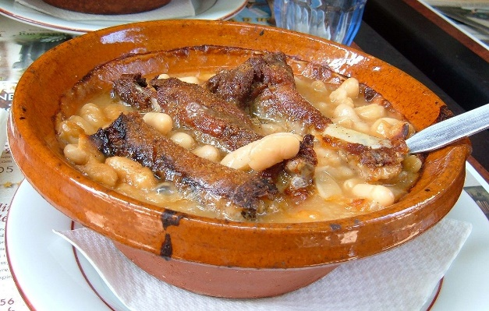
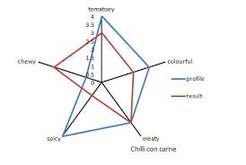
CULTURAL FOOD PROJECT
Task | P/W | 
A title page which sets out which country you will be researching, complete with appropriate pictures. | F S C E
Facts about the country – i.e. Language spoken, population, religion, famous people and any interesting facts and figures. | F S C E
A map of the country showing important landmarks, cities and geographical features. | F S C E
What ‘staple foods’ are grown and produced in that country | C E
Traditional and famous dishes. | C E
Describe the dishes you have chosen to cook and explain why you have chosen them. | S C E
Write an evaluation explaining how you cooked them and how they turned out. What could you have done to improve the dish? | S C E
Complete a Nutritional Analysis of each dish. (www.explore food. Calculate a recipe). | E
Draw or create a star profile showing analysis of your dish. (By hand or in Excel) | F S C E
Include an annotated photo of dish 1 | C E
A traditional bread from France is a baguette
Cassoulet – a traditional dish of mid and southern France
A sensory profile showing the attributes of the dish.

Slide 27
CULTURAL FOOD PROJECT
Plan of work
Product Name:
Time | Order of work
Equipment I will need: 1
Ingredients I will need:
Health & safety checks:

Slide 28
Star Profile
Product name: Chosen Country:
Time management
Your product score:
Perfect product score:
What does the star profile tell you?
Taste
Appearance
1
2 3 4 5
Country
Aroma
Skills
Colour
Texture

Slide 29
CULTURAL FOOD PROJECT
Evaluation of your chosen dish – Cultural Food Project
Comments on planning and organisation
Comments on making and following recipe/instructions
Comments on clearing up
Tester | Comment | Score /5
1
2
3

Slide 30
CULTURAL FOOD PROJECT
Conclusion
Comment on how your product met the design brief.
My product met the design brief because …….
To improve my product if I were to make it again, I would…
1
2
3
4

Slide 31
No ingredients?
In your books or on lined paper, write out the question and then write your answer, use full sentences.
What is the practical today?
List the equipment/utensils & functions of what is being used today
What skills are being used to make this dish?
What are the hygiene and safety hazards in the recipe? How can these be prevented/controlled?
What should a 'good' example of this dish look, smell and taste like? (Describe in detail with sensory language)
What are the common mistakes that may occur with this recipe? How can they be prevented or put right?
What key advice/tips would you give to someone making this recipe?
What nutrients are present in this dish? What nutrients are in excess (lots of) / deficient (missing) in the dish?
How could the dish be made healthier? Suggest at least 3 ways.
How can the dish be adapted to be suitable for: a. Gluten free? b. Lactose intolerance? c. Vegans?
Explain how you will be more organised with bringing your ingredients next lesson.

