Slide 2
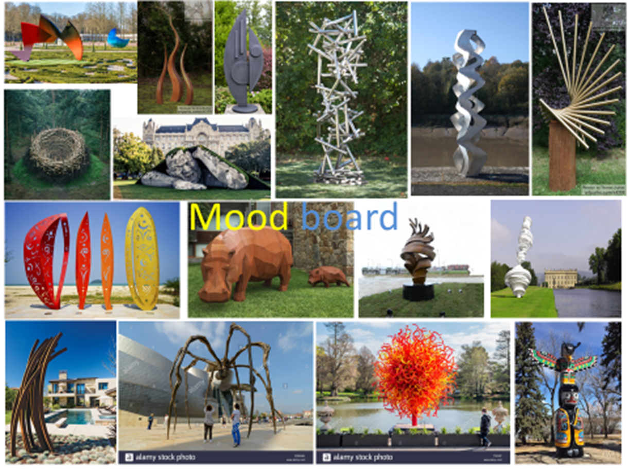
Outdoor Sculpture project
Brief: To design a sculpture for an outdoor environment.
Tasks:
You will research relevant artists and evaluate their work and use this research to help to produce your own ideas for a sculpture.
You will practice different drawing styles that will help you draw in 3D.

Slide 3
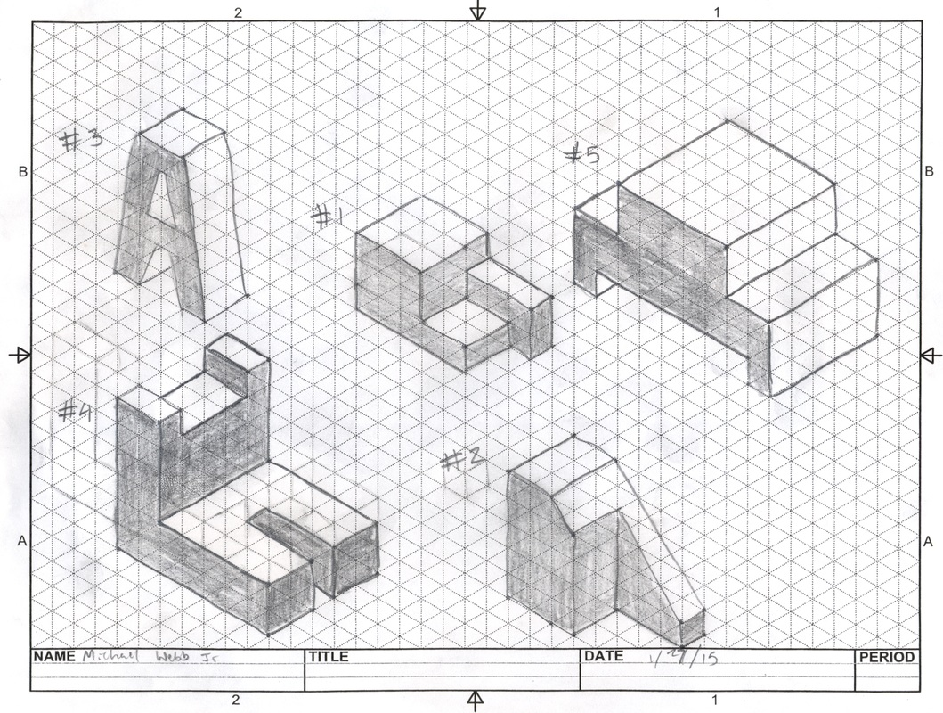
Week 1 task- Isometric Drawing is a way of drawing things in 3 dimensions. This week is a drawing task where you will follow a You Tube tutorial
Copy and paste the link below and follow the instructions. You will need to print slide 3 so you have a copy of the isometric paper to do the task. Follow the video carefully and use pause frequently to complete the task.
Extension-If you finish the task within lesson time practice drawing more shapes. On the next slide I have attached a picture of various geometric shapes that you can copy
https://www.youtube.com/watch?v=LY5OqKhEP9k
Isometric drawing example

Slide 4
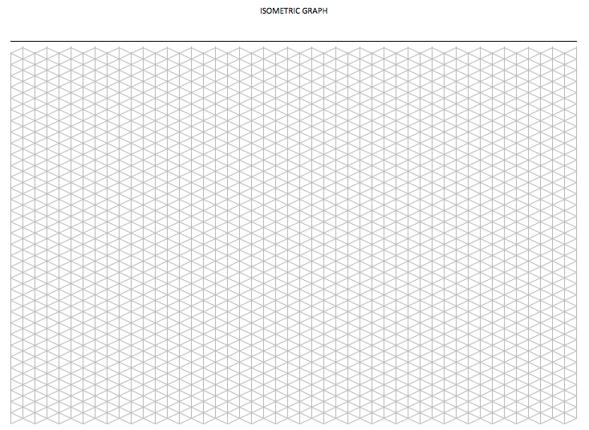
Week 1
Isometric Paper

Slide 5
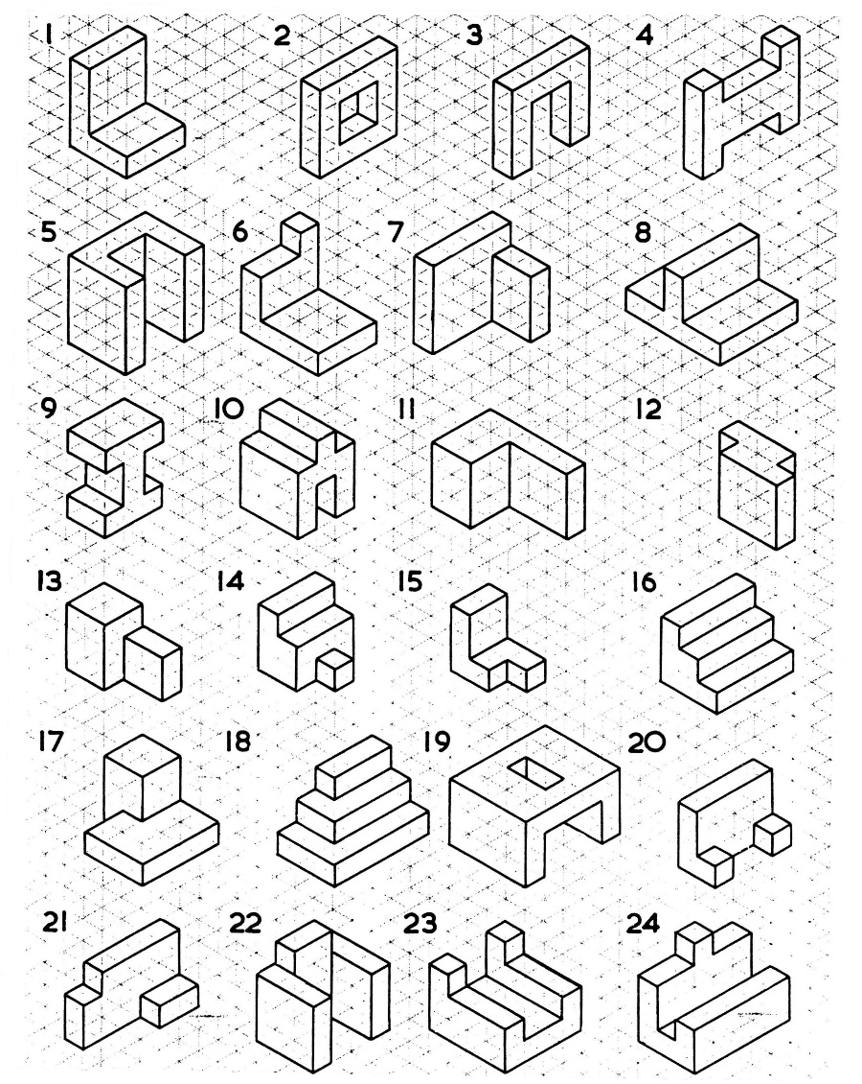
Week 1-Extension task

Slide 6
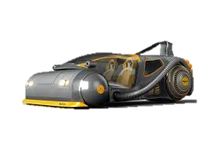
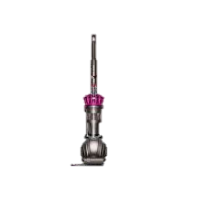
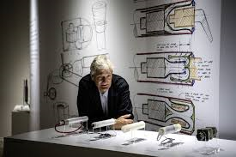
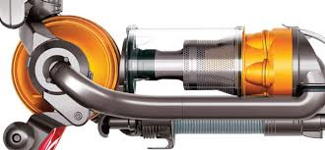
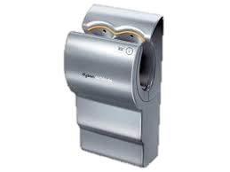
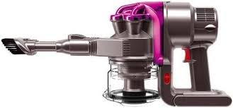
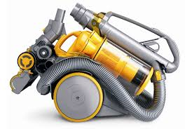
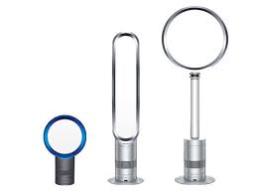
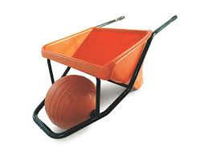
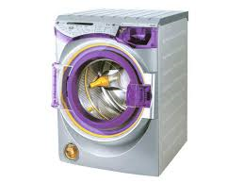
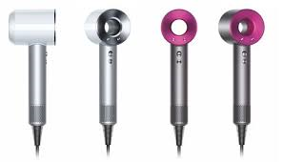
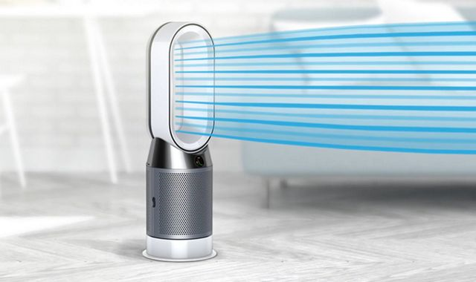
Week 2 task The artist you are going to research is Santiago Calatrava . He is an architect. Your first task is to find some images of the work of Santiago Calatrava
Use Google and search for www.calatrava.com Select images and choose eight images of work by Calatrava that you like.
Present them and write about them. I have provided a guide for you below. I have used the designer James Dyson as an example which is shown below.
You are to:
1) State who the artist is and what it is that they do- see point 1 below on the right hand side of the page for an example
2) Describe the work – see point 2 below for an example. This is about using descriptive language not ‘It Is unique’ or ‘It is eye catching’.
3) What do you like about the work- see point 3 below for an example
‘
1) James Dyson invents lots of different products but mainly things that are used around the house or workplace. He has invented-hand driers, vacuum cleaners, a wheelbarrow, hair dryer, a car.
2) I really like his designs for their use of colour and shape. I think his designs look very futuristic, like things from a sci-fi movie. I have used his hand dryer and wheelbarrow and both products are fun to use and look good.
3) His designs use lots of curves and flowing shapes. I think they look very nice to look at because of this. I also like the use of bold, bright colours and the use of softer shapes such as circles.
To design something in the style of James Dyson I will need to use curves, flowing shapes and bright, bold colours.
James Dyson
Inventor & Product designer

Slide 7
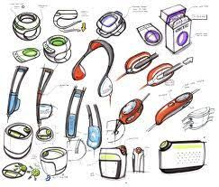
Week 3 task Design something in the style of Calatrava using the things you have identified as key features of his work. This could be anything at all but keep it simple and choose something like a household object such as a kettle, vase, table, chair
You only need to use sketching to do this task. A very good example of this is shown in the example. Draw in isometric projection. First and foremost I am interested in your ideas not how brilliantly they are drawn.
This example uses colour annotations to describe the work. Your design should use colour and annotations to describe the work. Try several different designs (you do not need to do as many in the example!) to try different ways of presenting your ideas.

Slide 8
Week 4 task The artist you are going to research is Thomas Heatherwick . He is an architect. Your first task is to find some images of the work of Thomas Heatherwick
Use Google and search for www.heatherwick.com View the website by navigating around the site and choose eight images of work by Heatherwick that you like.
Present them and write about them. I have provided a guide for you below. I have used the designer James Dyson as an example which is shown below.
You are to:
1) State who the artist is and what it is that they do- see point 1 below on the right hand side of the page for an example
2) Describe the work – see point 2 below for an example. This is about using descriptive language not ‘It Is unique’ or ‘It is eye catching’.
3) What do you like about the work- see point 3 below for an example
‘
1) James Dyson invents lots of different products but mainly things that are used around the house or workplace. He has invented-hand driers, vacuum cleaners, a wheelbarrow, hair dryer, a car.
2) I really like his designs for their use of colour and shape. I think his designs look very futuristic, like things from a sci-fi movie. I have used his hand dryer and wheelbarrow and both products are fun to use and look good.
3) His designs use lots of curves and flowing shapes. I think they look very nice to look at because of this. I also like the use of bold, bright colours and the use of softer shapes such as circles.
To design something in the style of James Dyson I will need to use curves, flowing shapes and bright, bold colours.
James Dyson
Inventor & Product designer

Slide 9
Week 5 task Design something in the style of Heatherwick using the things you have identified as key features of his work. This could be anything at all but keep it simple and choose something like a household object such as a kettle, vase, table, chair
You only need to use sketching to do this task. A very good example of this is shown in the example. Draw in isometric projection. First and foremost I am interested in your ideas not how brilliantly they are drawn.
This example uses colour annotations to describe the work. Your design should use colour and annotations to describe the work. Try several different designs (you do not need to do as many in the example!) to try different ways of presenting your ideas.

Slide 10
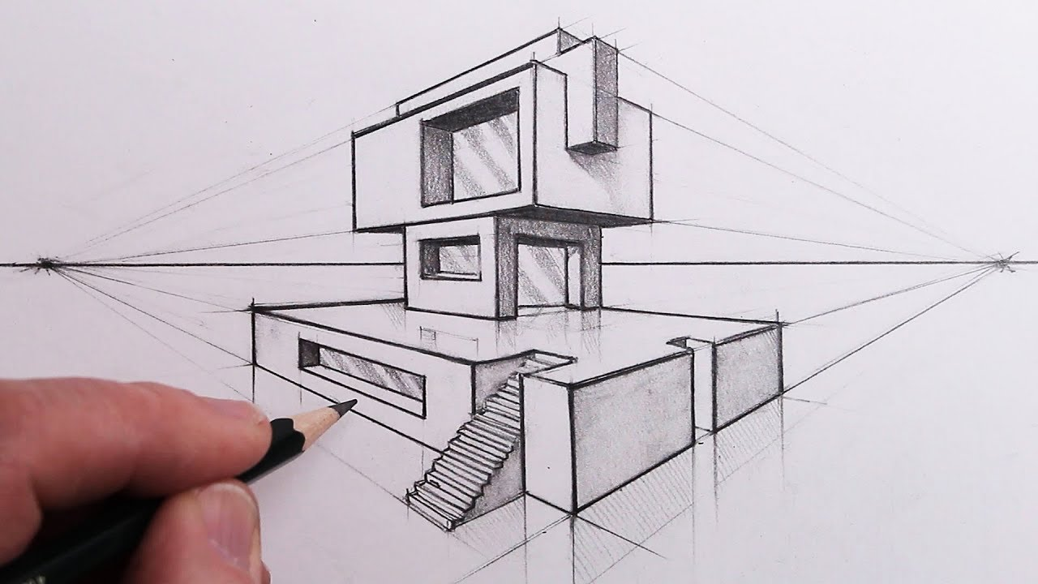
Week 6 task- Two point perspective drawing https://www.youtube.com/watch?v=w_LbQviO1K4 Copy and paste the link above and follow the instructions in the video. Two point perspective drawing is style of drawing that allows you to draw things in 3 dimensions. Much like isometric drawing from week 1, two point perspective is a really useful technique for drawing things quickly in 3D. This task is difficult in parts namely when drawing the steps. Be particularly careful when projecting the line forward for the bottom of the steps. Your lines must be parallel.

Slide 11
Week 7 task The artist you are going to research is Barbara Hepworth . She was a sculptor. Your first task is to find some images of the work of Barbara Hepworth
Use Google and search for Barbara Hepworth Sculptures. View her work and choose eight images of work by Hepworth that you like.
Present them and write about them. I have provided a guide for you below. I have used the designer James Dyson as an example which is shown below.
You are to:
1) State who the artist is and what it is that they do- see point 1 below on the right hand side of the page for an example
2) Describe the work – see point 2 below for an example. This is about using descriptive language not ‘It Is unique’ or ‘It is eye catching’.
3) What do you like about the work- see point 3 below for an example
‘
1) James Dyson invents lots of different products but mainly things that are used around the house or workplace. He has invented-hand driers, vacuum cleaners, a wheelbarrow, hair dryer, a car.
2) I really like his designs for their use of colour and shape. I think his designs look very futuristic, like things from a sci-fi movie. I have used his hand dryer and wheelbarrow and both products are fun to use and look good.
3) His designs use lots of curves and flowing shapes. I think they look very nice to look at because of this. I also like the use of bold, bright colours and the use of softer shapes such as circles.
To design something in the style of James Dyson I will need to use curves, flowing shapes and bright, bold colours.
James Dyson
Inventor & Product designer

Slide 12
Week 8 task Design something in the style of Hepworth using the things you have identified as key features of her work. This could be anything at all but keep it simple and choose something like a household object such as a kettle, vase, table, chair
You only need to use sketching to do this task. A very good example of this is shown in the example. Draw in isometric projection or two point perspective. First and foremost I am interested in your ideas not how brilliantly they are drawn.
This example uses colour annotations to describe the work. Your design should use colour and annotations to describe the work. Try several different designs (you do not need to do as many in the example!) to try different ways of presenting your ideas.

Slide 13
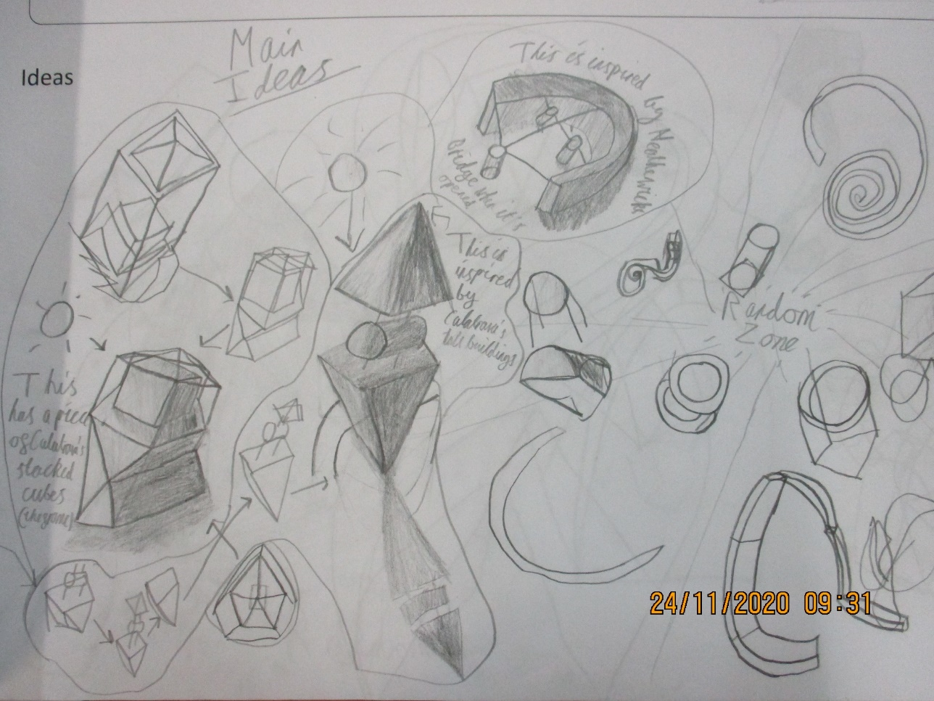
Week 9 & 10 task
For this task I would like you to use the knowledge you have gained from the various tasks you have done so far in this project to produce some ideas for a sculpture that will be situated outside.
On the next 3 pages I have pasted initial design ideas from 3 different students. The work shown is ideas for a sculpture based on the work of Calatrava, Heatherwick and Hepworth.
I like this design sheet because it is very energetic and busy and the ideas produced by the student are clearly influenced by the research. There is not much written communication to inform the reader what the student is thinking apart from a few notes.

Slide 14
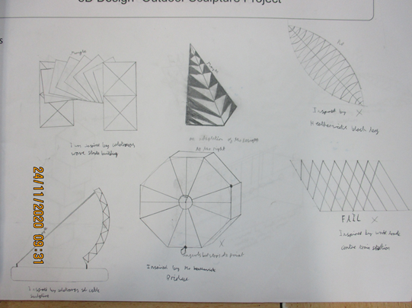
I like this design sheet because the presentation is very neat and organised. The student has not used isometric drawing but the presentation and ideas produced by the student are clearly influenced by the research. The annotation made by the student is sufficient to help the reader understand what the student is thinking but it would be better if there was more information.

Slide 15
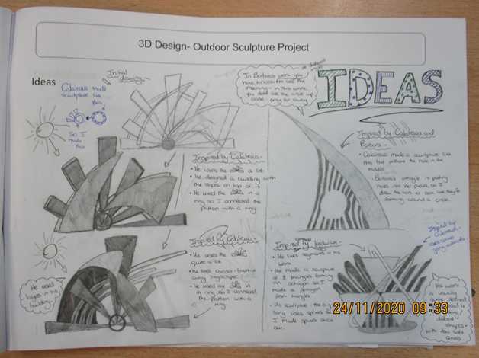
I like this design sheet because it is very well presented. It uses annotation really well to describe what the student is thinking, and the ideas produced by the student are clearly influenced by the research.
Task: produce a design sheet of initial ideas for a sculpture to situated outdoors. The examples I have provided will give a good idea of what your design sheet should look like.
Extension: Build a card model of one or more of your ideas. Photograph your model(s) and if you able to print off and attach to a new sheet of paper and keep with your initial ideas sheet.

