Slide 1



POST – 16 Information Session
Thursday 26th September 2024

Slide 2
POST – 16 Information Session
25
school weeks until
May 2025

Slide 3


Options…Post-16
COLLEGE
6th FORM
A-levels
FOUNDATION COURSES
T-LEVELS
APPRENTICESHIP

Slide 4


Slide 5
Destinations: being grateful for where we live…?!

Slide 6
For A-levels/equivalents, there will be an insistence on Grade 4+ in both English Language and Maths.
Where a student has not achieved these grades, most providers, including those offering apprenticeships will insist on re-takes.
This is regarded as part of ‘future-proofing’ for further progression.
Clarification, English/Maths

Slide 7

Health warning!!
Competition for places alongside pressure on being able to accommodate for increased numbers, including those needing to complete re-sits.
College offers: keep evidence of offer in case entry requirements are subsequently changed based on student numbers
Inconsistencies when grades not met
What we have learnt this year….

Slide 8
What am I buying into?
Did your GCSE choices meet your expectations?

Slide 9
Did I get what I expected?
Upon reflection did you do enough research?
Notes:
So we have now opened the bag and yes it wasn’t what you were expecting. This is how I want you to view your future options. Any college/sixth form you visit are going to sell you a product and you are buying into this product. The subject you are going to study is the product. Consider carefully the subjects you currently study and the new ones you want to find more information about. Were you excited by the subject, if you can find a passion about what you are studying this will automatically help you to succeed. When you are investigating make sure you know what you will be studying, for example if you enjoy natural disasters in Geography but hate tourism, check out what you will be studying in Geography A level don’t assume that it will be the same as at GCSE. This is a huge step you are about to take. So how do we research. We use the websites that are listed in the booklet that we would like you to collect as you leave. Check out what universities or employers want. Attend as many open evenings/days as you possibly can and talk to as many different people about your chosen subjects. Remember everyone has their own opinion and it is important that you listen to everyone but make your own choices. Work EXP

Slide 10
What should I have done?
Looked at reviews.
Made a check sheet with questions you felt were important.
Asked people who have taken this subject.
Quality of subject. (Check last years subject specific exam results)
Are you excited about this subject and the topic you will study or could you be wasting your time?
Does the subject fit your criteria?
Notes:
Many of you said you would buy from me the sensible ones asked o look in the bag first.
So we have done our research and made the right choices. What to do next. Start applying to your chosen college/sixth form as soon as the decision is done. This will then be one job you can tick off of your list and you can start giving 100% to school.

Slide 11

Entry requirements?
College and 6th Form entry requirements vary it is important to check these.
It is not only important to check what are the general entry requirements but also the subject specific requirements.
Don’t lack ambition or under-sell yourself but do be realistic!

Slide 12
Level by Level
Level 3 involves obtaining detailed knowledge and skills in a subject; appropriate for people wishing to progress to Higher Education, or working independently.
Level 3 - Advanced
A levels, diplomas, T-levels, advanced apprenticeships
Level 2 - Intermediate
GCSEs grades 4-9
Diplomas, intermediate apprenticeships
Level 2 involves building knowledge & skills in relation to an area of work or a subject area. It is appropriate as a starting point for many job roles
.
Level 1 – Foundation GCSEs, grades 1-3. Certificates, Diplomas
Level 1 is about activities that mostly relate to everyday situations and may be linked to fundamental job competence.
Notes:
Many of you said you would buy from me the sensible ones asked o look in the bag first.
So we have done our research and made the right choices. What to do next. Start applying to your chosen college/sixth form as soon as the decision is done. This will then be one job you can tick off of your list and you can start giving 100% to school.

Slide 13
A-levels: a level 3 qualification.
Assessed mainly by, traditional exams at end of two years.
Why study A-levels?
Allows students to keep their options open or to specialise.
There is a huge choice of subjects.
Recognised by Universities and employers.
Grades A* to E represent a pass at A-level

Slide 14
T-levels: Level 3
Two-year course
Minimum of 310 hours of work experience.
Equivalent to three A Levels
Created alongside employers
Include an extended industry placement
Attract UCAS points
Support progression into a skilled occupation; higher or degree level apprenticeships; higher level technical study, including university
Assessed through written examinations, projects, work experience, assessments.

Slide 15
Other Level 3 qualifications
Diplomas, BTECs
Why study these?
Mostly coursework
Equivalent to 1, 2 or 3 A levels.
Work experience
At some colleges can be mixed with A-levels.
Career related and more practical courses.
Look at how you get the best grades. Are you better at coursework than exams?

Slide 16
Level 2 qualifications
Level 2 qualifications have different ways of being assessed.
GCSEs are mainly exams at the end of one year.
Diplomas and Certificates are assessment, coursework and possibly an exam.
Why study level 2?
Allows students to keep their options open or to specialise.
There are a choice of subjects.
Recognised by employers.
Progression route on to level 3
Have to get a Grade 4 at English or Maths

Slide 17
Level 1 qualifications
Level 1 qualifications have different ways of being assessed.
Diplomas and Certificates are assessment, coursework and possibly an exam.
Why study level 1
Allows students to keep their options open or to specialise.
There are a choice of subjects.
Progression route on to level 2
Working towards a GCSE Grade 4 at English or Maths OR on a Functional Skills course in these subjects

Slide 18
Apprenticeships
There are hundreds of different jobs that can be done as an apprenticeship.
Some can be started as soon as you leave school.
Some can be started as soon as you have completed your A levels.
When you have completed your apprenticeship not only will you have the qualification you will have work experience.
Some companies do apprenticeships all the way through to degree level.
Remember you get paid for learning during an apprenticeship.

Slide 19
How does an Apprenticeship work?
You will work and possibly attend college.
Some employers will send you one day a week to college and you will work four days a week
Some employers will send you to college for two whole weeks and then you will work eight whole weeks.
Some employers will train you whilst you work and give you time during the working day to do your coursework.
Your employer decides the best way for you to learn.
If you do a Higher Apprenticeship you might not even go to work for the first year, you might just go to college!
.

Slide 20

4 Steps to a decision
Step 4 – Decide and have a back up plan
Step 3- Investigate your Post-16 options
Step 2- Qualification levels – what is your starting point
Step 1 – Careers Research
Notes:
So we have now opened the bag and yes it wasn’t what you were expecting. This is how I want you to view your future options. Any college/sixth form you visit are going to sell you a product and you are buying into this product. The subject you are going to study is the product. Consider carefully the subjects you currently study and the new ones you want to find more information about. Were you excited by the subject, if you can find a passion about what you are studying this will automatically help you to succeed. When you are investigating make sure you know what you will be studying, for example if you enjoy natural disasters in Geography but hate tourism, check out what you will be studying in Geography A level don’t assume that it will be the same as at GCSE. This is a huge step you are about to take. So how do we research. We use the websites that are listed in the booklet that we would like you to collect as you leave. Check out what universities or employers want. Attend as many open evenings/days as you possibly can and talk to as many different people about your chosen subjects. Remember everyone has their own opinion and it is important that you listen to everyone but make your own choices. Work EXP

Slide 21
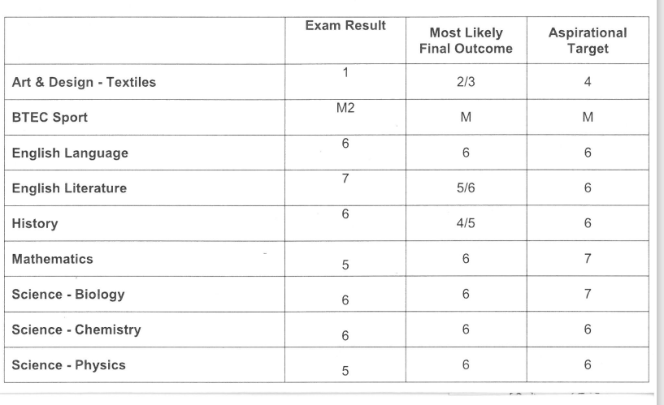
Back Up Plans/Lessons to Learn…
Some good results. This person gave up in Textiles. This resulted in not enough points to go to any of his three chosen sixth forms.
.

Slide 22
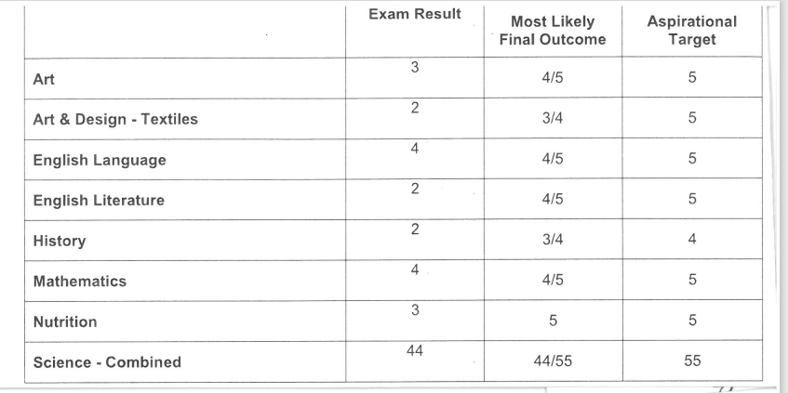
Back Up Plans/Lessons to Learn…
This person focused on the Maths, English and Science as that was the entry requirements for her course. However she only got four grade 4s and she needed five.
.

Slide 23
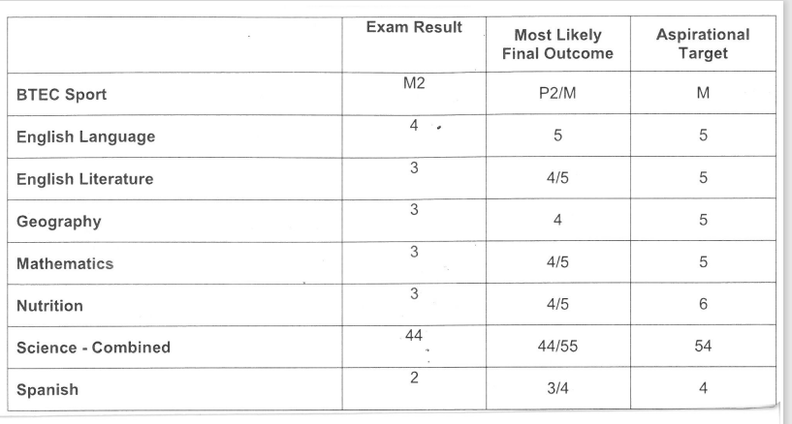
Back Up Plans/Lessons to Learn…
This person had to admit to her parent on results day that she had done no revision and thought she would just get the required grades.
.

Slide 24
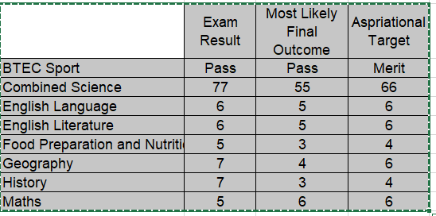
Back Up Plans/Lessons to Learn…
This person was quite lazy in KS4. He then worked really hard leading up to the exams and exceeded his targets. Unfortunately he still couldn’t do his chosen A Levels as he only got a 5 in GCSE maths and this stopped him taking Science at A Level.
.

Slide 25
What is success?
.
Success is…
getting the best grades possible for you.
being happy with your chosen pathway.
knowing you couldn’t have done any more.
believing in yourself and your decisions.

Slide 26

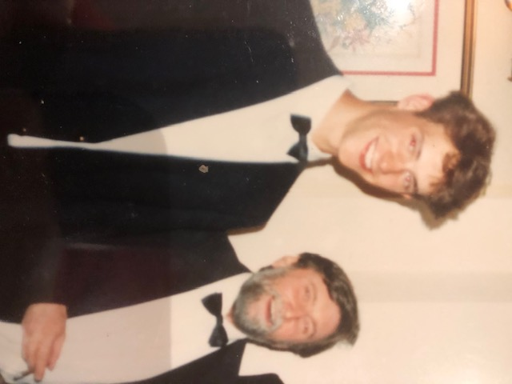
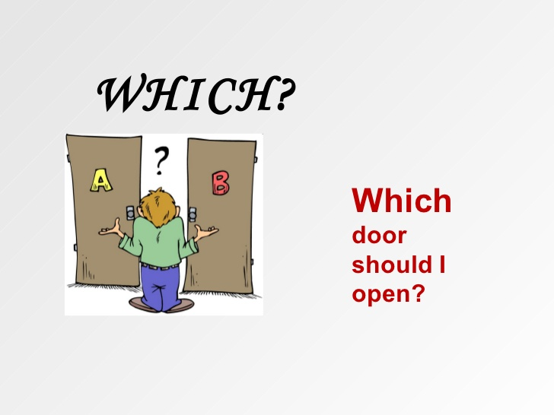

Mr Morland is 16...
.

Slide 27
My Checklist…
.
Subject
Interesting?
How much writing?
Is it creative?
Do I do presentations or public speaking?
How much time is spent on the practical?
Class size and set up
Are there High Achievers/UCAS Application support sessions?
Progression route for past student
Free time, what can I do, where can I spend it?
During Study time where can I study? Am I made to study?
How does the site make me feel?
Will they help you find a job/apprenticeship when you leave?
How do I feel overall What were the results in that subject last year?

Slide 28
A competitive market
.
Right now
  7 billion people on Earth
  5 billion adults
  3 billion people who want to work
  90% of these people want to work full-time
2.7 billion full-time formal jobs are wanted
With only 1.2 billion full-time jobs available
That’s a shortfall of 1.5 billion jobs
So, for every UK worker, there are 50 people on the planet who would like their job...

Slide 29
What we need you to do:
.
Promote excellent attendance
The importance of routine – agree the balance between work and social life
Help with organisation of books, room, bag!
Home study: 1-2 hours each evening and at weekends
Study buddy
Planning a revision timetable
Keep positive yet practical
Discuss post-16 pathways – access open evenings/events

Slide 30
Student attendance over one school year
.
98% attendance = approximately 4 days absent from school
95% attendance = approximately 10 days absent from school
90% attendance = approximately 20 days absent from school
85% attendance = approximately 28 days absent from school
80% attendance = approximately 38 days absent from school

Slide 31
The lessons learned from previous Year 11 cohorts
.
All tests and assessments feed into your experience of next summer.
Think always of your trajectory towards next summer
Have a destination and an aim in mind (and a back-up plan)
Make sure that these the destination and back up plan have both been fully researched
Think of how you will be remembered – how can we give you the best chance of that job in a reference?

Slide 32
Before – and on - 21st August 2025
.
BEFORE…this date, if you are invited to book an enrolment meeting, do so – immediately! Get in early in their schedules!
You need to see your results asap – if you can’t collect them in person, don’t wait for the post. Make sure you have arranged for them to be emailed (student’s personal email address!)
8.30-9.30am – collect results
Upload your results to your chosen post-16 provider OR take them in person for your enrolment meeting

