Slide 1
Year 9 German TERM 4: Echo 2 textbook, chapter 6
If pupils are absent from lessons they should spend time revising and learning vocabulary. All of the vocabulary for this term is on the following slides. First of all, they should recap the vocabulary which they learned the previous week. Then they should start to learn the next section of vocabulary which they have not yet covered in class. This could be done by using the look, cover, write, check method or by making flashcards etc.
Pupils can also revise vocabulary on Linguascope-
Username is kingshill password is love4langs
Any new vocabulary they learn can be written in their orange books or on paper.
If pupils wish to do extension work they can access free MFL lessons on the Oak National Academy website:
https://classroom.thenational.academy/subjects-by-key-stage

Slide 2
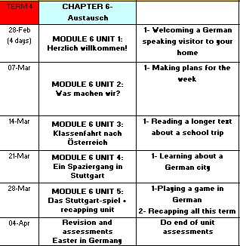

Slide 3
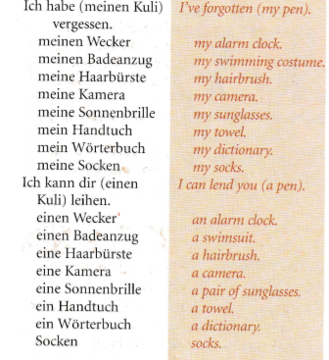
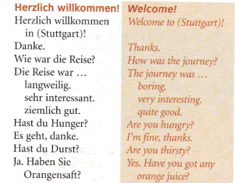
WEEK 1 –
Read through the vocabulary for this week and spend a good amount of time trying to learn it.

Slide 4
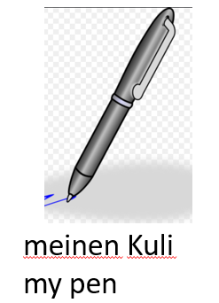
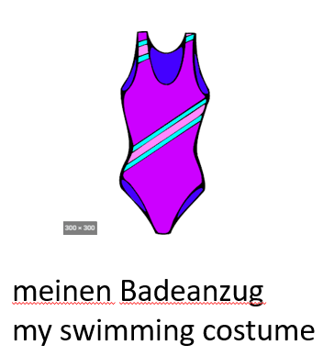
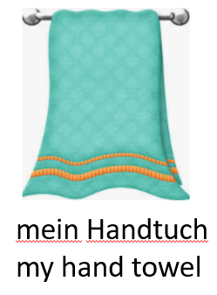
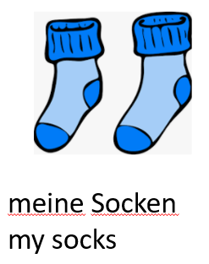
Try and remember what these things are. The words will be removed on the next slide for you to test yourself.
Ich habe …vergessen = I have forgotten…

Slide 5
Ich habe …vergessen
1.
2.
3.
4.
5.
6.
7.
8.
9.

Slide 6
Translate the following sentences in to English.
Ich habe meinen blauen Kuli und mein grünes Handtuch vergessen.
Ich habe meine schwarze Haarbürste und meinen kleinen Wecker vergessen.
Ich habe meinen bequemen Badeanzug und mein großes Wörterbuch vergessen.

Slide 7
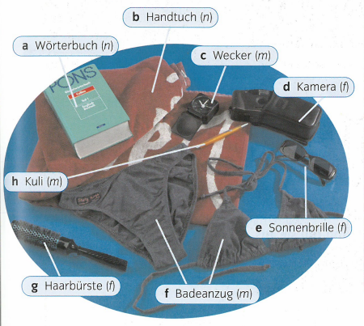

Slide 8
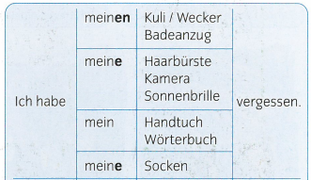
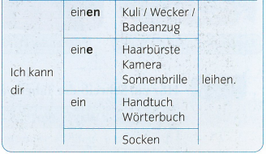
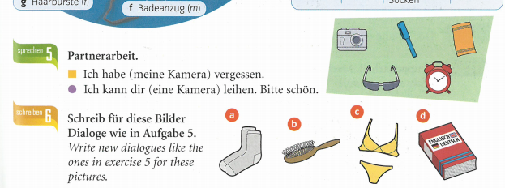
Writing task – do task 6
I have forgotten my…
I can lend you a…

Slide 9
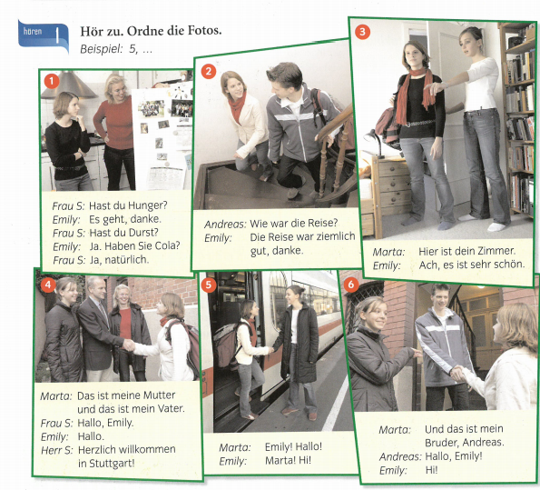
Listening task-
Listen to the conversation and put the photos in the correct order

Slide 10
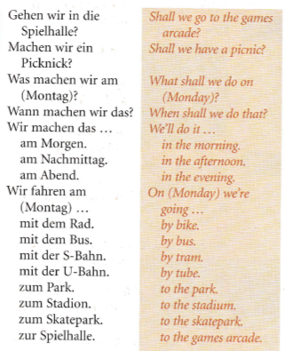
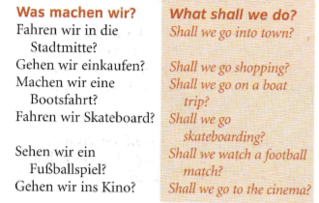
WEEK 2 –
Read through the vocabulary for this week and spend a good amount of time trying to learn it.

Slide 11
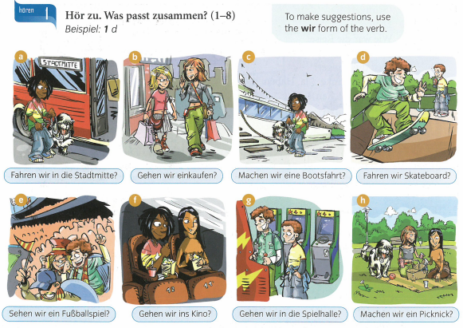
Listen to the recording. Write 1-8. Which suggestion do you hear?
Example, 1d

Slide 12
Listen to the recording about people making plans to meet. Copy the table and complete it in German.
(Day?) (What?/Where?) (Morning/afternoon/evening?)

Slide 13
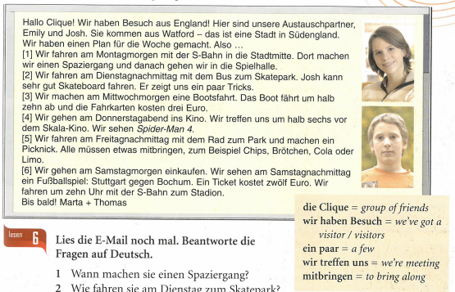
Answer the questions in English.
When are they going on a walk?
How are they getting to the skatepark on Tuesday?
How much does the boat trip on Wednesday cost?
What are they watching on Thursday?
Where are they having their picnic on Friday?
Where are they going on Saturday?

Slide 14
The information in a German sentence has to follow a set order. It is called the ‘Time, Manner, Place rule’. Look at the example below and then copy this information in to your book.

Slide 15
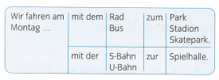
Follow the lines and make a sentence. Number one is done as an example.

Slide 16
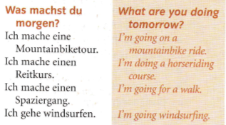
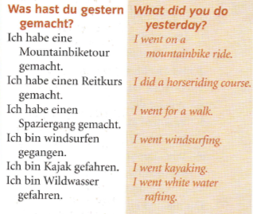
WEEK 3 –
Read through the vocabulary for this week and spend a good amount of time trying to learn it.
heute today

Slide 17
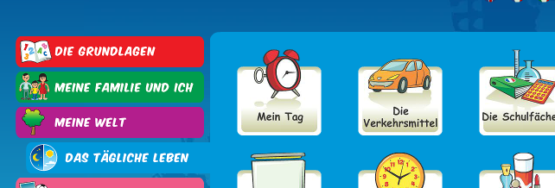
Log on to Linguascope and practise the transport words from last week (they are in the beginner section):
Username – kingshill password – love4langs

Slide 18
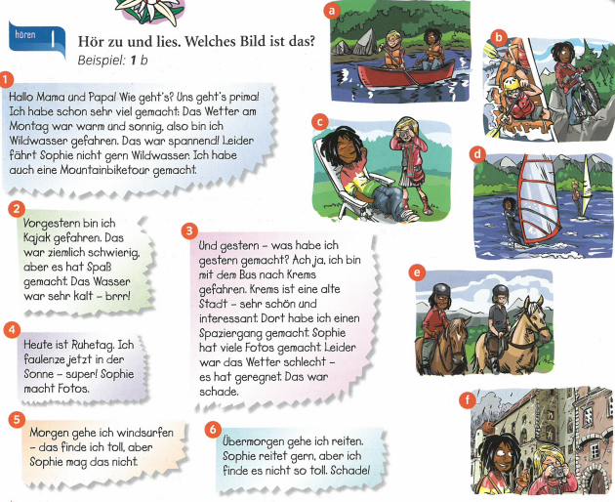
Listen to the recording and read along. Which picture matches each text?E.g. 1b

Slide 19
When you are trying to identify if a text is written in the past, present or future, look for clues like the ones below. Now go back and read the 6 texts on the previous slide and decide if they are past, present or future.
war-was
hatte- had

Slide 20
Listen to the recording. Write down 1-3. Write down which activity each of the 3 people mentions (a-f) and then say if they talk about it in the past, present or future tense.
Example, 1 b, past….

Slide 21
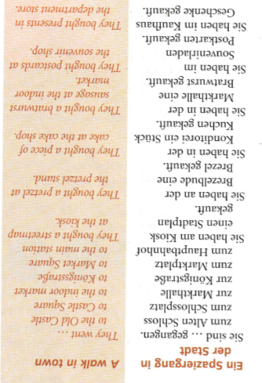
WEEK 4 –
Read through the vocabulary for this week and spend a good amount of time trying to learn it.

Slide 22
Copy this grammar information above and write the English too.
Sie haben gekauft = they bought
Sie sind gegangen= They went
Sie sind gefahren = they travelled/ went

Slide 23
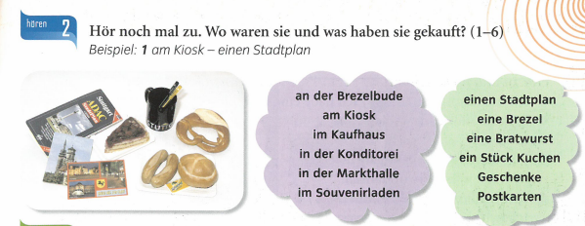
Listen to the recording. Where were they? What did they buy? Answer in German. Example below.

Slide 24
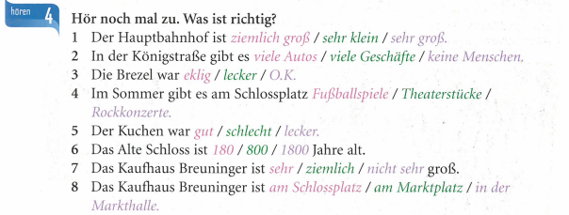
Listen to the recording again. Choose the correct word to complete each sentence.

Slide 25
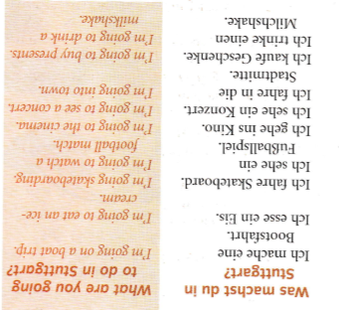
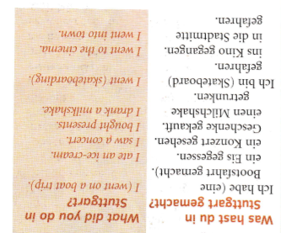
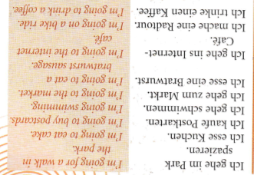
WEEK 5 –
Read through the vocabulary for this week. It is based on vocab you have already looked at this term and has phrases in different tenses. Then do the activities. They recap vocabulary from the whole chapter.

Slide 26
Listen to the recording. Write down 1-4. Answer the questions in English for each of the 4 people.

Slide 27
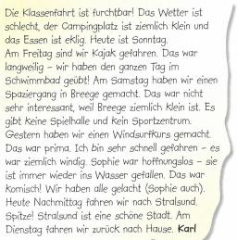
Read the text and answer the questions in English.
What problems are they having on the trip? (3 things)
What did Karl do on Friday evening?
Why was that boring?
What is the town of Breege like?
What was good? Why?
Who fell in the water?
What is Karl doing this afternoon?
Why does he think that is good?
Useful vocab:
geübt=practiced
hoffnungslos - hopeless
heute Nachmittag – this afternoon

Slide 28
Now, look back through your notes, at your vocab sheet and at the previous slides to start revising for your assessment next week. You could make flashcards, spider diagrams and posters to help you.

Slide 29
WEEK 6 –
This week is assessment week. Spend some time revising all of the vocab on these slides so far (or on your chapter 6 vocab sheet which is in your orange book) and then email your teacher for the test papers.
There is also some information about Easter in Germany to read through.

Slide 33
There is an Easter section on Linguascope in the beginner section too.
username – kingshill password – love4langs

