Slide 1


Design Situation & Brief
RED BULL has in recent years become the market leader in energy drinks in the UK. Their popularity has grown in part due to the excellent advertising and marketing campaign that the company conducts each year. The owner of the RED BULL, Dietrich Mateschitz is reportedly worth $4.0 billion. RED BULL also supports many sporting events, ranging from Formula 1 to the RED BULL AIR RACE.
In 2009, the competing energy drink company MONSTER ENERGY introduced a range of products into the UK. These products were pitched as a unisex product aimed at the younger generation, in particular teenagers with disposable income. This new product, along with aggressive advertising has enabled MONSTER ENERGY to claim a large market share.
To combat this, RED BULL wish to redesign and re-launch their flagship energy drink. You have been tasked with the following;
Design a new logo and slogan for the RED BULL brand.
Design and produce a graphic design on the front of the drinks can.
Produce a graphic for the external packaging to promote this new product.

Slide 2
Primary Research
Primary research is information that you have collected personally to analyse. For this project, find a range of Red Bull products (or similar energy drinks) and create a detailed research page to help you.
1.Find 3 images of previous energy drink products/designs
2.You can layout the work on a page and annotate around the image - Use the criteria below
Aesthetics - What does the product look like? What is the colour, texture, pattern and decoration of the product?
Client and user requirements - Who would buy the product and when would they use it? How well does the product do its job when compared to others? How marketable is it to the user?
1
2
3
Existing Products
3. Find three images which will help you with your ideas.
Patterns
Animal
Lettering style or font
Pattern
Animal
Lettering
Mood board Images
Pattern

Slide 3
Initial Ideas
Produce 3 ideas for your drinks can graphic. Add colour and detailed annotation to explain your work.
LOGO IDEAS

Slide 4
Drinks Can final design
Remember this graphic will wrap around the cylinder so include the logo/ product name and the relevant information such as content, barcode etc.

Slide 5
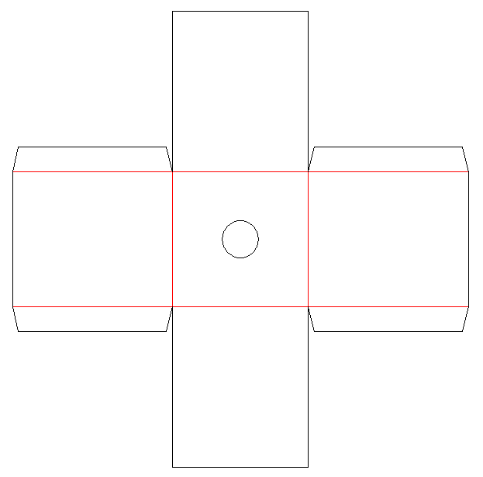
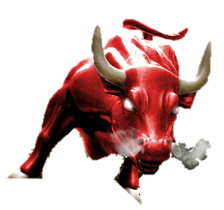
Initial Ideas for
Packaging
EXTERNAL GRAPHIC
DESIGN TEMPLATE

Slide 6
User Testing
Understanding the success of your product is important as a designer. User testing is a way of gathering information from potential users. Suggested improvements should also be considered in the redesign phase.
QUESTION | USER 1 | USER 2 | USER 3 | USER 4
What do you think of the colours I have used on the product ?
What……………………
Who………………….
How………………
HOW COULD THE PRODUCT BE IMPROVED?

