Slide 3
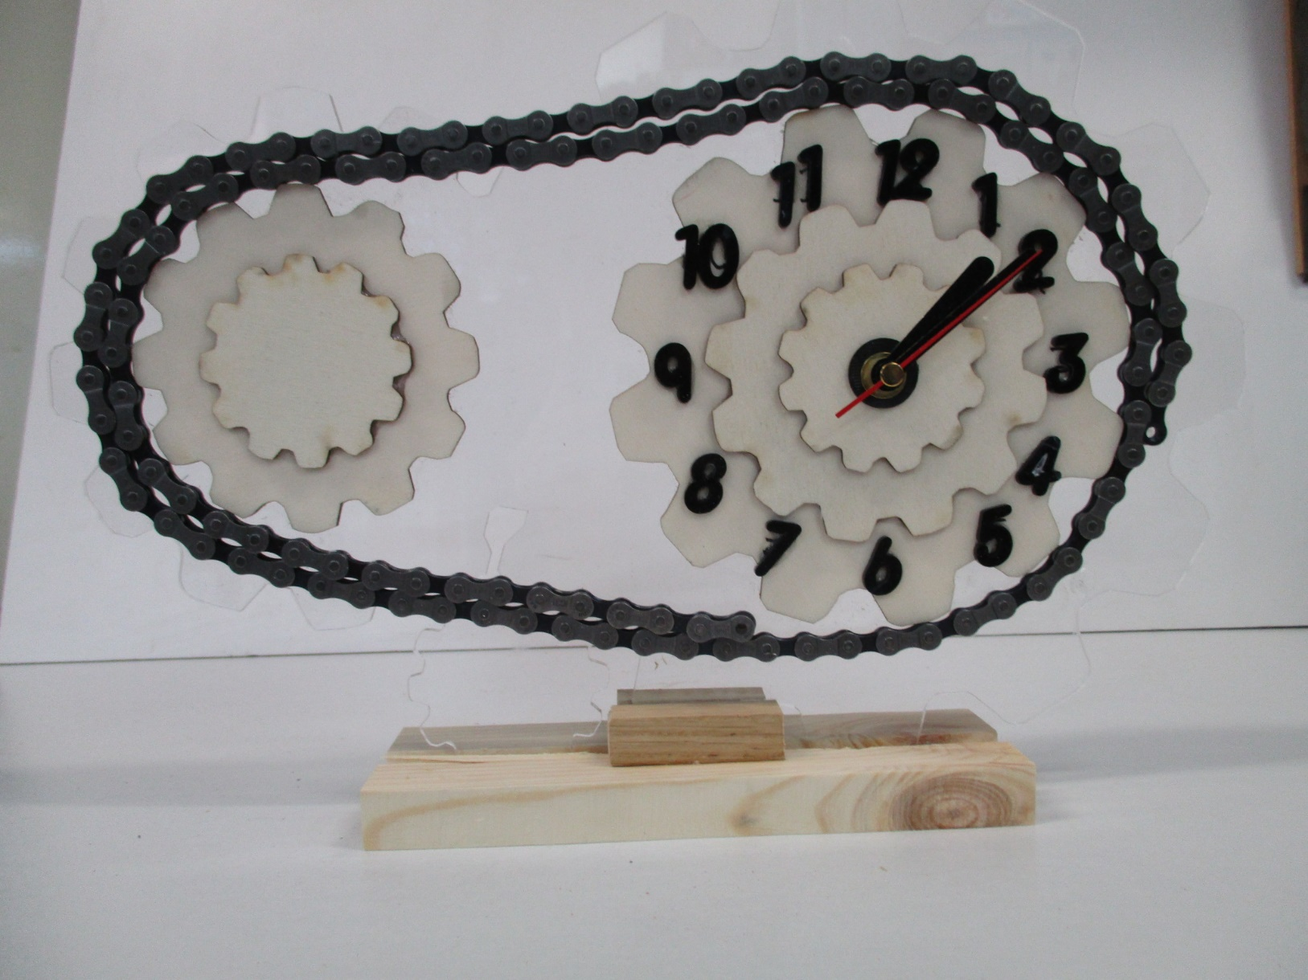
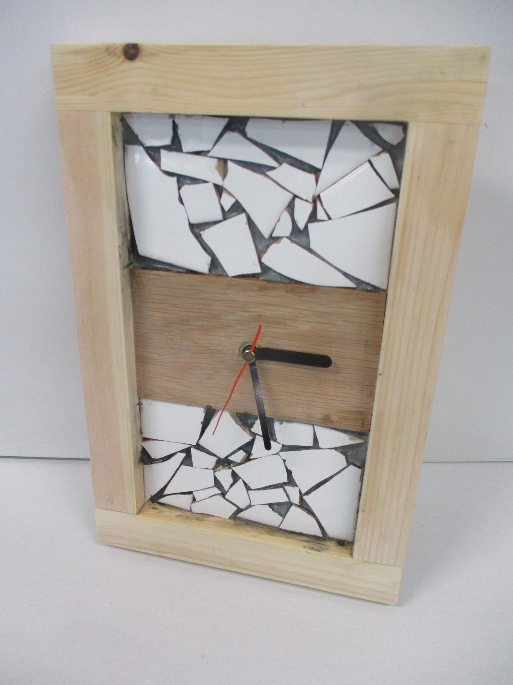
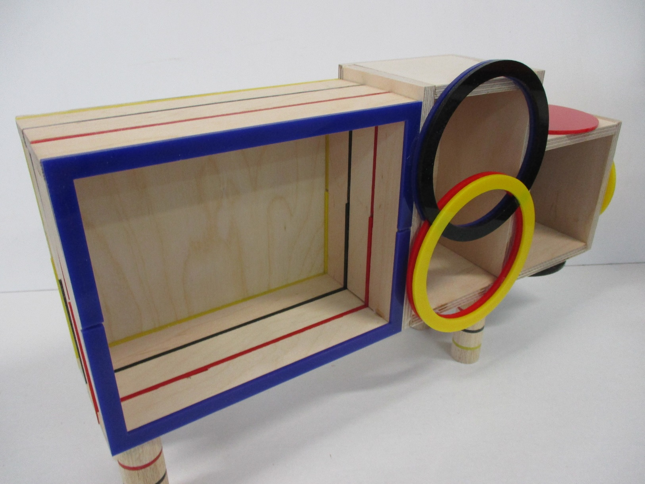
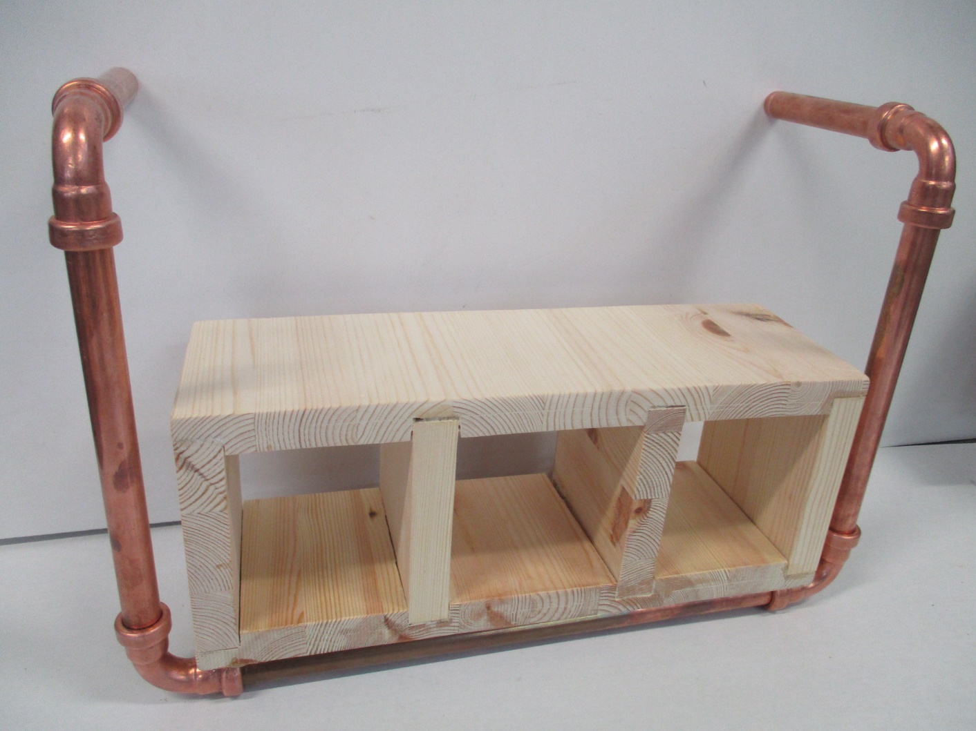

Slide 5
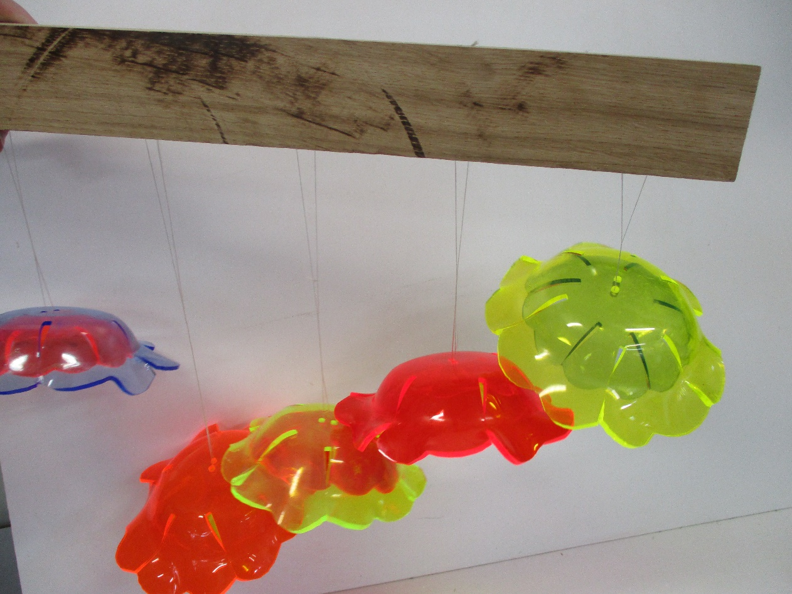
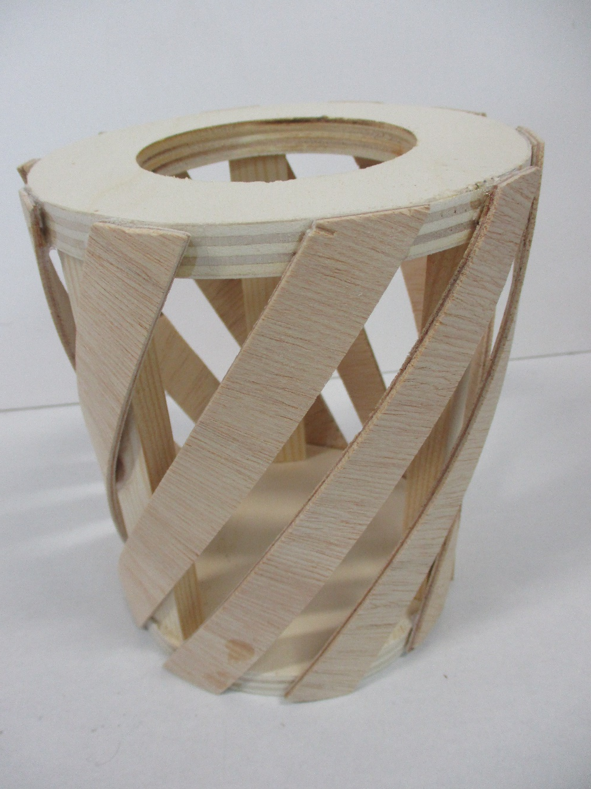
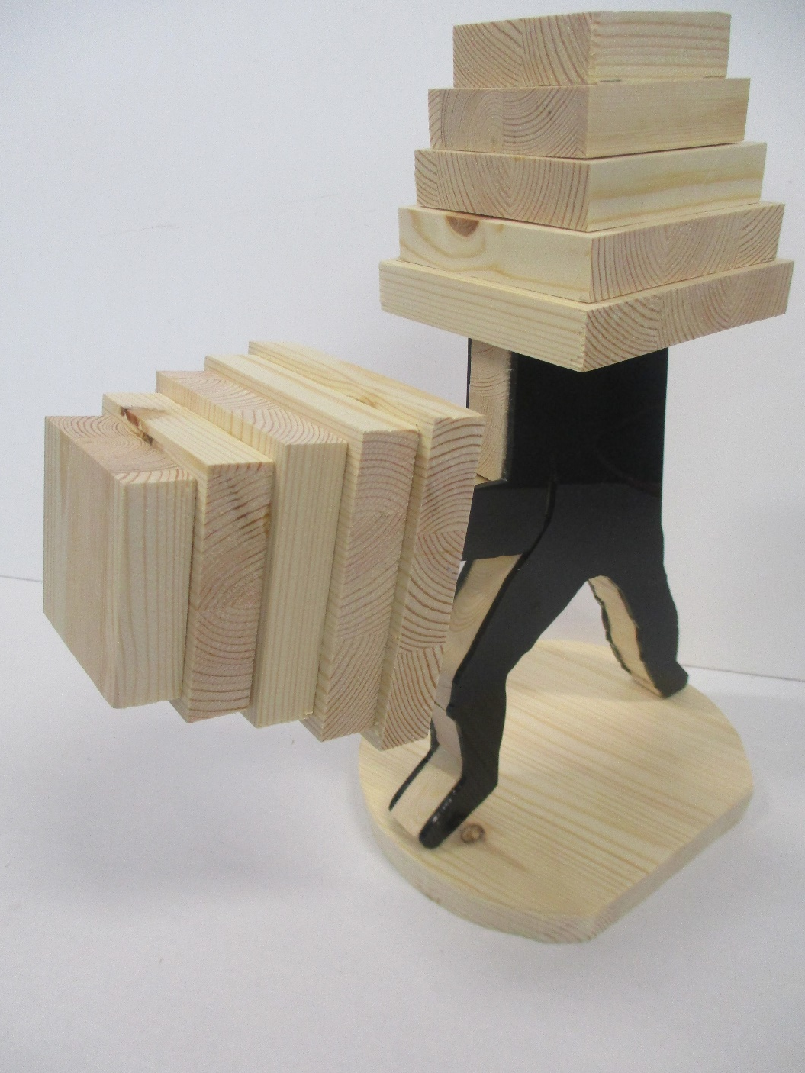

Slide 6
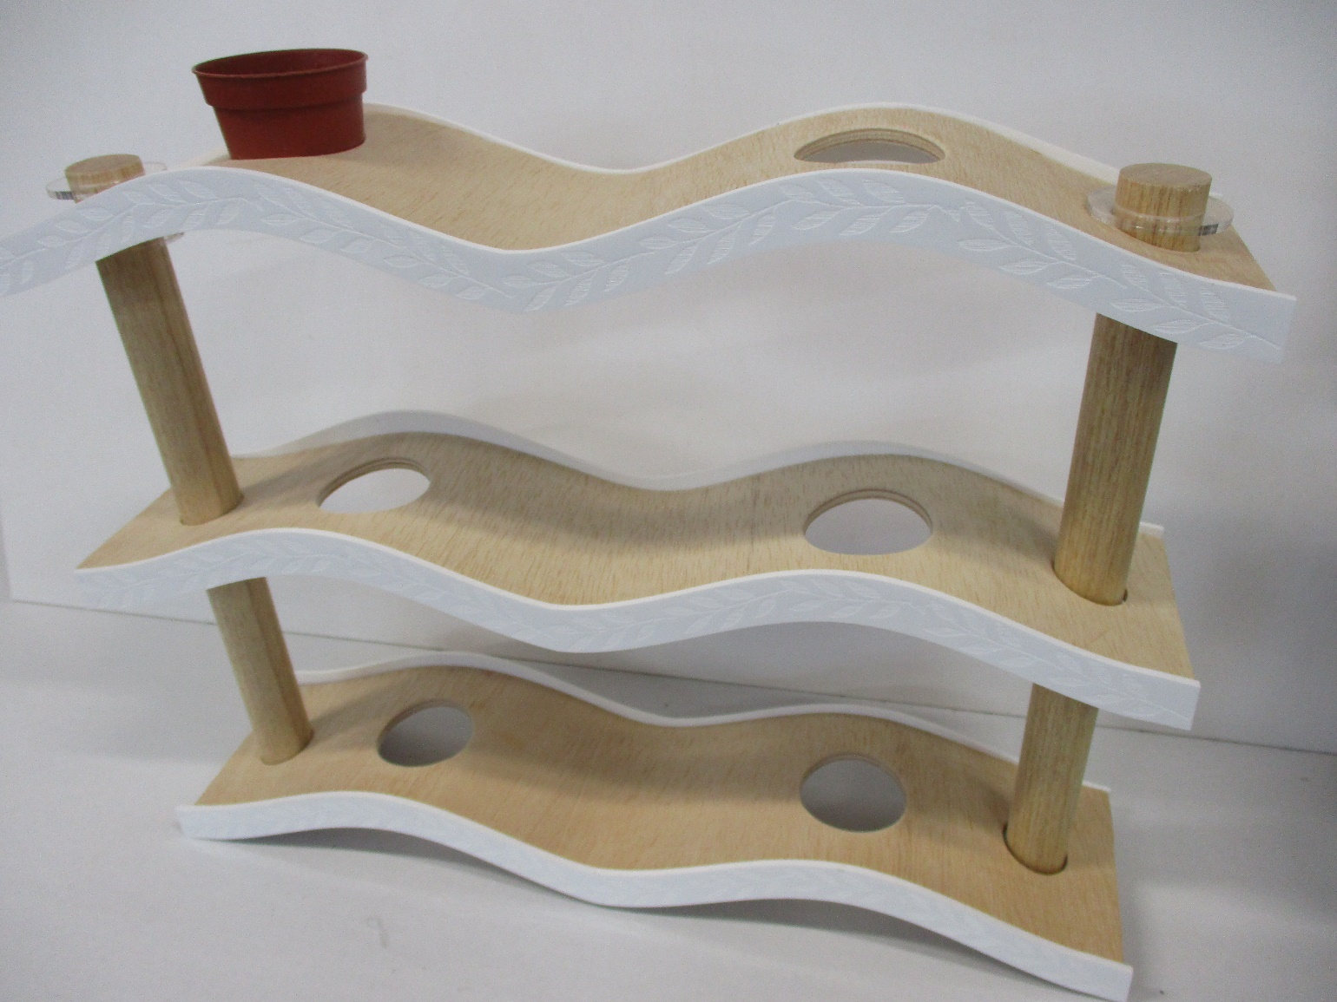
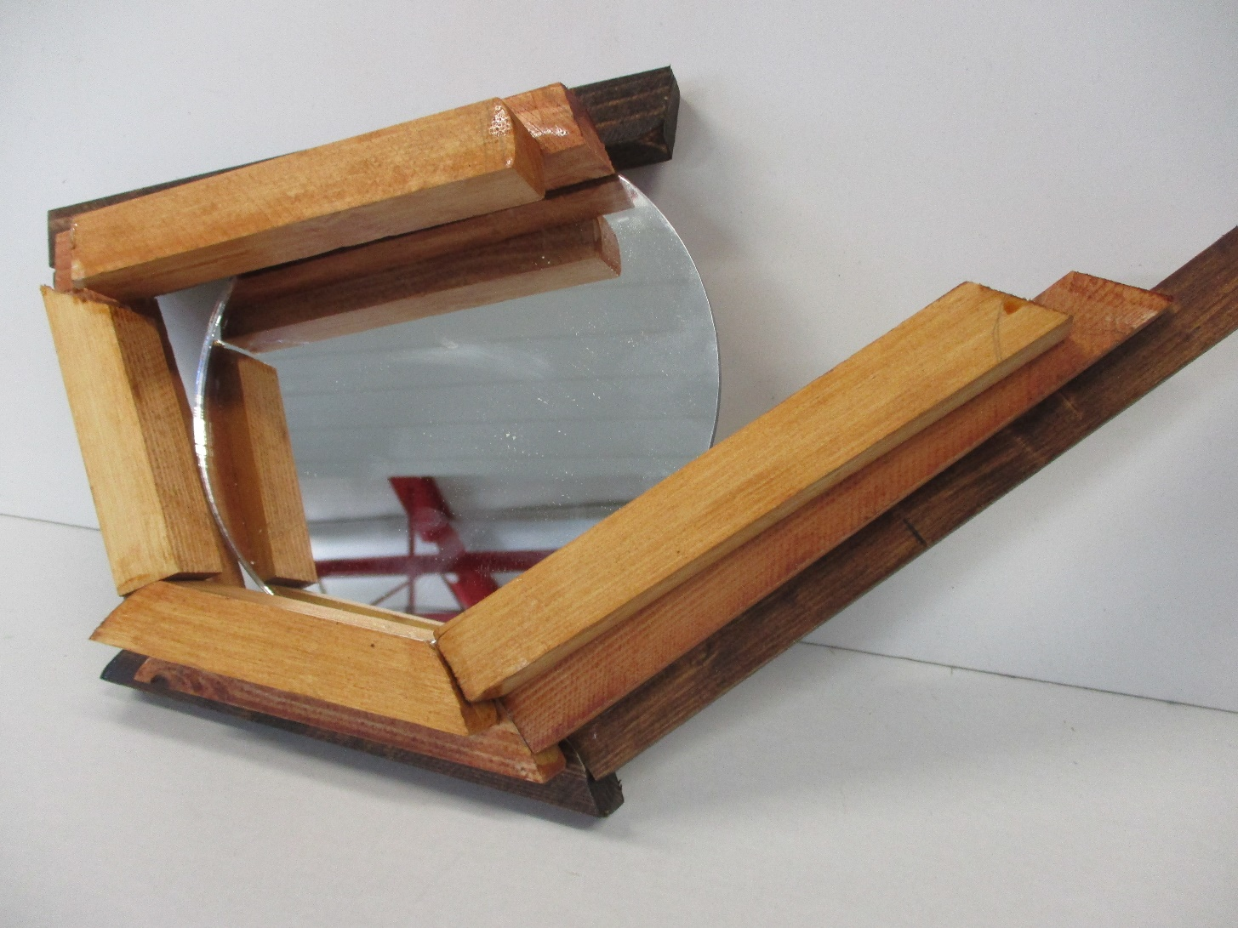
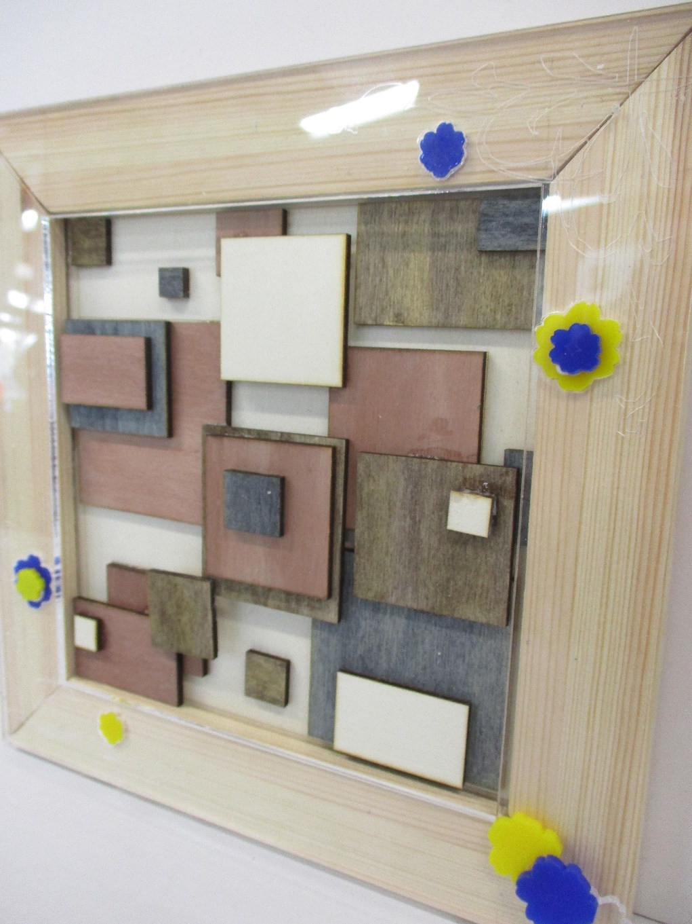
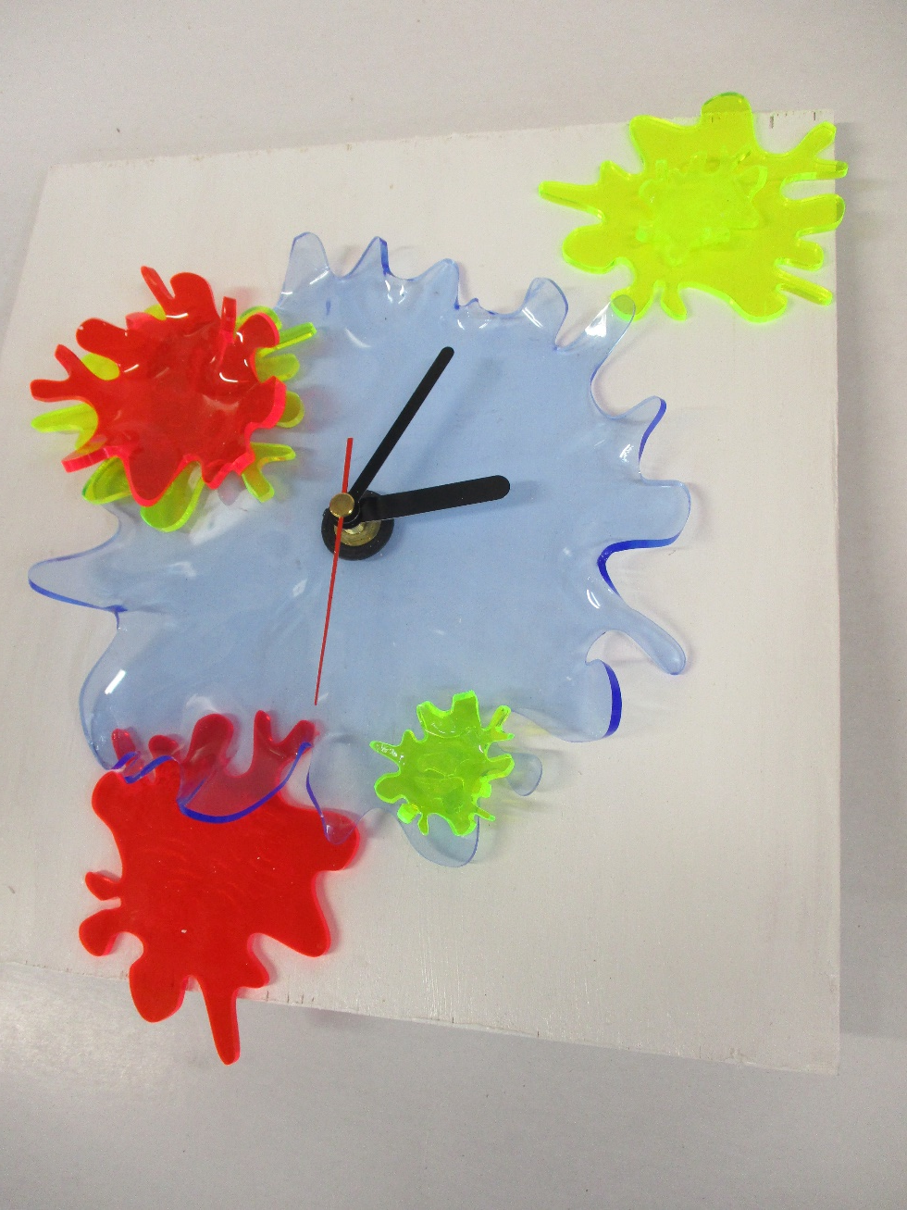
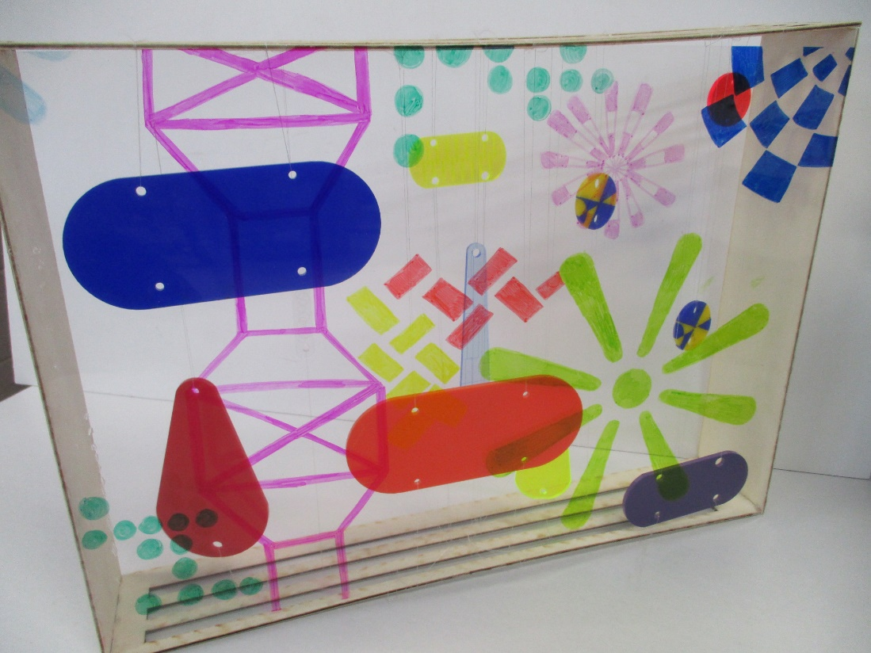

Slide 8
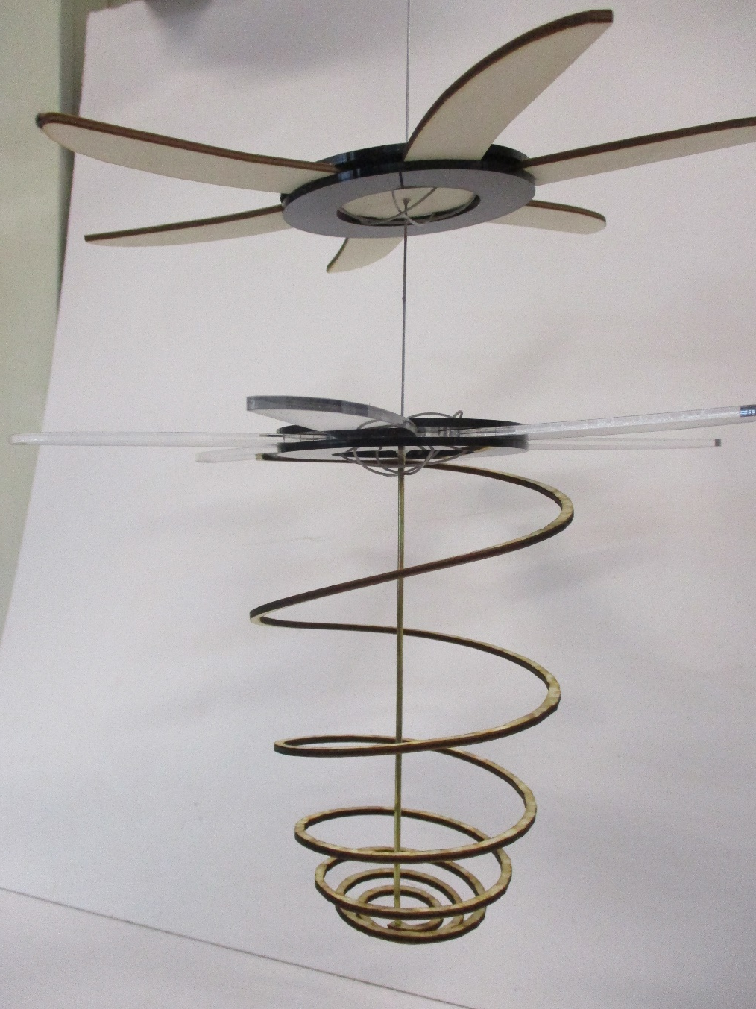
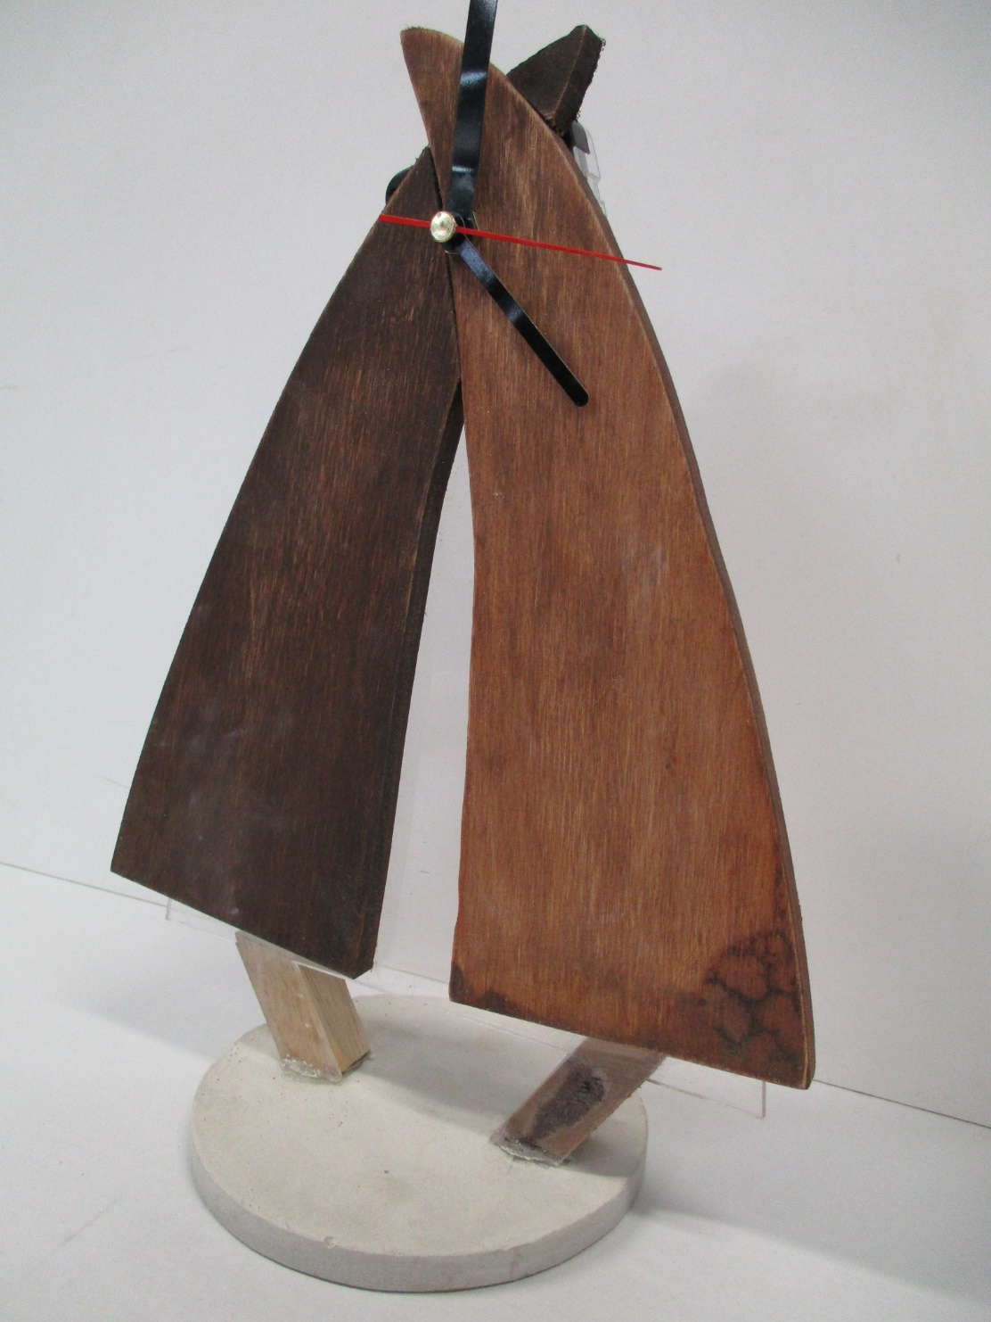
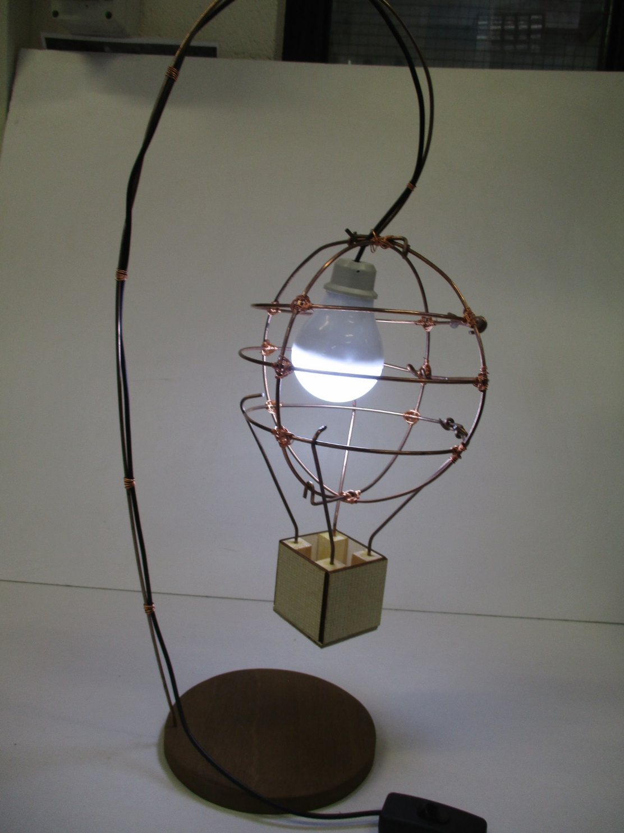

Slide 9
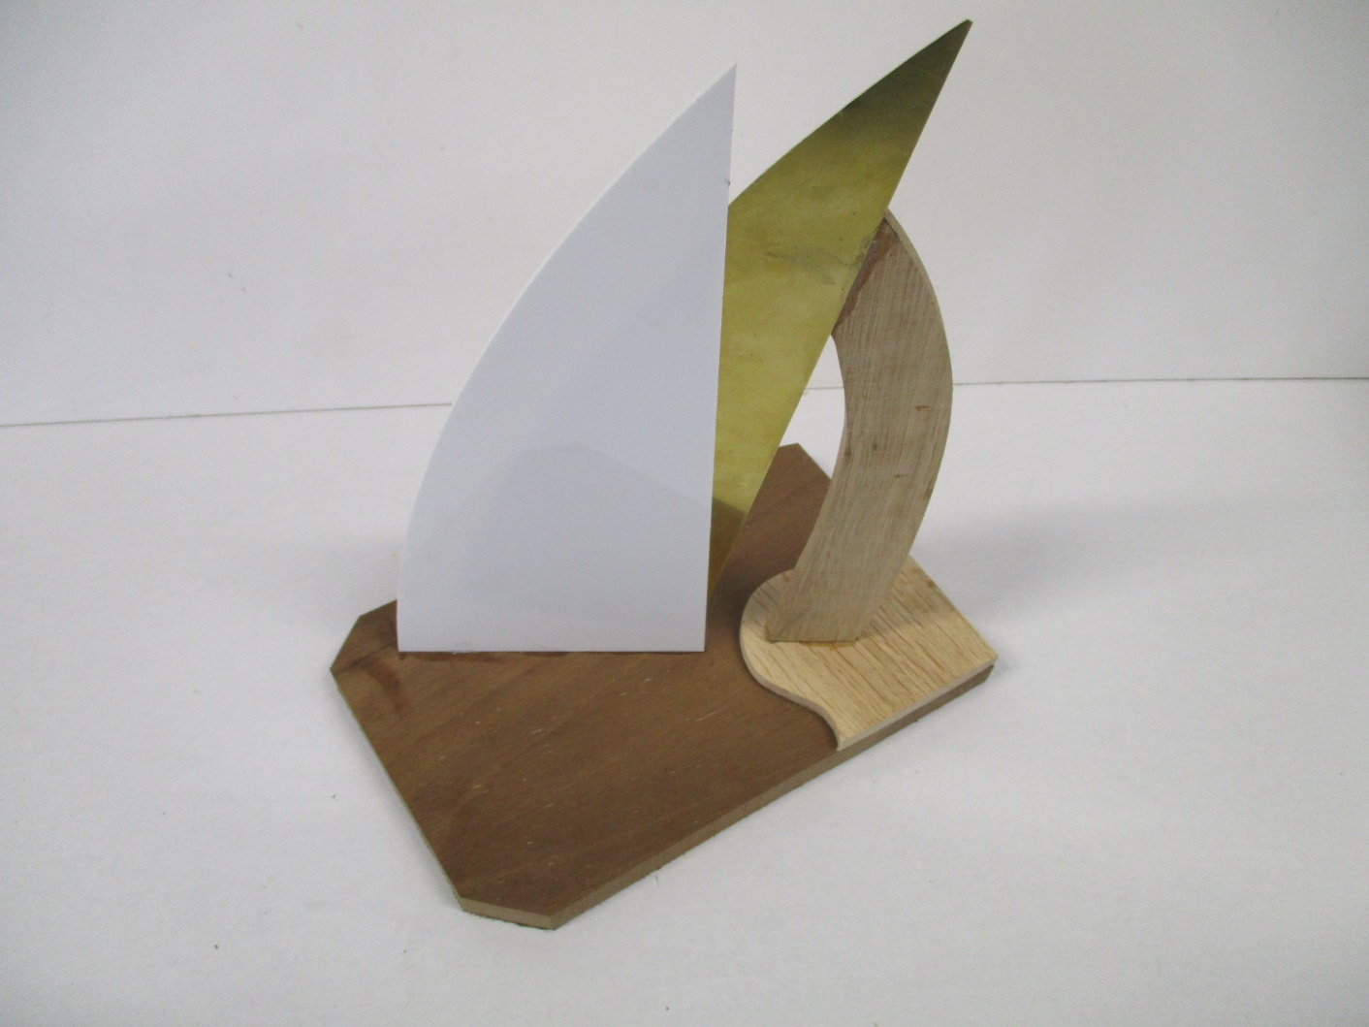
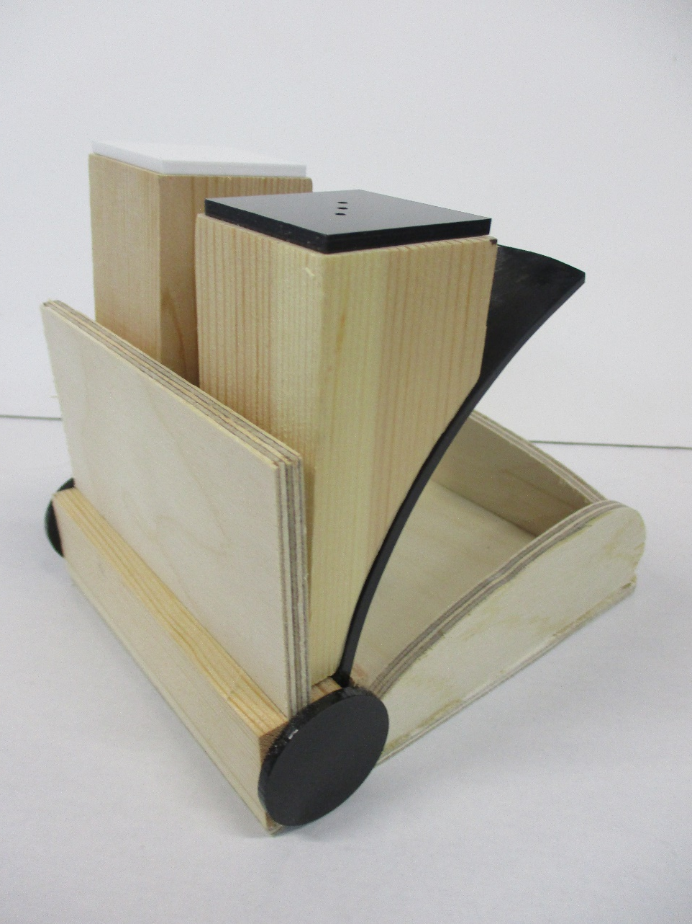
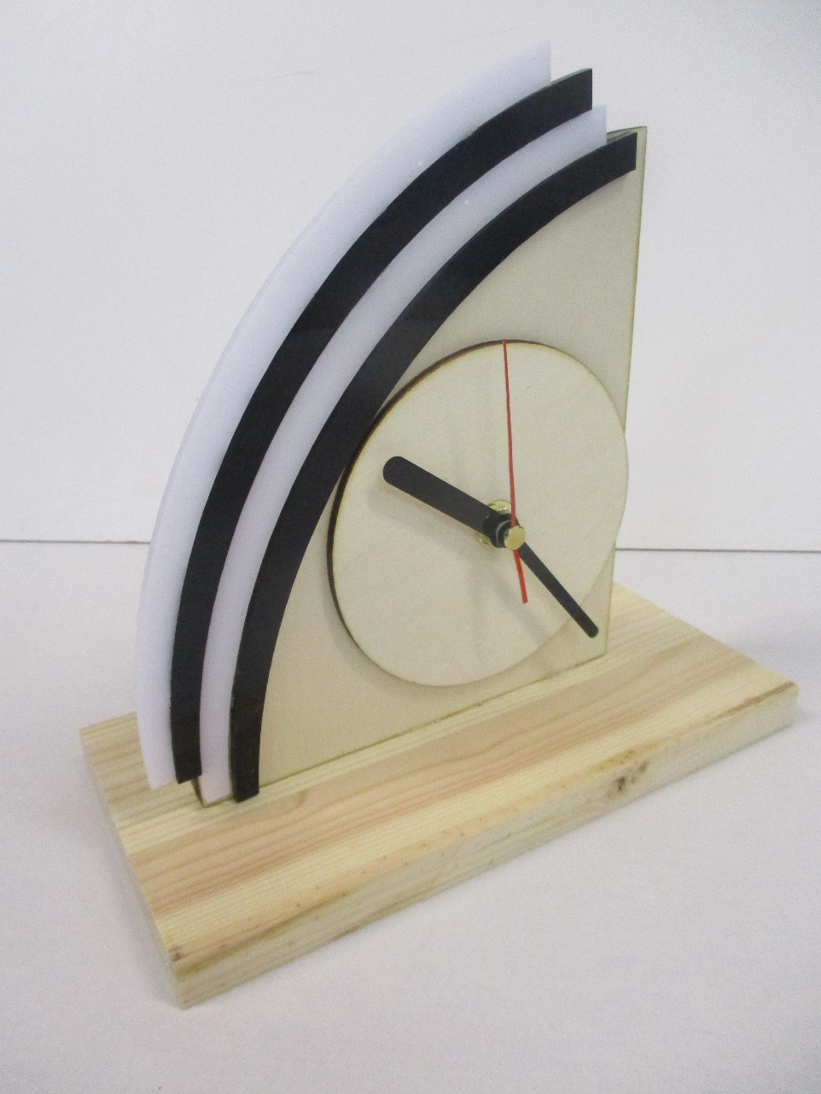
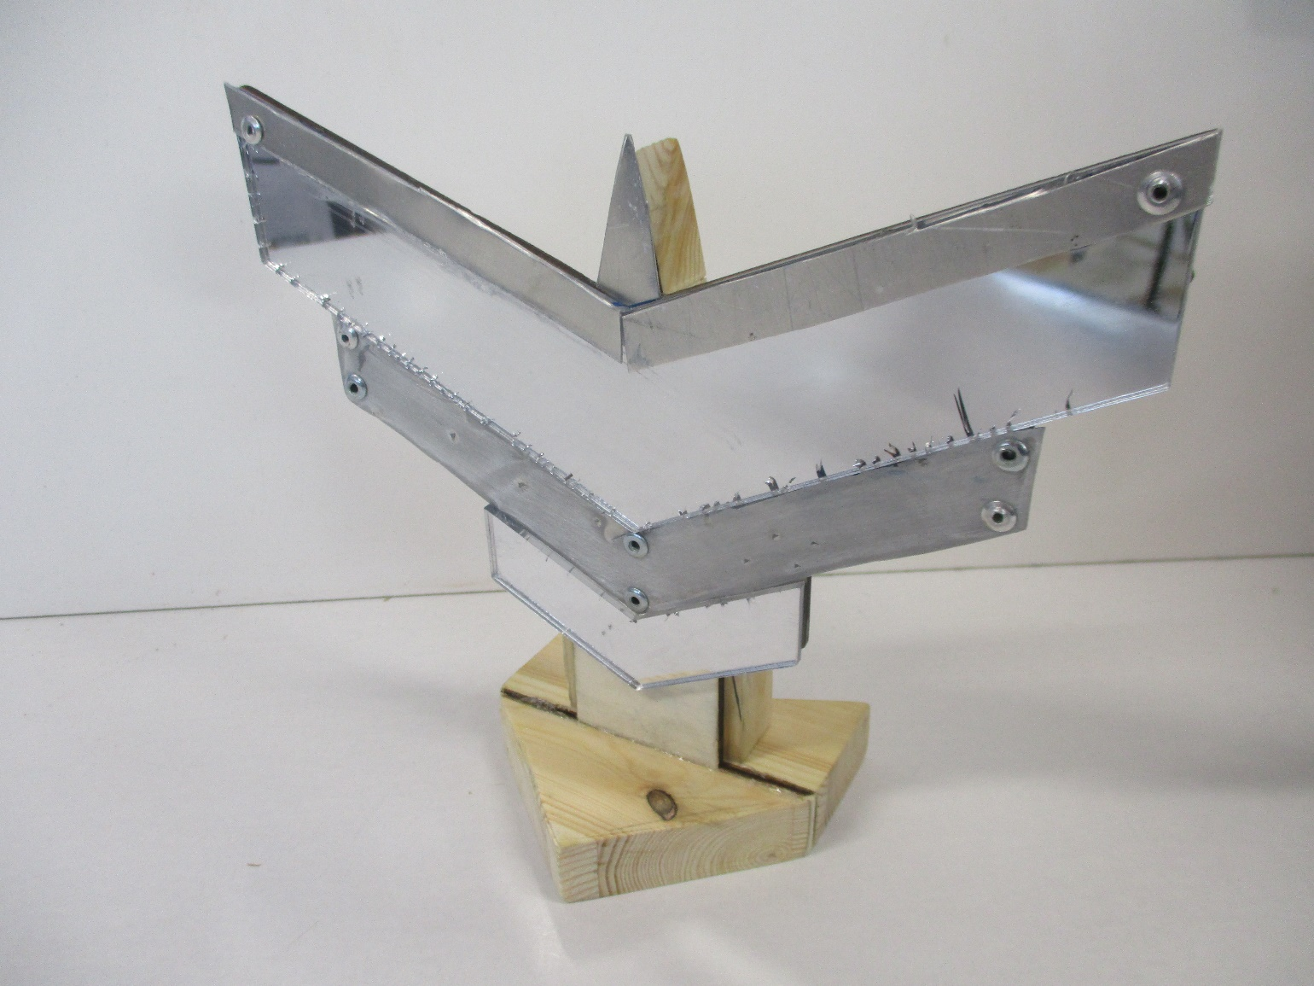

Slide 10
The theme for Product Design is ‘Furniture’
We all see trees around us, in streets, parks and woods. They have always been an inspiration for artists and designers. Trees have cultural, mystical and environmental significance, as reflected in poetry, literature, beliefs and ancient traditions. Designers who have used trees as the source for their work include Robert Bronwasser and design companies such as Straight Line Designs Inc. and Design Lush. Russell Pinch uses trees and roots as the basis of furniture designs.
What you will need to produce
The National Arboretum at Westonbirt wants you to come up with some new designs inspired by Trees. You should develop 2D and 3D designs and ideas in response to the client brief using your own primary and secondary research. You should make reference to specialist materials, techniques and processes. Consider form and function, colour, line, texture, mass, surface and volume. The client would like to see drawings, sketches, models, test pieces and maquettes to show your design ideas.
Inspired by this theme, choose one of the following:
Design a bench for 2-4 adults and/or children to sit while walking around the grounds.
Design a picnic bench (seats and table top) for 2-4 adults and/or children to sit at to have a picnic lunch.
Design a bench or seat for use by children in the children’s play area.
Your designs are to be inspired by trees and the objects, patterns, textures associated with Trees and Encourage, Promote and Celebrate good furniture design

Slide 11
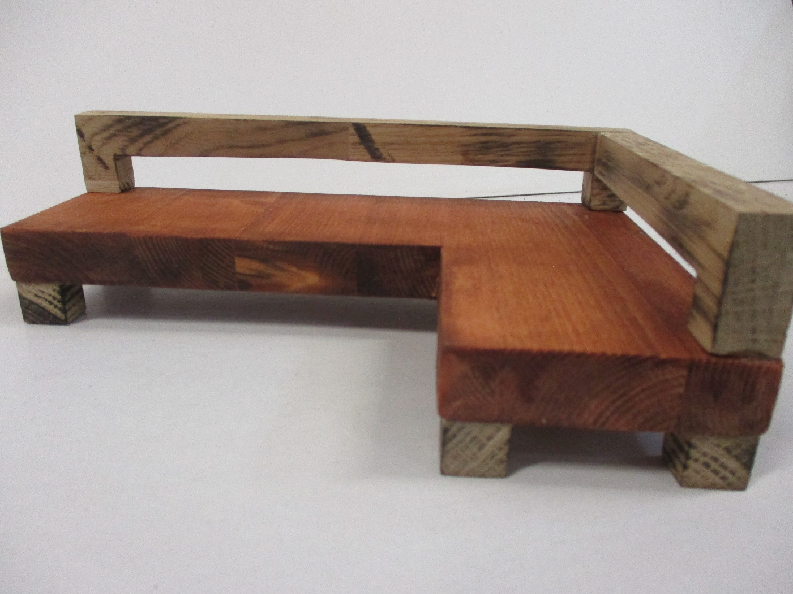
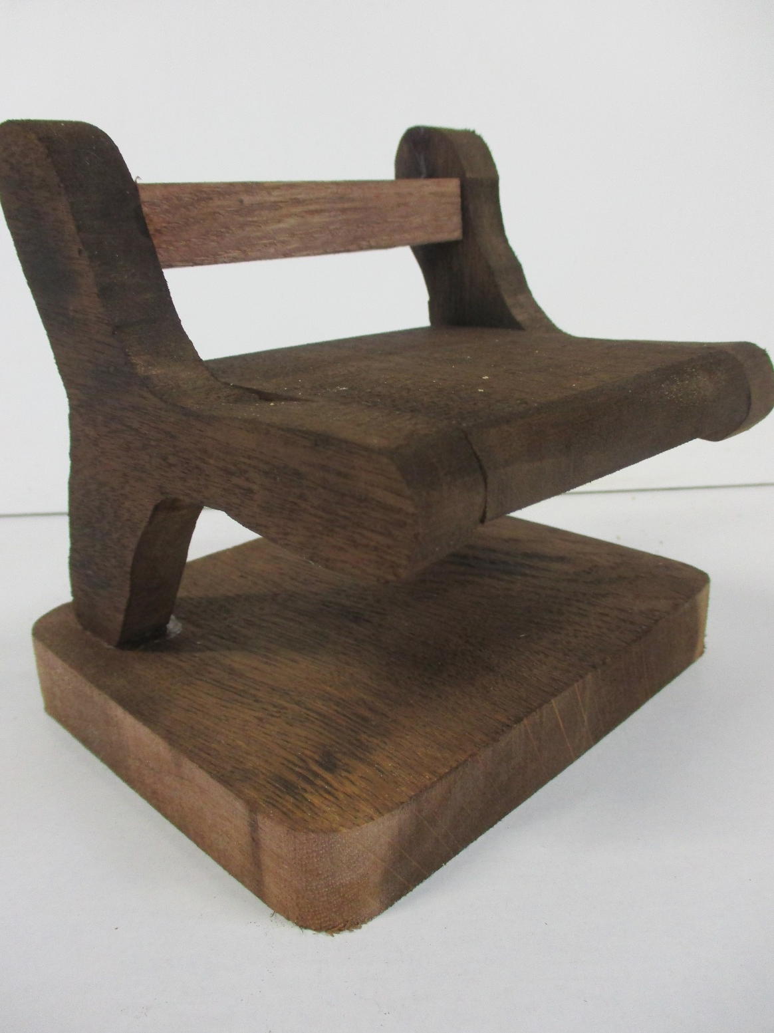
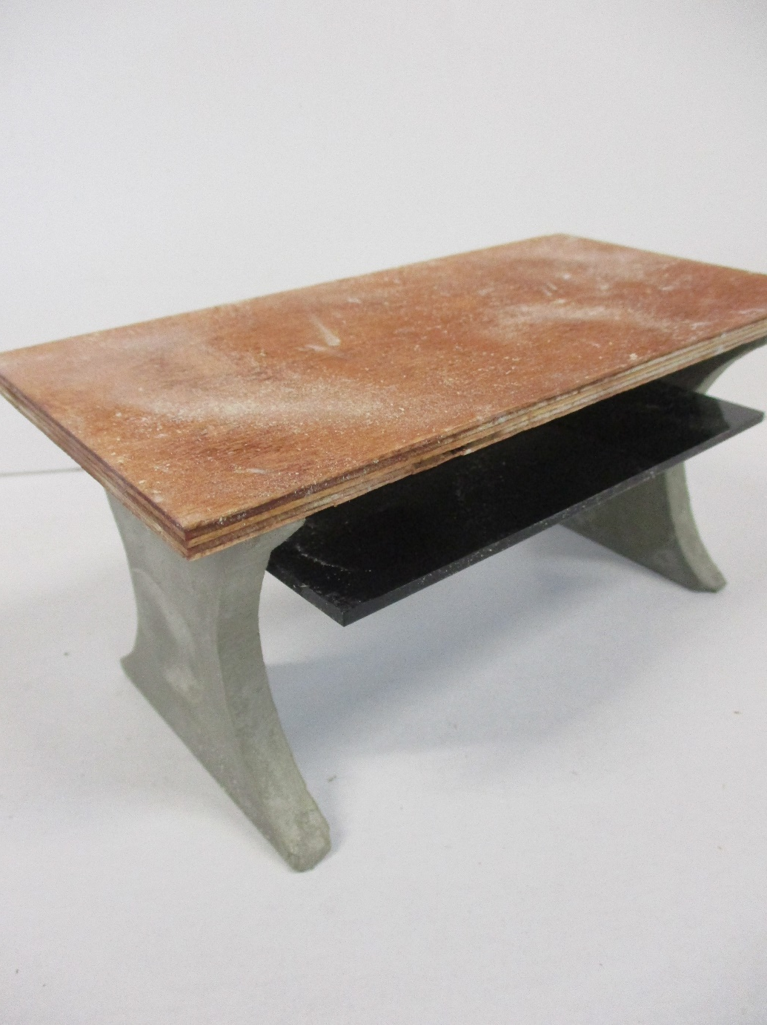

Slide 12
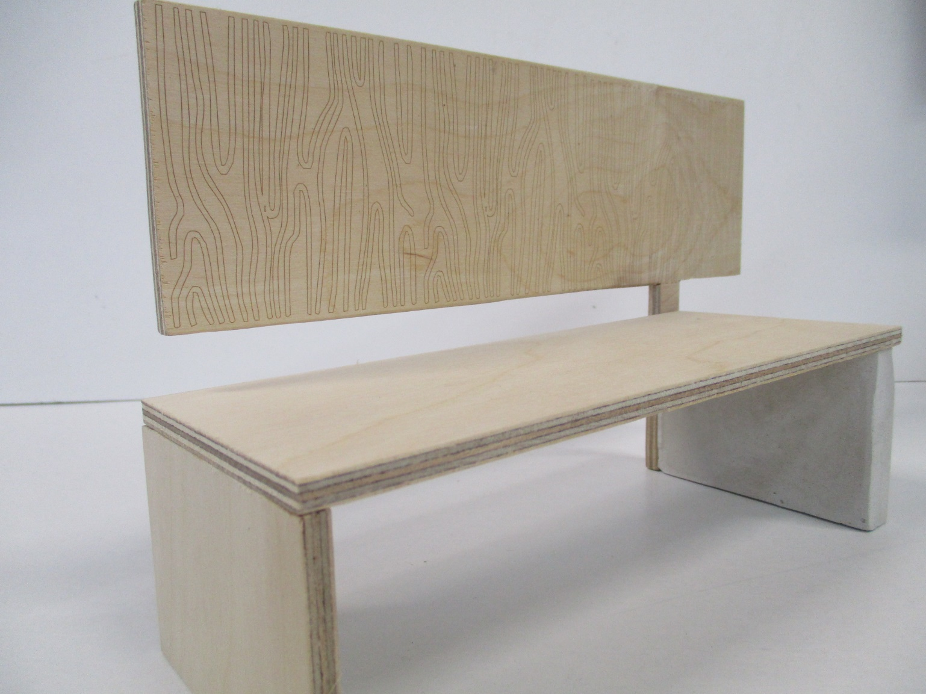
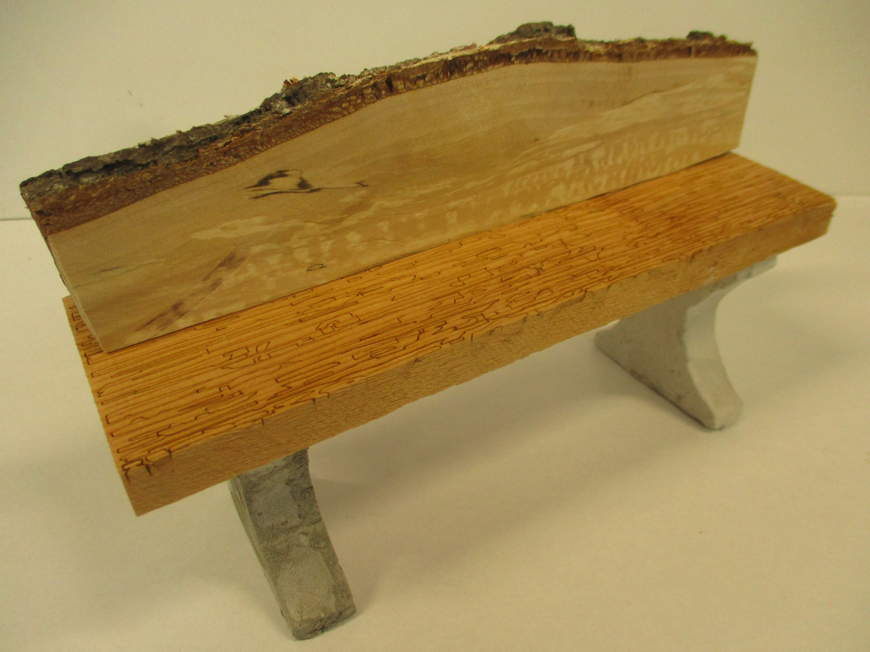
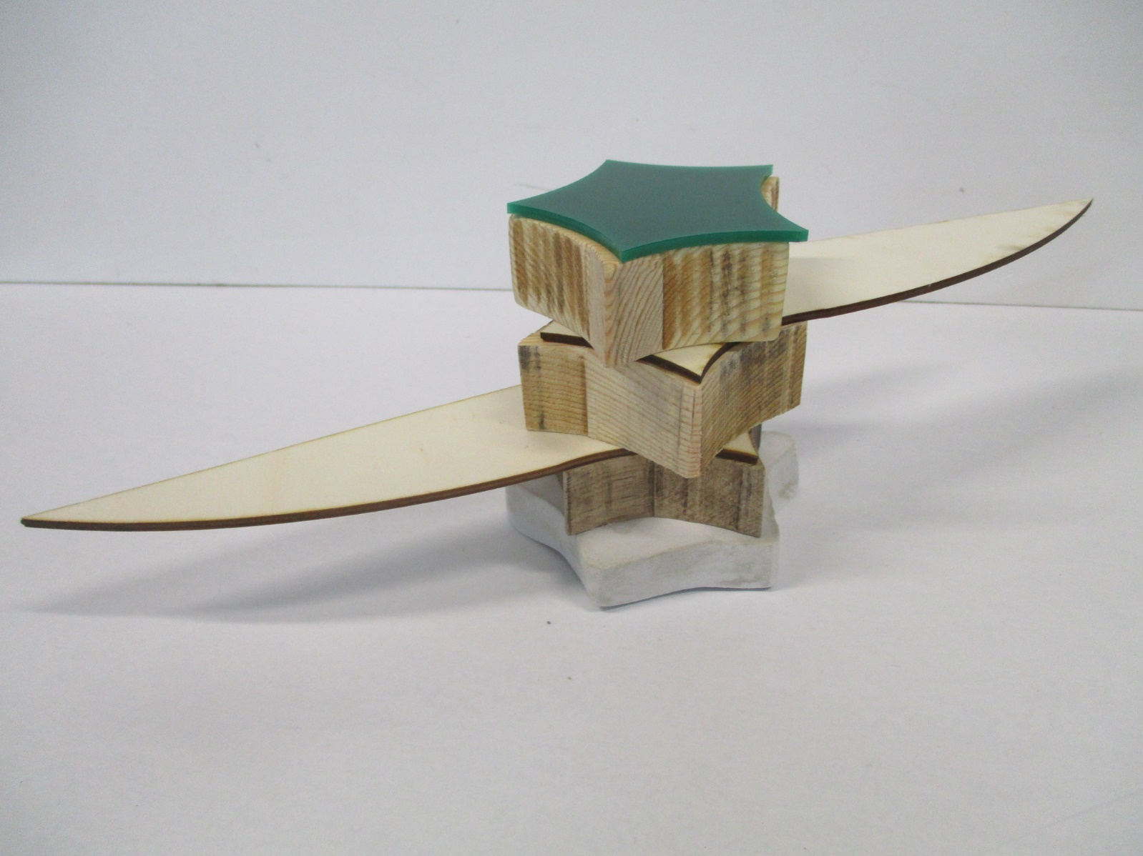
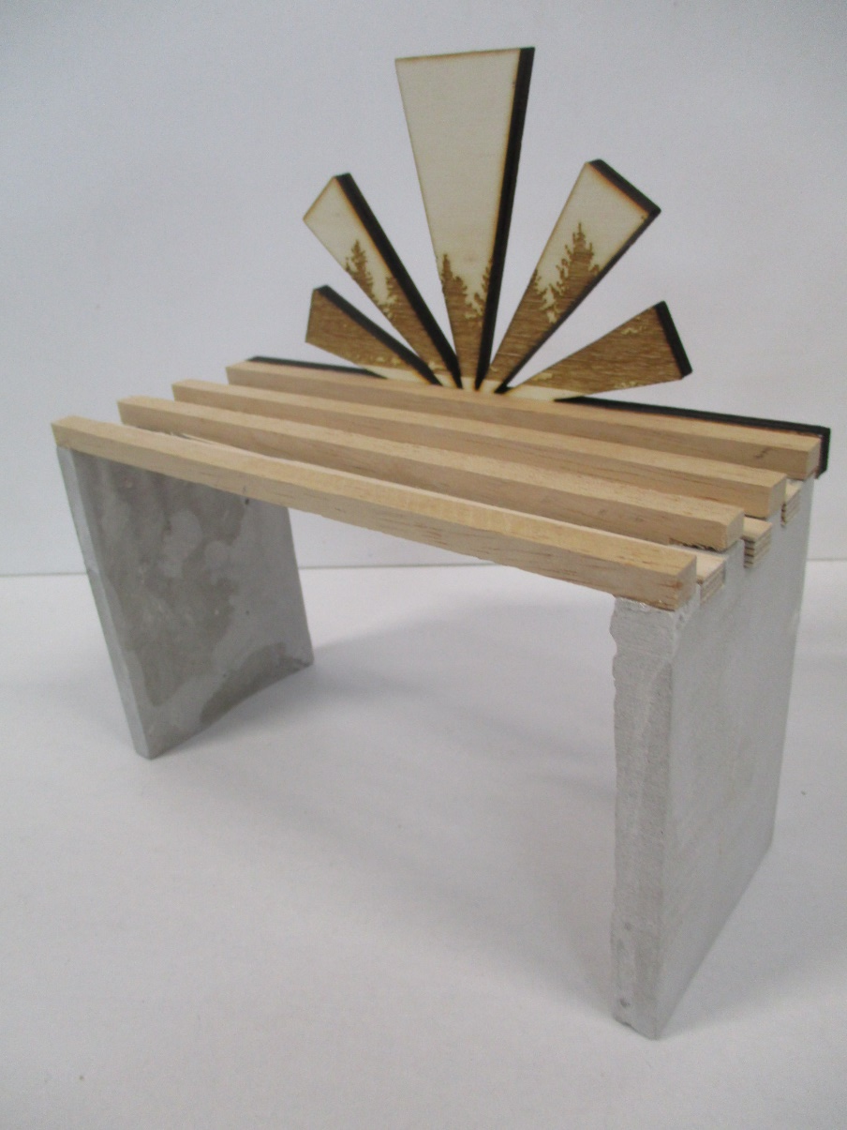

Slide 13
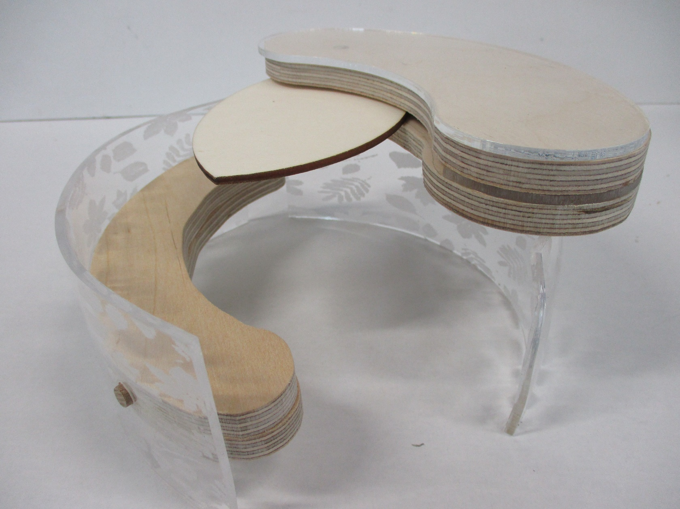
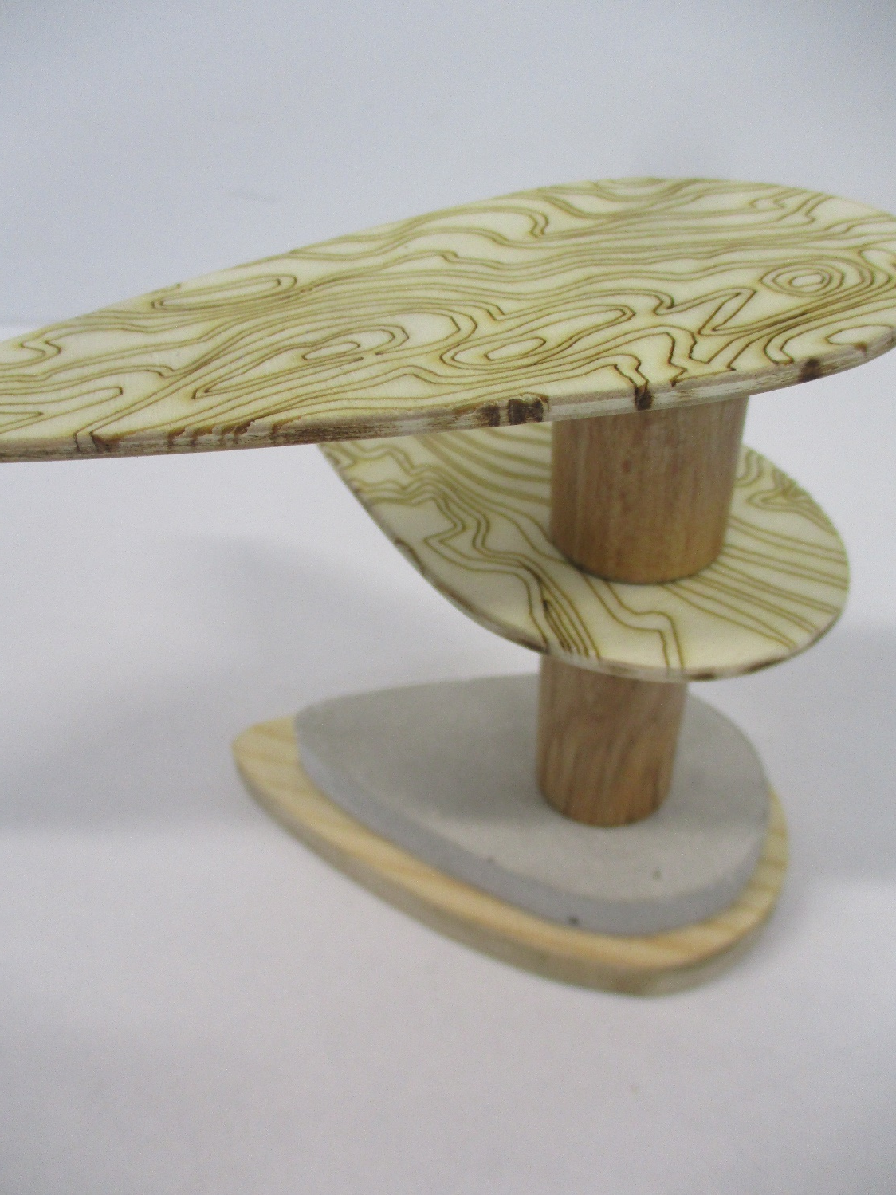
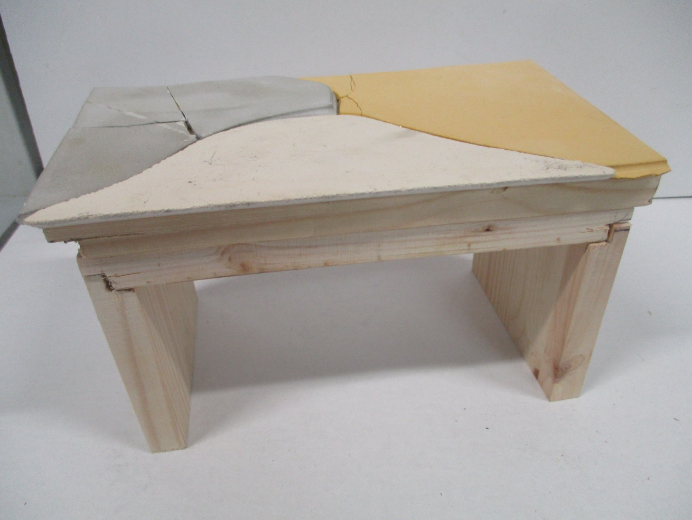

Slide 14
The National Arboretum at Westonbirt wants you to come up with some new designs inspired by Trees. You should develop 2D and 3D designs and ideas in response to the client brief using your own primary and secondary research. You should make reference to specialist materials, techniques and processes. Consider form and function, colour, line, texture, mass, surface and volume. The client would like to see drawings, sketches, models, test pieces and maquettes to show your design ideas.
Inspired by this theme, choose one of the following:
Design a bench for 2-4 adults and/or children to sit while walking around the grounds.
Design a picnic bench (seats and table top) for 2-4 adults and/or children to sit at to have a picnic lunch.
Design a bench or seat for use by children in the children’s play area.
Your designs are to be inspired by trees and the objects, patterns, textures associated with Trees and Encourage, Promote and Celebrate good furniture design.

Slide 15
Week 1
Theme Mood board
Response Mood board
1. Choose a starting point from slide 14.
Search starting point in Google and copy and paste inspirational images in here
3. From photo slides copy and paste examples of work that inspire you for the sort of response you could design and make for your chosen starting point
2. Copy and paste your chosen starting point from slide 14 in here
Exam Starting Point Analysis
Starting Point
Chosen starting point
I chose this because….
Action Plan
Over the next few weeks I will explore the work of different artists, looking carefully at their style and characteristics. I will think about how I can take inspiration from their work and develop it into a response of my own. I will develop a range of ideas, develop and experiment with a range of different materials and making techniques so that I can make my response in 10 hours.
3. Explain why you have chosen starting point compared to others in here
Sources:
Designing the 21st Century, Charlotte and Peter Fiell, Tasche
Design of the 20th Century, Charlotte and Peter Fiell, Taschen

Slide 16
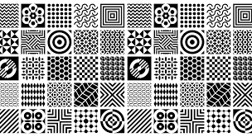
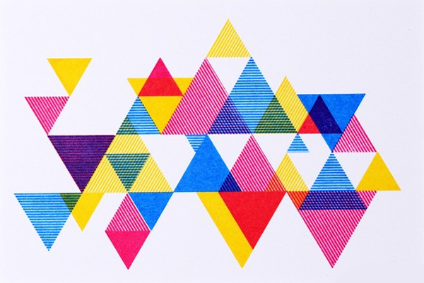
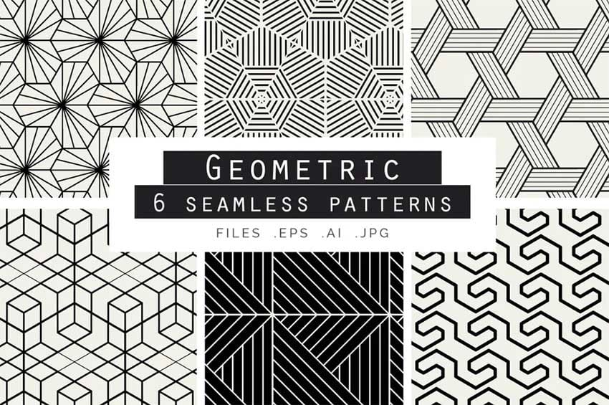
Week 1
Example
Theme Mood board
Response Mood board
3D sculptural piece i.e. Award / paperweight
Mirror
Clock
Wall shelf / book shelf
Container
Model of furniture
Light (you need to provide LED lights)
Starting Point Summary
I chose the starting point ‘Geometric’ because I like geometric shapes. I like the geometric shapes used in styles like Art Deco and Memphis. I like how simple shapes like squares, triangles, rectangles, hexagons, circles can be arranged into quite complex forms. I also like how geometric shapes can be used to create a variety of different patterns on surfaces like on one part as in the style of Memphis. I like how some geometric shapes can be arranged in an almost dream like form and almost impossibly balanced like in Abstract Moderne. There are many different responses that I am considering in response to Geometic. My most preferred are a 3D sculptural piece that could be an award or paperweight or container for small items. I feel like I can incorporate geometric shapes in the overall form of my response as well as the surface decoration.
Action Plan
Over the next few weeks I will explore the work of different artists, looking carefully at their style and characteristics. I will think about how I can take inspiration from their work and develop it into a response of my own. I will develop a range of ideas, develop and experiment with a range of different materials and making techniques so that I can make my response in 10 hours.
Salt and pepper shaker

Slide 17
Week 1
Put tracing paper over the top and draw concept designs blending the two taking inspiration from the shape, patterns, textures of theme and response options
On tracing paper Instructions
Design Concepts suggestion –
Fill the sheet of tracing paper with concepts taking inspiration from the images. Take inspiration from the shapes, textures and patterns.
Draw a concepts by copying aspects of the shape, texture, pattern.
For each concept explain what it is and what inspired it.
Combine the best bits from 2 different concepts to make a different idea.

Slide 18
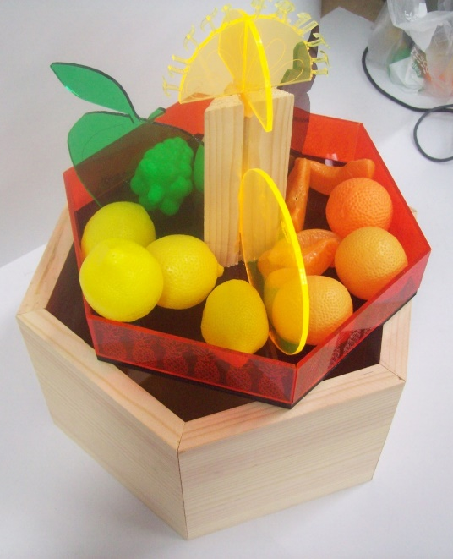
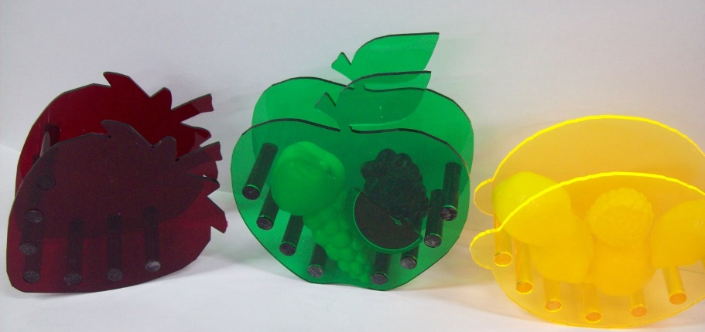
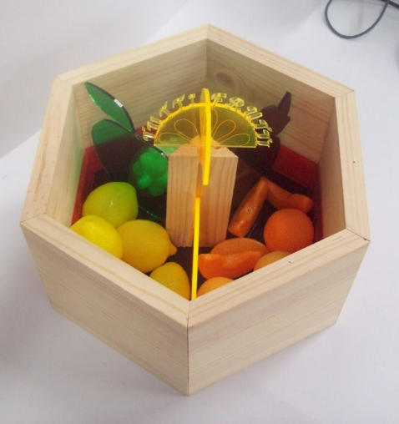
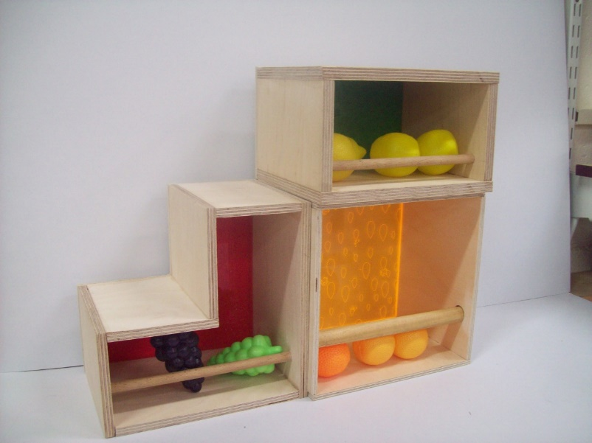
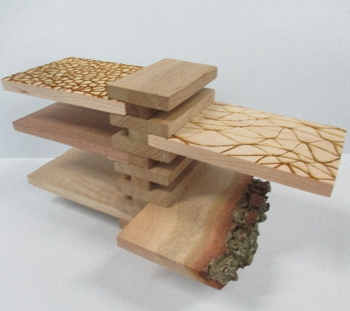
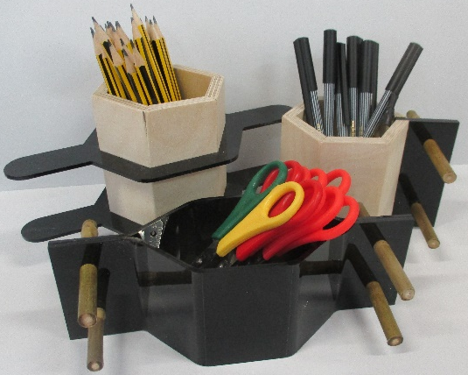
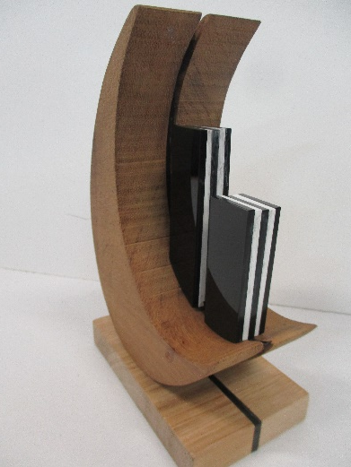
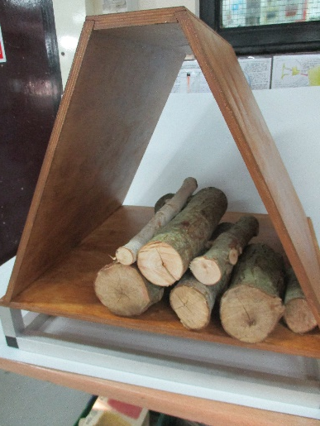
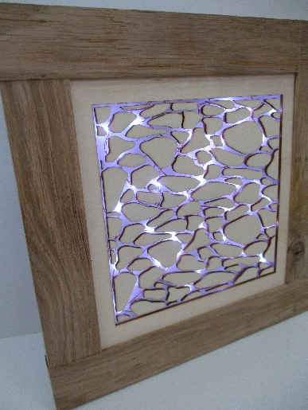
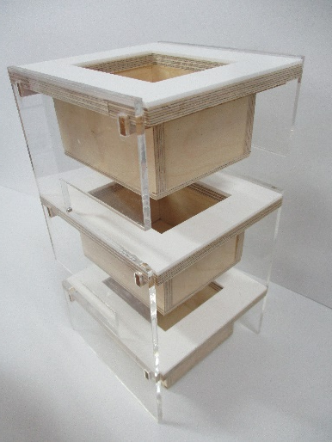
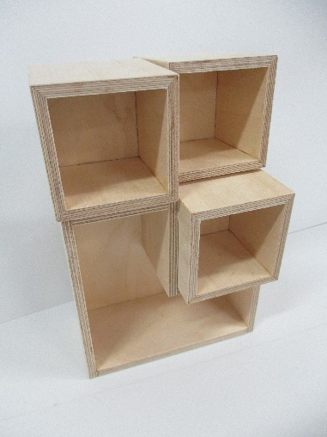
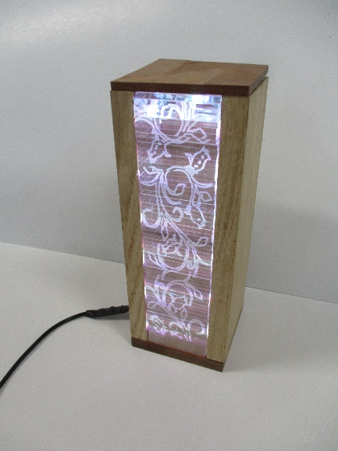
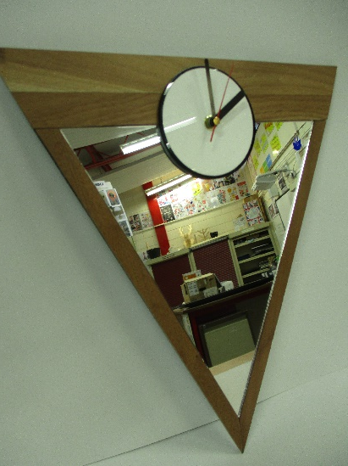
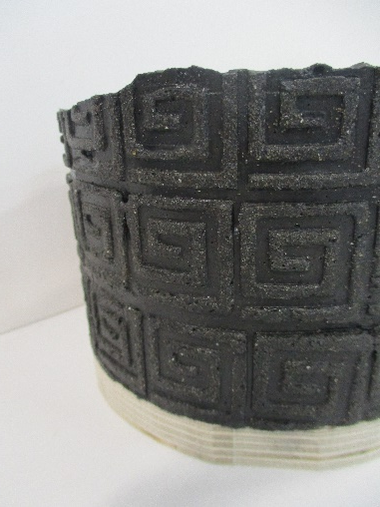
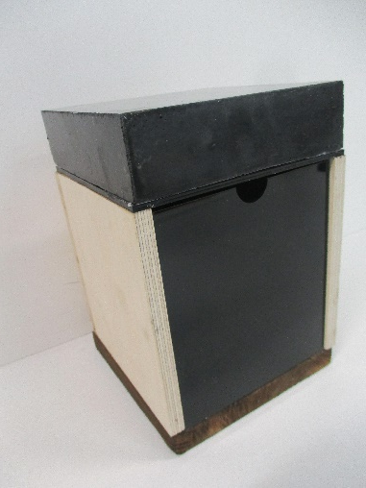
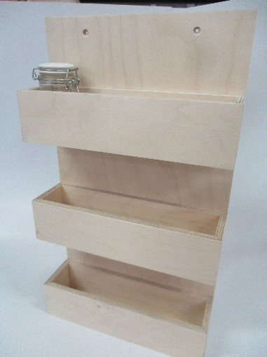
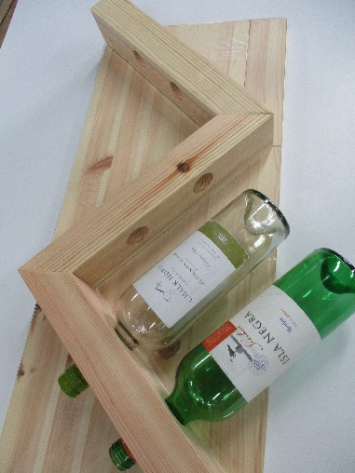
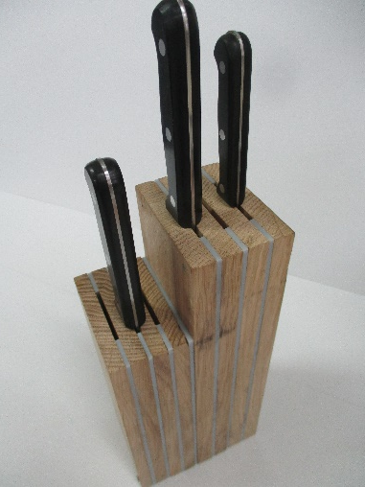
Week 1
Examples of exam work completed in 10 hours

Slide 19
Week 1
Three Dimensional sculpture (objet d’art, award/trophy, paperweight
Container

Slide 20
Week 1
Task 1 - Mood board of 2+ (minimum 2) images of inspirational images for each design brief
Clock
Mirror
Model of Small item of furniture (coffee table, side table, chair, shoe storage unit)
Light

Slide 21
Week 1

Slide 22
Week 1

Slide 23
Week 1

Slide 24
Week 1

Slide 25
Week 1

Slide 26
Week 1

