Slide 1
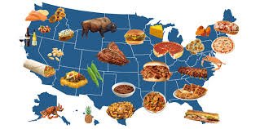
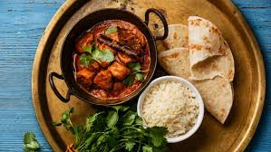
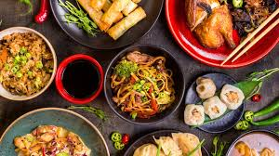

Food Technology
Year 9
Name:
Pathway:
Class:
Recipe Book

Slide 2
Recipe Index
Recipe | Date
Cheese & tomato tart
Quiche
Tear ‘n’ share bread/Fougasse
Roasted vegetable pasta bake
Chilli con carne
Lemon drizzle muffins
Cultural dish
Sausage rolls
Fruit crumble squares
Pre-practical check list
Place bags in locker areas.
Place planner, recipe booklet and pencil case on chair under desk.
Take jumper off and put apron on.
Tie hair back.
Roll up sleeves and wash hands
Place ingredients on plastic trays on your work area.
Collect equipment.
Put ALL carrier bags away and stools under the table.
Food Room Rules
Do not run in the food room.
Always carry knives safely with the blade pointed downwards.
Any cuts must be covered with a blue plaster.

Slide 3

What we are cooking and why
Throughout their practical cooking experiences, the students will be working towards GCSE standards when it comes to their practical skills.
We think it is important that the students practice these skills from the very start as it will enable them to become more confident and efficient when preparing and cooking food at school and at home.
Overleaf there is a table showing the 20 skills, which commodity (food item) the students will be using, the food science that takes place when cooking and the name of the dishes that these skills will be used in.
Below you will find the key to the table:
Commodity – which food group does the main ingredients belong to.
Food science – what causes this to happen? Why does it happen?
Practicals – what dishes are being made.

Slide 4
The 20 skills of Food Preparation and Nutrition
 | Year 9
Knife Skills | Fruit & vegetables
1 & 2 | Enzymic browning
 | C & T tart/quiche/bread/
 | Roasted veg pasta/chilli/
 | lemon drizzle muffins
Shaping skills | Cereals/flour
3 | Flavouring
 | C & T tart/quiche/bread/
 | sausage rolls
Tenderise & marinate | N/A
4
Select & adjust | Meat/vegetables
a cooking process | Convection/conduction
5 | chilli
Weigh & measure | All commodities
 | Accurate weighing & measuring
6 | All dishes
Preparation of | All commodities
equipment | Ensure equipment is safe to use
7 | Bread
Use of equipment | All commodities
mixer, and microwave | Microwave/melting butter
blender/food processor
8 | Muffins
Water-based methods | Pasta/meat/vegetables
using the hob | Boiling/simmering
9 | Chilli/pasta bake
Dry heat & fat-based | Pasta/meat/vegetables
methods using the hob | Conduction/browning meat/
10 | sauteing veges
 | Chilli
Using the grill | N/A
11
Using the oven | All commodities
12 | Convection/dextrinisation
 | coagulation/gluten formation
 | C & T tart/quiche/bread
 | muffins/roasted veg/sausage rolls
Make sauces | Meat/vegetable
13 | Conduction/browning meat/
 | sauteing veges/reduction
 | Chilli con carne
Set a mixture- gelation | N/A
gelation
14
Set a mixture - | Cereals/eggs
coagulation | coagulation
15 | Quiche
Use of raising agents | Cereals/eggs/dairy
16 | Chemical/biological & mechanical
 | aeration
 | Muffins
Make a dough | Cereals
17 | Gluten formation & fermentation
 | Bread
Shaping & | Cereal
finishing a dough | Gluten formation & fermentation
18 | Bread
Test for readiness | All commodties
19 | Establish if food is safe to eat
 | All dishes
Judge & manipulate | All commodities
sensory properties | Tasting & seasoning
20 | Roasted veges/chilli

Slide 5
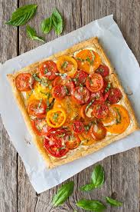
Cheese and tomato tart
Ingredients
375g packet puff pastry
1 small onion, 2 – 3 spring onions or ½ pepper
1 tbsp. pesto or tomato sauce
225g cherry tomatoes or 5 ‘normal’ tomatoes
150g cheese (grated)
1 tbsp. milk or 1 egg for glazing
Method
1. Set oven to 220⁰ C/Gas 7. Roll out pastry to fit onto baking tray.
2. Score a line around the rectangle 2cm from the edge. Brush milk/egg around the edge of the pastry.
3. Spread pesto onto pastry base.
4. Prepare all the vegetables.
5. Arrange vegetable on top and the sprinkle the cheese over the top.
6. Bake in the oven for 10-15 mins. Until the pastry and risen and golden brown.
7. Place on a baking tray to cool.

Slide 6

Quiche
Ingredients - for the pastry
200g plain flour
100g block butter
Filling
2 egg
150ml milk
1 onion
2 rashers cooked bacon or 100g ham
50g grated cheese
Method
1. Set oven 200⁰C/gas 6. Mis-en-place (collect equipment)
2. To make the pastry, rub the fat into the flour until it resembles breadcrumbs.
3. Add about 2 tbsp. water and mix into a dough. Do not add too much water.
4. Roll out the pastry and line the dish and place onto a baking tray.
5. Beat the egg and the milk. Put the fillings into the case and add the fillings.
6. Sprinkle the cheese on the top and cook for 25 mins. until the filling is set.

Slide 7
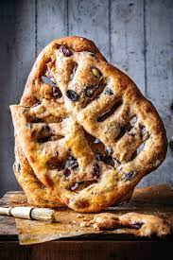
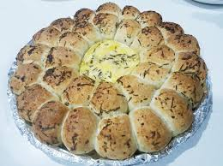
Tear ‘n’ share bread or Fougasse
Ingredients
300g strong bread flour
1 tsp salt, 1 tsp sugar
1 packet fast action yeast
Approx. 125ml warm water
Egg for glazing (opt.)
Toppings – choose from: cheese, herbs, cooked bacon, ham, dried fruit, cinnamon etc. (if using cinnamon, you will also need 2 tbsps. sugar)
Method
1. Set oven to 220˚C/gas 8. Place the flour in the bowl, add yeast and salt and mix together.
2. Add the warm water to the bowl and mix with your hand until a dough forms. Add any Flavourings.
3. Place on a floured surface and knead for 10 mins. until smooth and stretchy.
4. Divide the dough into 6 or 8 even pieces. Shape appropriately. Place fairly close together on a tray lined with paper or greased.
5. Cover loosely with Clingfilm or a clean tea towel and leave to prove until doubled in size.
6. Remove the cover, glaze with milk or egg, and add any toppings.
7. Bake for 10-12 mins. until the base sounds hollow when tapped.

Slide 8
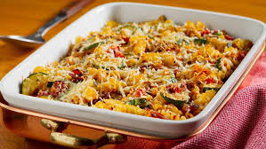
Roasted vegetable pasta bake
Ingredients
150g dried pasta shapes
1 courgette, 1 pepper (any colour), 1 onion (red or white)
1 garlic clove, 200g cherry tomatoes
2 tbsp. oil, fresh or dried thyme
75g grated cheese (cheddar, Parmesan or mozzarella)
Method
1. Set oven to 180°C/gas 6
2. Prepare all vegetables. Cut into bite-sized prices.
3. Place on a baking ray with the thyme, oil, salt and pepper. Mix ingredients together.
4. Place into oven for 30 mins. Stirring around after 15 mins. Cook until tender.
5. Fill a pan ¾ full of water and bring to the boil. Add pasta and cook for 10-12 mins. Until pasta is al dente. Grate the cheese.
6. Stir together the cooked pasta and vegetables and place in an ovenproof dish. Top with the grated cheese.
7. Bake in oven until cheese is golden brown and bubbling.

Slide 9
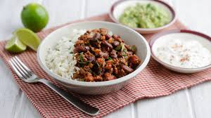
Chilli con carne
Ingredients
450 – 500g minced beef
400g can chopped tomatoes, 1 can kidney beans
1 onion, 1 garlic clove, 2 tbsp. tomato purée
1 tbsp. oil, 1 pepper (any colour), 1 beef stock cube
1 tsp chilli powder. 1 tsp ground cumin,
Method
1. Prepare the vegetables – peel and dice onion, pepper and crush garlic.
2. Heat oil in a saucepan over a medium heat. Add the vegetables and cook until soft.
3. Add beef and break up lumps with a wood spoon. Cook until meat is brown.
4. Add chilli powder and cumin. Add tomatoes, drained kidney beans and ½ can water and stir.
5. Add stock cube, purée and stir again.
6. Bring mixture to the boil and then reduce the heat and let the sauce simmer gently for about 20 - 30 mins. Leave the lid off the pan so that the water vapour escapes.
7. Stir sauce occasionally to stop it from sticking. Remove from heat when vegetables are cooked and the sauce is thick and flavourful. Serve with boiled rice.

Slide 10
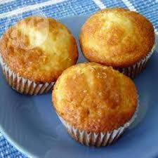
Lemon drizzle muffins
Ingredients -
125g self-raising flour
125g softened butter or margarine
125g caster sugar
2 eggs, 1 large lemon (juice and zest needed),
50g icing sugar (for syrup), 6 muffin cases
Method
1.Set oven to 180°C/gas 5. Place 6 muffin cases in cupcake tray.
2. Finely grate the lemon rind, cut the lemon in half and squeeze juice.
3. Cream together the butter, caster sugar and lemon rind in a bowl with a wooden spoon until light and fluffy.
4. Beat the eggs in a small bowl or jug and gradually add to the beaten mixture.
5. Sieve the flour and fold into the mixture with a metal spoon.
6. Place the mixture into the cases, and bake for approx. 20 mins until well-risen.
7. Mix the lemon juice and the icing sugar together and drizzle over the cakes.

Slide 11
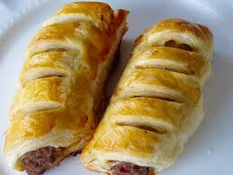
Sausage Rolls
Ingredients
500g ready-made puff pastry
8 sausages (or the equivalent)
Beaten egg or milk to glaze.
To add to stuffing: grated apple, chopped dried apricots, herbs/spices, mushroom etc.
Method
1. Set oven to 200°C/ gas 6.
2. Roll the pastry out on a floured surface into a rectangle approx. 40cm x 30cm.
3. Cut the rectangle in half lengthways to produce two long strips.
4. Prepare filling. If using sausages, remove the skins.
5. Mix the sausage meat and flavourings together. Divide sausage meat mixture in half and roll each piece into lengths and place onto the pastry.
6. Damp the edges of the pastry, press together and ‘crimp’ so that the filling is sealed.
7. Brush each length with egg and cut into even-sized rolls. Snip a hole in the top to let the steam out.
8. Place on baking tray and bake for about 20 mins. until golden brown. Ensure the meat is cooked thoroughly.

Slide 12
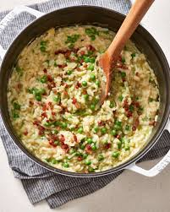
Risotto
Ingredients
200g ‘easy cook’ long grain rice
1 chicken or vegetable stock cube
1 onion, 1 pepper (any colour), 75g mushrooms, or any choice of Vegetable (sweetcorn, peas, broccoli, green beans, courgette etc.)
1 tsp mixed herbs, 1 clove garlic
1 tbsp. oil (Once home you could add cooked meat of your choice)
Method
1. Prepare all the vegetables, peel and crush garlic.
2. Melt oil in a saucepan and fry the onions and any other raw vegetables (not sweetcorn or peas) for approx. 5 mis on a medium heat.
3. Add herbs/spices, salt and pepper and cook for 2 mins.
4. Add rice and cook for 1 min. The rice should look glossy.
5. Dissolve the stock cube in 500mls boiling water.
6. Add peas and sweetcorn. Bring to the boil and simmer for 20 mins. Stirring occasionally until the rice is cooked. Add cooked meats etc. when reheating AT HOME.

Slide 13
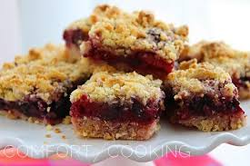
Fruity crumble squares
Ingredients
175g butter/margarine
250g plain flour
2 tbsp. cornflour
75g caster sugar
100g dried fruit (could use apricots or dates), 1 small eating apple
Method
1. Set oven to 180°C/ gas 7.
2. Grease and line a 20cm square cake tin.
3. Cut butter into pieces and put into a mixing bowl with the flour, cornflour and sugar.
4. Rub-in the butter with your fingertips until it looks like breadcrumbs. Place 3-4 tbsp. of this mixture and place in a small bowl for later use.
5. Squeeze the rest of the crumbs together to make a ball and then press into the base of the tin.
6. Cut dried apricot (if using) into small pieces. Grate the apple over the biscuit base.
7. Top biscuit base with dried fruits and sprinkle over the saved crumble mixture.
8. Bake in oven until golden brown. Leave to cool then cut into squares.

Slide 14
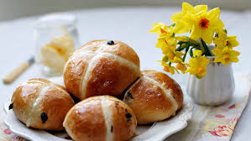
Hot Cross Buns
Ingredients
225g strong bread flour
½ - 1 tsp salt, 100g dried fruit, 1 tsp mixed spice
1 packet fast action dried yeast (1 tsp)
150mls (approx.) warm water
2 tbsp. flour the cross, 2 tbsp. caster sugar for glaze
Method
1. Set oven to 220°C/ gas 8. Grease a baking tray.
2. Sieve the flour and spice together, then add salt and yeast. Stir in the dried fruit.
3. Add the warm water to the ingredients and mix either with a round-bladed knife or your hand until the mixture comes together.
4. Place on a floured surface and knead for 10 mins. until smooth and stretchy.
5. Divide the dough into 6 even pieces. Shape and place onto the baking tray.
6. Cover loosely with cling film and leave to prove until doubled in size.
7. Remove cling film and pip o the cross. Bake for 10-12 mins. Until rise and golden brown.
8. Remove from oven and glaze with sugar syrup.

