Slide 1
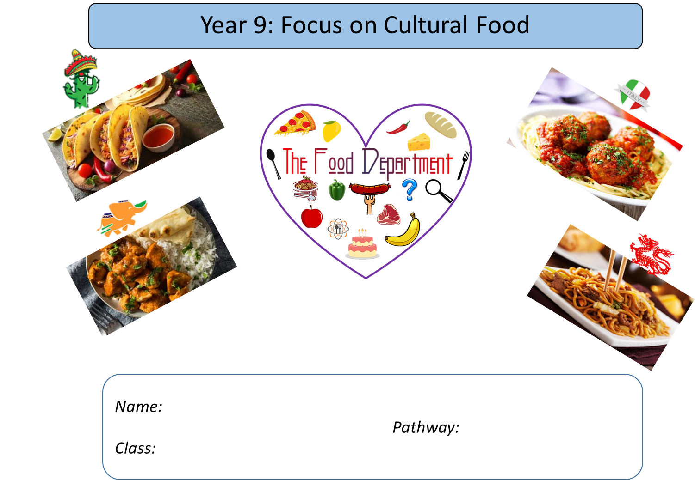

Slide 2
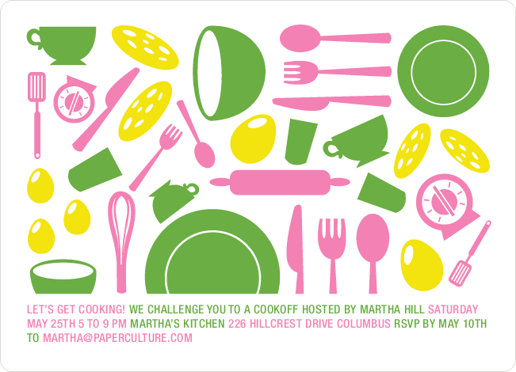
What we are cooking and why
Throughout their practical cooking experiences, the students will be working towards GCSE standards when it comes to their practical skills.
We think it is important that the students practice these skills from the very start as it will enable them to become more confident and efficient when preparing and cooking food at school and at home.
Overleaf there is a table showing the 20 skills, which commodity (food item) the students will be using, the food science that takes place when cooking and the name of the dishes that these skills will be used in.
Below you will find the key to the table:
Commodity – which food group does the main ingredients belong to.
Food science – what causes this to happen? Why does it happen?
Practicals – what dishes are being made.

Slide 3
The 20 skills of Food Preparation and Nutrition
 | Year 9
Knife Skills | Fruit & vegetables
1 & 2 | Enzymic browning
 | C & T tart/quiche/bread/
 | Roasted veg pasta/chilli/
 | lemon drizzle muffins
Shaping skills | Cereals/flour
3 | Flavouring
 | C & T tart/quiche/bread/
 | sausage rolls
Tenderise & marinate | N/A
4
Select & adjust | Meat/vegetables
a cooking process | Convection/conduction
5 | chilli
Weigh & measure | All commodities
 | Accurate weighing & measuring
6 | All dishes
Preparation of | All commodities
equipment | Ensure equipment is safe to use
7 | Bread
Use of equipment | All commodities
mixer, and microwave | Microwave/melting butter
blender/food processor
8 | Muffins
Water-based methods | Pasta/meat/vegetables
using the hob | Boiling/simmering
9 | Chilli/pasta bake
Dry heat & fat-based | Pasta/meat/vegetables
methods using the hob | Conduction/browning meat/
10 | sauteing veges
 | Chilli
Using the grill | N/A
11
Using the oven | All commodities
12 | Convection/dextrinisation
 | coagulation/gluten formation
 | C & T tart/quiche/bread
 | muffins/roasted veg/sausage rolls
Make sauces | Meat/vegetable
13 | Conduction/browning meat/
 | sauteing veges/reduction
 | Chilli con carne
Set a mixture- gelation | N/A
gelation
14
Set a mixture - | Cereals/eggs
coagulation | coagulation
15 | Quiche
Use of raising agents | Cereals/eggs/dairy
16 | Chemical/biological & mechanical
 | aeration
 | Muffins
Make a dough | Cereals
17 | Gluten formation & fermentation
 | Bread
Shaping & | Cereal
finishing a dough | Gluten formation & fermentation
18 | Bread
Test for readiness | All commodties
19 | Establish if food is safe to eat
 | All dishes
Judge & manipulate | All commodities
sensory properties | Tasting & seasoning
20 | Roasted veges/chilli

Slide 4
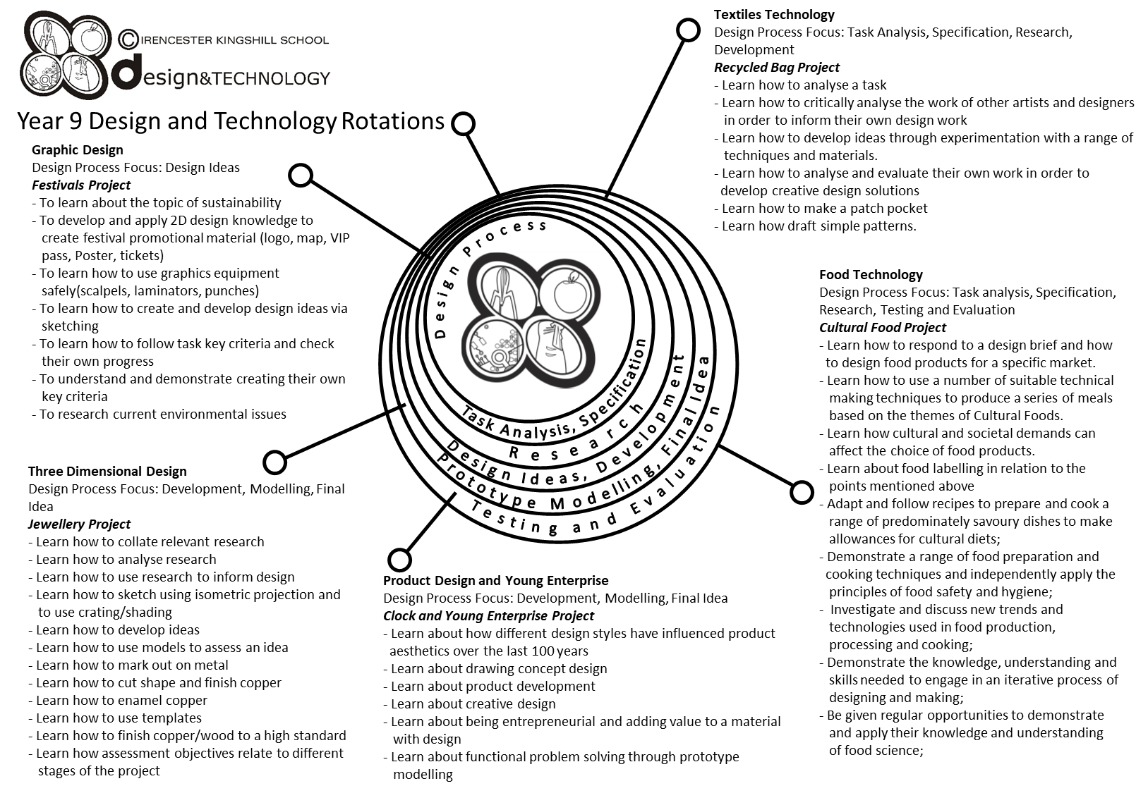

Slide 5
Year 9 pathways criteria – written work
Year 9 Foundation | Year 9 Secure | Year 9 Confident | Year 9 Exceptional
A title page showing the following from your chosen country: a flag, a map, main language spoken and famous people/chefs from that country. | All criteria met from the previous pathway, plus the population and main religions of that country. | All criteria met from previous pathway, with a discussion on at least three areas (e.g. religion, staple foods etc.) | All criteria met from previous pathway, with a discussion on at least five areas (e.g. religion, staple foods etc.)
A map of your chosen country stating the capital and three famous dishes from that country. | A map of your chosen country stating the capital and three famous dishes from that country, names of famous cities and landmarks. | A map of your chosen country stating the capital and three famous dishes from that country, names of famous cities, landmarks, and staple foods grown and produced in that country. | All criteria met from the previous pathway with a discussion on the sustainability on staple foods grown and produced in that country.
You have chosen your dish and have adapted a recipe from the book stating what new flavours you are choosing from your chosen country. | All criteria met from the previous pathway with one alternative dish you have also adapted that is influenced from your chosen country. | All criteria met from the previous pathway with two alternative dish you have also adapted that is influenced from your chosen country. | All criteria has been achieved with reference made to Social, Moral and Ethical issues (cost, religious influences etc.)
You have written your plan of making showing a start and finish time. | You have written your plan of making showing a start and finish time and some timings throughout. | You have written your plan of making showing a start and finish time, and some timings throughout. You have made reference to at least three control points. | You have written your plan of making showing a start and finish time, and some timings throughout. You have detailed control points.

Slide 6
Year 9 pathways criteria – practical work
Year 9 Foundation | Year 9 Secure | Year 9 Confident | Year 9 Exceptional
Some ingredients and equipment handled with reasonable control. | Most ingredients and equipment handled with co-ordination. | Most ingredients and equipment handled with excellent competence and co-ordination. | All ingredients and equipment handled with excellent competence and co-ordination.
Needed a little assistance. | Mostly independent – a little assistance. | Completely independent. Demonstrating good organisation. | Completely independent. Demonstrating a high level of organisation.
Mostly worked in a hygienic and safe manner. | Worked in a hygienic and safe manner. | Consistently worked in a hygienic and safe manner. | Consistently worked in a hygienic and safe manner.
Finished practical dish. | Finished on time. Sink and equipment cleaned and finished product packed away. | Finished well within the time limit. All equipment cleaned and finished product packed away, and extension work completed. | Finished well within the time limit. All equipment cleaned and finished product packed away, and extension work completed to a high standard.
Acceptable finish on end product. | Good finish to end product. | High quality product with excellent finish. | High quality product with excellent finish. Demonstrating good garnishing/decorating skills to finished product.

Slide 7


Food Technology – essential information
What to bring to school:
For each Food Technology lesson, you will need:
Your pencil case
Your work booklet
When you have your practical lessons, you must also bring:
Your ingredients – weighed and measured
A lidded container to take your food home in, clearly marked with your name
For some practical lessons you may also need a dish/tin to cook the food in.
If you do not bring in ingredients – you will NOT cook
When you get to school
On the days that you have practical lessons, you must take your ingredients to the food room BEFORE registration.
Place your high-risk ingredients (meat, dairy, fish) in the fridge and your dry ingredients in the Cool Room.
After your practical lesson you must leave your food in the cool room and collect after afternoon registration.
Think about the environment. Try not to use too many plastic bags for your ingredients Try to reuse
plastic pots and bags. Use old margarine tubs/sweet tins instead.
It is essential that you leave your unit drawers and cupboards CLEAN and TIDY, ready for the next class.
Please sign to show that you have read and understood the essential information set out below.
Name………………………………………………… Signature………………………………………….. Date…………………………….

Slide 8
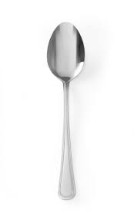
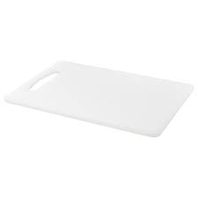
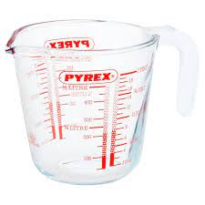
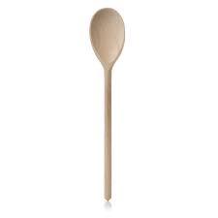
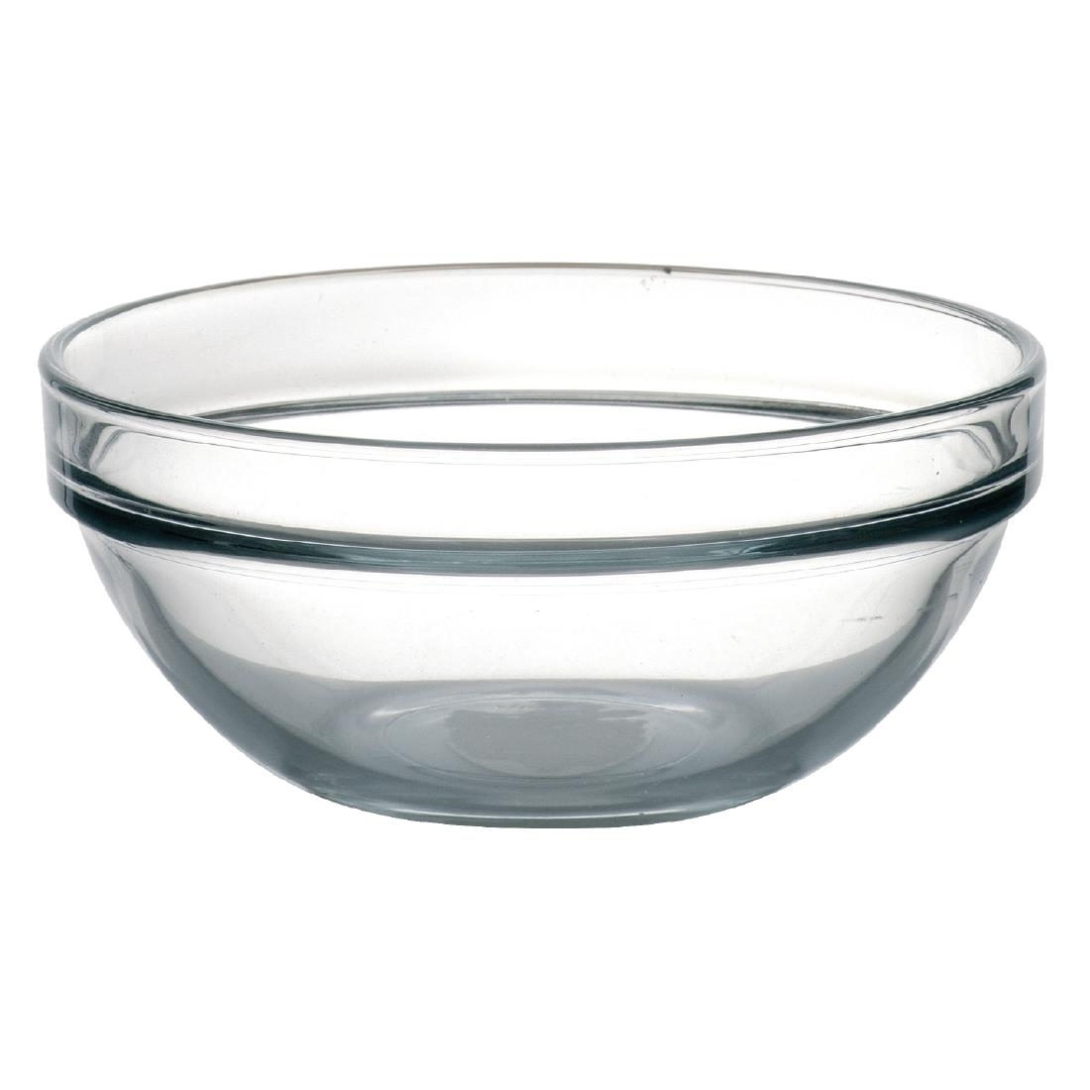
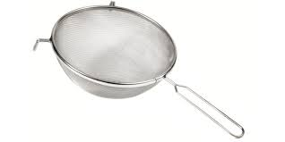
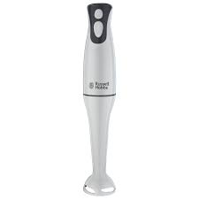
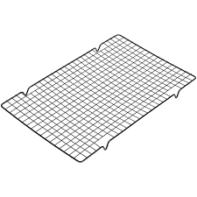
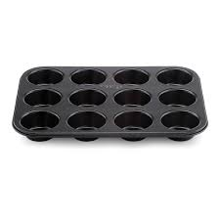
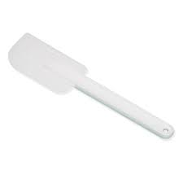
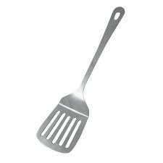
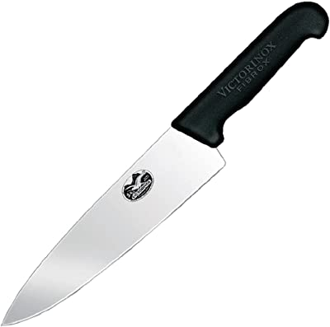
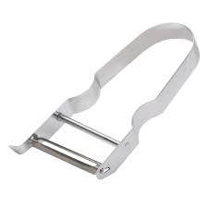
FOOD EQUIPMENT - SPELLING TEST
Identify the following pieces of equipment.
M_ _ _ _ _ _ _ _ _ | M_ _ _ _ _ _ _ _ _ _ _ | C _ _ _ _ _ _ _ _ _ _ _ _ | S _ _ _ _ | T _ _ _ _ _ _ _ _ _ | T _ _ _ _ _ _ _ | W _ _ _ _ _ _ _ _ _ _
V _ _ _ _ _ _ _ P _ _ _ _ _ | C _ _ _ _ _ K _ _ _ _ | H _ _ _ B _ _ _ _ _ _ | M _ _ _ _ _ T _ _ | C _ _ _ _ _ _ R _ _ _ | F _ _ _ S _ _ _ _ | S _ _ _ _ _ _

Slide 9
Skills group and techniques table
 | Skill group | Technique
1. | Knife Skills | Be able to demonstrate how to prepare fruit, vegetables, meat and fish safely and accurately using the following techniques - bridge hold, claw grip, peel, slice, dice and cut into even size pieces (i.e. batons, julienne)
2. | Prepare fruits and vegetables | Be able to demonstrate some of the following techniques (where appropriate): mash, shred, scissor snip, scoop, crush, grate, peel, segment, de-skin, de-seed, blanch, shape, pipe, blend, juice and prepare garnishes.
3. | Prepare, combine and shape | Be able to demonstrate some of the following techniques (where appropriate): roll, wrap, skewer, mix, coat, layer meat, fish and alternatives, and shape and bind wet mixtures (such as meatballs) whilst demonstrating the technical skill of preventing cross contamination and handle high risk foods correctly.
4 | Tenderise and marinate | Be able to demonstrate how acids denature protein (tenderises meat) and marinades add flavour and moisture when preparing vegetables, meat, fish, and alternatives (where appropriate).
5 | Select and adjust a cooking process | Be able to demonstrate the following techniques: select and adjust the cooking process and length of time to suit the ingredient, for example to match the cut of meat, fish and alternatives. E.g. check on the cooking time to ensure it is not burning.
6 | Weigh and measure | Be able to demonstrate accurate measurement of liquids and solids.
7 | Preparation of ingredients and equipment | Be able to demonstrate the following techniques: grease/oil, line, flour, evenly and with attention to finished product
8 | Use of equipment | Be able to demonstrate the following techniques: use a blender, food processor, mixer, and microwave
9 | Water based methods using the hob | Be able to demonstrate the following techniques: steaming, boiling and simmering, blanching and poaching
10 | Dry heat and fat based methods using the hob | Be able to demonstrate the following techniques: dry frying, pan (shallow frying), stir frying
11 | Using the grill | Be able to demonstrate the following techniques with a range of foods, such as vegetables, meat, fish or alternatives such as halloumi, seeds and nuts: char, grill or toast
12 | Using the oven | Be able to demonstrate the following techniques: baking, roasting, casseroles and/or tagines, braising

Slide 10
Skills group and techniques table cont.
 | Skill group | Technique
13 | Make sauces | Be able to demonstrate the following techniques (where appropriate): make a white sauce (starch gelatinisation) such as a roux and all in one blended sauce, béchamel, make a reduction sauce such as pasta sauce, curry sauce, gravy, meat sauce (including meat alternatives such as myco-protein and textured vegetable protein), make an emulsion sauce such as a salad dressing, demonstrate the technical skill of how to make a stabilised emulsion
14 | Set a mixture – removal of heat (gelation) | Be able to demonstrate the following techniques (where appropriate): use starch to set a mixture on chilling for layered desserts such as custard or cheesecake
15 | Set a mixture – heating (coagulation) | Be able to demonstrate the following techniques (where appropriate): use protein to set a mixture on heating such as denatured protein in eggs for quiche, choux pastry
16 | Use of raising agents | Be able to demonstrate the following techniques(where appropriate): use egg (colloid foam) as a raising agent - create a gas-in air foam - whisking egg whites, whisked sponge, use chemical raising agents - self raising flour, baking powder, bicarbonate of soda, use steam in a mixture (choux pastry, batter)
17 | Make a dough | Be able to demonstrate the following techniques (where appropriate): use the technical skills of shortening, gluten formation, fermentation (proving) for bread, pastry, pasta
18 | Shaping and finishing a dough | Be able to demonstrate the following techniques (where appropriate): roll out pastry, use a pasta machine, line a flan ring, create layers (palmiers), proving/resting, glazing and finishing such as pipe choux pastry, bread rolls, pasta, flat breads, pinwheels, pizza, calzone
19 | Test for readiness | Be able to demonstrate the following techniques (where appropriate): use a temperature probe, knife/skewer, finger or ‘poke’, test, ‘bite’, visual colour checks or sound to establish whether an ingredient or recipe is ready
20 | Judge and manipulate sensory properties | Be able to demonstrate the following techniques (where appropriate): how to taste and season during the cooking process, change the taste and aroma through the use of infusions, herbs and spices, paste, jus, reduction, how to change texture and flavour, use browning, (dextrinization) and glazing, add crust, crisp and crumbs, presentation and food styling – use garnishes and decorative techniques to improve the aesthetic qualities, demonstrate portioning and presenting

Slide 11
Health and Safety in the kitchen
The Food Technology classroom is one of the most dangerous rooms in the school. During the practical lessons, you will be using a range of equipment, such as sharp knives, ovens, hobs and electrical equipment. It is therefore really important that you follow strict health, safety and hygiene rules to reduce the risk of accidents and injuries.
Write down 10 Food Room Rules and give a brief explanation of why they are important.
1.
2.
3.
4.
5.
6.
7.
8.
9.
10.

Slide 12
Food Safety Quiz
Use your knowledge of Food Hygiene to answer the following questions. The following keywords will help you.
 | Diarrhoea | Warmth | Chilling | 5° - 63° | Cooking | Moisture | 75°
Food | Acidic | 72°+ | Nausea | Time | Salty | Vomiting | Bacteria
Red | Cleaning | 0° - 5° | Sugary | Once | Stomach cramps | -18° | Cross-contamination
 | Question | Answer
1. | What is the main cause of food poisoning?
2. | State 4 symptoms of food poisoning. | 1 2 3 4
3 | What conditions do bacteria need to multiply? | 1 2 3 4
4. | Name 3 conditions in which bacteria find it difficult to multiply. | S_ _ _ _ _ S_ _ _ _ A _ _ _ _ _
5. | What temperatures constitute the danger zone? Explain why.
6. | When cooked, what should the core temperature of food be?
7. | What temperature are most bacteria destroyed?
8. | What temperature should your fridge be kept at?
9. | What colour board should be used for raw meat? Explain why?
10. | What are the 4 C’s of Food Hygiene? | 1 2 3 4
11. | How many times can you reheat food?
12. | What temperature should your freezer be?

Slide 13
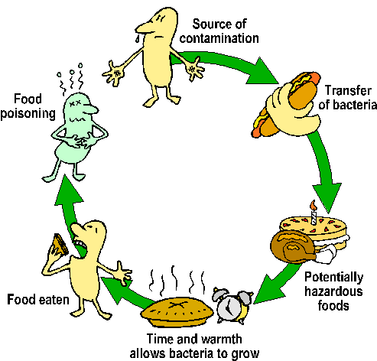
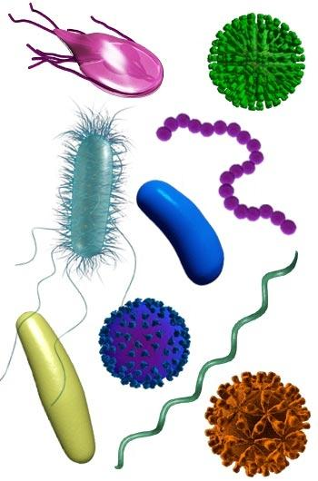
Food Contamination
FOOD SAFETY is the protection of consumer health and well being by safeguarding
food from anything that could cause harm
Food companies have a legal duty to produce food that is “safe to eat”.
Food should be protected from “Field to Fork”. FOOD CONTAMINATION is the
presence in food of any harmful or objectionable substance or object.
Hazards in food are anything that could cause illness, injury or discomfort.
There are 3 types of hazard
  Physical 2. Chemical 3. Biological
Place these contaminants under the correct heading
Plaster Viruses Fly spray Salmonella fungi
Sanitiser E.coli String Hair finger nail
Metal Bolt Yeast Pesticides Bleach soil
Physical | Chemical | Biological

Slide 14
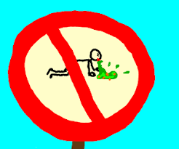
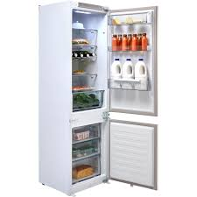
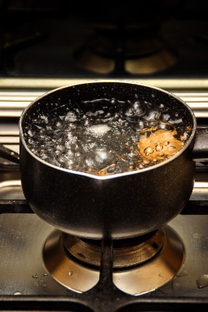

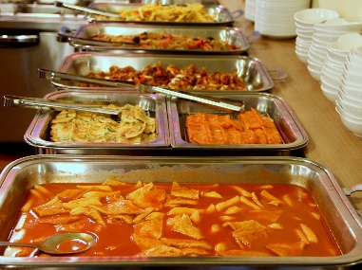
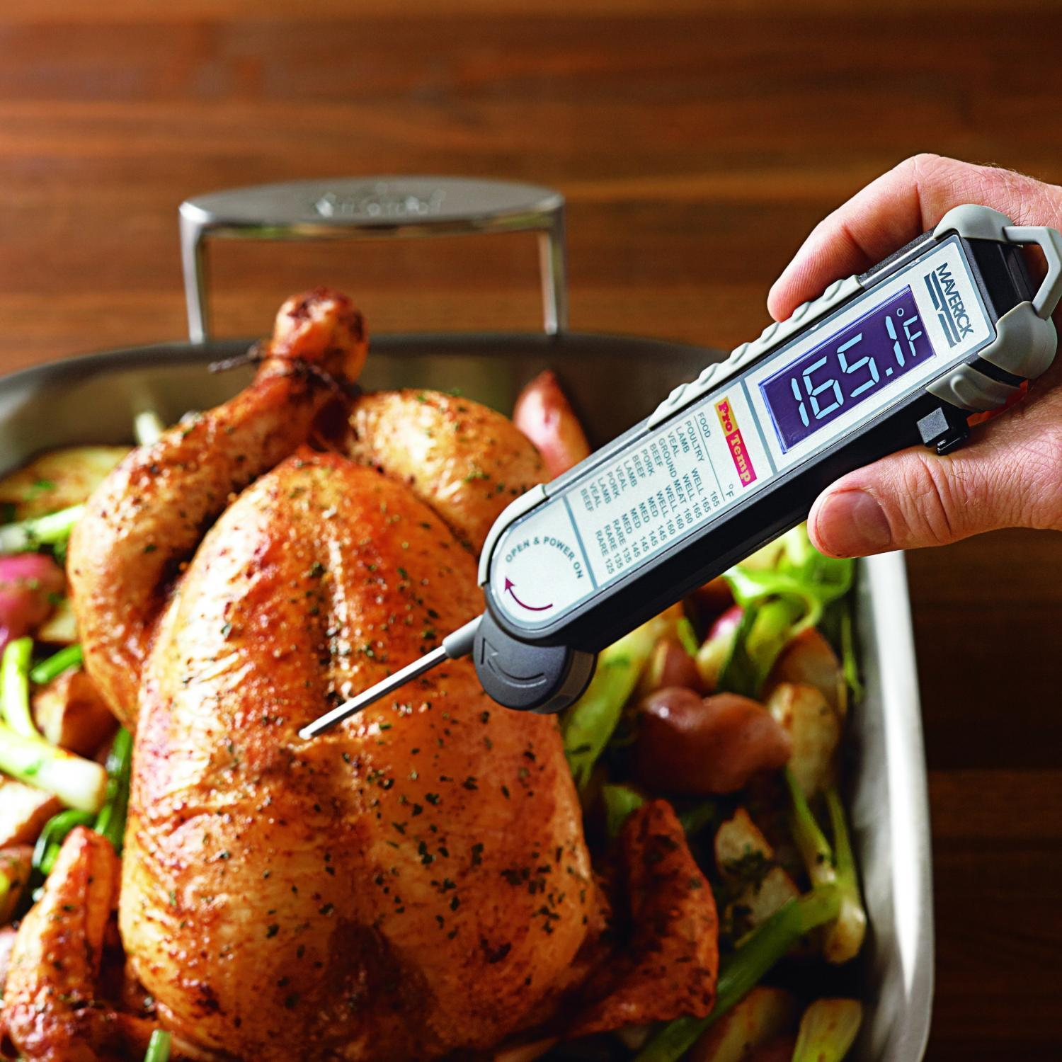
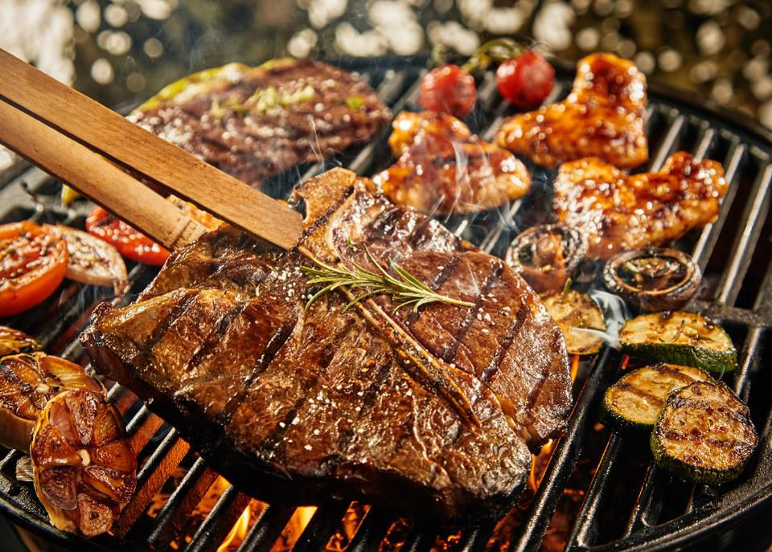
Fridge temperature should be:
The temperature of boiling water is:
water is…..
Important food temperatures
The Danger Zone where bacteria multiply is between
Freezer temperature should be:
The holding temperature and the temperature that cooked should be served at is:
The core temperature of cooked food should be:
To check the internal temperature of foods use a:
The core temperature of reheated food should be:

Slide 15
Implementing Dietary Goals
To improve the health of the nation, the government has set a range of dietary guidelines. We know that it is what we eat over a period of time rather than on any particular day that will affect our future health. To avoid illness and try to improve our general state of health we should follow the guidelines below
To reduce Fat, especially animal fat.
To reduce Sugary Foods
To reduce Salt
To increase Dietary Fibre.
As a nation we suffer from a range of Dietary Related Diseases.
Obesity, Heart Disease, Strokes, Tooth Decay, Gum Disease, Diabetes, High Blood Pressure, Constipation, Diverticular Disease, Cancer of Colon.
Use the above words to link the health problem with the dietary goal.
Dietary goal | Dietary related diseases | How to implement
Too much Fat, especially saturated fat, causes
Too much Sugar causes
Too much Salt causes
Not enough Dietary Fibre, fruit and vegetables causes

Slide 16
Nutrition – nourishment or energy obtained from food
A balanced diet has all the essential nutrients found in our food in the correct amounts
Nutrient | Types | Source of nutrient | Function
Protein | Animal
 | Plant
Carbohydrate | Starches
 | Sugars
Fats | Animal
 | Plant
Vitamins | Vitamin A
 | Vitamin B
 | Vitamin C
 | Vitamin D
Minerals | Iron
 | Calcium

Slide 17
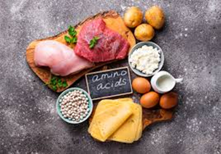
NUTRITION
Macro & Micro Nutrients
Protein
Protein is a ‘Macronutrient’ – which means it is needed by the body in large amounts.
1. Complete the word gap task
Animal Pulses Nut Repair Growth
Proteins assist with ______________ and ___________ of the body.
Proteins are found in __________________ products like meat, fish, cheese, milk and eggs. Vegetable sources include soya bean products, _______________ and _______________.
2. a) What do protein-rich foods have to contain to make them High Biological Value (HBV)?_____________________________________________________________
b) Which types of protein are typically HBV? ____________________________

Slide 18
3. Complete the table. Classify the following protein foods as ‘animal’ or ‘plant’ based protein.
NUTRITION
N.B. There is one plant-based protein that is HBV – name this plant-based protein………………..
Nuts | Dairy | Pork | Cereals | Cod | Poultry
Cheese | Kidney beans | Grains | Beef | Eggs | Milk
Animal (high biological value HBV) | Plant (low biological value LBV)
What is Quorn?
What are the benefits of eating Quorn instead of meat?

Slide 19
Carbohydrates are also classed as ‘Macronutrients’ – what does this mean?
______________________________________________________________
Complete the word gap task:
Starch Cereals Sugar Energy Fruit
Carbohydrates are needed to give the body ______________. There are two types of
Carbohydrate - _____________ and ______________.
Starch is found in ____________, cornflour, potatoes, pasta and flour.
Sugar is found in ______________, vegetables, honey, milk and processed foods.
2. When might the body need fast release (sugary) carbohydrates?
____________________________________________________________________
3. When might the body need slow release (starchy) carbohydrates?
____________________________________________________________________

Slide 20
Complete the table using the list of foods below. Classify them as fast or slow release carbohydrates.
NUTRITION
Fast release (sugary ) carbohydrates | Slow release (starchy) carbohydrates
Fruit | Jam | Vegetables | Sugary Cereals | Oats | Lentils
Honey | Potatoes | Peas | Energy drinks | Rice | Milk
Extension task
Which type of foods contain gluten?
If you were gluten intolerant (coeliac) which foods could you get your carbohydrates from?

Slide 21
NUTRITION
Fats are also ‘Macronutrients’.
Complete the word gap task:
butter insulate saturated energy plant
Fats help to provide concentrated sources of ____________ and help to _______________ the body in cold weather. There are two main types:
_________________________ fats are usually obtained from animal sources, for example _____________ and lard. Unsaturated fats come from ____________ sources, such as sunflower oil.
2. Complete the table using the lists of foods below. Classify them as saturated or unsaturated fats.
Saturated Fats | Unsaturated Fats
Meat | Olive oil | Eggs | Butter
Nuts | Cream | Vegetable oil | Oily fish

Slide 22
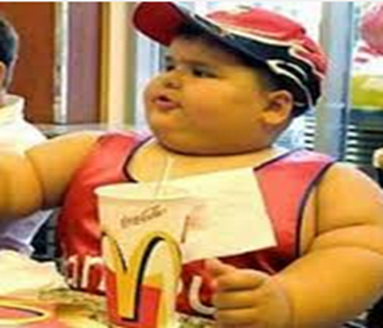
Extension task – consider all dietary goals to help you improve the health of this young man.
Write your answers here:
Health risks:
Changes to diet:
What health risks does this boy face?
If you were his parent, how would you change his diet?

Slide 23
NUTRITION
Vitamins are needed in very small amounts for growth and health therefore they are
Micronutrients’. The main vitamins are vitamin A, the B complex of vitamins (including thiamine and folic acid), vitamin C, vitamin D, vitamin E & vitamin K.
Match the vitamins to their function (job role in the body).
Give 3 examples of foods you would find each vitamin in.
A B C D E K
Fat Soluble | Function | Food Sources
e.g. Vitamin A | I’m important for growth, healthy skin and hair and I can help you see better at night. | Yellow peppers, carrots, dairy e.g. milk
 | You need me for healthy bones and teeth.
 | I help protect cells. I also help your immune system and repair DNA!
 | I help to clot your blood.
Water soluble | Function | Food Sources
 | We help with cell repair, digestion and energy release from carbohydrates.
 | I help you repair wounds and absorb iron to carry oxygenated red blood cells.

Slide 24
Packaging | Advantages | Disadvantages
Paper and card
Glass
Metal
Plastic and polystyrene
FOOD PACKAGING
Packaging
Looking after the environment is really important to prevent global warming. Remember the 3 ‘R’s R_ _ _ _ _, R_ _ _ _ & R_ _ _ _ _ .
How can we reduce the amount of waste within the home?

Slide 25
FOOD PACKAGING
Why do we package food? List as many reason as you can think of.
Make a list of 5 foods that are suitable for composting?
1.
2.
3.
4.
5.

Slide 26
Understanding recycling symbols
1 | Organic | 4 | Irradiation | 7 | Freezer | 10 | Vegetarian | 13 | Microwave
2 | British Farm Standards | 5 | Traffic Light Labelling | 8 | Barcode | 11 | Compostable packaging | 14 | 5 a Day
3 | Fairtrade | 6 | Litterman | 9 | Gluten Free | 12 | Freedom Food | 15 | Recyclable

Slide 27
Produce a poster to promote recycling in the home
Make your work eye-catching – use bold designs, bright colours, a slogan and a border

Slide 28
FOOD LABELLING
What does the label tell us?
Food labelling has to follow strict guidelines. This is a legal requirement and helps to protect the consumer and allows them to make informed choices.
Look at the label and find the following information. This information has to be visible on the label by law.
1 | Name of product
2 | Name and address of manufacturer
3 | List of ingredients
4 | Weight of product
5 | Date marking
6 | Storage instructions
7 | Instructions for use
8 | Place of origin
9 | Food Allergy information

Slide 29
Self-evaluation
What dish did you make today?________________________________________
State one achievement and one improvement based on your work today
Criteria | Achievement (What have you done well?) | Target for Improvement (What could you do better?)
Organisation e.g. brought all ingredients, apron, and box, got ready quickly.
Hygiene and safety e.g. washing your hands at the correct times, using the oven buddy system, using correct equipment, turned cooker off when finished.
Food preparation skills e.g. Using knife skills, measuring and weighing accurately, cooking for correct amount of time. (see p. 7)
Cleaning up e.g. clean dishes and sink area, put everything away in correct place, clean work area.
3. What skills did you use today? (see pages 7 & 8)
________________________________________
________________________________________
4. What could you do to improve your product?
________________________________________________________
Place photo here

Slide 30
Self-evaluation
What dish did you make today?________________________________________
State one achievement and one improvement based on your work today
Criteria | Achievement (What have you done well?) | Target for Improvement (What could you do better?)
Organisation e.g. brought all ingredients, apron, and box, got ready quickly.
Hygiene and safety e.g. washing your hands at the correct times, using the oven buddy system, using correct equipment, turned cooker off when finished.
Food preparation skills e.g. Using knife skills, measuring and weighing accurately, cooking for correct amount of time. (See p.7)
Cleaning up e.g. clean dishes and sink area, put everything away in correct place, clean work area.
3. What skills did you use today? (see pages 7 & 8)
________________________________________
________________________________________
4. What could you do to improve your product?
________________________________________________________
Place photo here

Slide 31
No ingredients?
In your books or on lined paper, write out the question and then write your answer, use full sentences.
What is the practical today?
List the equipment/utensils & functions of what is being used today
What skills are being used to make this dish?
What are the hygiene and safety hazards in the recipe? How can these be prevented/controlled?
What should a 'good' example of this dish look, smell and taste like? (Describe in detail with sensory language)
What are the common mistakes that may occur with this recipe? How can they be prevented or put right?
What key advice/tips would you give to someone making this recipe?
What nutrients are present in this dish? What nutrients are in excess (lots of) / deficient (missing) in the dish?
How could the dish be made healthier? Suggest at least 3 ways.
How can the dish be adapted to be suitable for: a. Gluten free? b. Lactose intolerance? c. Vegans?
Explain how you will be more organised with bringing your ingredients next lesson.

