Slide 1
Year 9 Product Design
Creative Design
Name
Design & Technology group
Pathway
Project Assessment

Slide 2

Textiles Technology
Design Process Focus: Task Analysis, Specification, Research, Development
Recycled Bag Project
- Learn how to analyse a task
- Learn how to critically analyse the work of other artists and designers
in order to inform their own design work
- Learn how to develop ideas through experimentation with a range of
techniques and materials.
- Learn how to analyse and evaluate their own work in order to
develop creative design solutions
- Learn how to make a patch pocket
- Learn how draft simple patterns.
Year 9 Design and Technology Rotations
Graphic Design
Design Process Focus: Design Ideas
Festivals Project
- To learn about the topic of sustainability
- To develop and apply 2D design knowledge to
create festival promotional material (logo, map, VIP
pass, Poster, tickets)
- To learn how to use graphics equipment
safely(scalpels, laminators, punches)
- To learn how to create and develop design ideas via
sketching
- To learn how to follow task key criteria and check
their own progress
- To understand and demonstrate creating their own
key criteria
- To research current environmental issues
Food Technology
Design Process Focus: Task analysis, Specification, Research, Testing and Evaluation
Cultural Food Project
- Learn how to respond to a design brief and how
to design food products for a specific market.
- Learn how to use a number of suitable technical
making techniques to produce a series of meals
based on the themes of Cultural Foods.
- Learn how cultural and societal demands can
affect the choice of food products.
- Learn about food labelling in relation to the
points mentioned above
- Adapt and follow recipes to prepare and cook a
range of predominately savoury dishes to make
allowances for cultural diets;
- Demonstrate a range of food preparation and
cooking techniques and independently apply the
principles of food safety and hygiene;
- Investigate and discuss new trends and
technologies used in food production,
processing and cooking;
- Demonstrate the knowledge, understanding and
skills needed to engage in an iterative process of
designing and making;
- Be given regular opportunities to demonstrate
and apply their knowledge and understanding
of food science;
Three Dimensional Design
Design Process Focus: Development, Modelling, Final Idea
Jewellery Project
- Learn how to collate relevant research
- Learn how to analyse research
- Learn how to use research to inform design
- Learn how to sketch using isometric projection and
to use crating/shading
- Learn how to develop ideas
- Learn how to use models to assess an idea
- Learn how to mark out on metal
- Learn how to cut shape and finish copper
- Learn how to enamel copper
- Learn how to use templates
- Learn how to finish copper/wood to a high standard
- Learn how assessment objectives relate to different
stages of the project
Product Design and Young Enterprise
Design Process Focus: Development, Modelling, Final Idea
Young Enterprise Project
- Learn about how different design styles have influenced product
aesthetics over the last 100 years
- Learn about drawing concept design
- Learn about product development
- Learn about creative design
- Learn about being entrepreneurial and adding value to a material
with design
- Learn about functional problem solving through prototype
modelling

Slide 3
 | Research and Analysis | Concept / Design ideas, other drawings and Evaluations | Design Development and model/ technique experimentation | Outcome and Presentation of Work
Exceptional | You have shown a highly developed understanding of the design brief and user needs within the specification. You have shown a highly developed ability in your research that includes design style analysis, product analysis and home based research. You have a shown a highly developed ability to be able to use your creative research and purposeful investigations to effectively develop creative design concept ideas | You have shown a highly developed to draw your concept / initial ideas and explain them. You have shown a highly developed ability to skilfully record your ideas, drawings, observations and insights and explain all of what, how and why in your work as it progresses. You have judged how effective the information you used was helping you to design and make and how your final outcome may have changed from your original design. | You have shown a highly developed ability to refine ideas through design development You have shown a highly developed ability in effectively selecting and experimenting with different materials, techniques and processes You have completed a detailed step by step plan showing the range of tools and equipment and modifying it where necessary. | You have shown a highly developed ability in your practical outcome - Confidently made creative outcome with precision using a range of tools and equipment. You have worked well independently and paid attention to its quality and to function. You have shown a highly developed ability in the presentation of your work
Confident | You have shown a consistent understanding of the design brief and user needs within the specification. You have shown a consistent ability in your research that includes design style analysis, product analysis and home based research. You have a shown a consistent ability to be able to use your creative research and purposeful investigations to effectively develop design concept ideas | You have shown a consistent ability to draw your concept / initial ideas and explain them. You have shown a consistent ability to skilfully record your ideas, drawings, observations and insights and explain all of what, how and why in your work as it progresses. You have in your evaluation identified what worked well in the designing and making and what could be improved to overcome problems. | You have shown a consistent ability to refine ideas through design development You have shown a consistent ability in effectively selecting and experimenting with different materials, techniques and processes You have completed a step by step plan showing the range of tools and equipment. | You have shown a consistent ability in your practical outcome - Confidently made outcome with some precision using a range of tools and equipment. You have worked well independently and paid attention to its quality of finish and function. You have shown a consistent ability in the presentation of your work
Secure | You have shown a moderate understanding of the design brief and user needs within the specification. You have shown a moderate ability in your research that includes design style analysis, product analysis and home based research. You have a shown a moderate ability to be able to use your research and investigations to effectively develop design concept ideas | You have shown a moderate ability to draw your concept / initial ideas and explain them. You have shown a moderate ability to skilfully record your ideas, drawings, observations and insights and explain all of what, how and why in your work as it progresses. You have in your evaluation identified what worked well in the designing and making and have made some suggestions as to what could be improved to overcome some problems identified. | You have shown a moderate ability to refine ideas through design development You have shown a moderate ability in effectively selecting and experimenting with different materials, techniques and processes You have completed a step by step plan showing some of the tools and equipment used in the making process. | You have shown a moderate ability in your practical outcome - some accuracy using a range of tools and equipment. You have worked independently at time and have sought the assistance of others when necessary. You have shown a moderate ability in the presentation of your work
Foundation | You have shown some understanding of the design brief and user needs within the specification. You have shown some ability in your research that includes design style analysis, product analysis and home based research. You have a shown some ability to be able to use your research to effectively develop design concept ideas | You have shown some ability to draw your concept / initial ideas and explain them. You have shown some ability to skilfully record your ideas, drawings, observations and insights and explain all of what, how and why in your work as it progresses. You have in your evaluation identified some things that worked well in the designing and making and have made limited suggestions as to what could be improved. | You have shown some ability to refine ideas through design development You have shown some ability in effectively selecting and experimenting with different materials, techniques and processes You have produced a step by step plan that is very brief and shows minimal reference to tools, equipment and process. | You have shown some ability in your practical outcome - some limit in accuracy and understanding of materials and their properties. You have worked independently occasionally but have sought the assistance of others most of the time. You have shown some ability in the presentation of your work
Pathways Assessment Criteria

Slide 4


- Three Dimensional Design
3D Design shapes the world around you from the pencil in your hand to the stool that you are sat on and the table you are sat at.
Every product has been thought about, drawn, developed, modelled, failed, redesigned into a finished functional thing.
Be curious...
Be Inquisitive...
Be an engineer...
Believe in your own ideas...
Try out everything...
Be a do'er...
Prove others wrong...
Be a maker...
Look at things differently...
Embrace failure...
Seize opportunities...
Your ideas are just as good as anybody else's...
Inspiration will follow..
Your ideas and ingenuity shape the world in your image for the better...
Discover what you like most...
Exam results are important but so are other skills…
Invent, design things and make things to control the whole process…
Be creative...
Iterative design and developments = make one change at a time
Be a problem solver...
Throw yourself into everything...
Be challenged to be...
3D Design rotation | GSCE Art and Design – 3D design Assessment Objectives
Creativity in design – Chair in a Design Style of the last 100 Years | AO1: Develop ideas through investigations, demonstrating critical understanding of sources.
Prototyping | AO2: Refine work by exploring ideas, selecting and experimenting with appropriate media, materials, techniques and processes.
Practical Skill and Materials – Finger jointed wooden pencil case and acrylic plastic personalisation | AO3: Record ideas, observations and insights relevant to intentions as work progresses.
 | AO4: Present a personal and meaningful response that realises intentions and demonstrates understanding of visual language.

Slide 5
Homework – when completed stick over this page
In Design and Technology we would like you to understand and appreciate the characteristics of good and bad design.
Task: You are to write about one product you cannot live without and one product you wish you had never bought or been given. Explain what the features or characteristics are and why they are so successful or not!
Things to include:
What exactly are your two products?
Why have you chosen them?
What is so good or bad about them?
How could you improve the design?
Give an example where a product by a well known designer / engineer has been unsuccessful and explain why. For example Clive Sinclair’s electric car or James Dyson’s Ball barrow.
How should I present it?
On A4 paper
Remember a title and any sub-titles
Remember to support your written work with some images
Remember to put your name on your work
Homework Success Criteria
+ You have followed and included all of the “things to include” and presented your work very well by using titles, sub titles and images or drawings to support your written work. All written work must be in your own words and include your own opinions.
= You have followed and included some of the “things to include” and presented your work well by using a title and images or drawings to support your written work. All written work must be in your own words.
– You have followed and included few of the “things to include”. Your work may not be presented appropriately as it will be missing titles, sub titles or your name. There will be lots of information that is copied and pasted from the internet with no opinions of your own.

Slide 6
Art Deco
Pop Art
Memphis
When?
What?.
Who?
What does the style look like?
My chair design idea in a Art Deco style
When?
What?
Who?
What does the style look like?
My chair design idea in a Pop Art style
When?
What?
Who?
What does the style look like?
My chair design idea in a Memphis style

Slide 7
De Stijl
Organic
High Tech
When?
What?
Who?
What does the style look like?
My chair design idea in a De Stijl style
When?
What?
Who?
What does the style look like?
My chair design idea in a Organic style
When?
What?
Who?
What does the style look like?
My chair design idea in a High Tech style
Arts and Crafts
When?
What?
Who?
What does the style look like?
My chair design idea in a Arts and Crafts style

Slide 8
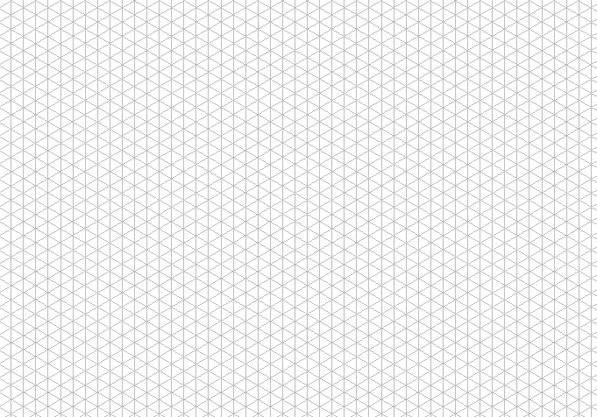
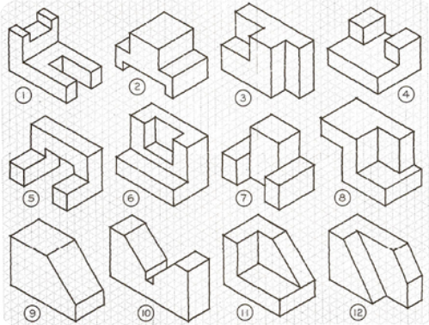
Option1 - Draw the example isometric shapes 1-12 using the isometric paper to help

Slide 10
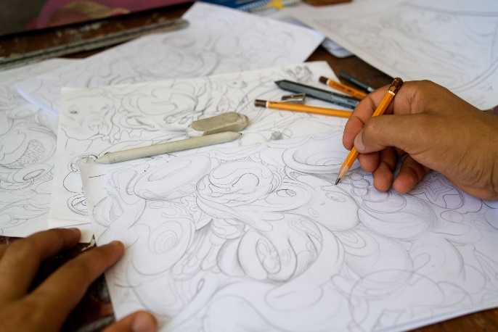
Observational Drawing and concept designs
Success Criteria – have you?
What is it (chair, bench, stool, rocking chair, lounger)?
What inspired it?
How have you changed and adapted the shape / pattern / texture into your design?

Slide 11
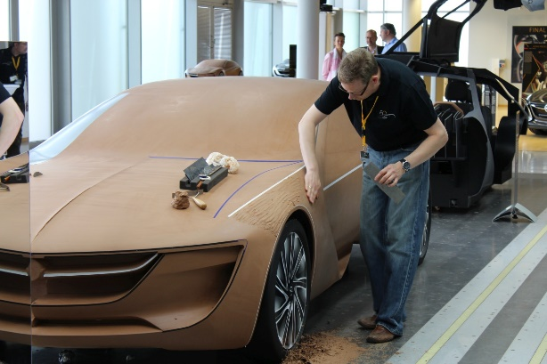
Clay modelling and concept designs
Success Criteria – have you?
What is it (chair, bench, stool, rocking chair, lounger)?
What inspired it?
How have you changed and adapted the shape / pattern / texture into your design?

Slide 12
Design Ideas
Success Criteria – have you?
Explained what inspired your chair ideas?
Explained how your designs are ergonomic?
Explained who would use each chair, for what and where in the home?
Explained what the unique selling points (USPs) of your designs are?

Slide 13
Design Development
Success Criteria – have you?
Explained what has changed in each of your design developments?
Explained if your designs developments have improved the FORM / FUNCTION?

Slide 14
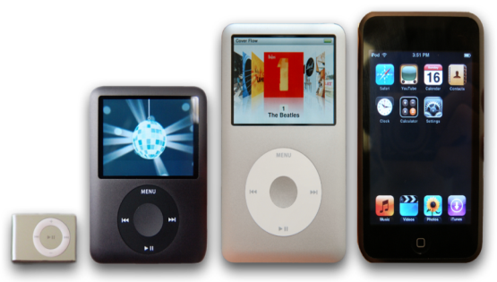
Homework – when completed stick over this page
In Product Design you need examine existing design ideas and how the design or/and technology has been developed to further improve the function and user experience.
Task: You are to investigate one product that has been developed examining the original product features and characteristics and comparing them to what are they like now and what they could be in the future?
Things to include:
A drawing or image of the product in the past and after being developed.
Explain in detail why you chosen to investigate the product.
Explain in detail how the product’s design features and characteristics have been developed for better or worse.
Draw a design idea for the next development to the product and explain how your development (s) will further improve the function and user experience.
How should I present it?
On A4 paper
Remember a title and any sub-titles
Remember to support your written work with some images
Remember to put your name on your work
?
Homework Success Criteria
+ You have followed and included all of the “things to include” and presented your work very well by using titles, sub titles and images or drawings to support your written work. All written work must be in your own words and include your own opinions.
= You have followed and included some of the “things to include” and presented your work well by using a title and images or drawings to support your written work. All written work must be in your own words.
– You have followed and included few of the “things to include”. Your work may not be presented appropriately as it will be missing titles, sub titles or your name. There will be lots of information that is copied and pasted from the internet with no opinions of your own.

Slide 16
Homework – when completed stick over this page
In Product Design you need to learn about creativity in design and how you can keep your design ideas imaginative.
Task: You are to investigate the history of a design company called Alessi.
Things to include:
Who are Alessi and when did it all begin?
Who are the key designers at Alessi?
What do you think of the company’s design style?
What are you favourite Alessi products and why are they your favourite?
How should I present it?
On A4 paper
Remember a title and any sub-titles
Remember to support your written work with some images
Remember to put your name on your work
Check these out – http://www.designcouncil.org.uk/Case-studies/Alessi/
http://www.alessi.com/en/company/history
Homework Success Criteria
+ You have followed and included all of the “things to include” and presented your work very well by using titles, sub titles and images or drawings to support your written work. All written work must be in your own words and include your own opinions.
= You have followed and included some of the “things to include” and presented your work well by using a title and images or drawings to support your written work. All written work must be in your own words.
– You have followed and included few of the “things to include”. Your work may not be presented appropriately as it will be missing titles, sub titles or your name. There will be lots of information that is copied and pasted from the internet with no opinions of your own.

