Slide 1
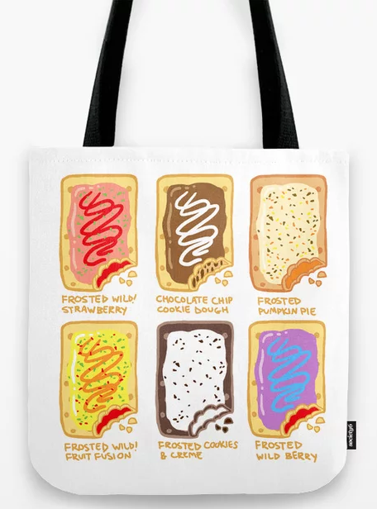
Food Shopping Bag
Year 8 Textiles
Name……………………………………………………
Design & Technology group…………………………..
Pathway: …………………………………………........
Teacher: ………………………………………………..
Personal target:

Slide 2
What are we learning and why?
During this project you will be developing skills and knowledge which would be useful to you at GCSE. GCSE Textiles follows a very similar structure to 3D design, Art and Photography so what you learn here will be useful in other subjects. At GCSE your work is assessed using four Assessment Objectives these are: Researching Ideas, Developing ideas and designing, Communicating ideas through drawing and writing and Final Product. Here is how the work you will do during the project will be useful.
Researching Ideas | Developing and trialing ideas and designing | Communicating Ideas | Final Product
Artist and designer research page Colour theory research Repeat pattern research Observational drawings (primary research) | Motif design page Block print and stencil samples Repeat pattern design ideas | Motif designs page Observational drawings Evaluating samples Writing about the work of another artists or designer | Skills demonstrated: Sewing machine Block Print Stenciling Transfer paint print Hand embroidery Appliqué

Slide 3
Whole class Product Analysis 1.
The bag we are using is: ……………………………………..
Material:
The product is made from ……………………………………………..
I think this fabric was chosen because ………………………….. .………………………………………
I think the fabric is suitable because ………………………………………………………………………………………………
Aesthetics/ Decoration:
The product has been decorated using ………………………………………………………………………………………..
I think this improves the look of the product because ………………………………………………………………………………………………………………………………………………………………………
Construction Techniques used:
The product has been made using the following techniques ………………………………………………………………………………………………
I think these techniques were used because …………………………………………………………………………………………...
Customer:
I think that …………………… would by this product because ……………………………………………………………………………..
They would use it for ………………………………………………………………………………
I think the product would appeal to the customer because ………………………………………………………………………………
Word bank support: Hand sewing, sewing machine, zig zag stitch, straight stitch, reinforced, strong, neat, cheap, quick.
Word bank support: polyester, felt, cotton, plastic, hessian, silk, aesthetically pleasing, strong, smooth, waterproof, soft, can hold a graphic print, fit for purpose, durable, fun, cheap material, sustainable.
Word bank support: Paint, printing, stencils, applique, buttons, sequins, aesthetically pleasing, duits target market, modern, durable.
Summary: My opinion
Explain the following:
Overall I think this product is…
Word bank support: Families, elderly, young professionals, teenagers, young children, shopping, filing, sorting, carrying lunch, carrying heavy items, simple, durable, aesthetically pleasing.

Slide 4
Individual Work: Product Analysis 2.
The bag we are using is: ……………………………………..
Material:
The product is made from ……………………………………………..
I think this fabric was chosen because ………………………….. .………………………………………
I think the fabric is suitable because ………………………………………………………………………………………………
Aesthetics/ Decoration:
The product has been decorated using ………………………………………………………………………………………..
I think this improves the look of the product because ………………………………………………………………………………………………………………………………………………………………………
Construction Techniques used:
The product has been made using the following techniques ………………………………………………………………………………………………
I think these techniques were used because …………………………………………………………………………………………...
Customer:
I think that …………………… would by this product because ……………………………………………………………………………..
They would use it for ………………………………………………………………………………
I think the product would appeal to the customer because ………………………………………………………………………………
Word bank support: Hand sewing, sewing machine, zig zag stitch, straight stitch, reinforced, strong, neat, cheap, quick.
Word bank support: polyester, felt, cotton, plastic, hessian, silk, aesthetically pleasing, strong, smooth, waterproof, soft, can hold a graphic print, fit for purpose, durable, fun, cheap material, sustainable.
Word bank support: Paint, printing, stencils, applique, buttons, sequins, aesthetically pleasing, duits target market, modern, durable.
Summary: My opinion
Explain the following:
Overall I think this product is…
Word bank support: Families, elderly, young professionals, teenagers, young children, shopping, filing, sorting, carrying lunch, carrying heavy items, simple, durable, aesthetically pleasing.

Slide 5
Individual Work: Product Analysis 3.
The bag we are using is: ……………………………………..
Material:
The product is made from ……………………………………………..
I think this fabric was chosen because ………………………….. .………………………………………
I think the fabric is suitable because ………………………………………………………………………………………………
Aesthetics/ Decoration:
The product has been decorated using ………………………………………………………………………………………..
I think this improves the look of the product because ………………………………………………………………………………………………………………………………………………………………………
Construction Techniques used:
The product has been made using the following techniques ………………………………………………………………………………………………
I think these techniques were used because …………………………………………………………………………………………...
Customer:
I think that …………………… would by this product because ……………………………………………………………………………..
They would use it for ………………………………………………………………………………
I think the product would appeal to the customer because ………………………………………………………………………………
Word bank support: Hand sewing, sewing machine, zig zag stitch, straight stitch, reinforced, strong, neat, cheap, quick.
Word bank support: polyester, felt, cotton, plastic, hessian, silk, aesthetically pleasing, strong, smooth, waterproof, soft, can hold a graphic print, fit for purpose, durable, fun, cheap material, sustainable.
Word bank support: Paint, printing, stencils, applique, buttons, sequins, aesthetically pleasing, duits target market, modern, durable.
Summary: My opinion
Explain the following:
Overall I think this product is…
Word bank support: Families, elderly, young professionals, teenagers, young children, shopping, filing, sorting, carrying lunch, carrying heavy items, simple, durable, aesthetically pleasing.

Slide 6
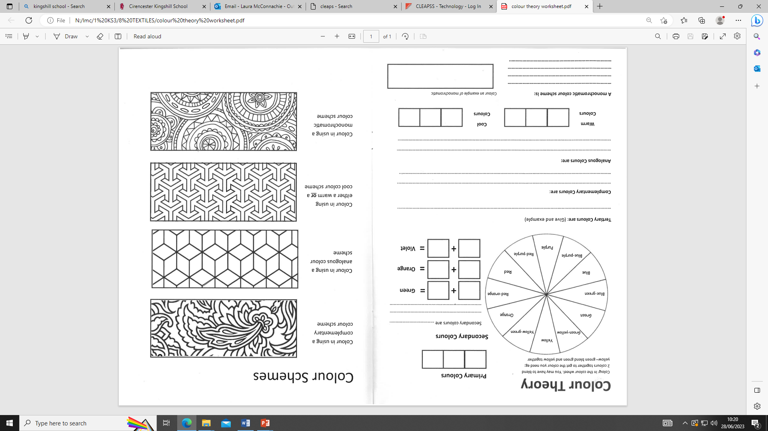

Slide 7
List all the items you can think of:
Task Analysis: Food Types
Fruit
Vegetables
Dairy
Cupboard items
Meat:
Drinks
Fridge items
Snacks:
There are five food groups:
F _ _ _ _ and v_ _ _ _ _ _ _ _ _
C _ _ _ _ _ _ _ _ _ _ _ _
P _ _ _ _ _ _ _
D _ _ _ _
F _ _ s and O _ _ s
Take-aways:
……………………..:
……………………..:
……………………..:
Researching this will help you have more ideas for what to decorate your bag with!

Slide 8
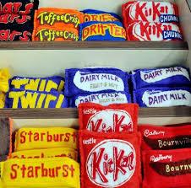
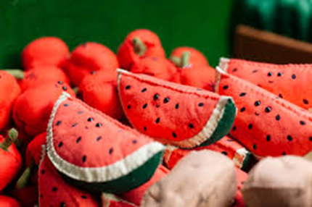
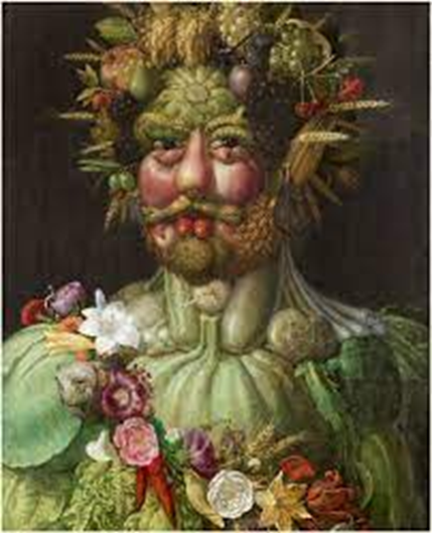
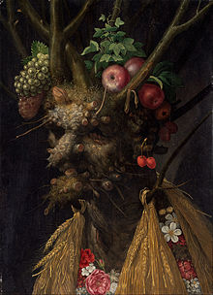
Food in Art
High level answers:
Describe effects, presentation and you opinions of their work
Low level answers:
State what you see.
Food has been providing a source of inspiration for artists for hundreds of years.
Have a look at the examples of art inspired by food below and answer the questions.
What sort of food can you see in the picture?:
How has the food in the picture been presented?
How do you think the art work has been made?
Describe the artists use of colour
What do you like/ not like about this work?
Giuseppe Arcimboldo
What sort of food can you see in the picture?:
How has the food in the picture been presented?
How do you think the art work has been made?
Describe the artists use of colour
What do you like/ not like about this work?
Lucy Sparrow

Slide 9
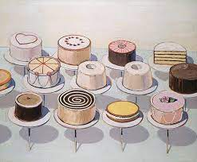
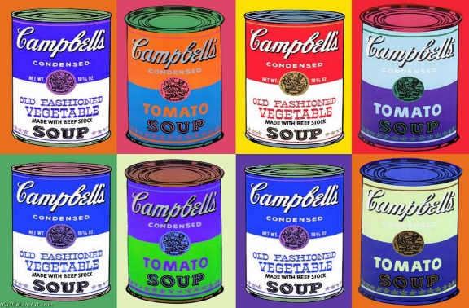
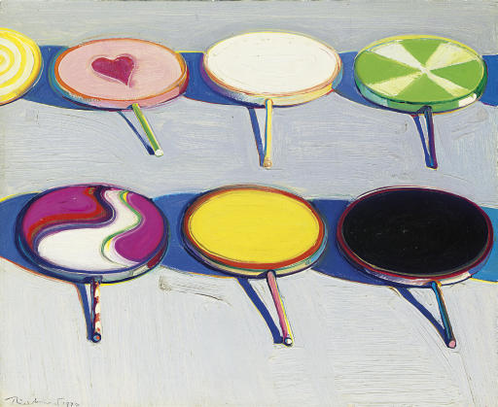
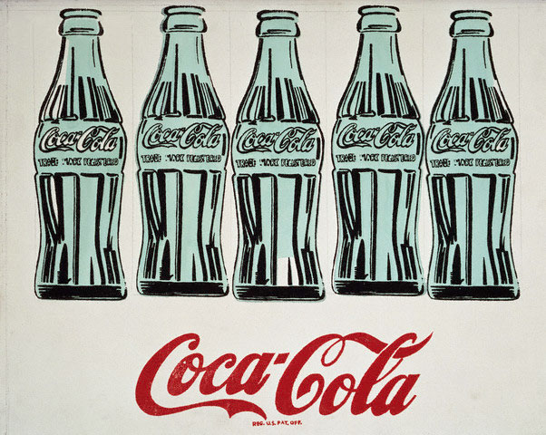
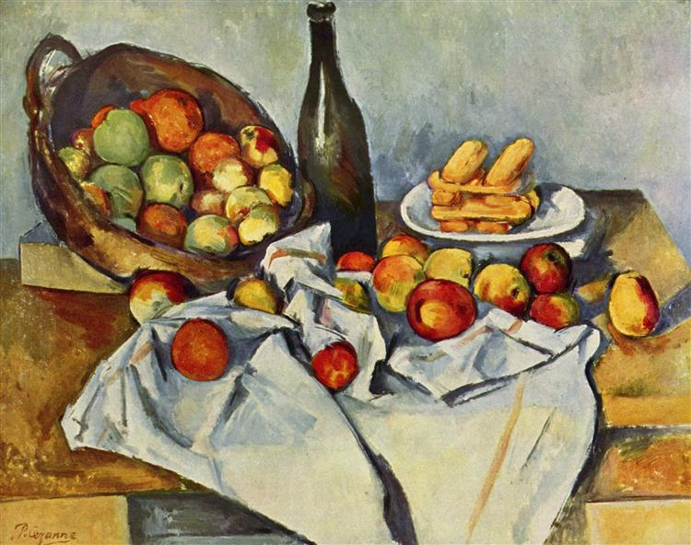
What sort of food can you see in the picture?:
How has the food in the picture been presented?
How do you think the art work has been made?
Describe the artists use of colour
What do you like/ not like about this work?
Wayne Thiebaud
Andy Warhol
Paul Cezanne
What sort of food can you see in the picture?:
How has the food in the picture been presented?
How do you think the art work has been made?
Describe the artists use of colour
What do you like/ not like about this work?
What sort of food can you see in the picture?:
How has the food in the picture been presented?
How do you think the art work has been made?
Describe the artists use of colour
What do you like/ not like about this work?

Slide 10
Observational Drawings
Task 1:
Continuous line sketch
Task 2:
Sketch with your opposite hand
Task 3:
Sketch with your eyes closed

Slide 11
Observational Drawings
Task 4:
5 minute sketch
Task 5:
10 minute drawing
Task 6:
15 minute drawing

Slide 12
Homework: Food Moodboard
Create a moodboard of food/ food packaging which you think would make an eye catching design to go onto your bag.
Include food with interesting shapes, colours, details or packaging with eye catching logos will work best.
Include at least 10 images.
Label the food you have chosen to say why you think they would make a good design.
Foundation | Secure | Confident | Exceptional
-Your moodboard includes a title and at least 5 relevant images. | You have chosen at least 10 inspirational and relevant images. You have added some simple labelling to the images you have chosen eg: labelling a colour/ saying what food it is. | A well presented moodboard. Your moodboard should be full. A wide range of relevant images You have labelled your images to explain why you think they would make a good design for your bag. | A detailed moodboard made by collaging images over each other. Your moodboard is presented to a high standard (look at the GCSE examples) Detailed labelling to explain how you could take inspiration from the images you have chosen. Use of your own sketches.

Slide 13
Motif Design Page
Using your moodboard and observational drawings to help you produce a minimum of 4 designs for motifs which you could use for the designs on your bag.
*Make them simple as you will need to be able to cut the design in fabric

Slide 14
Block Print
Stick a Sample of block print here
Equipment list:
How to make a block print:
Step by step instructions:

Slide 15
Stencil
Equipment list:
Stick a Sample of stencilling here
How to make a stencil:
Step by step instructions:
Can you explain the difference between a positive and negative stencil?:

Slide 16
Sewing Machine Instructions
x
Lift the presser foot lever
Place the material under it, put the presser foot down carefully
Use the pedal for speed, slowly and carefully
Lift the presser foot leaver making sure the needle is up when you want to remove the work
Pull the work to the side leaving a LONG thread and cut near your work NOT the needle

Slide 17
Evaluation of My Bag
Give yourself a mark out of 10
(1: Poor, 10: Outstanding)
Complete the following sentences
I most enjoyed: ………………………………………………………………………….
I am proud of: …………………………………………………………………………….
It was the first time I…………………………………………………………………….
I need to practice more at ……………………………………………………………
My friends think………………………………………………………………………
My teacher thinks…………………………………………………………………….
If I were to make it again I would change ……………………………………..
Work completed on time
Block printing
Stencils
Assembling all parts
Using pins
Creative designs
Good cutting skills
Threading a needle
Tying a knot
Applique -Hand sewing neatness
Packed away neatly
Helpful to others
Independent
Focussed

Slide 18
Lessons learned help sheet task:
Produce a help sheet for the next student to use for the parts that you found tricky.

