Slide 1
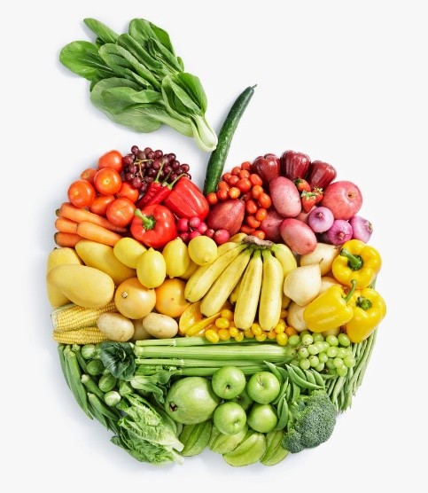
Food Technology
Year 8
Name:
Pathway:
Class:
Recipe Book

Slide 2
Recipe Index
Recipe | Date
Breakfast muffins
Garlic & rosemary focaccia
Pizza
Chilli veg noodles
Mac ‘n’ veg cheese
Bolognese sauce
Mini quiche tartlets
Victoria Sandwich cake
Meatball & bean stew
Pre-practical check list
Place bags in locker areas.
Place planner, recipe booklet and pencil case on your desk.
Take jumper off and put apron on.
Tie hair back.
Roll up sleeves and wash hands
Place ingredients on plastic trays on your work area.
Collect equipment.
Put ALL carrier bags away and stools under the table.
Food Room Rules
Do not run in the food room.
Always carry knives safely with the blade pointed downwards.
Any cuts must be covered with a blue plaster.

Slide 3
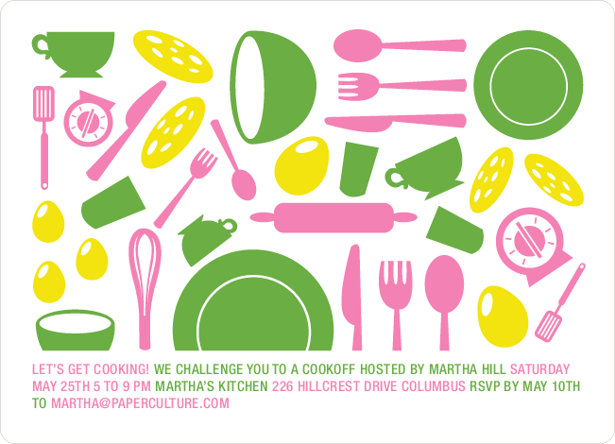
What we are cooking and why
Throughout their practical cooking experiences, the students will be working towards GCSE standards when it comes to their practical skills.
We think it is important that the students practice these skills from the very start as it will enable them to become more confident and efficient when preparing and cooking food at school and at home.
Overleaf there is a table showing the 20 skills, which commodity (food item) the students will be using, the food science that takes place when cooking and the name of the dishes that these skills will be used in.
Below you will find the key to the table:
Commodity – which food group does the main ingredients belong to.
Food science – what causes this to happen? Why does it happen?
Practicals – what dishes are being made.

Slide 4
The 20 skills of Food preparation and Nutrition
 | Year 8
Knife Skills | Fruit & vegetables
1 & 2 | Enzymic Browning
 | Roasted vegetables/pasta salad
 | Bolognese/lemon drizzle muffins
Shaping skills | Cereals/flour
3 | Biological aeration/gluten formation
 | Bread rolls/pizza
Tenderise & marinate | N/A
4
Select & adjust | Vegetables/pasta
a cooking process | Convection/conduction
5 | Pasta salad/roasted vegetables/
 | Bolognese
Weigh & measure | All commodities
 | Accurate weighing & measuring
 | All dishes
Preparation of | All commodities
equipment | Ensure equipment is safe to use
7 | Bread/pizza/roasted veg/
 | Victoria sandwich
Use of equipment | All commodities
mixer, and microwave | Conduction
blender/food processor
8 | Pizza sauce
Water-based methods | Meat/vegetables
using the hob | Boiling/simmering
9 | Bolognese
Dry heat & fat-based | Meat/vegetables
methods using the hob | Conduction/browning meat/
10 | sauteing veges
 | Bolognese
Using the grill | N/A
11
Using the oven | Cereals/Vegetables
12 | Convection/aeration
 | Muffins/bread/pizza/roasted veg/
 | Victoria sandwich
Make sauces | Meat/vegetable
13 | Conduction/browning meat/
 | sauteing veges/reduction
 | Bolognese
Set a mixture- gelation | N/A
gelation
14
Set a mixture - | N/A
coagulation
15
Use of raising agents | Cereals/vegetables/dairy
16 | Chemical/biological & mechanical
 | aeration
 | Muffins/bread/pizza/
 | Victoria sandwich
Make a dough | Cereal/dairy
17 | Gluten formation & fermentation
 | Bread/pizza
Shaping & | Cereal
finishing a dough | Gluten formation & fermentation
18 | Bread/pizza
Test for readiness | All commodties
19 | Establish if food is safe to eat
 | All dishes
Judge & manipulate | All commodities
sensory properties | Tasting & seasoning
20 | Roasted veg/Bolognese

Slide 5
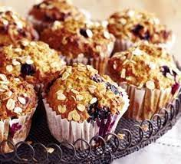
Breakfast Muffins
Ingredients
12 paper muffin cases
250g self raising flour & 2 tsp baking powder
100g sugar
1 egg & 150g canned fruit (in juice) or fresh if preferred.
230ml milk & 60g vegetable/sunflower oil
1 – 2 tbsp oats for topping (optional)
Method
Heat oven 180 C / Gas 6. Place muffin cases in the muffin tin.
Mix all the ingredients together (except the fruit) to form a smooth batter.
Drain the juice from the fruit, then stir the fruit (chopped if too large) into the batter.
Divide the mixture evenly between the cases. Sprinkle on a tablespoon oats.
Bake for 20-25 mins. Until golden. Leave to cool on a cooling.
Notes:
Click on picture to watch ‘how to make’ video.

Slide 6
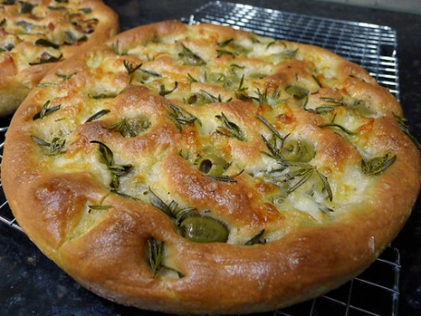
Garlic and rosemary focaccia
Ingredients
250g strong bread flour
2 tsp salt, 1 clove garlic, 1 tsp dried rosemary or 1 bunch fresh
1 packet (7g) fast action dried yeast
170 mls (approx.) warm water
2 Tbsp olive oil
Method
1. Oil a shallow baking tray/cake tin/foil dish
2. Add the flour to a bowl, add 1 tsp salt, and the packet of dried yeast.
3. Mix in 170mls warm water. Add 1 tbsp of the oil. Mix with your hands until dough comes together.
4. Place on a floured surface and knead the dough for 10 minutes until smooth and stretchy.
5. Press the dough into the tray/tin, place the mixing bowl over the top and leave for 10 mins. to prove.
6. Press fingers into the dough to make dimples. Sprinkle over the remaining salt, the rosemary, the garlic and the oil. At this stage, you can shape the dough if you want to.
7. Place into a cold oven, then turn the heat to maximum and cook for 15 – 20 until golden

Slide 7

Pizza
Ingredients for the sauce
1 tin tomatoes, 1 clove garlic, fresh or dried basil, 1 tbsp olive oil
Dough
150g strong white flour
1 tsp salt, 1 sachet yeast
2 tbsp olive oil, approx. 150ml warm water
Toppings – grated cheddar, ball of mozzarella, ham, peppers, pepperoni, red onion etc.
Method
1. Set oven to 220˚C/gas 8. Grease baking tray
2. Start by making the sauce. Heat the oil in a pan and add the garlic. After 1 minute add the tomatoes and the herbs. Once boiling, turn down the heat and simmer.
3. Put the flour into a bowl and add the salt and the yeast. Add the olive oil and gradually the water until you have stick (but not too sticky!) dough.
4. Place on a floured surface and knead the dough for 10 minutes until smooth and stretchy.
5. Place the cleaned bowl over the dough and leave to prove for 10 minutes.
6. Prepare your topping, grate cheese, slice tomatoes etc.
7. Roll out the dough and place it on the tray. Add your sauce and the toppings.
8. Place in the oven and cook for 10-12 mins until the cheese is bubbling and golden brown.
Notes:
Click on both pictures to watch videos – bigger picture is making the dough, smaller picture is shaping the dough into rolls.

Slide 8
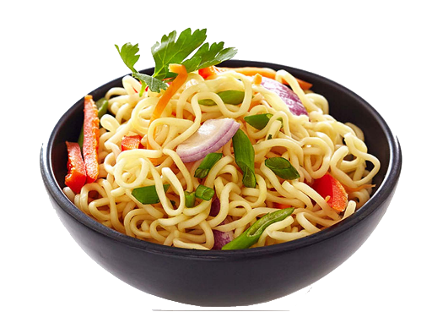
Chilli-veg noodles
Ingredients
1 x dried noodle nest (around 60g)
½ red (or brown) onion, 1 carrot, ½ pepper (any colour)
1 clove garlic, 1 tsp oil, pinch chilli flakes
50g frozen peas, ¼ - ½ tsp ginger (dried or fresh)
¼ - ½ tsp pepper, 50ml water
1 tbsp soy sauce
Method
1. Place the noodle nest in a measuring jug and cover with boiling water – leave 10 mins.
2. Peel and slice the onion, carrot and garlic.
3. Deseed and slice the pepper.
4. Add the oil to a saucepan and fry the onion and carrot for 3 – 4 mins, then add the garlic and chilli flakes and cook for 2 – 3 mins.
5. Add the pepper (veg), peas, ginger, white pepper and water – cook for 2 – 3 mins.
6. Drain the noodles into a sieve and then mix into the vegetables.
7. Stir through the soy sauce and serve!
Notes:
Click on picture for ‘how to make’ video 6.35 minutes

Slide 9
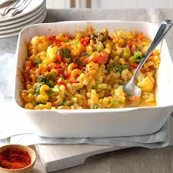
Mac, veg ‘n’ cheese
Ingredients
100g dried macaroni or other shapes
100g frozen vegetables or the equivalent fresh but cooked
75g Cheddar cheese, grated
25g butter/spread, 25g plain flour, 250ml milk
Method
1. Preheat the oven to 200g/gas 6
2. Fill a large saucepan with water and bring to the boil. Add the pasta.
3. Cook for 10 – 12 minutes until al dente. Add the frozen vegetables 5 minutes BEFORE the end of cooking. Now make the sauce.
4. Place the butter, flour and milk into a saucepan. Bring to the boil whisking all the time until it has thickened. Remove from the heat and add half the cheese.
5. Drain the pasta and vegetables into a colander. Stir the pasta into the cheese sauce.
6. Pour the mixture into an ovenproof dish and scatter the rest of the cheese over.
7. Place dish onto baking tray and bake for 10 minutes until golden brown.

Slide 10
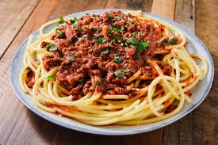
Bolognese sauce
Ingredients
450g minced beef
1 tin (400g) chopped tomatoes, 1 clove garlic
1 onion, 1 carrot (you could also add peppers, mushrooms, celery)
2 tbsp. tomato purée, 1 tbsp oil
1 beef stock cube, 1 bay leaf
1 tsp. mixed herbs (fresh or dried) preferably basil
Method
1. Prepare the vegetables – dice the onion, carrot & celery. Slice or crush the garlic.
2. Heat oil in a saucepan over a medium heat. Add the vegetables and cook for 5 mins.
3. Add the meat and break up with a wooden spoon. Cook until meat turns brown.
4. Dissolve the stock cube in 300ml boiling water and add to the meat.
5. Add the tin of tomatoes, purée, herbs and bay leaf and stir well.
6. Bring the mixture to the boil and then reduce the heat and let the sauce simmer for 20-30 minutes. Leave the lid on the pan at an angle to allow the sauce to reduce and thicken.
7. When the vegetables are soft, the sauce is ready. Serve with pasta.

Slide 11
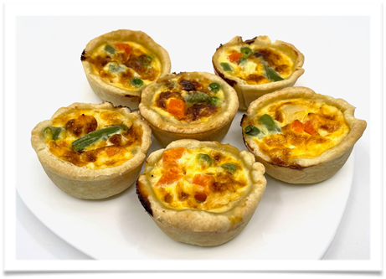
Mini quiche tartlets
Ingredients
100g plain flour
50g butter or baking fat
1 large egg (or 2 small)
60ml milk
60g frozen mixed vegetables, some chopped ham or cooked bacon
25g cheese, grated
Method
Preheat oven to 200˚C/Gas
Lightly grease the muffin tin
To make the pastry, cut the fat into small pieces, rub it into the flour, until it looks like breadcrumbs. Add 2 – 3 tbsp. cold water and mix into a dough.
On a floured surface, roll out the pastry and use scone cutters to make 6 - 8 circles
Place the vegetables and ham in the pastry cases. Grate the cheese.
Whisk the egg and the milk together, add seasoning if required.
Pour the egg mixture into the cases and top with the cheese.
8. Bake for 15 – 20 minutes until golden brown. Place on a cooling rack.

Slide 12
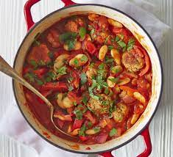
Meatball bean stew
Ingredients
2 sausages (meat or veggie)
½ onion, 1 clove garlic, 1 tsp oil
100g cabbage (about ¹/₆ – ¹/₈)
½ 400g (200g) can chopped tomatoes, ½ 400g (200g) baked beans (or cannelini, butter beans)
1 tsp mustard, ½ vegetable stock cube
Method
1. Squeeze the meat out of the sausages and form into 6–8 meatballs. Wash hands.
2. Peel and chop the onion and garlic.
3. Slice the cabbage into thin strips.
4. Fry the onion, garlic and meatballs for about 5 minutes until brown. Be careful not to burn the garlic.
5. Place the stock cube into a jug and add 100ml boiling water. Stir until dissolved.
6. Add the stock, and tomatoes to the meatballs. Add the mustard.
7. Now add the cabbage and the beans. Cook for 5 – 8 minutes with the lid on.
8. Your delicious stew is now ready. Serve at home with mashed potato or crusty bread.

Slide 13
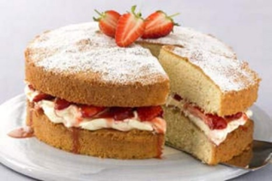
Victoria Sandwich Cake
Ingredients
125g Self raising flour
125g Caster sugar
125g Butter or margarine
2 eggs
3 – 4 tbsp. jam for filling and 1 tbsp. icing for dusting over the top
Method
1. Set oven to 180°C/gas 4. Grease and line 2 16 cm round cake tins.
2. Cream together the sugar and butter with a wooden spoon until light and fluffy.
3. Beat the eggs into the mixture, one at a time. Beat well in between.
4.Sieve the flour into your mixture and then fold in using a metal spoon.
5. Divide the mixture between the two cake tins and carefully spread the mixture out.
6. Bake for 20 minutes until golden brown and well risen. Use the skewer test to check.
7. Turn the cakes out of the tins and leave to cool.
8. Spread jam onto one side and then sandwich together.
9. Sieve icing sugar over the top of the top sponge.

