Slide 1
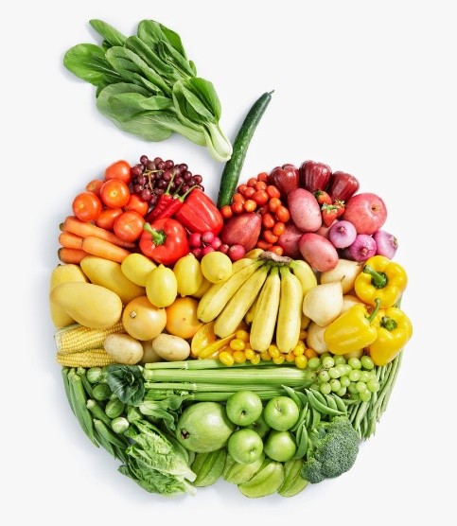
Food Technology
Year 8
Name:
Pathway:
Class:
Focus on Practical Skills and Healthy Eating

Slide 2
What we will learn in Year 8
Lesson | Recipe | Skill
1 | Health, safety & food hygiene | How to work safely in the food room
2 | Breakfast Muffins | Weighing/measuring, mixing, draining, dividing, using the oven.
3 | Garlic & rosemary focaccia | Weighing/measuring, mixing, forming a dough, kneading, shaping, peeling, chopping, using the oven.
4 | Pizza | Weighing/measuring, mixing, forming a dough, kneading, shaping, rolling out dough, peeling, chopping, using the oven.
5 | Chilli vegetable noodles | Weighing/measuring, peeling, slicing/chopping, deseeding, using the hob, mixing, frying.
6 | Mac veg ‘n’ cheese | Weighing/measuring, grating, mixing, whisking, using the hob and oven
7 | Mini quiche tartlets | Weighing/measuring, rubbing-in, mixing, cutting, grating, rolling out pastry, pouring, using the oven
8 | Meatball and bean stew | Weighing/measuring, forming, peeling, chopping, using the hobs, mixing
9 | Victoria Sponge | Weighing/measuring, creaming, cracking eggs, folding in flour, dividing, using the oven

Slide 3
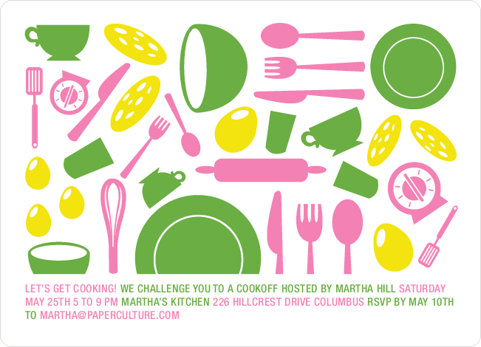
What we are cooking and why
Throughout their practical cooking experiences, the students will be working towards GCSE standards when it comes to their practical skills.
We think it is important that the students practice these skills from the very start as it will enable them to become more confident and efficient when preparing and cooking food at school and at home.
Overleaf there is a table showing the 20 skills, which commodity (food item) the students will be using, the food science that takes place when cooking and the name of the dishes that these skills will be used in.
Below you will find the key to the table:
Commodity – which food group does the main ingredients belong to.
Food science – what causes this to happen? Why does it happen?
Practical's – what dishes are being made.

Slide 4
The 20 skills of Food preparation and Nutrition
 | Year 8
Knife Skills | Fruit & vegetables
1 & 2 | Enzymic Browning
 | Roasted vegetables/pasta salad
 | Bolognese/lemon drizzle muffins
Shaping skills | Cereals/flour
3 | Biological aeration/gluten formation
 | Bread rolls/pizza
Tenderise & marinate | N/A
4
Select & adjust | Vegetables/pasta
a cooking process | Convection/conduction
5 | Pasta salad/roasted vegetables/
 | Bolognese
Weigh & measure | All commodities
 | Accurate weighing & measuring
 | All dishes
Preparation of | All commodities
equipment | Ensure equipment is safe to use
7 | Bread/pizza/roasted veg/
 | Victoria sandwich
Use of equipment | All commodities
mixer, and microwave | Conduction
blender/food processor
8 | Pizza sauce
Water-based methods | Meat/vegetables
using the hob | Boiling/simmering
9 | Bolognese
Dry heat & fat-based | Meat/vegetables
methods using the hob | Conduction/browning meat/
10 | sautéing veges
 | Bolognese
Using the grill | N/A
11
Using the oven | Cereals/Vegetables
12 | Convection/aeration
 | Muffins/bread/pizza/roasted veg/
 | Victoria sandwich
Make sauces | Meat/vegetable
13 | Conduction/browning meat/
 | sauteing veges/reduction
 | Bolognese
Set a mixture- gelation | N/A
gelation
14
Set a mixture - | N/A
coagulation
15
Use of raising agents | Cereals/vegetables/dairy
16 | Chemical/biological & mechanical
 | aeration
 | Muffins/bread/pizza/
 | Victoria sandwich
Make a dough | Cereal/dairy
17 | Gluten formation & fermentation
 | Bread/pizza
Shaping & | Cereal
finishing a dough | Gluten formation & fermentation
18 | Bread/pizza
Test for readiness | All commodties
19 | Establish if food is safe to eat
 | All dishes
Judge & manipulate | All commodities
sensory properties | Tasting & seasoning
20 | Roasted veg/Bolognese

Slide 5
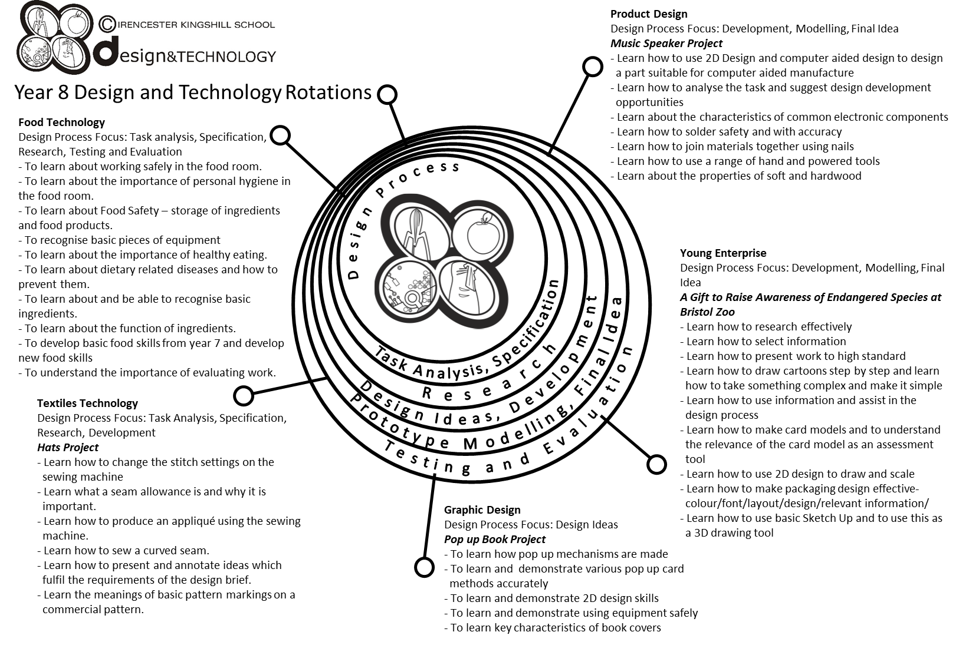

Slide 6
Year 8 pathways criteria
Year 8 Foundation | Year 8 Secure | Year 8 Confident | Year 8 Excellent
Four initial design ideas, completed and rendered. | Four initial design ideas, completed and rendered with accuracy. | All criteria from previous pathway has been completed to a high standard. | All criteria from previous pathway has been achieved to an exceptional standard.
At least two annotations made on each design. | Four annotations made on each design. | Six annotations made on each design. | Eight plus annotations made on each design.
One view of design ideas. | You have drawn some of your design ideas in 3D. | You have drawn all of your design ideas in 3D. | You have drawn all of your design ideas in 3D, showing some designs with different views e.g. cross-section.
You have named your chosen target market. | You have identified why your design is suitable for your chosen target market. | All criteria from previous pathway has been achieved with reference made to the design specification. | All criteria from previous pathway has been achieved with reference made to the design specification and a detailed design proposal has been completed.
You have a written plan of making. | You have written your plan of making showing a start and finish time. | You have written your plan of making with some timings. | You have written a detailed plan of making with timings and some control points.
Some ingredients and equipment handled with reasonable control. | Most ingredients and equipment handled with co-ordination. | Most ingredients and equipment handled with excellent competence and co-ordination. | All ingredients and equipment handled with excellent competence and co-ordination.
Practical sessions - needed a little assistance. | Practical session - mostly independent – a little assistance. | Practical sessions - completely independent. Demonstrating good organisation. | Practical sessions - Completely independent. Demonstrating a high level of organisation.
Mostly worked in a hygienic and safe manner. | Worked in a hygienic and safe manner. | Consistently worked in a hygienic and safe manner. | Consistently worked in a hygienic and safe manner.
Finished practical dish. | Finished on time. Sink and equipment cleaned and finished product packed away. | Finished well within the time limit. All equipment cleaned and finished product packed away, and extension work completed. | Finished well within the time limit. All equipment cleaned and finished product packed away, and extension work completed to a high standard.
Acceptable finish on end product. | Good finish to end product. | High quality product with excellent finish. | High quality product with excellent finish. Demonstrating good garnishing/decorating skills to finished product.

Slide 7


Food Technology – essential information
What to bring to school:
For each Food Technology lesson, you will need:
Your ingredients – weighed and measured
A lidded container to take your food home in, clearly marked with your name
Your pencil case
Your planner
Your work booklet
For some practical lessons you may also need a dish/tin to cook the food in.
If you do not bring in ingredients – you will NOT cook
When you get to school
You must take your ingredients to the food room BEFORE registration.
Place your high-risk ingredients (meat, dairy, fish) in the fridge and your dry ingredients in the Cool Room.
After your practical lesson you must leave your food in the cool room and collect after afternoon registration.
Think about the environment. Try not to use too many plastic bags for your ingredients Try to reuse
plastic pots and bags. Use old margarine tubs/sweet tins instead.
It is essential that you leave your unit drawers and cupboards CLEAN and TIDY, ready for the next class.
Please sign to show that you have read and understood the essential information set out below.
Name………………………………………………… Signature………………………………………….. Date…………………………….

Slide 8
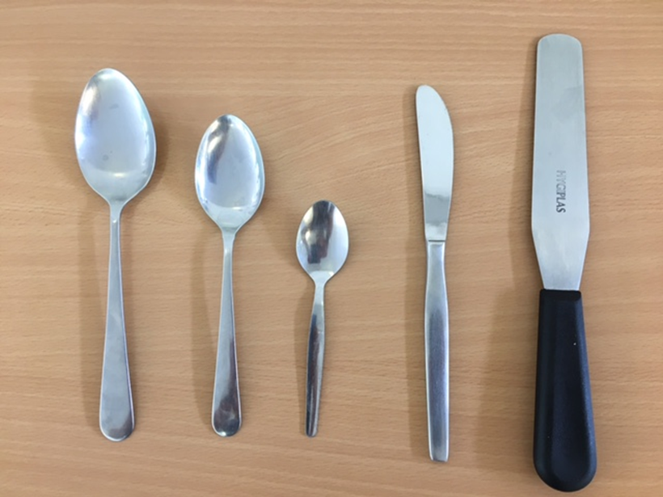
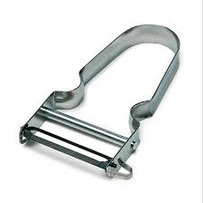

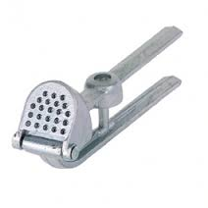
Recognising Equipment
Key words | Teaspoon | Palette knife | Dessert spoon | Kitchen Knife | Tablespoon
Can you name the equipment? Use the box above to help you.
A | B | C | D | E
In recipes what do the following abbreviations stand for?
tsp | dsp | tbsp.
A
B
C
D
E
Name the following pieces of equipment and their uses:
Name: P | Name: G | Name: Z
Use: | Use: | Use:

Slide 9
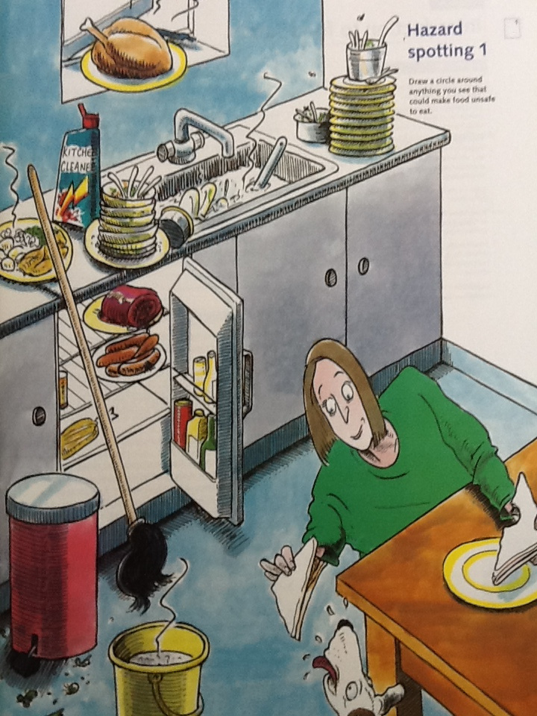
Kitchen and Personal Hygiene
Look at the kitchen below and identify 10 hazards. Number each hazard and give a brief explanation.
1
2
3
4
5
6
7
8
9
10

Slide 11

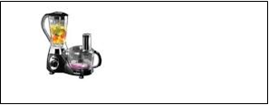
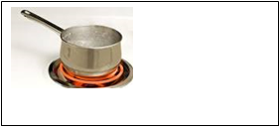


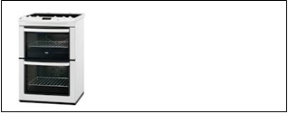
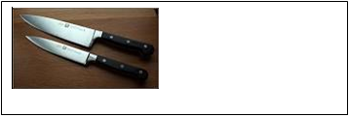
Safety in Food Technology
Each year many thousands of people are injured through accidents in the home. You can help to prevent accidents by thinking carefully about how you and your team work safely in the Food Room.
Read through the following rules. Why are they important when working in the food room?
Identify the main possible danger areas in the Food Room:
Electrical equipment
Hot pans/hob
Risk:
Risk:
1 | Make sure all bags and stools are out of the way.
2 | Walk; don’t run in the food room.
3 | Beware of any spilt food.
4 | Don’t leave pan handles sticking out over edge of a cooker or work surface.
5 | Always use dry oven gloves.
6 | Take care when using and washing sharp knives.
Naked gas flame
Electricity/trailing wires
Risk:
Risk:
Hot oven
Sharp knives
Risk:
Risk:

Slide 12

Design an informative safety poster for the Food Room.

Slide 13
Homework Task – Research 3 different types of Bread. You must include an image of the bread –country of origin – description of the bread. Complete the following table.
 | 1 | 2 | 3
NAME OF BREAD
IMAGE OF BREAD
COUNTRY OF ORIGIN
DESCRIPTION

Slide 14
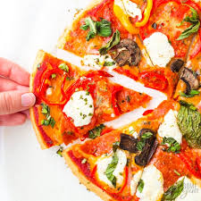
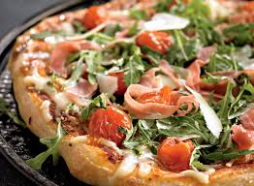
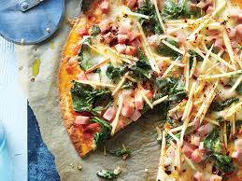
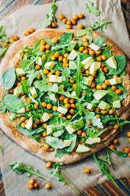
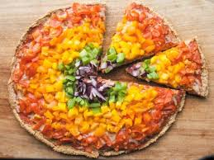
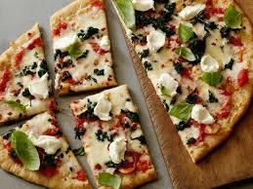
Design a pizza brief
Tesco have asked you to design and make a new pizza aimed at teenagers promoting healthy eating.
Your task is to design, draw and annotate 4 pizza designs that would fit the brief. Please think about the appearance, flavours, textures and use of healthy ingredients for the pizza.
Consider your 4 designs and choose the one you feel will be most successful.

Slide 15
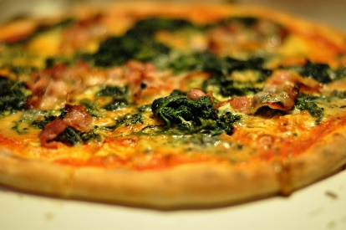
Homework – Designing a Pizza
The word pizza is Italian for pie.
A Margherita Pizza is the most popular pizza followed closely by a Pepperoni Pizza.
Produce 4 different design ideas.
Key words: to help you to check your spelling: tomato, mozzarella, basil, pepperoni, pineapple,
Remember to sketch with a pencil, render and annotate your sketches in detail.
Design 1 | Design 2
Design 3 | Design 4

Slide 16
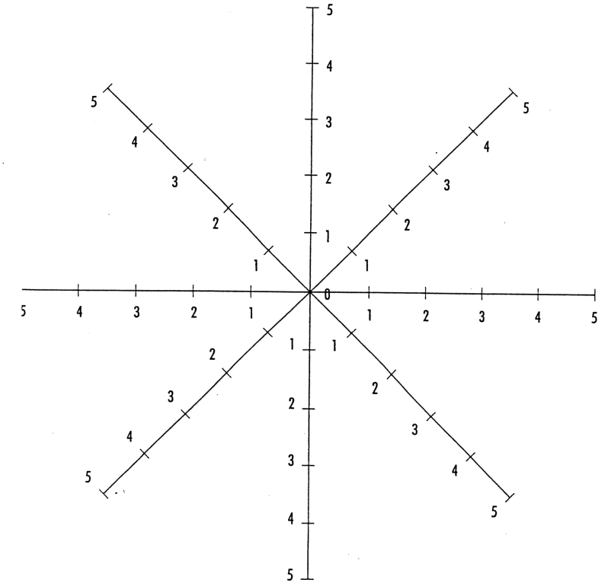
Evaluation
Made safely and hygienically
Complete all the following questions in full sentences.
1 | Did you meet the criteria of your design brief?
2 | Were you well organised? Explain.
3 | Did you find anything difficult?
4 | Could you of done anything differently or better?
5 | Did you learn any new skills?
6 | Underline the practical skills you used: | Kneading - Shaping - Rolling - Glazing - Grating Chopping – Slicing.
7 | Were you pleased with your final result? Why?
Time management
Skills
Shape
Appeal to
Appearance
Colour
Texture

Slide 17
Homework – Produce a fact file on Pasta. Your fact file should include a title - 10 interesting facts – images and a border.
(You can do your work on this page or print off and stick work into your booklet)

