Slide 1
Year 8 Product Design
Desk Tidy Project
Name
Design & Technology group
Pathway
Project Assessment :

Slide 2

Product Design
Design Process Focus: Development, Modelling, Final Idea
Desk tidy Project
- Learn how to use 2D Design and computer aided design to design
a part suitable for computer aided manufacture
- Learn how to analyse the task and suggest design development
opportunities
- Learn about the characteristics of common electronic components
- Learn how to solder safety and with accuracy
- Learn how to join materials together using nails
- Learn how to use a range of hand and powered tools
- Learn about the properties of soft and hardwood
Year 8 Design and Technology Rotations
Food Technology
Design Process Focus: Task analysis, Specification, Research, Testing and Evaluation
- To learn about working safely in the food room.
- To learn about the importance of personal hygiene in the food room.
- To learn about Food Safety – storage of ingredients and food products.
- To recognise basic pieces of equipment
- To learn about the importance of healthy eating.
- To learn about dietary related diseases and how to prevent them.
- To learn about and be able to recognise basic ingredients.
- To learn about the function of ingredients.
- To develop basic food skills from year 7 and develop new food skills
- To understand the importance of evaluating work.
Young Enterprise
Design Process Focus: Development, Modelling, Final Idea
A Gift to Raise Awareness of Endangered Species at Bristol Zoo
- Learn how to research effectively
- Learn how to select information
- Learn how to present work to high standard
- Learn how to draw cartoons step by step and learn
how to take something complex and make it simple
- Learn how to use information and assist in the
design process
- Learn how to make card models and to understand
the relevance of the card model as an assessment
tool
- Learn how to use 2D design to draw and scale
- Learn how to make packaging design effective-
colour/font/layout/design/relevant information/
- Learn how to use basic Sketch Up and to use this as
a 3D drawing tool
Textiles Technology
Design Process Focus: Task Analysis, Specification, Research, Development
Hats Project
- Learn how to change the stitch settings on the
sewing machine
- Learn what a seam allowance is and why it is
important.
- Learn how to produce an appliqué using the sewing
machine.
- Learn how to sew a curved seam.
- Learn how to present and annotate ideas which
fulfil the requirements of the design brief.
- Learn the meanings of basic pattern markings on a
commercial pattern.
Graphic Design
Design Process Focus: Design Ideas
Pop up Book Project
- To learn how pop up mechanisms are made
- To learn and demonstrate various pop up card
methods accurately
- To learn and demonstrate 2D design skills
- To learn and demonstrate using equipment safely
- To learn key characteristics of book covers

Slide 3
Pathway | Design work |  | Final product (Practical) | Evaluation
 | Task Analysis and Research | Drawing techniques
Exceptional | It is detailed with your own opinions added You have consistently updated your project throughout. All your work has followed the “things to include” criteria. Your work is presented very well in an appropriate format using titles, sub titles and images or drawings to support written work. Your work is in your own words and includes your own opinions. | 4 designs accurately drawn in 3D and coloured. A final design is drawn in 3D and clearly shows making intentions. Detailed ACCESS FM annotation with improvements included and drawn. Computer Aided Design (CAD) drawing completed using some advanced tools and awareness of dimensions and tolerances. | Desk tidy is made using a variety of components including plywood and acrylic. The desk tidy is cut, shaped and finished with precision. Your desk tidy is personalised and is creative. Your have making plans. These have been adapted and you have explained why. You have worked independently. | Your evaluation includes improvements to practical skills and the finished design. Your improvements are explained and annotated in detail. Your evaluation is critical and effective throughout.
Confident | It is detailed with additional information added. It has been updated with some tools/processes. Your work is presented very well in an appropriate format using titles, sub titles and images or drawings to support written work. Your work is in your own words and includes your own opinions | 4 designs drawn accurately in 3D and coloured. Detailed ACCESS FM annotation with improvements included. Computer Aided Design (CAD) drawing completed using some advanced tools. | Desk tidy is made using a variety of components including plywood and acrylic. The desk tidy is cut, shaped and finished with precision. Attempts have been made to personalise the desk tidy with decorations. There is evidence of understanding of the characteristics of the materials, equipment and processes. | Your evaluation includes improvements to practical skills and the finished design. Your improvements are suggested and labelled.
Secure | It is basic with some additional information added. You have some work has followed the “things to include” criteria. Your work is presented well in an appropriate format using titles, sub titles and images or drawings to support written work. All work is in your own words. | 3 designs drawn in 3D and coloured. Designs annotated using ACCESS FM headings. Computer Aided Design (CAD) drawing completed using most functional tools. | Desk tidy is made using a variety of components including plywood and acrylic. The desk tidy is cut, shaped and finished with some precision. During making work is checked and modified in the light of progress. | Your evaluation includes improvements to practical skills and the finished design.
Foundation | It is basic and neatly presented with no spelling mistakes. You have little work that has followed the “things to include” criteria. Work may be missing titles, sub titles or your name. A significant proportion of work will rely on copy and pasted information with no opinions of your own. | 2 designs drawn in 3D. Basic comments made using ACCESS FM headings. Computer Aided Design (CAD) drawing completed using limited number of tools. | Final product is made using a variety of components including plywood and acrylic. The product is cut, shaped and finished with some accuracy. Some attention has been made to the quality of the finish and function. | Your evaluation of completed product includes improvements to practical skills. Tools & equipment are identified correctly.

Slide 4
2
Explain what is CAD & CAM in the space below. Use pictures and text and try to give an example of where each is used.
What is CAD?
What is CAM?
Place image or illustration here
Place image or illustration here
Teacher comment:

Slide 5
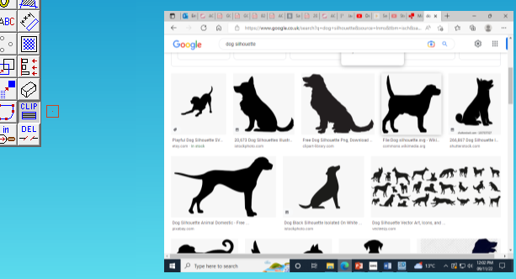
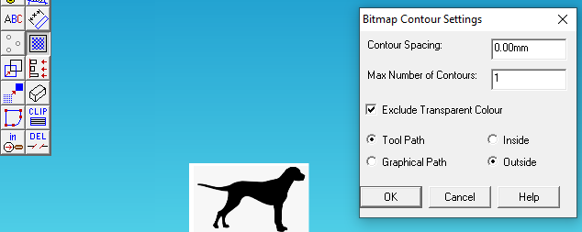
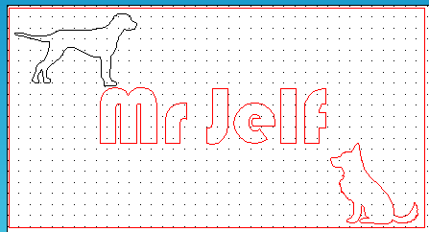
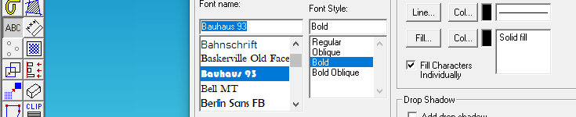
2D Design - Computer Aided Design Evidence
Example – Stick a copy of your front design over the top when complete
I used the crop tool to cut out the images I didn’t need
I used the contour bitmap tool to create a line around the outside of my shape .
I started with an image that I copied and pasted into 2D Design.
This shape is black because I want it engraved.
The lines are red because I want the shape cut out of my desk tidy front.
I used the font Bauhaus 93 because it supports the centre of the letter.

Slide 6
Homework – Stick a copy of your homework over the top when complete
In Design and Technology we would like you to understand and appreciate the work of Iconic Designers like Thomas Heatherwick
Task: You are to complete a profile on Thomas Heatherwick and at least 3 examples of his work.
Things to include:
Some information about Thomas Heatherwick
Choose at least 3 examples of his work and either draw or include an image of them. Around each include the following -
What is it?
What do you think about the FORM (the aesthetic, or appearance)?
What do you think about the FUNCTION (what it does and how it works)?
How should I present it?
On A4 paper
Remember a title and any sub-titles
Remember to support your written work with some images
Remember to put your name on your work
Homework Success Criteria
A – You have followed and included all of the “things to include” and presented your work very well by using titles, sub titles and images or drawings to support your written work. All written work must be in your own words and include your own opinions.
B- You have followed and included some of the “things to include” and presented your work well by using a title and images or drawings to support your written work. All written work must be in your own words.
C – You have followed and included few of the “things to include”. Your work may not be presented appropriately as it will be missing titles, sub titles or your name. There will be lots of information that is copied and pasted from the internet with no opinions of your own

Slide 7
Step by Step to making a Desk Tidy

Slide 8
Homework – Stick a copy of your homework over the top when complete
In Product Design we will be learning about mechanisms and using a mechanism in the back of your desk tidy.
Task: You are to investigate and explain what is a Cam.
Things to include:
1. Investigate and explain what is a Cam using the following web pages to help you.
2. Give some examples of the different shapes and effects.
http://www.technologystudent.com/cams/cam1.htm
http://www.technologystudent.com/cams/cam2.htm
http://www.technologystudent.com/cams/cam10.htm
2. Give an example of where a Cam in used in an everyday product.
How should I present it?
On A4 paper in PowerPoint
Remember a title and any sub-titles
Remember to support your written work with some images
Remember to put your name on your work
Homework Success Criteria
+ You have followed and included all of the “things to include” and presented your work very well by using titles, sub titles and images or drawings to support your written work. All written work must be in your own words and include your own opinions.
= You have followed and included some of the “things to include” and presented your work well by using a title and images or drawings to support your written work. All written work must be in your own words.
– You have followed and included few of the “things to include”. Your work may not be presented appropriately as it will be missing titles, sub titles or your name. There will be lots of information that is copied and pasted from the internet with no opinions of your own

Slide 9
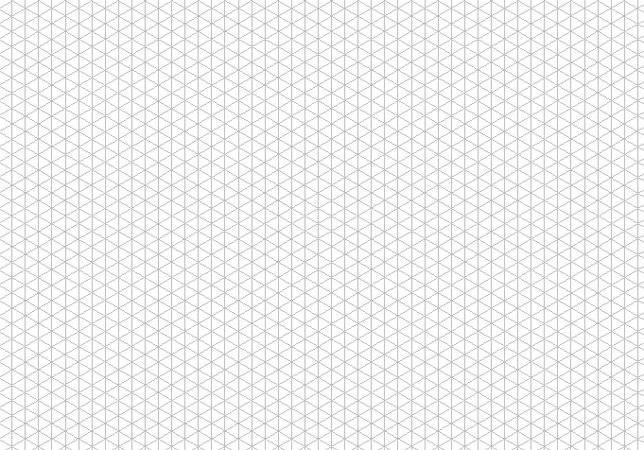
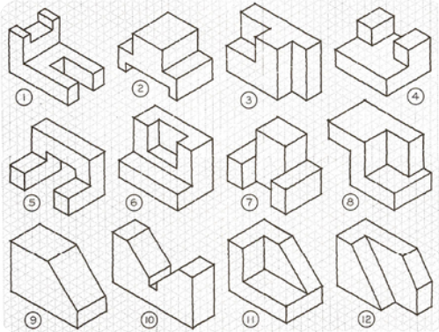
Draw the example isometric shapes 1-12 using the isometric paper to help

Slide 11
Research on Woods: Using words and diagrams explain where softwood, hardwood and manufactured woods come from
Write 2 examples of softwoods, hardwoods and man made woods in here.
8
Softwood
Draw a coniferous tree in here
Name
Characteristics
Properties
Hardwood
Draw a deciduous tree in here
Manufactured Woods
Draw how ply wood is made in here

Slide 12
Evaluation – Answer the following questions using the sentence starters to begin
1. What was the project about?
The project was about….
2. What knowledge have you learnt? Think about using Computer Aided Design (CAD) to draw the front, cutting, nailing, sanding, drilling, isometric drawing
The knowledge I have learnt is…
3. What tools and techniques have you used?
The tools and techniques I have used are…
4. What parts did you enjoy most and least?
I liked / didn’t like…
5. How could you improve your desk tidy design?
I could improve my project by….
6. What parts held you up and how did you overcome it?
I was held up by ….I overcame it by….
7. When did you need help?
I needed help when….I got help from…
8. When did you lose interest and how did you get the enjoyment back?
I lost interest when…I got more enjoyment back when….

