Slide 1
Year 7
Food Technology
Recipe Book
Name: ………………………….
Teacher: Miss McConnachie

Slide 2
Remember
When Planning for practical lessons remember the following things:
*Check the planning record for what you are cooking each lesson as it may be different from the order in this recipe book*
If you forget your ingredients you will not cook
Weigh out your ingredients at home carefully
Place high risk foods in the year 7 fridge before the lesson (e.g. milk, butter, cream, meat)
Make sure your name is on your ingredients
Place all finished products in the cool room on the year 7 shelf
Collect all food products after your last lesson finishes
You will need an appropriately sized container to take your work home in, an a bag for that to go in (where appropriate)
Your product may be hot, bring a tea towel to wrap it in (where appropriate)
Bring a hairband (where appropriate)

Slide 3
What are we making when??
Stick a copy of your
practical planning record here!

Slide 4
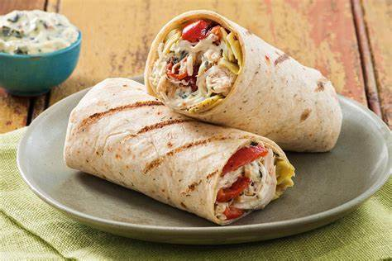
Ready to go Wraps
Equipment: Large mixing bowl, Box grater, table spoon,
metal plate, white chopping board and a small sharp knife.
Ingredients
4 tortilla wraps
8 small or 4 large slices of ham / or vegetarian alternative
¼ cucumber
4 small tomatoes
¼ carrot
40g cheddar cheese
Foil for wrapping each wrap
Method
1. Chop the cucumber and tomatoes and peel and grate the carrot.
2. Grate the cheese and add all chopped vegetables to the bowl
3. Lay out the tortillas on a flat surface
4. Place 1-2 slices of ham in the middle of each tortilla wrap
5. Divide the sliced cucumber, tomato, carrot and grated cheese between each wrap, leaving a 2cm edge at one end.
6. Starting at the other end, roll up as tightly as you can.
7. Wrap each tortilla in kitchen foil and twist the ends to seal. This will keep fresh in the fridge for up to 3 days. ☺

Slide 5
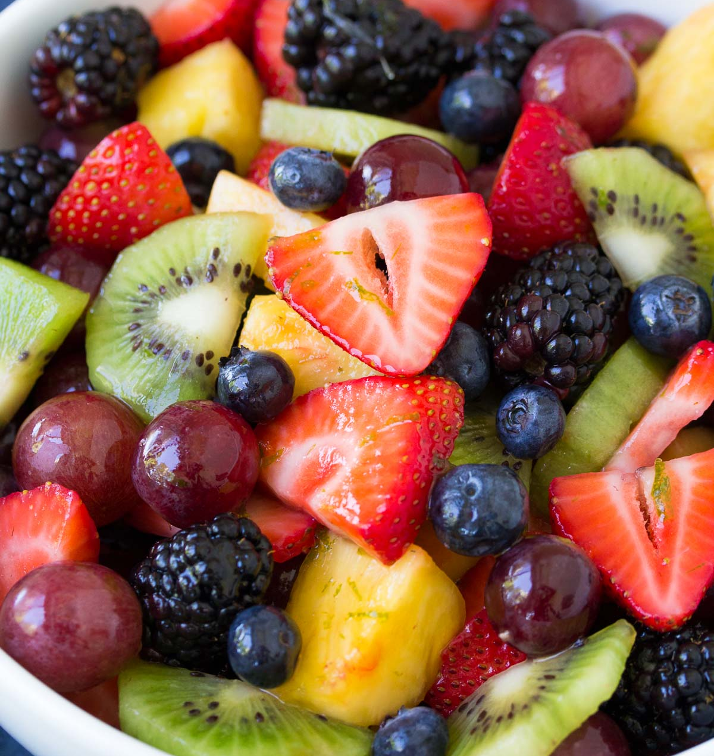
Fruit Salad
Equipment: Large mixing bowl, table spoon,
metal plate, white chopping board and a small sharp knife.
Ingredients *do not bring bananas
Please bring a selection of fruit that will fit in your container. Choose one item from each category:
A fruit with a stone: e.g. Plum / handful of cherries / peach / apricot
A fruit with segments: Tangerine / orange / Pomegranate
A berry fruit: strawberry / blueberry / blackberry / raspberry / grape
An apple: x1 eating apple (*and 1tbsp Lemon juice)
Method
1. Chop the fruit carefully following each class demonstration.
2. Place waste material on the metal plates
3. Place fruit in containers

Slide 6
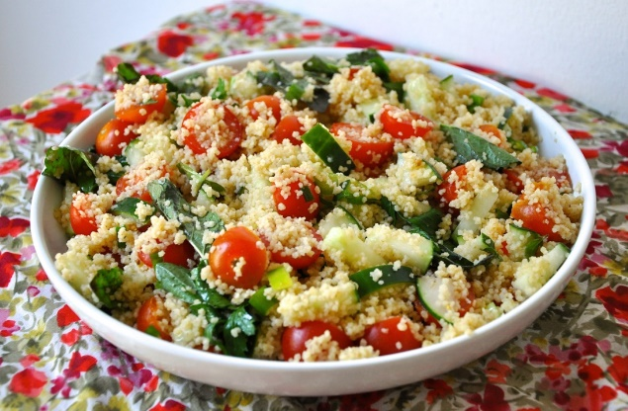
Couscous Salad
Equipment: Large mixing bowl, table spoon, measuring jug
metal plate, white chopping board, fork, and a small sharp knife.
Ingredients
350mls boiling water (provided at school)
x1 stock cube
200g Cous Cous
2 spring onions or half a red onion
½ a yellow pepper
¼ cucumber
2 medium tomatoes
2 tablespoons of fresh parsley
Method
1. Boil the kettle carefully and measure out 350mls of water, add the stock cube and mix until blended.
2. Place couscous in the large bowl and add the liquid.
3. Leave to stand for 5 minutes then fluff with a fork.
4. Chop the tomatoes, onion and cucumber into small chunks.
5. Slice the pepper into small strips.
6. Chop the fresh parsley
7. Add all the vegetables to the couscous and gently stir everything together. This will keep fresh in the fridge for up to 3 days. You can re-fresh with a spoon of olive oil ☺

Slide 7
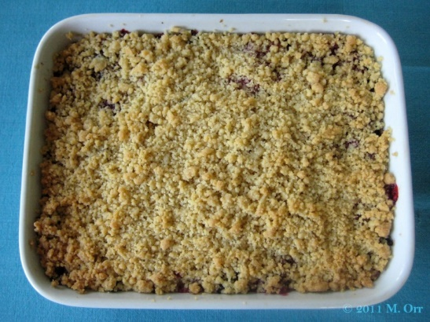
*Please bring a small/medium oven proof dish and a
tea towel to wrap it in if you are leaving with a hot crumble*
Fruit Crumble
Equipment: Ovenproof dish, baking tray, mixing bowl, sieve, tablespoon, round bladed knife, baking tray.
Ingredients: Filling
600g cooked fruit (apples / plums / blackberries /or a mixture OR a tin of pie filling.
Ingredients: Crumble topping
150g plain white flour
75g Margarine or butter
50g granulated sugar
Method
1. Re-heat oven to 200oC / Gas 6
2. Place the cooked fruit into the bottom of the oven proof dish
3. Sieve flour into a bowl. Cut margarine into small pieces and rub the flour using your fingertips until I resembles breadcrumbs.
4. Stir in the sugar.
5. Spoon the mixture onto the fruit, taking care NOT to flatten the surface of the crumble.
6. Put the dish in the oven and cook for 20-30 minutes or until golden brown.

Slide 8
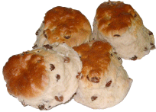
Scones
Equipment: Mixing bowl, Sieve, baking tray, Palllette knife, measuring jug, round bladed knife.
Ingredients
225g self-raising flour
50g butter / margarine
40g caster sugar
120ml milk
FLAVOURINGS: 50g dried fruit (e.g. sultanas, raisins, cherries, cranberries) or 50g cheese (do not add the sugar)
Method
1. Pre-heat oven to 200oC / gas 6. Grease a baking tray.
2. Sieve the flour into a bowl and rub in the fat until it resembles breadcrumbs
3. Stir in any flavourings e.g. fruit & sugar or cheese
4. Gradually add the milk, stirring with a knife to form a soft dough
5. Place dough onto a floured surface and roll out to a thickness of 2-3 cm
6. Cut out rounds and place on a baking tray. *You may want to wash the top with a brush and milk. Bake for 8-12 minutes until well risen

Slide 9
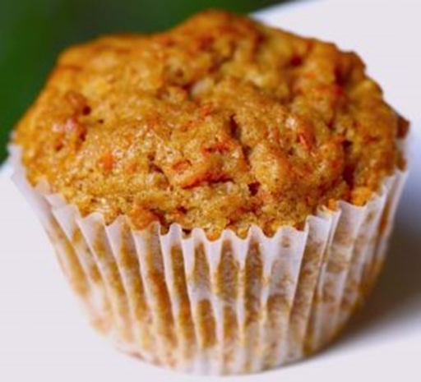
Mini Carrot Cakes
Equipment: Mixing bowl, Sieve, wooden spoon, round teaspoon, table spoon, grater.
Ingredients
100g Self-raising flour
75g butter / margarine
75g caster sugar
125g Carrots
75g Raisins
1 medium egg, beaten
1 level tsp baking powder
12 paper cake cases or 6 muffin cases
Method
Pre-heat oven to 180oC / gas 6. Grease a baking tray.
1. Peel and grate carrots on to a plate.
2. Cream the butter and sugar with a wooden spoon until light and creamy.
3.Add grated carrots
4. Sieve in flour, cinnamon and Baking powder
5. Add egg and mix well
6. Mix in dried fruit
7. Divide mixture evenly between bun cases.
Bake 15 mins until well risen and golden brown.

Slide 10
Chocolate Chip Muffins
Nb. Bicarb is x3/4 times stronger than baking powder, careful not to confuse the two.

Slide 11
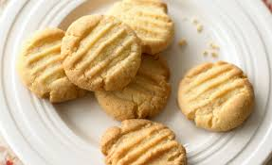
Crunchy Biscuits
Equipment: Mixing bowl, Sieve, baking tray, Pallett knife, wooden spoon, round bladed knife.
Ingredients
125g Plain flour
100g butter / margarine
50g caster sugar
FLAVOURINGS that could be used: 25g dried fruit (e.g. sultanas, raisins, cherries, cranberries) ½ tsp vanilla or almond essence, 1tsp ground ginger/cinnamon/mixe4d spice Zest or orange/lemon
Method
1. Pre-heat oven to 180oC / gas 6. Grease a baking tray.
2. Cream the butter and sugar with a wooden spoon until light and creamy.
3. Add flour and flavourings and mix to a dough.
4. Divide mixture into 8 even sized pieces
5. Flatten out on baking tray
6. Place in Oven and cook for 10-15 mins. Until golden brown.

