Slide 1
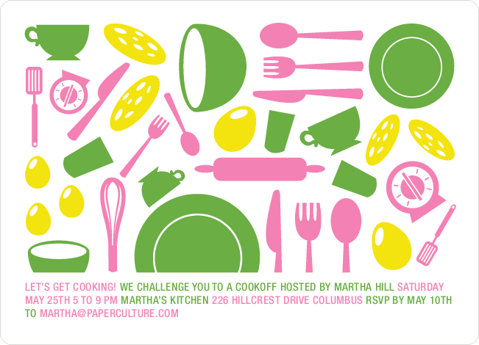

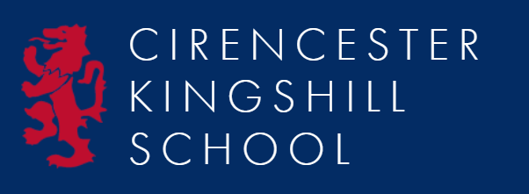
Food Technology
Year 7
Workbook
Name: …………………………….…..
DT Group:…………………………….
Pathway: ……………………………….
Teacher: Miss McConnachie

Slide 2
What we are cooking and why
Throughout their practical cooking experiences, the students will be working towards GCSE standards when it comes to their practical skills.
We think it is important that the students practice these skills from the very start as it will enable them to become more confident and efficient when preparing and cooking food at school and at home.
Overleaf there is a table showing the 20 skills, which commodity (food item) the students will be using, the food science that takes place when cooking and the name of the dishes that these skills will be used in.
Below you will find the key to the table:
Commodity – which food group does the main ingredients belong to.
Food science – what causes this to happen? Why does it happen?
Practicals – what dishes are being made.

Slide 3
The 20 skills of Food preparation and Nutrition
 | Year 7
Knife Skills | Fruit & vegs/cereals
1 & 2 | Oxidation
 | Fresh fruit salad/crumble/
 | carrot cakes/wraps
Shaping skills | Cereals/flour
3 | Chemical/mechanical aeration
 | Scones/wraps
Tenderise & marinate | N/A
4
Select & adjust | Fruit/cereal
a cooking process | Convection/conduction
5 | Scones/fruit crumble/carrot cakes
Weigh & measure | All commodities
 | Accurate weighing & measuring
 | All dishes
Preparation of | All commodities
equipment | Ensure equipment is safe to use
7 | Scones
Use of equipment | All commodities
mixer, and microwave | Ensuring safety at all times
blender/food processor
8
Water-based methods | N/A
using the hob
9
Dry heat & fat-based | N/A
methods using the hob
10
Using the grill | N/A
11
Using the oven | Fruit & cereal
12 | Convection
 | Crumble/carrot cakes/
 | biscuits
Make sauces | N/A
13
Set a mixture- gelation | N/A
gelation
14
Set a mixture - | N/A
coagulation
15
Use of raising agents | Cereals/fruit & vegs
16 | Chemical & mechanical aeration
 | Carrot cakes/scones
Make a dough | Cereal
17 | Chemical & mechanical aeration
 | Scones
Shaping & | Cereal
finishing a dough | Chemical & mechanical aeration
18 | Scones
Test for readiness | All commodities
19 | Establish if food is safe to eat
 | Crumble/scones/biscuits/
 | carrot cakes
Judge & manipulate | All commodities
sensory properties | Tasting & seasoning
20 | All dishes

Slide 4

Food Technology
Pupils must communicate what and when they are cooking with the person who completes the food shopping in advance each week.
The majority of lessons require pupils to weigh out the ingredients prior to lessons as part of their homework
What to bring to school (general):
Your pencil case
Your planner (if applicable)
Your recipe booklet
What to for a practical lesson (specific):
  Your ingredients
  A container to take your food home in
  Maybe a dish or tin to cook your food in
When you get to school:
On days when you have a practical lesson you must take your ingredients to the food room before registration
Place high risk food in the fridge and dry ingredients in the cool room.
After your practical lesson you must leave your food product in the food room and collect it after afternoon registration.
Written work and Practical Assessment
Marking criteria:
Pay attention to mark schemes, they will list desirable features for you to consider including to get the best grades.
Assessment
Self and peer assessments via evaluations including rating scales, discussions (e.g. organisation, safety, hygiene)
Teacher: Pupils will be marked according to their DT pupil specific pathway ( Foundation / Secure / Confident / Exceptional; found at the back of this booklet) and whether they are below at or above their expected level of progress (+ = - )
Support
Pupils are supported physically in class with demonstrations and PowerPoint materials. Support with writing can be shown by sentence starters, symbols, images as well as explanations of key words. Numeracy supported through weighing out ingredients.
Extension work:
These are extra tasks you can choose to do if you want to show you can stretch your knowledge
Recognising Success
Chef of the week:
Each practical either one or two pupils from the whole group will be selected by the teacher or teaching assistant as being exceptional at a part of their practical. They will receive the honour of wearing the chefs hat for the remainder of the lesson.
1

Slide 5
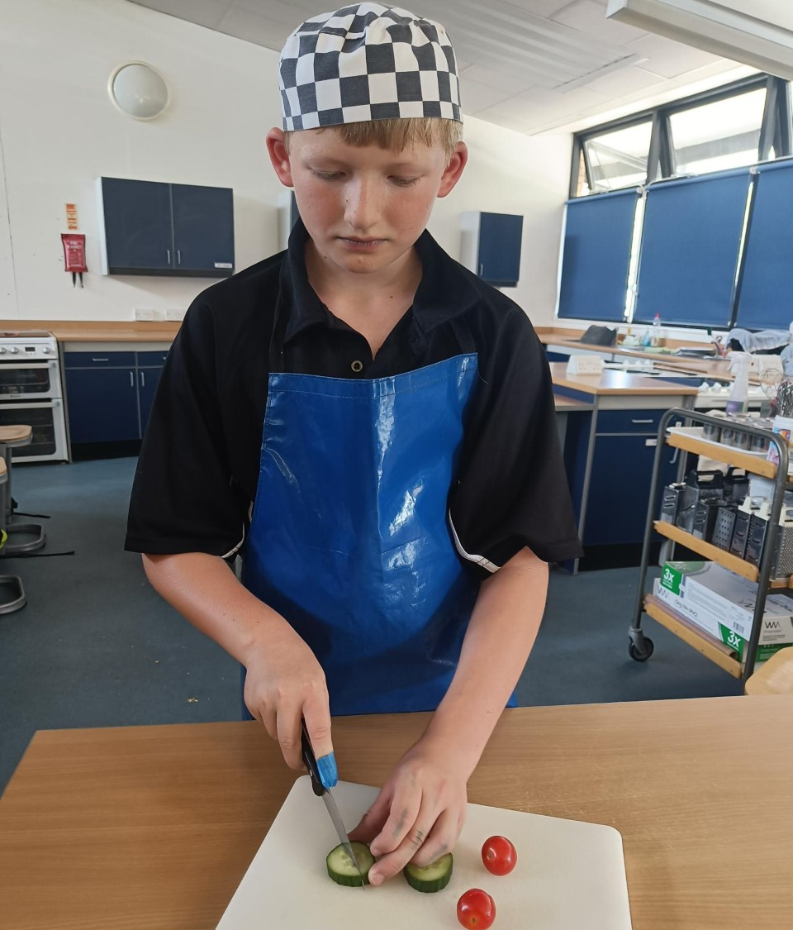
Working in the Food Technology Room
To keep us safe and the food we prepare safe to eat, we must remember the following:
Always tie long _ _ _ _ back
Always wear a _ _ _ _ _ apron
Remove any
_ _ _ _ _ _ _ _ _
Always _ _ _ _ your hands
Always cover any cuts or grazes with a _ _ _ _ plaster
Poster Design Task
Choose one of the above points to create a poster to remind pupils of the importance of rules in
the technology area. Draw in pencil, colour in pencil, outline in pen. *See mark scheme.
WWW: Neatness, clear message, use of space, original, drawing skills, creativity, enthusiasm
Other:
EBI: Neater, clearer writing, clearer message, better placement or ideas, neater rendering,
Other:
*Teacher’s Mark Scheme:
On target?
+ = -
2

Slide 6

Safety in the Food Technology Room
Each year many thousands of people are injured through accidents. Many of these accidents could be prevented. You can help prevent accidents by thinking carefully about how you and your team can work safely in the kitchen.
Where are the possible danger areas in the food room?
1.
4.
2.
5.
3.
6.
Read through the following rules and explain why you think they are important.
a) Make sure all bags and stools are placed out of the way
b) Walk, don’t run
c) Beware of spilt food
d) Do not leave saucepan handles, knives or glass bowls dangerously over the edge of a surface or cooker
e) Always use dry oven gloves when handling hot dishes
3

Slide 7
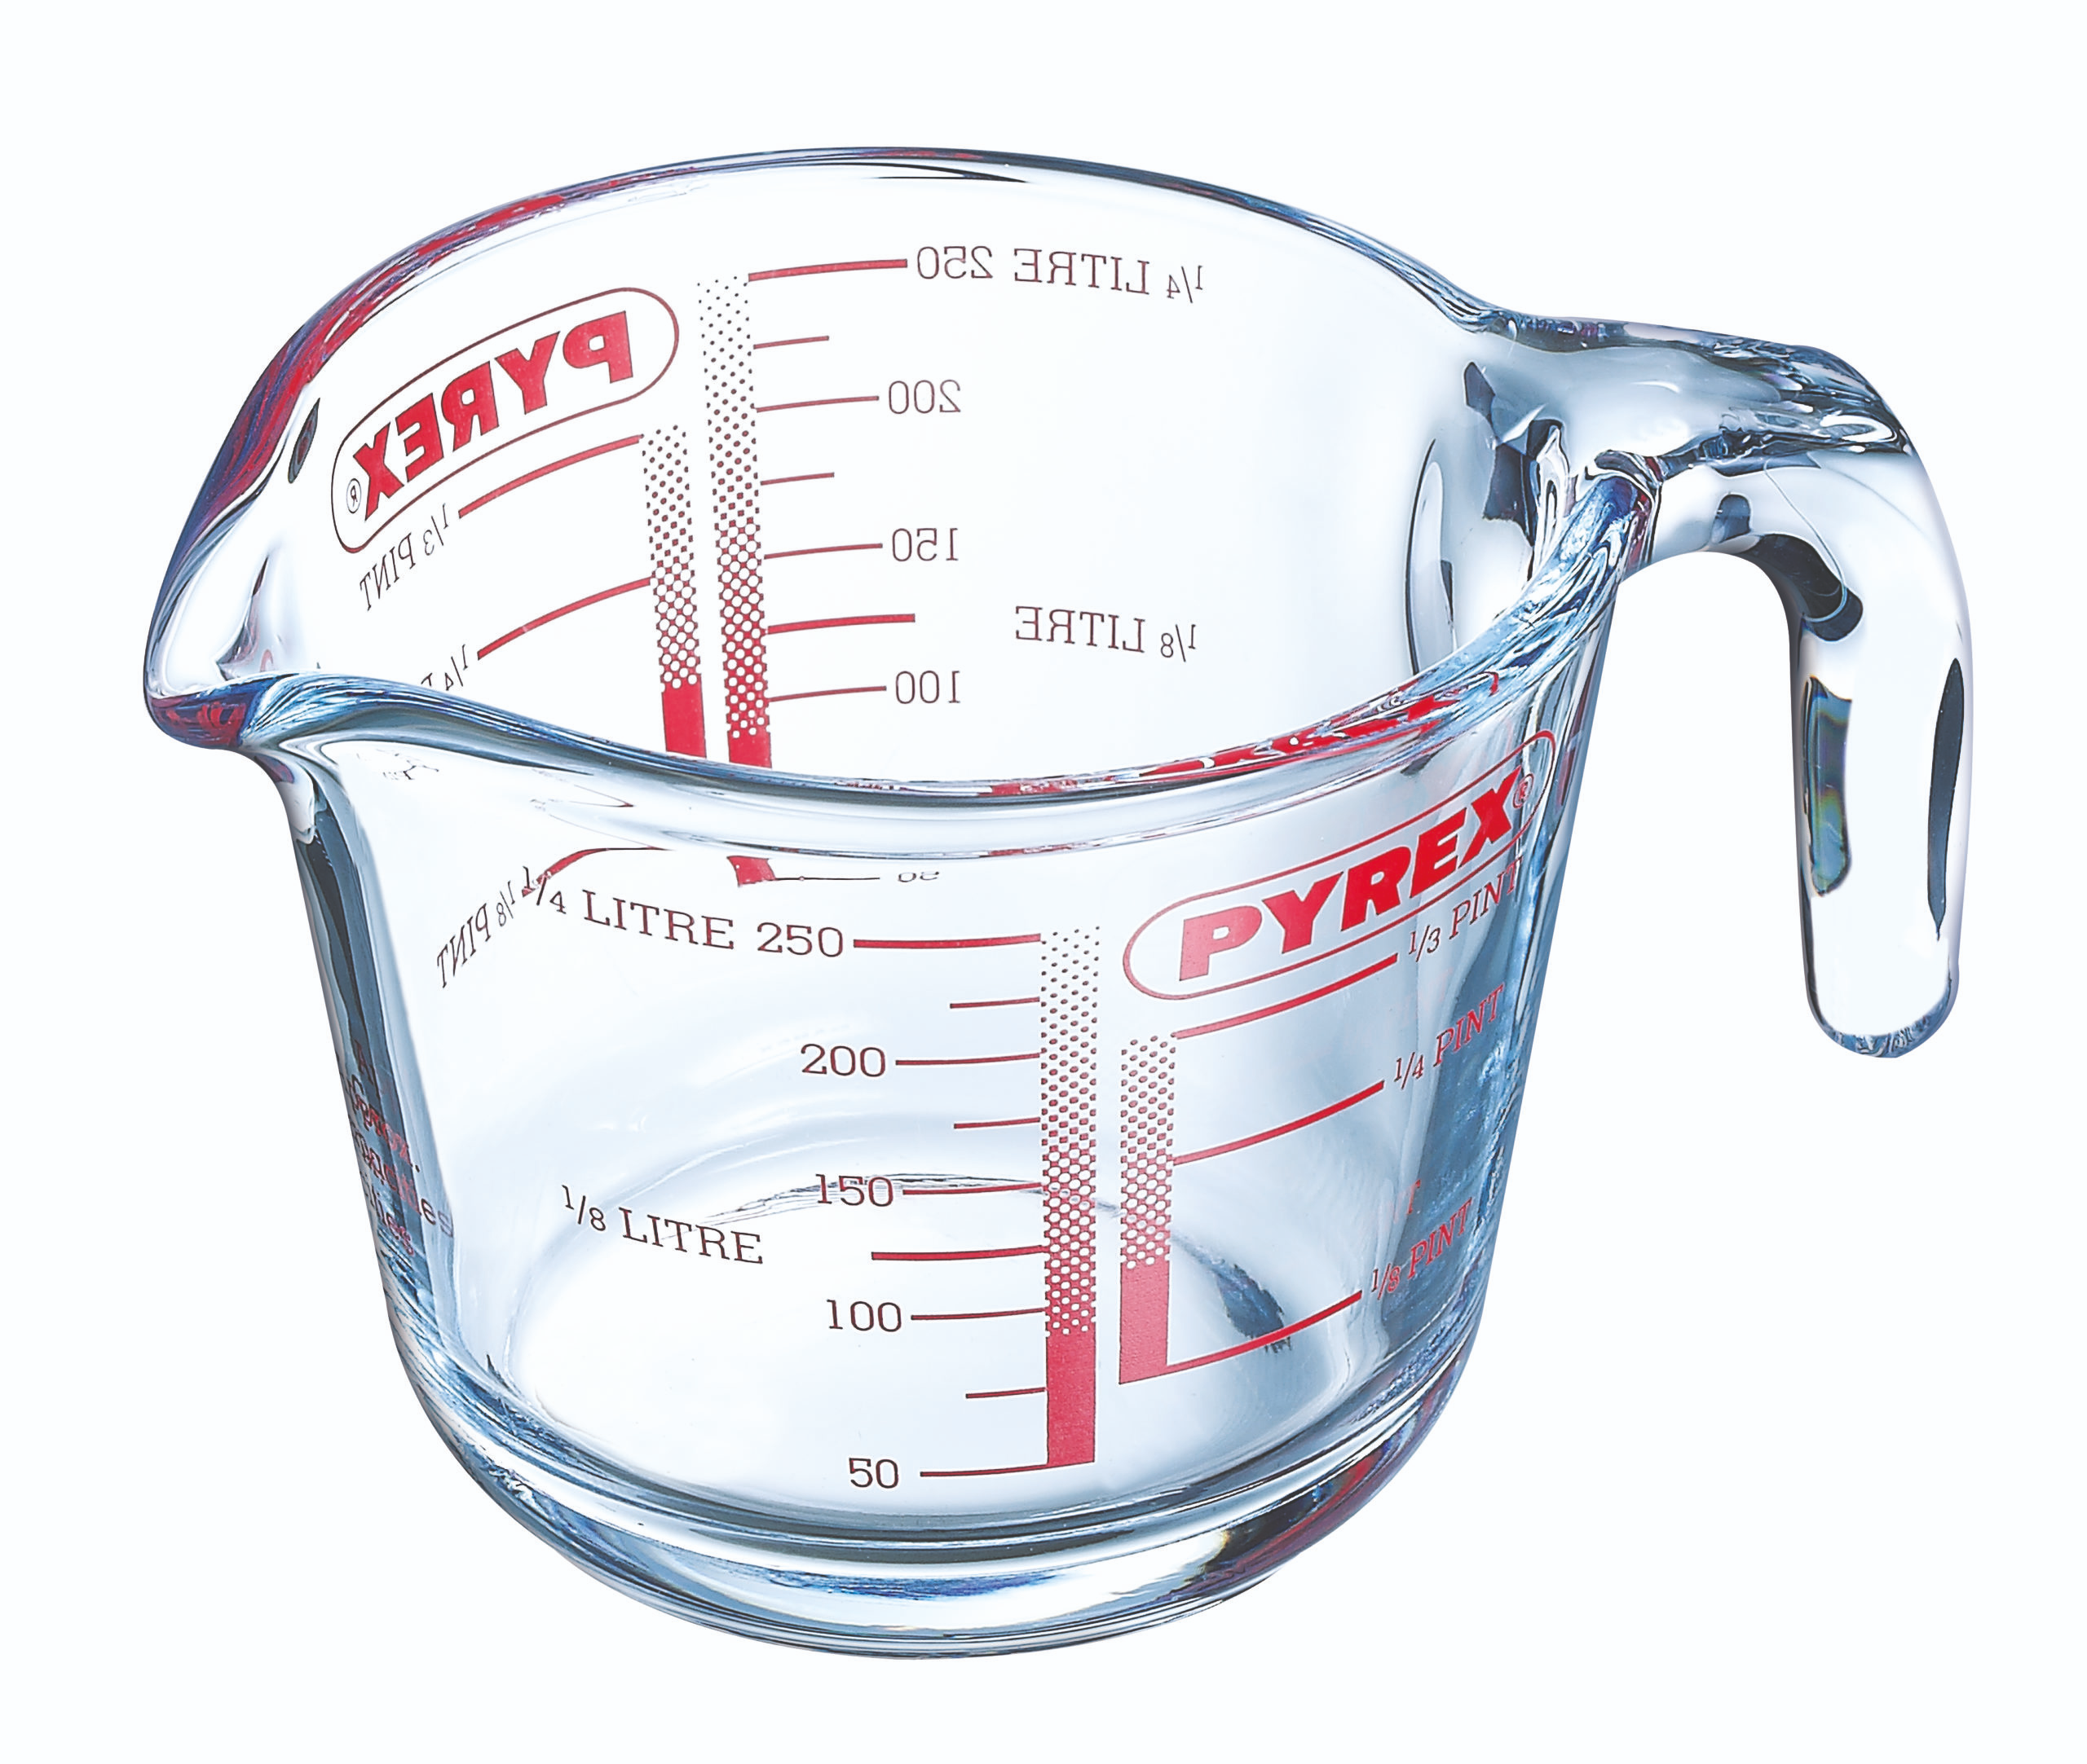
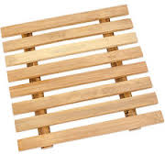
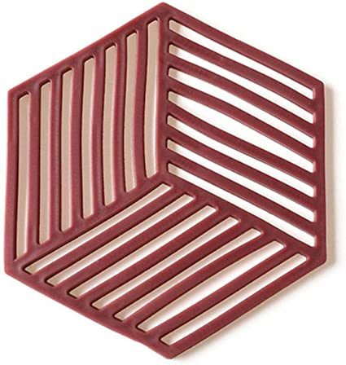
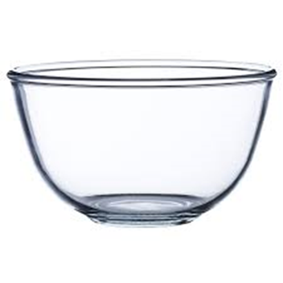
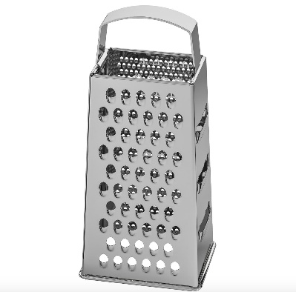
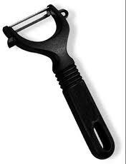
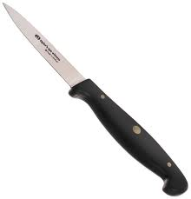
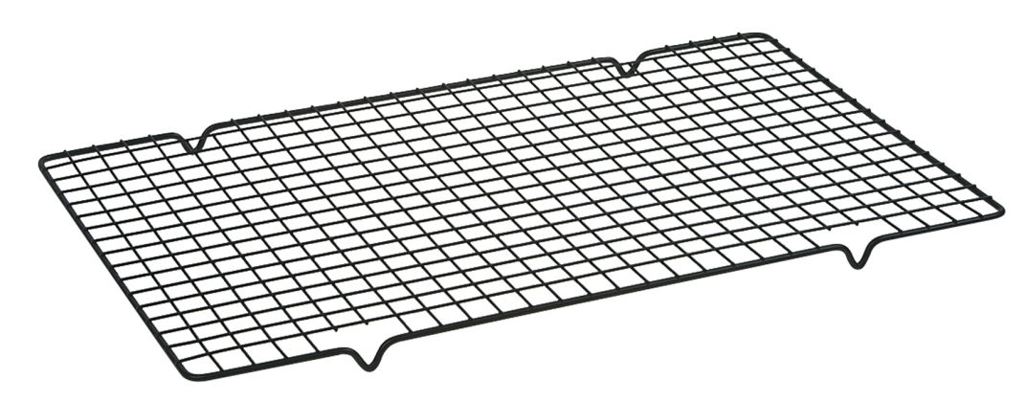
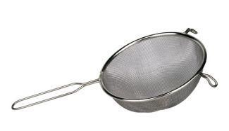
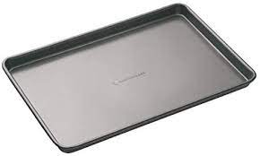
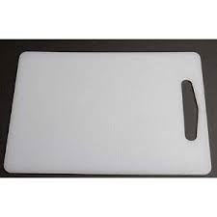
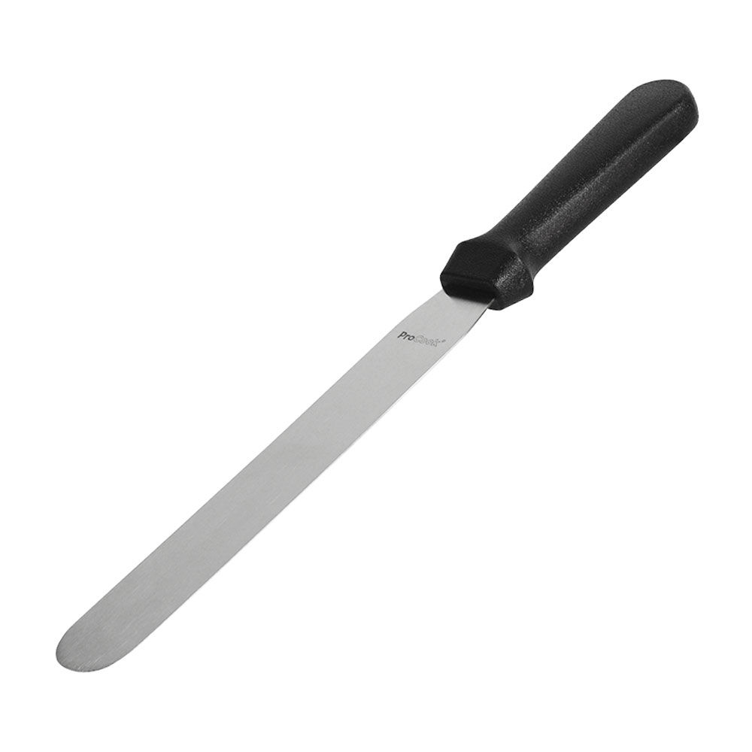
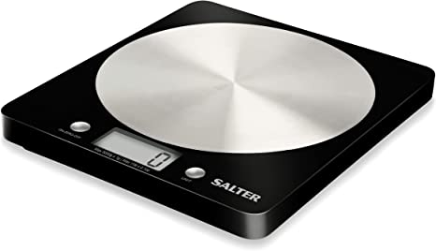
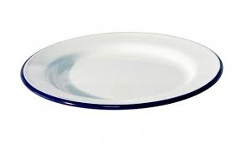
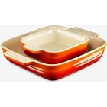
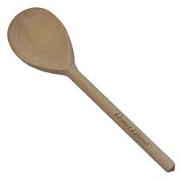
Equipment
Peer assessed by:
Score:
/15
In the food room you will use a range of equipment.
Can you identify the following pieces of equipment?
or
Extension: What Where How Why
a)Mark the items you have uses before with a *
b) I have also used other equipment found in the kitchen, such as:
4

Slide 8
Complete the sentences:
Using the words in the table below, complete the following sentences:
Measuring jug | Chef’s knife | Wooden spoon | Sieve | Spatula
Scales | Grater | Chopping board | Vegetable peeler | Cooling rack
A _____________________ to chop ingredients.
Vegetables should be peeled using a _____________________ not a chef’s knife
To measure 150ml of milk you would use a __________________________
To measure 150g of flour you would use a ___________________________
To mix ingredients in a bowl you would use a ________________________
To grate cheese or a carrot you would use a ________________________
To remove lumps from flour to aerate the flour you would use a ________________________
To cool baked foods such as scones you would put food on a _____________________________
Equipment Wordsearch
s | A | u | c | e | p | a | n | d | t
c | k | r | o | f | z | s | s | o | i
t | r | s | l | i | c | s | o | m | N
e | e | k | a | l | w | o | b | o | S
v | t | a | n | r | e | b | e | u | Y
e | t | j | d | i | a | h | b | l | a
i | u | u | e | z | f | l | a | d | R
S | c | g | r | a | t | e | R | s | t
n | i | p | g | n | i | l | l | o | R
j | a | b | s | p | a | t | u | l | a
Extension: What Where How Why
a)Why shouldn’t you put something hot on a wooden or plastic surface?
b) what is a ‘ml’?
c) What is a ‘g’
d) What is a ‘tsp’?
e) What is a ‘tbsp’?
5

Slide 9
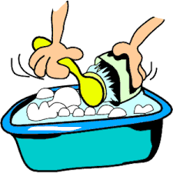
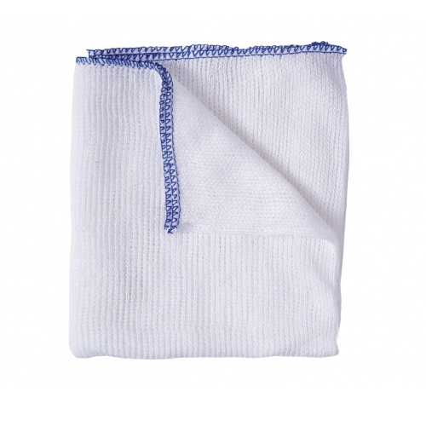
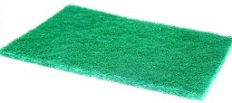
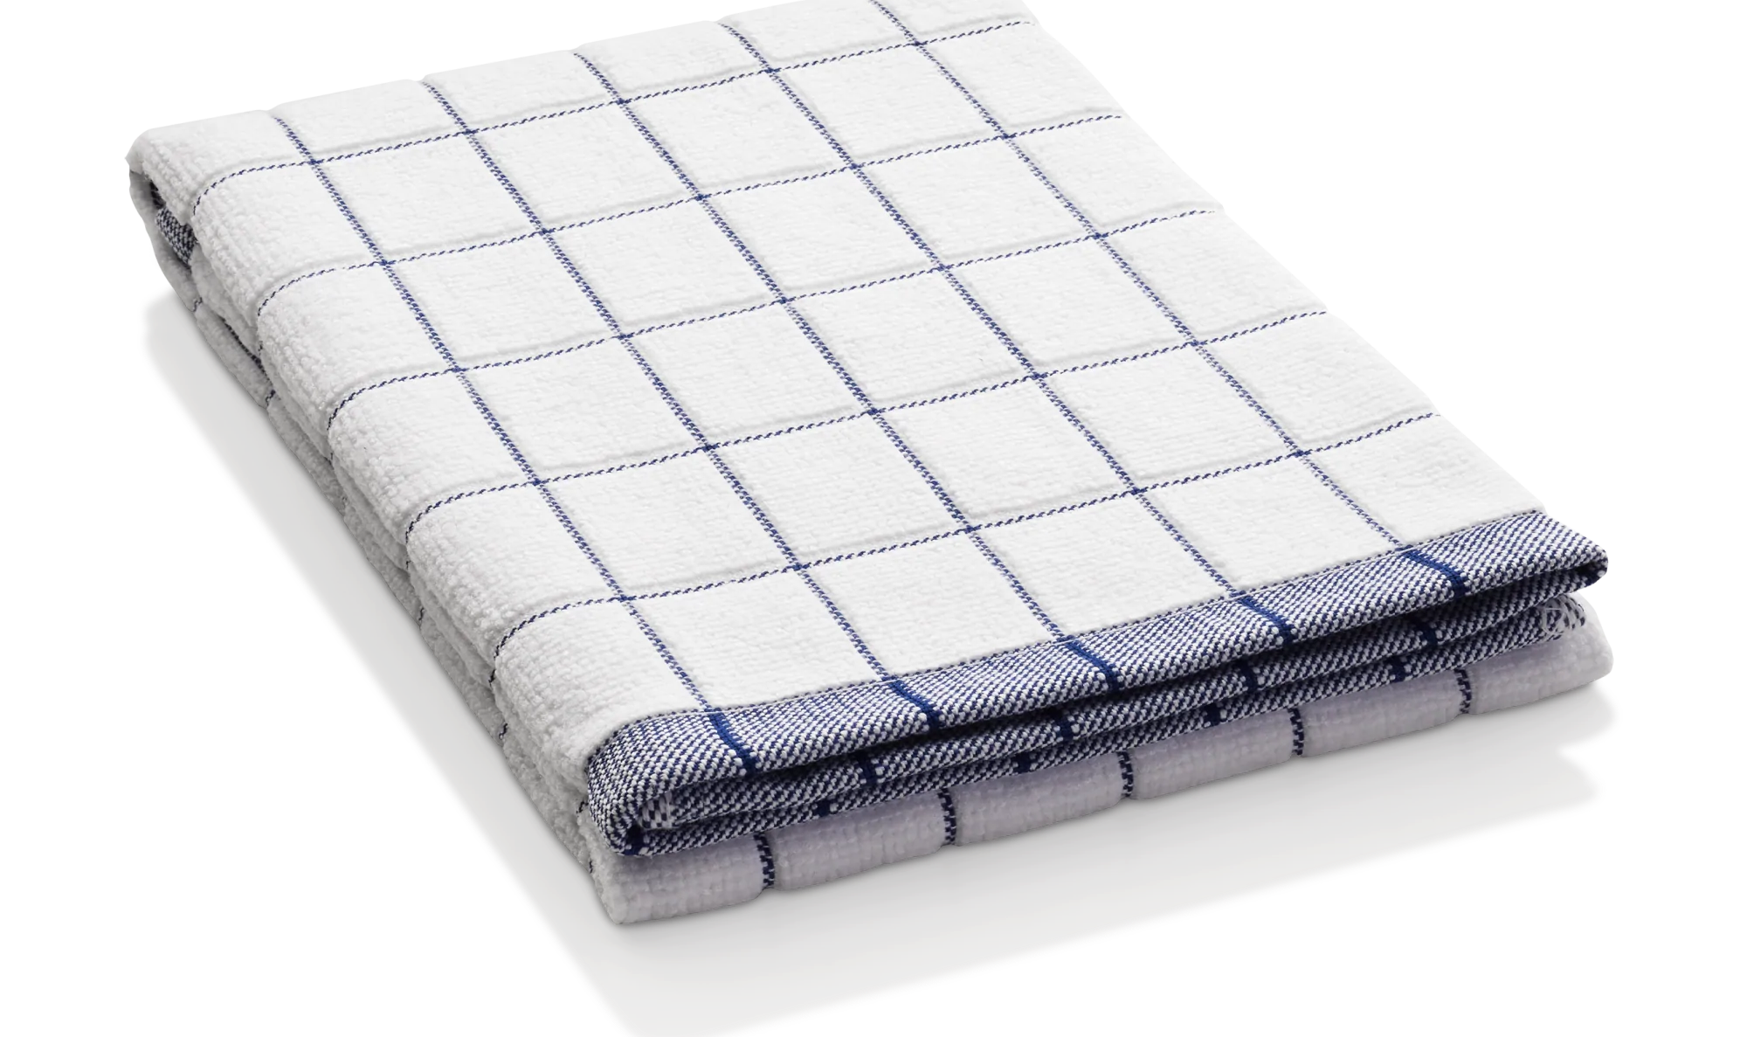
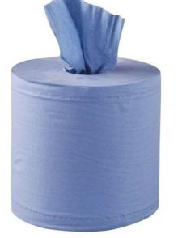

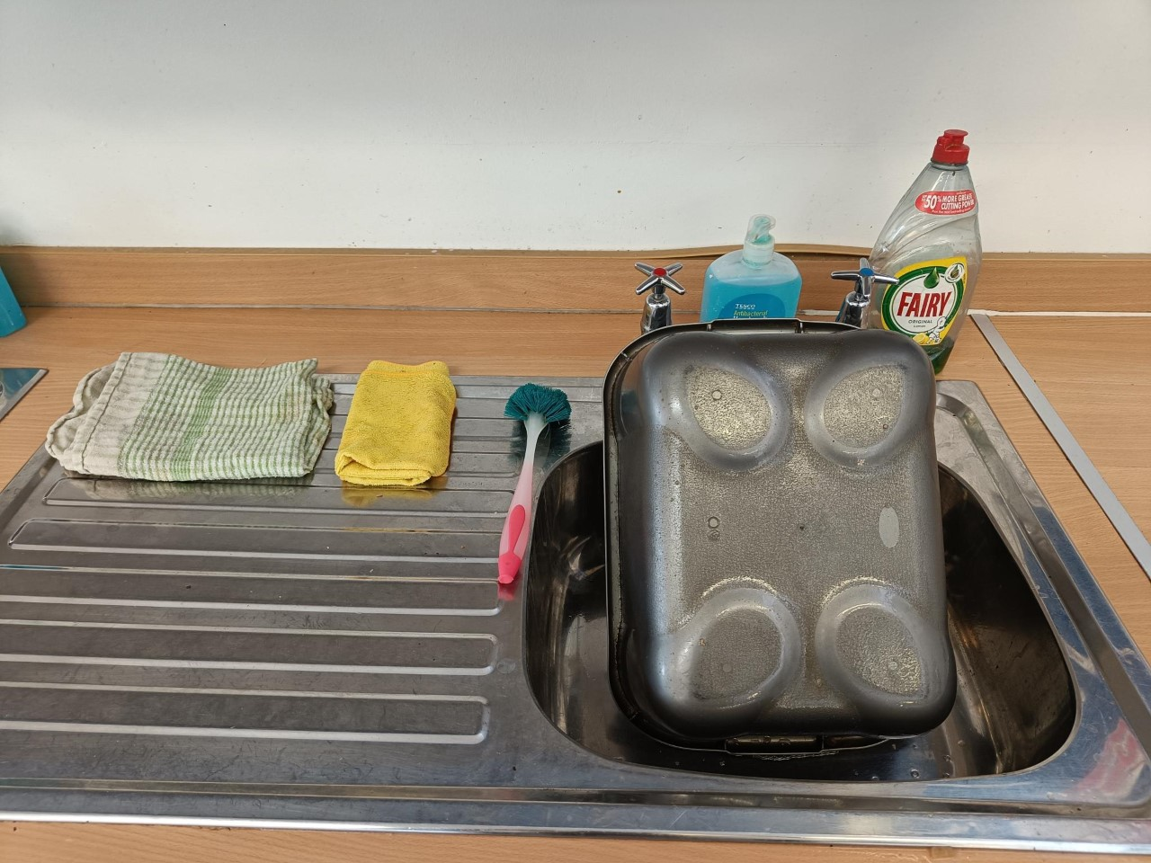
Washing up
A very important part of cooking is washing up, and it is essential that it is done properly.
Always wash up with HOT soapy water.
The hot water loosens the food particles and the detergent helps emulsify grease
1. It is important to wash dishes in the correct order, cleanest dishes should be washed first because…..
A dishcloth is used for washing surfaces and dishes
A green scourer is for scrubbing pans and baking trays
Tea towels are used for drying dishes
Blue paper towel is for drying hands or mopping up small floor spillages
a
b
c
Complete the sentences:
d
Using the words in the table below, complete the following sentences:
Cloth | Glassware | Scourer | Tea towel
Hot water | Cloth | Soak | Sink
Knives | Upside down | Detergent | Blue paper towel
To wash up you will need:
_____________________ and a _________ to remove grease and loosen food
A _____________________ to remove stubborn foods
A ________________to wipe tables
A _________ to wipe equipment in the soapy water
A ______________ to dry the dishes
Stack up all of he dirty equipment at the side of the _____________
_____________ to dry your hands
Fill saucepans and cooking dishes with water to leave to _____________
Wash the _______________and cutlery first so they do not smear
Do not put ____________ into the washing up bowl as you cannot see them
Drain the dishes _____________________ on the draining board
Wipe all work surfaces with a __________ wrung in hot soapy water
A sink should be left clean and dry.
No food scraps at the bottom of the sink or plug hole
The washing up bowl and detergents put away neatly
6

Slide 10
Washing up Homework
Please stick in your photo/s on this page and describe what you did
Self Assessment
WWW: preparing the area, remembering the steps, independent, using the right equipment, being tidy,
Being efficient, using hot water,
Other:
EBI:
7

Slide 11

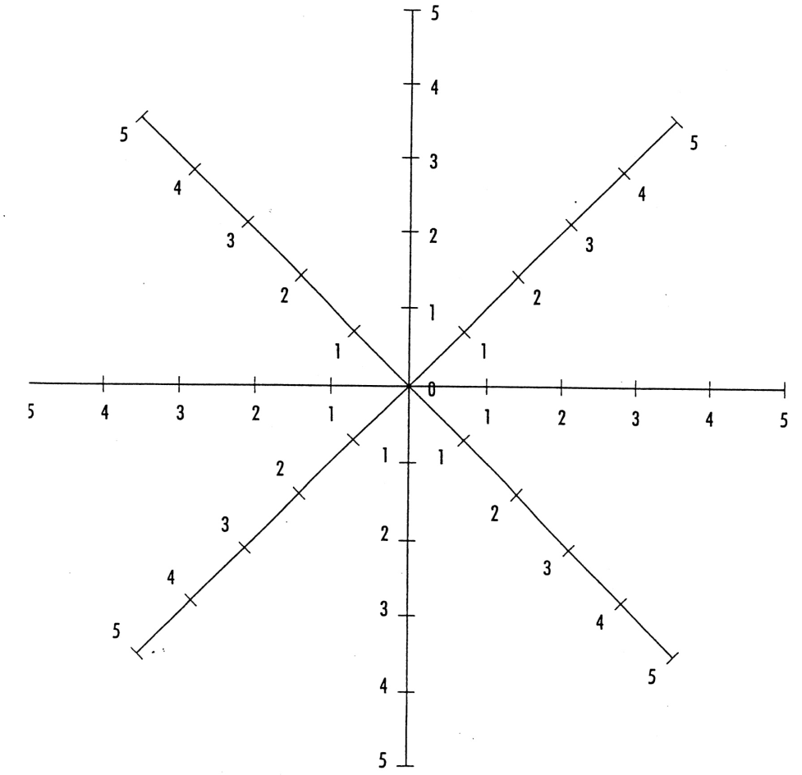

Evaluation of: __________ _________
1. Use the key below to mark your numbers on the Star Diagram; and then join up the points (like a spider’s web)
Key:
5 - best
4 - good
3 - average
2 - not so good
1 – worst
Made safely and hygienically?
Flavouring
choice?
Method completed effectively?
Consistent
shape?
Appeal to target market?
Colour: Light
golden brown?
All fit on one tray?
Texture:
crunchy outside/softer inside?
2. Grade yourself 1-5 in the blank areas for these categories
Organisation | Have all of my ingredients? | Have all my ingredients weighed out ready | Tidy work area (e.g. no bags) | Recipe to follow | How much help did I need? | Container to take the products home in?
Key:
5 - best
4 - good
3 - average
2 - not so good
1 - worst
N/A - not applicable
(doesn’t apply)
Safety | Used oven gloves | Pre-heated oven to the correct temperature | Stood to one side of the oven | Hot trays not put on surfaces | Pan handles in | Used equipment safely
Hygiene | Hair | Hands | Apron | Surface clean before use | Washing up | Not wiped on clothing | Surface clean after use
3. What do you think was the best thing about your product?
4. How could you improve the product:
8

Slide 12
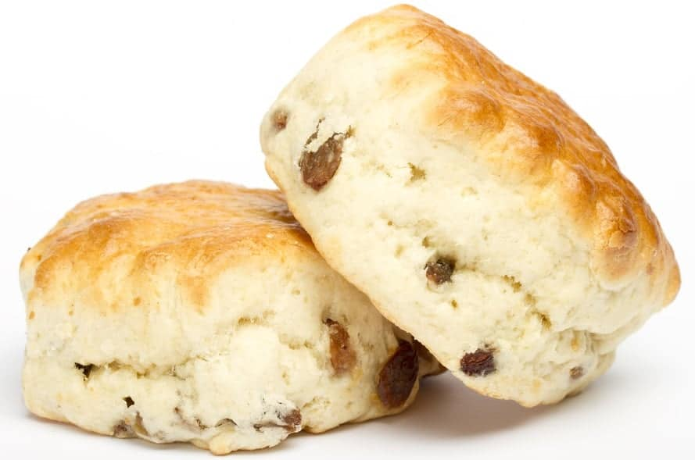
Design Challenge
Context
Your class has been asked by a local bakery to design and trial types of healthy scones that will help customers celebrate important times of the year. The design of the scones needs to consider healthy guidelines and should include two healthy ingredients/flavourings. You will be expected to use students at school and family members to test your ideas.
Design Brief
To design and make a ____________ scone. The scone will appeal to the ________________ and be suitable to be sold in a ______________. The scone will be used to ________________ important times of the year.
Healthy and not healthy ingredient example suggestions:
Healthy ingredients:
Vanilla essence
Sultans
Cinnamon
Mixed spice
Chives
Orange
Chilli
Rocket
Blueberry
Aubergine
Not very healthy ingredients*
Chocolate chips
Glace cherries
Cheese
Bacon
* some ingredients on this list are higher in fat or sugar which doesn’t always mean they are unhealthy
Add to the following mind map suggesting different types of celebrations:
Birthdays
Celebrations
9

Slide 14
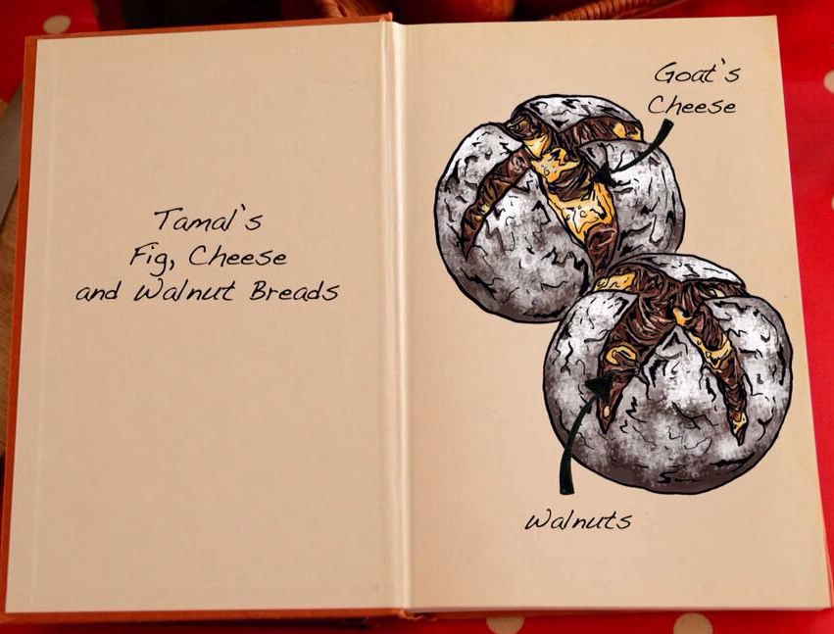
Design Ideas: Scones
Draw four different flavour combination ideas for your scones
  Draw in pencil
  Colour in pencil
  Outline in pen
Using the information on the previous page, annotate (label)
each one, commenting on:
  Shape
  Texture
  Flavour
  Target group
  Chosen celebration
  Method pf making
Real life example design idea from the British bake off illustrator Tom Hovey showing an annotated bun design
Possible Flavour Ideas
Cinnamon & apple
Coconut and lime
Mango and Chili
Cheese and bacon
Cheese and onion
Cheese and pineapple
Peanut Butter and Chocolate
Chocolate and orange
Raspberry and chocolate
Chocolate and mint
Caramel and vanilla
Cinnamon & raisin
Design Idea 1:
Design Idea 2:
  Shape:
  Texture:
  Flavour:
  Target group:
  Chosen celebration:
  Method of making:
  Shape:
  Texture:
  Flavour:
  Target group:
  Chosen celebration:
  Method of making:
Design Idea 3:
Design Idea 4:
  Shape:
  Texture:
  Flavour:
  Target group:
  Chosen celebration:
  Method of making:
  Shape:
  Texture:
  Flavour:
  Target group:
  Chosen celebration:
  Method of making:
WWW: Neatness, clear message, use of space, original, drawing skills, creativity, enthusiasm
Other:
EBI: Neater, clearer writing, clearer message, better placement or ideas, neater rendering,
Other:
On target?
+ = -
10
1

Slide 15
Evaluation of: __________ _________
1. Use the key below to mark your numbers on the Star Diagram; and then join up the points (like a spider’s web)
Key:
5 - best
4 - good
3 - average
2 - not so good
1 – worst
Made safely and hygienically?
Flavouring
choice?
Method completed effectively?
Consistent
shape?
Appeal to target market?
Colour: Light
golden brown?
All fit on one tray?
Texture:
crunchy outside/softer inside?
2. Grade yourself 1-5 in the blank areas for these categories
Organisation | Have all of my ingredients? | Have all my ingredients weighed out ready | Tidy work area (e.g. no bags) | Recipe to follow | How much help did I need? | Container to take the products home in?
Key:
5 - best
4 - good
3 - average
2 - not so good
1 - worst
N/A - not applicable
(doesn’t apply)
Safety | Used oven gloves | Pre-heated oven to the correct temperature | Stood to one side of the oven | Hot trays not put on surfaces | Pan handles in | Used equipment safely
Hygiene | Hair | Hands | Apron | Surface clean before use | Washing up | Not wiped on clothing | Surface clean after use
3. What do you think was the best thing about your product?
4. How could you improve the product:
11

Slide 16
Evaluation of: __________ _________
1. Use the key below to mark your numbers on the Star Diagram; and then join up the points (like a spider’s web)
Key:
5 - best
4 - good
3 - average
2 - not so good
1 – worst
Made safely and hygienically?
Flavouring
choice?
Method completed effectively?
Consistent
shape?
Appeal to target market?
Colour: Light
golden brown?
All fit on one tray?
Texture:
crunchy outside/softer inside?
2. Grade yourself 1-5 in the blank areas for these categories
Organisation | Have all of my ingredients? | Have all my ingredients weighed out ready | Tidy work area (e.g. no bags) | Recipe to follow | How much help did I need? | Container to take the products home in?
Key:
5 - best
4 - good
3 - average
2 - not so good
1 - worst
N/A - not applicable
(doesn’t apply)
Safety | Used oven gloves | Pre-heated oven to the correct temperature | Stood to one side of the oven | Hot trays not put on surfaces | Pan handles in | Used equipment safely
Hygiene | Hair | Hands | Apron | Surface clean before use | Washing up | Not wiped on clothing | Surface clean after use
3. What do you think was the best thing about your product?
4. How could you improve the product:
12

Slide 17
Evaluation of: __________ _________
1. Use the key below to mark your numbers on the Star Diagram; and then join up the points (like a spider’s web)
Key:
5 - best
4 - good
3 - average
2 - not so good
1 – worst
Made safely and hygienically?
Flavouring
choice?
Method completed effectively?
Consistent
shape?
Appeal to target market?
Colour: Light
golden brown?
All fit on one tray?
Texture:
crunchy outside/softer inside?
2. Grade yourself 1-5 in the blank areas for these categories
Organisation | Have all of my ingredients? | Have all my ingredients weighed out ready | Tidy work area (e.g. no bags) | Recipe to follow | How much help did I need? | Container to take the products home in?
Key:
5 - best
4 - good
3 - average
2 - not so good
1 - worst
N/A - not applicable
(doesn’t apply)
Safety | Used oven gloves | Pre-heated oven to the correct temperature | Stood to one side of the oven | Hot trays not put on surfaces | Pan handles in | Used equipment safely
Hygiene | Hair | Hands | Apron | Surface clean before use | Washing up | Not wiped on clothing | Surface clean after use
3. What do you think was the best thing about your product?
4. How could you improve the product:
13

Slide 18
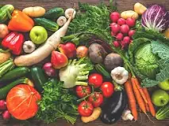
Fruit and Vegetables
A fruit develops from the flower of a plant. Fruits contain seeds
Vegetables develop from other parts of the plant: can consist of roots, stems and leaves
1. List or draw your answers in the boxes below:
Red fruit
Yellow/Orange fruit
Green fruit
Red vegetables
Yellow/Orange vegetables
Green vegetables
2. Complete research and then answer the questions below.
(possible sources: internet / books / the teacher power-point)
Answers:
1 | How many portions of fruit and vegetables are we recommended eating daily?
2 | Can we count potatoes as one of our daily portions?
3 | How many glasses of fruit juice can we include in our 5 portions?
4 | We are recommended to eat fresh fruits and vegetables. What other varieties of fruits and vegetables can we also include in our 5 a day?
5 | Why should we eat a ‘Rainbow’ of fruits and vegetables?
6 | Give 3 examples of citrus fruits | 1. 2. 3.
7 | Citrus fruits are important sources of which vitamin? | Vitamin
8 | Why should we eat skins of fruits and vegetables?
9 | Why should we use a peeler to remove any skins rather than a knife?
10 | Is a tomato a fruit or a vegetable?
14

Slide 19
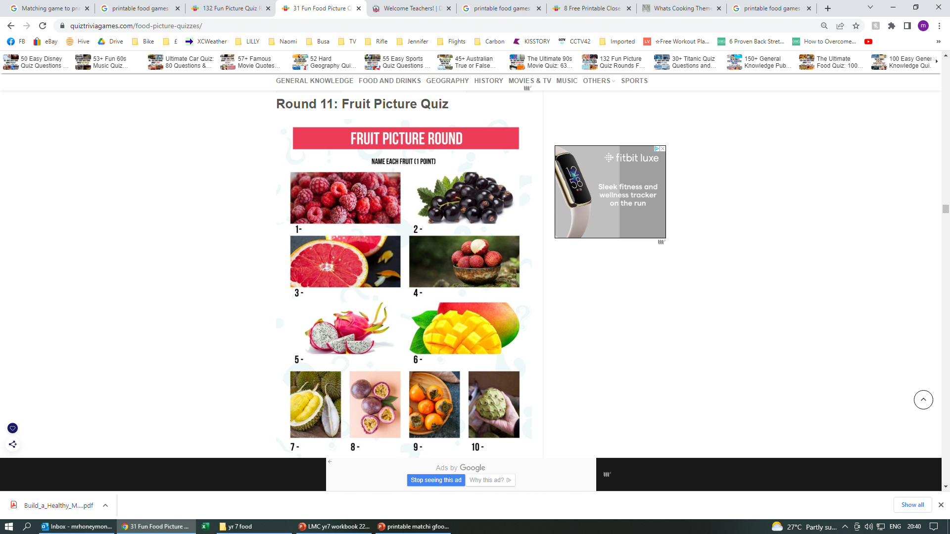
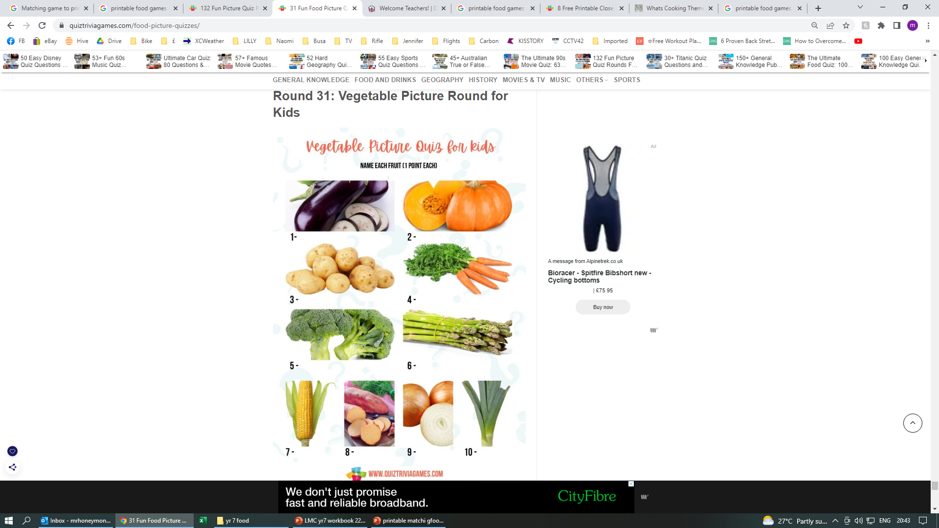
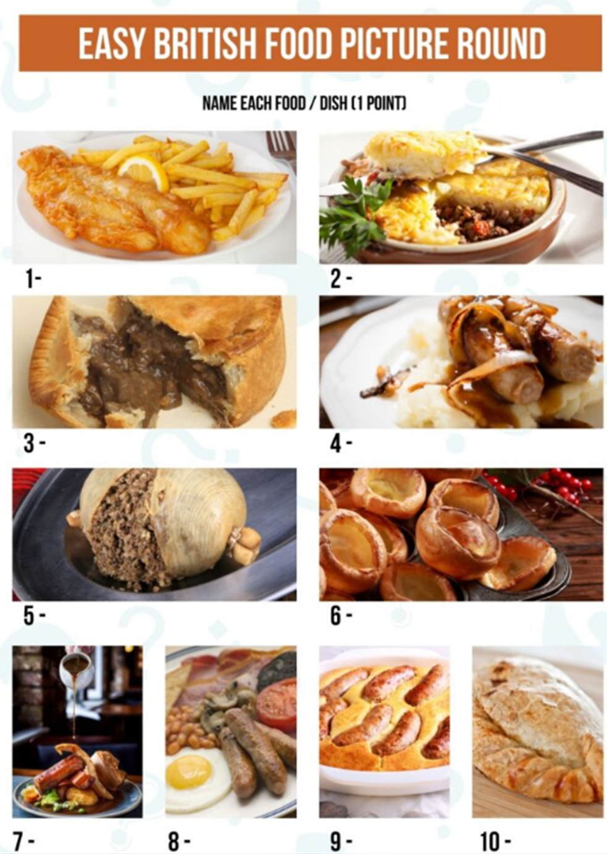
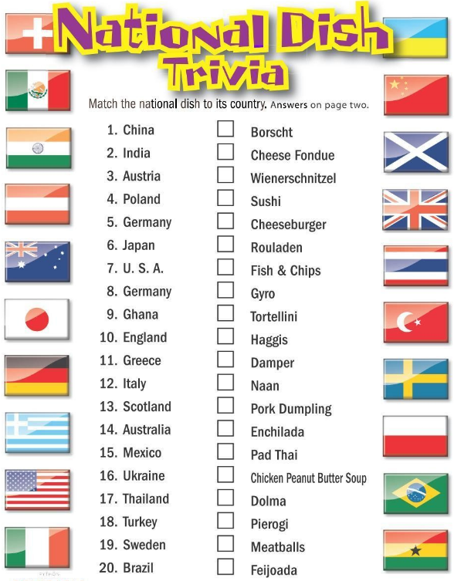
Quiz Time!
15

Slide 20
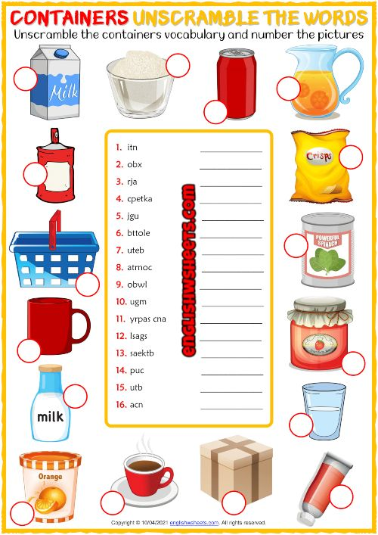
Word Scramble
Quiz answers
British Food Picture Quiz Answers
Fish and Chips
Shepherd’s pie
Steak and kidney pie
Bangers and Mash
Haggis
Yorkshire Pudding
Sunday Roast
Full English Breakfast
Toad in the hole
Cornish Pasty
Vegetable Picture Round Answers
Aubergine (Eggplant)
Pumpkin
Potatoes
Carrot
Broccoli
Asparagus
Corn
Sweet potatoes
Onion
Leek
Fruit Picture Quiz Answers
Raspberry
Blackcurrant
Grapefruit
Lychee
Dragon Fruit
Mango
Durian
Passion Fruit
Persimmon
Cherimoya
16

Slide 21
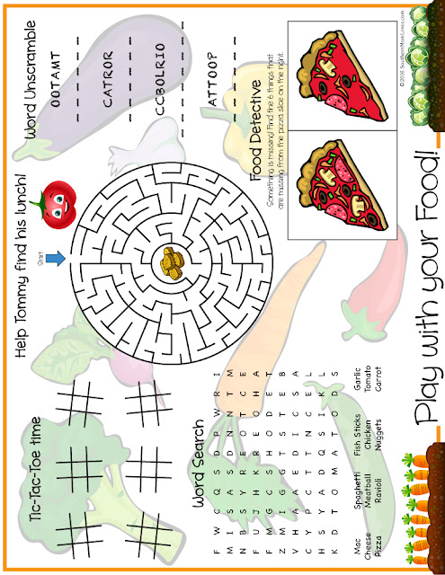
Placemat Fun
17

Slide 22
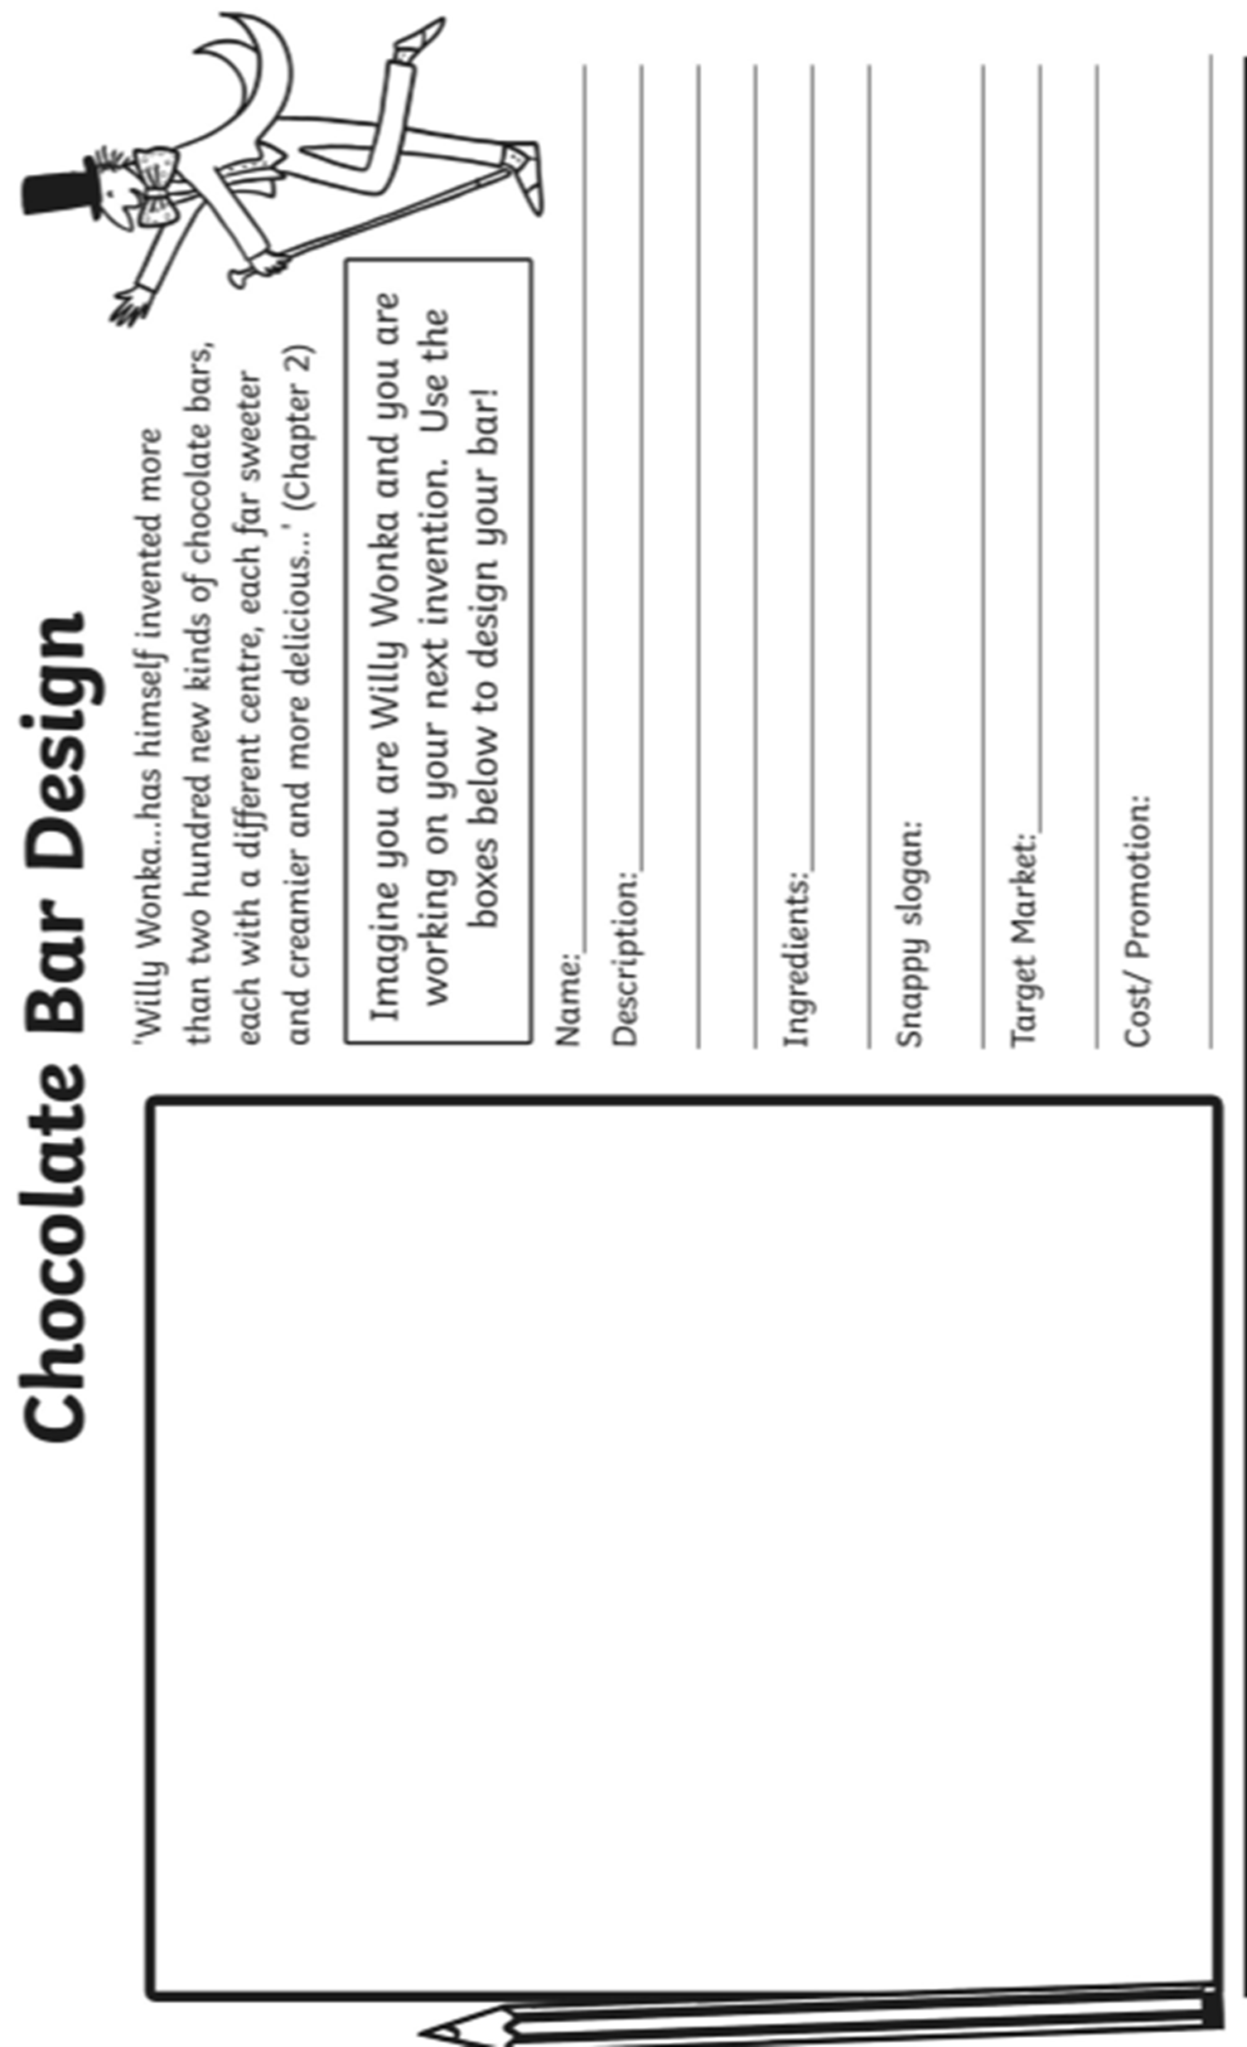
18

Slide 23
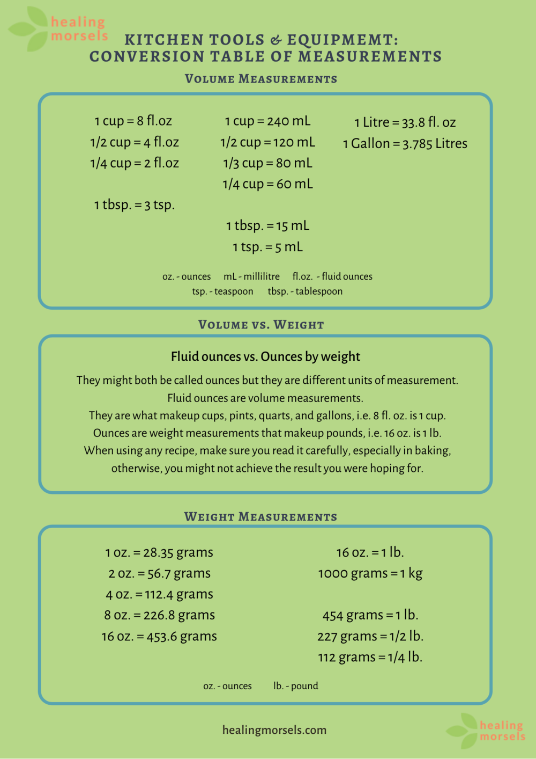
Literacy in Food Technology
Here are some examples of tricky words students tend to find hard to spell.
Write out the following words correctly:
Sieve |  | temperature
safety |  | bacteria
texture |  | crunchy
hygiene |  | creaming
vegetable |  | weight
Numeracy in Food Technology
You practice numeracy in each of your homeworks, measuring out your ingredients.
It can be very tricky as food can be measured in many different units depending on the type
(solid/ liquid) and which unit the recipe uses.
Please use the chart below for your reference when weighing out your ingredients before school. ☺
19

Slide 24
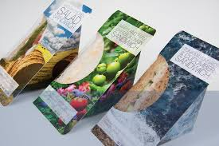
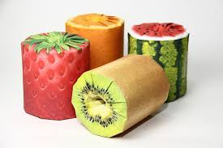
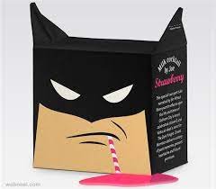
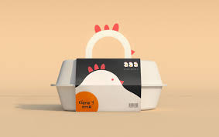
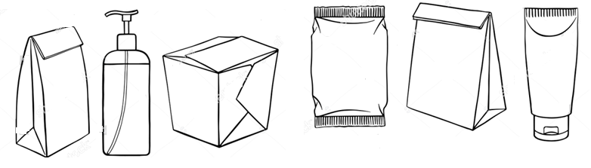
Design Challenge: Food Packaging
The function of packaging is to:
Contain the product
Protect the product
Inform customers of what is and what is in it
Promote it so it will sell
Here are some examples of creative food packaging and plain 3D packaging shapes.
Using inspiration from the above designs:
1. Decide on a product
2. Choose a packaging shape.
3. Recreate the shape in the box below and add your own designs.
Draw in pencil
Colour in pencil
Outline in pen
My product is ______________________
My target market is: __________________
They would buy my design because___________________________________________________________________
20

Slide 25
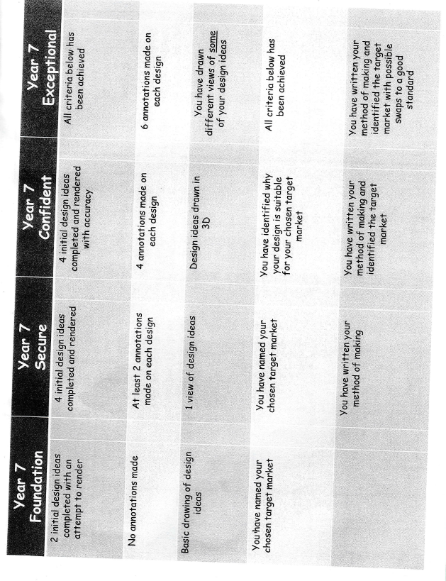
Scone Design Assessment Criteria
21

Slide 26
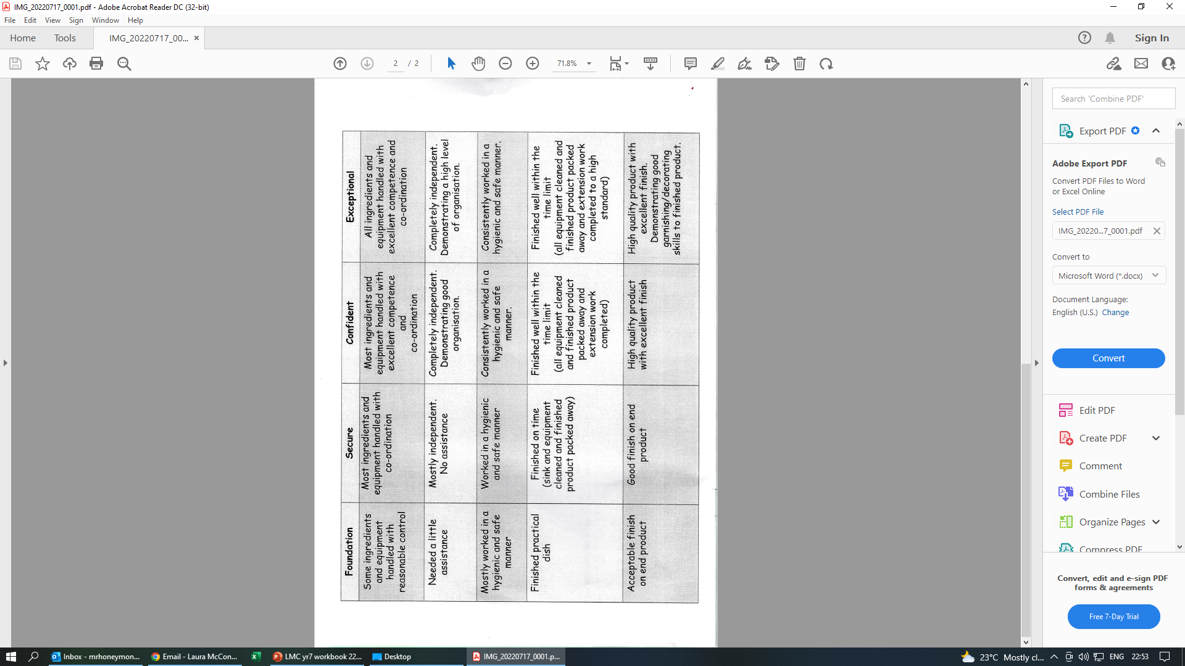
Practical Lesson Assessment Criteria
22

