Slide 1
Year 7 Product Design
Project Based Learning
Name
Design & Technology group
Pathway
Project Assessment :

Slide 2

Food Technology
Design Process Focus: Task analysis, Specification, Research, Testing and Evaluation
Introduction to Food and Nutrition
- To learn about weighing and measuring ingredients
- To learn how to use the oven
- To learn about ingredients – recognising them, using them
- To learn basic cooking/baking skills
- To learn about safety and hygiene – work in a safe way, how to
wash up, personal hygiene
- To learn how to use equipment safely and correctly.
- To learn how to generate ideas from basic recipes.
Year 7 Design and Technology Rotations
Graphic Design
Design Process Focus: Design Ideas
2D Design and Mechanisms
- Understand the terms CAD/CAM
- Be able to identify the advantages and disadvantages of CAD/CAM
- Introduction to 2D design tools this is achieved through a series of focus tasks aimed at introducing the different tools/ skills.
- Final outcome is a moving picture with a linear mechanism.
Systems and Control
Design Process Focus: Development, Modelling, Final Idea
Electronic Sign Project
- Learn about health and safety in the workshop
- Learn how to read a brief
- Learn how to use Publisher and how to copy &
paste & size and format images
- Learn how to recognise tools
- Learn the importance of accuracy
- Learn how to mark out use correct tools-Try-
square/steel rule/compass/pencil/bench hook/saw
- Learn how to use machine power tools-
sander/pillar drill/scroll saw
- Learn about materials and their properties
- Learn how to use a scalpel safely
- Learn how to use glue
- Learn how to build a simple electrical circuit and
the function of the different components within
the circuit
- Learn how to solder safely
- Learn to how to assess progress
- Learn how to problem solve
- Learn how to help others
- Learn the importance of finishing to a high standard
Textiles Technology
Design Process Focus: Task Analysis, Specification, Research, Development
Doorstop Project
- Learn how to use basic Textiles equipment such as
scissors and the sewing machine
- Learn how to design products which meet a brief
and be able to annotate work effectively to be able
to communicate ideas.
- Learn how to mark a basic pattern out onto a piece
of fabric and cut it out accurately.
- Learn how to tie dye fabric.
- Learn how to make an appliqué
- Learn a variety of embroidery stitches to attach
appliqué onto work and add pattern and texture to
work.
- Learn how to create a basic straight seam on the
sewing machine.
Product Design
Design Process Focus: Development, Modelling, Final Idea
Technical Drawing Project
- To learn about drawing in Oblique, Isometric and Orthographic
- To learn how to effectively communicate design ideas
- To learn how to use 3D Computer Aided Design
- To learn how to draw in Perspective
- To learn how to present design ideas creatively

Slide 3
Pathway | Problem Solving | Development | Realisation | Presentation
Exceptional | Use research from a range of appropriate sources to develop innovative design decisions. You have identified many different opportunities in the brief chosen. You have original creative ideas developed in response to the brief. You have a creative use of materials, technologies, systems. You have demonstrated an ability to take design solutions from different places and develop them into a new context. | Use consistent design iteration to combine, synthesise and extend ideas into new concepts Design process is cyclic and many different ideas have been developed, tested, refined and clear improvement seen in the quality and function of the design. | Identify, apply and explain how technical skills have been used to enhance functions and outcomes. Make an effective contribution to a team and understand the needs of other team members. Understand roles and strengths in working as a team and make a key contribution to achieving outcomes in a given time frame, taking account of the needs of all team members. Tools, equipment and machinery used safely and with a high level of skill and accuracy | Excellent contribution in your team role with some leadership demonstrated Make a relevant contribution to a presentation which effectively explains, analyses and justifies the project process and outcomes. Clear and well delivered. All aspects of the design explained with successes and failures encountered. Explanation about the strengths and weaknesses of the team Questions answered well with detail, reasoning and justification
Confident | Use research to inform design decisions. You have identified different opportunities in the brief chosen. You have some creative ideas developed in response to the brief. You have been inspired by the research undertaken | Understand how ideas can improve through iteration. Design process is cyclic and different ideas have been developed, tested, refined and improvement seen in the quality and function of the design. | Identify and apply the technical skills required to complete the project. Make an effective contribution to a team and understand the needs of other team members. Tools, equipment and machinery used safely and with a good level of skill and accuracy | Excellent contribution in your team role Make a relevant contribution to a presentation which effectively explains the project process and outcomes
Secure | Carry out primary and secondary research. You have some opportunities in the brief chosen. You have an idea developed in response to the brief. You have used your research to begin your ideas. | List design ideas and know how to develop them through experimental prototyping Design process has some cyclic testing, refinements | Identify, justify and understand the technical skills required to carry out the project. Act as part of a team. Tools, equipment and machinery used safely and with some skill and accuracy | Good contribution in your team role Make a relevant contribution to a presentation
Foundation | Carry out primary and secondary research. You have used the ideas of others along with some of your own in the brief chosen. You have an idea to meet the brief. Your idea may be taken from your research | List design ideas and know how to develop them through experimental prototyping. Design process is linear | Identify, justify and understand the technical skills required to carry out the project. Act as part of a team. Tools, equipment and machinery used safely | Make a contribution in your team role Make a contribution in the presentation

Slide 4
Homework – when completed stick over this page
In Design and Technology we would like you to understand and appreciate the work of product designers, fashion designers, engineers, chefs.
Task: You are to complete a profile on a designer and 1 example of their work
Things to include:
Who is she / he?
What is she / he famous for?
Examine in detail one example of their work and explain why you have chosen it
What do you think about her / his design style?
Explain how you could further develop the design to enhance the aesthetics / function / ergonomics
How should I present it?
On A4 paper
Remember a title and any sub-titles
Remember to support your written work with some images
Remember to put your name on your work
Homework Success Criteria
+ You have followed and included all of the “things to include” and presented your work very well by using titles, sub titles and images or drawings to support your written work. All written work must be in your own words and include your own opinions.
= You have followed and included some of the “things to include” and presented your work well by using a title and images or drawings to support your written work. All written work must be in your own words.
- You have followed and included few of the “things to include”. Your work may not be presented appropriately as it will be missing titles, sub titles or your name. There will be lots of information that is copied and pasted from the internet with no opinions of your own

Slide 5
Home or school help
Sports
Table
Chair
Re-design furniture
Your Invention Design Ideas
Desk
Sofa
Hobbies
Mind Map Design Opportunities
Your ideas!
Travel

Slide 6
idea 1
idea 2
The best / worst bits of my design are ….and because…to make them better I will…
The best / worst bits of my design are ….and because…to make them better I will…
idea 3
idea 4
Design Ideas
The best / worst bits of my design are ….and because…to make them better I will…
The best / worst bits of my design are ….and because…to make them better I will…

Slide 7
Design development 5
Design Development of Initial Idea number
Design development 1
Stretch
Make something(s) bigger in your initial idea
What has changed?
Has it improved the design?
Add something(s) to your initial idea
My original initial idea
Design development 4
What has changed?
Has it improved the design?
Squash
Make something(s) smaller in your initial idea
Design development 2
Subtract
take away something(s) from your initial idea
Mirror
Repeat something(s) from your initial idea
What has changed?
Has it improved the design?
Design Development
Design development 3
What has changed?
Has it improved the design?
What has changed?
Has it improved the design?

Slide 8
Homework – when completed stick over this page
In Design and Technology we would like you to understand and appreciate Iconic Product Designs
Task: You are to complete a profile on your chosen Iconic Design
Things to include:
What is the product?
Why did you choose the product?
Why do you think it is a DESIGN ICON?
Who is the designer or company that designed it?
What do you think about the FORM of the product?
What do you think about the FUNCTION of the product?
How should I present it?
On A4 paper
Remember a title and any sub-titles
Remember to support your written work with some images
Remember to put your name on your work
Homework Success Criteria
A – You have followed and included all of the “things to include” and presented your work very well by using titles, sub titles and images or drawings to support your written work. All written work must be in your own words and include your own opinions.
B- You have followed and included some of the “things to include” and presented your work well by using a title and images or drawings to support your written work. All written work must be in your own words.
C – You have followed and included few of the “things to include”. Your work may not be presented appropriately as it will be missing titles, sub titles or your name. There will be lots of information that is copied and pasted from the internet with no opinions of your own

Slide 9
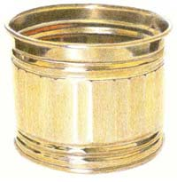
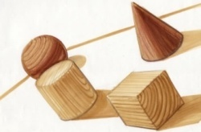
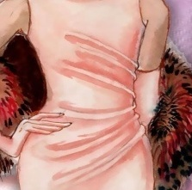
Shading, Rendering and Texture
Equipment list
Sharp pencil(s) HB, 2-4B and 2-4H
Sharpener
Rubber
Sharp coloured pencils
Shading – Pencil Only
Shade the box from dark to light using the flat edge of your sharp pencil
Texture – Pencils and Colour Only
A texture is how an object feels. How can we translate something we feel into something we see?
The material and surface dictate how much light is reflected.
Hard Surfaces like metal and glass are reflective so use sharp crisp edges with strong contrast.
Soft Surfaces like woods do not reflect much light so use soft shading and blending.
Rough Surfaces like fabrics will have mixed light reflection and so a mixture of sharp contrast with soft blending should be used.
Shading
Fabric
Shading – Pencil Only
Shade the box dark, light to dark using the flat edge of your sharp pencil
Rendering – Colour Pencil Only
As before use your shading technique to render with one colour from light to dark
Select 2 colours and blend those 2 colours from 1 to another (E.G. Blue from the left, shading 4 squares right. Green from the left, shading 4 squares left)
Blend 2 or more colours smoothly
Sketch your initials as block capital letters and show off your new rendering and shading skills
1
2
3
Wood
Glass
4
Metal
Plastic
A
R
V
S
D
M
P

Slide 10
Final design idea
Success Criteria – have you?
Explained why it is your best idea?
Explained what inspired it?
Explained how your design has improved from your original idea through development and prototyping?
Explained what the unique selling points (USPs) of your design are?
Explained what it is for and where it will be used?
Used colour to show what materials it would be made of?

Slide 11
Homework – when completed stick over this page
In Design and Technology we would like you to understand and appreciate the work of different companies
Task: You are to complete a profile on a company
Things to include:
What is the company?
Why have you chosen the company?
What is the company logo?
Is there a hidden meaning/message in the logo?
How should I present it?
On A4 paper
Remember a title and any sub-titles
Remember to support your written work with some images
Remember to put your name on your work
Homework Success Criteria
+ You have followed and included all of the “things to include” and presented your work very well by using titles, sub titles and images or drawings to support your written work. All written work must be in your own words and include your own opinions.
= You have followed and included some of the “things to include” and presented your work well by using a title and images or drawings to support your written work. All written work must be in your own words.
- You have followed and included few of the “things to include”. Your work may not be presented appropriately as it will be missing titles, sub titles or your name. There will be lots of information that is copied and pasted from the internet with no opinions of your own

Slide 12
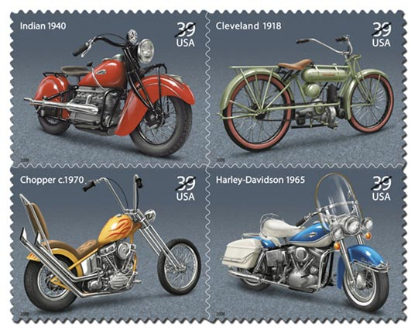
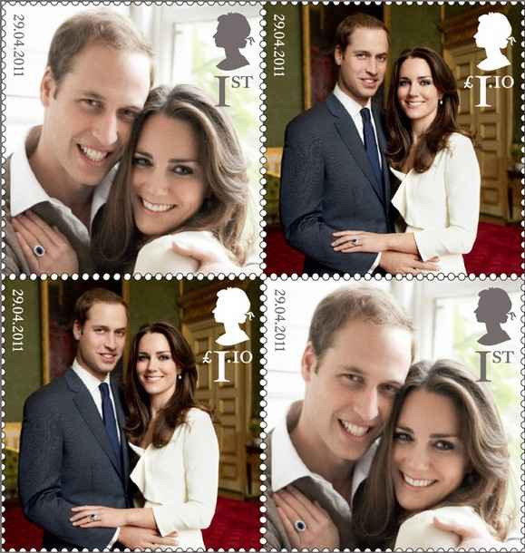

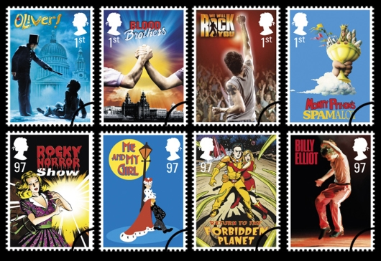
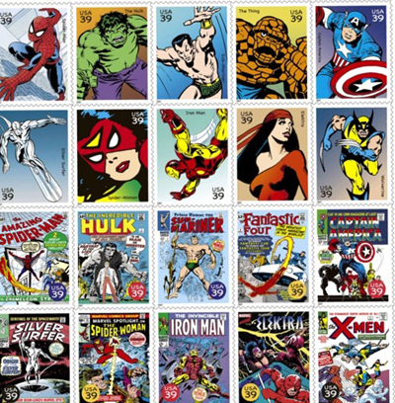
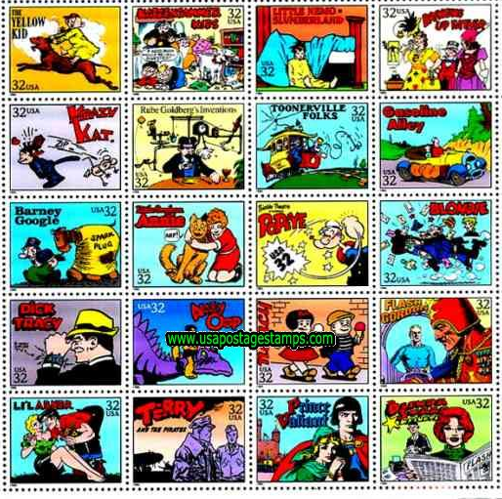

Research and Mind map page, P3, M3, D3
Science
Objectives: You will produce varied and imaginative design ideas for a range of commemorative stamps.
Task 1: Write as many possible ideas for your stamps around the themes in the boxes.
Films
Art / artists
Technology
Famous places
Nature
Countries
Cars / bikes
Famous people
Cartoons
Royal family
Planets
Sports

Slide 13



Drawing pages
Task 3 – Choose a stamp from the examples
Task 1 – Choose one of these stamps to copy
Task 2 – Copy it as accurately as possible in the box
below and colour it in
Task 4 – Copy it as accurately as possible in one of these boxes

Slide 14
Design Development - Choose 4 of your favourite stamp designs from the examples.
Develop each one using some of the development opportunities from Scamper
DEVELOPING A DESIGN
ADD – add bits to the design
SUBTRACT – take bits away from the design
SQUASH – make bits smaller in the design
STRETCH – make bits bigger in the design

Slide 15
Design Ideas - Draw 4 of your own designs for a postage stamp.
Think about what theme(s) to could use from your mind map page

Slide 16
Final design – Draw your best design and colour it in.
It could be one of your design developments or a different design of your own.

Slide 17
Explanation pages
You need to explain and evaluate what you did, how you did it and what you think of the outcomes. Here’s a few questions to get you started
Where did you get your inspiration for your design ideas?
What tools, techniques and materials did you use to produce your design ideas and your final piece?
What do you think of the range of design ideas that you drew?
How does your final piece compare with the designs you first drew. Are they different and if so explain why.
How does your final piece compare with existing commemorative stamps on the market. Are you pleased with the outcome. How could you improve it further?

