Slide 1
Top left: Classwork
Top Right:
Monday, 15 November 2021
Title: Disability in Sport
Big Picture: Learning Outcome A: Explore types and provision of sport and physical activity for different types of participant.
Learning Objectives: To be able to identify the different types of disability, and explain how this might impact someone’s sports performance.
What we did last lesson: Types of participants.
What are we doing next lesson: Medical conditions in sport.
BTEC Tech Award Level 1/2 in Sport
Miss Dundas - PE Department

Slide 2
‘Hook’
What do you think of these facts and figures?
Do any of these surprise you?
Do you think it would be more or less?
BTEC Tech Award Level 1/2 in Sport
Miss Dundas - PE Department

Slide 3
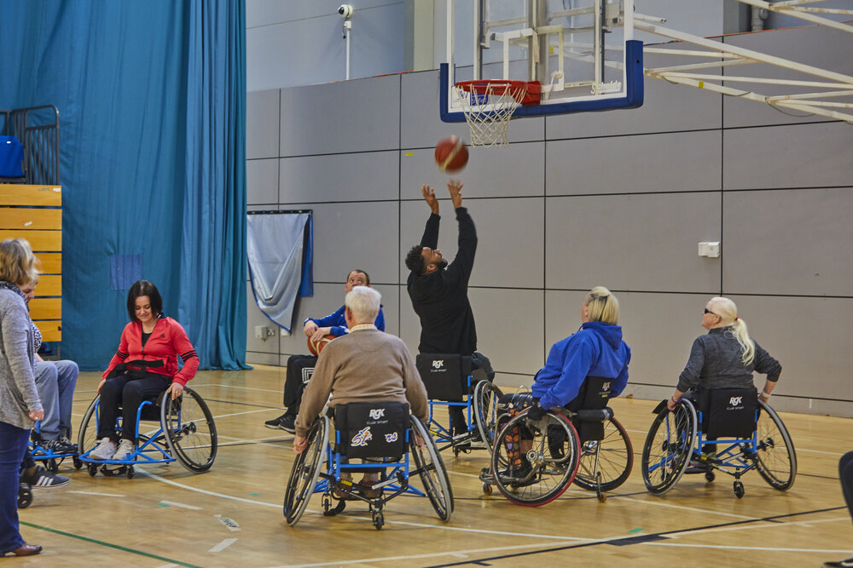
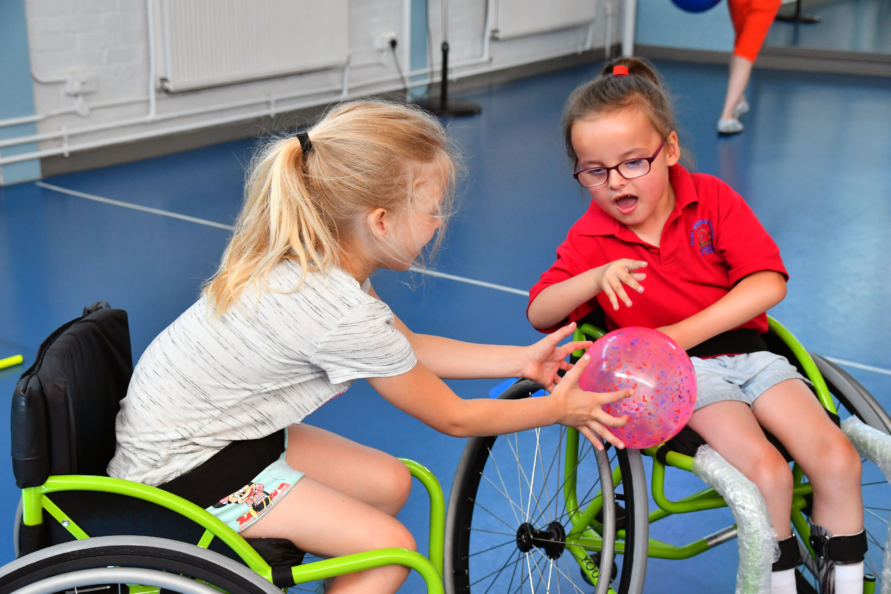
Disability in sport
What is the definition of a disability?
A physical or mental condition that limits a person's movements, senses, or activities.
You’re disabled under the Equality Act 2010 if you have a physical or mental impairment that has a ‘substantial’ and ‘long-term’ negative effect on your ability to do normal daily activities.
BTEC Tech Award Level 1/2 in Sport
Miss Dundas - PE Department

Slide 4
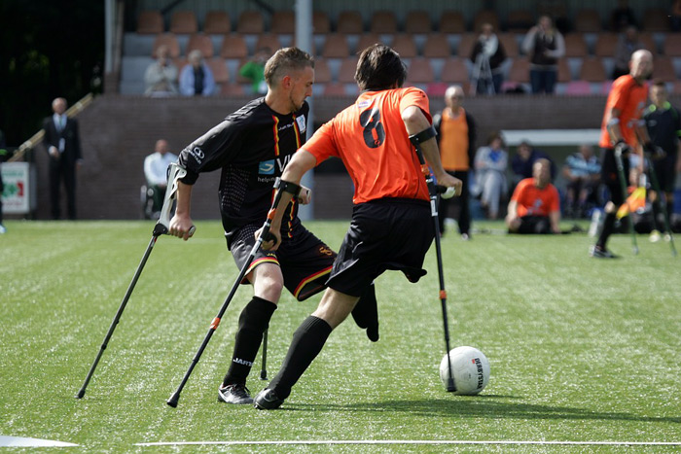
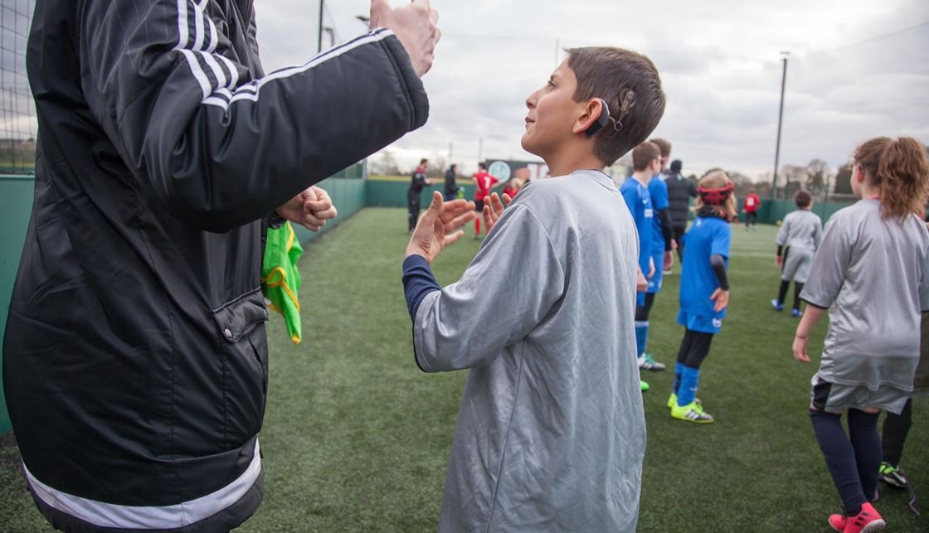
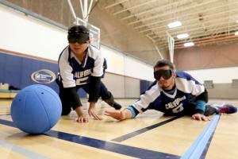
What are the three main disabilities?
Can you think of the three top categories that disabilities fall under?
Physical
Visual
Hearing
BTEC Tech Award Level 1/2 in Sport
Miss Dundas - PE Department

Slide 5
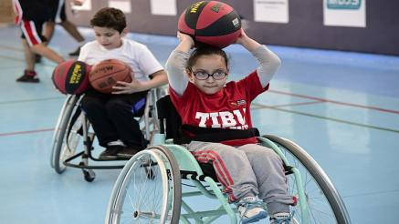
Physical
Impact?
What is a physical impairment?
The physical capacity to move, coordinate actions, or perform physical activities is significantly limited, impaired, or delayed and is exhibited by difficulties in one or more of the following areas: physical and motor tasks; independent movement; performing basic life functions.
Something that physical stops or significantly limits you from being able to carry out daily tasks.
BTEC Tech Award Level 1/2 in Sport
Miss Dundas - PE Department

Slide 6
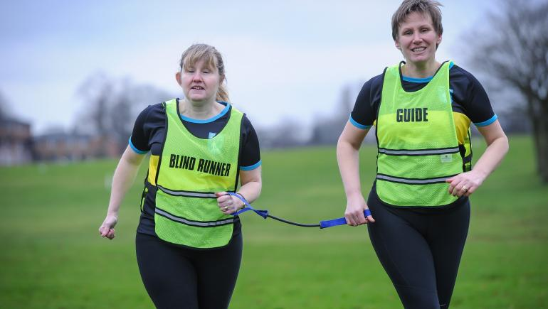
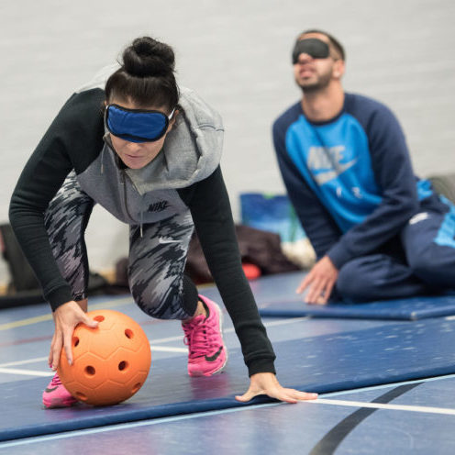
Visual
Impact?
What is a visual impairment?
Visual impairment is a term experts use to describe any kind of vision loss, whether it's someone who cannot see at all or someone who has partial vision loss.
BTEC Tech Award Level 1/2 in Sport
Miss Dundas - PE Department

Slide 7
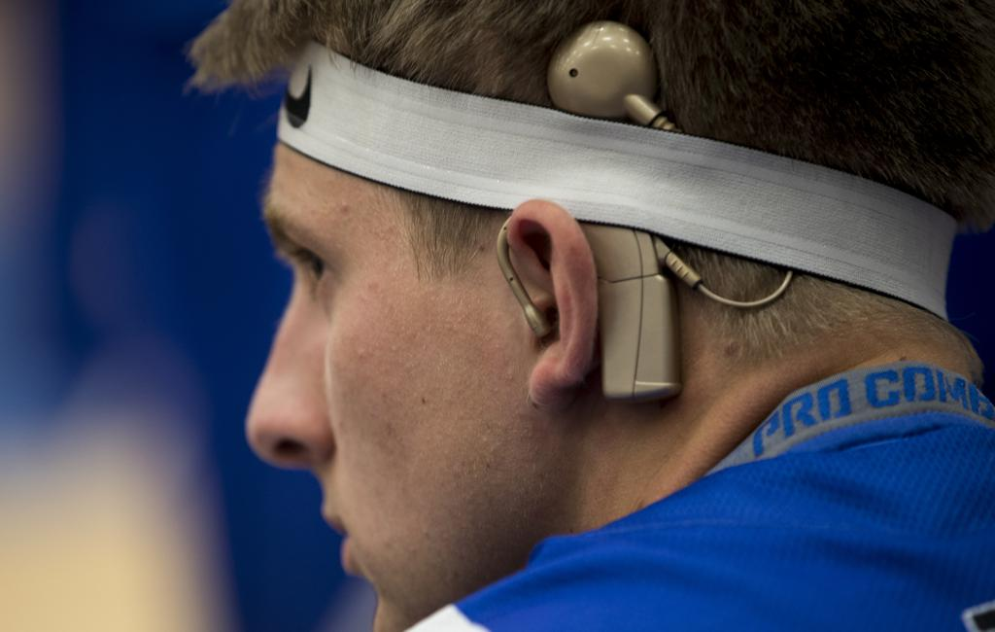
Hearing
Impact?
What is a hearing impairment?
Hearing impairment or deafness covers are terms we use to refer to someone who has some level of hearing loss.
BTEC Tech Award Level 1/2 in Sport
Miss Dundas - PE Department

Slide 8
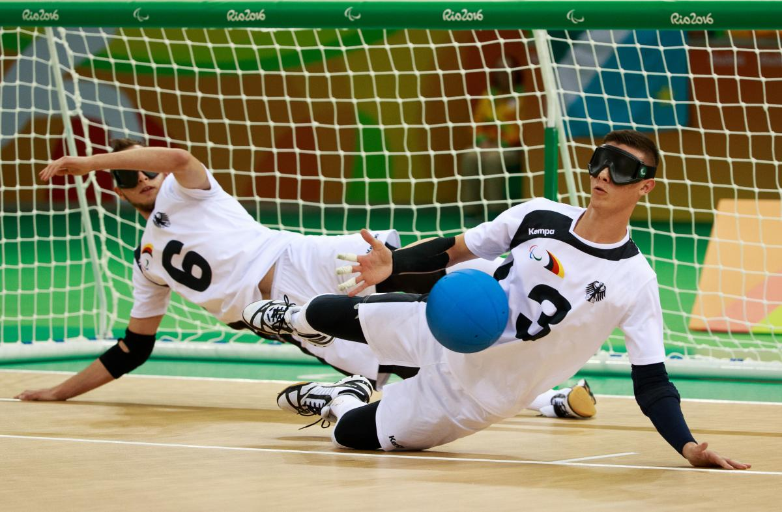
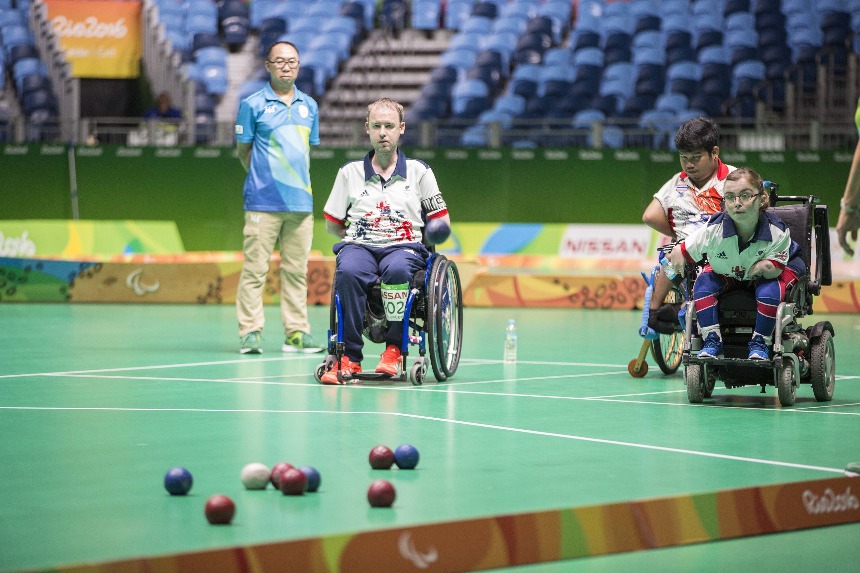
Can you think of any disability sports?
Paralympics
https://www.youtube.com/watch?v=OjIP9EFbcWY
Goalball
https://www.youtube.com/watch?v=0bZ51jzmbAQ
BOCCIA
https://www.youtube.com/watch?v=rKw9kavRFbU
Any other sports but changed to be in a wheelchair? Competing against the same level of disability?
BTEC Tech Award Level 1/2 in Sport
Miss Dundas - PE Department

Slide 9
Purple Zone Expectations
You are working independently.
You are working in silence.
No hands up or questions once the time has started.
You will have 5 minutes.
Let’s look at the task first…
Notes:
Letter to annotate for persuasive features

Slide 10
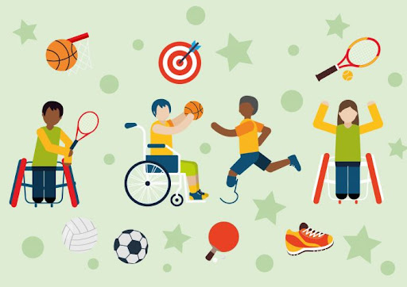
Purple Zone
Extension: Which one of the following would you miss the most if you lost in.
Hearing
Sight
Ability to walk
Complete the sheet and fill in the blanks.
Which one of these disabilities or medical conditions do you think impacts on sport the most and why?
Sentence starters | Top tip:
____ has the most impact on someone’s performance because _______. | Try and think about how a sport would need to be changed. Consider how that person would feel about not being able to participate.
BTEC Tech Award Level 1/2 in Sport
Miss Dundas - PE Department

Slide 11
Remember no question is a stupid question, apart from the one you didn’t ask.
Have a fantastic rest of the day!!
Complete your plenary task before you leave the room.
BTEC Tech Award Level 1/2 in Sport
Miss Dundas - PE Department

