Slide 1
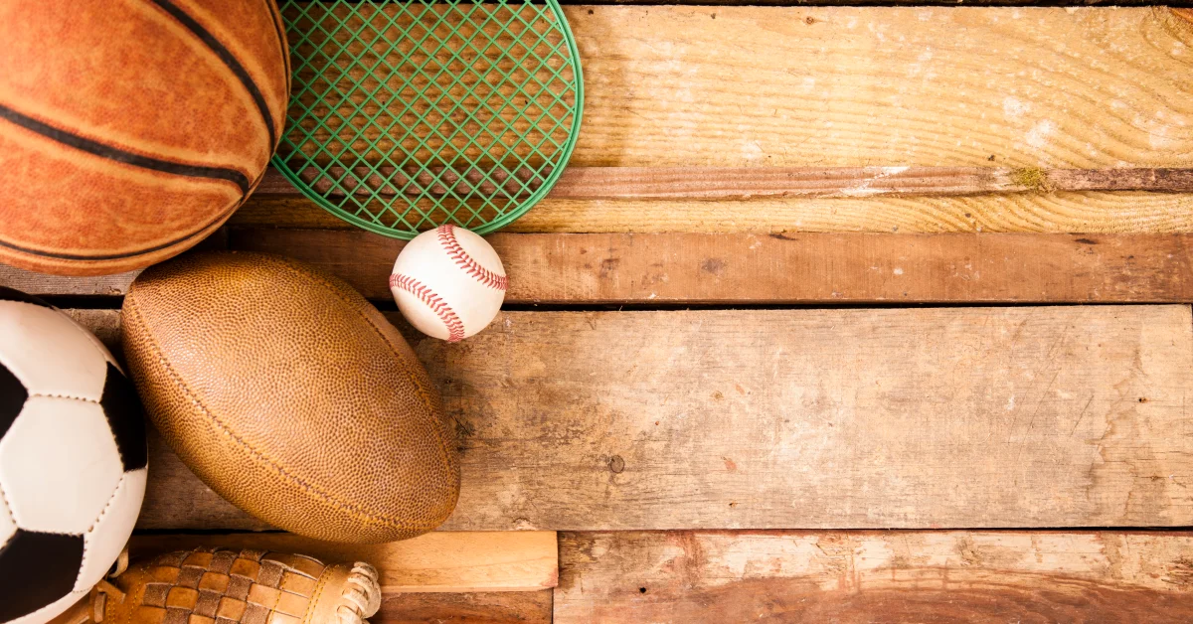
Top left: Classwork
Top Right:
Monday, 15 November 2021
Title: Types of participants
Big Picture: Learning Outcome A: Explore types and provision of sport and physical activity for different types of participant.
Learning Objectives: To be able to identify the different types of participants within sport, and highlight which activities are appropriate.
What we did last lesson: Sports provisions.
What are we doing next lesson: Disabilities in sport.
BTEC Tech Award Level 1/2 in Sport
Miss Dundas - PE Department

Slide 2
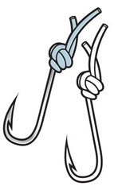
‘Hook’
Name a benefit of physical activity
Give me an answer for the following….
Name a physical activity
Name a sport
Name one of the three sports provisions
Name a benefit of sport
BTEC Tech Award Level 1/2 in Sport
Miss Dundas - PE Department

Slide 3
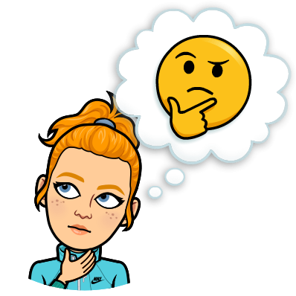
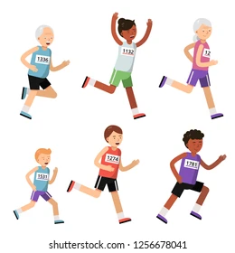
Types of participants
Is every sport suitable for everyone?
Why?
BTEC Tech Award Level 1/2 in Sport
Miss Dundas - PE Department

Slide 4
Participation in sport
What do you think can influence participation in sport?
People have different preferences and reasons for choosing to participate in sport and their choice is influenced by a number of factors including:
Age | Gender | Role Models | Ethnicity
Disability | Economic Status | Religion | Cost
Access | Social factors | Sexuality | Family and peers
BTEC Tech Award Level 1/2 in Sport
Miss Dundas - PE Department

Slide 5
Age
How does age affect physical activity and sport?
Ageing affects people in different ways. There are, though, some age-related trends that can affect participation in sport.
Children need to develop gross motor skills from an early age to become confident movers.
Adolescents experience a growth spurt that changes their physical development. This affects how they acquire skills and how they feel, ie confidence, self-esteem and body image.
Older people may experience weight-gain and decreasing flexibility and strength, and find it harder to recover from injury. They may lose confidence in their physical abilities.
BTEC Tech Award Level 1/2 in Sport
Miss Dundas - PE Department

Slide 6
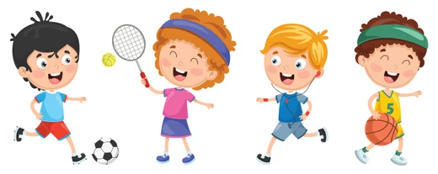
Primary school age children
Aged 5- 11 years old
What physical activity and sport do you think is most appropriate for this age group?
Playing in the playground, grassroot sports, playing in the park, non-contact sports
BTEC Tech Award Level 1/2 in Sport
Miss Dundas - PE Department

Slide 7
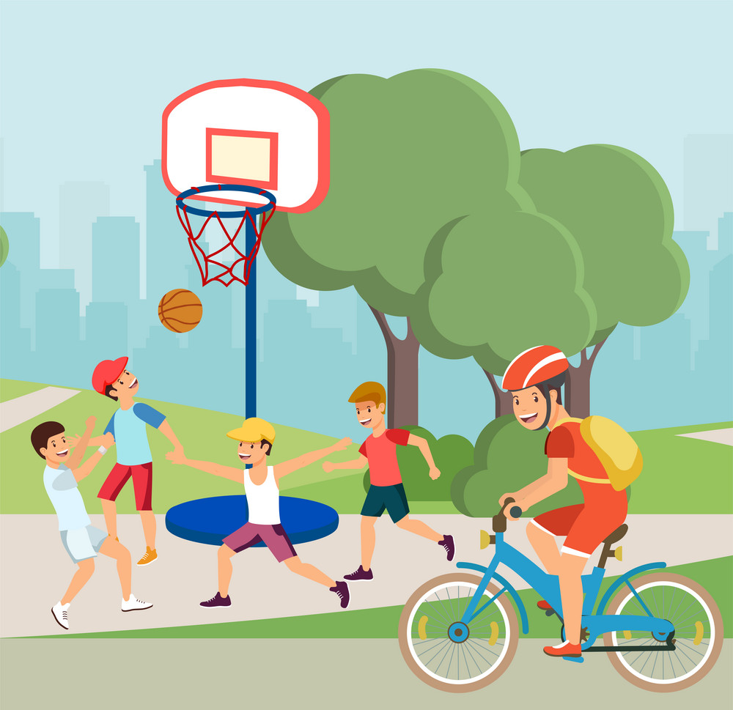
Adolescents
Aged 12 – 17 years old
What physical activity and sport do you think is most appropriate for this age group?
All sports and physical activity – no limitations
BTEC Tech Award Level 1/2 in Sport
Miss Dundas - PE Department

Slide 8
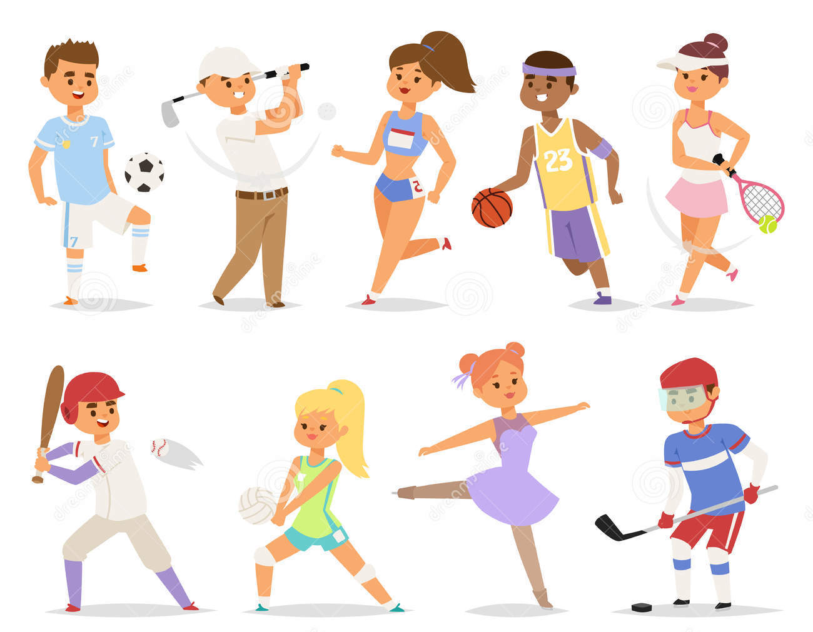
Adults
Aged 18 – 49 years old
What physical activity and sport do you think is most appropriate for this age group?
All sports and physical activity – no limitations
BTEC Tech Award Level 1/2 in Sport
Miss Dundas - PE Department

Slide 9
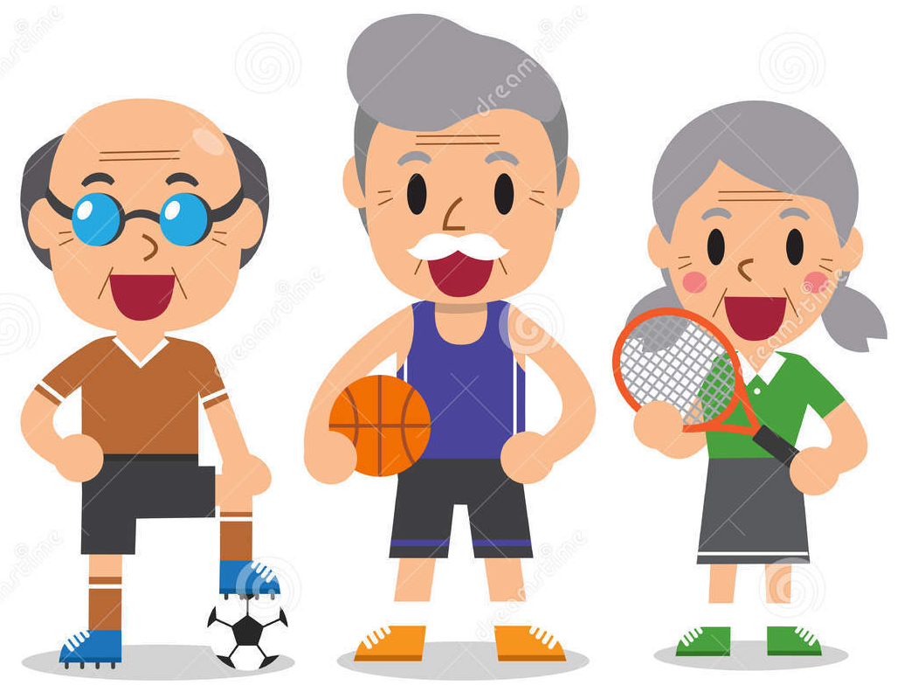
Older adults
Aged 50 years +
What physical activity and sport do you think is most appropriate for this age group?
Walking football, touch rugby, chair exercises, gym, walking, yoga, Pilates.
BTEC Tech Award Level 1/2 in Sport
Miss Dundas - PE Department

Slide 10
Gender
Does gender affect sport?
In the UK, 1.9 million fewer women than men take part in sport each week. There is a significant drop in girls' participation from age 11. By age 14, boys are twice as active as girls.
Why?
BTEC Tech Award Level 1/2 in Sport
Miss Dundas - PE Department
Notes:
All girls and women have their own reasons for taking or not taking part in physical activity. Research shows there are some common barriers to participation. Many girls and/or women:
don't see the relevance of PE and sport to their lives
think choices in PE and school sport are limited
dislike taking part with boys or men who monopolise play or who play aggressively
are more motivated by having fun, making friends and keeping fit than excelling
feel judged and are therefore embarrassed by how they look
have less spare time due to childcare and domestic responsibilities
lack positive role models - locally and nationally
see that women's sport usually has a lower status and gets less coverage in the media
Tackling these barriers will support more girls and women to take part in physical activity as part of a healthy lifestyle. This means consulting girls and women to find out what works for them.

Slide 11
Purple Zone Expectations
You are working independently.
You are working in silence.
No hands up or questions once the time has started.
You will have 5 minutes.
Let’s look at the task first…
Notes:
Letter to annotate for persuasive features

Slide 12
Purple Zone
Complete the sheet the you have been given.
Extension:
Can you think why social environment might affect someone taking part?
Sentence starters | Top tip:
Gender can affect participation because… Age can affect someone taking apart in physical activity because… | Try and think about the barriers to different participants getting involved.
BTEC Tech Award Level 1/2 in Sport
Miss Dundas - PE Department

Slide 13
Remember no question is a stupid question, apart from the one you didn’t ask.
Have a fantastic rest of the day!!
Complete your plenary task before you leave the room.
BTEC Tech Award Level 1/2 in Sport
Miss Dundas - PE Department

