Slide 1
Top left: Classwork
Top Right:
Monday, 15 November 2021
Title: Sports Provisions
Big Picture: Learning Outcome A: Explore types and provision of sport and physical activity for different types of participant.
Learning Objectives: To be able to identify what the three different provisions are for sport and physical activity.
What we did last lesson: Outdoor adventurous activities.
What are we doing next lesson: Types of participants.
BTEC Tech Award Level 1/2 in Sport
Miss Dundas - PE Department

Slide 2
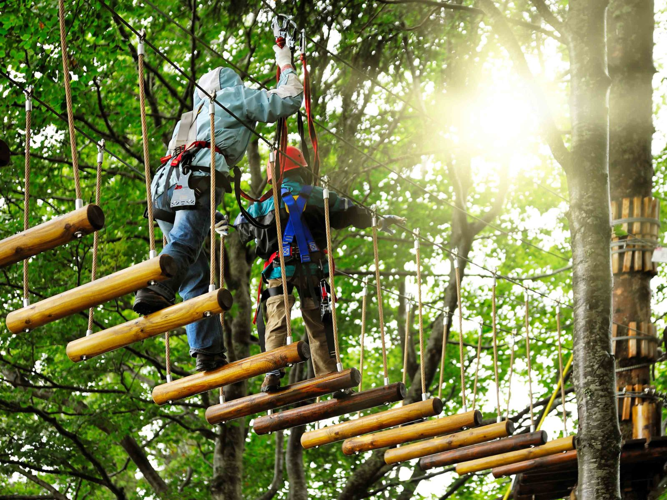
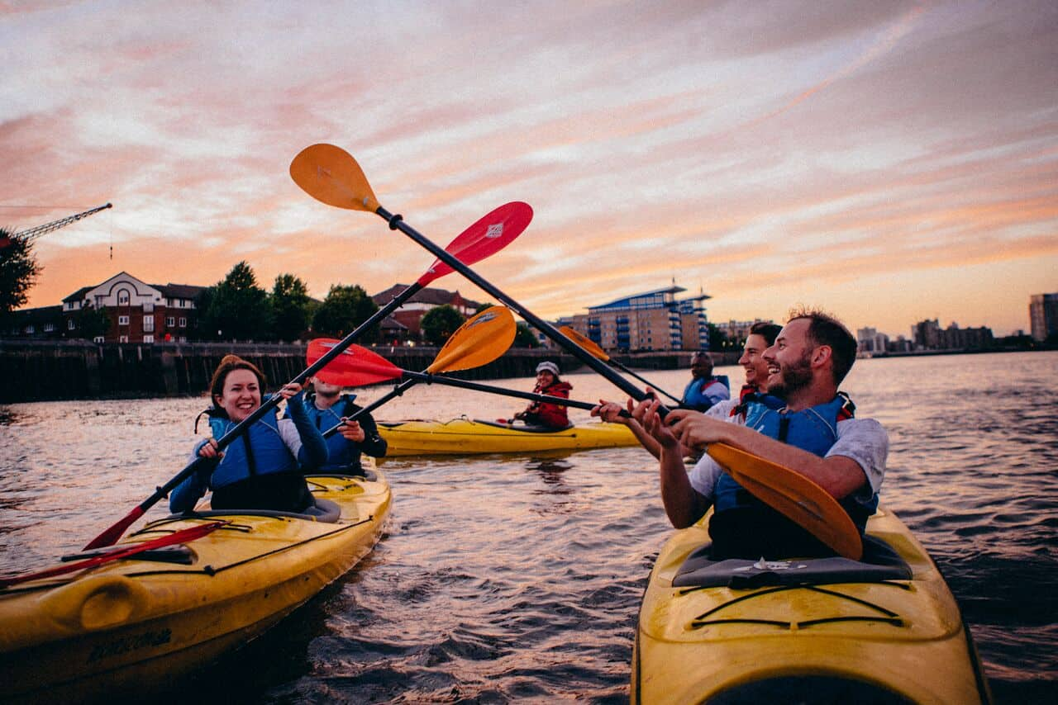
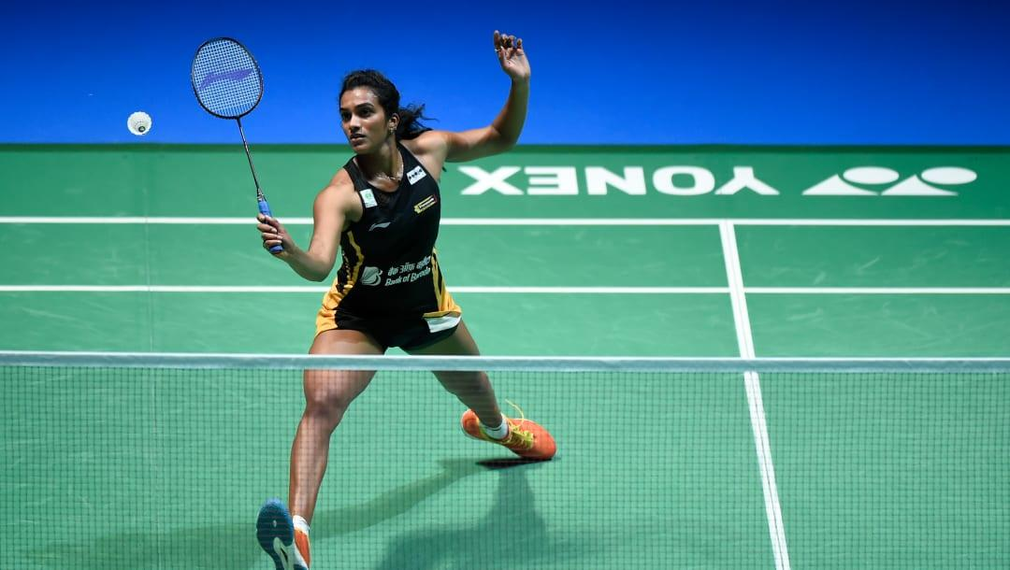
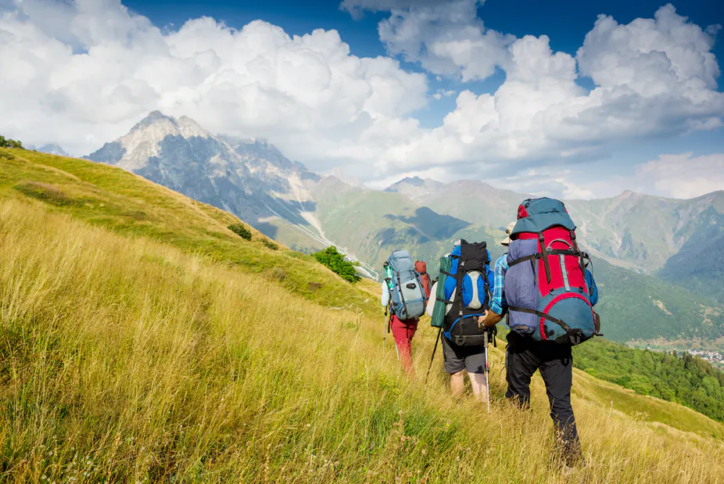
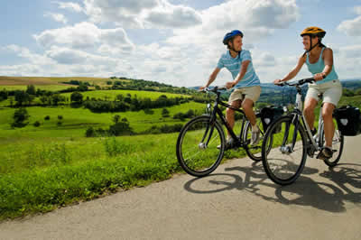
‘Hook’
Benefit of physical activity?????
Benefit of sport?????
Why do people do outdoor activities??
What is it??
You need to name the sport or physical activity and state whether it is a sport, physical activity or outdoor activity.
Or complete the question.
BTEC Tech Award Level 1/2 in Sport
Miss Dundas - PE Department

Slide 3
Sports Provisions
Do you know what sports provisions are? Can you think of anything?
The supply of sporting activities. The provision of sports facilities and opportunities in Britain is the result of the interaction between the public, private and voluntary sectors.
Provision - The action of providing or supplying something for use.
BTEC Tech Award Level 1/2 in Sport
Miss Dundas - PE Department

Slide 4
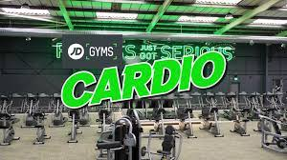
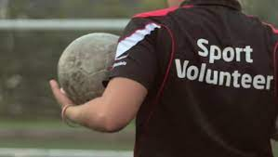
Provisions for sport and physical activity
What are the three different provisions for sport and physical activity?
Public sector
Private sector
Volunteer sector
BTEC Tech Award Level 1/2 in Sport
Miss Dundas - PE Department

Slide 5
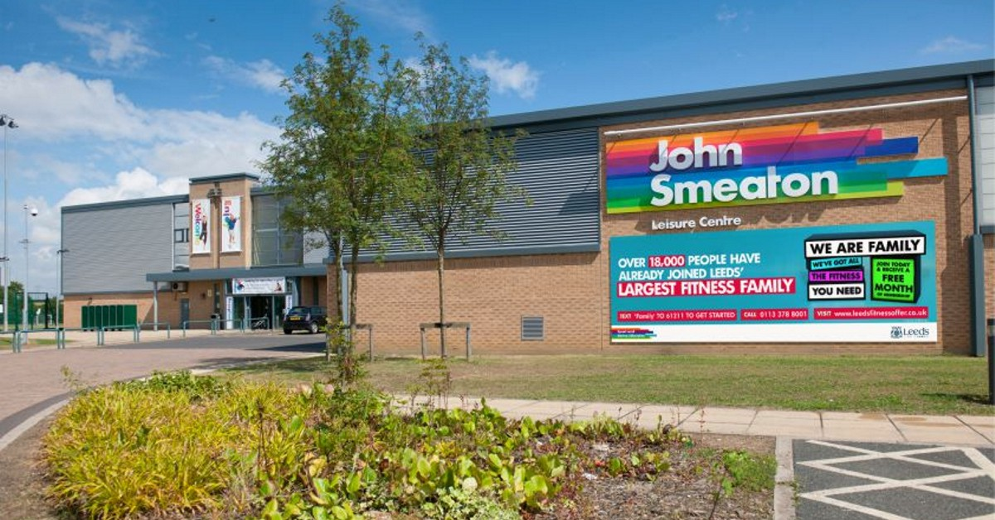
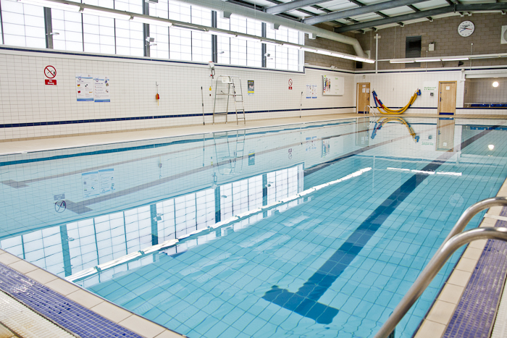
Public sector
What is the public sector?
Public sector organisations are owned by the government. They provide goods and services for the benefit of the community. They are run by the government. They operate with money raised from taxes.
BTEC Tech Award Level 1/2 in Sport
Miss Dundas - PE Department

Slide 6
Advantages and disadvantages
What are the advantages and disadvantages of the public sector?
Advantages | Disadvantages
Cheaper than private sector leisure centres. | Limited government funding, sometimes lacking enough money.
All-inclusive environments that are suitable for everyone in the community. | Constant political interference and withdrawal of funds and support.
 | Takes a lot longer to make changes to timetables, sports and facilities.
BTEC Tech Award Level 1/2 in Sport
Miss Dundas - PE Department

Slide 7
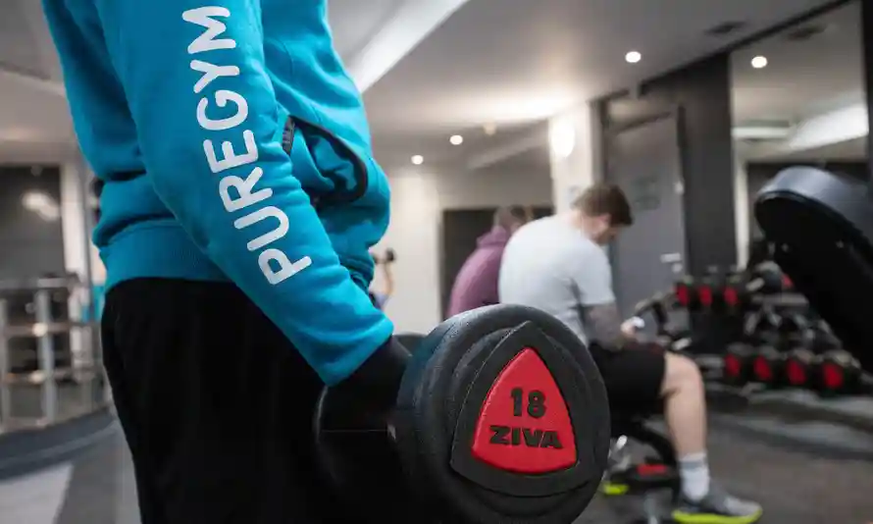
Private sector
What is the private sector?
The private sector is the part of the economy that is run by individuals and companies for profit and is not state controlled.
BTEC Tech Award Level 1/2 in Sport
Miss Dundas - PE Department

Slide 8
Advantages and disadvantages
What are the advantages and disadvantages of the private sector?
Advantages | Disadvantages
Fantastic facilities that are state of the art and continually updated. | More expensive membership prices.
Provide a wider range of sports and physical activity compared to the public sector. | Less inclusive than public sector sports provisions as they are normally specialised.
Can respond quickly to new trends and sports to suit the community.
BTEC Tech Award Level 1/2 in Sport
Miss Dundas - PE Department

Slide 9
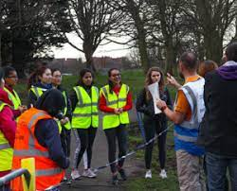
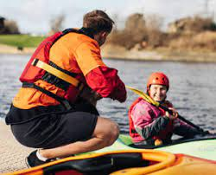
Volunteer sector
What is the volunteer sector?
The 'voluntary sector' refers to organisations whose primary purpose is to create social impact rather than profit.
BTEC Tech Award Level 1/2 in Sport
Miss Dundas - PE Department

Slide 10
Advantages and disadvantages
What are the advantages and disadvantages of the volunteer sector?
Advantages | Disadvantages
It creates a community feeling where parents/carers and children can come together. | Relying on people in the community to take the time to help out, can't hold people accountable.
The volunteering is more specialised to the needs of the community. | Less money to be able to support the team, facilities and training.
It's more rewarding because you are doing it to support and help others within the community. | There is a lot more commitment and responsibility involved that you are not getting paid for.
BTEC Tech Award Level 1/2 in Sport
Miss Dundas - PE Department

Slide 11
Purple Zone Expectations
You are working independently.
You are working in silence.
No hands up or questions once the time has started.
You will have 5 minutes.
Let’s look at the task first…
Notes:
Letter to annotate for persuasive features

Slide 12
Purple Zone
Complete the sheet and fill in the blanks – use the words in red.
Which sector in your opinion is the best and why?
What are the advantages and disadvantages to this sector and why have you chosen it?
Extension:
Can you add on which one you think is the worst and why.
Sentence starters | Top tip:
I have chosen the ….. sector This is because I feel that.... The advantages of this sector are.... The disadvantages of this sector are... | Try and ensure that you highlight the reason as to why you have chosen that sector. Include why it is a good thing and why it is a bad thing.

Slide 13
Remember no question is a stupid question, apart from the one you didn’t ask.
Have a fantastic rest of the day!!
Complete your plenary task before you leave the room.
BTEC Tech Award Level 1/2 in Sport
Miss Dundas - PE Department

