Slide 1
Top left: Classwork
Top Right:
Monday, 15 November 2021
Title: Outdoor Adventurous Activities
Big Picture: Learning Outcome A: Explore types and provision of sport and physical activity for different types of participant.
Learning Objectives: To be able to identify different outdoor adventurous activities, and state the benefits.
What we did last lesson: Benefits of sport and physical activity.
What are we doing next lesson: Sports Provisions.
BTEC Tech Award Level 1/2 in Sport
Miss Dundas - PE Department

Slide 2
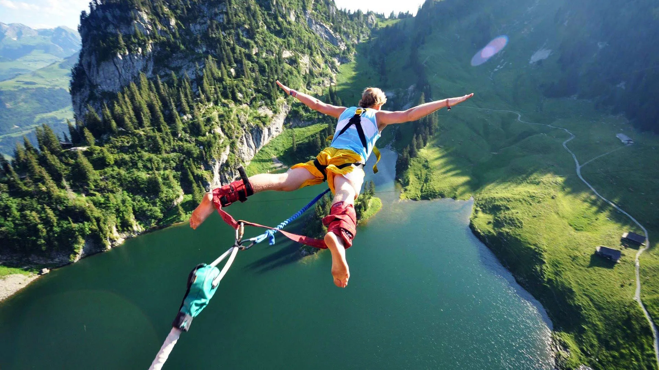
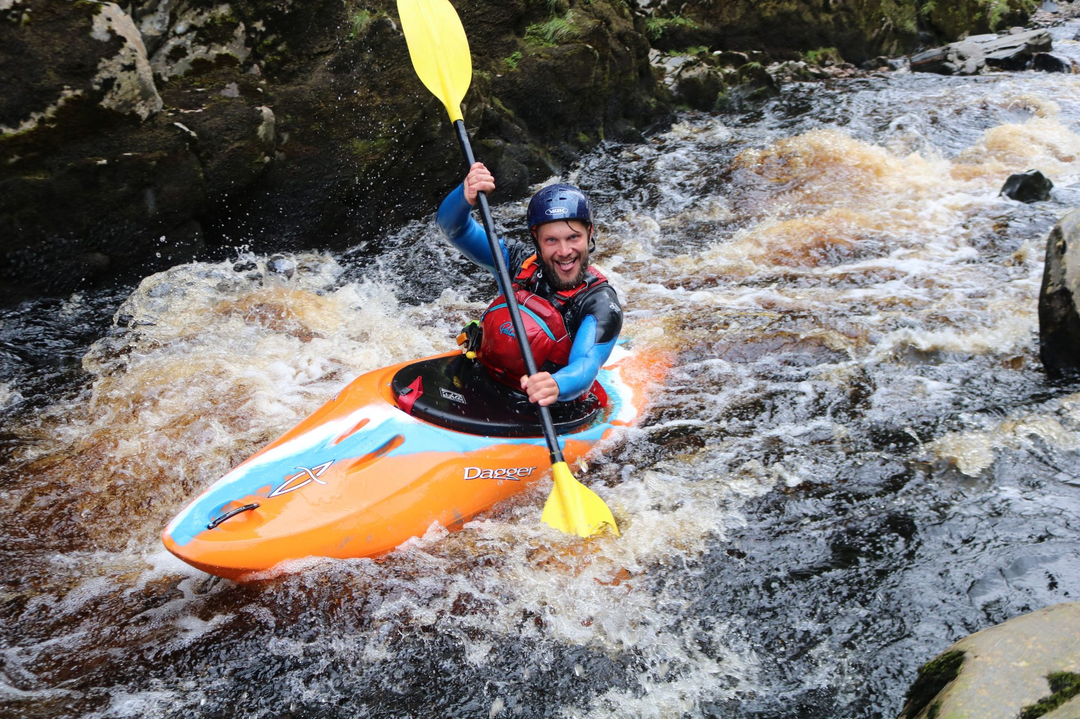
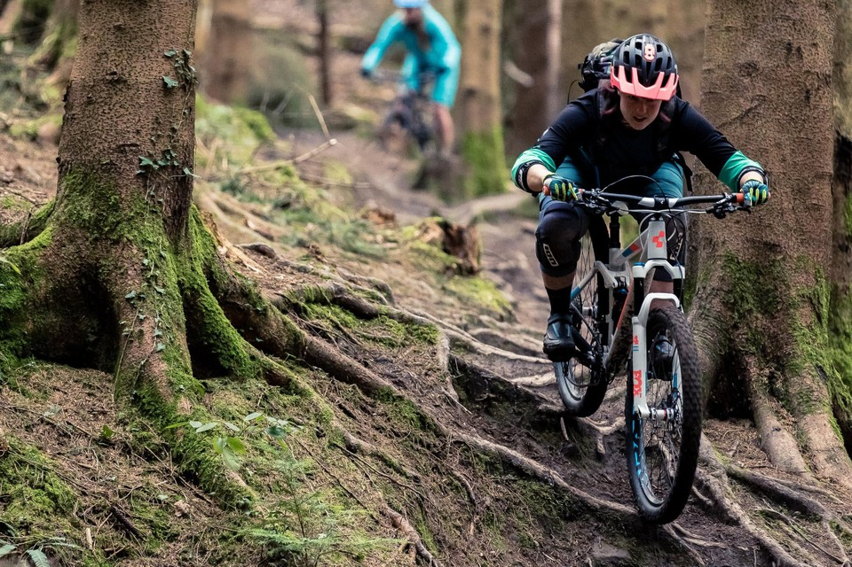
‘Hook’
Name the sport…..
What do all of these have in common?
BTEC Tech Award Level 1/2 in Sport

Slide 3
Re-cap
Complete the table – what can you remember?
Name a sport
Identify a benefit of Sport
Name a physical activity
Name a benefit of physical activity
BTEC Tech Award Level 1/2 in Sport
Miss Dundas - PE Department

Slide 4
What is the definition of Outdoor Activities?
Outdoor activity refers to activities engaged in outside, most commonly in natural settings.
When the activity involves exceptional excitement, physical challenge, or risk.
BTEC Tech Award Level 1/2 in Sport
Miss Dundas - PE Department

Slide 5
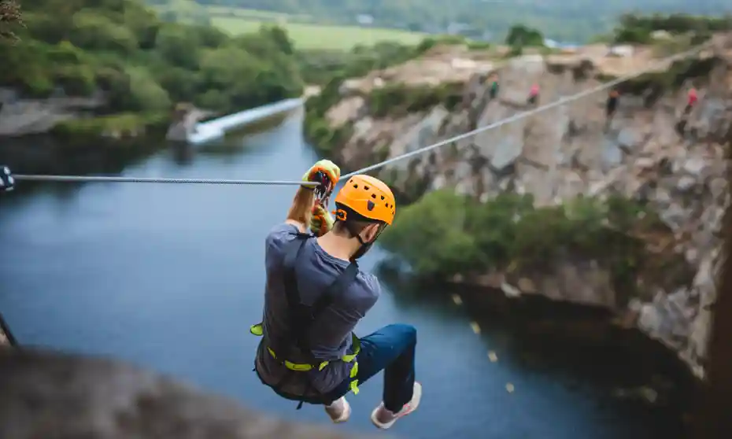
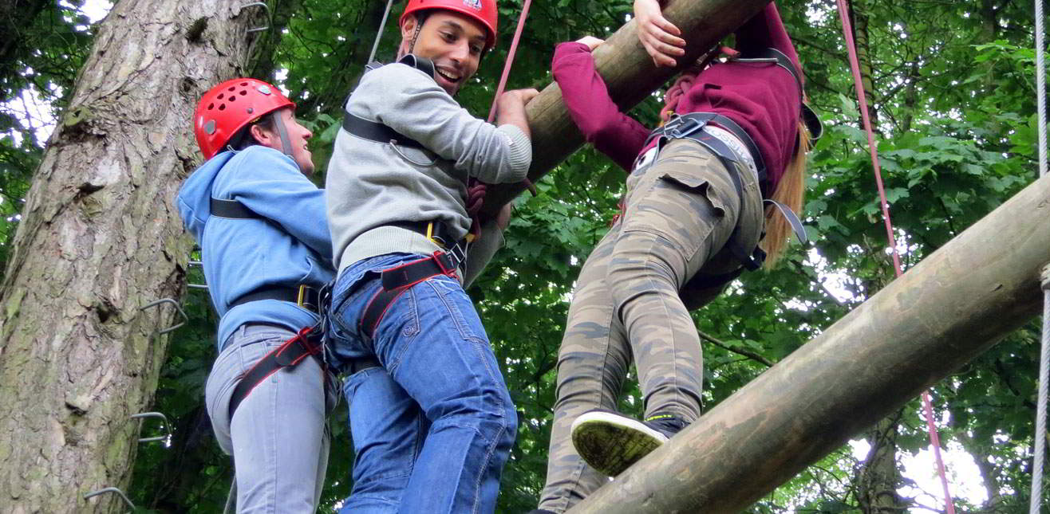
Outdoor activities
These activities are increasingly popular with adults and team building activities as part of CPD.
What makes them risky is that they involve the potential for failure.
Learning how to win, succeed and fail, take risks to help others and meet challenges in unfamiliar surroundings are important for people’s development.
BTEC Tech Award Level 1/2 in Sport
Miss Dundas - PE Department

Slide 6
Positive risk taking
What do you think positive risk taking is?
Not all risk taking is bad!
Some risks are good and promote healthy development. Risk taking is linked to development changes in the brain that help you become a healthy adult.
An element of this is required for children and young adults to test the boundaries and develop as individuals.
BTEC Tech Award Level 1/2 in Sport
Miss Dundas - PE Department

Slide 7
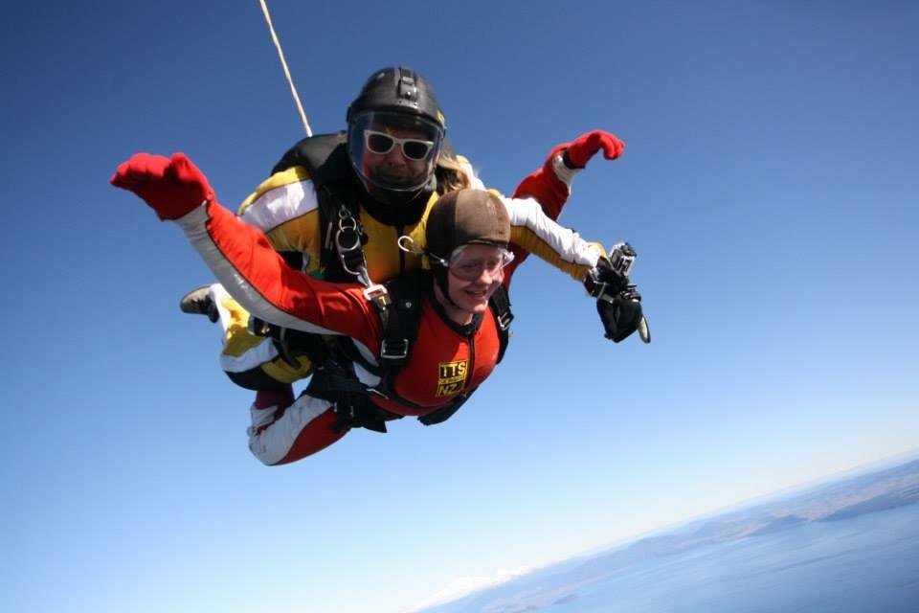
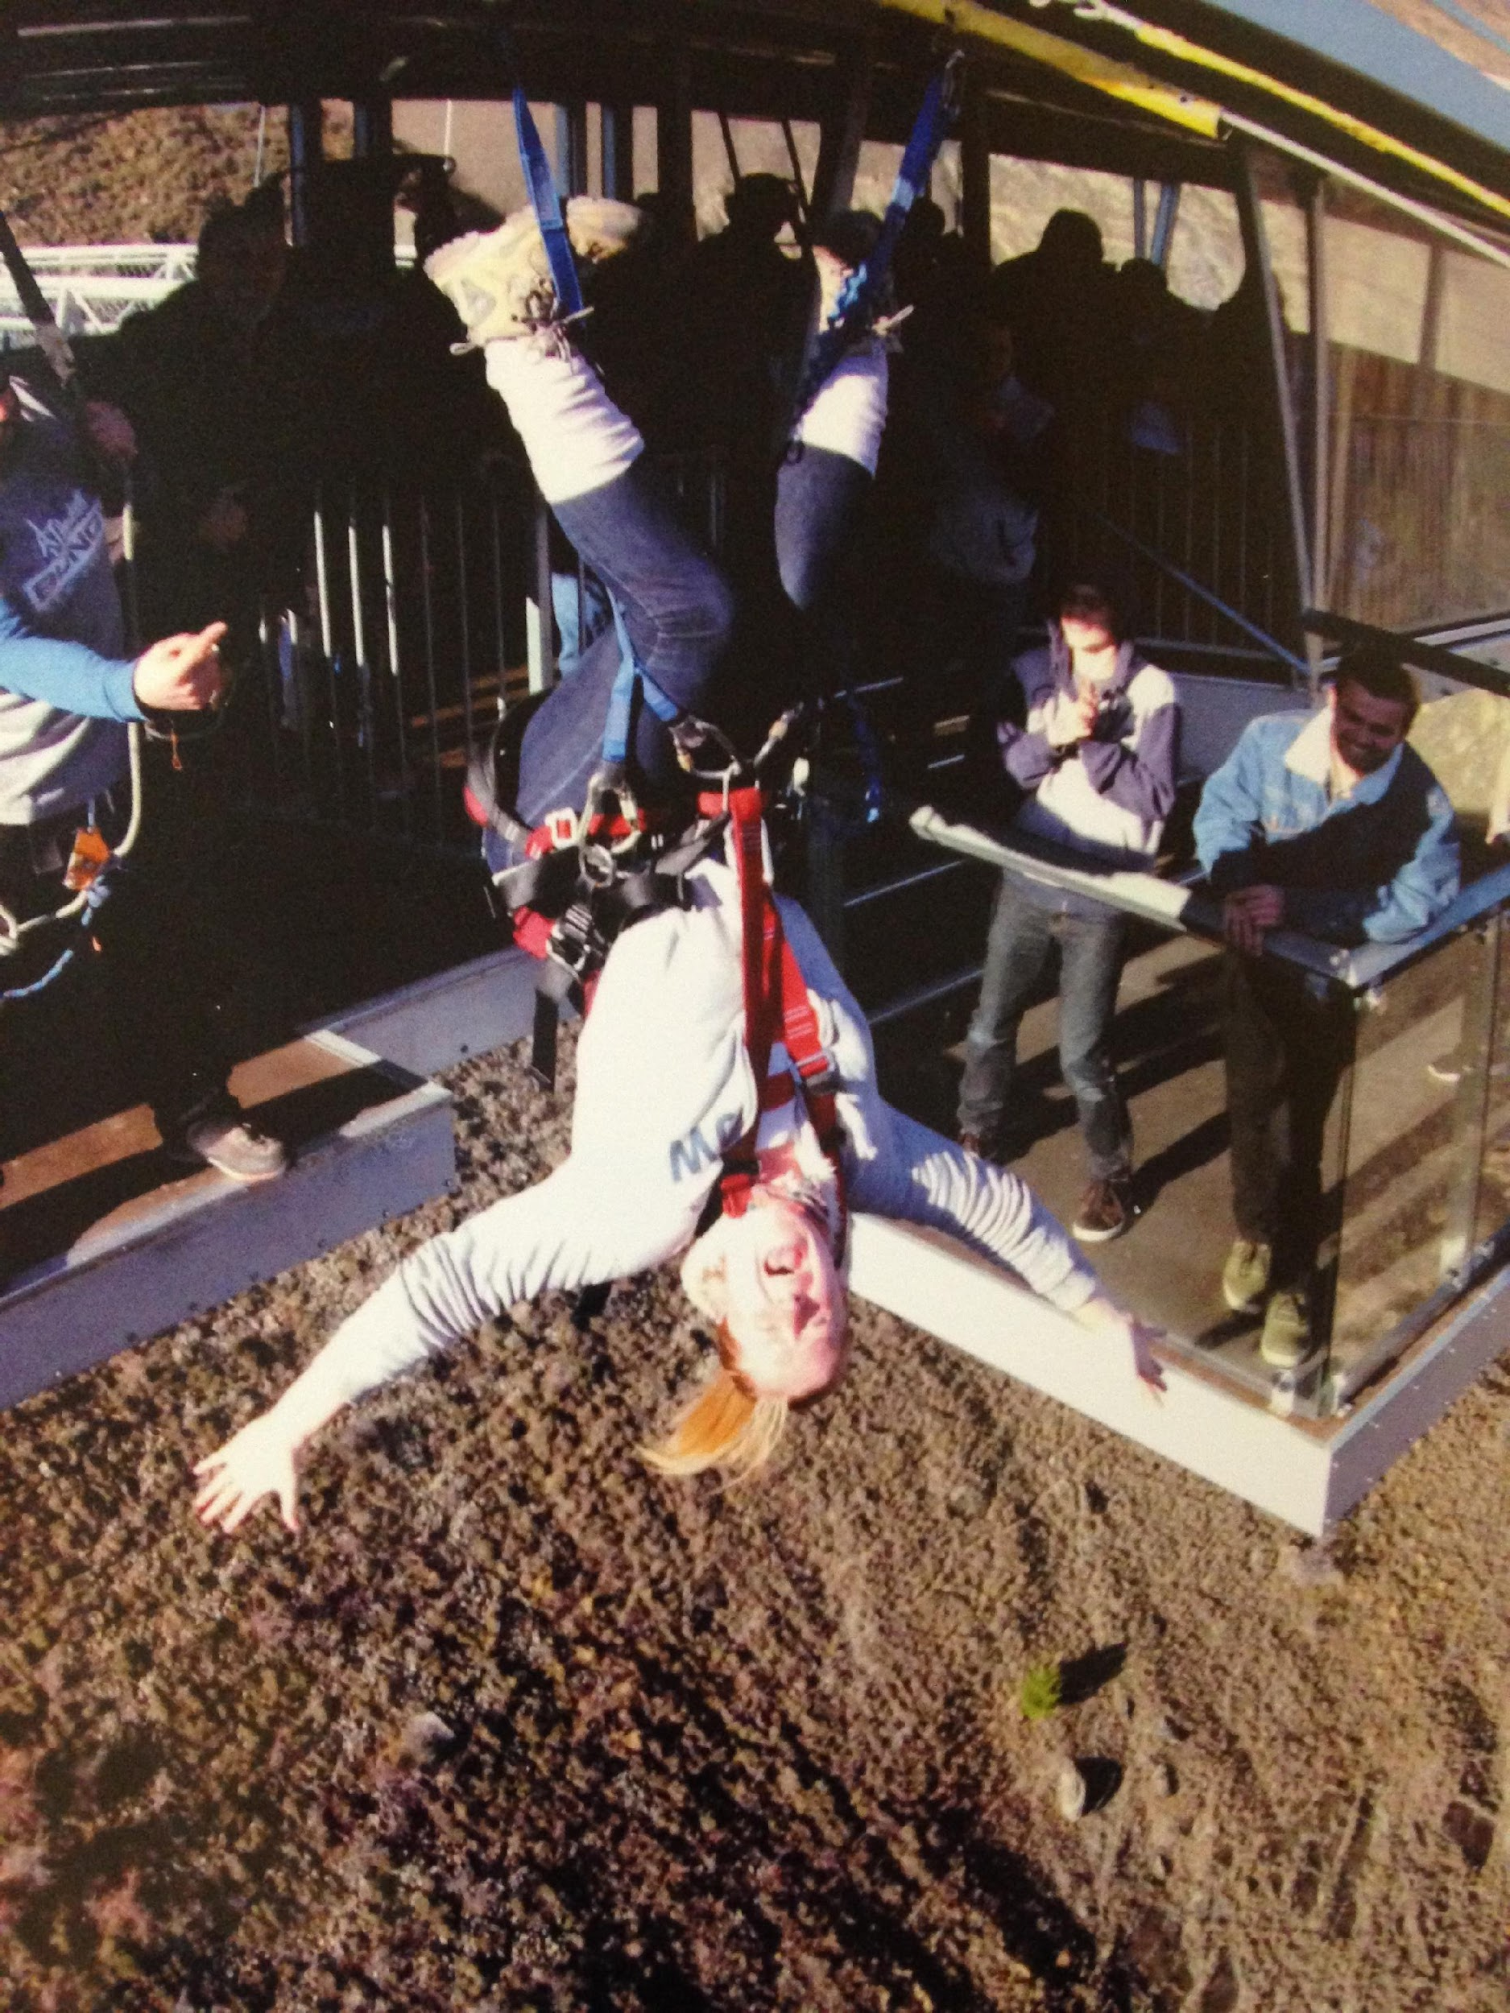
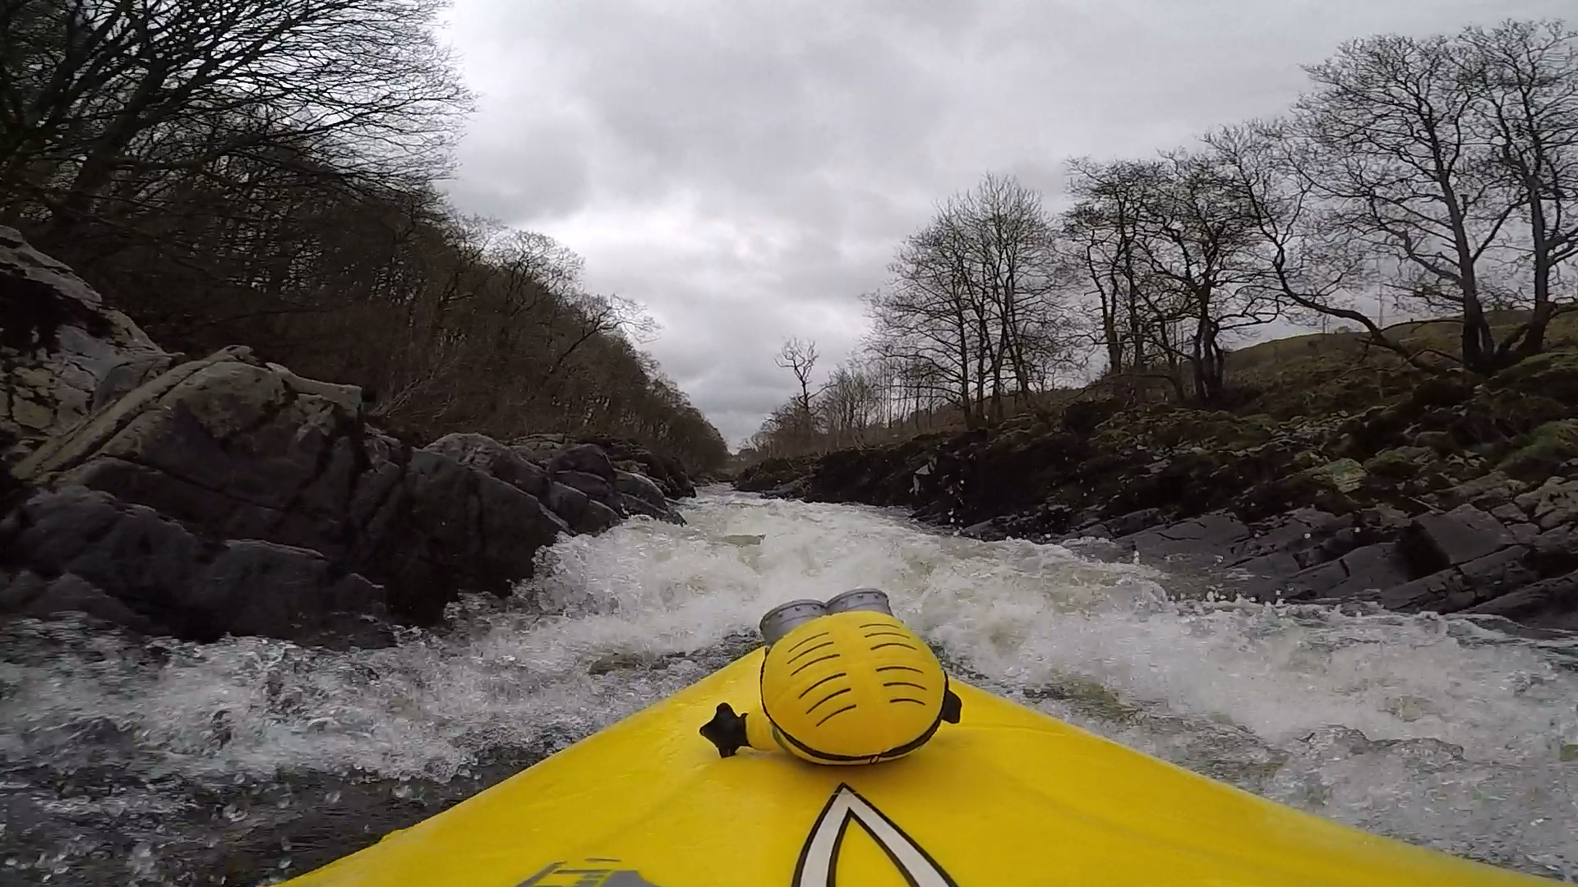
Why do people do it?
BTEC Tech Award Level 1/2 in Sport
Miss Dundas - PE Department

Slide 8
Why might people do this?
They enjoy it.
They feel a sense of achievement from the challenge.
Something different to traditional sports that they may not enjoy.
BTEC Tech Award Level 1/2 in Sport
Miss Dundas - PE Department

Slide 9
So thinking about why people do it….. What do you think are the benefits of these activities?
BTEC Tech Award Level 1/2 in Sport
Miss Dundas - PE Department

Slide 10
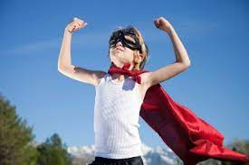
Benefits of outdoor activities
Improved self confidence
Improved self-esteem
Meet new people
Learn new skills
Time away from life stressors
Time away from electronic devices
BTEC Tech Award Level 1/2 in Sport
Miss Dundas - PE Department

Slide 11
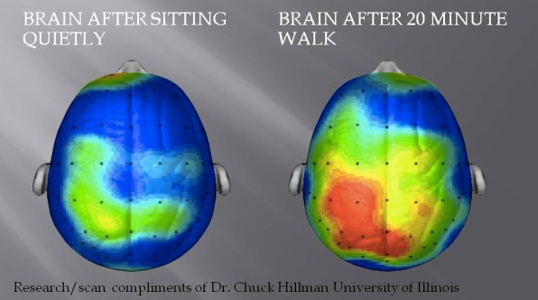
Endorphin release
Endorphins are released into the brain when you exercise.
Endorphins are neurotransmitters – a chemical linked with an energetic and positive outlook on life.
They also have other benefits such as:-
Reducing stress
Helping to fight anxiety and depression
Boosting self-esteem
Promoting restful sleep
BTEC Tech Award Level 1/2 in Sport
Miss Dundas - PE Department

Slide 12
Purple Zone Expectations
You are working independently.
You are working in silence.
No hands up or questions once the time has started.
You will have 5 minutes.
Let’s look at the task first…
Notes:
Letter to annotate for persuasive features

Slide 13
Purple Zone
Write down which outdoor activity you would most like to try and why? Or if you have done any of these before how did it make you feel?
Extension:
Add to your answer two different benefits of these activities.
Sentence starters | Top tip:
When I did …… I felt I want to try ….. because I think it will make me feel… | Try and think about the environment that these activities are set in.
BTEC Tech Award Level 1/2 in Sport
Miss Dundas - PE Department

Slide 14
Remember no question is a stupid question, apart from the one you didn’t ask.
Have a fantastic rest of the day!!
Complete your plenary task before you leave the room.
BTEC Tech Award Level 1/2 in Sport
Miss Dundas - PE Department

