Slide 1
Top left: Classwork
Top Right:
Monday, 15 November 2021
Title: Benefits of taking part in sport
Big Picture: Learning Outcome A: Explore types and provision of sport and physical activity for different types of participant.
Learning Objectives: To be able to highlight why it is important for your health and wellbeing to take part in sport and physical activity.
What we did last lesson: Types of sport and physical activity.
What are we doing next lesson: Outdoor activities.
BTEC Tech Award Level 1/2 in Sport
- PE Department

Slide 2
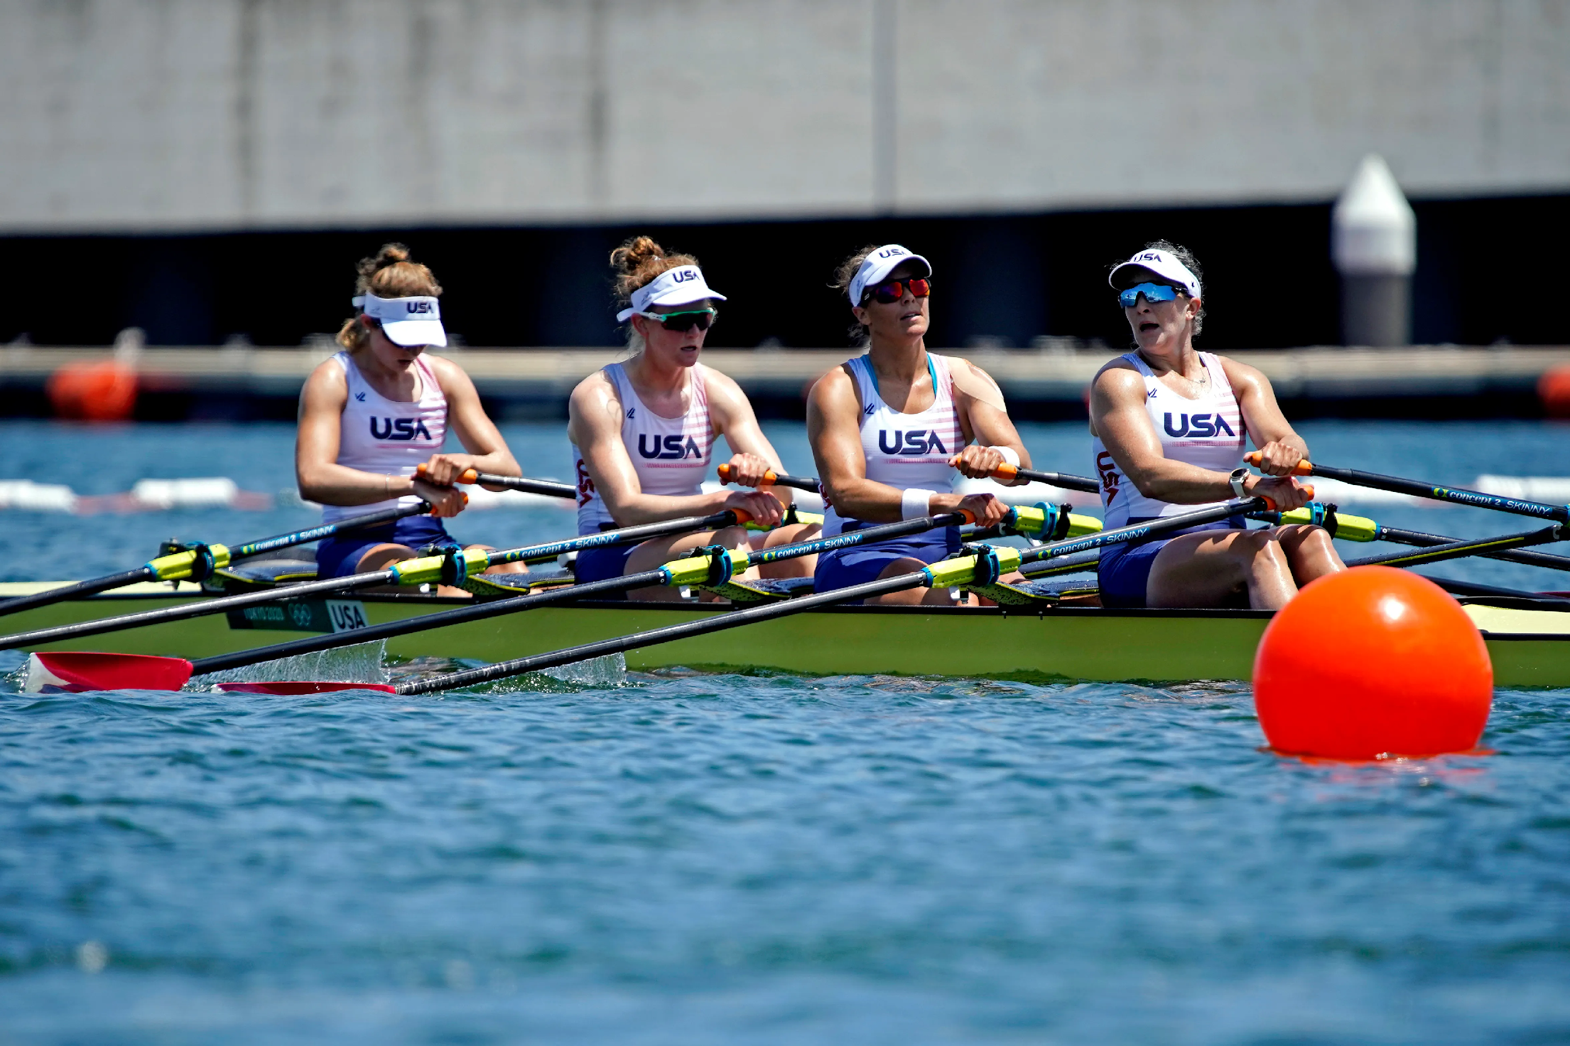
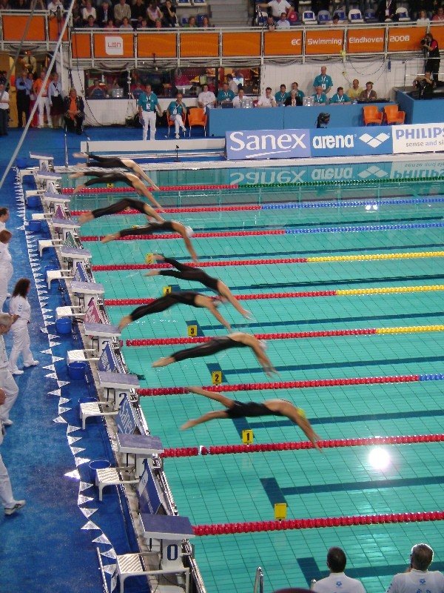
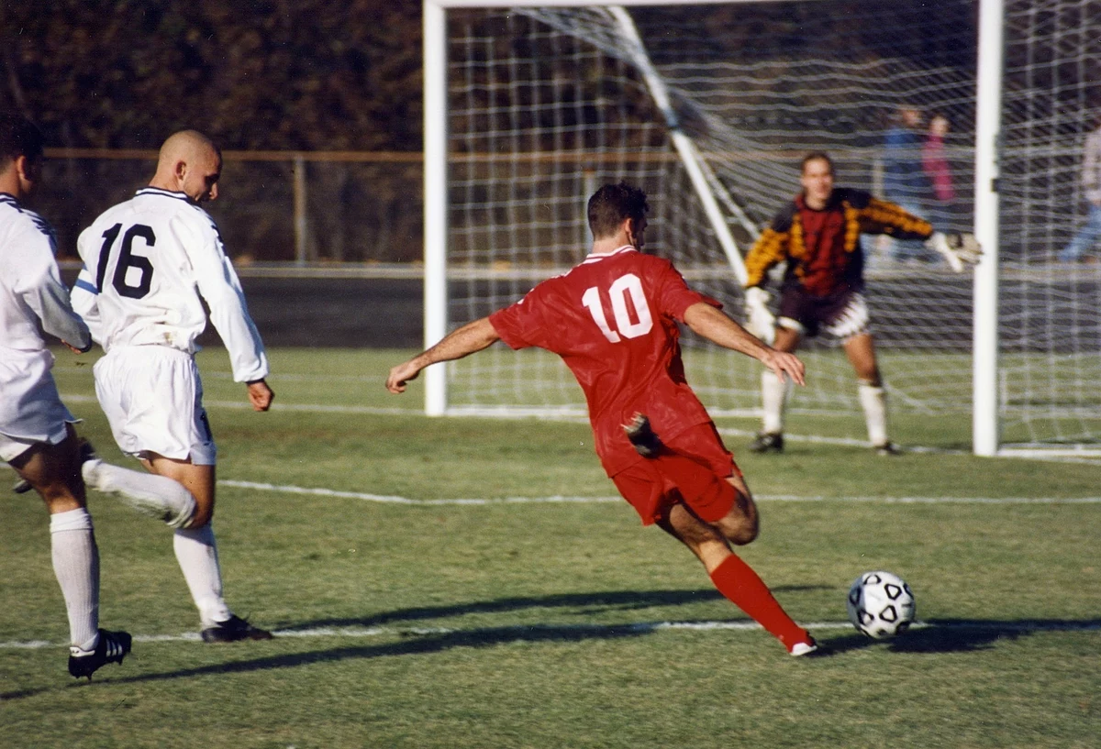
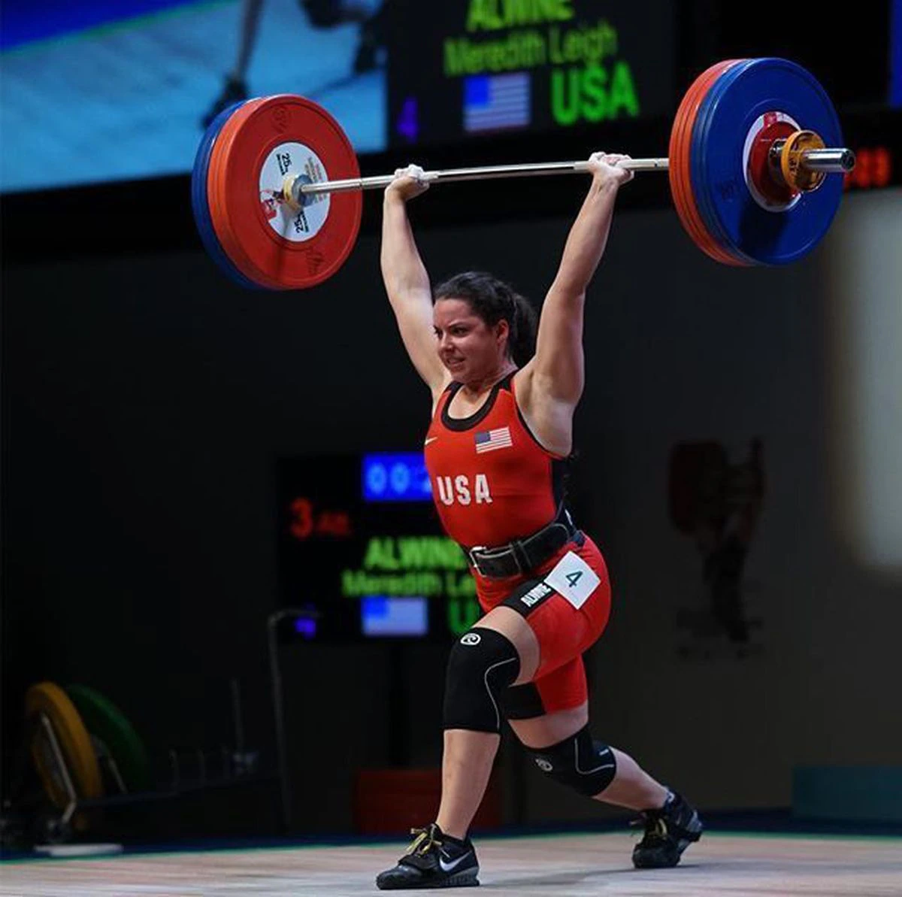
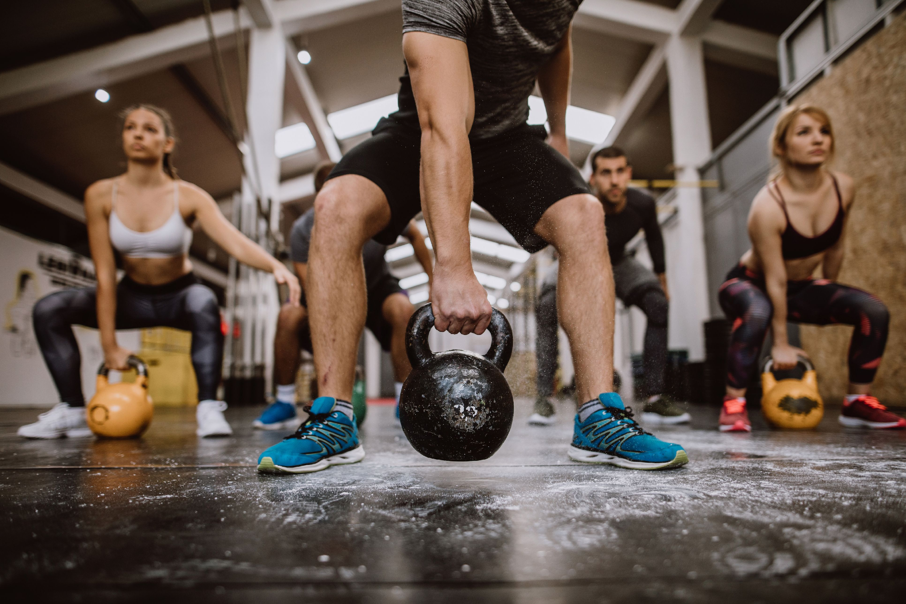
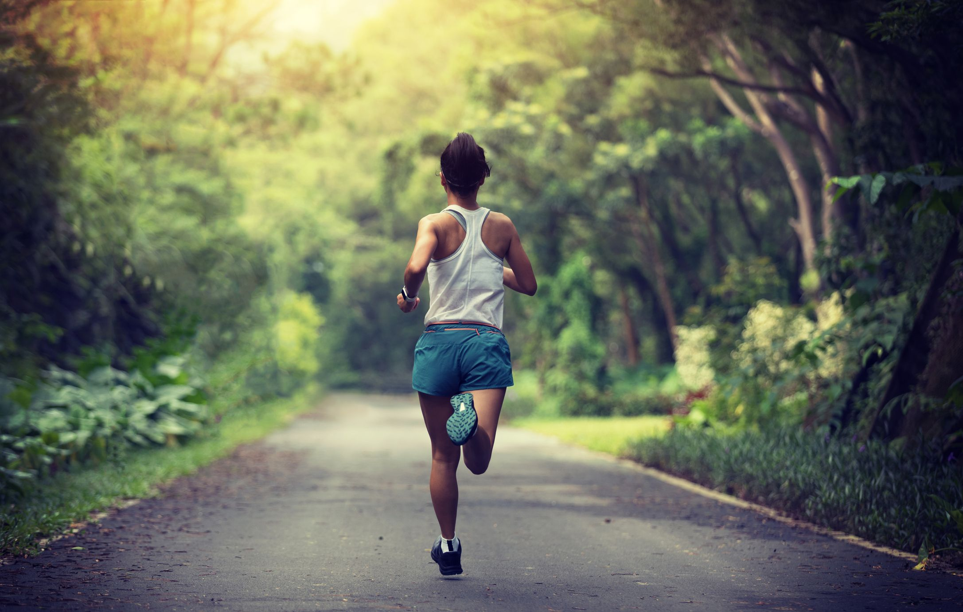
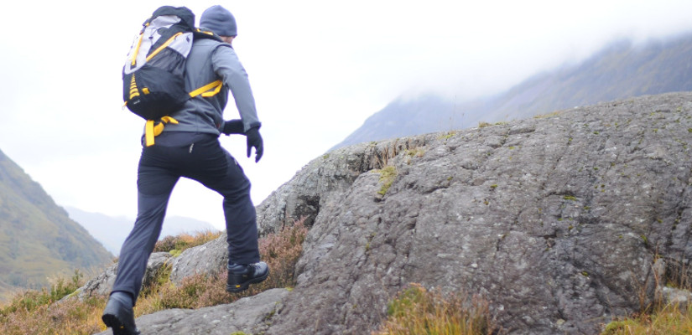
‘Hook’
Re-cap sports and physical activity.
Which is which? Sport or Physical Activity
BTEC Tech Award Level 1/2 in Sport
PE Department

Slide 3
Once you have taken part in sport or physical activity how do you feel?
Bullet point as many reasons as you can. Think about your PE lessons.
Clear mind
Too hot
Tired
Stress relieved
Energised
BTEC Tech Award Level 1/2 in Sport
PE Department

Slide 4
What are the benefits of taking part in sport?
Bullet point as many reasons as you can. Think about your Gorse Gets Healthy sessions.
BTEC Tech Award Level 1/2 in Sport
PE Department

Slide 5
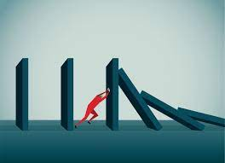
Benefits of taking part in sport
Improve fitness
Meet new people
Develop new leadership skills
Resilience
Self-confidence from competitions
BTEC Tech Award Level 1/2 in Sport
- PE Department

Slide 6
Who can remember the difference between sport and physical activity?
Which one is which?
BTEC Tech Award Level 1/2 in Sport
PE Department

Slide 7
Benefits of taking part in physical activity
Meet new people
Set fitness goals
Improve confidence
Improved body composition
Improve physical health
BTEC Tech Award Level 1/2 in Sport
PE Department

Slide 8
Purple Zone Expectations
You are working independently.
You are working in silence.
No hands up or questions once the time has started.
You will have 5 minutes.
Let’s look at the task first…
Notes:
Letter to annotate for persuasive features

Slide 9
Purple Zone
Write a short paragraph to explain three different benefits of taking part in sport and physical activity.
Extension:
Can you complete a second paragraph with different benefits?
Sentence starters | Top tip:
Sport is important because… Physical activity can benefit an individual because… | Look at the table that we have just completed together as a class and put it into full sentences. Identify sport or physical activity. Name the benefit.
BTEC Tech Award Level 1/2 in Sport
- PE Department

Slide 10
Remember no question is a stupid question, apart from the one you didn’t ask.
Have a fantastic rest of the day!!
Complete your plenary task before you leave the room.
BTEC Tech Award Level 1/2 in Sport
- PE Department

