Slide 2
Recap and recall
Name 2 team sports and 2 individual sports.
What is the difference between team sports and individual sports?
Where would you do OAA?
Explain what a NGB is.
Date: Monday 9th May 2022
Big question: Can I explain how sports and physical activity participation can affect an individual?
Lesson question: Can I compare the differences between a range of physical activities?
Expectations
Complete all work to a high standard
Books kept neat and tidy
Hands up to contribute
Do not talk when I am talking
Dream big!!! - Why should we exercise?

Slide 3
BTEC Component 1 - preparing participants to take part in sport and physical activity
Lesson question: Can I compare the differences between a range of physical activities?

Slide 4
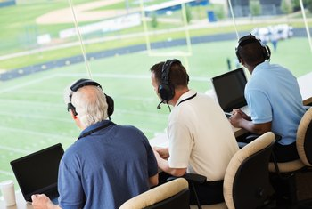
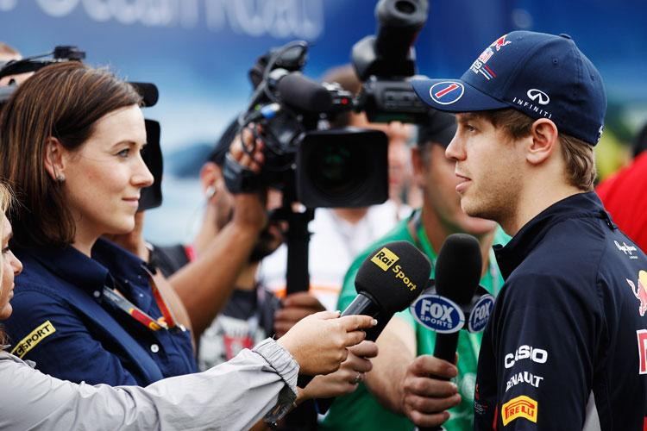
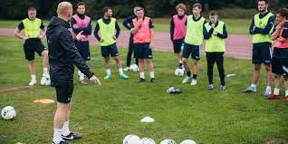
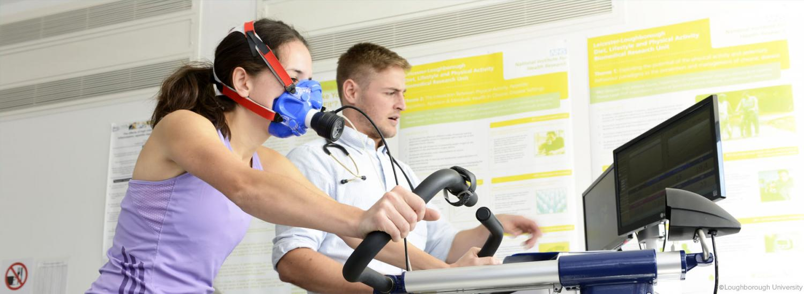
Careers in sport…
Lesson question: Can I compare the differences between a range of physical activities?

Slide 5
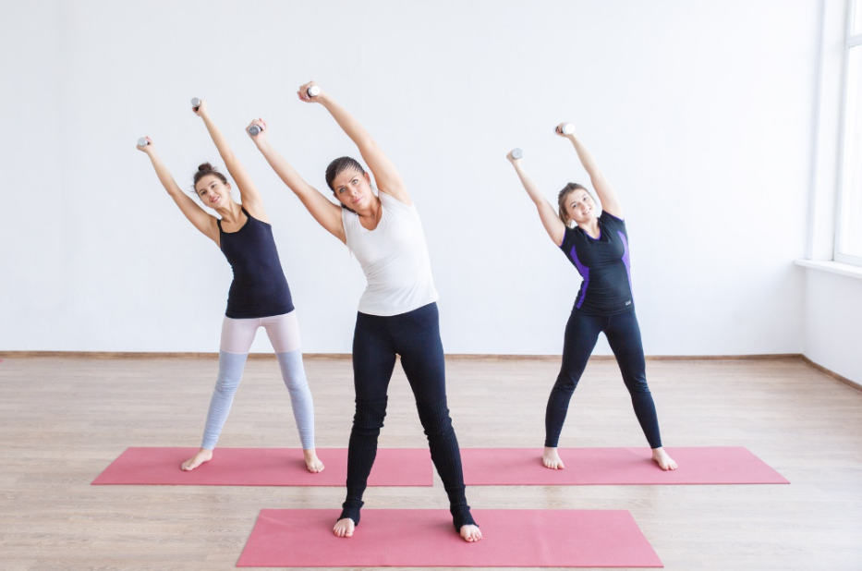
What are physical activities?
With the person next to you discuss what you think physical activities might be…
Definition:
Physical activities are any form of exercise or movement of the body that uses energy.
Exercise is a structured program of activity geared toward achieving or maintaining physical fitness. It is actually a sub-category of physical activity
Lesson question: Can I compare the differences between a range of physical activities?

Slide 6
Activities that increase fitness
Physical activities can increase levels of fitness.
Physical fitness refers to an athlete's capacity to meet the varied physical demands of their sport without reducing the athlete to a fatigued state.
Lesson question: Can I compare the differences between a range of physical activities?

Slide 7
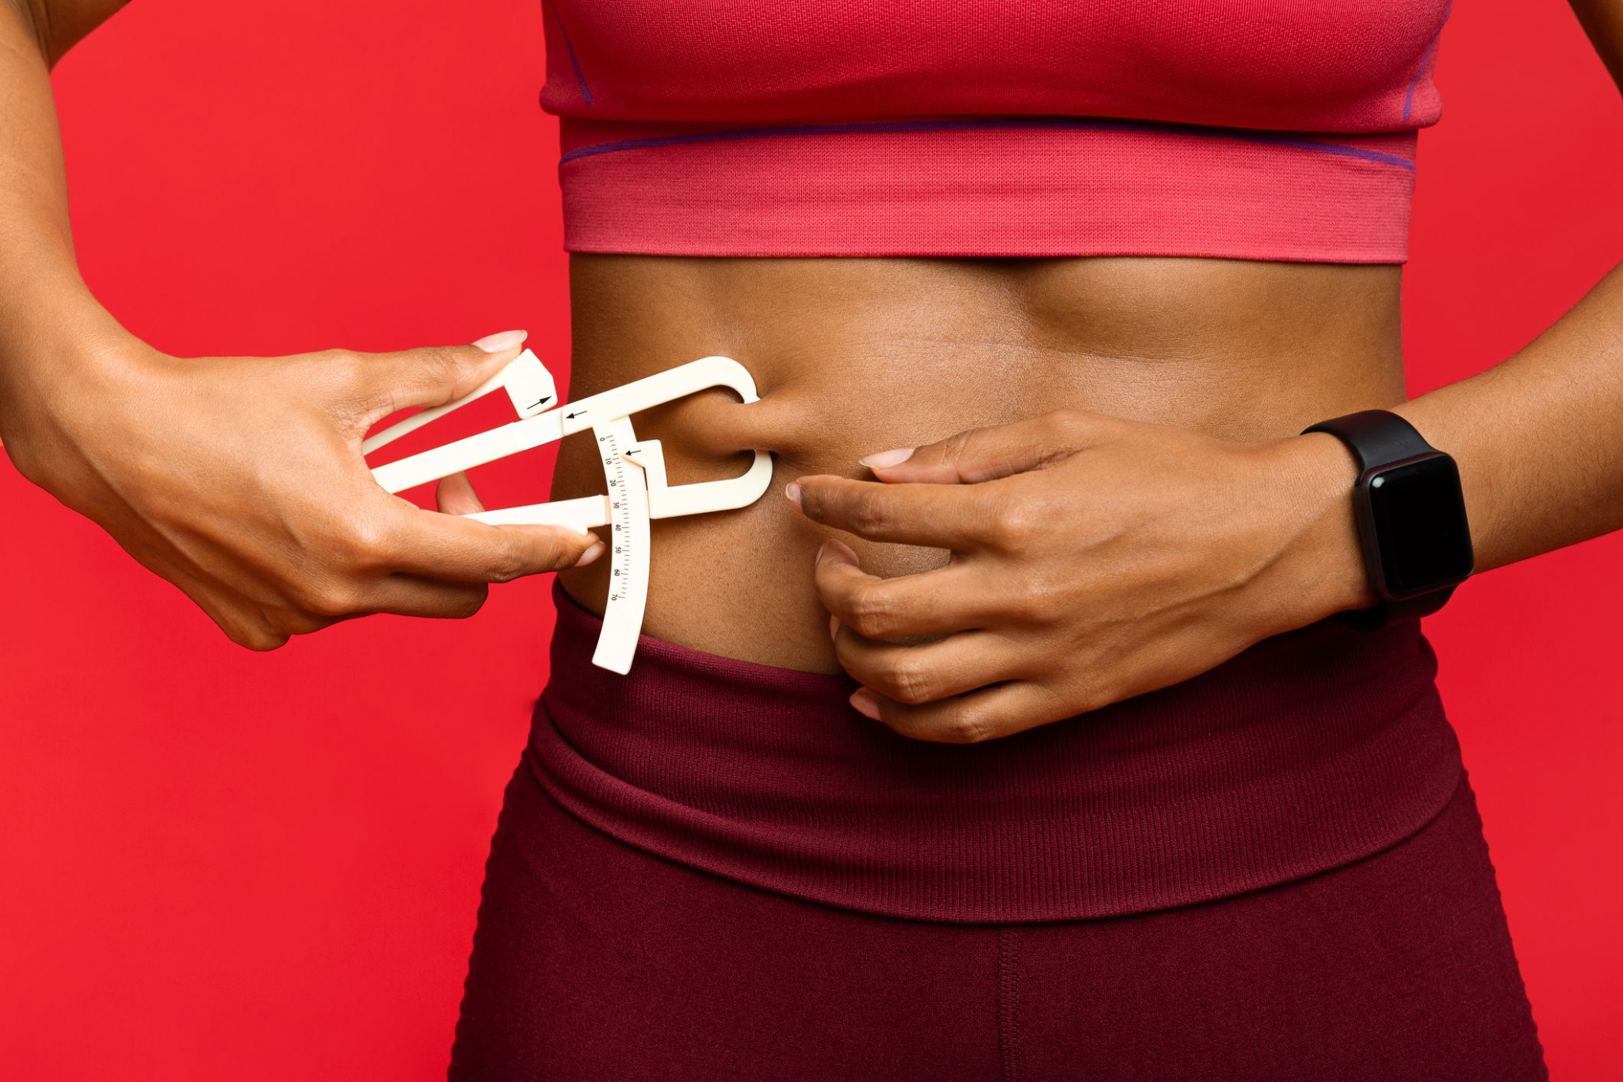
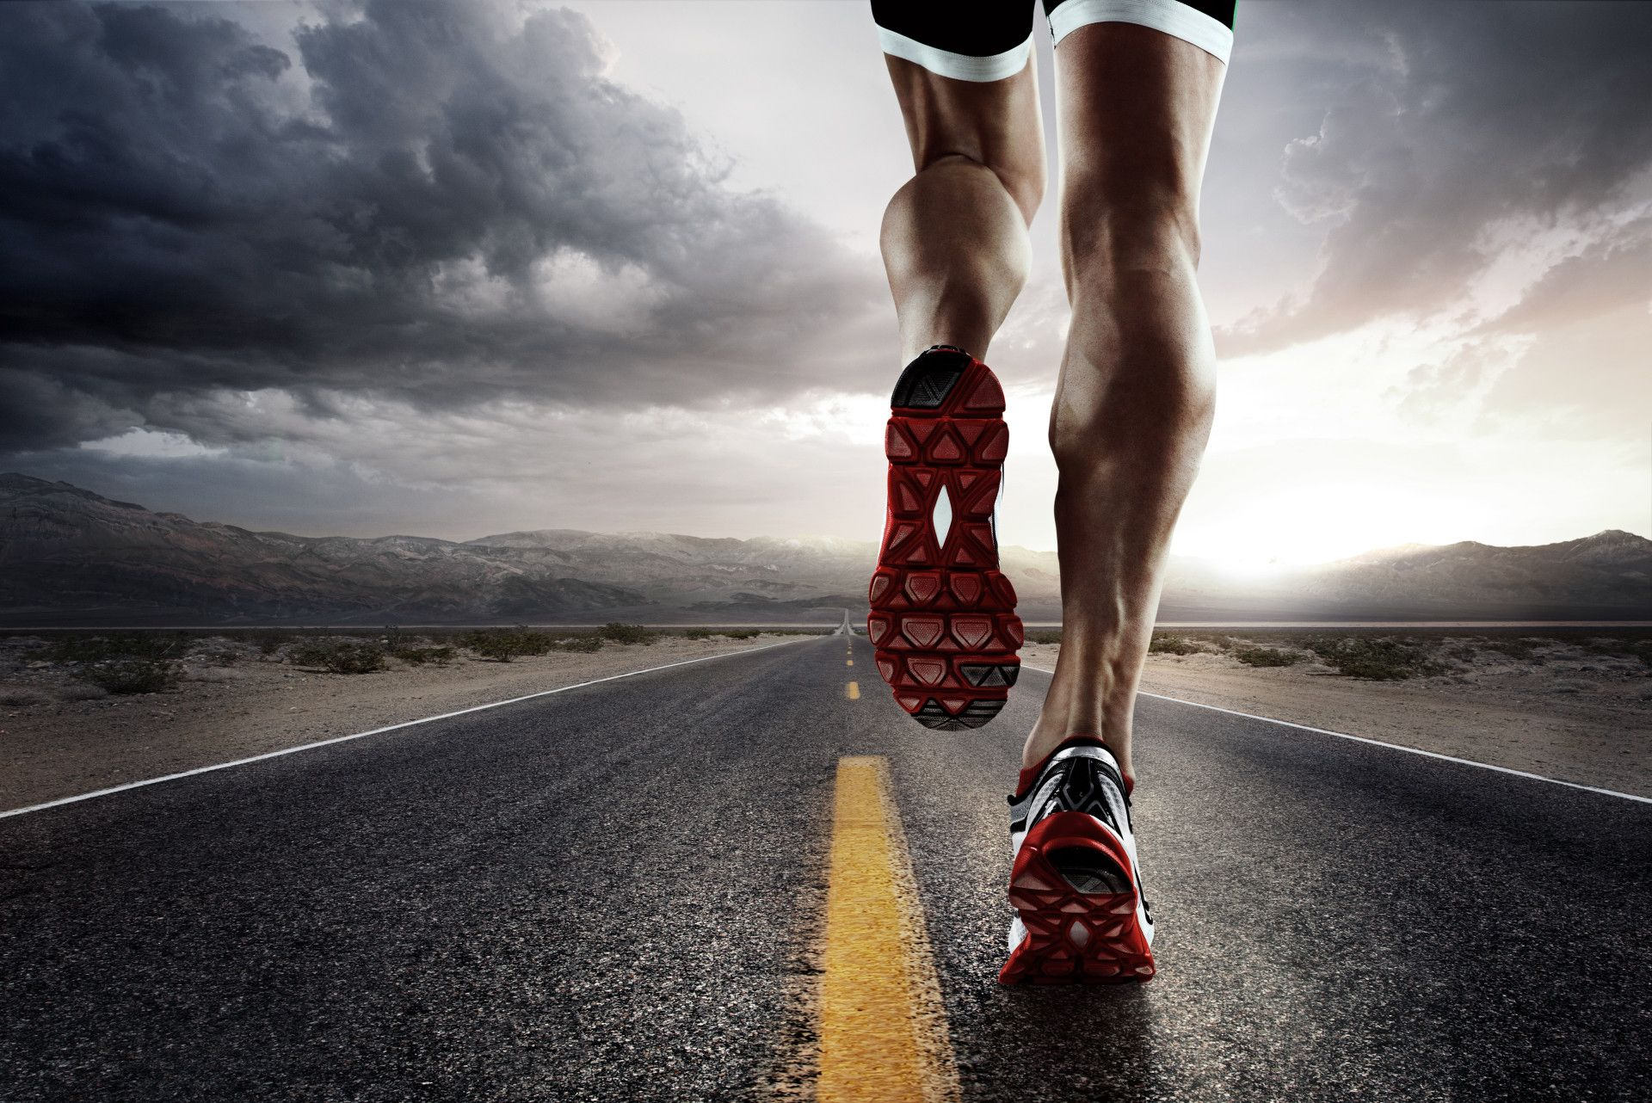
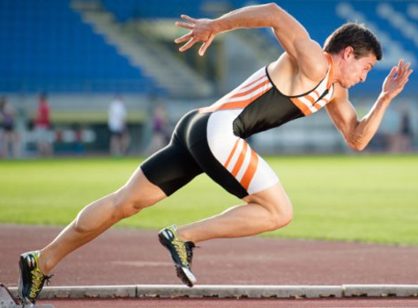
There are 5 components of fitness…
Can you identify what the 5 components of fitness might be? Write them down in your books!
1
2
BODY COMPOSITION
ENDURANCE
3
4
5
SPEED
STRENGTH
FLEXIBILITY
Lesson question: Can I compare the differences between a range of physical activities?

Slide 8
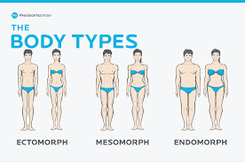
BODY COMPOSITION
Body composition refers to the athlete's body fat. In most sports, the athlete will try to keep his/her levels of body fat to a minimum. In general, the higher the percentage of body fat, the lower the performance.
A fit woman's body fat generally falls between 21% and 24%. A fit man's body fat generally falls between 14% and 17%
Lesson question: Can I compare the differences between a range of physical activities?

Slide 9
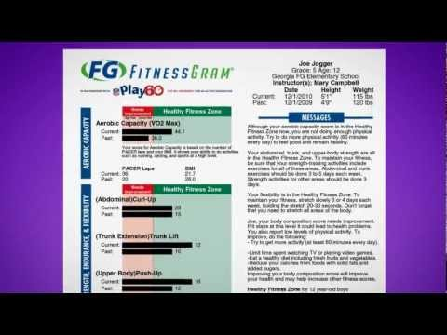

Slide 10
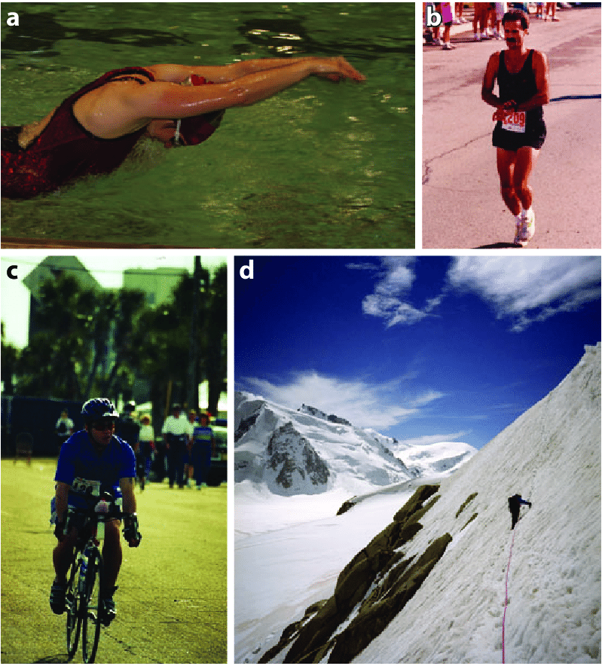
ENDURANCE
We can define endurance as the ability to continue to endure a stress, hardship or level of suffering. refers to training the aerobic system as opposed to the anaerobic system
What is an endurance sport?… An endurance sport is any sport in which there is a requirement to sustain an activity level while enduring a level of physical stress.
What activities would increase endurance? Or be considered an endurance activity?
Lesson question: Can I compare the differences between a range of physical activities?

Slide 11
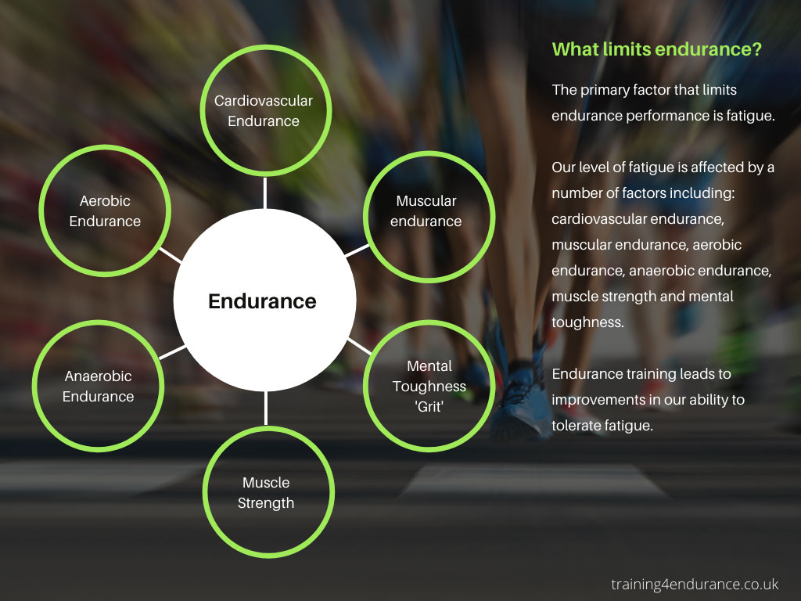
ENDURANCE
Task - in your own words summarise the benefits of endurance activities
Improves the efficiency of heart, respiratory and circulatory systems.
Increased ability to absorb and transport oxygen.
Improved capacity of muscles to absorb and use oxygen.
Increase efficiency of aerobic energy systems.
Improved VO2 Max

Slide 12
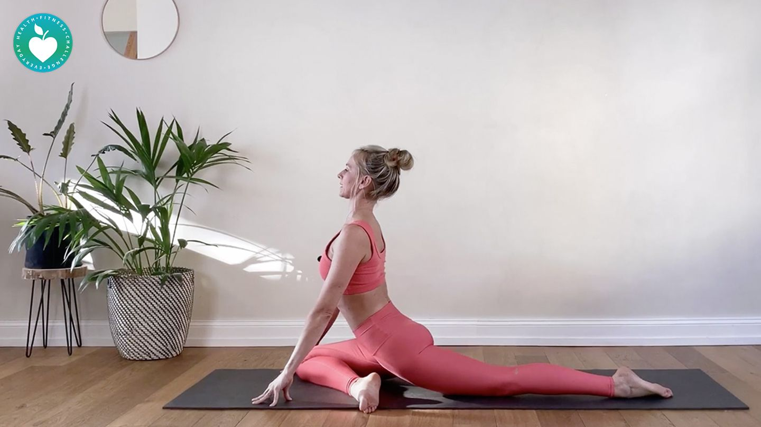
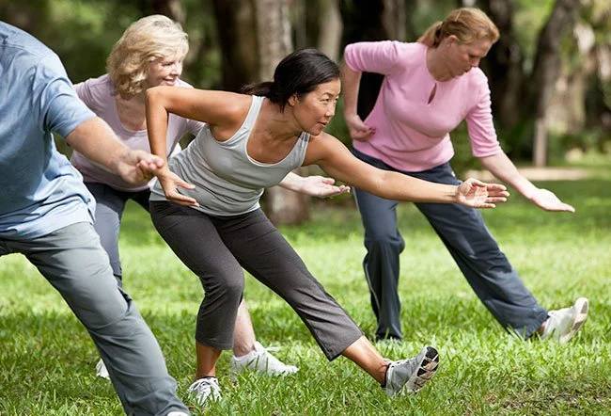
FLEXIBILITY
Flexibility is the range of movement possible at a joint. It allows performers to reach, stretch and move their joints to gain possession, to make a motif look interesting or to achieve a more effective or efficient position.
Stretching
Tai Chi
Pilates
Yoga
Dream big - what might be the possible benefits of flexibility?
Lesson question: Can I compare the differences between a range of physical activities?
Notes:
Discuss posture, movement, mobility, reduces risk of injury and muscle soreness.

Slide 13
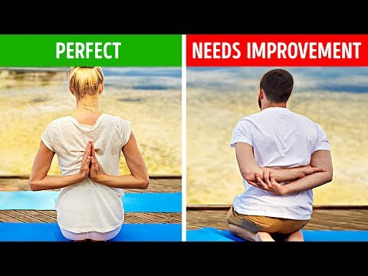
TEST YOUR FLEXIBILITY
Lesson question: Can I compare the differences between a range of physical activities?

Slide 14
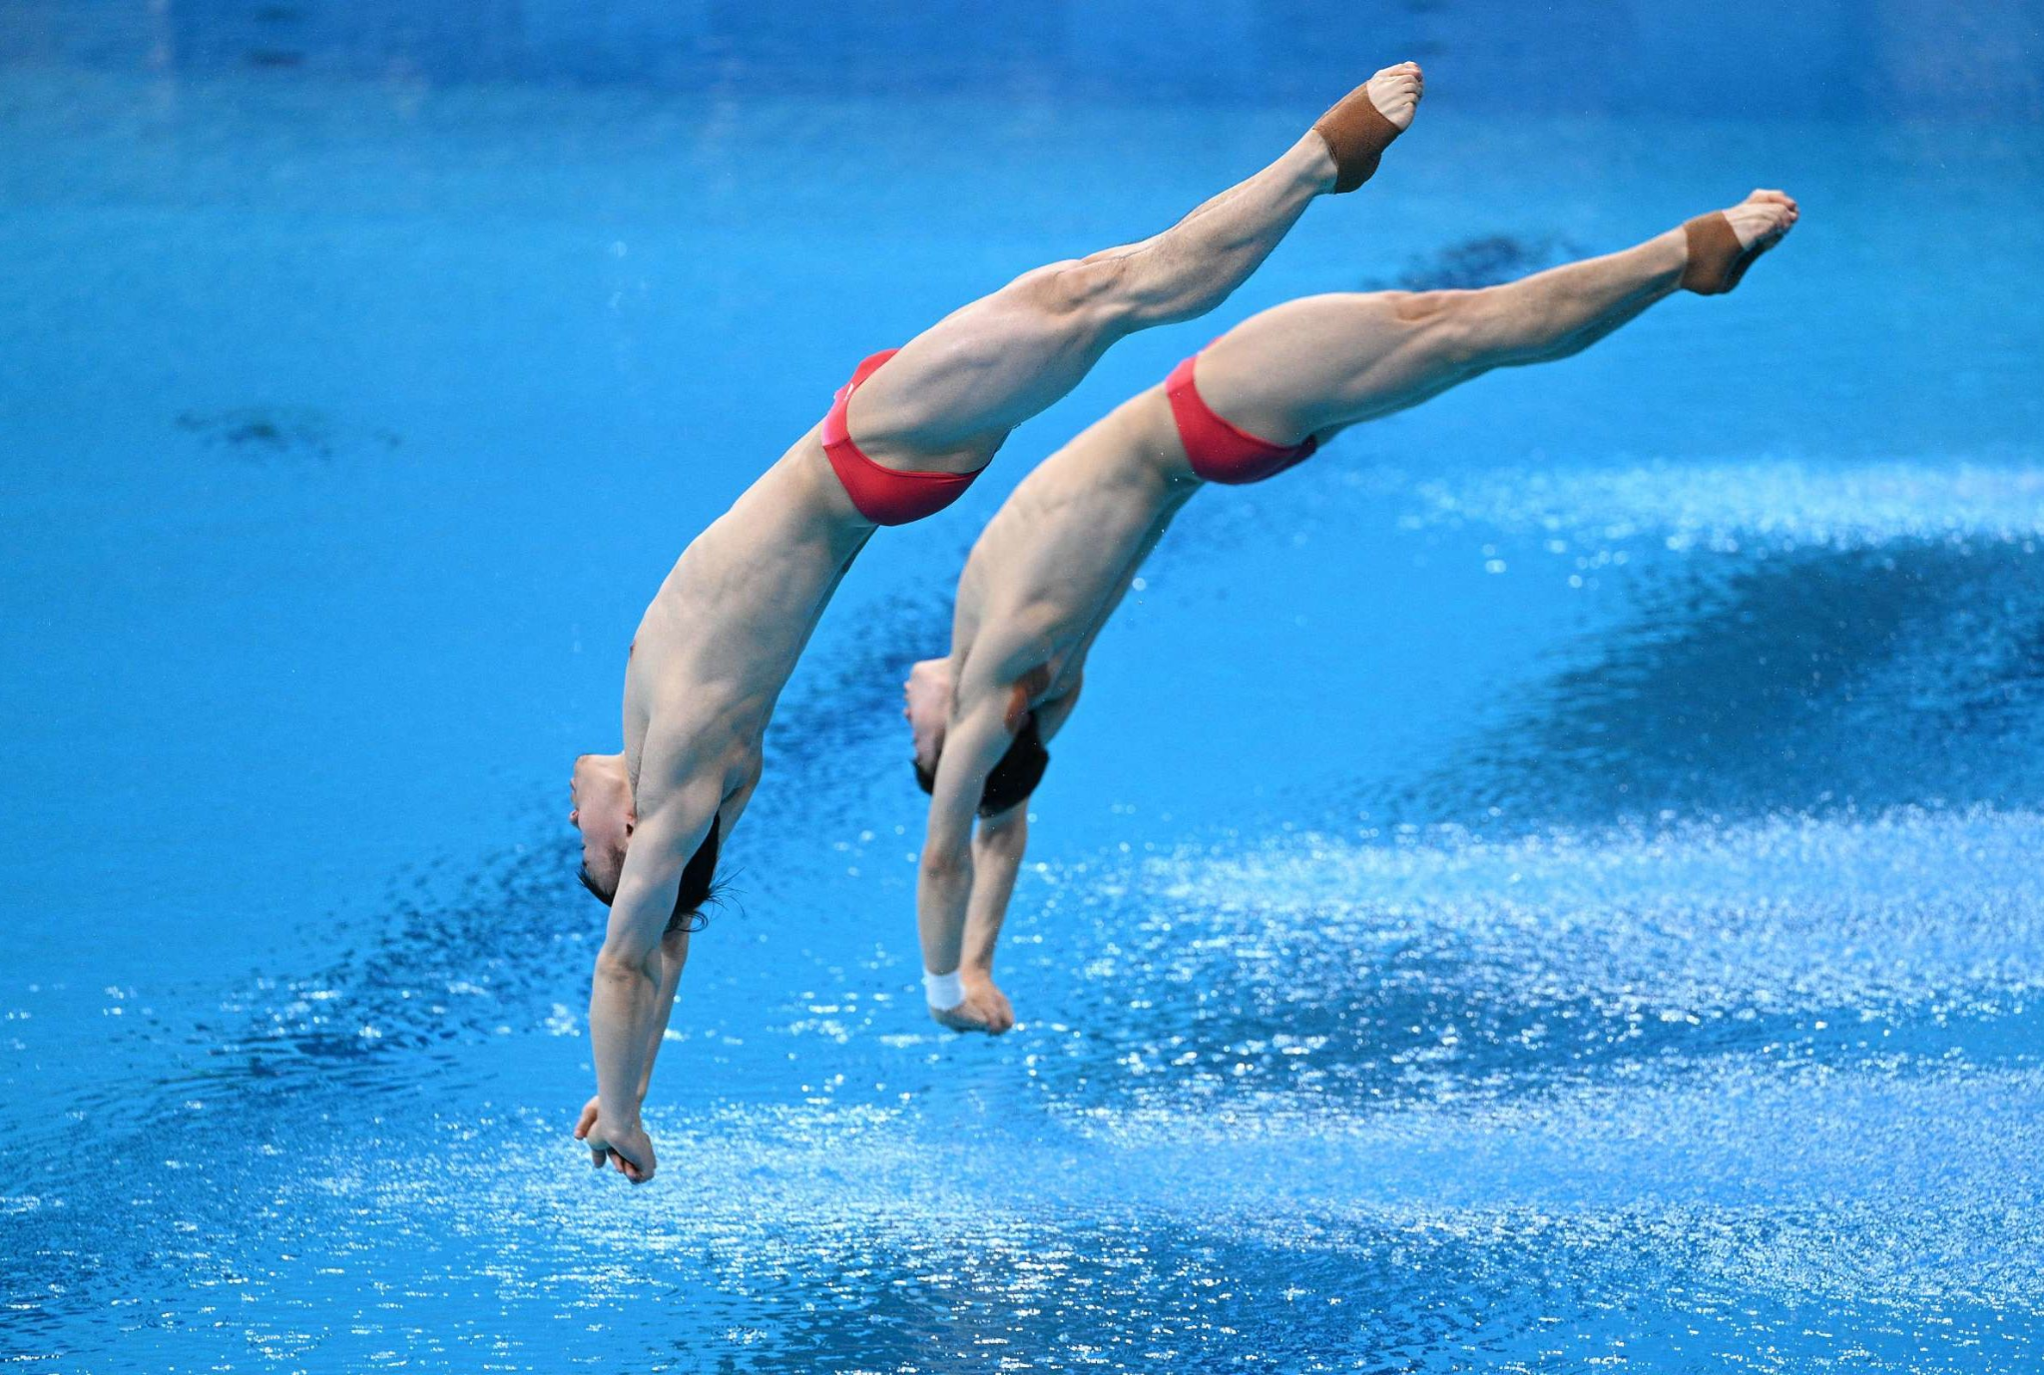
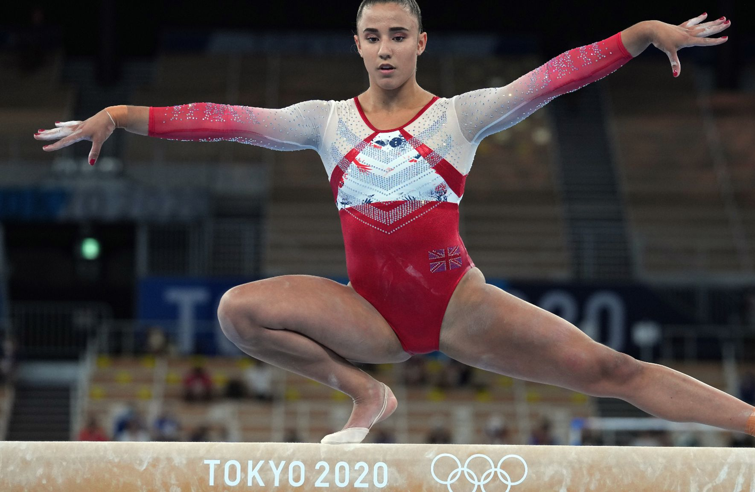
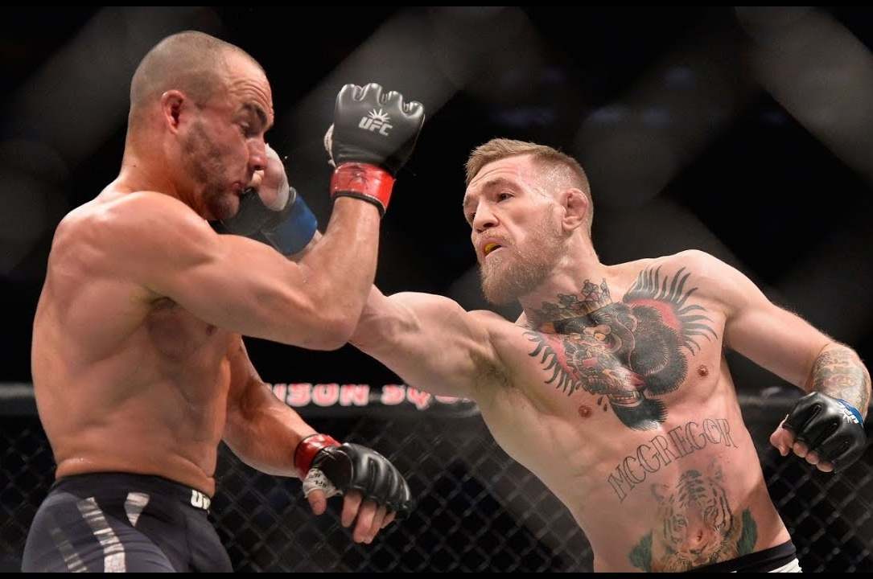
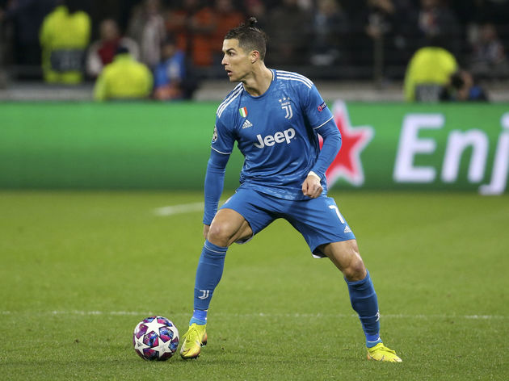
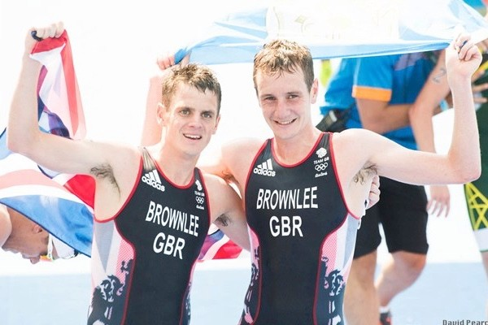
Flexibility and sport
Diver
Gymnast
UFC fighter
Sports analyst time!!
Choose one of the following sports and analyse why it is important to be flexible.
Top tip - include the benefits we have discussed..
*Model*
Footballer
Triathlete (Swim, run, bike)
Lesson question: Can I compare the differences between a range of physical activities?

Slide 15
STRENGTH
The common definition is "the ability to exert a force against a resistance". The strength needed for a sprinter to explode from the blocks is different from the strength required by a weightlifter to lift a 200kg barbell.
Activities that increase strength
Resistance training (also called strength training or weight training) is the use of resistance to muscular contraction to build the strength, anaerobic endurance and size of skeletal muscles.
In your group, you need to make a spider diagram and think of different activities that will increase strength.
HINT!! - what might you use in a gym?
Lesson question: Can I compare the differences between a range of physical activities?

Slide 16
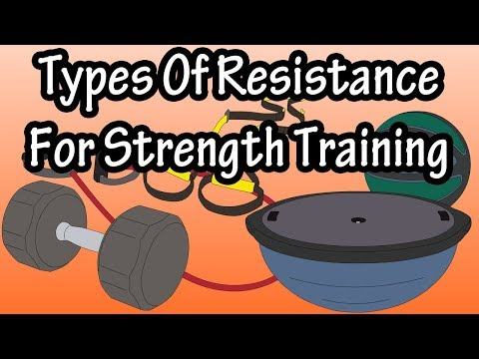
STRENGTH
As the video plays, add to your spider diagram. Once you have finished you need to all copy the spider diagram in your books
Lesson question: Can I compare the differences between a range of physical activities?

Slide 17
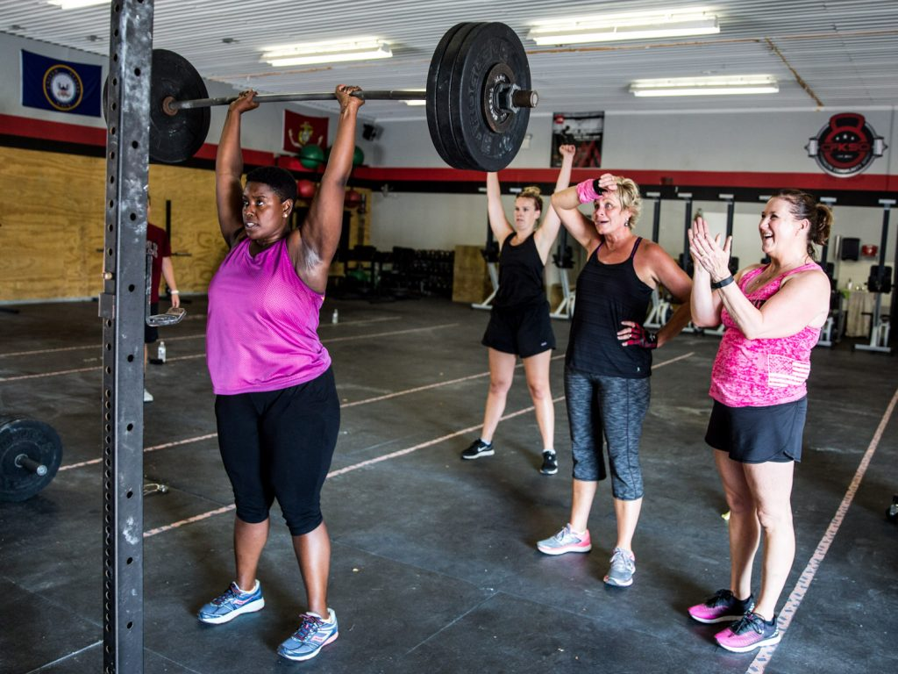
STRENGTH
Another form of strength activities might be classes in the gym such as:
BodyPump
Crossfit
GRIT
Legs, Bums and Tums
Lesson question: Can I compare the differences between a range of physical activities?

Slide 18
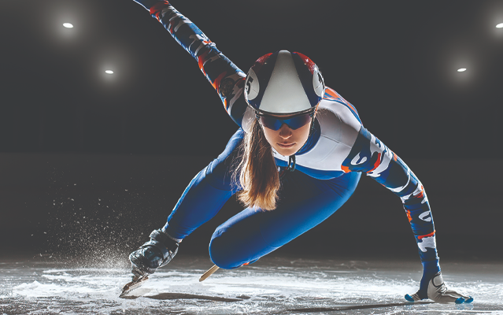
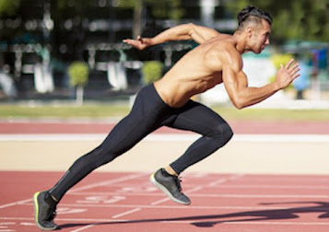
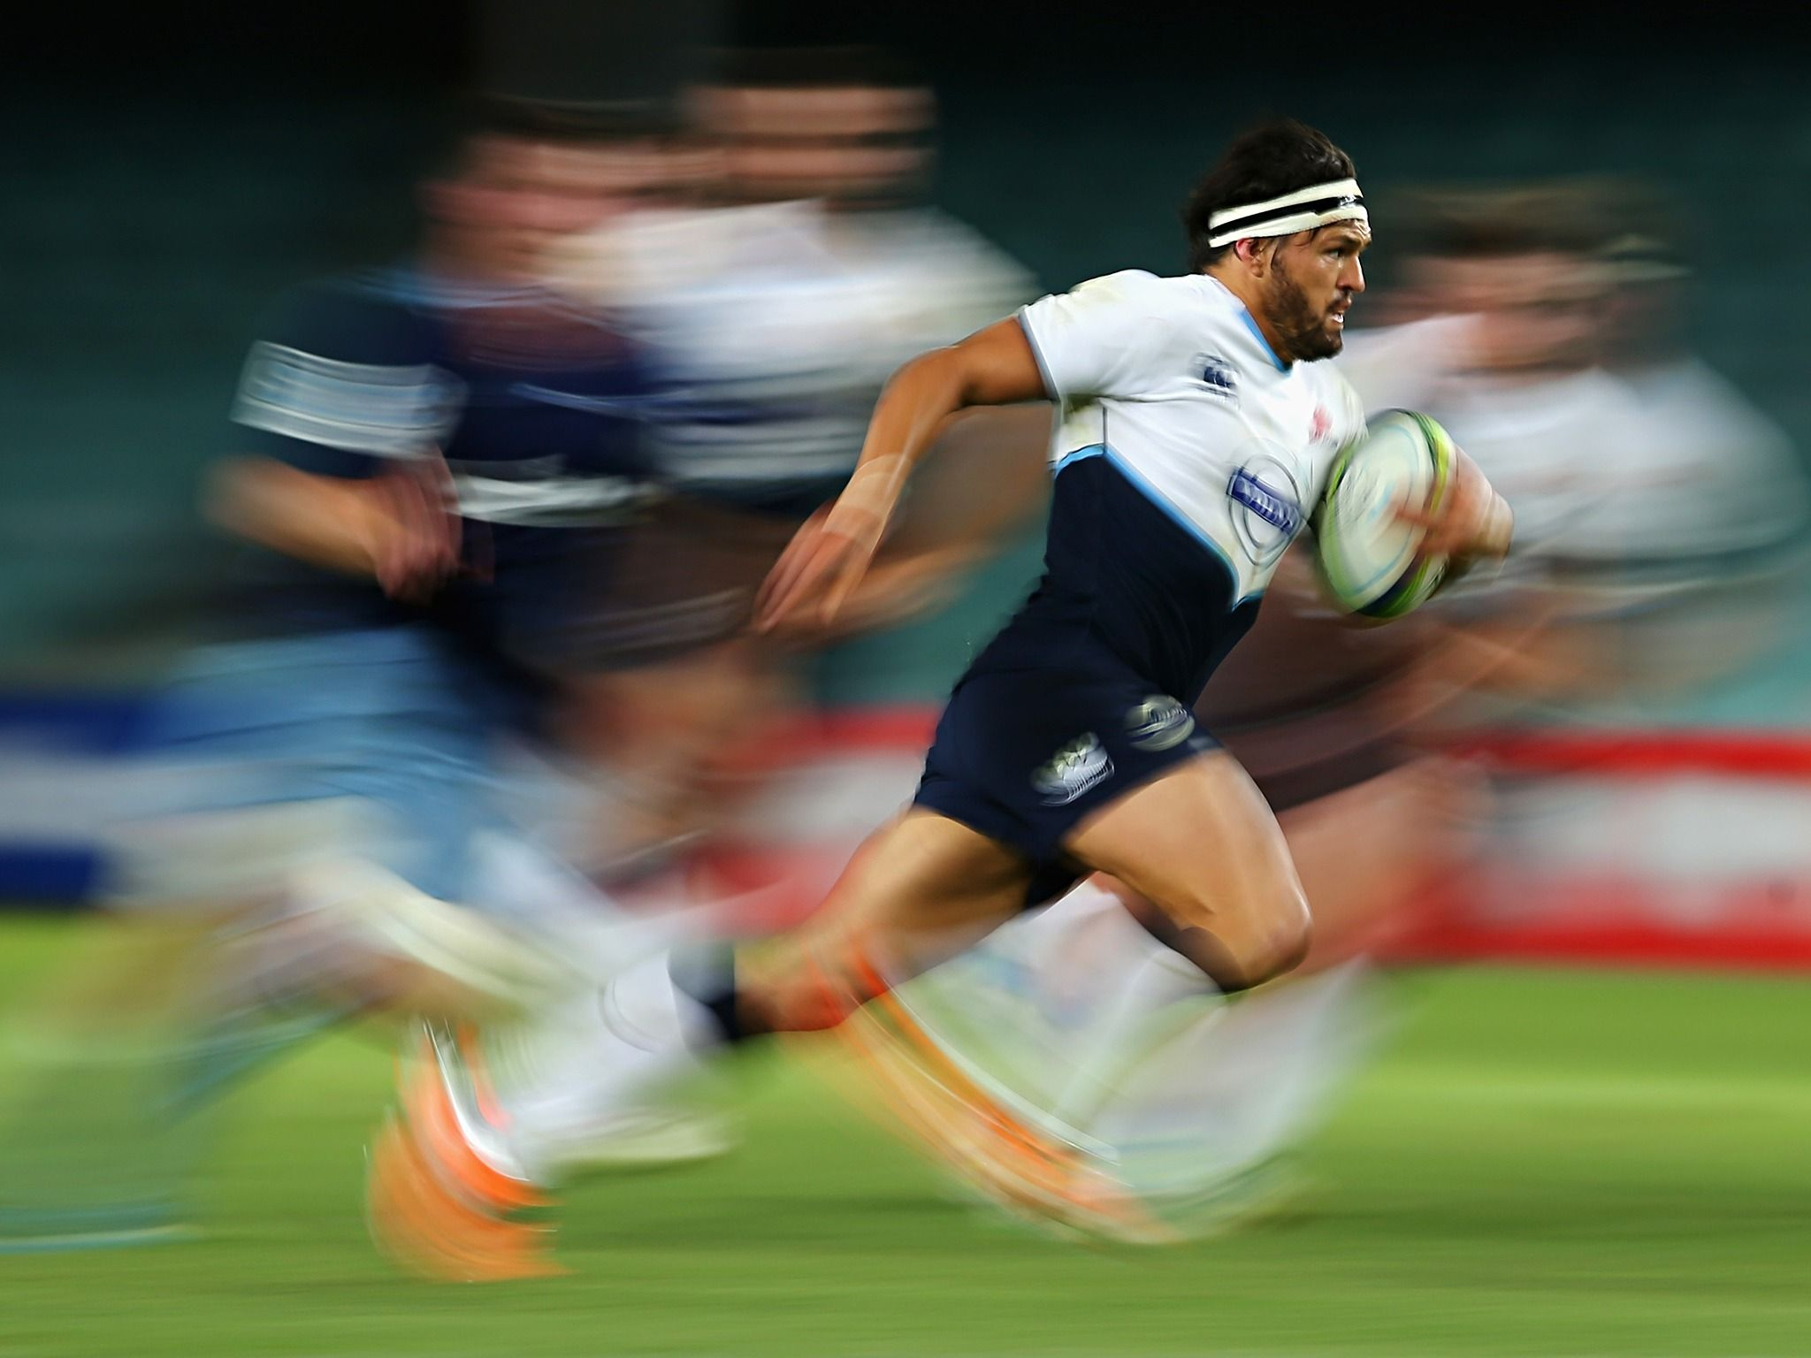
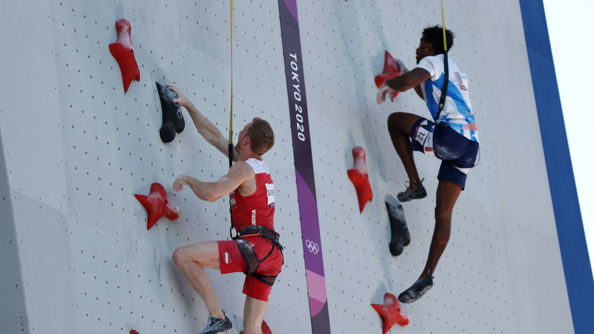
SPEED
Speed is the rate at which someone or something moves or operates or is able to move or operate.
Which sports need speed to be successful?
How do all the components of fitness related together?
Lesson question: Can I compare the differences between a range of physical activities?

Slide 19
Independent task
Task -
Using the information we have gathered in today's lesson - I want you to compare the difference between three different activities and explain why they are different using the information about which component of fitness the activity falls into
Key words - strength, speed, flexibility, endurance.
Comparison words - on the other hand, however, this is because,
Lesson question: Can I compare the differences between a range of physical activities?

Slide 20
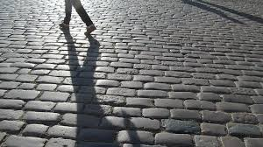
Lesson Expectations
End of the Lesson
Clear away all your equipment or log off if on a computer when told to, never turn the computers off.
Do not pack up until told to.
When you pack up, make sure your desk is tidy and make sure your chair is under.
Once your areas is clean and tidy please stand behind your desk with your chair tucked in.
Please check your uniform before you leave the classroom

