Slide 2
Recap and recall
Define resilience
List three benefits that exercise has to our physical health
Explain what might be the negative effects of not participating in sport
Date: Tuesday 4th October
Big question: Can I explain how sports and physical activity participation can affect an individual?
Lesson question: Can explain the different types of provision available for outdoor adventurous activities?
Expectations
Complete all work to a high standard
Books kept neat and tidy
Hands up to contribute
Do not talk when I am talking
Dream big!!! - Why is cardiovascular fitness important when taking part in PA?

Slide 3
BTEC Component 1 - preparing participants to take part in sport and physical activity
Lesson question: Can I explain the benefits of outdoor adventurous activities?

Slide 4
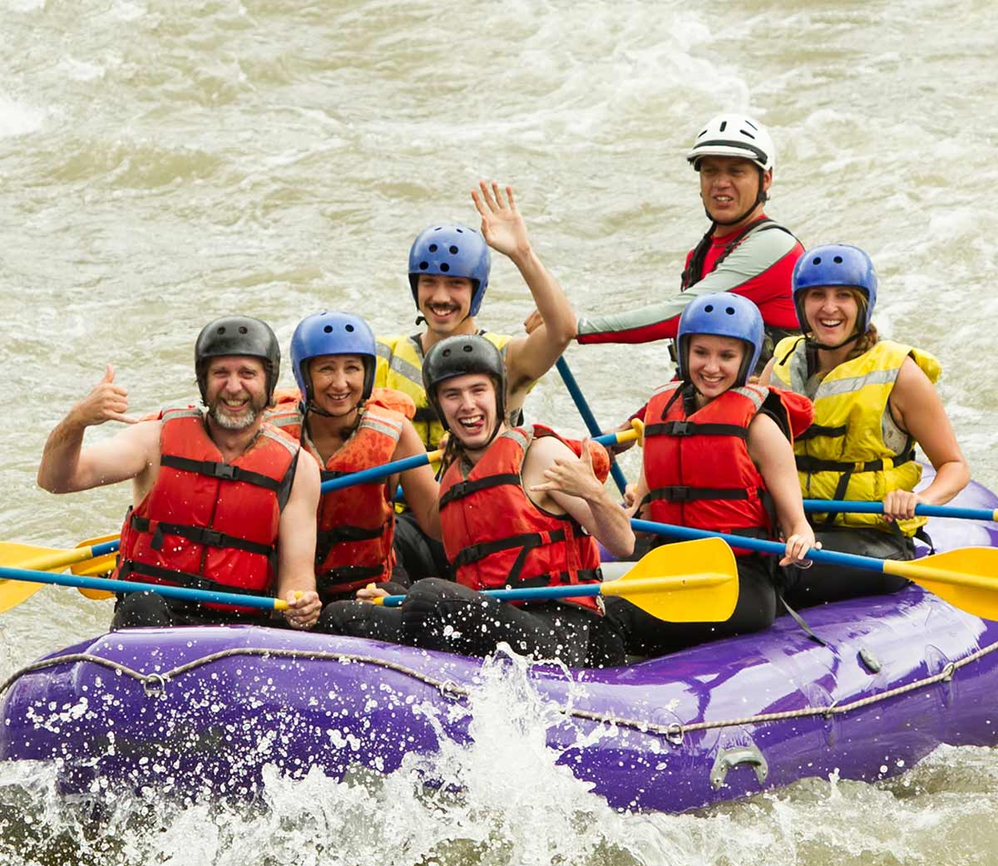
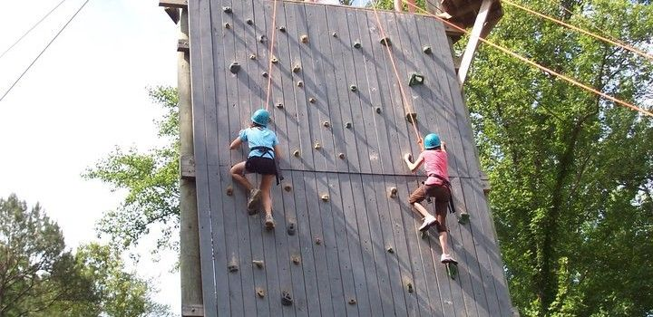
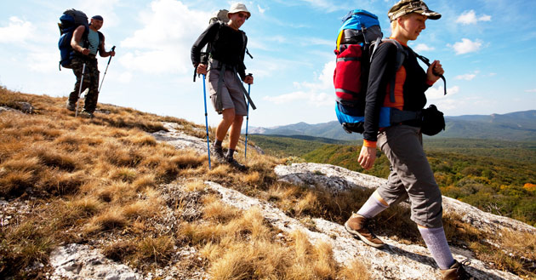
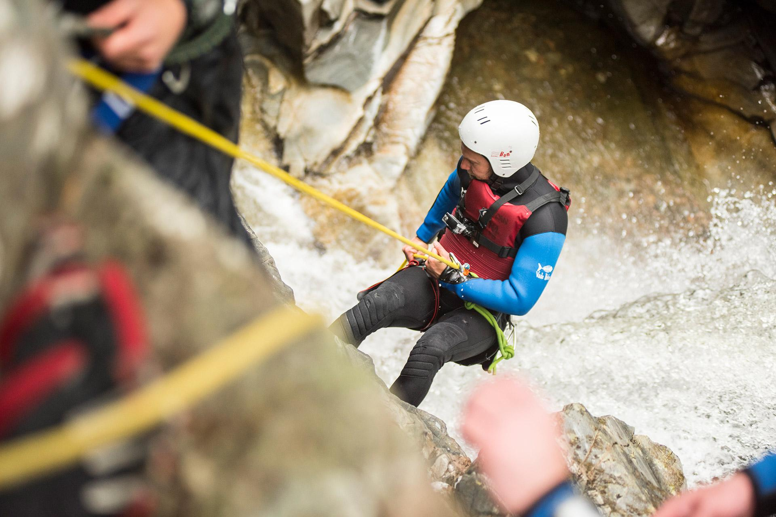
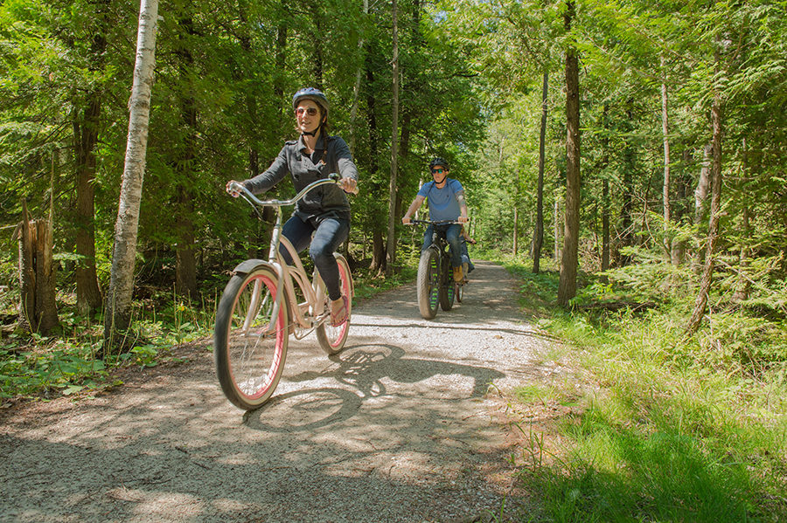
What are outdoor adventurous activities?
Discuss with your partner what outdoor adventurous activities might be
Lesson question: Can I explain the benefits of outdoor adventurous activities?

Slide 5
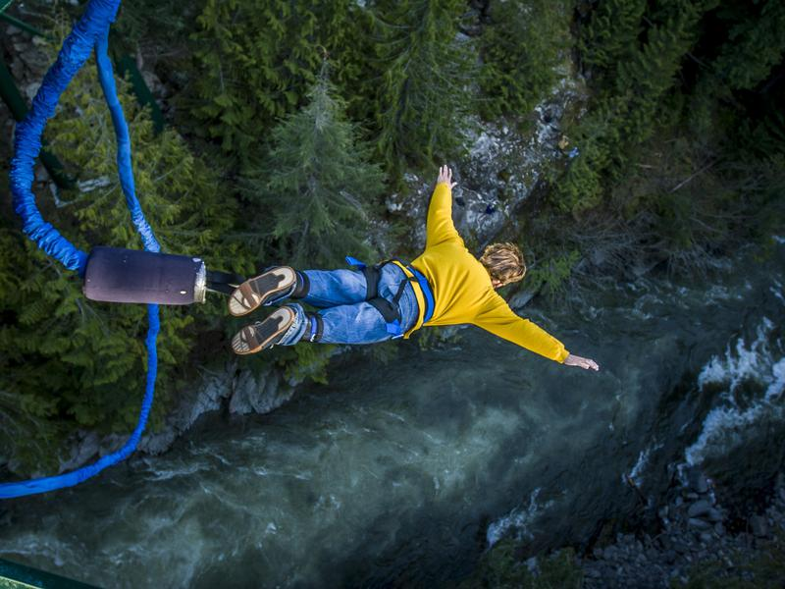
What are outdoor adventurous activities?
Outdoor activities: are activities that are undertaken in the natural environment during a persons free time for example in the woods, lakes or mountains.
Adventurous activities: are activities that are undertaken in the natural environment but have an element of challenge or risk.
Lesson question: Can I explain the benefits of outdoor adventurous activities?

Slide 6
What are outdoor adventurous activities?
What is the difference between OAA and normal sports?
In the natural environment- each environment might not be the same
Risk and danger is greater
An adrenaline rush
Not always rule bound
Challenging - up against the natural forces
Reliance on self and others
Summarise the information in your books.
Dream big; Explain how people might need to keep themselves safe in OAA in comparison to normal sports.
Lesson question: Can I explain the benefits of outdoor adventurous activities?

Slide 7
Examples of activities
Archery
Canoeing
Kayaking
Walking
Biking
Sailing
Raft building
Orienteering
Rope courses
Rock climbing
White water rafting
Skydiving
Zipline
Abseiling
Bouldering
Caving
Windsurfing
Parachuting
Parasailing
Skiing

Slide 8
Research of OAA activities
Individual research task
Mrs H is going to put you into groups and you must chose a different activity from the list.
Your task is to research ONE OAA activity. You will have 10 minutes to gather as much information as possible.
You will then have 2 minutes each to feedback your information to your team who will then need to write down the information about the activity.
Archery
Canoeing
Kayaking
Walking
Biking
Sailing
Raft building
Orienteering
Rope courses
Bouldering
Abseiling
Zipline
Rock climbing

Slide 9
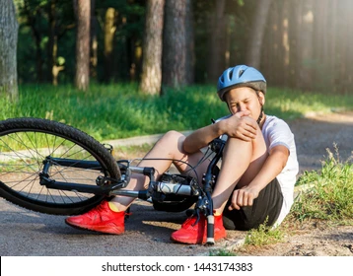
Benefits of OAA
One of the big benefits of taking part in OAA is that it is a positive risk taking experience.
What are the negative risks that might be associated with OAA?
Accident
Injury
Out of comfort zone
Not feeling confident
Definition of risk: a situation involving exposure to danger.
Lesson question: Can I explain the benefits of outdoor adventurous activities?

Slide 10
Benefits of OAA
One of the big benefits of taking part in OAA is that it is a positive risk taking experience.
Task: in your books explain why OAA is a positive risk taking experience
What might individuals feel during the activity
What might they do differently
How will they feel afterwards?
What might happen if they didn't take part in the activity?
Sentence starters:
OAA helps people because…
They might do something that…
They will feel happier because…
Key words
Challenge
Feel
Resilient
Once you have written your answer, underline or highlight the benefits when participating in OAA.
Lesson question: Can I explain the benefits of outdoor adventurous activities?

Slide 11
Benefits of OAA
Self assessment time
Time to self assess your answer to see if you included the key aspects of OAA and positive risk taking. Should you have not included these, please add them in now in a different colour pen
Helps people to take risks in a safe environment as they are supported by instructors
They will get an adrenaline rush and feel good
They might not have participated in this activity before so feel like they have accomplished a new challenge
They might have overcome a fear and feel good
Lesson question: Can I explain the benefits of outdoor adventurous activities?

Slide 12
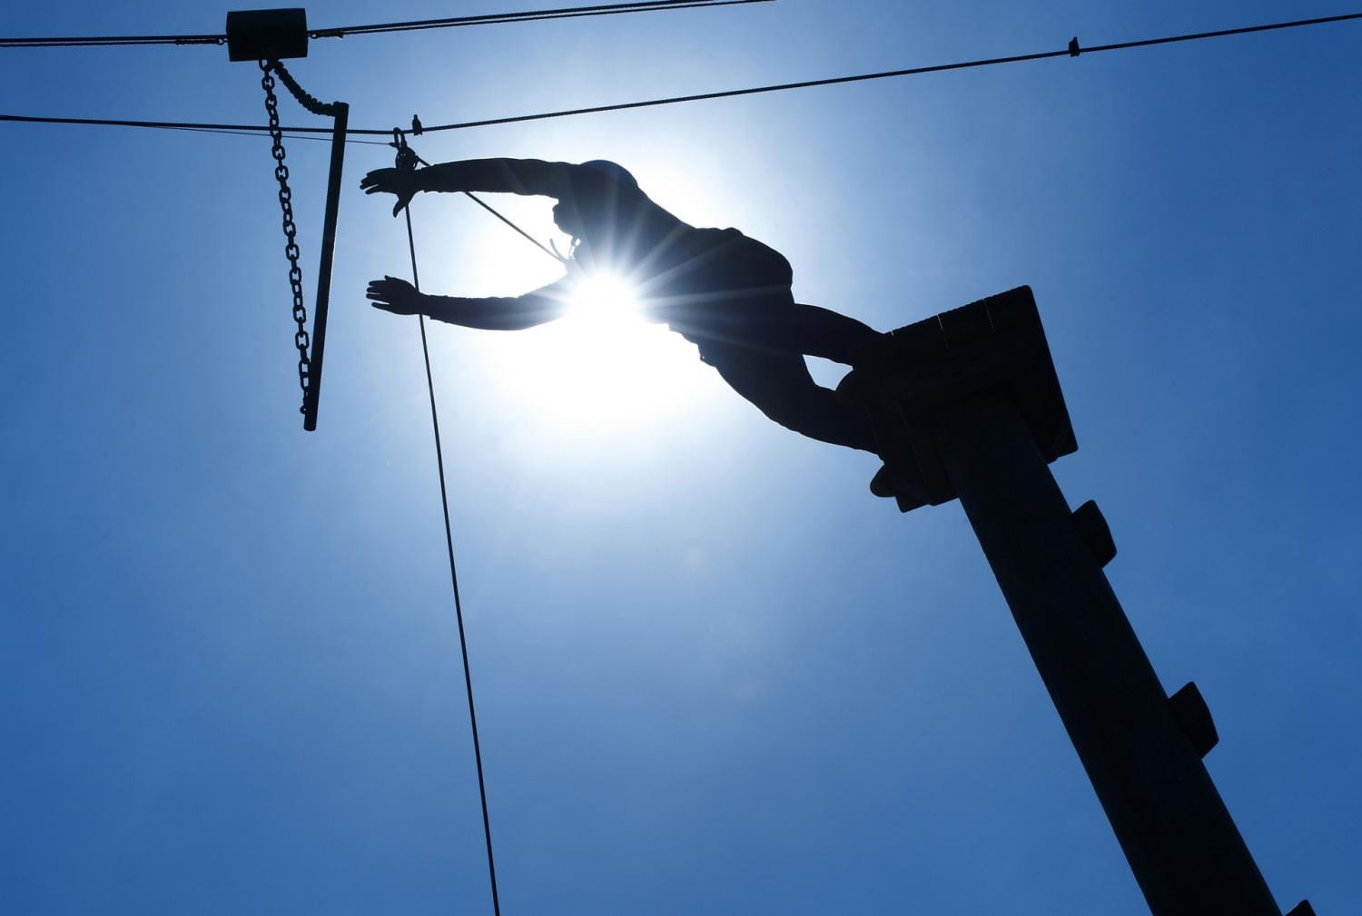
Benefits of OAA
Outdoor Adventurous activities help people to improve self confidence and self esteem
Think back to a time when you had to do something you were scared of…how did you feel afterwards when you completed it?
OAA challenges us to step out of our comfort zone and have to adapt to a new situation which helps us to give us confidence to tackle new challenges.
RESILIENCE
Lesson question: Can I explain the benefits of outdoor adventurous activities?

Slide 13
Benefits of OAA
OAA can also help us to build new skills…
Co-operation
Leadership skills
Teamwork
What skills can you think of?
Communication
Trust
Respect for others
Problem solving
For each skill - give a reason why!
Lesson question: Can I explain the benefits of outdoor adventurous activities?

Slide 14
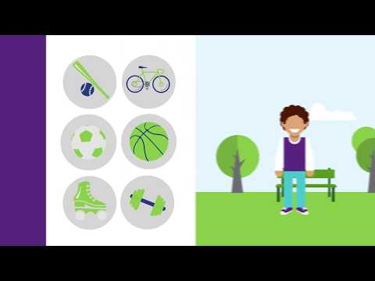
Benefits of OAA
Being outside is beneficial because it means that we can be away from stresses that may be indoor or on electronic devices.
According to a study the average Brit spends at least 22 hours a day indoors.
While the video plays, summarise the benefits included.
Lesson question: Can I explain the benefits of outdoor adventurous activities?

Slide 15
Benefits of OAA
Vitamin D is essential for healthy bones. In the UK we get most of our vitamin D from sunlight exposure from around late March/early April to the end of September.
We need vitamin D to help the body absorb calcium and phosphate from our diet. These minerals are important for healthy bones, teeth and muscles.
A lack of vitamin D, known as vitamin D deficiency, can cause bones to become soft and weak, which can lead to bone deformities.
Lesson question: Can I explain the benefits of outdoor adventurous activities?

Slide 16
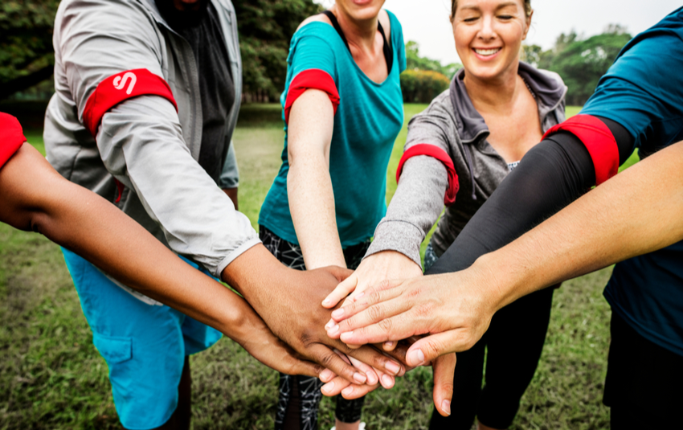
Benefits of OAA
OAA helps us to meet new people..
OAA activities rely on teamwork because you are in a situation where the risk is higher than normal.
Outdoor adventures require collective cooperation and helping each other out. Problem-solving and collaboration are key on long and more-demanding programs and may include cheering each other on during a long hike!
Lesson question: Can I explain the benefits of outdoor adventurous activities?

Slide 17
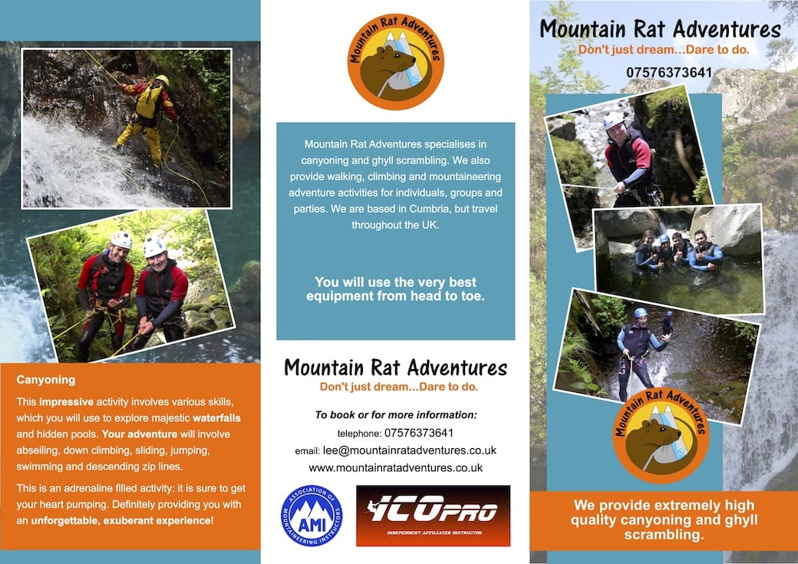
Task - Leaflet
Your task it to create a leaflet for an activity centre to help persuade people to come and visit. You need to justify the benefits of doing the activities on offer and explain why they are important for health
You must include:
Name for the activity centre
Location of the activity centre
Activities on offer
The benefits of doing these activities
How much they cost
Lesson question: Can I explain the benefits of outdoor adventurous activities?

Slide 18
Lesson question: Can I explain the benefits of Outdoor Adventurous Activities?
In today’s lesson, you need to continue to finish off your leaflet for your activity centre, all activities must have descriptions of the activity and what it will help people who come to your activity centre with.
Here is an example of a top level description:
Here at top sports centre we offer a range of different activities. One of these activities is kayaking. Kayaking is an activity that was created by the inuits in the arctic regions thousands of years ago. It has become more popular over the years and is considered an outdoor adventurous activity. This activity is available to do at tops sports centre and has lots of different benefits. One benefit is that it will help with stress relief. With kayaking being an outdoor activity it means that you can take time away from your device and just focus on the serenity of nature and forget what is going on in life! All your stresses will go if you do this activity!
Description
Benefit
explanation

Slide 19
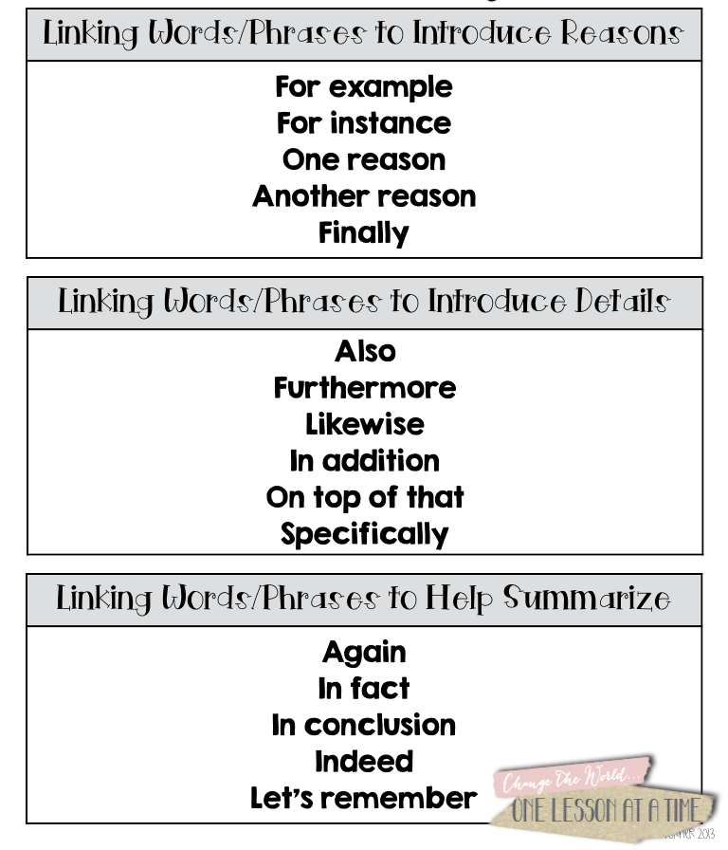
Checklist for success!
Name and logo for activity centre
Three different activities
Paragraph summarising what the activity is and benefits
Linking words used to explain the benefits
Cost of the activity

Slide 20
Benefits of OAA
To summarise
3 things you have learnt about OAA
2 benefits that OAA can provide people
1 thing you wish to learn more about
Lesson question: Can I explain the benefits of outdoor adventurous activities?

