Slide 2
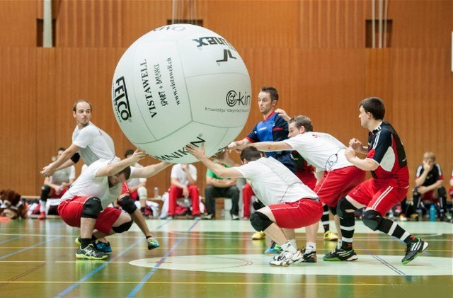
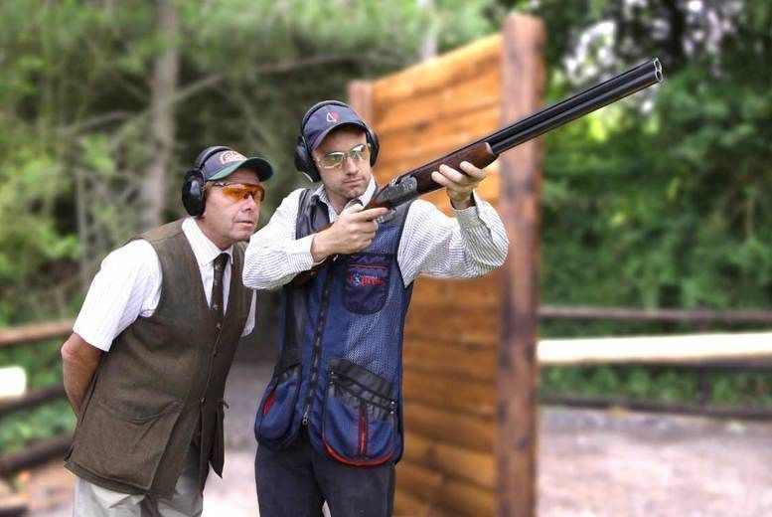
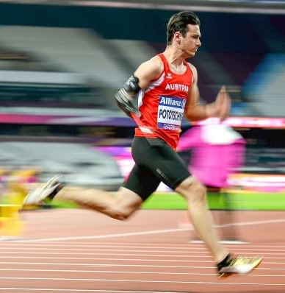
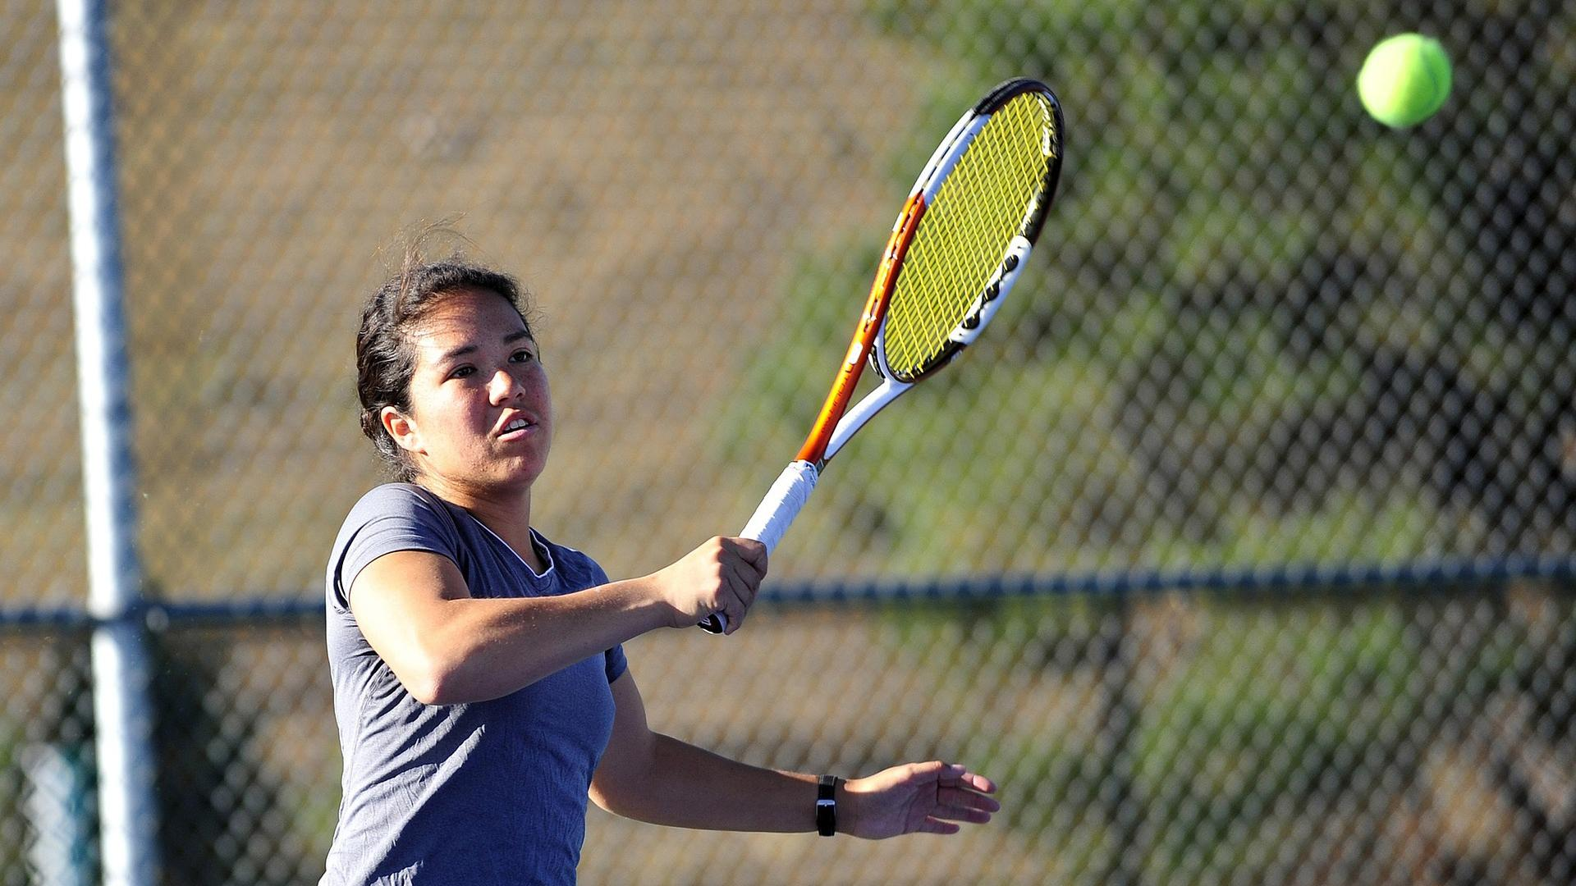
Title: Component 1 - Preparing participants to take part in sport and physical activity
Starter: In your books list as many sports as you can think of!
Extension: then categorise these sports into team sports or individual sports
Now add to your list in a different colour for the ones you are missing!
Notes:
Tennis, cricket, badminton, table tennis, athletics (any discipline), swimming, football, rugby, golf, clay pigeon shooting, archery, skiing, iceskating, bobsleigh, cycling, karate, boxing, judo, rock climbing, hockey, netball, weightlifting, surfing, skateboarding, goalball, bocia, dressage, equestrian, sailing, rowing, fencing, volleyball, triathlon, racing, basketball, hurling, lacrosse, handball

Slide 3
BTEC Component 1 - preparing participants to take part in sport and physical activity
Questions???
Lesson question: Can I identify the different types of sports and the benefits they have on the body?

Slide 4
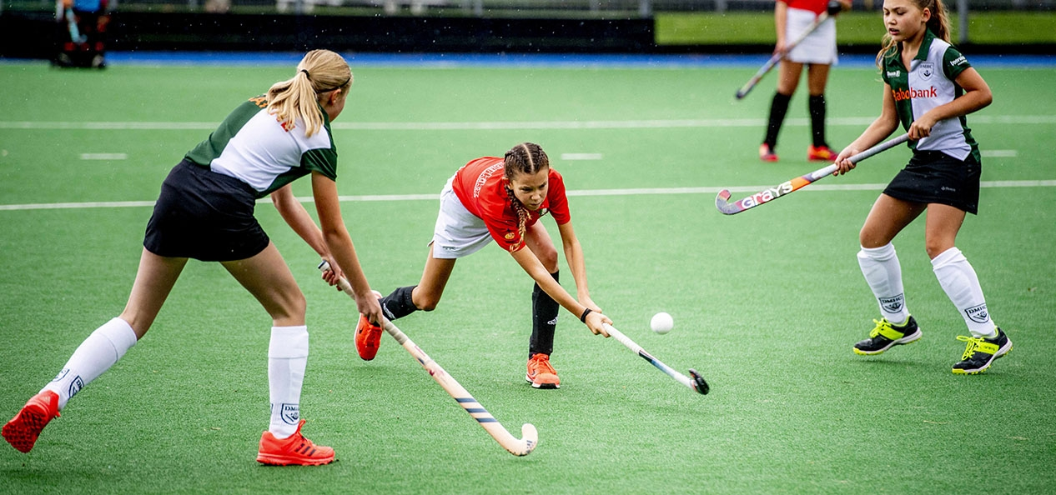
Sports
Definition: Sports are competitive activities that involve physical exertion, have rules and regulations and an NGB
NGB’s stand for national governing bodies
With the person next to you identify three key words in the definition and highlight or underline them in your book.
Lesson question: Can I identify the different types of sports and the benefits they have on the body?

Slide 5
Roles of National Governing Bodies
The National Governing Bodies of sport, also known as NGB’s, are an essential element of sport that governs and administers a sport on a national level for the UK or one of the home nations individually.
Big question...what things do you think the NGB’s are responsible for?
You have 2 minutes to discuss with your partner! GO!!!
Lesson question: Can I identify the different types of sports and the benefits they have on the body?

Slide 6
Roles of National Governing Bodies
Task: Summarise in no more than three sentences why NGB’s are important.
What would happen without them?
What would sports look like?
Would it be fair?
National governing bodies are responsible for
Overseeing the rules of their sport
Clubs
Coaching - running courses to train more coaches and continue to provide best practice in their sport
Competitions
How to spend the money generated by membership fees, grants, TV rights, Lottery funding
Control and regulate the environment of the sport
Develop the sport
Advertising and encouraging participation in the sport
Increasing accessibility to the sport
Sentence starters:
NGB’s help to….
They also allow…..
Without NGB’s…..
Lesson question: Can I identify the different types of sports and the benefits they have on the body?

Slide 7
Team Sports
Definition: A team sport includes any sport where individuals are organized into opposite teams which compete to win. Team members act together towards a shared objective. Team members set goals, make decisions, communicate, manage conflict, and solve problems in a supportive, trusting atmosphere.
Lesson question: Can I identify the different types of sports and the benefits they have on the body?

Slide 8
Individual Sports
Definition: An individual sport is where a person competes against themselves either generating a time or a score which is then compared against others. Individual sports can form part of a team in which the score are combined. Traditionally they compete alone.
Lesson question: Can I identify the different types of sports and the benefits they have on the body?

Slide 9
Research task
Your task now is to research four National governing bodies for TWO of your chosen sports. You will need to:
Name the national governing body
Who is in charge of the NGB
What do they do to encourage participation
Publicise the sport
Promote equality and fair play
You will need to write this information down in your books!
Lesson question: Can I identify the different types of sports and the benefits they have on the body?

Slide 10
Peer assessment time
Swap your book with the person next to you. You are going to mark their research
For each sport have they included:
Name of the national governing body
Who is in charge of the NGB
What do they do to encourage participation
How they publicise the sport
How they promote equality and fair play
Once you have marked each other work, write down one NEW thing you have learned about a NGB and what their role is..
Lesson question: Can I identify the different types of sports and the benefits they have on the body?

Slide 11
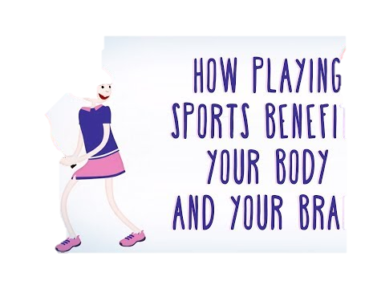
What are the benefits of taking part in sport?
Watch the video.
Make a note of any KEY benefits you think that sport has on your body and brain
https://www.youtube.com/watch?v=hmFQqjMF_f0
benefits of exercise
Lesson question: Can I identify the different types of sports and the benefits they have on the body?

Slide 12
Benefits of taking part in sport
The UK Chief Medical Officers’ Guidelines recommend each week adults do:
at least 150 minutes moderate intensity activity, 75 minutes’ vigorous activity, or a mixture of both
strengthening activities on two days
reducing extended periods of sitting
Physical activity has significant benefits for health, both physical and mental, and can help to prevent and manage over 20 chronic conditions and diseases, including some cancers, heart disease, type 2 diabetes and depression.
Physical inactivity is responsible for one in six UK deaths (equal to smoking) and is estimated to cost the UK £7.4 billion annually (including £0.9 billion to the NHS alone).
Unfortunately our population is around 20% less active than in the 1960s. If current trends continue, it will be 35% less active by 2030.
Lesson question: Can I identify the different types of sports and the benefits they have on the body?

Slide 13
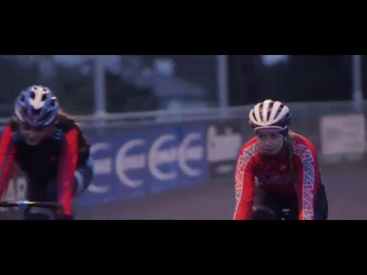
Benefits of taking part in sport
Develops and improves fitness
Get to meet new people
Develop leadership skills
Build resilience
Time away from electronic devices
Stress relief
Lesson question: Can I identify the different types of sports and the benefits they have on the body?

Slide 14
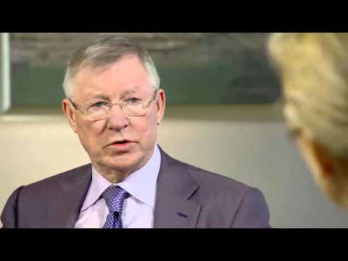
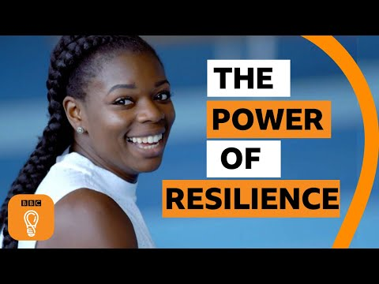
Leadership and resilience
Why is leadership and resilience important in sport?
Write down two reasons why you think it's important.
Now watch the video, you will have two minutes after the video to add to your list and add more reasons why.
http://www.youtube.com/watch?v=6QKY1sXP0rg
http://www.youtube.com/watch?v=6QKY1sXP0rg
Lesson question: Can I identify the different types of sports and the benefits they have on the body?
Notes:
Doesnt give up
Not scared
Tries different things
Believes in young peoples
Develops players

Slide 15
Stress relief
The average person will spend 34 years of their life looking at screens.
Being active and playing sports can help us to get away from screens and relieve stress.
Sport and physical activity helps us because
It improves concentration
Releases endorphins (feel good hormones)
Improves sleep
Helps maintain weight
Boost self confidence
Add any more benefits that you can think of!
Lesson question: Can I identify the different types of sports and the benefits they have on the body?

Slide 16
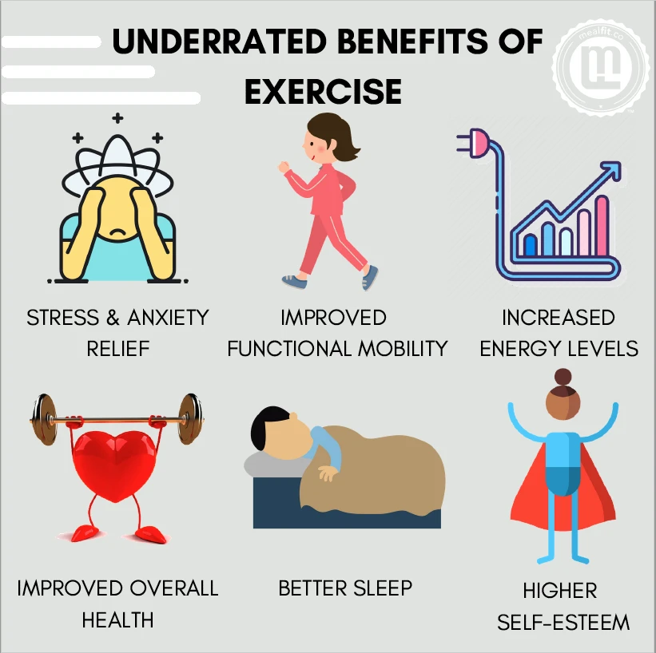
Benefits of taking part in sport
Task
Think about your own sport participation, what benefits do YOU get from playing or competing in the sport you do and why?
Example
There are many benefits to participating in sport. The sport I play is netball, I enjoy playing netball because it is competitive and fast paced. This helps to improve my fitness levels and makes my overall health and performance better. It means I do not get out of breath as much when running because I play twice a week.
Lesson question: Can I identify the different types of sports and the benefits they have on the body?

Slide 17
Homework / Class task
Scenario
Bob is 30 years old and has just moved to South Cerney, he doesn’t have many friends and has low self confidence, he wants to take part in sports but he is unsure of what is available in the area and what benefits he will get from participating in sport.
You have to write a minimum of half an A4 (maximum one side of a4) word document in size 12 font advising Bob what on ONE sport available in and Cirencester what the benefits it will give to him.
Once you have completed this please hand it in. Deadline 27th September.
Lesson question: Can I identify the different types of sports and the benefits they have on the body?

