Slide 1


Year 9 French TERM 6:
If pupils are absent from lessons they should spend time revising and learning vocabulary. All of the vocabulary for this term is on the following slides. First of all, they should recap the vocabulary which they learned the previous week. Then they should start to learn the next section of vocabulary which they have not yet covered in class. This could be done by using the look, cover, write, check method or by making flashcards etc.
Pupils can also revise vocabulary on Linguascope-
Username is kingshill password is bonjour123
Any new vocabulary they learn can be written in their orange books or on paper.
If pupils wish to do extension work they can access free MFL lessons on the Oak National Academy website:
https://classroom.thenational.academy/subjects-by-key-stage

Slide 2
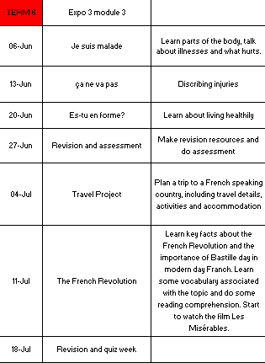

Slide 3
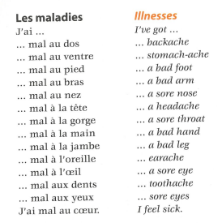
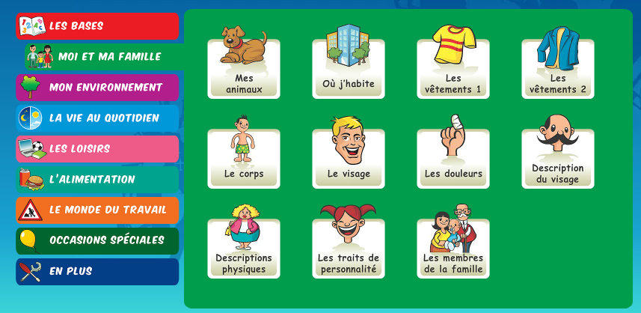
Week 1 – w/c 6th June
vocab
- Make this vocabulary into a poster about body parts and illnesses.
- Play some games on linguascope in the ‘Les douleurs’ and ‘Le Corps’ sections.

Slide 4

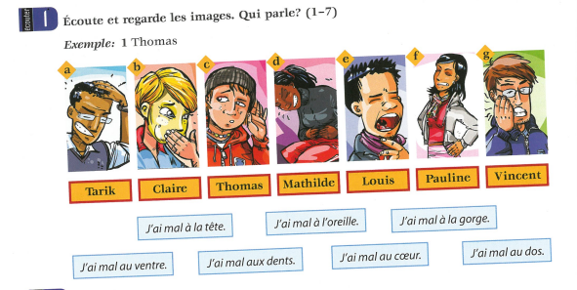
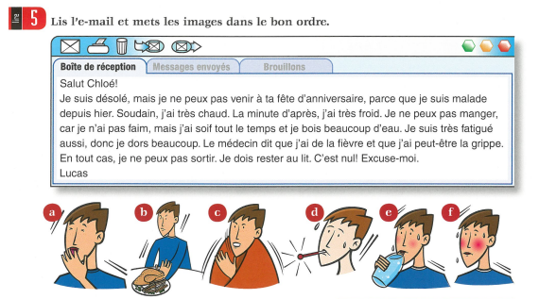
- Do this listening activity, write the name of who is talking for each question.
- Read this email and put the pictures in the correct order

Slide 5
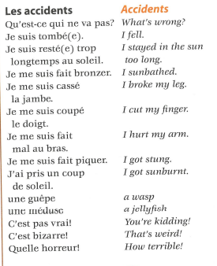
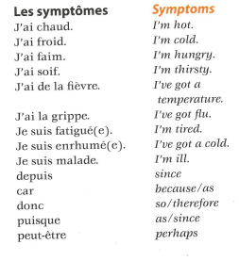
Week 2 – w/c 13th June
vocab
Practice the vocab on quizlet:
https://quizlet.com/_bm9vhi?x=1qqt&i=1jjrw5

Slide 6
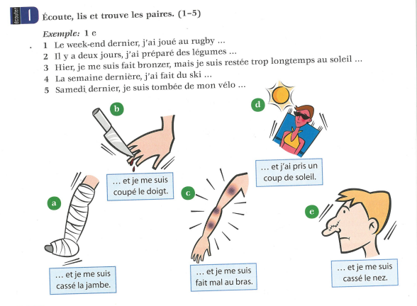
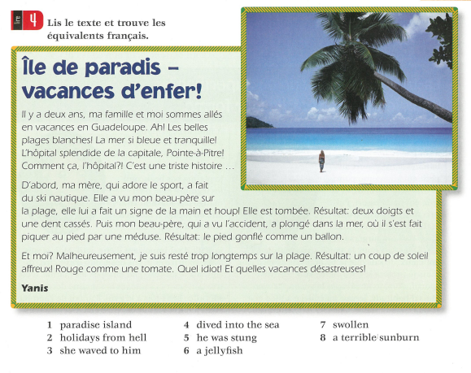
- Listen to the recording and find the pairs
- Read the text and find the sentences at the bottom in the text.

Slide 7
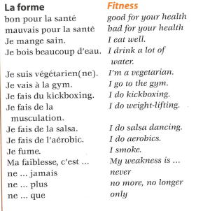
Week 3 – w/c 20th June
vocab
Make a poster out of the words on this slide and on the previous slides. You may choose to make flashcards to help you learn the vocab.

Slide 8


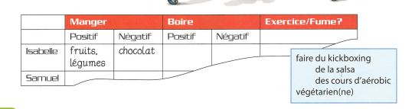
Read the text and answer the questions – true or false

Slide 9

Week 4 w/c 27th June
This week is revision and assessment week. Contact your teacher for the assessment papers. Make sure you have revised all of the words and expressions that we have learnt this term.

Slide 10
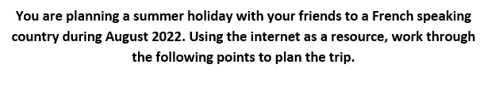
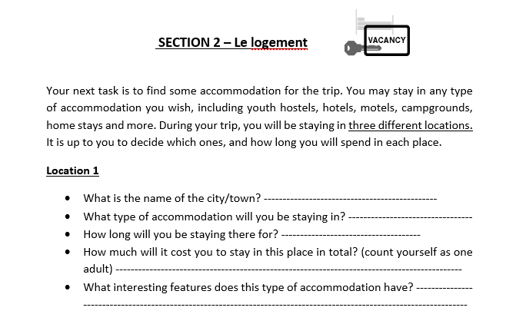
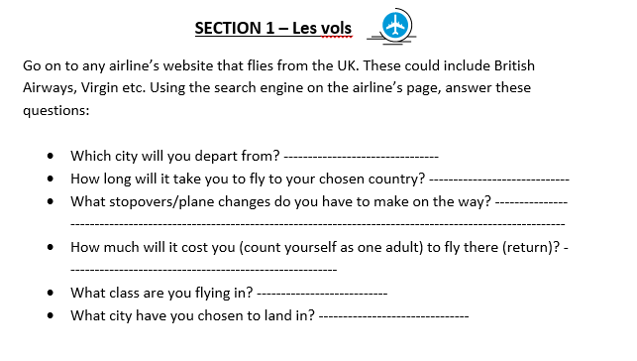
Week 5 w/c 4th July

Slide 11
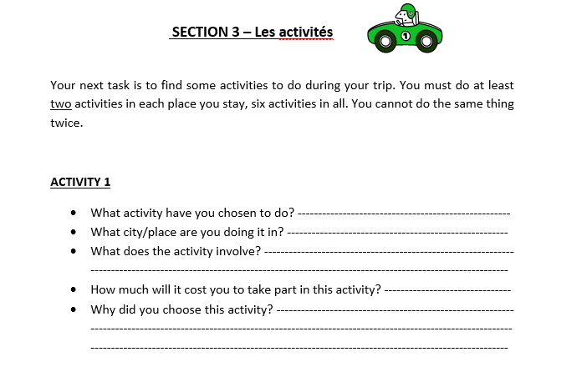
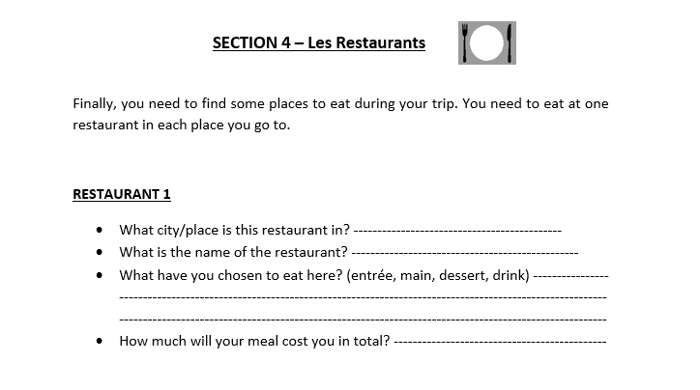

Slide 12
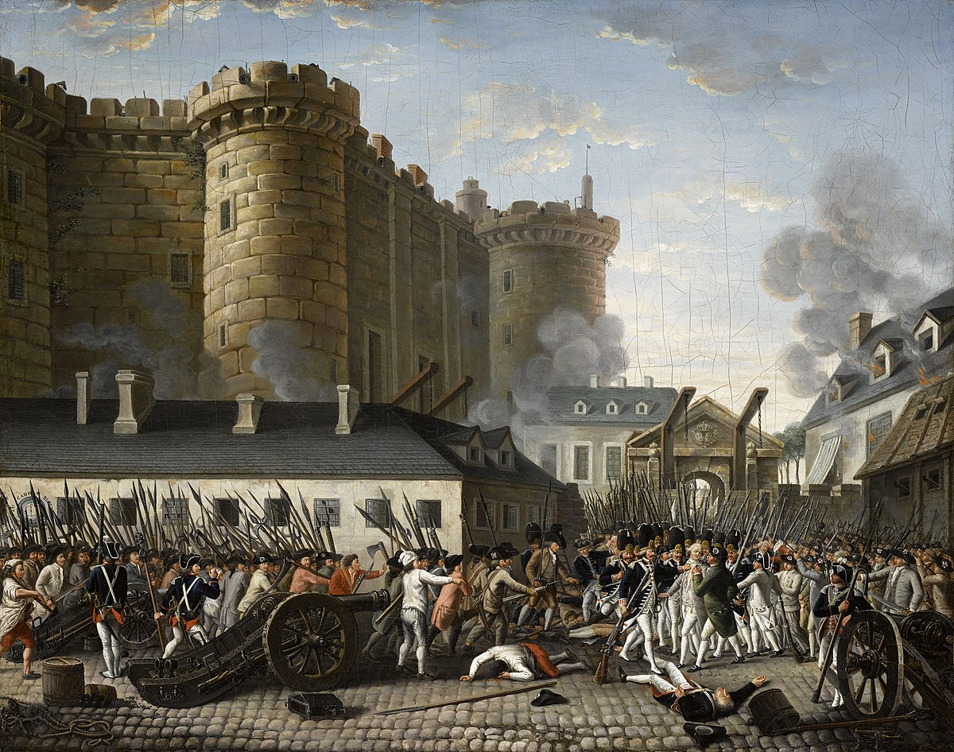
Week 6 w/c 11th July
Project week:
Do some research about the French Revolution. Find out some information about the following points:
1 – When did it happen?
2 – What happened?
3 – Why did it happen?
4 – What was life like in France for ‘normal’ people before the French Revolution?
5 – What do French people do nowadays to commemorate the French Revolution?
When you have done your research, make a PowerPoint or a poster with the information you have found.

Slide 13



Week 7 w/c 18th July
Recap the vocabulary you have learned this year by using your orange books, Linguascope, Quizlet and Blooket (you can play individual games on Blooket too).
Linguascope username is kingshill and the password is mfl123*

