Slide 1


Year 8 German TERM 6: Echo 2 textbook, chapter 2
If pupils are absent from lessons they should spend time revising and learning vocabulary. All of the vocabulary for this term is on the following slides. First of all, they should recap the vocabulary which they learned the previous week. Then they should start to learn the next section of vocabulary which they have not yet covered in class. This could be done by using the look, cover, write, check method or by making flashcards etc.
Pupils can also revise vocabulary on Linguascope-
Username is kingshill password is bonjour123
Any new vocabulary they learn can be written in their orange books or on paper.
If pupils wish to do extension work they can access free MFL lessons on the Oak National Academy website:
https://classroom.thenational.academy/subjects-by-key-stage

Slide 2
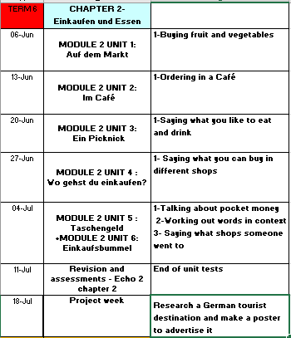

Slide 3
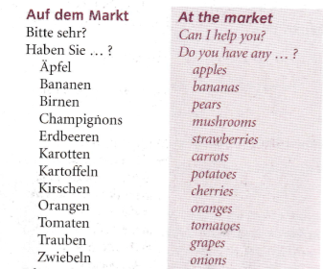
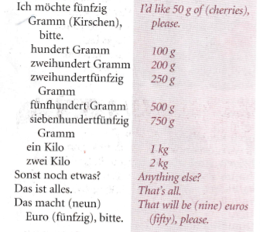
Read through the vocabulary for this week and spend a good amount of time trying to learn it. You will need these words to complete the tasks on the next few slides.
Week 1 – w/c 6th June
vocab

Slide 4
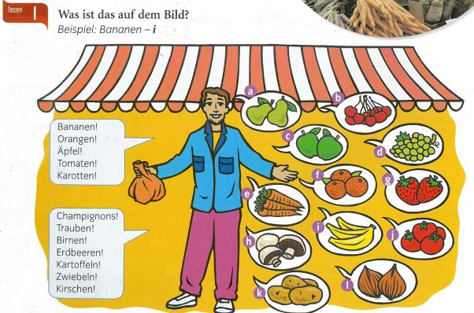
Label the items a-l in German

Slide 5
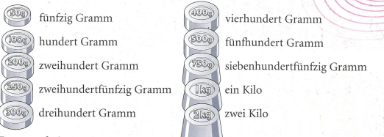

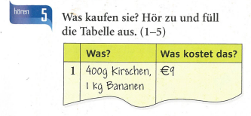
Listen to the recording. What do they buy and how much does it cost?

Slide 6

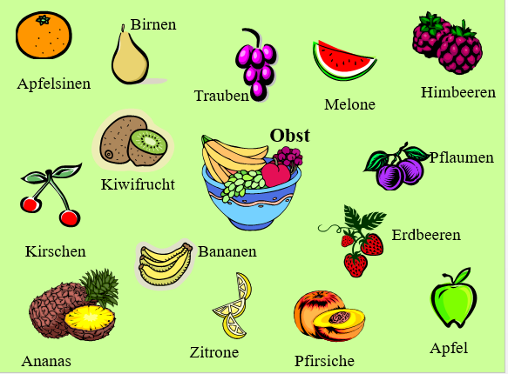
Obst und Gemüse – fruit and veg
Make a poster using these fruit and vegetable words

Slide 7
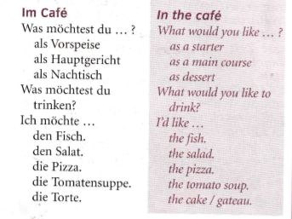
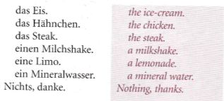
Week 2 – w/c 13th June
vocab
Read through the vocabulary for this week and spend a good amount of time trying to learn it. You will need these words to complete the tasks on the next few slides.

Slide 8
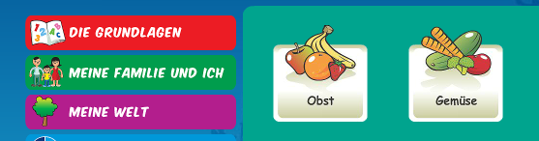
Practise the fruit and drink vocabulary from last week by logging on to Linguascope and playing some of the games. You need to be in the beginner area.
Username – kingshill password – mfl123*

Slide 9
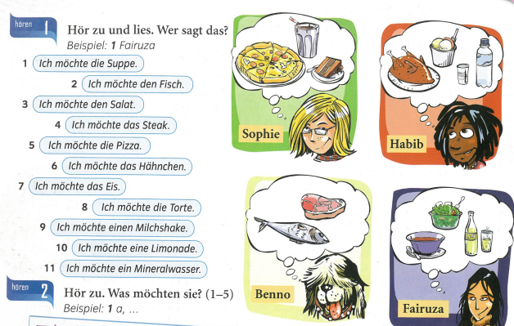
Ich möchte =
I would like
Look at the pictures to see what each person orders. Then look at the sentences 1-11 and work out who said them.
1) Fairuza

Slide 10
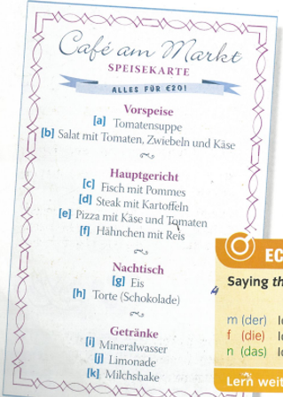
Listen to the recording. Write down 1-5. What does each person order from the menu? Write down the letters of the things they order.
Example, 1 a,….

Slide 11
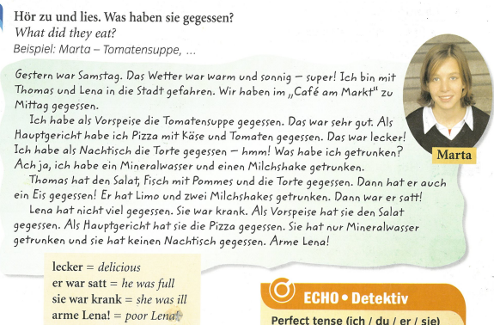
Ich habe gegessen = I ate
Ich habe getrunken = I drank
What did Marta and Thomas eat?

Slide 12
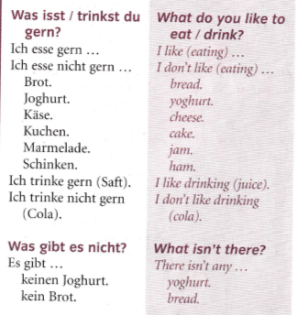
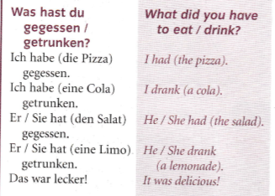
Week 3 – w/c 20th June
vocab
Read through the vocabulary for this week and spend a good amount of time trying to learn it. You will need these words to complete the tasks on the next few slides.

Slide 13
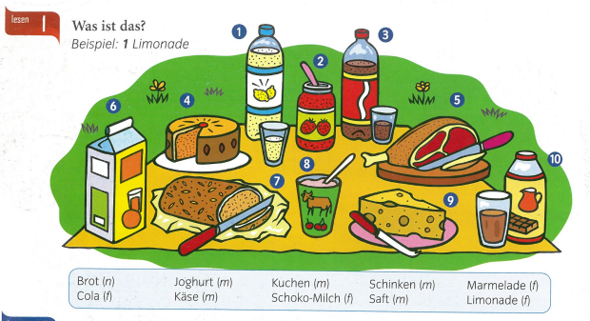
Label the items 1-10 in German

Slide 14
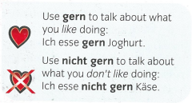
Remember…

Slide 15
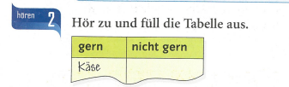
Listen to the recording. What do they like and what don’t they like?
Now make a list in German of the foods and drinks you like and don’t like.

Slide 16
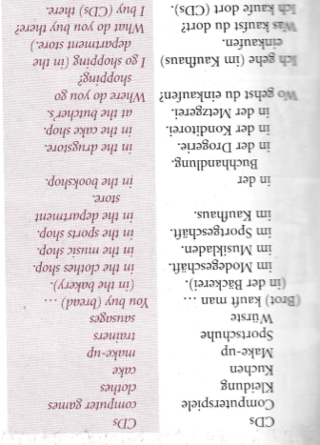
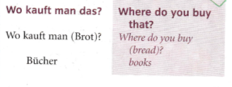
Week 4 – w/c 27th June
vocab
Read through the vocabulary for this week and spend a good amount of time trying to learn it. You will need these words to complete the tasks on the next few slides.

Slide 17
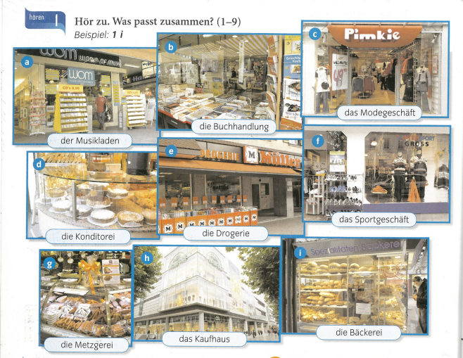
Listen to the recording. Write down 1-9. Which shop do they mention? Choose from a-i

Slide 18

Listen to the recording. Which type of shop do they go to and what do they buy?

Slide 19
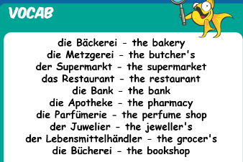
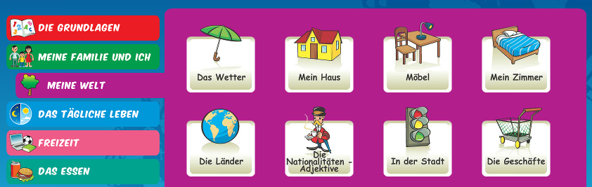
Practise the shops vocabulary by logging on to Linguascope and playing some of the games. You need to be in the beginner area.
Username – kingshill password – mfl123*
Make a note of the new words

Slide 20
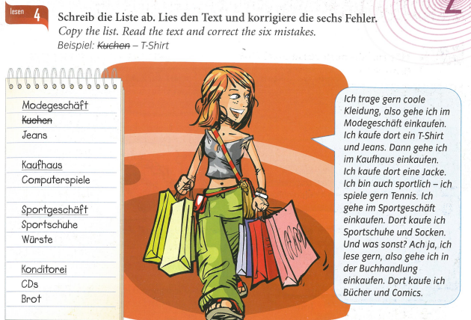

Slide 21
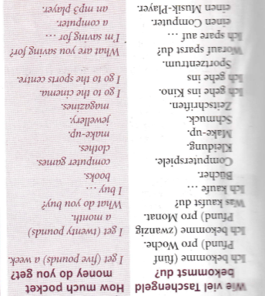
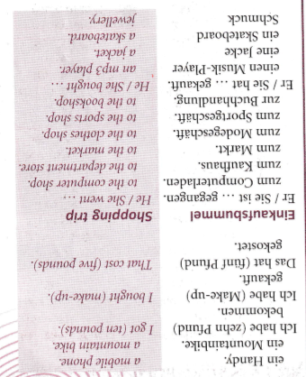
Week 5 – w/c 4th July
vocab
Read through the vocabulary for this week and spend a good amount of time trying to learn it. You will need these words to complete the tasks on the next few slides.

Slide 22
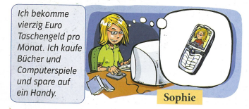
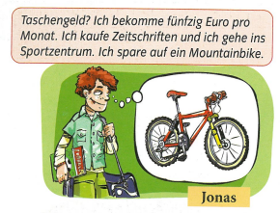
Copy out the German passages and then translate them in to English.

Slide 23
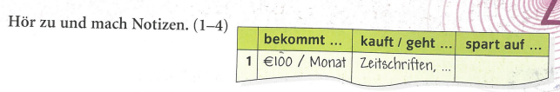
Listen to the recording. How much money do they get? What do they buy/where do they go? And what are they saving for?
Remember –
Ich bekomme = I get
Ick kaufe = I buy
Ich spare auf = I’m saving for

Slide 24
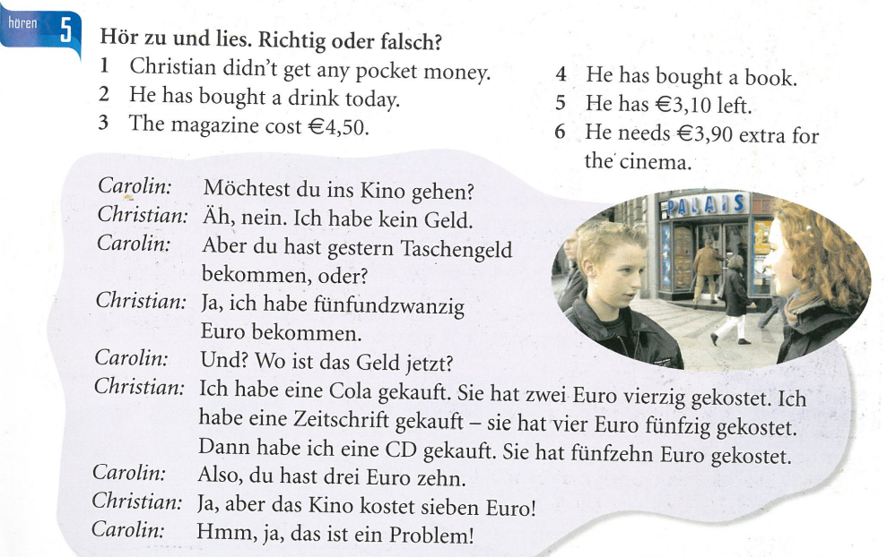
Read the conversation between Carolin and Christian and say if the 6 statements are true or false

Slide 25

Week 6 w/c 11th July
This week is revision and assessment week. Contact your teacher for the assessment papers. Make sure you have revised all of the words and expressions that we have learnt this term. All of the vocabulary can be found on the previous slides, if your book is in school

Slide 26

Week 7 w/c 18th July
Project week:
Research an area of Germany, Austria or Switzerland which is popular with tourists. Make a poster or a presentation about the place, please include the following information.
- What is the place called and whereabouts is it?
- What can tourists do there?
- Where can tourists stay? Please find some examples of accommodation available (hotels, campsites, holiday homes etc)
- Find some nice restaurants in the area, are there any regional specialities?

