Slide 1
Year 7 German rotation 2:
If pupils are absent from lessons they should spend time revising and learning vocabulary. All of the vocabulary for this term is on the following slides. First of all, they should recap the vocabulary which they learned the previous week. Then they should start to learn the next section of vocabulary which they have not yet covered in class. This could be done by using the look, cover, write, check method or by making flashcards etc. It should also be copied in to their orange books. There are also a few tasks to complete. A plan for the term is on the next slide.
Pupils can also revise vocabulary on Linguascope-
Username is kingshill password is mfl123*
Any new vocabulary they learn can be written in their orange books or on paper.
If pupils wish to do extension work they can access free MFL lessons on the Oak National Academy website:
https://classroom.thenational.academy/subjects-by-key-stage

Slide 2
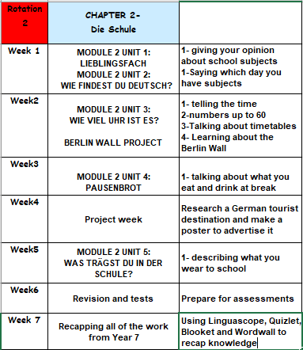

Slide 3
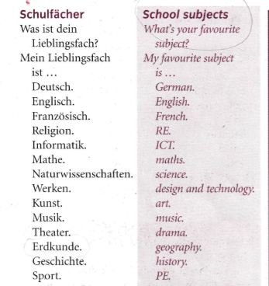
WEEK 1 – w/c 6th June
Read through the vocabulary for this week and spend a good amount of time trying to learn it. There are 2 slides of words to look at. You will need these words to complete the tasks on the next few slides.

Slide 4
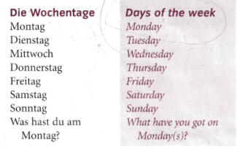
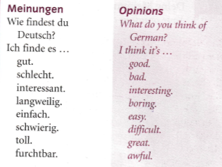

Slide 5
Copy down the following:
Was ist dein Lieblingsfach? – What is your favourite subject?
Mein Lieblingsfach ist Mathe – My favourite subject is maths.
Now write a sentence in German saying what your favourite subject is.

Slide 6
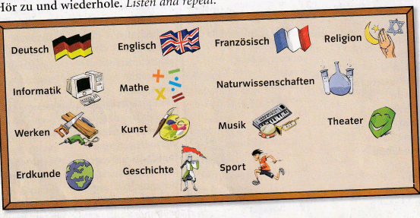
Listen to the recording. Write 1-12. Which subject do they mention?
E.g. Musik

Slide 7
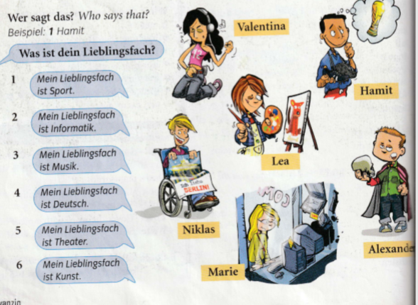
Look at the pictures of the 6 children – Valentina, Hamit, Lea, Niklas, Marie and Alexander.
Then look at the 6 sentences saying what their favourite subject is. Match them up.
Example –
1= Hamit
(because the sentence says my favourite subject is PE and he is dreaming of the world cup)

Slide 8
Copy down the days of the week in to your orange books (make sure they have a capital letter just like in English)
Montag-Monday Dienstag-Tuesday Mittwoch-Wednesday Donnerstag-Thursday
Freitag-Friday Samstag-Saturday Sonntag-Sunday
Did you notice that Thursday is very different to the other days? This is because it translates as ‘midweek’ as Wednesday is half way through the working week.

Slide 9
Listen to the recording. Write down 1-7. Which day do they say?
Example 1) e

Slide 10
Listen to the recording. Write down 1-8. What do they think of the subjects?
Remember:
Wie findest du? Means ‘What do you think of…?’
Ich finde es… means ‘I find it …’
Example = 1)a

Slide 11
Make a poster in German about your opinions of school subjects and draw some pictures.
For example:
Ich finde Deutsch gut
Ich finde Mathe schwierig

Slide 12
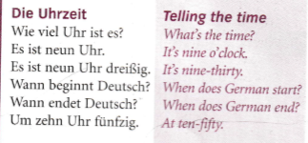
Week 2 w/c 13th June
Read through the vocabulary for this week and spend a good amount of time trying to learn it. You will need these words to complete the tasks on the next few slides.
You also need to look at the Berlin Wall slides which are in the pupil work area, as we are looking at that this week in school.

Slide 13
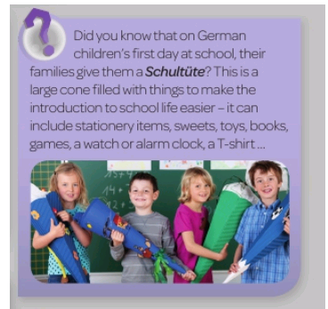
This week we are going to learn how to tell the time in German. You will need to recap numbers first on the following slide.
What do you think of this?

Slide 14
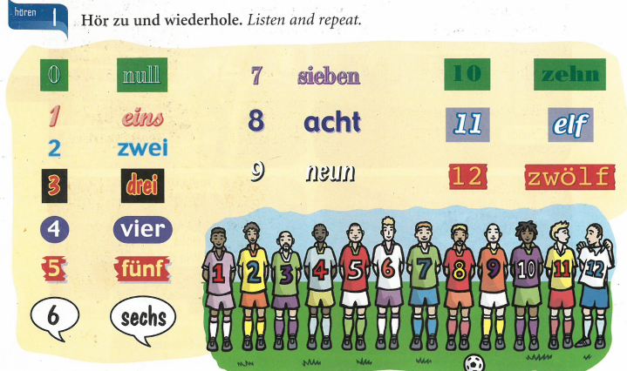
We are going to learn some big numbers this week. First let’s recap the numbers 1-12. Click on the listening track

Slide 15
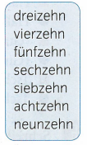
The numbers 1-9 are very important and we will see those again later when we count from 20-100 so I would like you to say them in your head a few times now.
Now let’s look at 13-19. What do you notice?
1- eins
2- zwei
3- drei
4- vier
5-fünf
6-sechs
7-sieben
8-acht
9- neun
Notice the s is missing off sechs and the en is missing of sieben,

Slide 16
You are now well on the way to learning all of your numbers. Lets look at the following. Make a note of these in your books:
20 -zwanzig
30- dreißig
40 – vierzig
50 – fünfzig
60 – sechzig
70 – siebzig
80 – achtzig
90- neunzig
Be careful not to muddle up zehn and zig, especially when listening to numbers.
fünfzehn = 15
fünfzig = 50
Notice the s is missing off sechs and the en is missing of sieben, just like with 16 and 17
Also, dreißig isn’t written with a z but it sounds the same

Slide 17
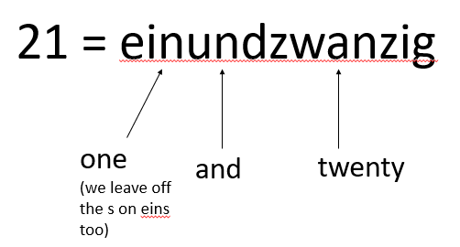
We now have everything we need to put the numbers together. Let’s look at how it works. For all numbers 21-99 we say the second number first in German. For example…
22=zweiundzwanzig 87=siebenundachtzig
35 = fünfunddreißig 49=neunundvierzig

Slide 18
Wie viel Uhr ist es?- What time is it? This is how you do the o’clock times in the 24hr clock. Make a note of a couple of examples.
08:00
17:00
Es ist acht Uhr.
Es ist siebzehn Uhr.
03:00
20:00
Es ist zwanzig Uhr.
Es ist drei Uhr.
14:00
23:00
Es ist vierzehn Uhr.
Es ist dreiundzwanzig Uhr.

Slide 19
This is how you do other times. You say the o’clock time first and then just say the minutes. Write down a couple of examples.
08:05
17:40
Es ist acht Uhr fünf.
Es ist siebzehn Uhr vierzig.
03:10
20:45
Es ist drei Uhr zehn.
Es ist zwanzig Uhr
fünfundvierzig.
14:25
23:58
Es ist vierzehn Uhr
fünfundzwanzig.
Es ist dreiundzwanzig Uhr
achtundfünfzig.

Slide 20
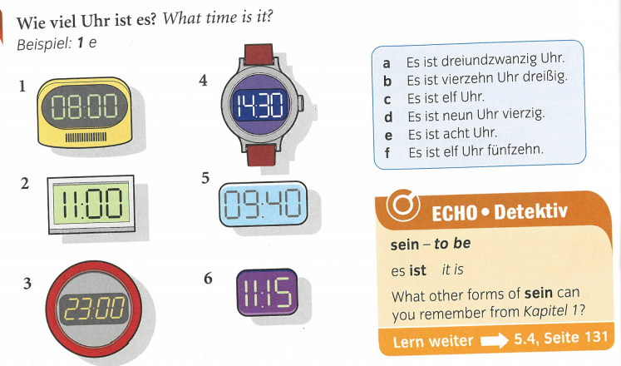
Echo 1 text book page 28 ex1
Match up the watches and clocks 1-6 with the times on the right a-f

Slide 21
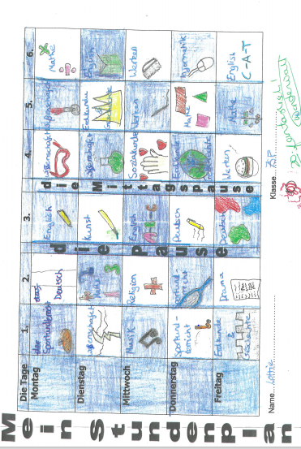
You are now going to make your timetable (Stundenplan) in German. Fill in the spaces with
the subjects (don’t forget capital letters). Then draw a picture to represent each one. There is
a printable version on the next slide
Mein Studenplan = my timetable
Die Pause = break
Lesen-reading
Die Mittagspause = lunch
Sozialkunde=PSHE
Alphabetisierung = literacy
Geisteswissenschaften = humanities
✓
✓

Slide 22
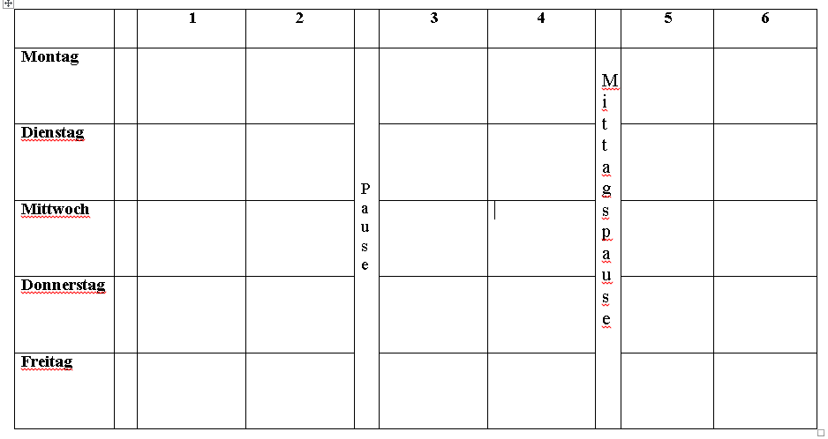
Try and write out your timetable in German. Print out the one below or copy it on to paper.)
Pause=break Mittagspause=lunch (I have put this after period 4 otherwise it would have been difficult to write in the subject)

Slide 23
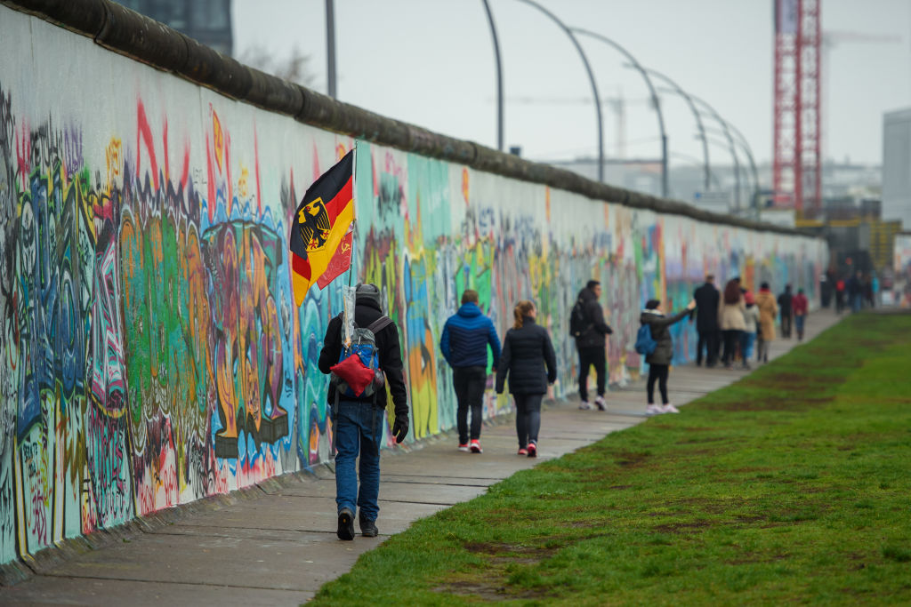
Look at the slides about the Berlin Wall. This is an important part of German history.

Slide 24
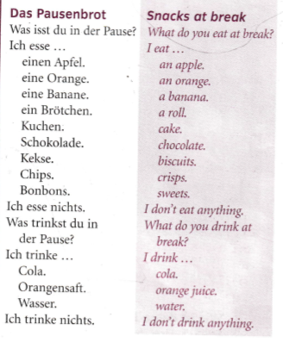
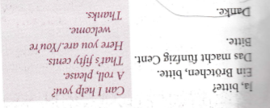
Week 3 w/c 20th June
Read through the vocabulary for this week and spend a good amount of time trying to learn it. You will need these words to complete the tasks on the next few slides.

Slide 25
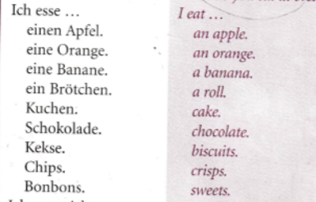
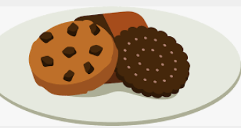
Make a poster in your books of these food and drink items. Draw a picture and label the items in German and English – Don’t forget the capital letters in German.

Slide 26
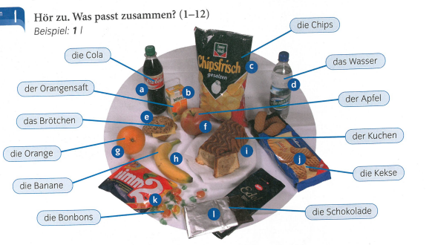
Listen to the recording. Which food or drink item is mentioned? Write down 1-12 and the correct letter. Example 1) l

Slide 27
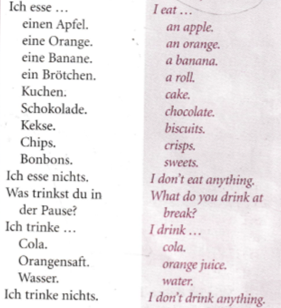
Listen to the recording. What does each
person say they eat and drink?
Example:
Peter – a sandwich, an apple

Slide 28
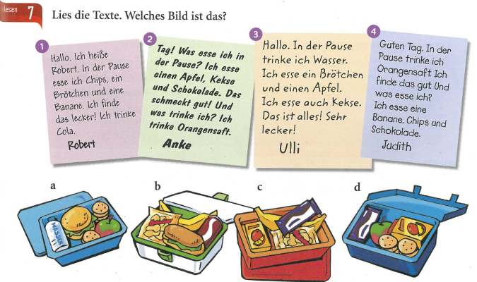
Read the descriptions and match them to the lunchboxes

Slide 29
Week 4 w/c 27th June
Project week:
Research an area of Germany, Austria or Switzerland which is popular with tourists. Make a poster or a presentation about the place, please include the following information.
- What is the place called and whereabouts is it?
- What can tourists do there?
- Where can tourists stay? Please find some examples of accommodation available (hotels, campsites, holiday homes etc)
- Find some nice restaurants in the area, are there any regional specialities?

Slide 30
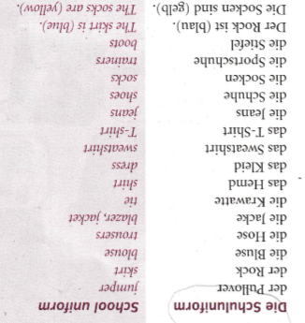
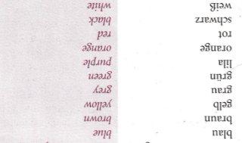
Week 5 w/c 4th July
Read through the vocabulary for this week and spend a good amount of time trying to learn it. You will need these words to complete the tasks on the next few slides. There are more words on the next slide too.

Slide 31
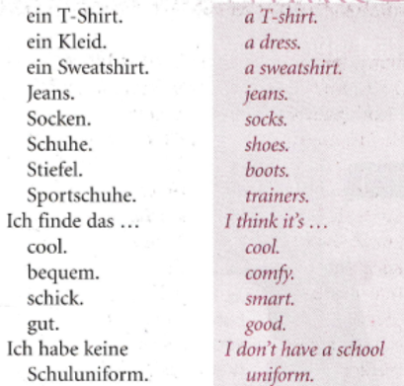
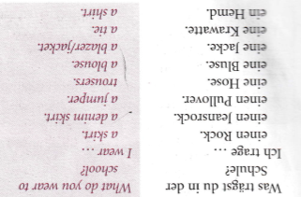

Slide 32
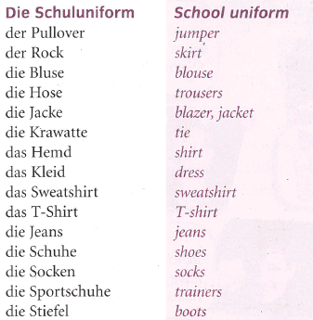
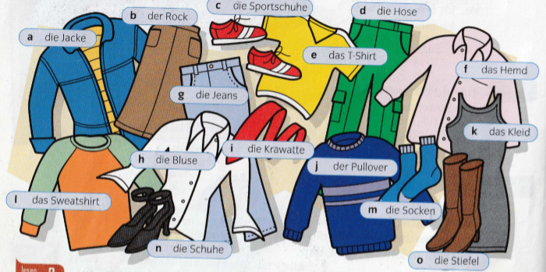
Did you know that in Germany pupils don’t wear a school uniform?
Look at the picture below. Copy the pictures and label them in your book. Remember der/die/das are the German words for ‘the’. Title ‘die Kleider – clothes’

Slide 33
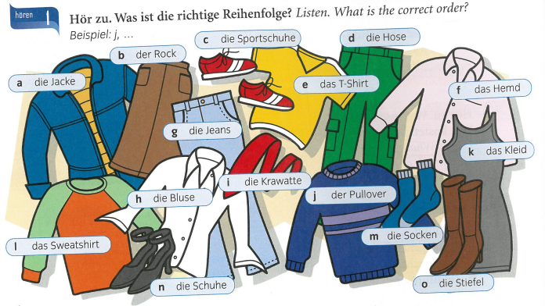
Listen to the recording. What order do they mention the items? Write down the letters in the correct order.
Example, j, …

Slide 34
Look at the picture. Are the 6 statements true or false?
Remember ‘ist’ means ‘is’ and ‘sind’ means ‘are’

Slide 35
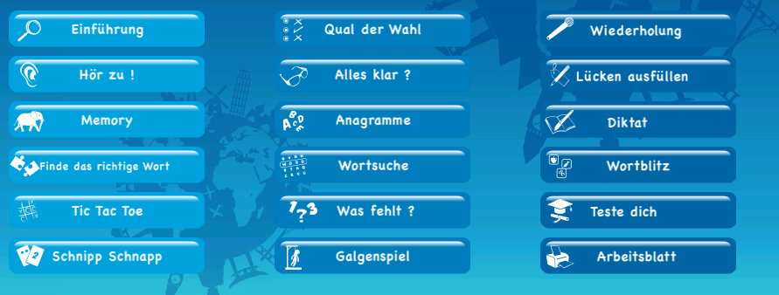
Log on to the beginner’s section of Linguascope and practise the clothes vocabulary (Die Kleidung 1 and 2). You will find this in the green section as seen below. Make a note of the new vocabulary that is introduced (shorts/suit/dungarees etc).
username = kingshill password= mfl123*
Optional task-
If you would like to print out a worksheet or take a quick test you will find that here:

Slide 36
Week 6 w/c 11th July
This week is assessment week. Spend some time revising all of the vocab on these slides so far (or revise the chapter 2 vocab sheet in your exercise book) and then email your teacher for the test papers. There are also revision activities on the next slide.

Slide 37
Look at the 6 pictures below. Write down what they are in German
Unscramble these school subjects. Example is done for you.
Example – tuksn = Kunst
1. hsedctu 2.kendurde 3. kiofrnmita 4. iksmu 5. tahme

Slide 38
Are these statements positive or negative?

Slide 39
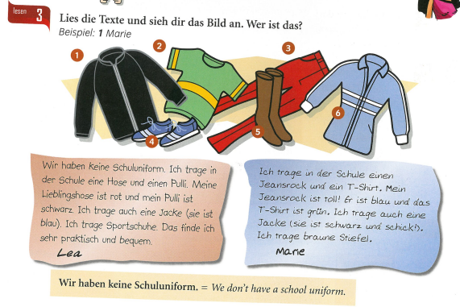
Read the texts about Lea and Marie. Who mentions the items of clothing? Example 1 Marie

Slide 40
Week 7 w/c 18th July
Vocabulary revision week. Recap the topics we have done this year in German. You can use Quizlet, Linguascope or Blooket. There are some suggestions for Linguascope on the following slides.

Slide 41
Log on to Linguascope and practise the school subjects in German. You will find them in the pale blue part of the beginner section (die Schulfächer). There is a worksheet you can print out and a test you can do if you would like to. Listen carefully to how they are pronounced and repeat the words.
username = kingshill password= mfl123*

Slide 42
Log on to the beginner’s section of Linguascope and practise the clothes vocabulary (Die Kleidung 1 and 2). You will find this in the green section as seen below. Make a note of the new vocabulary that is introduced (shorts/suit/dungarees etc).
username = kingshill password= mfl123*
Optional task-
If you would like to print out a worksheet or take a quick test you will find that here:

