Slide 1


Year 7 French rotation 2:
If pupils are absent from lessons they should spend time revising and learning vocabulary. All of the vocabulary for this term is on the following slides. First of all, they should recap the vocabulary which they learned the previous week. Then they should start to learn the next section of vocabulary which they have not yet covered in class. This could be done by using the look, cover, write, check method or by making flashcards etc. It should also be copied in to their orange books. There are also a few tasks to complete. A plan for the term is on the next slide.
Pupils can also revise vocabulary on Linguascope-
Username is kingshill password is mfl123*
Any new vocabulary they learn can be written in their orange books or on paper.
If pupils wish to do extension work they can access free MFL lessons on the Oak National Academy website:
https://classroom.thenational.academy/subjects-by-key-stage

Slide 2
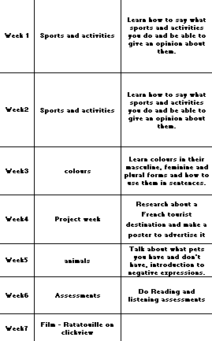
Watch the film and research French foods

Slide 3






WEEK 1 – w/c 6th June
This term you will study French.
Make a French title page in your orange book.
Ideas for the design are below:

Slide 4
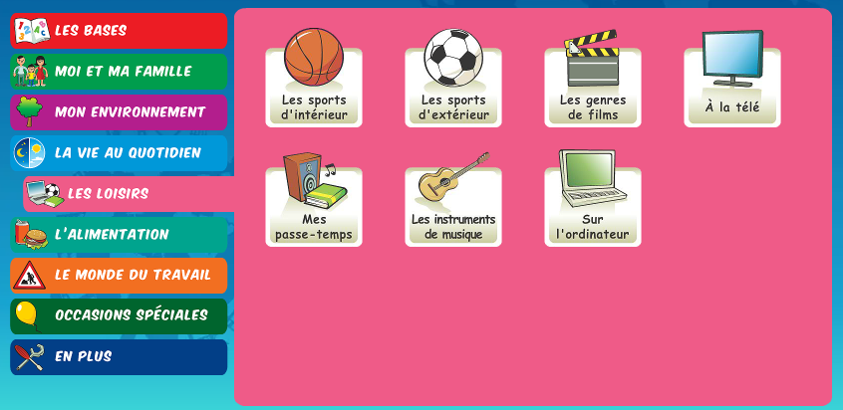
Make a poster out of these words and play some games on linguascope
Les activités
la danse – dance
la musique – music
la gymnastique – gymnastics
le foot – football
le rugby – rugby
le tennis – tennis
le judo – judo
le volley – volleyball
le golf – golf
le basket – basketball
le skate – skateboarding
le vélo – cycling
les jeux vidéos – video games

Slide 5
Week 2 w/c 13th June
Les opinions - opinions
j’aime – I like
je n’aime pas – I don’t like
j’adore – I love
je déteste – I hate
Tu aimes…? – Do you like…?
Parce que c’est – because it is
Super – super
Fantastique - fantastic
Amusant - fun
Intéressant – interesting
Nul – rubbish
Fatigant – tiring
Difficile - difficult
Ennuyeux – boring
Je préfère – I prefer
Make these words into a poster. Use the words we learnt last week combined with these words and make up 5 sentences of your own and translate them into English.

Slide 6
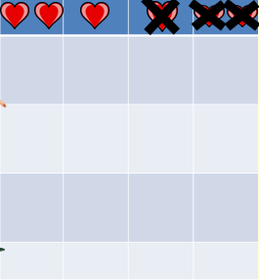

Listen and make a note of each person’s likes and dislikes.
Play some games on Quizlet using this link:
Quizlet revision

Slide 7
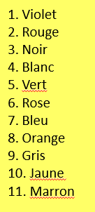
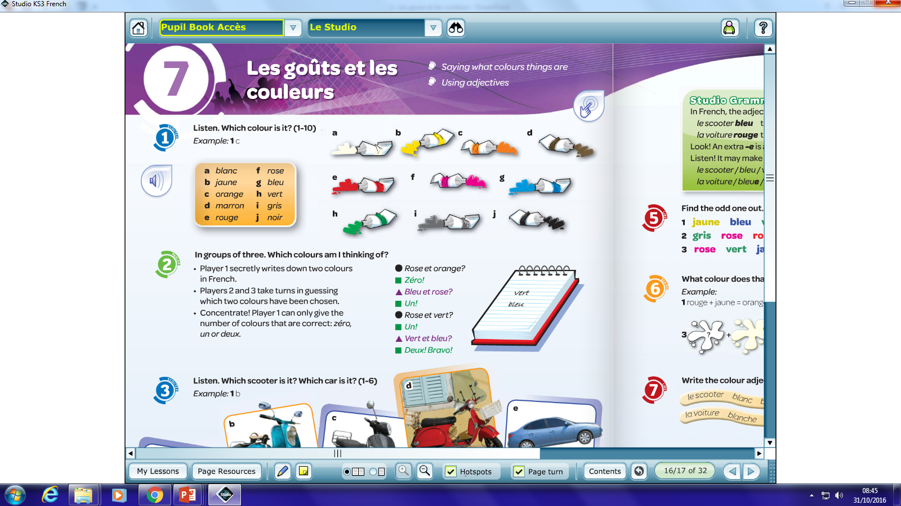
Week 3 w/c 20th June
Write these colours in your book. Can you guess what they are in English? Use www.wordreference.com to check your answers.
Do this listening activity, write down the letter of the colour that you hear.

Slide 8
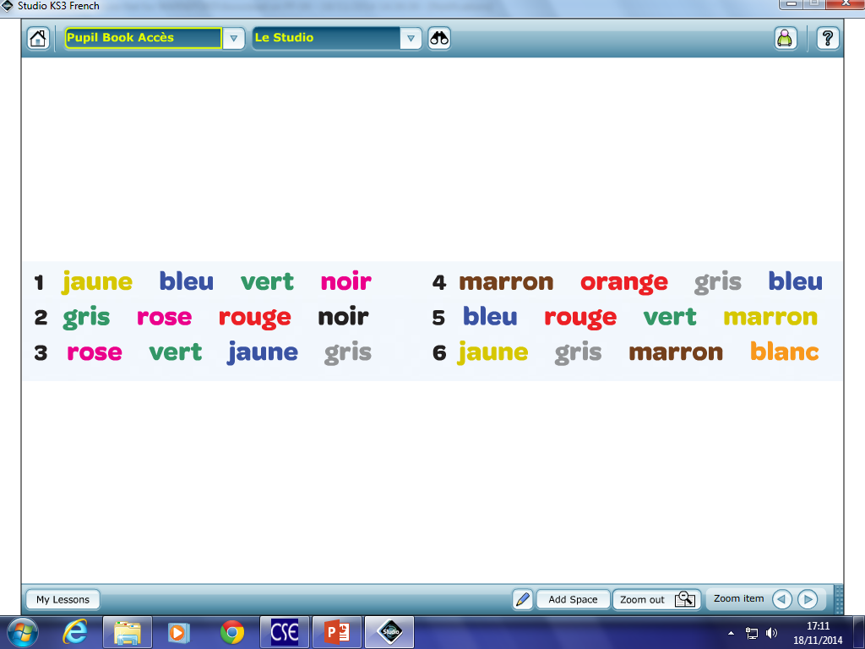
Which colour is the odd one out in each row?
RULE:
Usually in English the adjective (describing word) goes _______ the noun (object). In French the adjective usually comes ________ the noun. For example…
What do you notice about how this sentence is written? Complete the rule and write it in your book.
C’est un crayon bleu
- it is a blue pencil

Slide 9
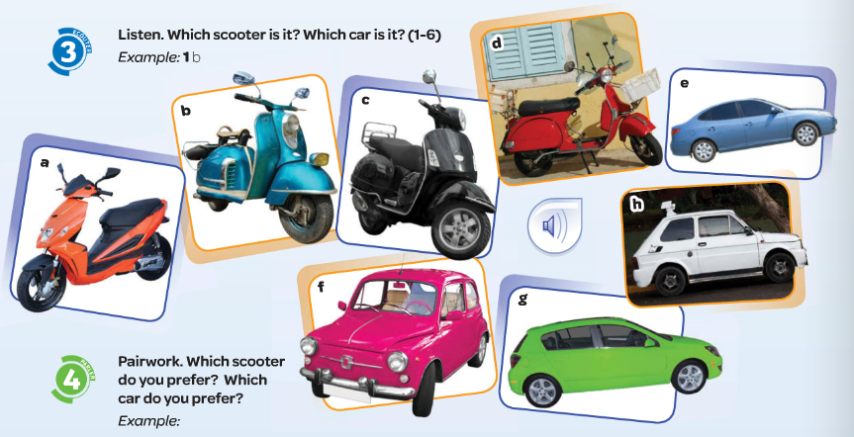
Listen – which car or scooter are they describing?

Slide 10
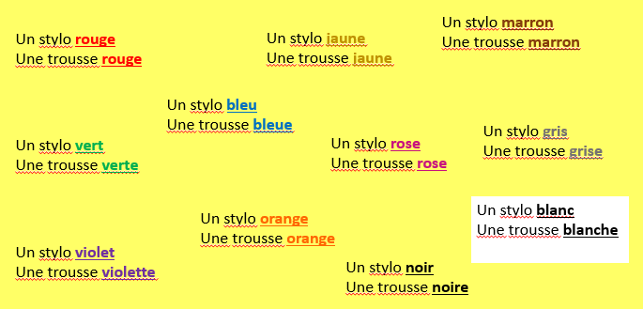
Notice how the spelling of the colours change when the noun they are describing is masculine or feminine. Copy down and translate the examples.

Slide 11

Week 4 w/c 27th June
Project week:
Research an area of France which is popular with tourists. Make a poster or a presentation about the place, please include the following information.
- What is the place called and whereabouts in France is it?
- What can tourists do there?
- Where can tourists stay? Please find some examples of accommodation available (hotels, campsites, holiday homes etc)
- Find some nice restaurants in the area, are there any regional specialities?

Slide 12
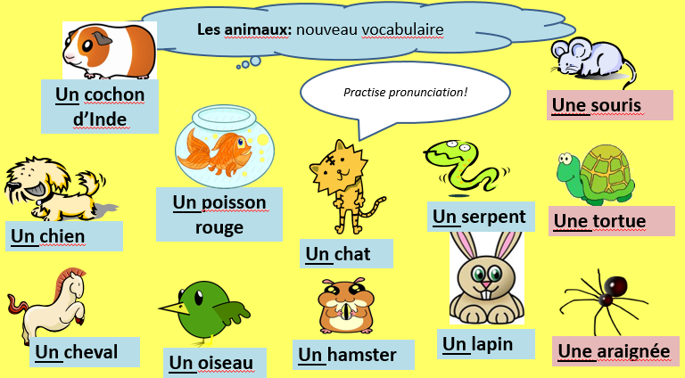
Week 5 w/c 4th July
Copy the new vocabulary and draw a picture for each one.
Extension – can you add the colour to your expression (see notes from the previous lesson about how to do this).

Slide 13
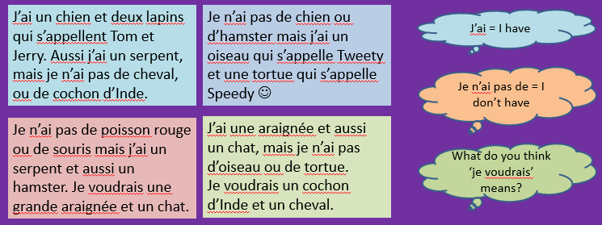
Copy and translate the texts. Then write one of your own to say what animals you have and don’t have. Remember, it doesn’t have to be true – make it up!!
Play some games to practice the animal vocabulary on quizlet – click the link:
Les Animaux

Slide 14

Week 6 w/c 11th July
This week is revision and assessment week. Contact your teacher for the assessment papers. Make sure you have revised all of the words and expressions that we have learnt this term.

Slide 15
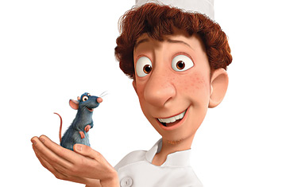

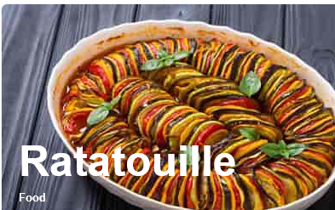
Week 7 w/c 18th July
Film week!
Watch Ratatouille, this can be found on Clickview.
Look in the ‘pupils’ section on the school website for information on how to watch films on Clickview
After watching the film, research traditional French foods and make an information poster or PowerPoint about it.

