Slide 1
Key Events of the 20^{th/21st} Century
Walt: To be able to explain important modern historical events.

Slide 2
Task-
Your task is to pick an event from the 20th/21st Century and write a detailed report or fact file about it.
You need to include details such as:
Dates
Location
Background
What happened?
Importance
Think about your presentation and include pictures or illustrations if you can.

Slide 3
You can use this Powerpoint as inspiration for what event you will pick.
Look through the following slides for examples of significant events during the 20th century.

Slide 4
Write the numbers 1-12 in your margin.
Can you name the key events

Slide 5
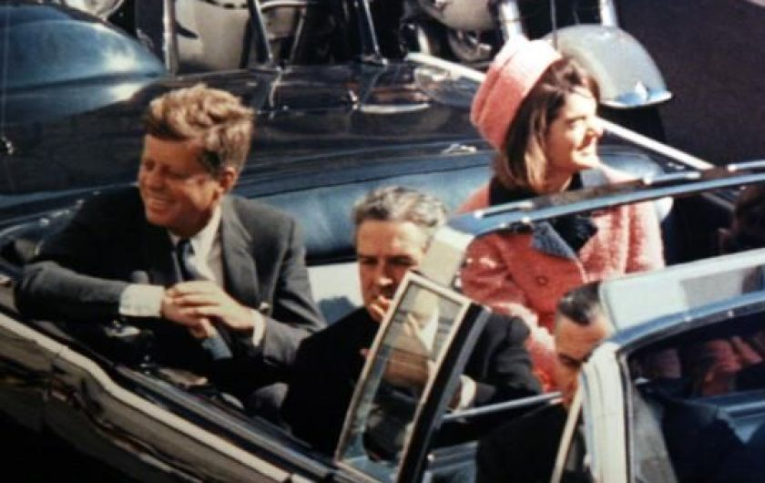
1) Assassination of American President JFK

Slide 6
2) Man landing on the moon

Slide 7
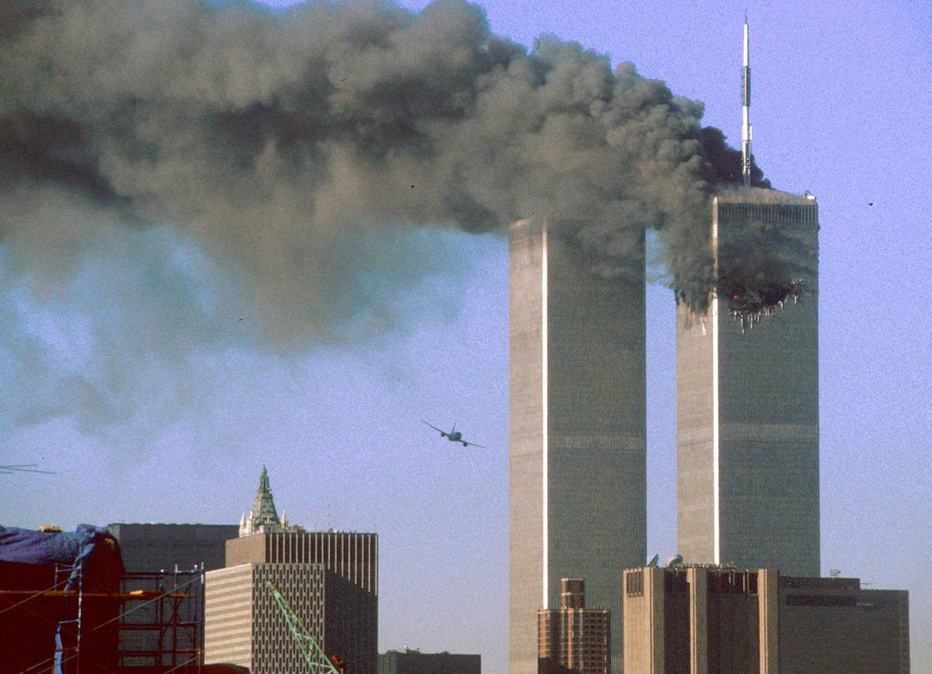
3) Terrorism Twin Towers NYC

Slide 8
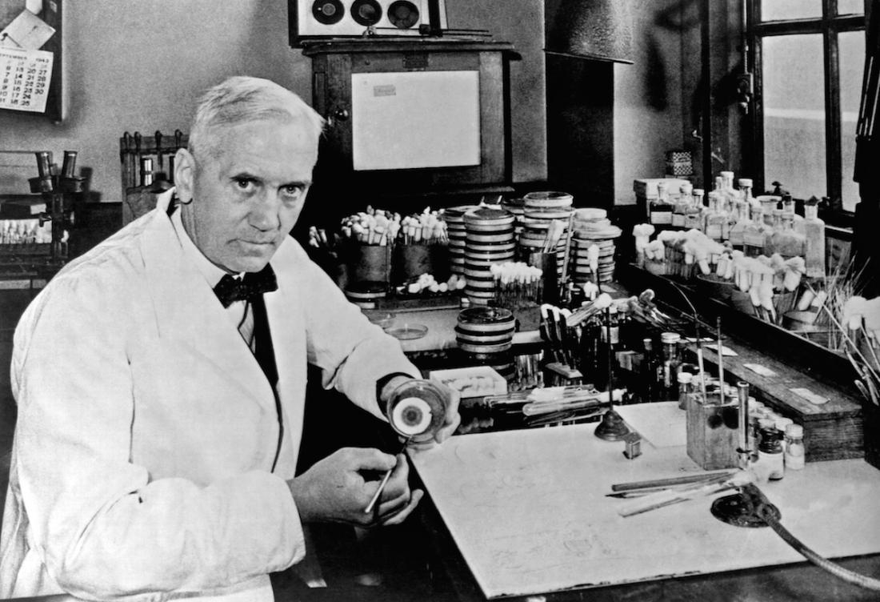
4) Penicillin- Alexander Fleming

Slide 9
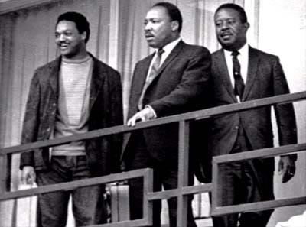
5) Assassination of MLK

Slide 10
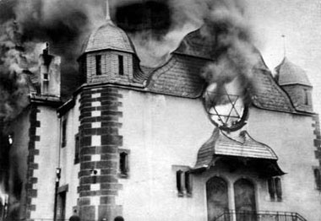
6) Kristallnacht

Slide 11
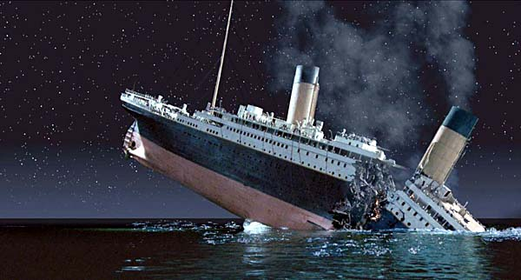
7) The sinking of the Titanic

Slide 12
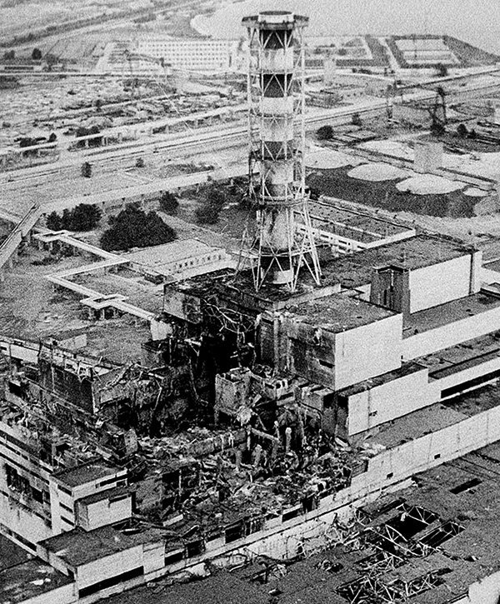
8) Chernobyl

Slide 13
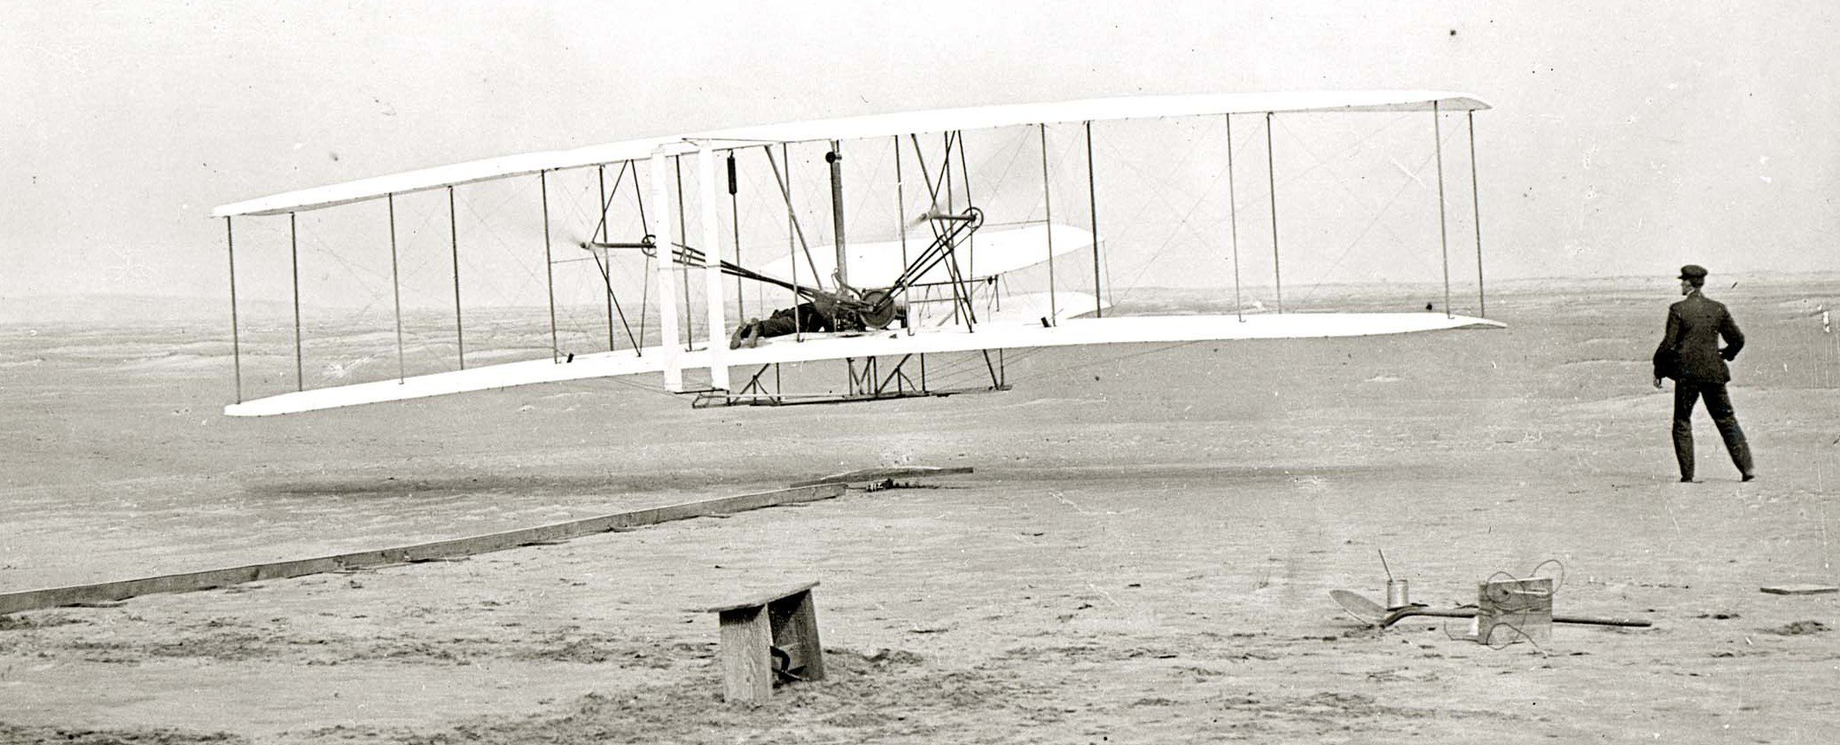
9) The First Flight- Wright brothers

Slide 14
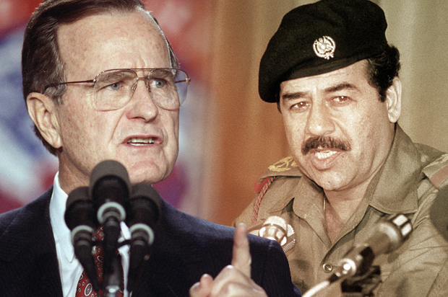
10) The 1st Gulf War

Slide 15
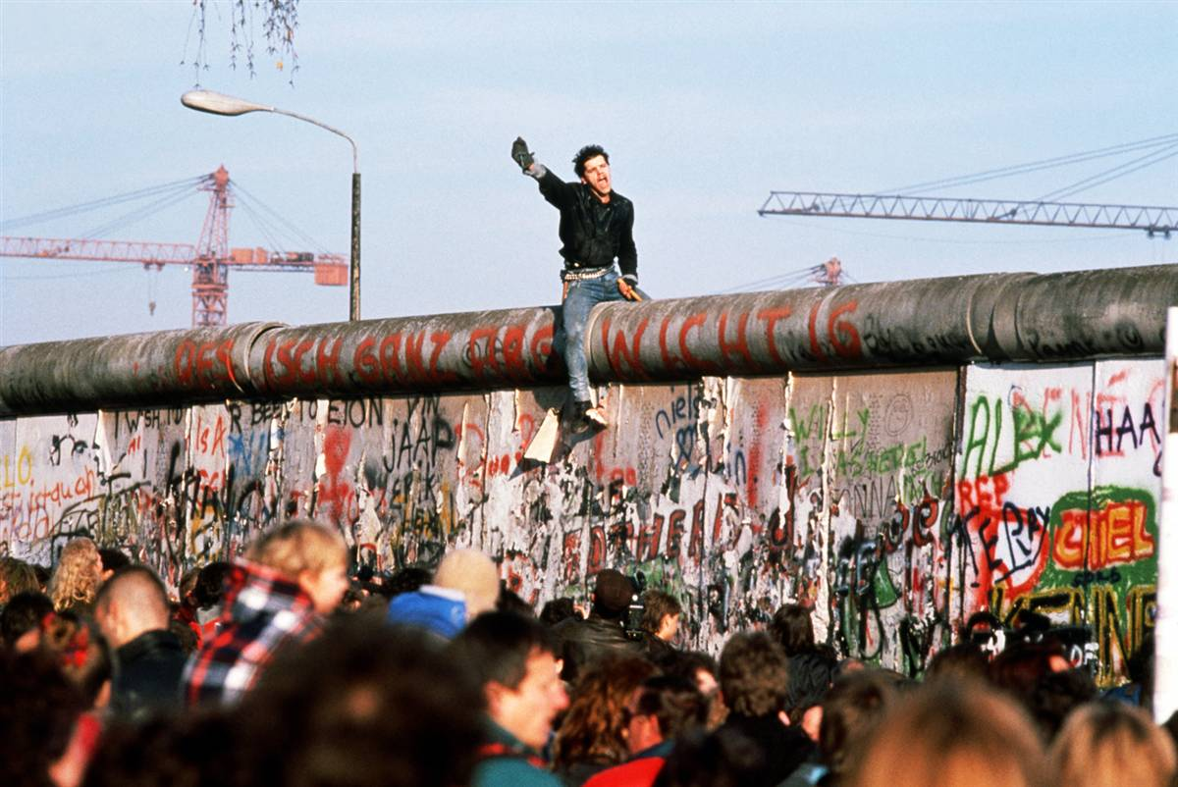
11) The Berlin Wall coming down

Slide 16
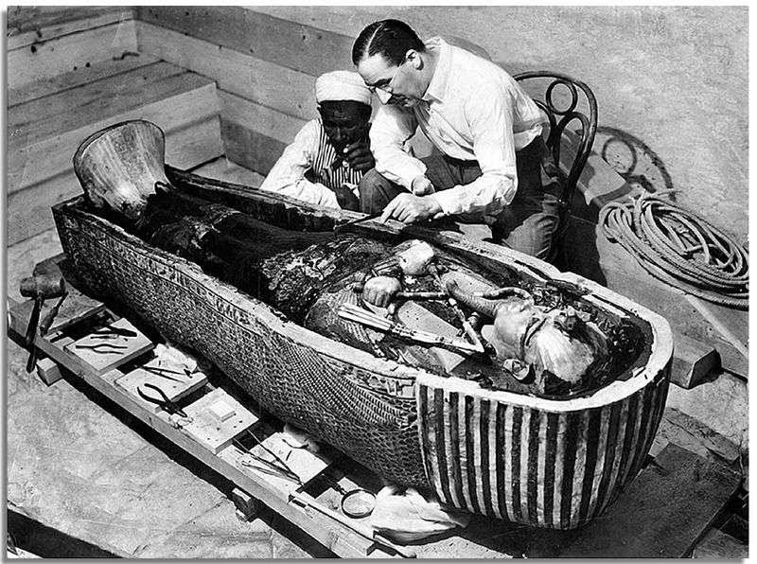
12) Tutankhamun’s tomb

Slide 17
Task:

Slide 18
1903 Wright Flyer Flyer I or 1903 Flyer
Ist successful heavier than air powered aircraft. Designed by Wright brothers, made of giant spruce wood, with a gasoline engine, the pilot flew on his stomach.
Flew 4 times on December 17th 1903 in North Carolina. See it today in National Air and Space Museum in Washington DC.
Important as it began the ‘pioneer age of aviation’

Slide 19
Other:
Amelia Earhart- American Aviation Pioneer.
1st female to fly solo across the Atlantic in 1928. During an attempt to a circumnavigational flight of the globe in 1937 her plane disappeared over the Pacific.
D.B.Cooper-hijacked a Boeing 727 aircraft in 1971, only unsolved case of air piracy.

Slide 20
1912 Titanic
https://youtu.be/Et3C2o5Ujyg
British Passenger liner operated by White Star Line sank in the North Atlantic Ocean on 15th April 1912 striking an iceburg on its maiden voyage from Southampton to New York City. 2,224 passengers were on board and around 1,500 died. The Final survivor Millvina Dean who was 2 months old at the time died in 2009 aged 97. The wreck was discovered in 1985.

Slide 21
Other:
Lusitania, Cuncard Ocean Liner was on its return voyage from Pier 54 New York to Liverpool. It was hit by a torpedo from a German U-boat and sank off the coast of Ireland on 7th May 1915, 1,198 of 1,959 passengers perished. It was one of the reasons USA entered the war.
USS Arizona. Sank with the loss of 1,177 crew on 7TH December 1941 during the attack on Pearl Harbour.

Slide 22
Tutankhamun’s Tomb
Employed by Lord Carnarvon, Howard Carter discovered the tomb in November 1922, in the Valley of the Kings, Egypt. On discovery it was unsealed and apparent that it had been breached at least twice in ancient times. The tomb was opened on 29th November 1922 and the mummy discovered in October 1923. It took 8 years to empty the tomb with its contents being sent to the Egyptian Museum in Cairo.
https://youtu.be/IZPS9DeKvZQ

Slide 23
Other:
South Pole Expedition:
The first expedition to reach the geographic South Pole was led by the Norwegian explorer Roald Amundsen. He and four others arrived at the pole on 14 December 1911,^{[n 1]} five weeks ahead of a British party led by Robert Falcon Scott as part of the Terra Nova Expedition. Amundsen and his team returned safely to their base, and later heard that Scott and his four companions had died on their return journey.

Slide 24
Alexander Fleming-Penicillin 1928
Alexander Fleming was a Scottish physician and microbiologist. He had witnessed many soldiers die in WWI of septic wounds while working in an army hospital. In 1922 he began searching for a cure. In 1928 by chance he discovered penicillin. However there was little funding for his discovery. Eventually in the 1930’s Howard Florey and Ernst chain brought about the mass production of penicillin, all 3 won the Nobel Price in 1945. Fleming was voted in time magazines 100 most important people in 1999.

Slide 25
Other:
1st successful transplant of the cornea of the eye.
1st successful heart transplant carried out in 1967.
1st CT scan on a patient took place on 1st October 1971
Louise Joy Brown was the first test tube baby in 1978
Dolly the sheep was cloned in 1996

Slide 26
Kristallnact
In November 1938, a German diplomat was murdered in Paris by a Jew. The Nazis used this to start Kristallnact or ‘ the night of the broken glass’ on the 9th-10th November 1938. There was anti-Jewish rioting throughout Germany and Jewish shops
( 7,000) and synagogues ( 267 ) were destroyed. 30,000 Jewish men were arrested and sent to the concentration camps.
https://youtu.be/_q_8sLOxJHM

Slide 27
Other:
The Night of the Long Knives
The Wall Street Crash 1929
The Manchurian Crisis 1931
The Invasion of Abyssinia 1935
Appeasement- Neville Chamberlain
Invasion of Poland 1939

Slide 28
Assassination of JFK
John F. Kennedy was the 35th President of the US and was assassinated on Friday 22nd November 1963 at 12.30pm in Dallas, Texas.
He was riding in a motorcade with his wife Jackie and the Texas Governor.
Lee Harvey Oswald was arrested for the shooting but was shot dead by Jack Ruby on 24th November while being transferred. Jack Ruby died in prison in 1967.
https://youtu.be/0FCqjClIxuU

Slide 29
Assassination of MLK JR
Martin Luther King was an American clergyman and civil rights leader. He is known for his use of non violence and civil disobedience. He was fatally shot at the Lorraine Motel in Memphis, Tennessee on April 4th 1968. James Earl Ray was arrested for his murder, he died in prison in 1998.
https://youtu.be/eRINqQcIZsI

Slide 30
Other:
Death of Nelson Mandela December 2013
Death of Princess Diana August 1997
Murder of the Romanovs by communist revolutionaries in July 1918.
Assassination of Mahatma Gandhi 30th January 1948.

Slide 31
The Moon Landing
On 20th July 1969 the Apollo 11 mission was the first spaceflight that landed humans on the moon. Neil Armstrong was the first man to step on the moon followed by Buzz Aldrin. They spent about 2 and a quarter hours outside the spacecraft. Michael Collins flew the Command Module alone while they were on the surface.
https://youtu.be/cwZb2mqId0A

Slide 32
Other:
Space Race- USA/USSR
Sputnik 1st Satellite
1st dog in Space
1st spaceman Yuri Gagarin
Apollo 13 ‘Houston we have a problem’

Slide 33
Chernobyl 1986
The Chernobyl disaster was caused by a nuclear accident that occurred on 26th April 1986 at the no.4 reactor in the Chernobyl Nuclear Power Plant in the former USSR now the Ukraine. Initially less than 100 people died. However the environmental and long term human consequences have been huge. 4 square km of pine forest died, with large numbers of cattle and horses. Cattle have been born with deformities as well humans. The number of cancer deaths in the area are well above average. The whole area is an exclusion zone and will be for 20,000 years.

Slide 34
The Berlin Wall 1989
After WW2, Europe was carved up by the Soviet Union and its former Western allies. The Berlin Wall had separated Berlin from 1961, into West Berlin and East Germany. It is 96 miles in length. It was built by the GDR, German Democratic Republic, to stop an exodus of people defecting to the more prosperous west. Between 1961 and 1989 over 100,000 tried to cross, some where killed about 5,000 succeeded. The fall of the wall came after a series of revolutions in Eastern Bloc countries like Poland and Hungary, and with a weakening Soviet Union, this led to demonstrations in East Germany. This was the fall of the Iron Curtain.
https://youtu.be/8thC4hOn_C8

Slide 35
The First Gulf War
The first Gulf War led by George H.W.Bush against President pf Iraq Saddam Hussein.
It began on 2nd August 1990 until 28th February 1991 and was given the codename Operation Desert Shield.
It was a war waged by coalition forces from 35 nations led by the United States against Iraq in response to the Iraqi army invading and occupying Kuwait.

Slide 36
Twin Towers
On the morning of September 11, 2001, 19 terrorists hijacked four American passenger planes. Two were flown into the twin towers of the World Trade Centre, leading to the collapse of first the Southern and then the Northern tower. A third plane was flown into the Pentagon building in Washington and the fourth plane crashed in Pennsylvania. In total 2,996 people died. It was carried out by al-Qaeda who are fighting a holy war against the west.

