Slide 1
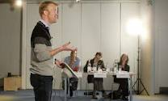
Monologues
How can we use movement and body language to establish our character?
Workshop on techniques to help
In-role work

Slide 2
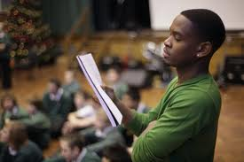
Warm-up Tasks
Do your monologue as if you are throwing things
Do your monologue as if you are being chased/chasing
Move chairs as you say your monologue

Slide 3
Vocal Skills
An outstanding command of vocal skills is demonstrated, including clarity and use of pause, pace, pitch, tone, inflection and projection throughout the performance. | 9-10
Vocal skills are used consistently in ways that demonstrate an excellent degree of control in terms of clarity and use of pause, pace, pitch, tone, inflection and projection in performance. | 7-8
A good control of vocal skills is shown in terms of pause, clarity, pace, pitch, inflection and projection in most of the performance. | 5-6
Vocal skills are adequate and used with some clarity, but there are limitations that impair the performance. | 3-4
Characterisation
There is outstanding understanding of the role and its context within the play. Characterisation is complete, consistent and fully committed to the style and context. | 9-10
There is excellent understanding of the role and its context within the play. Characterisation is thorough, consistent and sympathetic to the style and context. | 7-8
There is good understanding of the role and its context within the play. Characterisation is sound demonstrating understanding of style and context. | 5-6
There is adequate understanding of the role and its context within the play. Characterisation is apparent but lacks consistency. There is some regard to the style and context. | 3-4

Slide 4
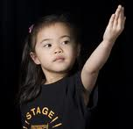
Rehearsal Time
Focus on the movement and gesture of your character
Run it with no movement
Gradually block the use of space – where you walk, sit down etc
Add gesture at certain moments – don’t overfill it
Have moments of stillness to build tension appropriately

Slide 5
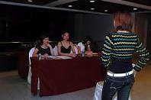
Monologues
How can we use our vocal skills to develop and sustain our character?
Vocal workshop
Rehearsal focusing on use of voice

Slide 6
Warm-up Tasks
Take each line and decide which one word per line you will put the stress on,
I want to go out
I want to go out
I want to go out
I want to go out
I want to go out
Stand in the centre of the room – when someone else passes you have to adjust your volume as to keep your monologue a secret

Slide 7
Vocal Skills
An outstanding command of vocal skills is demonstrated, including clarity and use of pause, pace, pitch, tone, inflection and projection throughout the performance. | 9-10
Vocal skills are used consistently in ways that demonstrate an excellent degree of control in terms of clarity and use of pause, pace, pitch, tone, inflection and projection in performance. | 7-8
A good control of vocal skills is shown in terms of pause, clarity, pace, pitch, inflection and projection in most of the performance. | 5-6
Vocal skills are adequate and used with some clarity, but there are limitations that impair the performance. | 3-4
Characterisation
There is outstanding understanding of the role and its context within the play. Characterisation is complete, consistent and fully committed to the style and context. | 9-10
There is excellent understanding of the role and its context within the play. Characterisation is thorough, consistent and sympathetic to the style and context. | 7-8
There is good understanding of the role and its context within the play. Characterisation is sound demonstrating understanding of style and context. | 5-6
There is adequate understanding of the role and its context within the play. Characterisation is apparent but lacks consistency. There is some regard to the style and context. | 3-4

Slide 8
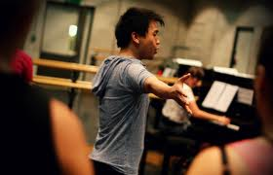
Rehearsal Time
Look at where you pause in the speech – mark it on the sheet, and how long for. Why is tension important at that point?
Vary the pitch and tone according to the emotion of your character at certain points – make a note of the emotion on the sheet to remind you

Slide 9
Written Work
How can we use our character analysis to help us annotate scripts and justify the decisions we make?
Show a thorough understanding of our characters by writing notes that reveal the motivation and sub-text
Fully justify the decisions for choosing the monologue

Slide 10
Written Performance Concept
The rationale shows an outstanding response to the chosen play in relation to its social, historical, cultural and political context. There is a comprehensive account of both the preparation process and the intended interpretation. | 9-10
The rationale shows an excellent response to the chosen play in relation to its social, historical, cultural and political context. There is a detailed account of both the preparation process and the intended interpretation. | 7-8
The rationale shows a good response to the chosen play in relation to its social, historical, cultural and political context. There is a clear account of both the preparation process and the intended interpretation. | 5-6
The rationale shows an adequate response to the chosen play in relation to its social, historical, cultural and political context. There is only a superficial account of both the preparation process and the intended interpretation. | 3-4

Slide 11
Units and Objectives
Units of action: Sections of a scene which represent the individual actions of a character
Objectives: What a character wants. The motivation which propels a character through individual units of action
Stanislavski

Slide 12
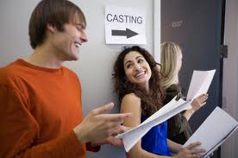
Monologues
How can we develop our characters using a naturalistic approach?
Short workshop looking at naturalistic approaches to text
Rehearsal using naturalistic techniques

Slide 13
Warm-up Tasks
Do monologue as different types of characters - e.g lawyer, teacher, judge, politician
Do monologue with different audiences - children, old people etc etc
Simplify your monologue down to just Freeze frames

Slide 14
The Magic If. . .
Working with a partner, select one of the following simple activities:• Lighting a fire • Making breakfast • Reading • Setting a table• Waiting • Drinking • Making a bed • Unloading groceries .You are going to perform three variations of this same activity, each time changing the “if”For example:• A couple makes breakfast the morning after their son died in a car accident.• A couple makes breakfast the morning after their wedding.• A middle-class couple in a rut makes breakfast on a typical morning where each partner is silently mulling over the many disappointments of his/her life, considering his/her partner’s role in these various disappointments.

Slide 15
Stanislavski Techniques
Subtext. This is not spoken, but rather, interpreted by the actor through intonation, gesture, body language, pauses. Through the actor’s imagination, the subtext is ‘spoken’ to the audience. Stan said: ‘spectators come to the theatre to hear the subtext. They can read the text at home’.
Emotion Memory. Recreate an event from the past in order to regenerate the ‘feelings’ experienced at that time. These feelings are then used in the current acting situation in order to fill out the role with ‘human depth and personal involvement’

Slide 16
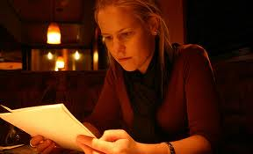
Rehearsal Time
Annotate the script with the sub-text
Rehearse with the new meaning to give depth
Pick out particular moments where the emotion is intense. Think of an experience from your past in order to evoke this emotion and put this into your performance

Slide 17
Monologues
How can we combine voice and movement skills to communicate our character fully?
General warm-up tasks to engage our performance skills
Rehearse your piece

Slide 18
Warm-up Tasks
Simplify your monologues down to just Freeze frames
Take away the words and communicate the meaning with just gesture
Create a mime that sums up your monologue
Do this for all 3!

Slide 19
Rehearsal Time
Go through your monologue
Mark yourself on the criteria sheet and give yourself a target to improve
If you are finished, pair up and mark each others work

