Slide 1
Component 3 practice –
Development review
Part 1: Describe your ideas for the final response(30 minutes approximately)
I plan to..
My aim is to…
The design concepts I have drawn are inspired by..
The design ideas I have chosen are my best because…
I have developed these by..
If time allows I might be able to ….

Slide 2
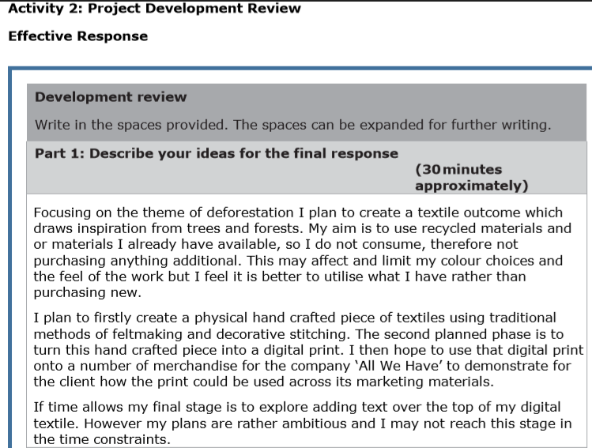

Slide 4
Component 3 practice –
Development review
Part 2: How have your ideas been supported by research and exploration? (30 minutes approximately)
The development of my ideas was..
I considered using …
I researched…
Using primary research I ..
Using secondary research I…
The making methods and experimentation I carried out was..
From this I learnt …
The design styles that influences my ideas were…
The characteristics I incorporated into my ideas are…

Slide 6
Ineffective

Slide 7
Component 3 practice –
Development review
Part 3: How will your final response meet the needs of the client?(30 minutes approximately
The intended audience / target user group is..
My design is fit for purpose by..
The materials, technique and processes I will use are..

