Slide 1
STARTER ACTIVITY
Work out this anagram for the lesson
SIHPNUMTNE
1
Write you name on the board according to your answer
“The more strict the rules are, the better people behave”
2

Slide 2
Your Task
You must prepare a Blog to give new pupils information on rewards at Kingshill school.
To be successful you must include:
Details of the Rewards and how you earn them in your school.
Whether you think the rewards are effective and why.
You could include:
An example of your most successful reward.
You have 25 minutes only to finish your presentation

Slide 3
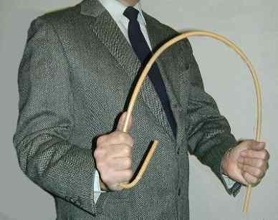
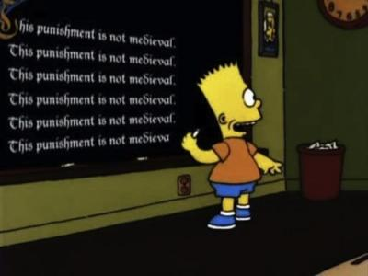
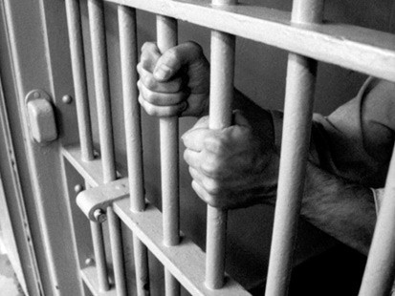
Does punishment work?
I will understand the aims of punishments.
I will evaluate a punishment I have been given.

Slide 4
To Start…
What is the aim of punishment?
( Write down the correct answers to the question above)
To make the person feel bad
To make people feel important
To stop people breaking the rules again
To make society/school a better place
To scare people
To protect people
To make money
To make people change their behaviour
There is no aim

Slide 5
Pair Work
How do you know when punishment has been successful?
How can we have human rights AND punishment at the same time?

Slide 6
Individual work
Write about a time when you have been punished and it has been a successful punishment.
Then write about a time when you have been punished and it has been an unsuccessful punishment.
(No other people should be named in the account. It should be factual and need not be about punishments awarded at school.)

Slide 7
Success Criteria
Your piece of writing should be at least a page long.
You should include details about what you did and your punishment.
You should include reasons why it was/was not successful.

Slide 8
30
2
It would be better without punishments.
(Discuss)
2
Name one school punishment
Name one school reward
5
What is the best reward you have been given?
12 + Stamp
Suggest why some punishments don’t work
2
10
Name one school reward
2
What makes a punishment work
Name one school punishment
8
8
Give one reason for rewards
Give one reason for punishments
1
Name one school reward
2
Name one school punishment

Slide 9
A Random Quiz
How many humanities rooms are there in the school?
In what year did the referendum vote for Brexit to happen?
Who is the head of Year 9?
What important event happened for women in the UK 100 years ago?
How many tutor groups are in Year 8?
Who is the British Prime Minister?
How many English teachers are there?
Who is the current British foreign minister?
How many times a week should you get PSHE homework?
When was the last general election?

Slide 10
Answers
4
2016
Mr Edwards
Women aged 30 and over got the vote
7
Theresa May
7
Boris Johnson
0
2017

Slide 11
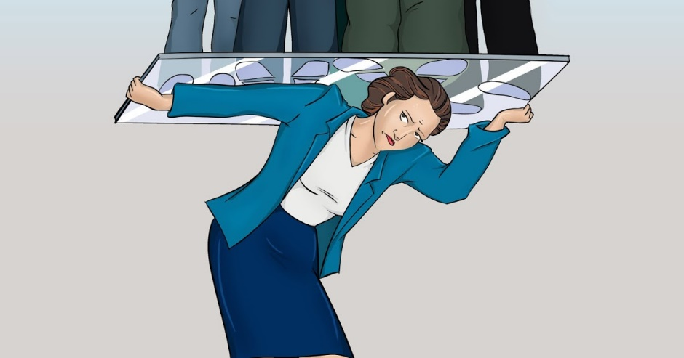
The Glass Ceiling
To know what is meant by the glass ceiling
To discuss why men and women can be treated unfairly
To identify how men and women could be treated equally

Slide 12
Write a definition
https://www.youtube.com/watch?v=Yk1K1dHgXi4
A glass ceiling is a metaphor used to represent an invisible barrier that keeps a given demographic (typically applied to minorities) from rising beyond a certain level in a hierarchy.

Slide 13
Pair work
Make a list of the reasons many women don’t achieve the same career success as men.
Write these reasons in your book
Be prepared to share

Slide 14
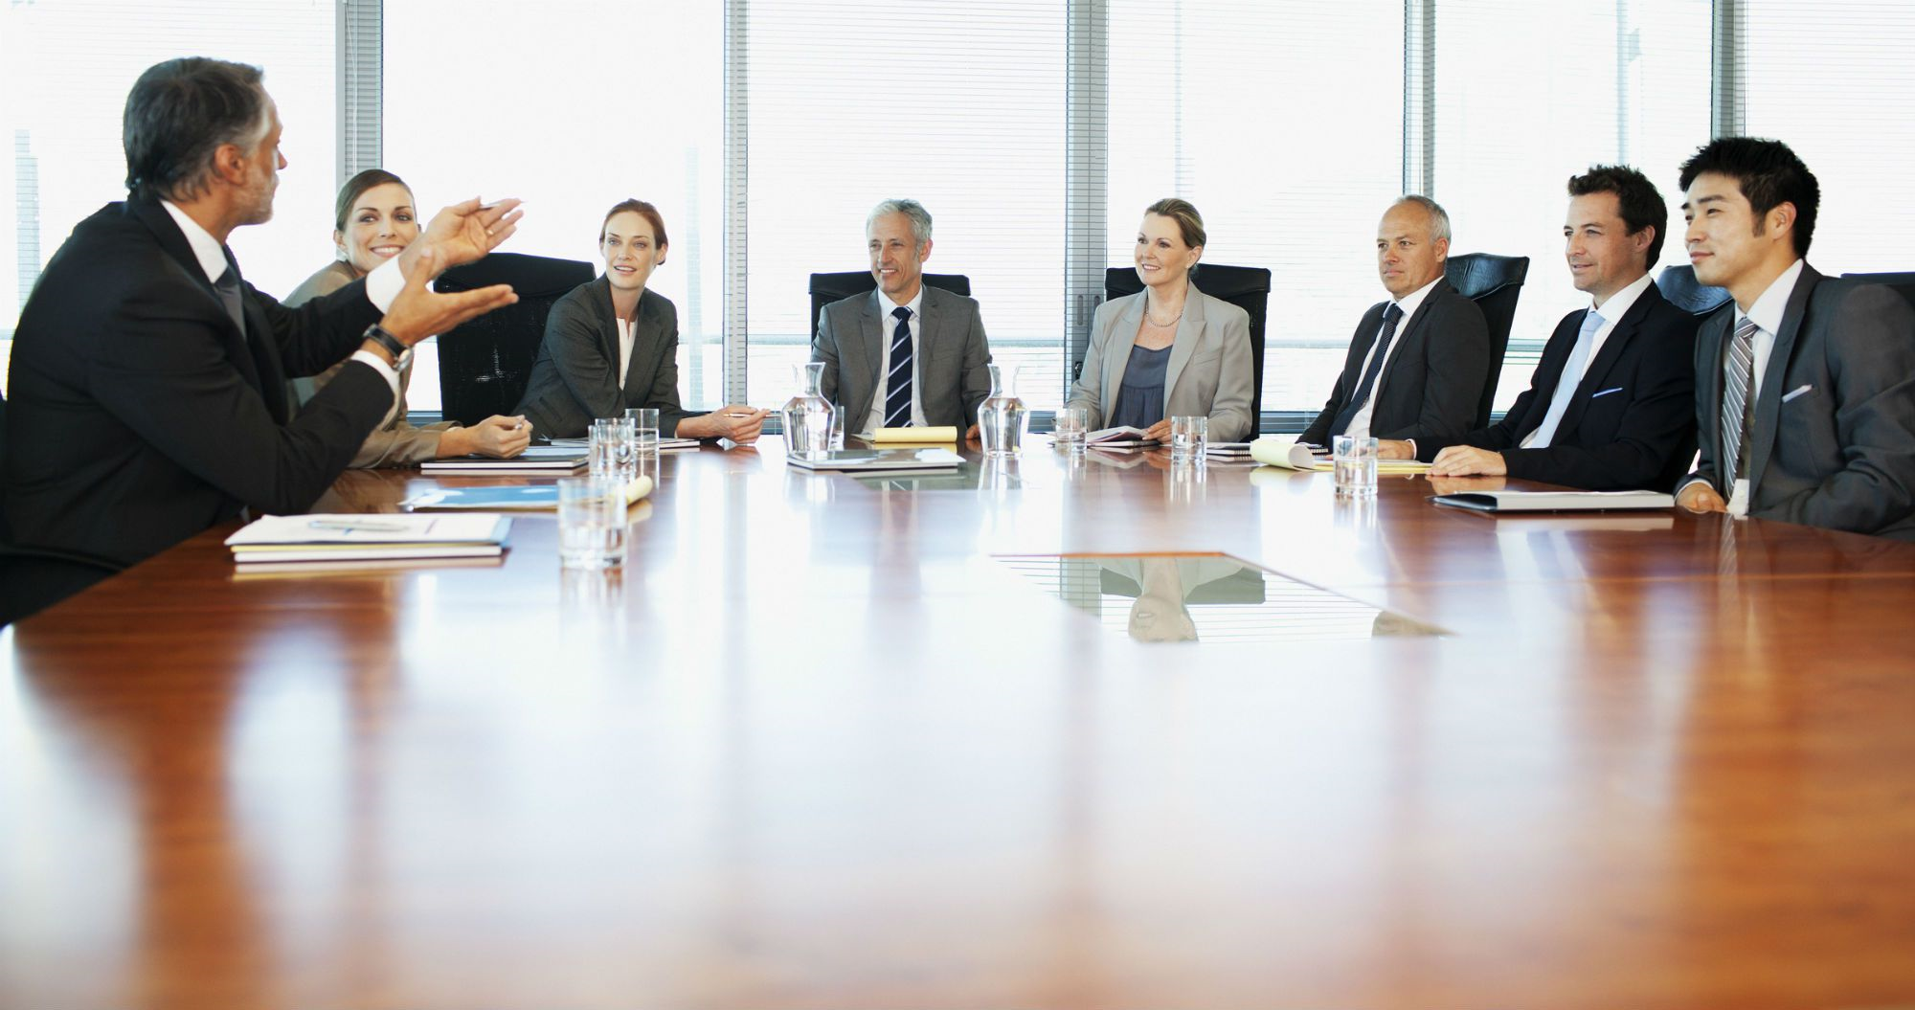
Group Work
You are now on the executive board of a company. E.g. Apple.
You must come up with three ways your company is going to make sure men and women are treated equally.

Slide 15
“Men and women will never be equal”
Write a paragraph in your book to explain your view.
Challenge: Why might somebody disagree with you?

Slide 16
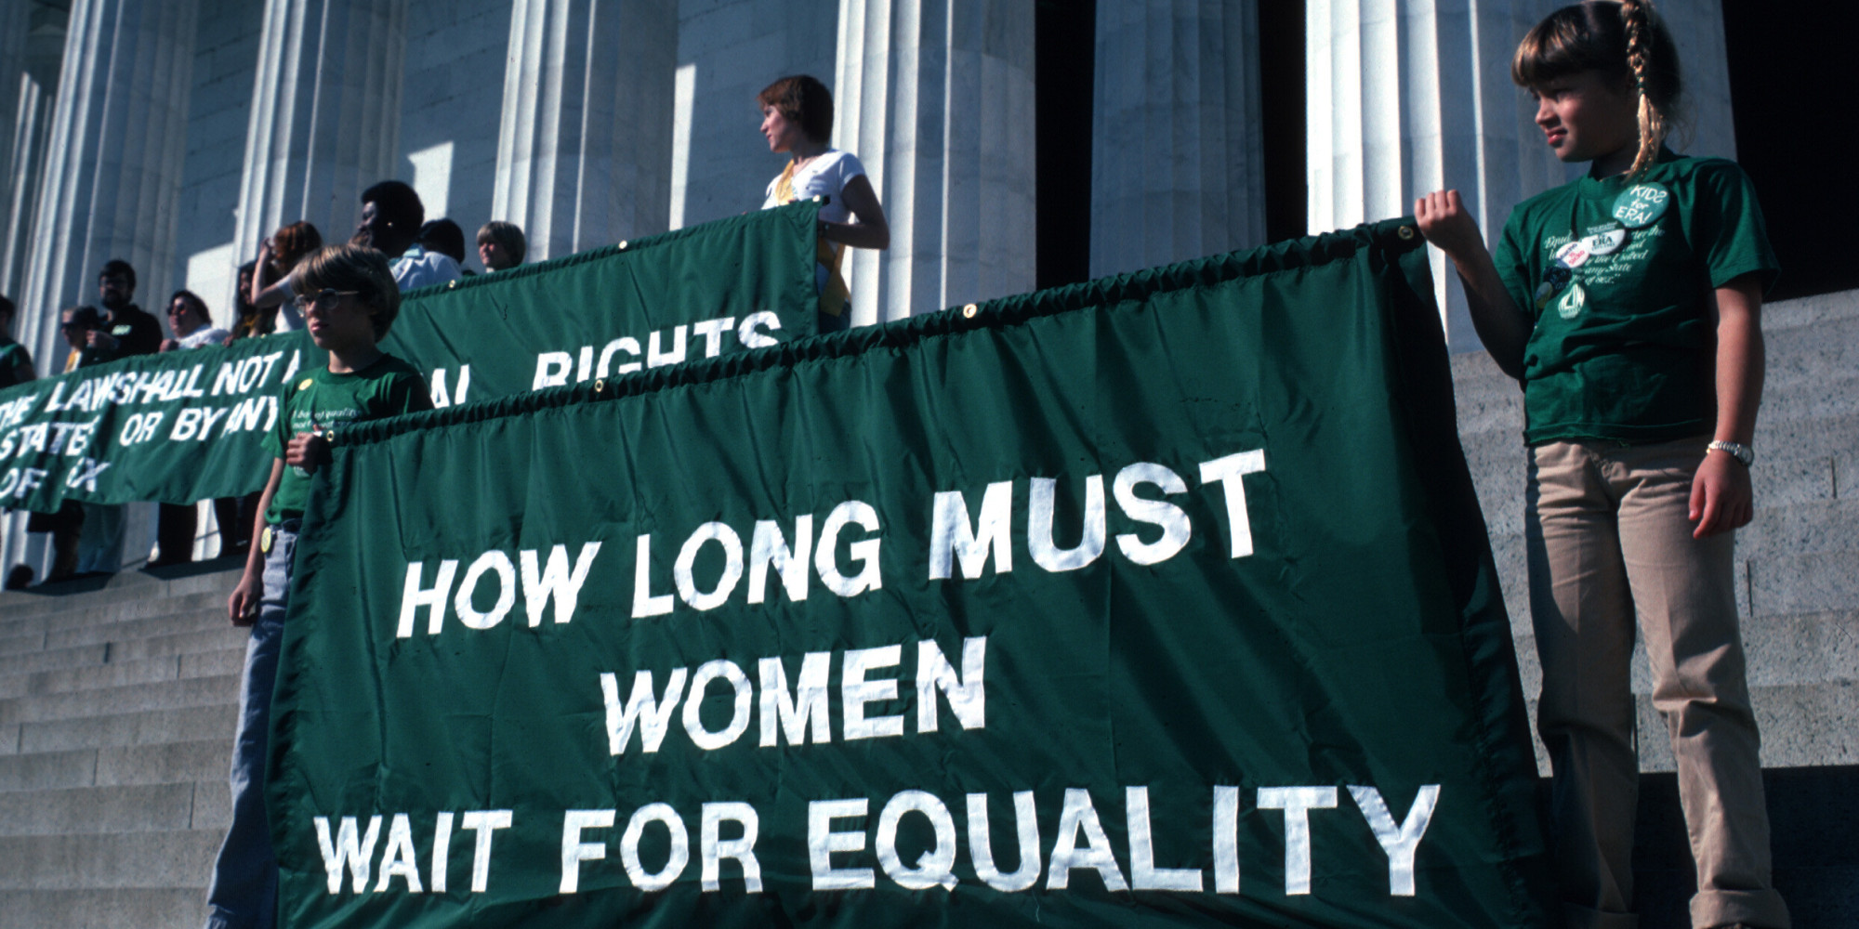

Slide 18
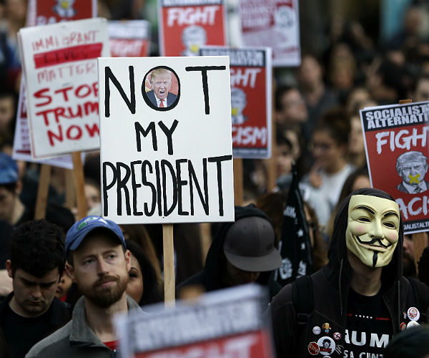

Slide 19
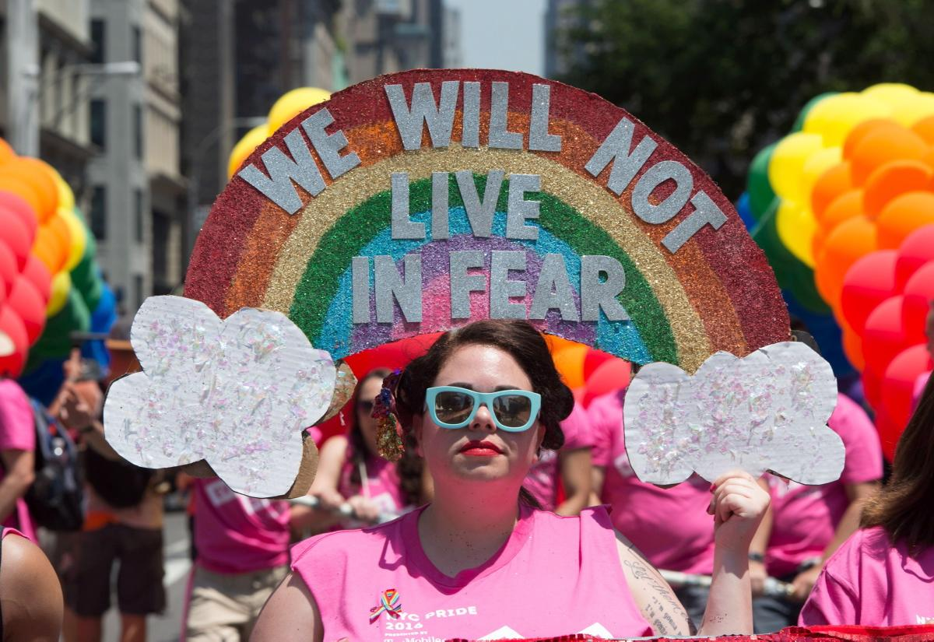

Slide 20
In 2018 5 countries still have the death penalty for people found to be in a gay relationship…
In 2015 it was reported that black people in the UK are still far more likely to be stopped and searched by the police…
In 2018 some women in the UK are still being paid less than men in the same job and worldwide women earn on average 18.2% less than men…

Slide 21
There is still a lot to fight for…
…this module is about the people who stand up to fight…

Slide 22
Censorship
I will know what censorship is
I will know why things are censored
I will discuss the positives and negatives of censorship

Slide 23
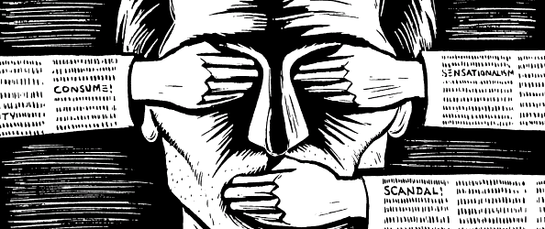
What is censorship?
“the suppression or prohibition of any parts of books, films, news, etc. that are considered obscene, politically unacceptable, or a threat to security.”
Suppression: Squashing something down
Prohibition: Forbidding something legally

Slide 24
Put your hands up if you have ever watched a film or played a game that is rated 15.
Put your hands up if you have ever watched a film or played a game that is rated 18.

Slide 25
Why do we have censorship?
To protect?
To limit our knowledge?
To control how we view something?

Slide 26
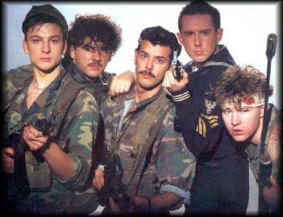
Watch the clip. https://www.youtube.com/watch?v=mCpz3LAjxek&safe=true
Why do you think this song was banned in 1983?
Even though it was banned it went to Number 1 the week it was released.

Slide 27
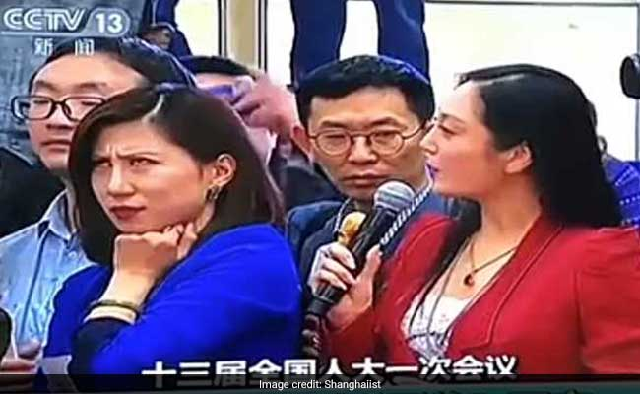
A recent case in the news
https://www.youtube.com/watch?v=C98K1Lg5blU&safe=true
Watch the clip.
Do you think the government
should be able to control
what we do and see?
Notes:
In this clip the reporter is rolling her eyes at another reporter who is asking a staged question to the Chinese government set by the government to make them look good. After the video went viral the Chinese government took it off the Chinese internet and banned the Chinese media from talking about it. The reporter has not been seen at work since.

Slide 28
Write the title below
The Positive and Negative points about censorship
Think about protecting people (especially children) from certain images
Think about our views being controlled by the government.

