Slide 1
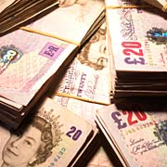
ECONOMIC CITIZENSHIP
I will know what recession and growth mean.
I will know what happens during a period of recession.
I will understand the link between recession and unemployment.
WHAT WOULD HAPPEN IF NO ONE SPENT ANY MONEY APART FROM BUYING JUST ENOUGH FOOD TO LIVE, AND THEY SAVED ALL THEIR MONEY INSTEAD?
WHAT IF EVERYONE SPENT ALL THEIR MONEY ALL THE TIME, THEY NEVER SAVED A PENNY, JUST SPENT WHAT THEY HAD AND BORROWED AS MUCH MONEY AS THEY COULD AND SPENT THAT TOO?

Slide 2
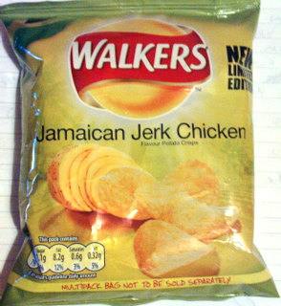
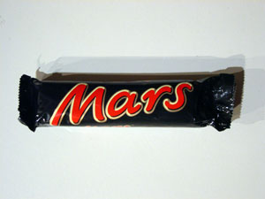
INFLATION
Why do prices go up?

Slide 3
The GDP generally goes up.
A recession is when the GDP goes down over two successive quarters.
All sorts of things can cause recessions.
Eg: Interest rates rising
International market forces – rising oil prices,
recessions in other countries etc
A VISCIOUS CIRCLE!

Slide 4
http://news.bbc.co.uk/1/hi/7847279.stm

Slide 5
“We have to deal with the mess the last government left.”
True or false?

Slide 6
The Credit Crunch?
A sudden shortage of funds for lending. Meaning fewer loans available.
The recent credit crunch was driven by a sharp rise in defaults on subprime mortgages. These mortgages were mainly in America but the resulting shortage of funds spread throughout the rest of the world.
US mortgage companies sell inappropriate mortgages to customers with bad credit ratings/low income.
Mortgage brokers took commissions for selling mortgages.
Brokers borrowed money to be able to offer mortgages and/or sold debt to banks.
Most of these mortgages had introductory low interest rates.
In 2007 US had to increase interest rates because of inflation.
Low income home owners default on mortgages.
US mortgage companies go bankrupt.
Knock-on effect on US banks who had bought the debt.
Banks then become reluctant to lend money to anyone.

Slide 7
Recession of 2008/09
Credit crunch - shortage of finance
Falling house prices - related to shortage of mortgages and credit crunch
Inflation squeezing incomes and reducing disposable income
Collapse in confidence of finance sector causing lower confidence amongst 'real economy'

Slide 8
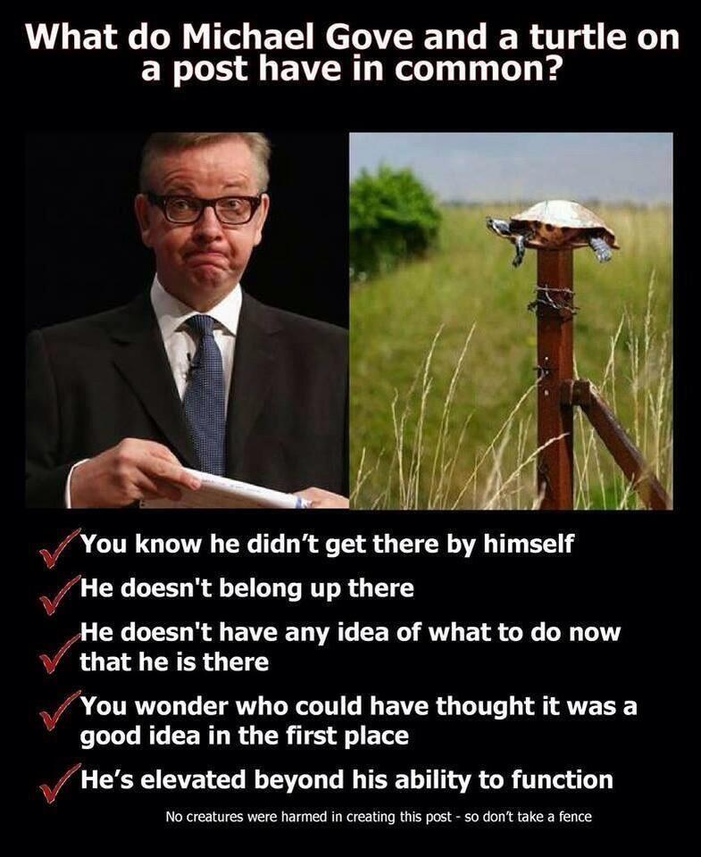
Why do employers and employees disagree?
Teacher joke!

Slide 9
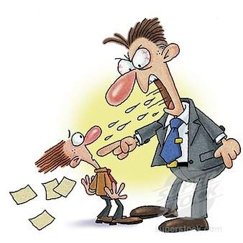
An employee
Meet Jim and Jeff…
Jim works for Jeff.
List what Jim wants from his job as an ‘employee’.
List what Jeff want from Jim as his ‘employer’.
JEFF
JIM
An employer

Slide 10
Employer (Jeff)
Employee (Jim)
An interesting job in a pleasant, safe environment
Good pay and other benefits (e.g. pension)
Long term contract with sick pay/ redundancy
Training to develop skills
Chances for promotion
To be consulted if there are changes to the business
Satisfied customers
High sales
Low costs
High quality work from staff
Well trained, motivated staff
Competitive prices
For the business to grow
To make profit
Why might these different people
disagree?
Which things do they have in common?
Which are different?

Slide 11
Which of these are legal rights for employers? Which are for employees?
From 13, not work for more than 2 hours on a school day | A fair reason and notice before dismissal | Issue warnings, cuts in pay or dismissal if employees damage business | Maternity (39 weeks) and Paternity (2 weeks) leave
Pay at or above the minimum wage | Right to have honest, obedient employees | No work can be done aged 13-16 before 7am or after 7pm | Right to have employees not disclose confidential information
Right to protection from copied ideas (patents/ copyrights) | Not discriminated against | Right to have employees take care f property | A healthy, safe place to work
Paid holidays | Making a company ‘limited’ so they can make loans without risking their own finances | A written contract explaining pay, conditions and work to do | Allowed regular rest breaks

Slide 12
How employees and employers are protected
Trade Unions – For employees
E.g. Unison, NUT, TUC (Trade Union Congress)
Campaign to improve working conditions/ help people claim legal rights
Negotiate pay deals
Employers’ associations – For employers
E.g. CBI – Confederation of British Industry
Campaign over issues that benefit businesses e.g. tax system/ transport system/ public services/ laws affecting businesses
Why might the TUC and the CBI disagree?
How do the interests of the
people they represent differ?

Slide 13
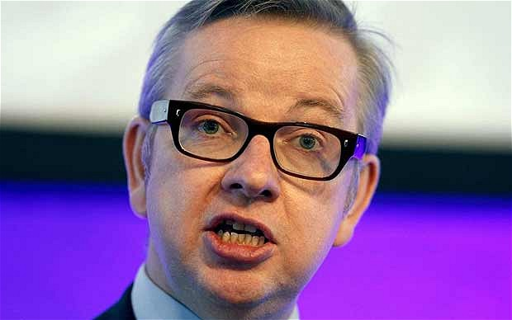
Case Study – Teaching Unions
This is Michael Gove. He was Minister for Education in 2014. He is a Conservative. He is every teachers’ favourite person (ask them! He really is!).

Slide 14
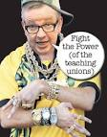
Teachers from the teaching union NUT (National Union of Teachers) went on strike in 2014.
The strike was for the following
reasons:-
Pay and Pensions
Conditions (e.g. hours of work,
workload and being judged as
‘not working hard enough’)
Michael Gove has been refusing
to meet with the unions, giving them
no other choice but to strike
It is not the only teaching
Union which is why not every
teacher went on strike.

Slide 15
Look at the following documents and videos
List reasons FOR and AGAINST teachers going on strike (write down where it came from)
What is your opinion?

Slide 16
Document 1
Why I have no choice but to strike (from the NUT website)
Michael Gove is reducing education to the rote learning of facts and procedures, not developing young people's ability to understand, think and question.
He would ultimately like to see schools run for profit. This would be a disaster for any vision of a decent education system in which we all work together for the benefit of young people.
His changes mean the real value of teachers pay has been cut by 16 percent in the last four years. His government has seen teachers’ working hours soar, and he wants to force us to work until 68.
You can't have a high quality education system with committed teachers on this basis. That's why 4 in 10 teachers quit in the first five years after qualifying.

Slide 17
Document 2
A video from the NUT website
https://www.youtube.com/watch?v=cHZC_R49vZI

Slide 18
Document 3 – Changes to Education Policy under Michael Gove
Pupils are now no longer allowed to take GCSE or A Level exams early. They must all be done at the end of the year/ course
Teachers do not need to be qualified to teach – this will encourage skilled people from other professions to become teachers
GCSEs will be harder to test brighter pupils
Controlled Assessments will be scrapped
Any business, parent, teacher, university of faith group can set up a school in their local area

Slide 19
Some people do not agree with the strike, even if they agree with the REASONS for the strike.
Some people think that strike action is unfair on the families and children.
Some people think teachers should not be allowed to strike.
Some people think the other unions are doing the right thing by trying to negotiate with Michael Gove.

Slide 20
Document 4 – BBC News
Mr Laws told the BBC there had been no basis for Wednesday's strike.
He said: "I do not understand why the NUT are taking this industrial action in the middle of talks."
Mr Laws said he was currently in talks with seven trade unions, but only the NUT had chosen to strike.
A spokesman for the DfE said: "The NUT has tried to create as much disruption for pupils and parents today as possible.
"In spite of this, thanks to many hard-working teachers and heads, only 12% of schools across the country were closed today. This is by far the lowest level of support for any national teachers' strike since 2010.
The action means thousands of children missed lessons
"They [the NUT] called for talks to avoid industrial action, we agreed to their request, and talks have been taking place weekly. Despite this - and without the support of any of the other six unions engaged in the talks - the NUT has today taken industrial action.
"While the impact in many schools has been negligible, it has disrupted parents' lives, held back children's education and damaged the reputation of the profession."

Slide 21
Document 5 – Michael Gove at the Tory conference.
http://www.youtube.com/watch?v=-PxMVUPCdtE

Slide 22
Document 6 – Michael Gove discussing Education Policy on Question Time
http://www.youtube.com/watch?v=GANPlIK5_w4

Slide 23
Evaluate the viewpoint that teachers were right to strike in March 2014
In your answer you must:
• Explain arguments in favour of the strike.
• Explain arguments against the strike.
• Use relevant examples to support your answer.
• Explain your own point of view.

Slide 24
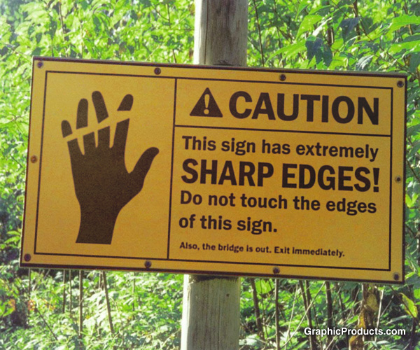
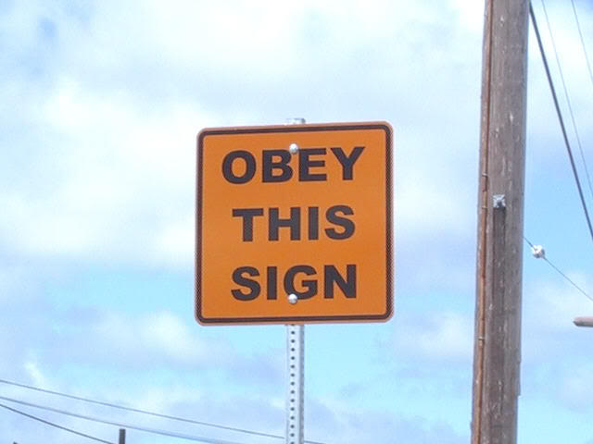
How should businesses obey the law?
Which of these statements do you agree with most? Why?
‘Companies should focus on making profit, no matter what.’
OR
‘Companies should care more about the environment than making money.’
‘Companies should help out local communities and give local people jobs.’
OR
‘Companies should employ the hardest workers for the least amount
of money to ensure the company is successful.’

Slide 25
Watch this video and write a sentence describing what copyrights are
http://www.youtube.com/watch?v=eATwzWz1Dzw&safe=active
Why do you think companies
should obey copyrights?
What problems are there with
enforcing copyrights?
e.g. downloading music

Slide 26
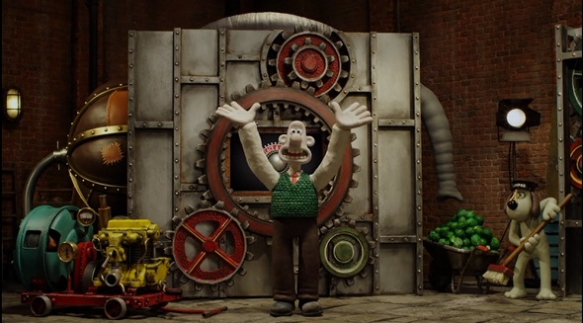
Patents – the legal right to stop people copying your inventions
Invention
Why do you think companies
should obey patents?
Inventor

Slide 27
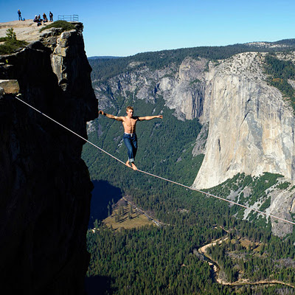
Companies need to balance costs with other factors like……
List reasons why it might be
good for a company to:-
Help the environment
Look after the local community
Cost/
Profit
Protecting the environment/
Helping the community
Mentalist

Slide 28
Corporate Social Responsibility (CSR)
List these advantages in your books:-
Advantages to a company being socially responsible:-
Gain a good reputation
Supporting community/ caring for environment – could encourage business
Workers feel valued and work harder
Other businesses will want to work with them
Can you think of examples of social responsibility? E.g. dahn th’ASDA?

Slide 29
These are all ways that the government encourages people to be environmentally responsible. Can you match the law to the definition?
Landfill Tax | Air Passenger Duty | Climate Change Levy | Fuel Duty
Vehicle Excise Duty (road tax) | Congestion charge | Annual charge for vehicles on the road. The more CO2 emissions, the more you pay | A charge to companies for high energy use. Designed to limit damage by climate change
Tax on waste thrown in a landfill site. Encourages companies to recycle | Tax on petrol and diesel. 72% of fuel is tax. Designed to encourage people to use fuel efficient cars | Tax on airline tickets to pay for cost of fuel. Designed to encourage people to fly less often. | Charge for driving in central London. Designed to reduce traffic and the pollution it causes.
Rate each of these ways of helping the environment out of 10. Which are the best? Which are the worst? Why?

Slide 31
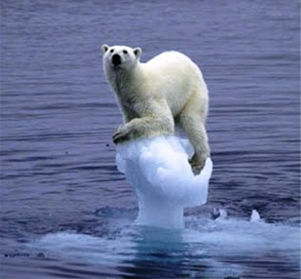
What is sustainable development and Fair Trade?
How many effects of global warming can you name?

Slide 32
What is sustainable development?
"Sustainable development is development that meets the needs of the present, without compromising the ability of future generations to meet their own needs.”
http://www.youtube.com/watch?v=eEFwaQej_0E#t=51

Slide 33
How can we promote Sustainable development….
In school?
Discuss in pairs and make a list in your books
Sustainable schools are great places to learn, where pupils develop self-esteem and reach high standards of achievement. You might notice that:
• little is wasted and anything surplus is recycled, composted or donated;
• food is seasonal and locally sourced;
• rainwater is collected for the school grounds and flushing toilets; and
• there is a zero-tolerance approach to litter, graffiti and bullying.

Slide 34
How can we promote Sustainable development….
At Home?
What do you do at home to promote a sustainable living?
The 5 R’s
reduce?
repair?
reuse?
recycle?
rot (compost)?
Give examples of these.

Slide 35
KEYWORD = Agenda 21
In 1992, the UN met to discuss ways to promote sustainable development.
They came up with Agenda 21 which included 2,500 recommendations for:-
Reducing wasteful use of natural resources
Fighting poverty
Protecting the atmosphere, oceans, animals and plant life
Finding sustainable ways to support the earth’s population
Discuss ways governments and countries can
do this.
Are there any reasons why some countries
might be against cutting use of natural resources?
E.g. poorer/ developing countries (LEDCS)

Slide 36
Document 1 – Adapted from an airline website

Slide 37
What is Fair Trade?
Fair trade is about better prices, decent working conditions, local sustainability, and fair terms of trade for farmers and workers in the developing world.
The FAIR TRADE Mark is an independent consumer label which appears on UK products as a guarantee that they have been certified against internationally agreed Fair trade standards
Have you seen this mark on any products?

Slide 38
What are the benefits of Fair Trade?
Watch the following video and make a list of the ways that fair trade can benefit people
You could add your own ideas too
http://www.youtube.com/watch?v=drvPrMtXcaE

Slide 39
How can we become more responsible as consumers?
https://www.youtube.com/watch?v=jwoFyFiVsic
How could we promote Fair trade at Kingshill? Mind map your ideas

Slide 40
Caldicot Castle
- the future -

Slide 41
In 2019 Caldicot Castle received half the number of visitors of other nearby castles.
A report by countryside manager Matthew Lewis, said it is essential to maintain a vibrant and attractive visitor attraction, to ensure optimum use of the castle and support the local economy.
Unemployment in the area is rising. It is currently higher than in neighbouring regions.

Slide 42
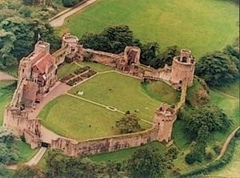
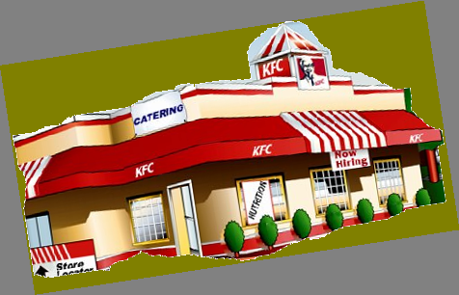
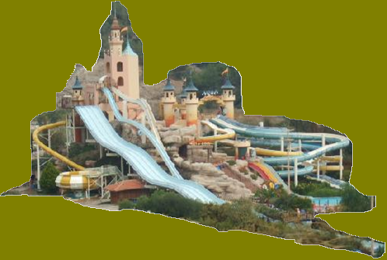
Stage One: Replace rear wall with large multi-screen cinema.
CaldiCastle Water & Leisure Park!
Stage Two: Main buildings restructured to form KFC fast food outlet.
Stage Three: Main area within castle grounds transformed into large open-air water-park with a “castle” theme.

Slide 43
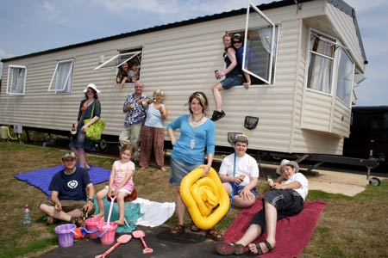
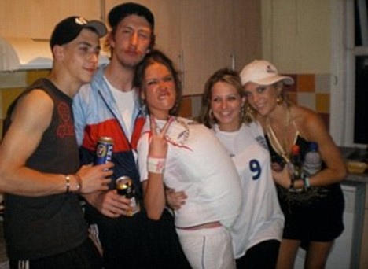
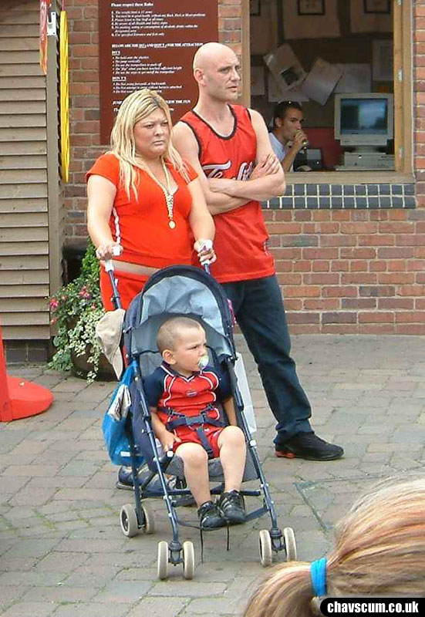
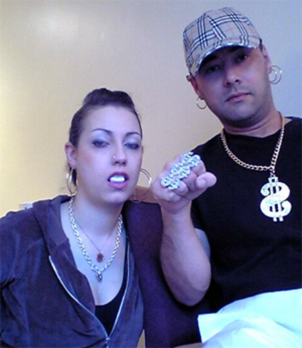
THE SURVEY
We surveyed a total of four typical British families. They unanimously voted for CaldiCastle Water & Leisure Park.

Slide 44
FOR
AGAINST
Think of as many different reasons as you can. Be prepared to defend them and argue for them. This means you must also think of the arguments against them and be prepared to say why your arguments are better.

