Slide 1


Year 9 Spanish TERM 4: Viva 2 textbook, chapter 5
If pupils are absent from lessons they should spend time revising and learning vocabulary. All of the vocabulary for this term is on the following slides. First of all, they should recap the vocabulary which they learned the previous week. Then they should start to learn the next section of vocabulary which they have not yet covered in class. This could be done by using the look, cover, write, check method or by making flashcards etc.
Pupils can also revise vocabulary on Linguascope-
Username is kingshill password is bonjour123
Any new vocabulary they learn can be written in their orange books or on paper.
If pupils wish to do extension work they can access free MFL lessons on the Oak National Academy website:
https://classroom.thenational.academy/subjects-by-key-stage

Slide 2
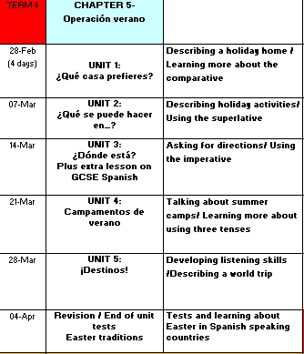

Slide 3
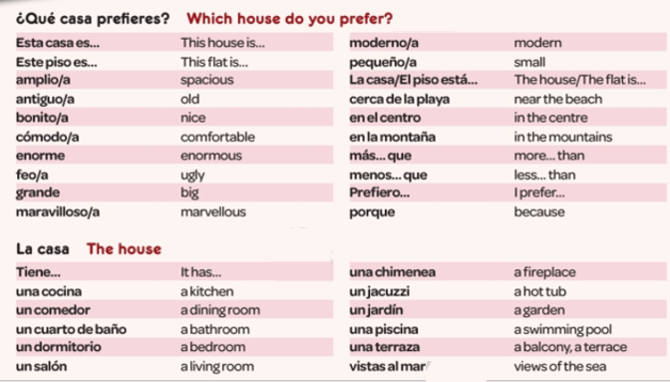


WEEK 1 – w/c 28th February
Read through the vocabulary for this week and spend a good amount of time trying to learn it.

Slide 4
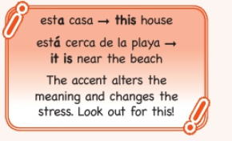
Copy the grammar point below in to your books

Slide 5
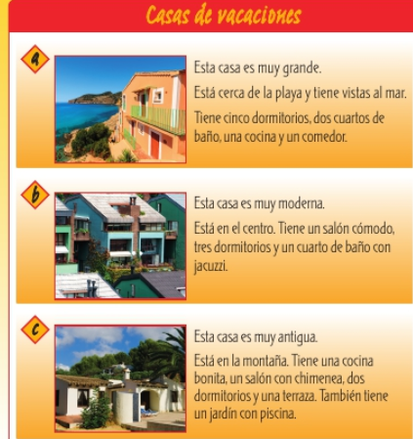
Translate the adverts in to English.

Slide 6
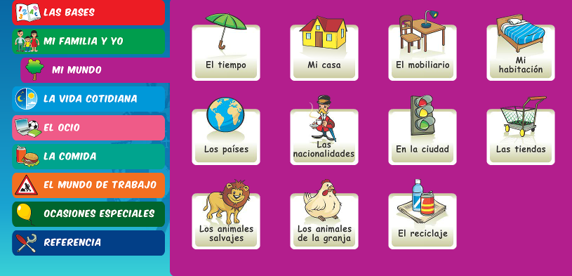
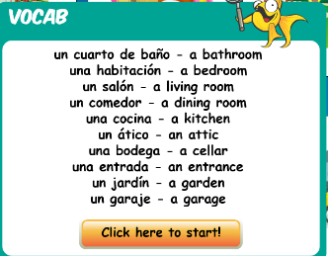
Linguascope practice…
Revisit rooms in the house for 5 minutes in the beginner section.
Make sure you have any new vocab written down
USERNAME = kingshill
PASSWORD = mfl123*

Slide 7

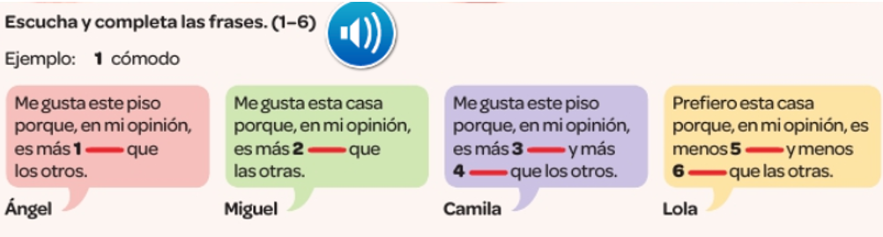


Listen to the recording. Fill in the gap with one of the words from below.

Slide 8
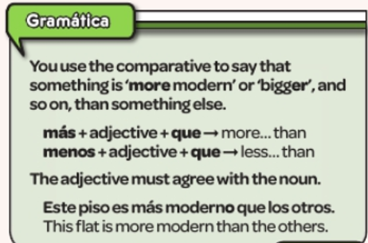
Below is a reminder of how to compare things. Make a note of the grammar point below.

Slide 9
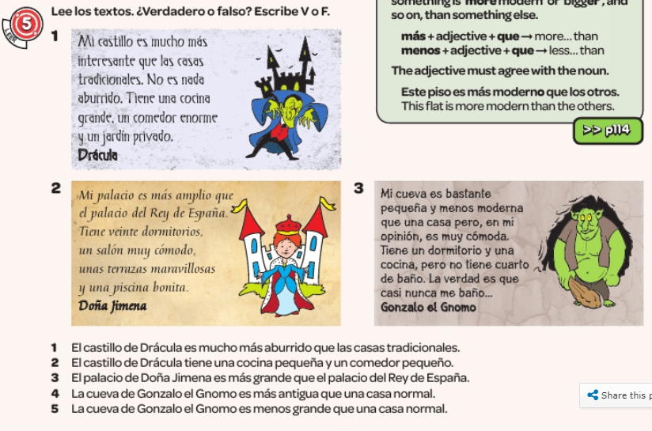
Read the texts and then say if the sentences are true or false.

Slide 10
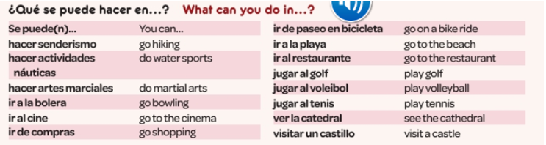
WEEK 2 – w/c 7th March
Read through the vocabulary for this week and spend a good amount of time trying to learn it.

Slide 11
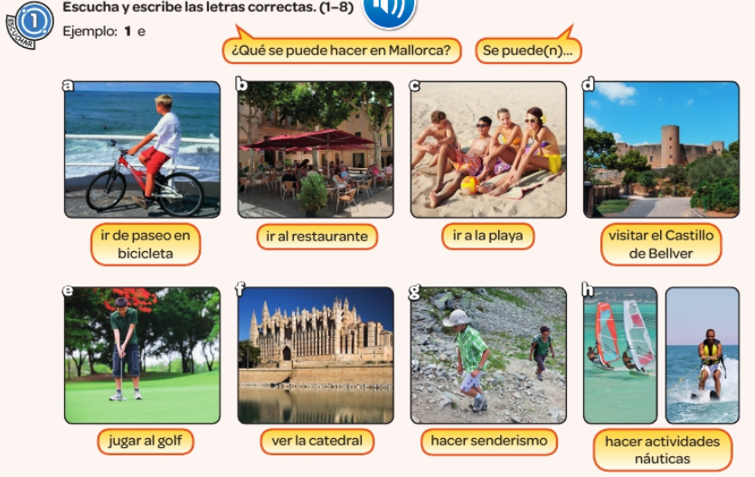
Listen to the recording. Which activity do they say you can do? Example, 1e

Slide 12
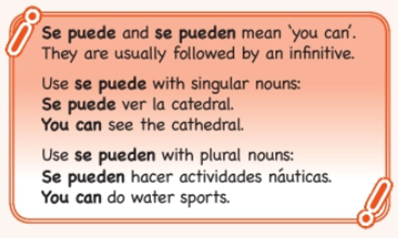
Copy the grammar point below in to your books

Slide 13
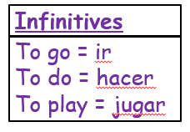
Translate the sentences in to Spanish. The first one has been done for you.
You can go to the cinema.
You can play tennis.
You can do martial arts.
You can go to the bowling alley.
You can play volleyball.
You can go shopping.
Se puede ir al cine.

Slide 14
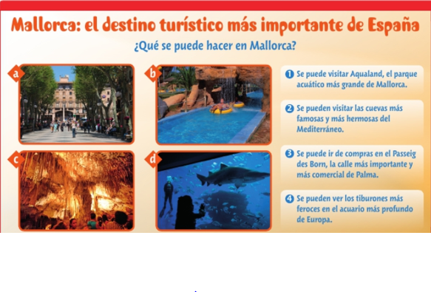
Match the pictures to the descriptions.

Slide 15

Listen to the recording. Write down 1-5. What are they planning to do? Which day and activity do they mention? Answer in English.

Slide 16
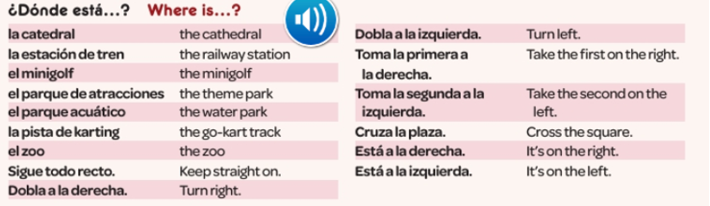

WEEK 3 – w/c 14th March
Read through the vocabulary for this week and spend a good amount of time trying to learn it.

Slide 17
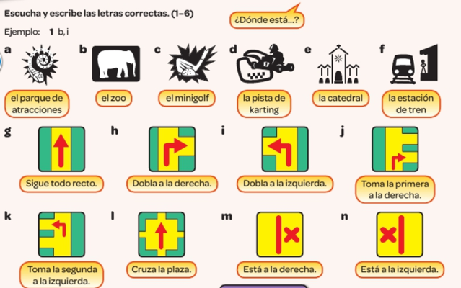
Listen to the recording. Which place do they want directions to and how do you get there?
Example, 1 b, i

Slide 18
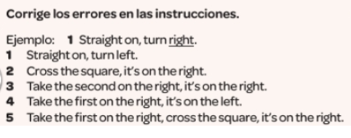
Listen to the directions they give on the recording. Correct the errors.

Slide 19
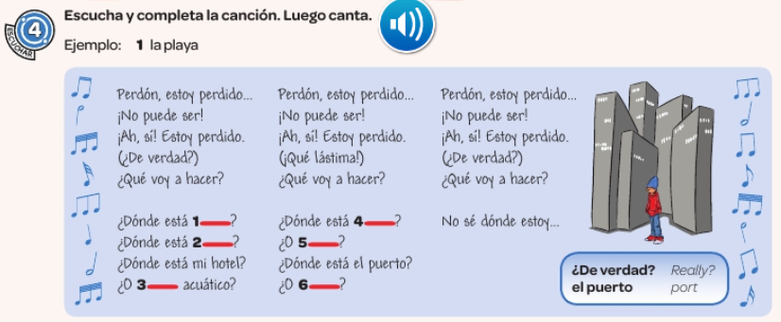

Listen to the song. Fill in the missing words.

Slide 20
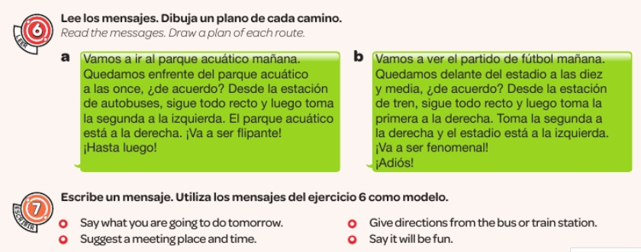

Slide 21
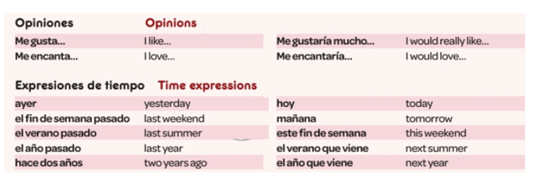
WEEK 4 – w/c 21st March
Read through the vocabulary for this week and spend a good amount of time trying to learn it.

Slide 22
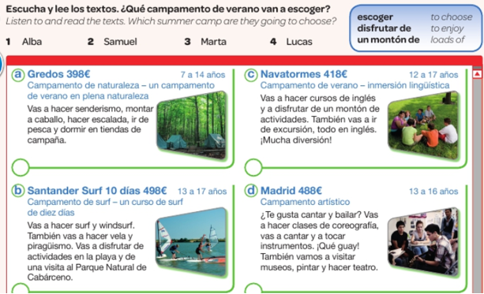
Listen to the recording and read the descriptions. Which holiday camp does each person choose?

Slide 23
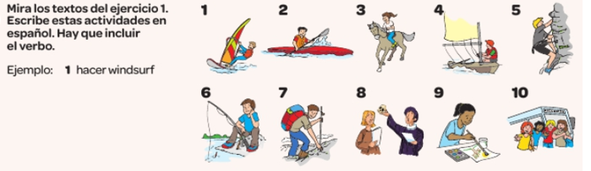
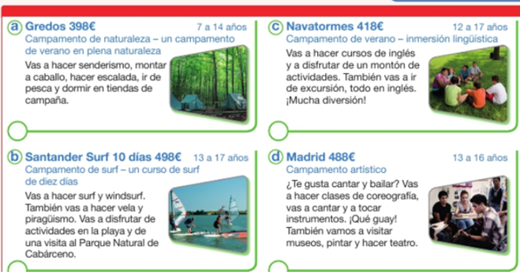
Read the 4 texts again. Find the Spanish for these 10 activities in the 4 texts.
Example,
1- hacer windsurf

Slide 24
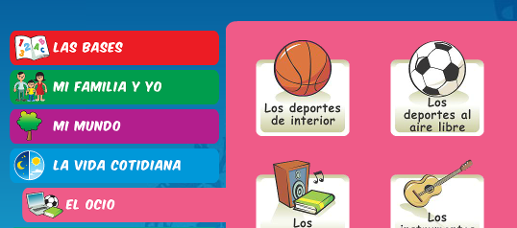
Linguascope practice…
Practise sports vocab in the beginner section.
Make sure you have any new vocab written down
USERNAME = kingshill
PASSWORD = mfl123*

Slide 25
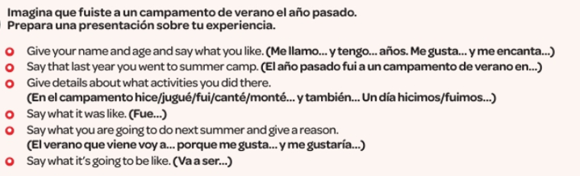
Write a short passage about going on a summer camp last year. Use the sentence starters below to help you.

Slide 26
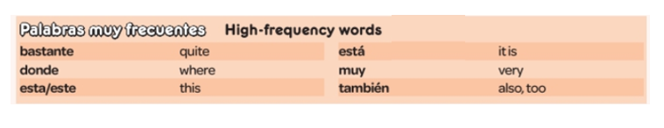
WEEK 5 – w/c 28th March
There is only a small amount of new vocabulary to learn this week. For the tasks on the following pages you will need to look back at the vocabulary you have learned over the last few weeks or use the chapter 5 vocab sheet which should be in your orange book.

Slide 27
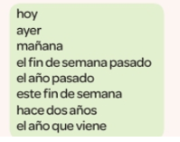
Copy out the Spanish time expressions and write the English next to them. Use an online dictionary if necessary.

Slide 28
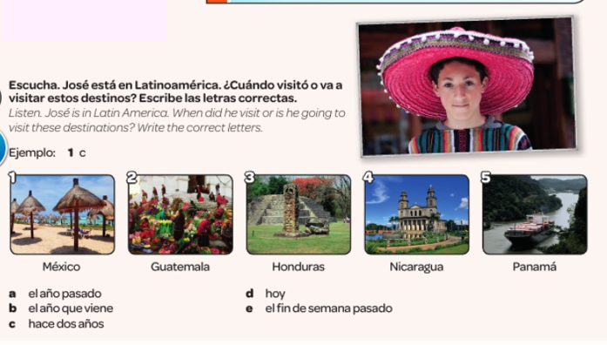

Slide 29
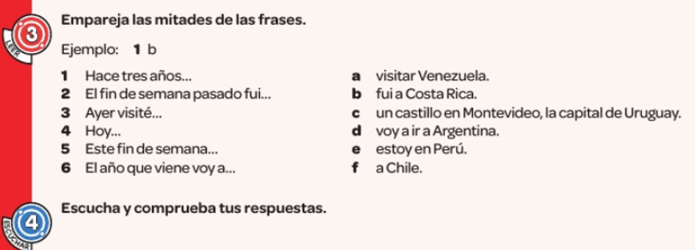
Match up the two halves of the sentence for task 3. Listen to the recording and check your answers in task 4.

Slide 30
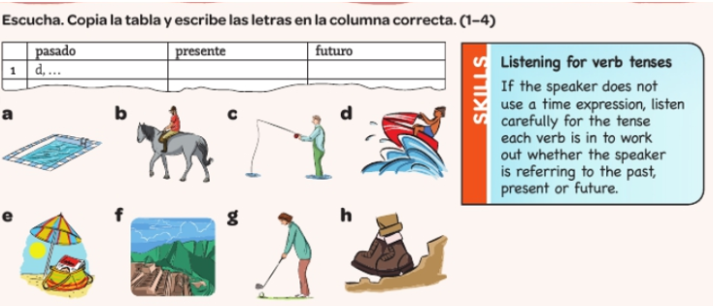
Listen to the recording. Copy and complete the table. Which tasks are done in the past, present and future?

Slide 31
Start revising for the end of unit assessments next week.

Slide 32
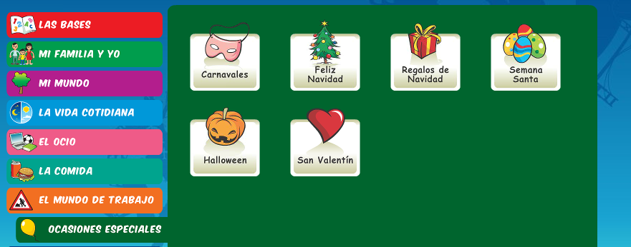
WEEK 6 – w/c 7th April
This week is assessment week. Spend some time revising all of the vocab on these slides so far (or on your chapter 5 vocab sheet which is in your orange book) and then email your teacher for the test papers.
There is also some information about Easter in Spain to read through or you could research how Easter is celebrated in another Spanish speaking country.
There is an Easter section on Linguascope in the beginner section too.

Slide 33
The Spanish word for 'Easter' is Pascua.
The seven days leading up to Easter Sunday are called Holy Week, or La Semana Santa in Spanish.
All over Spain, it is a week of spectacular street processions (procesiones).

Slide 34
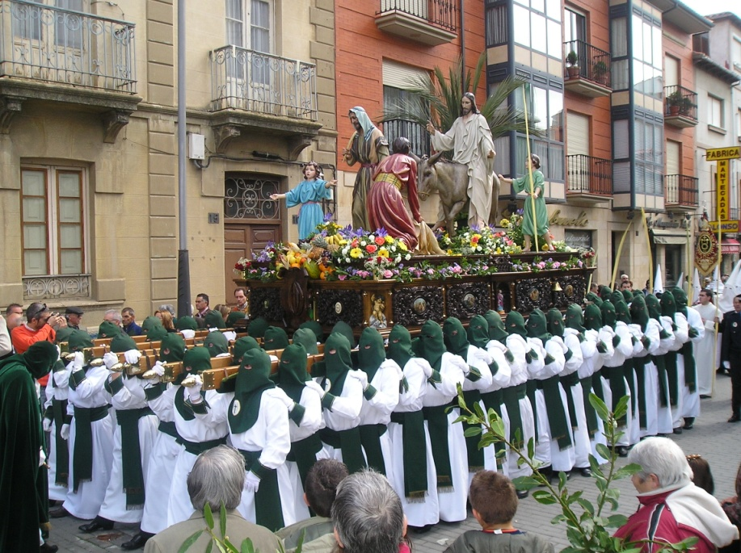
During La Semana Santa, starting on el Domingo de Ramos, Spanish towns have street parades every day.
In the processions, people carry and follow floats,
known as pasos.
On the floats, there are statues of Jesús and La Virgen María. The floats are beautifully decorated with flowers, gold, silver, candles and fine fabrics.

Slide 35


Easter week in Spain is a time of serious processions and remembering the events leading up to and including the death of Jesus.
But, on Easter Day (El Domingo de Resurrección) it is a day of happiness and celebration because on this day the Resurrection of Jesus is remembered.
In recent years the tradition of giving Easter Eggs has really taken off.

Slide 36
The most exciting place to visit during La Semana Santa is probably the city of Sevilla in the south of Spain.
Its processions are the most impressive and famous, attracting hundreds of thousands of visitors.
As a result, the city becomes overcrowded, but it is a very exciting and interesting time to be there!

