Slide 1


Year 9 French TERM 4: Studio 2 textbook, chapter 4
If pupils are absent from lessons they should spend time revising and learning vocabulary. All of the vocabulary for this term is on the following slides. First of all, they should recap the vocabulary which they learned the previous week. Then they should start to learn the next section of vocabulary which they have not yet covered in class. This could be done by using the look, cover, write, check method or by making flashcards etc.
Pupils can also revise vocabulary on Linguascope-
Username is kingshill password is bonjour123
Any new vocabulary they learn can be written in their orange books or on paper.
If pupils wish to do extension work they can access free MFL lessons on the Oak National Academy website:
https://classroom.thenational.academy/subjects-by-key-stage

Slide 2
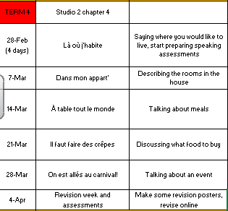

Slide 3
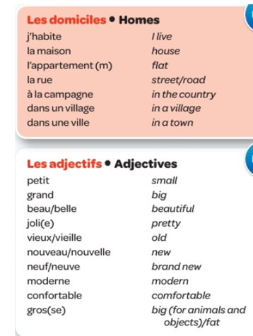
Week 1 w/c 28th Feb
Read through the vocabulary for this week and spend a good amount of time trying to learn it.

Slide 4
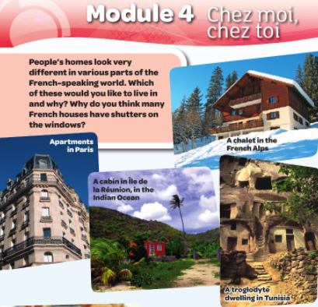
These next 3 slides give you some cultural information about France.

Slide 5
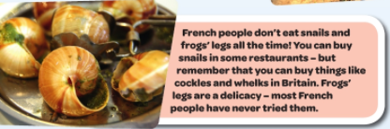
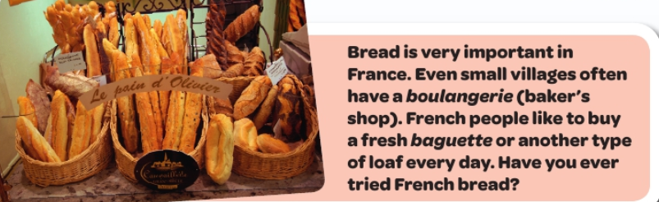

Slide 6
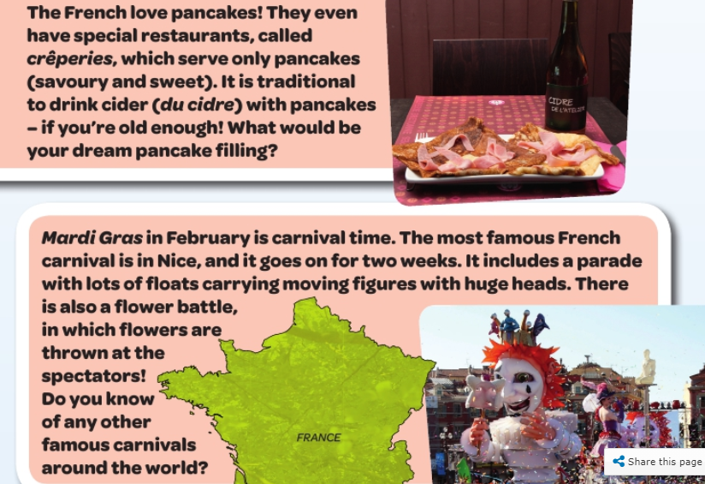

Slide 7

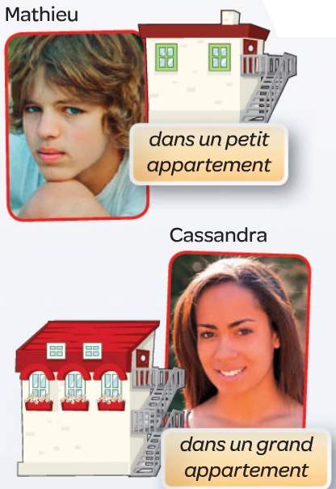
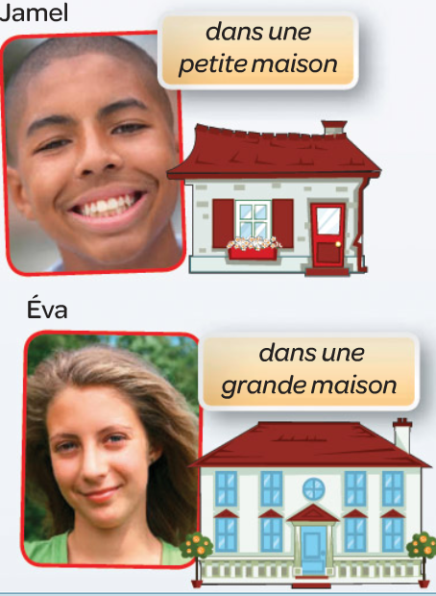
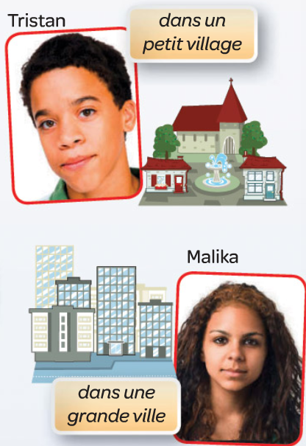
Écoutez. C’est qui? (1-6)
Listen to the recording. Write down 1-6. Who is talking?

Slide 8
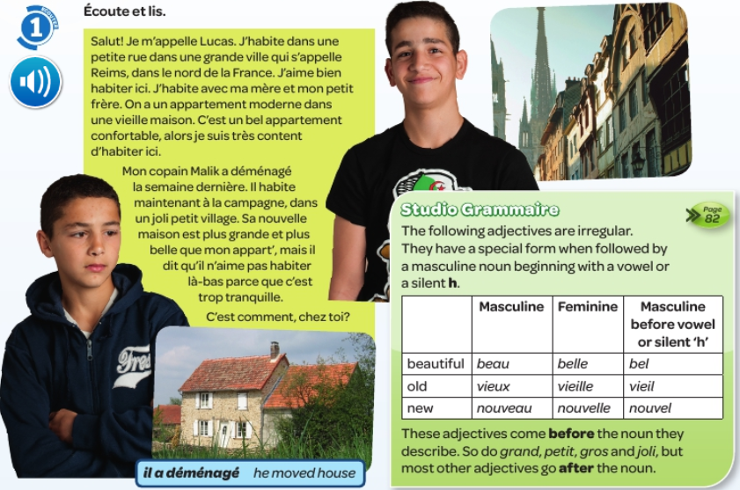
Read about where Lucas lives. Look up any new words and make a list in your orange books. Then copy the grammar information.

Slide 9
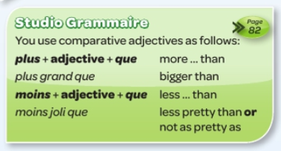

Copy the grammar notes in to your book and try and learn them.

Slide 10
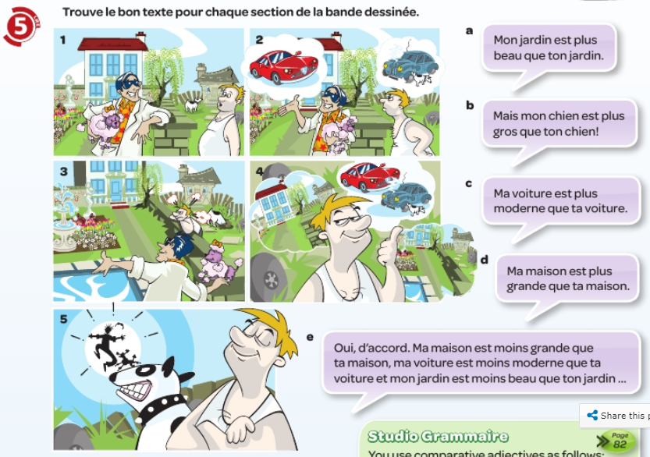
Match up each picture with one of the texts.

Slide 11
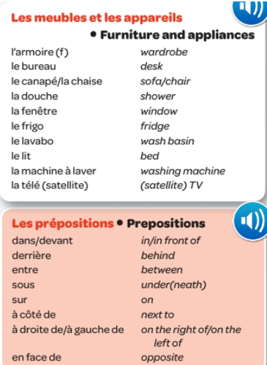
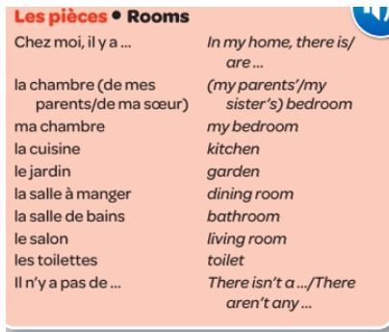
WEEK 2 – w/c 7th March
Read through the vocabulary for this week and spend a good amount of time trying to learn it.

Slide 12

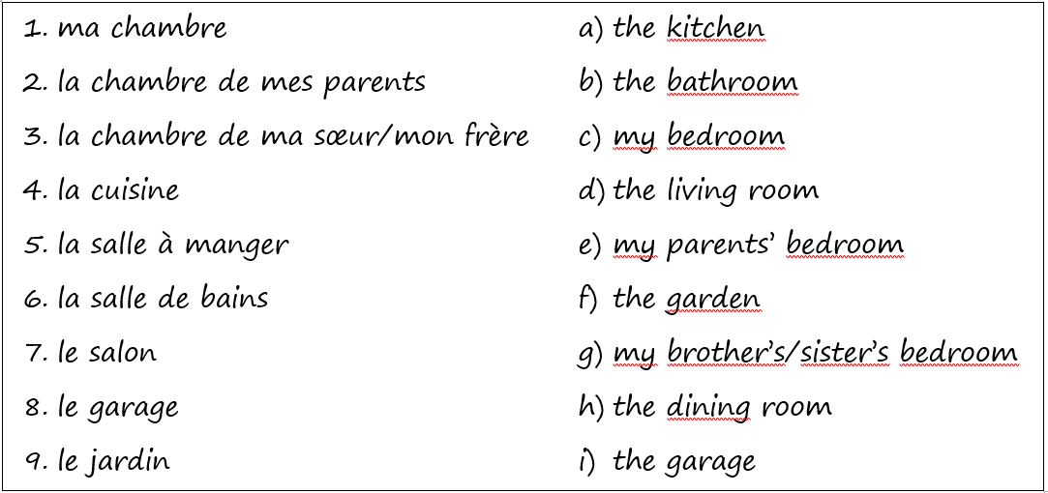

Slide 13
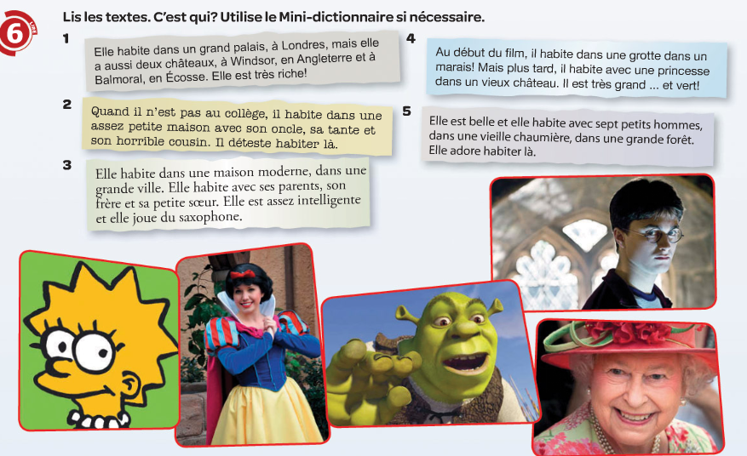
Match the descriptions to the person who lives there

Slide 14
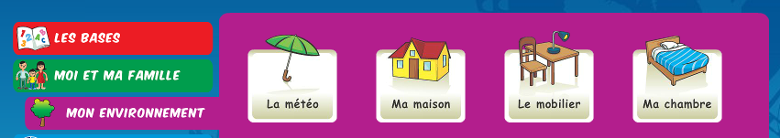
Log on to Linguascope and practise the rooms in a house and furniture words (they are in the beginner section):
Username – kingshill password – mfl123*
Make a list of the new words in your books. There will be quite a few.

Slide 15
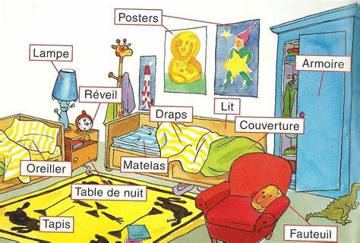
Make a plan or a picture of your bedroom (or your ideal bedroom) on a piece of A4 paper. Label all of the furniture items in French. You may use an online dictionary if you don’t know the word you need.

Slide 16
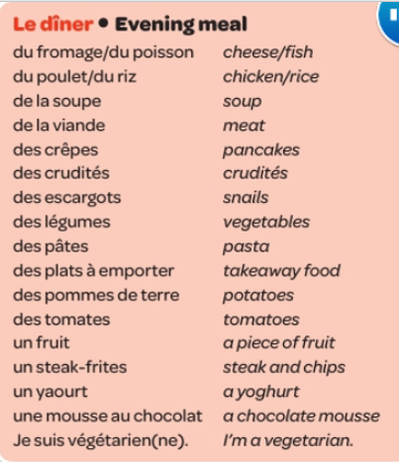
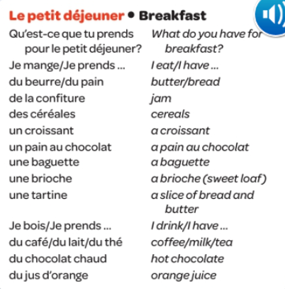
WEEK 3 – w/c 14th March
Read through the vocabulary for this week and spend a good amount of time trying to learn it.

Slide 17
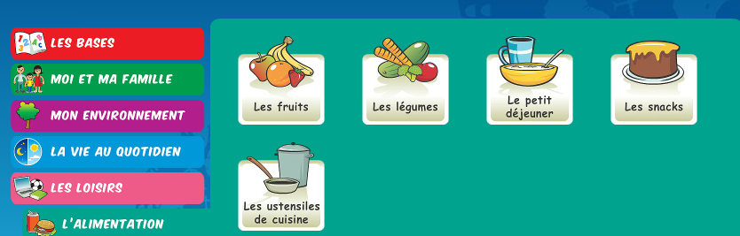
Log on to Linguascope and practise the food words (they are in the beginner section):
Username – kingshill password – mfl123*
Make a list of the new words in your books.

Slide 18
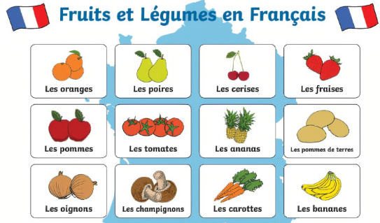
Make a poster of as many French food and drink items as possible. Use the vocab from this week and the Linguascope words too. You must draw a picture and label each item in French.

Slide 19
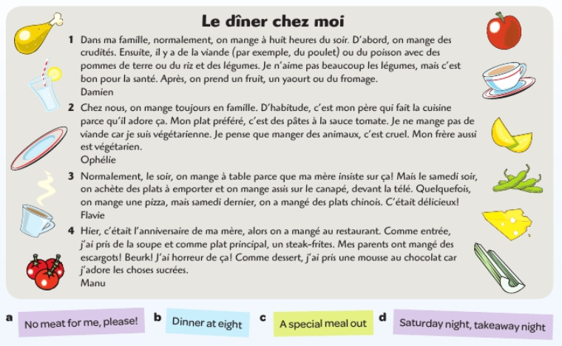
Find the correct headline for each text. Write the number and letter.

Slide 20
Write what you usually eat, what you ate and drank yesterday and what you are going to eat and drink tomorrow. It can be imaginary.
What you usually eat for breakfast – normalement, pour le petit dejeuner, je prends/mange/bois……
What you sometimes eat – Mais quelquefois……
What time you eat dinner – Chez moi, le soir on mange à (time).
What your meals are like – D’habitude, on mange en famille/ à table/ assis sur le canapé/ devant la télé.
Your favourite dish – mon plat préféré, c’est….
What you ate and drank yesterday – hier, j’ai mangé……. et j’ai bu………
What you are going to eat and drink tomorrow – demain, je vais manger….. je vais boire……

Slide 21
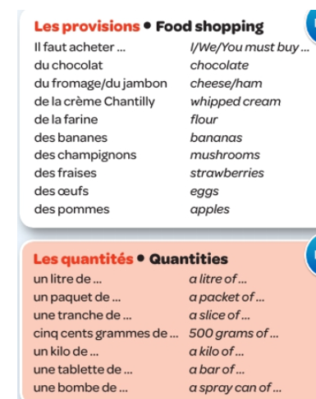
WEEK 4 – w/c 21st March
Week 4 vocab
Read through the vocabulary for this week and spend a good amount of time trying to learn it.

Slide 22
Log on to Linguascope and practise the food words from last week (they are in the beginner section):
Username – kingshill password – mfl123*
Make a list of the new words in your books, if you did not do this last week.

Slide 23
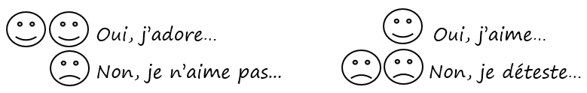
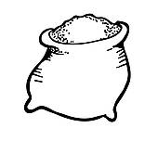





Tu aimes…?
Write a few sentences n French giving your opinions about what food you like and dislike
le sucre
les bananes
le chocolat
les citrons
le fromage
les fraises
le jambon
les pommes

Slide 24
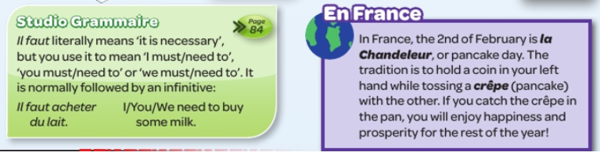
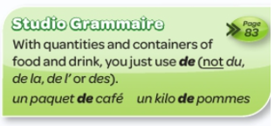
Copy the grammar information and read about pancake day in France

Slide 25
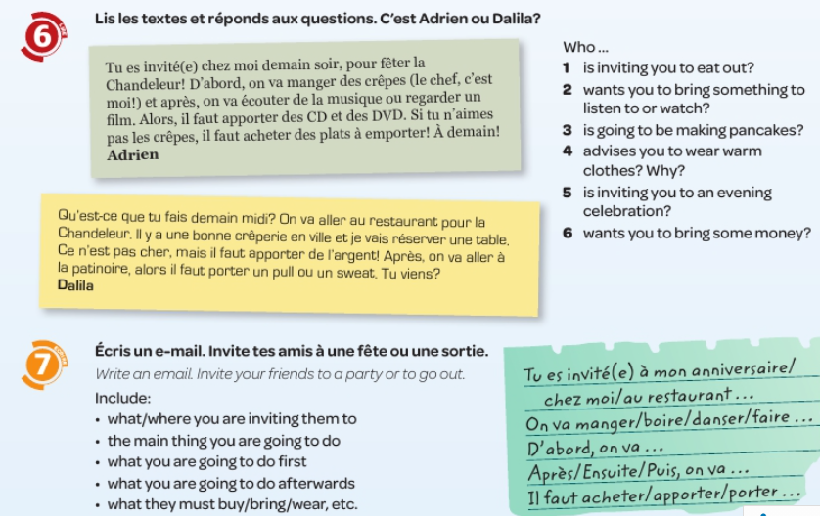

Slide 26
WEEK 5 –
w/c 28th March
There are no new words to look at this week but please work through the tasks on the following pages about Carnival and tenses. When finished, start revising for your assessments. Read through all of the vocab on the previous slide.

Slide 27
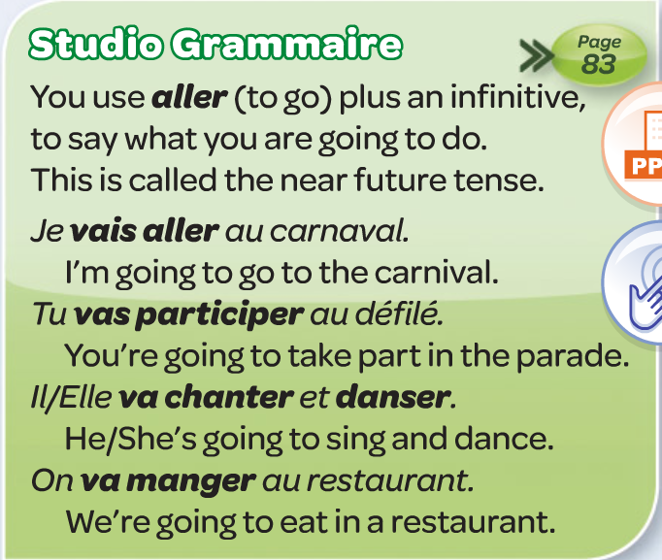
Copy the grammar notes:

Slide 28
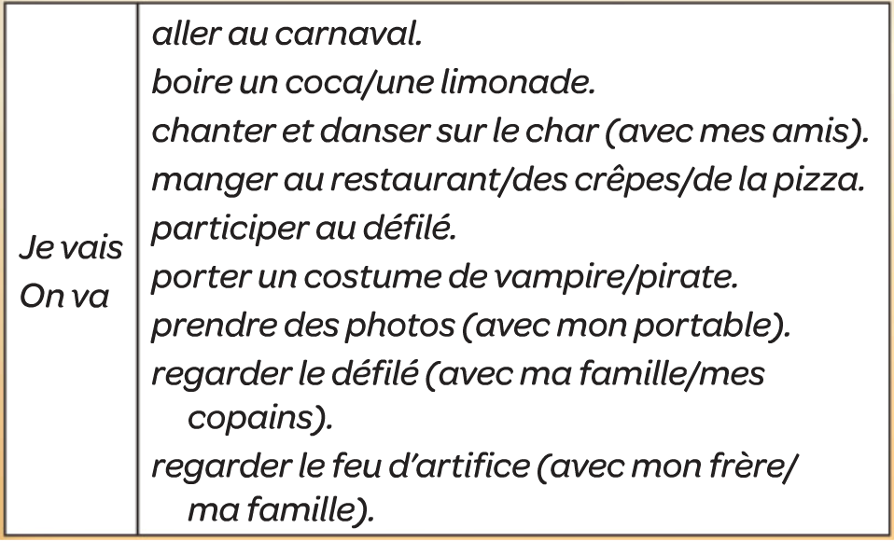
Qu’est tu vas faire au carnaval? What are you going to do at the carnival?
Translate these sentences in to English. You may use an online dictionary to help you if necessary.

Slide 29
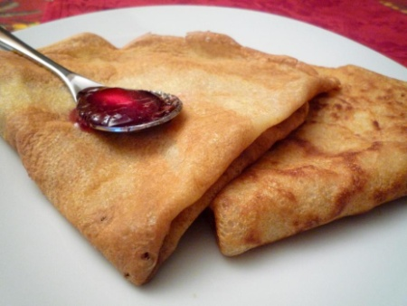
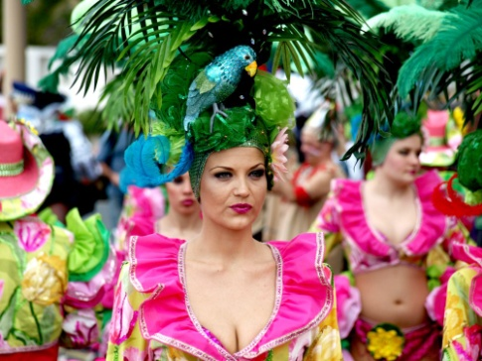
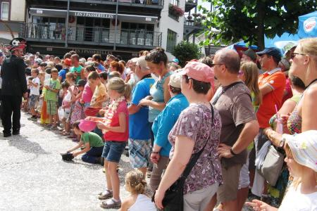

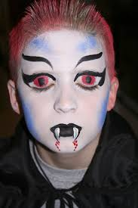
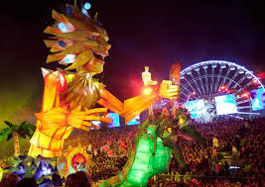
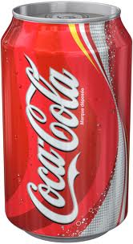

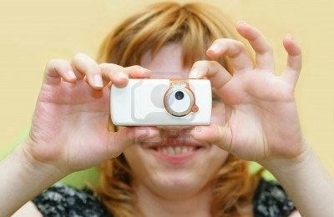
Match the pictures with the sentences
A
B
C
D
E
F
G
H
I
3. Je vais regarder le défilé.
4. Je vais boire du coca.
6. On va prendre des photos avec son portable.
2. On va manger des crêpes.
5. Je vais aller au Carnaval de Nice
1. On va danser sur le char.
9. On va regarder le feu d’artifice.
7. On va participer au défilé.
8. Je vais porter un costume de vampire.

Slide 30
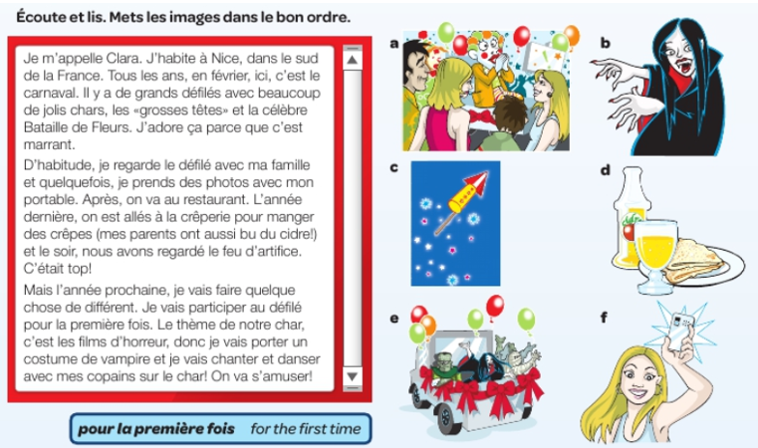
Read about carnival. Put the pictures in the correct order.

Slide 31
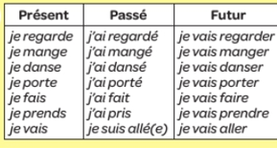
Read through these verbs below to remind yourself how to form the different tenses.

Slide 32

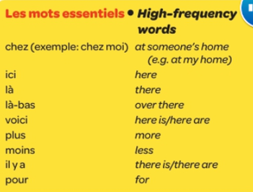

WEEK 6 – w/c 7th Feb
This week is revision week and assessment week. You need to revise all of the work that we have done this term, use this presentation for all of the vocab lists. Contact Mrs Millar for the assessment papers.
Also look at the list of high frequency words too.
You can then read about Easter in France and make your own powerpoint / poster about it.

Slide 33

Pâques en France
Learning objective:
Today, we are learning about Easter in France

Slide 34
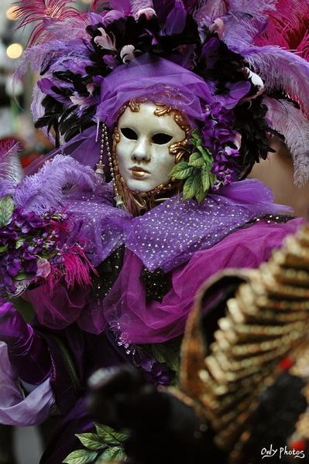
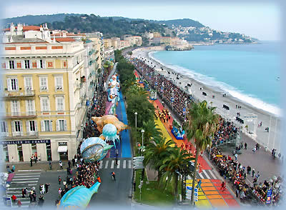
Le carnaval
Carnival is the festive season immediately before Lent.
During carnival, there are parades and street parties. People dress up.
Le Carnaval de Nice
In the city of Nice, in the south of France, there is a very famous carnival every year.
In fact, it is the original Mardi Gras carnival and the oldest in the world!

Slide 35
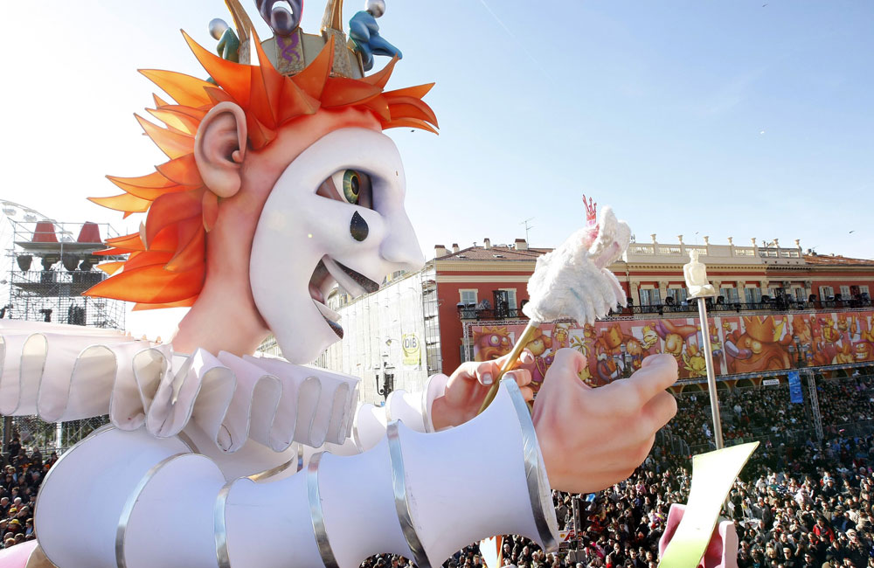
Le Carnaval de Nice
During the two weeks leading up to Mardi Gras, there are street parties, parades, shows, concerts, fireworks and general merry-making!
People wear fancy-dress.

Slide 36

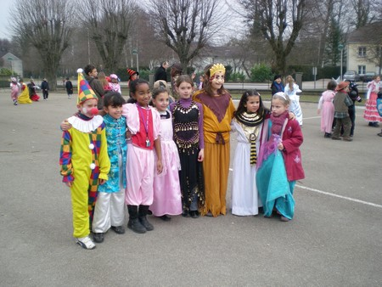
Mardi Gras
The carnival period finishes with Mardi Gras. It actually means ‘Fat Tuesday' and it is known as Shrove Tuesday in English.
It is the last day when you can eat everything you like before the fasting period of Lent.
Children often celebrate Carnaval and Mardi Gras together.
They can dress up to go to school or wear a mask.

Slide 37
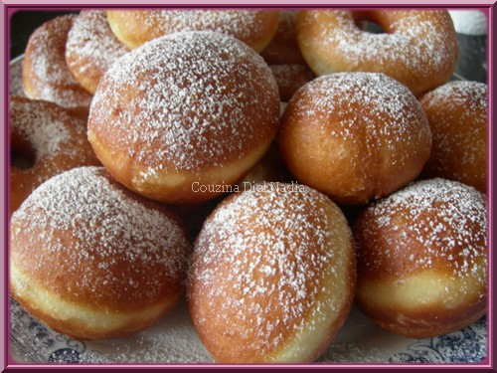
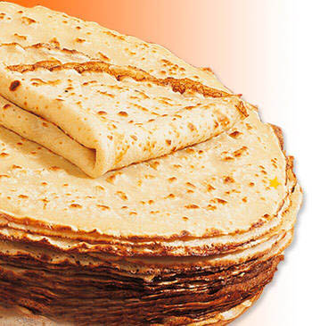
Mardi Gras
On Mardi Gras, French people traditionally eat doughnuts (les beignets) or pancakes (les crêpes).
These are the traditional food of Mardi Gras because they are a good way to use up all the extra flour, eggs and butter that should not be eaten during Lent.

Slide 38
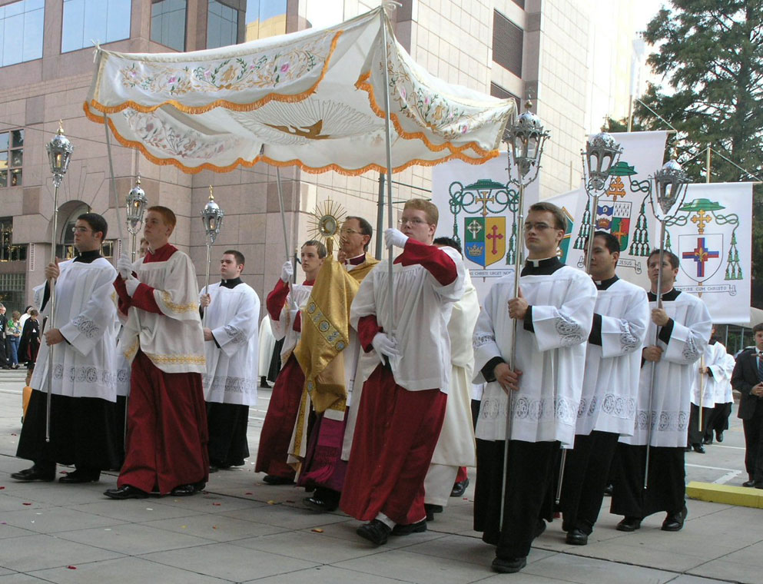
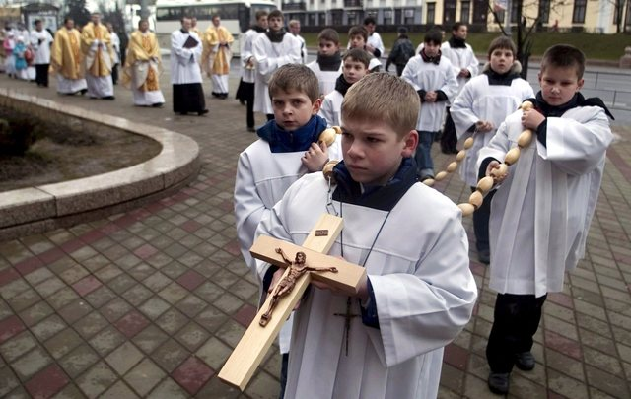
Les processions
There are lots of processions and religious parades in towns.

Slide 39
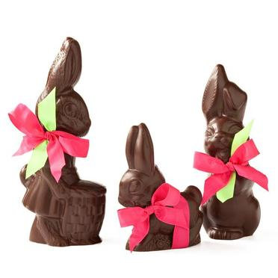



Le dimanche de Pâques
Early on the morning of Easter Sunday , the Easter bells (les cloches de Pâques) fly back to France!
They drop chocolate eggs, chickens, bells and bunnies in the gardens of the French towns.

Slide 40

La chasse aux œufs
In the morning, the children awake very excited because it is time to search for the chocolate egg hunt (la chasse aux œufs).

Slide 41




Les œufs de Pâques
The tradition of the Easter eggs dates back from the 4th century.
The eggs which were not eaten during Lent used to be decorated and then offered for Easter.

Slide 42


Les chocolats
In France, April fish are also an Easter symbol and that is why you will find chocolate fish (la friture) in the shops too!
You can buy chocolates goodies in sweet shops (les confiseries) or in shops specialising in chocolate (les chocolateries).

Slide 43

Le repas
There is generally an enormous amount of delicious food to eat.
French people spend a lot of the day eating with the whole family altogether.
It is a very special and happy day.
Bon appétit!

Slide 44


Le repas
People traditionally eat roast lamb (l'agneau).
There are lots of vegetables, for example, potatoes (les pommes de terre).
In the Alsace region, the traditional dessert is a biscuit in the shape of the Easter lamb (l’agneau pascal or Osterlamala).

Slide 45

Le repas
In the Vendée region, the traditional cake is called Pacaude or la Gâche de Pâques.
It is a very rich bread mixture, like a brioche - containing bread flour, sugar, milk, yeast, butter and eggs.

Slide 46

Information
If a baby is born around Easter-time, the name chosen for the baby might be Pascal, meaning 'belonging to Easter'.

