Slide 1


Year 8 Spanish TERM 4: Viva 1 textbook, chapter 4
If pupils are absent from lessons they should spend time revising and learning vocabulary. All of the vocabulary for this term is on the following slides. First of all, they should recap the vocabulary which they learned the previous week. Then they should start to learn the next section of vocabulary which they have not yet covered in class. This could be done by using the look, cover, write, check method or by making flashcards etc. It should also be written in their orange book. There are also a few tasks to complete. A plan for the term is on the next slide.
Pupils can also revise vocabulary on Linguascope-
Username is kingshill password is mfl123*
Any new vocabulary they learn can be written in their orange books or on paper.
If pupils wish to do extension work they can access free MFL lessons on the Oak National Academy website:
https://classroom.thenational.academy/subjects-by-key-stage

Slide 2
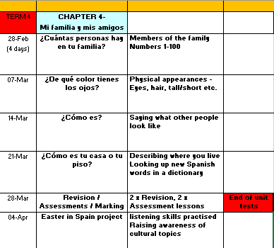

Slide 3
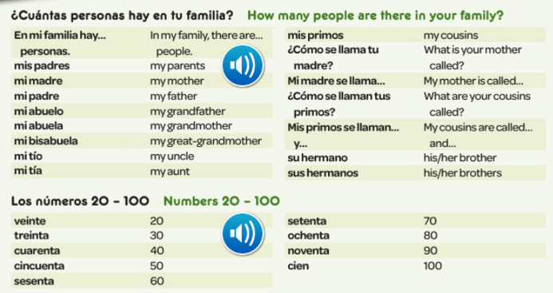

WEEK 1 – w/c 28th February
Spend a good amount of time reading through the vocabulary for this week. Then try and learn it

Slide 4

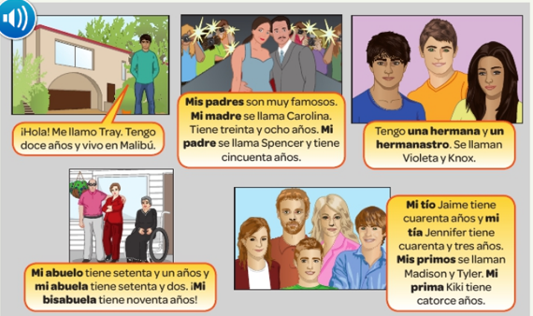

Listen to the recording and read along as Tray introduces his family.

Slide 5
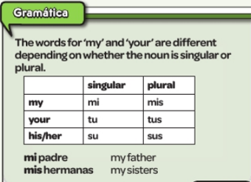
Copy out the grammar in to your book.
You need to add an ‘s’ to the word for my, your, his/her if the thing you are talking about is plural. E.g. brothers / cousins / grandparents.
His and her are the same word in Spanish – less to remember!
So, how would you say…?
  My sister
  Your mother
  His cousin (male)
  Her brothers

Slide 6
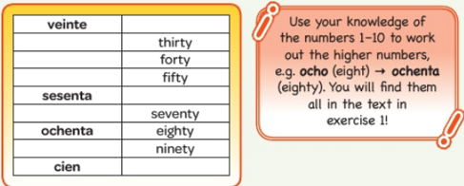
Copy and complete the table in Spanish.

Slide 7
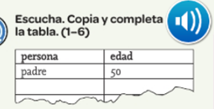

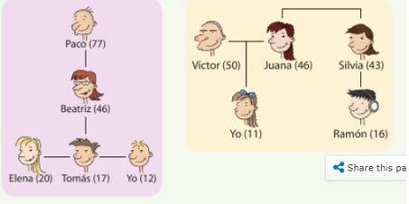
Listen to the recording. Copy the table and complete it in Spanish. Which person is being described and how old are they?

Slide 8
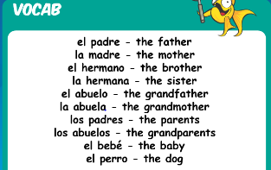


Log in to Linguascope username – kingshill password – mfl123*
Then have a go at the ‘los miembros de la familia’ (family members) section in the green section of the beginner area. Make a note of any words.

Slide 9
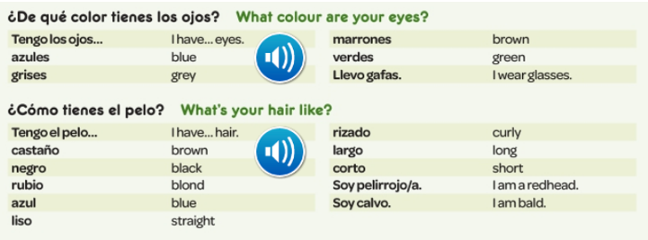
WEEK 2 – w/c 7th March
Spend a good amount of time reading through the vocabulary for this week. Then try and learn it

Slide 10
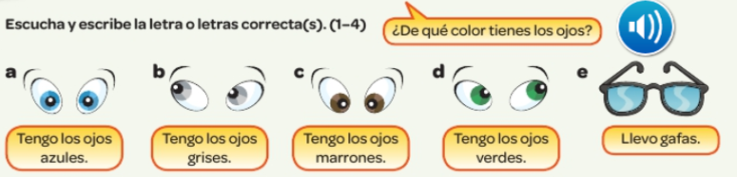

Listen to the recording. Write down 1-4. Which description do you hear? a, b, c,d or e?

Slide 11
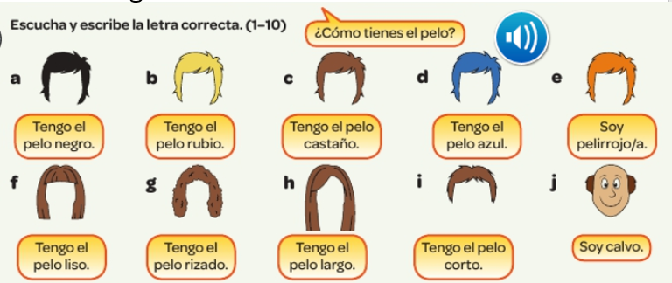
Listen to the recording. Write down 1-10. Which description do you hear?

Slide 12
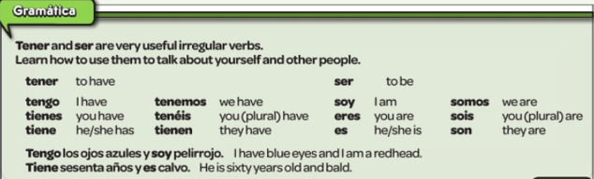
Copy out the following grammar:

Slide 13
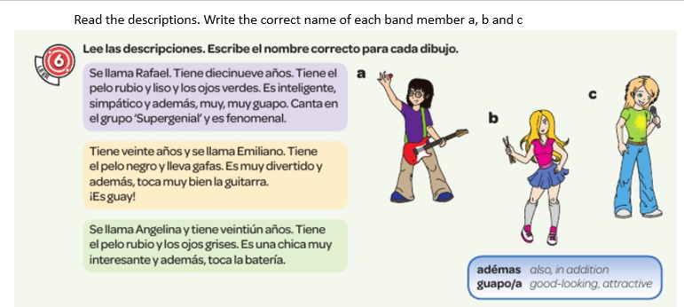

Slide 14
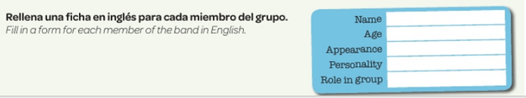
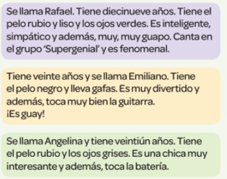

Slide 15
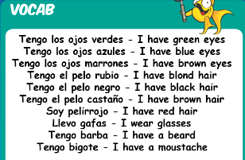
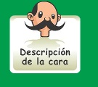
Log in to Linguascope username – kingshill password – mfl123*
Then have a go at the ‘Descripción de la cara’ (facial description) section in the green section of the beginner area. Make a note of any words.

Slide 16
Try writing a brief description of what you look like using the words from this week.

Slide 17
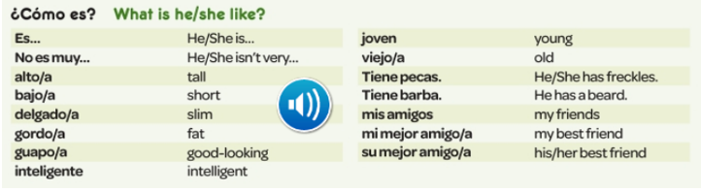
WEEK 3 – w/c 14th March
Spend a good amount of time reading through the vocabulary for this week. Then try and learn it

Slide 18
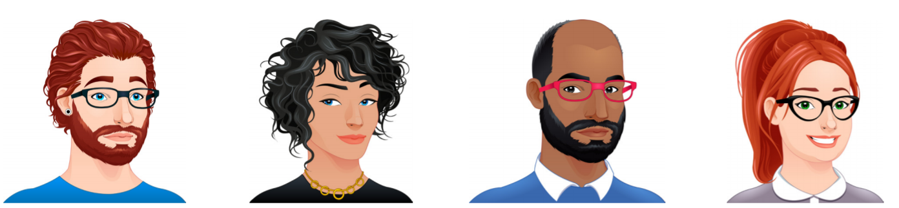
Tengo I have
Tiene He/she has
Soy I am
Es He/she is
Translate the descriptions for each person in to English.This task is recapping the vocab from last week, so look back at last week’s words if necessary.
Tiene los ojos azules y es pelirrojo. Tiene el pelo corto y rizado.
Tiene los ojos azules y (tiene) el pelo negro, corto y rizado.
Tiene los ojos marrones y (tiene) el pelo negro y corto. Lleva gafas.
Tiene los ojos verdes y es pelirroja. Tiene el pelo largo y liso. Lleva gafas

Slide 19
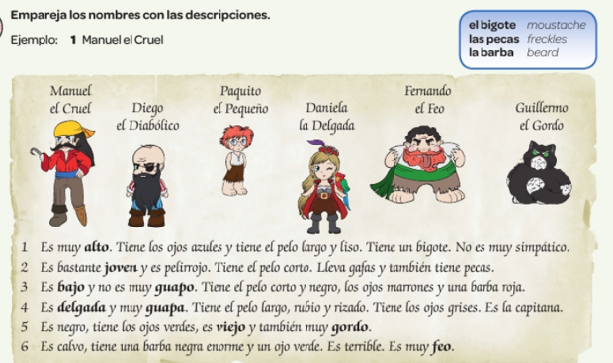
Read the 6 descriptions and then write the name of the character which is being described.

Slide 20
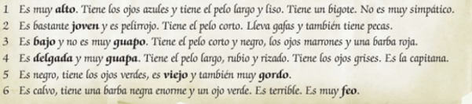

Read the 6 descriptions again and find the Spanish for the 6 phrases at the bottom of the slide.

Slide 21
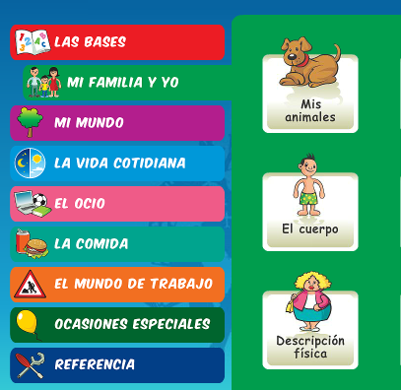
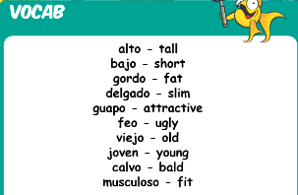
Log in to Linguascope username – kingshill password – mfl123*
Then have a go at the ‘Descripción de la física’ (physical description) section in the green section of the beginner area. Make a note of any words.

Slide 22
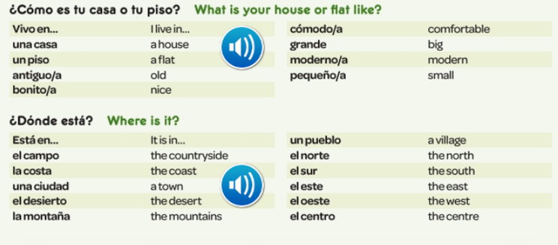

WEEK 4 – w/c 21st March
Spend a good amount of time reading through the vocabulary for this week. Then try and learn it

Slide 23
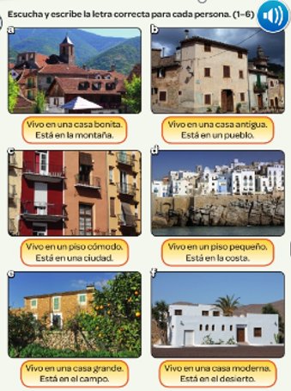
Listen to the recording. Which place is being described? a, b, c, d, e, f?

Slide 24
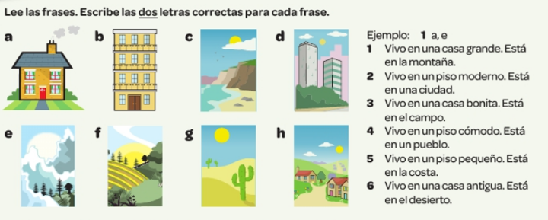
Match up the pictures with the 6 descriptions.

Slide 25
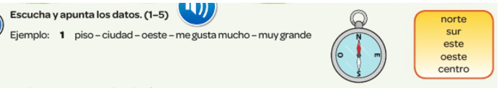

Listen to the recording. Write down any information you hear in Spanish for the 5 people who are describing where they live.

Slide 26
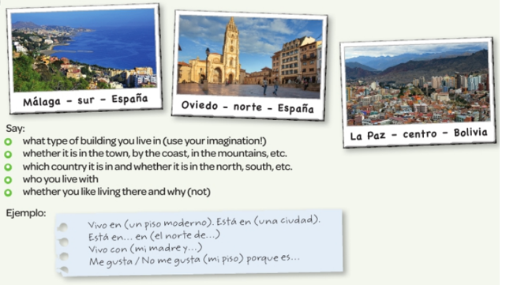
Pretend you live in one of the places in the pictures. Give the information below. Sentences starters in Spanish are given you too.

Slide 27
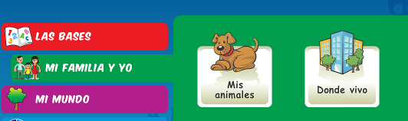
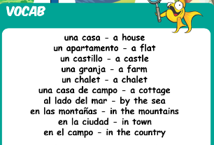
Log in to Linguascope username – kingshill password – mfl123*
Then have a go at the ‘Donde vivo’ (Where I live) section in the green section of the beginner area. Make a note of any words.

Slide 28
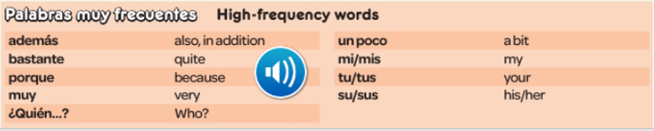

WEEK 5 – w/c 28th March
This week is assessment week. Spend some time revising all of the vocab on these slides so far and then email your teacher for the test papers. There are also revision activities on the next slide and some extra vocab below.

Slide 29
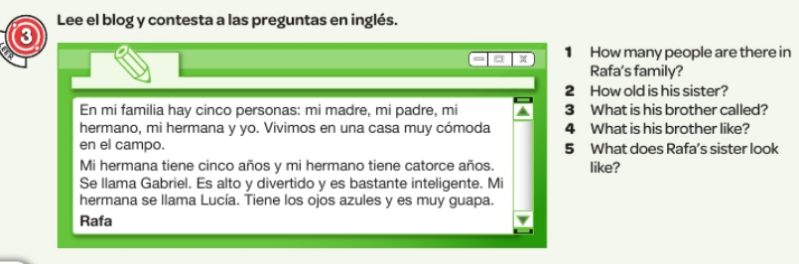
Read the information and then answer the questions in English.

Slide 30
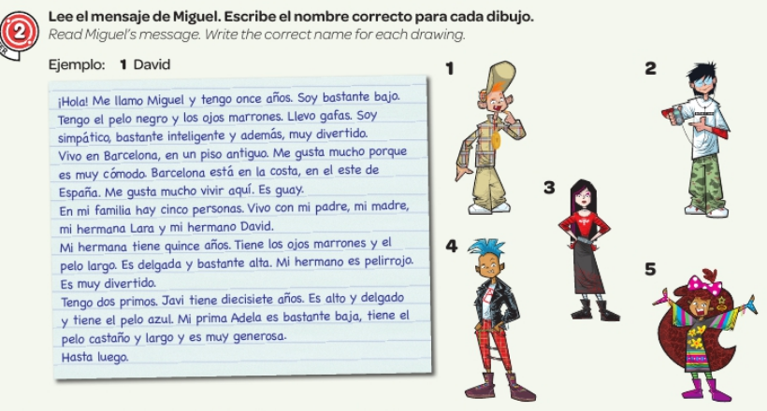

Slide 31
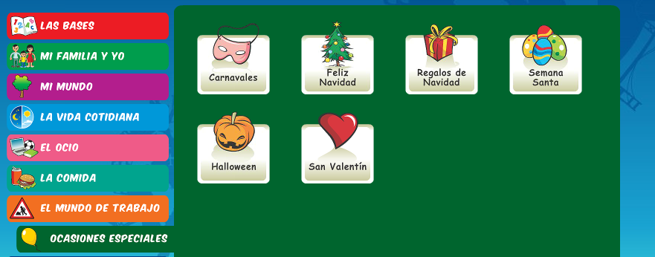
WEEK 6 – w/c 7th April
Learn about Easter in Spain by reading the following slides. Then make your own poster or Powerpoint about Easter in Spain or a Spanish speaking country.
There is an Easter section on Linguascope in the beginner section too.

Slide 32
The Spanish word for 'Easter' is Pascua.
The seven days leading up to Easter Sunday are called Holy Week, or La Semana Santa in Spanish.
All over Spain, it is a week of spectacular street processions (procesiones).

Slide 33
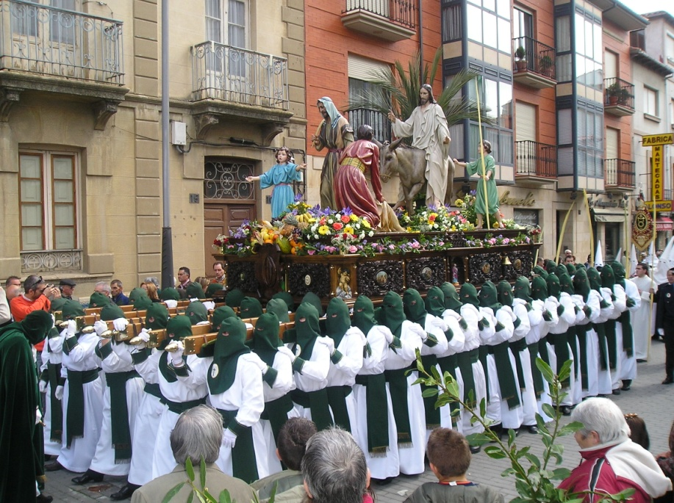
During La Semana Santa, starting on el Domingo de Ramos, Spanish towns have street parades every day.
In the processions, people carry and follow floats,
known as pasos.
On the floats, there are statues of Jesús and La Virgen María. The floats are beautifully decorated with flowers, gold, silver, candles and fine fabrics.

Slide 34


Easter week in Spain is a time of serious processions and remembering the events leading up to and including the death of Jesus.
But, on Easter Day (El Domingo de Resurrección) it is a day of happiness and celebration because on this day the Resurrection of Jesus is remembered.
In recent years the tradition of giving Easter Eggs has really taken off.

Slide 35
The most exciting place to visit during La Semana Santa is probably the city of Sevilla in the south of Spain.
Its processions are the most impressive and famous, attracting hundreds of thousands of visitors.
As a result, the city becomes overcrowded, but it is a very exciting and interesting time to be there!

