Slide 1


Year 8 German TERM 4: Echo 1 textbook, chapter 6
If pupils are absent from lessons they should spend time revising and learning vocabulary. All of the vocabulary for this term is on the following slides. First of all, they should recap the vocabulary which they learned the previous week. Then they should start to learn the next section of vocabulary which they have not yet covered in class. This could be done by using the look, cover, write, check method or by making flashcards etc. It should also be written in their orange book. There are also a few tasks to complete. A plan for the term is on the next slide.
Pupils can also revise vocabulary on Linguascope-
Username is kingshill password is mfl123*
Any new vocabulary they learn can be written in their orange books or on paper.
If pupils wish to do extension work they can access free MFL lessons on the Oak National Academy website:
https://classroom.thenational.academy/subjects-by-key-stage

Slide 2
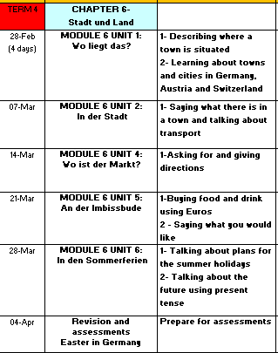

Slide 3
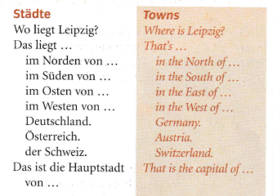
WEEK 1 – w/c 28th February
Read through the vocabulary for this week and spend a good amount of time trying to learn it. You will need these words to complete the tasks on the next few slides.

Slide 4
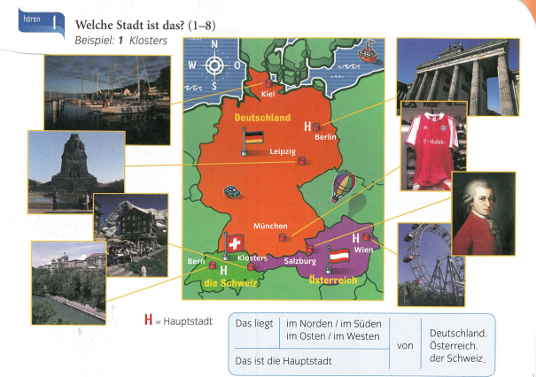

Listen to the recording. Which place are they talking about? Example, 1= Klosters

Slide 5

Make a note of the following:

Slide 6
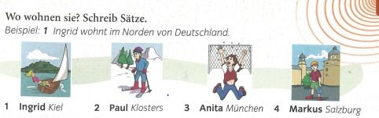
Write a sentence about each person saying where they live. The first one is done for you as an example.

Slide 7
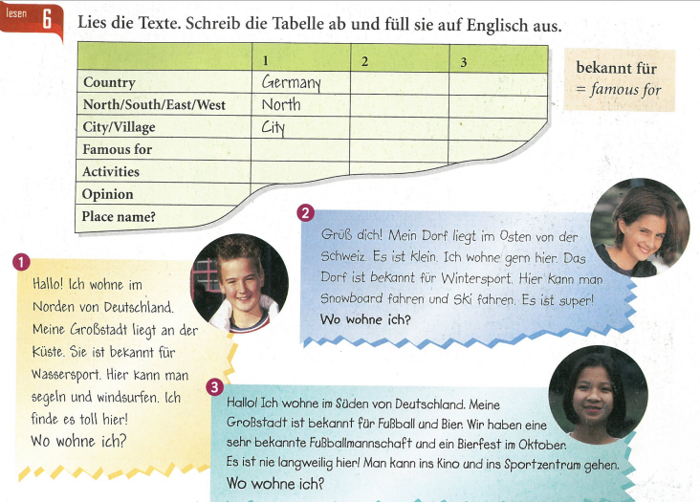
Copy the table. Read the texts and fill in the table for each person in English.

Slide 8
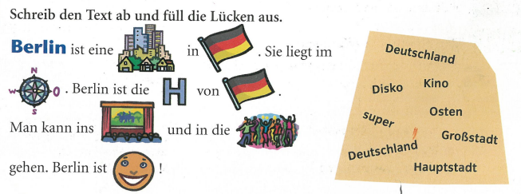
Copy the text and replace the pictures with a word from the right hand side.

Slide 9
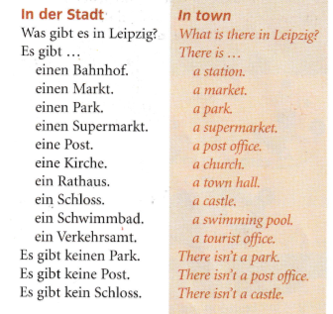
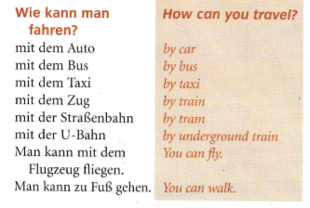
WEEK 2 – w/c 7th March
Read through the vocabulary for this week and spend a good amount of time trying to learn it. You will need these words to complete the tasks on the next few slides.

Slide 10
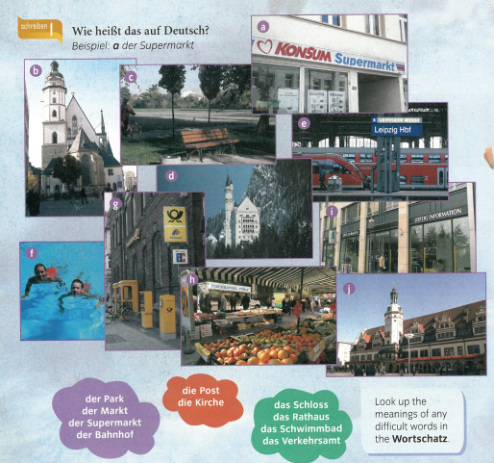
Write down a-j.
Say what each of the pictures are in German using the words from in the coloured clouds.
Example –
a- der Supermarkt
(i is the tourist information and j is the town hall)

Slide 11

Listen to the recording and write 1-3. What do the 3 people say they have in their towns? Use the letters a-j from the previous task or you could make a list in English of the places they mention.
Example 1) f, a….

Slide 12
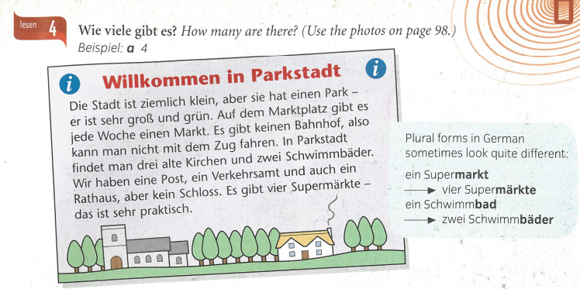
Make a list of how many things are in the town. Example, a) 4 (4 supermarkets)
Remember, keinen/keine/kein mean there isn’t

Slide 13
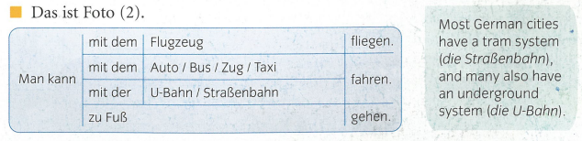
Man kann means ‘you can/ one can’
So ‘Man kann mit dem Auto fahren’ means ‘you can travel by car’
We use fliegen (fly) with Flugzeug (aeroplane)
We use gehen (go) with zu Fuß (on foot)

Slide 14
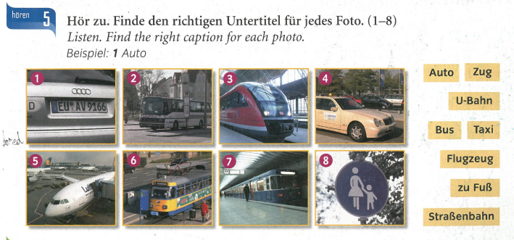
Write down the correct German word for each type of transport. Listen to the recording to check your answers. Example – 1) Auto

Slide 15

Write a few sentences about your town in German. Say what it is called, what it has in the town and how you can travel. Example below.

Slide 16
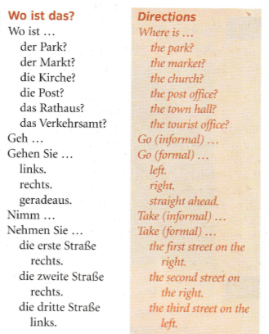
WEEK 3 – w/c 14th March
Read through the vocabulary for this week and spend a good amount of time trying to learn it. You will need these words to complete the tasks on the next few slides.

Slide 17
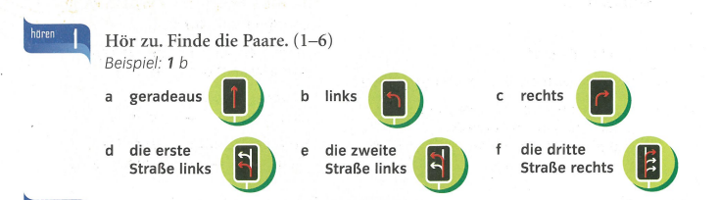
Listen to the recording. Which direction do you hear? a,b,c,d,e or f?
Example, 1b

Slide 18
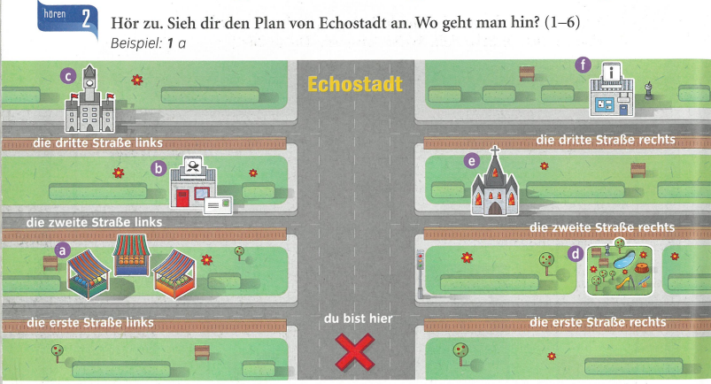
Listen to the recording. Which place are they directing you to? a, b, c, d, e or f?
Start at the red cross each time. Example, 1) a (they bleep out the name of the place otherwise you would know straight away where you are going!)

Slide 19
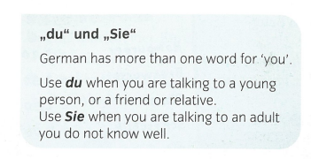
Use this when directing a young person, friend or relative:
Geh…- go…
Nimm…take…
Use this when directing an adult or someone you don’t know well:
Gehen Sie – go
Nehmen Sie - take

Slide 20
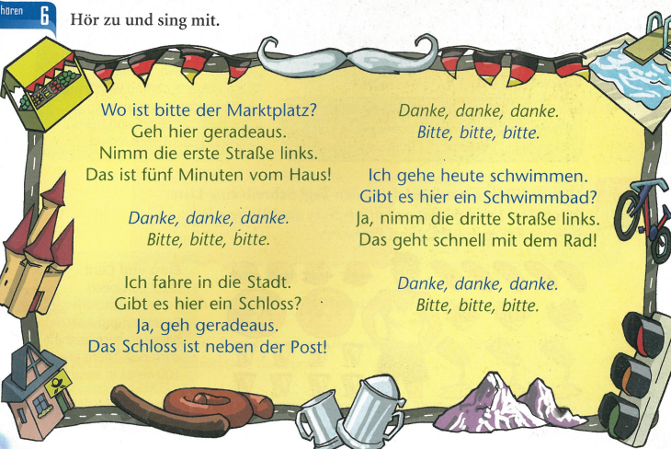
Listen to the song about directions and sing along!

Slide 21
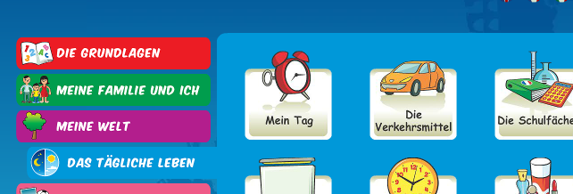
Log on to Linguascope and practise the transport words from last week (they are in the beginner section):
Username – kingshill password – mfl123*

Slide 22
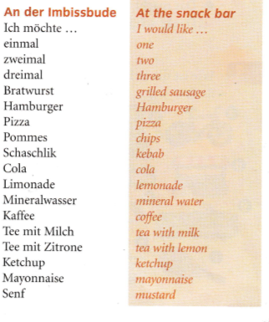
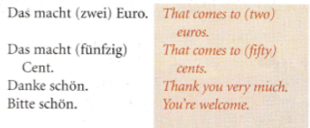
WEEK 4 – w/c 21st March
Read through the vocabulary for this week and spend a good amount of time trying to learn it. You will need these words to complete the tasks on the next few slides.

Slide 23
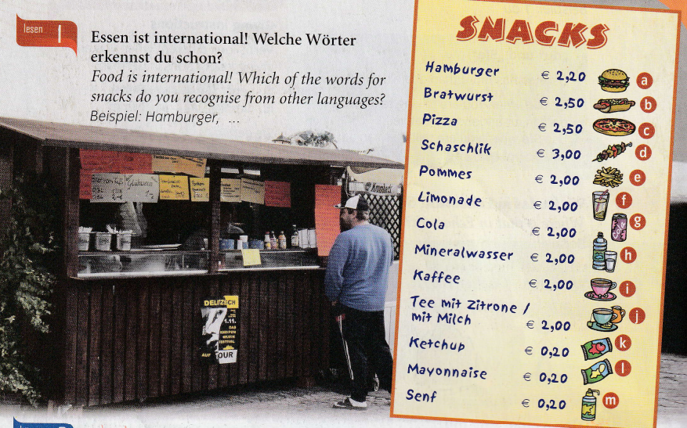

Slide 24
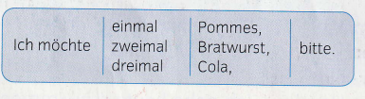
When ordering in Germany, you can use the following phrase:
Ich möchte – I would like
Instead of just saying, ein, zwei or drei though we say einmal, zweimal, dreimal

Slide 25
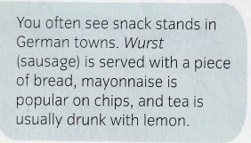
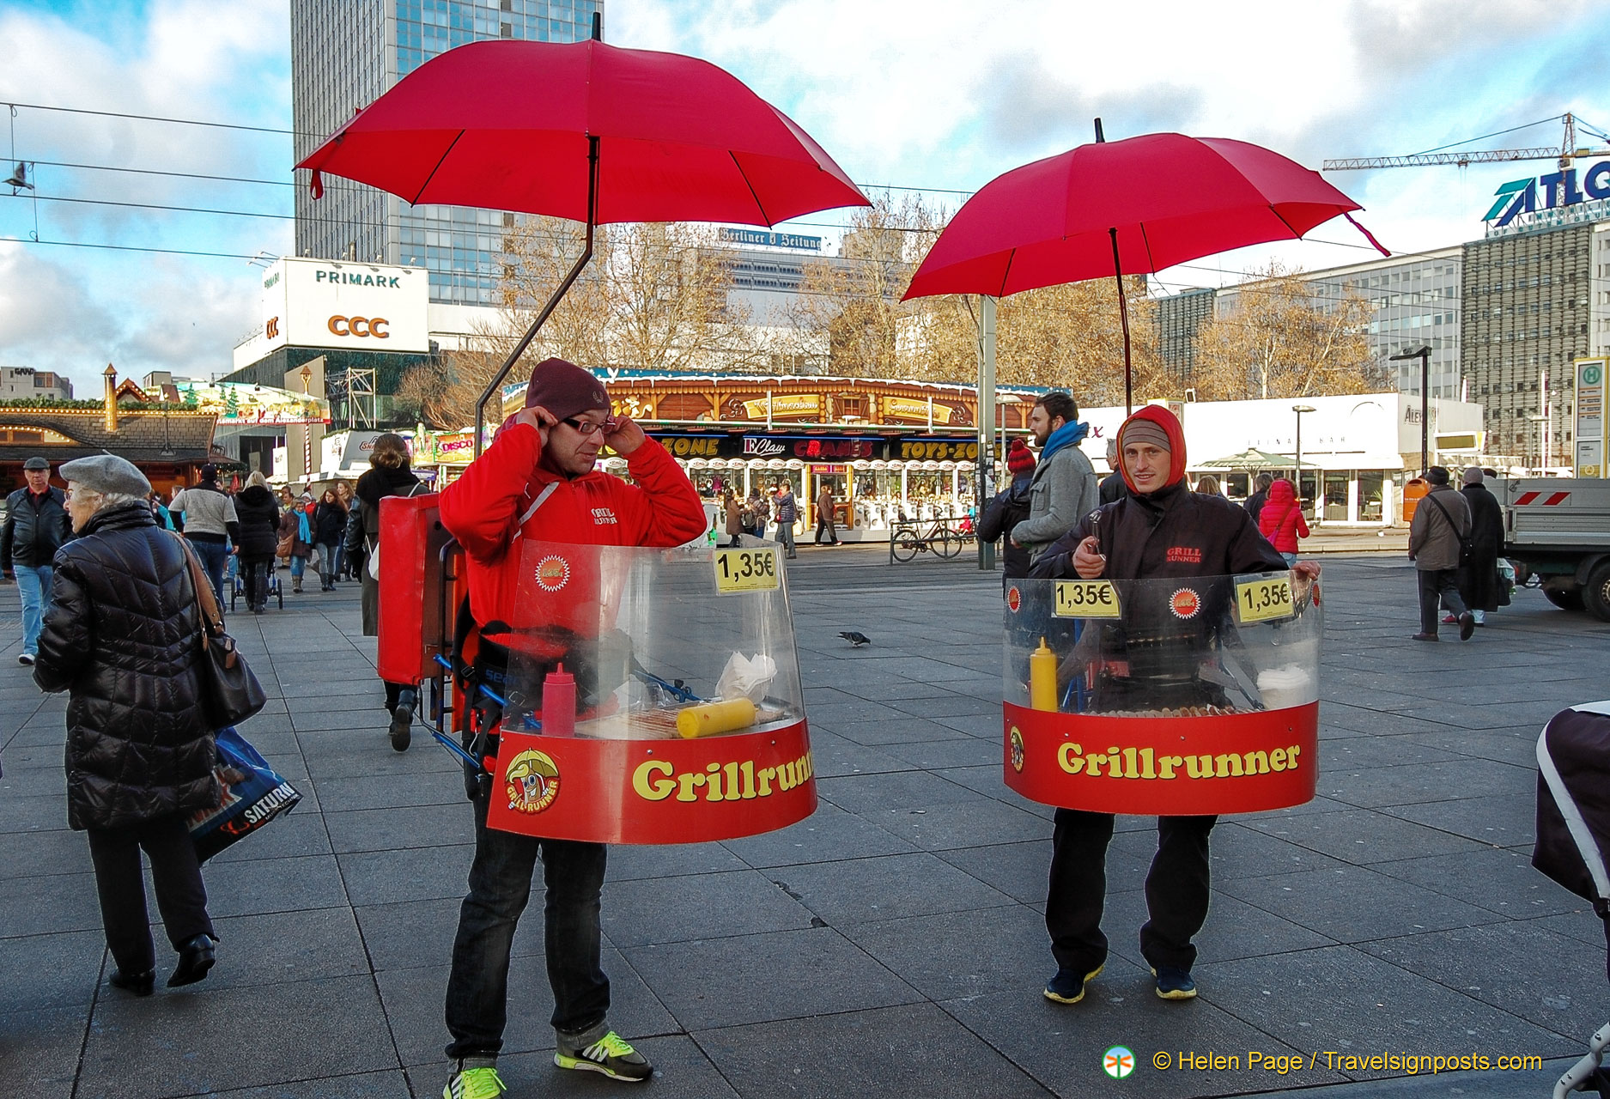
These people sell Bratwurst (sausages) on the streets on Berlin. They cook the sausages whilst walking around!

Slide 26
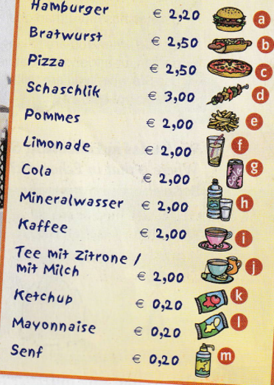
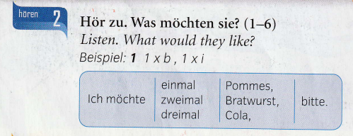
Listen to the recording. What does each of the 6 people order? Example, 1) 1xb, 1x1 (1 Bratwurst and 1coffee)

Slide 27
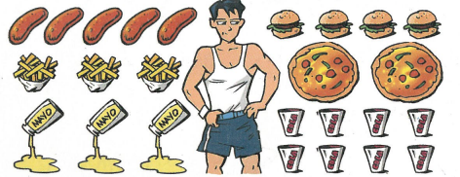
Make a list of what Friedrich eats every day.
Example, Friedrich isst fünfmal Bratwurst… (Friedrich eats 5 (lots of) Bratwursts)

Slide 28
Ich esse (nicht) gern – I (don’t) like to eat
Ich trinke (nicht) gern – I (don’t) like to drink
Write a couple of sentences saying what you like to eat/ don’t like to eat and what you like /don’t like to drink from the selection on the right.

Slide 29
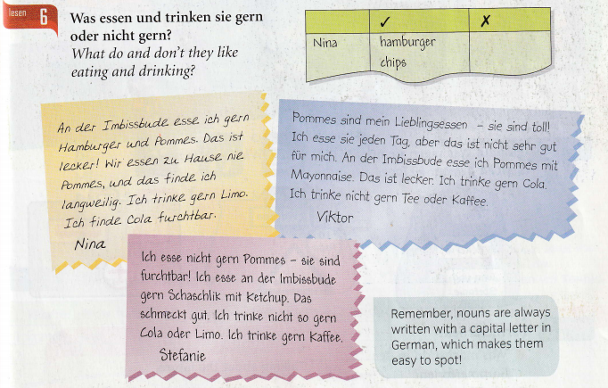
lecker=tasty
furchtbar=awful

Slide 30
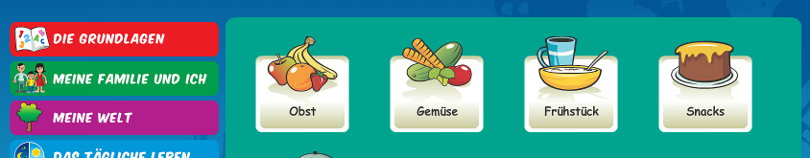
Log on to Linguascope and practise some food and drink words (they are in the beginner section). Make a note of any new ones:
Username – kingshill password – mfl123*

Slide 31
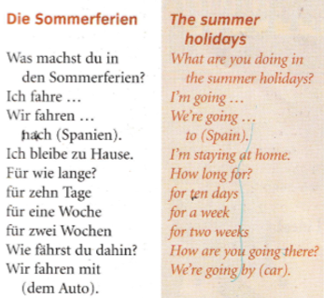
WEEK 5 – w/c 28th March
Read through the vocabulary for this week and spend a good amount of time trying to learn it. You will need these words to complete the tasks on the next few slides.

Slide 32
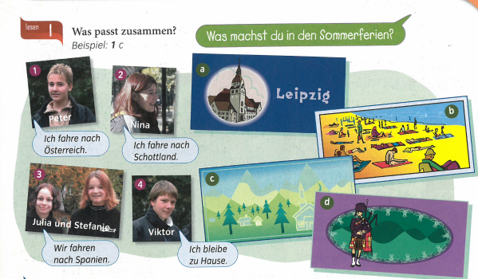
Match up what the people say with the pictures.
Example, 1C

Slide 33
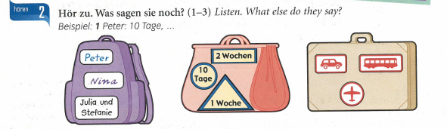
Listen to the track. What do they say?
Write the person’s name, how long they are travelling for and which type of transport they are using.

Slide 34
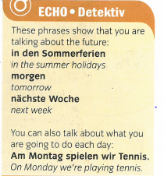
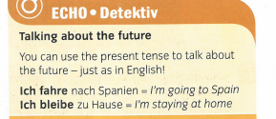
Make a note of the following grammar points:

Slide 35
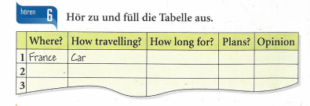
Listen to the track. Copy the table and fill in the information (in English).

Slide 36
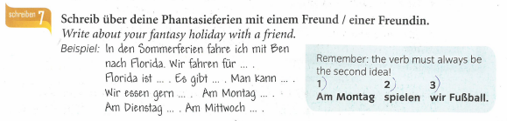

Slide 37
WEEK 6 – w/c 7th April
This week is assessment week. Spend some time revising all of the vocab on these slides so far (or revise the chapter 6 vocab sheet in your exercise book) and then email your teacher for the test papers. There are also revision activities on the next slide.
There is also some information about Easter in Germany to read through.

Slide 38
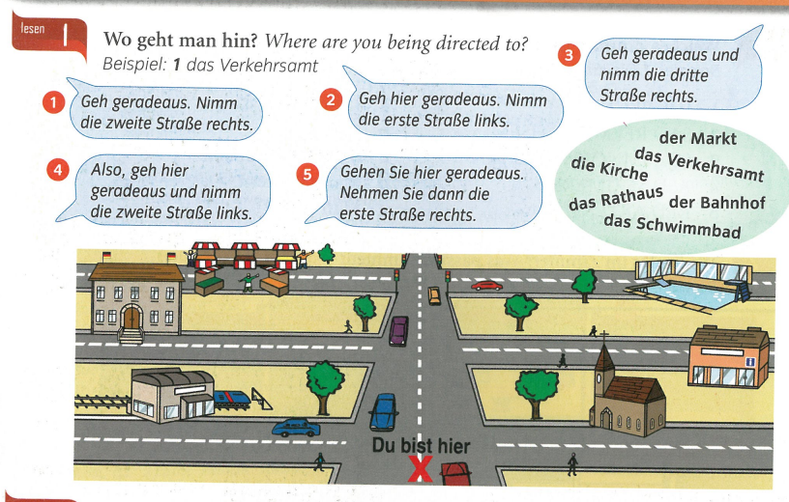

Slide 39
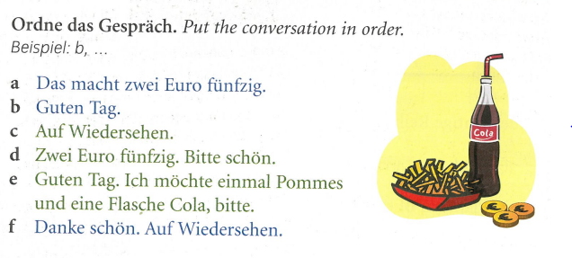

Slide 40
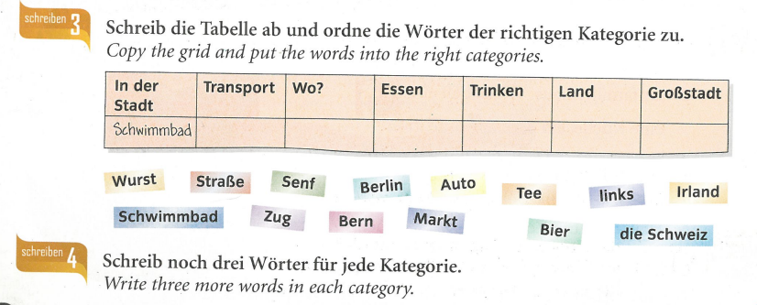
(2 words per category)
KEY VOCAB:
In der Stadt – in town
Wo? Where?
Essen- food
Trinken – drink
Land- country
Großstadt - city

Slide 41
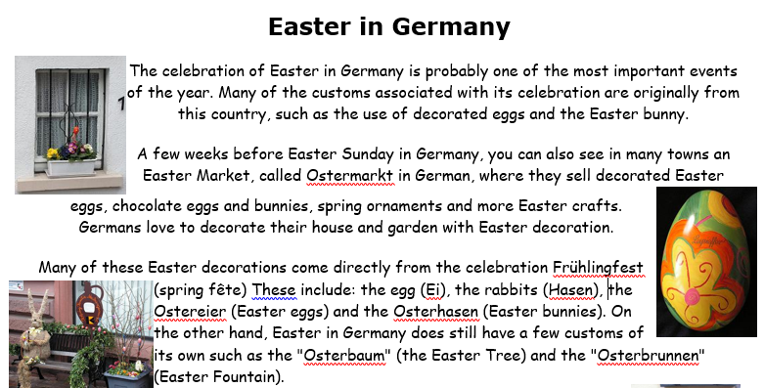

Slide 42
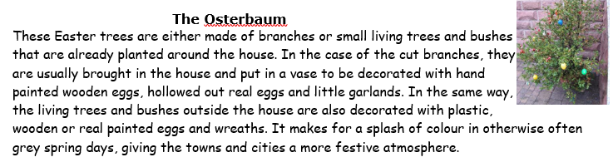

Slide 43
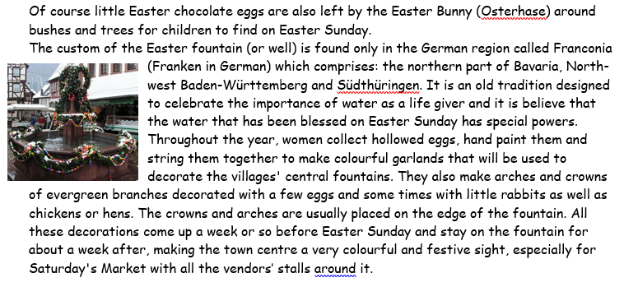

Slide 44
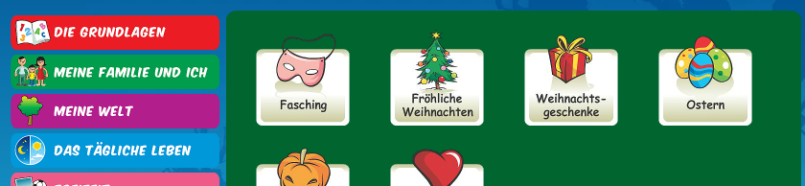
There is an Easter section on Linguascope in the beginner section too.
username – kingshill password – mfl123*

