Slide 1


Year 8 French TERM 4: Studio 1 textbook, chapter 3
If pupils are absent from lessons they should spend time revising and learning vocabulary. All of the vocabulary for this term is on the following slides. First of all, they should recap the vocabulary which they learned the previous week. Then they should start to learn the next section of vocabulary which they have not yet covered in class. This could be done by using the look, cover, write, check method or by making flashcards etc. It should also be written in their orange book. There are also a few tasks to complete. A plan for the term is on the next slide.
Pupils can also revise vocabulary on Linguascope-
Username is kingshill password is mfl123*
Any new vocabulary they learn can be written in their orange books or on paper.
If pupils wish to do extension work they can access free MFL lessons on the Oak National Academy website:
https://classroom.thenational.academy/subjects-by-key-stage

Slide 2
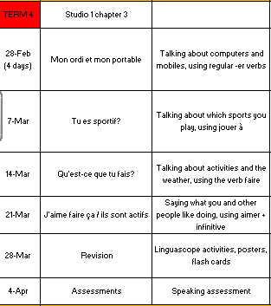

Slide 3
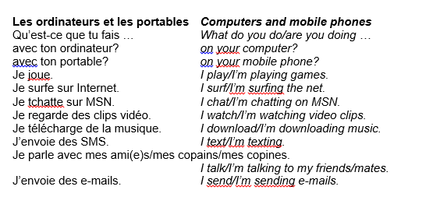
Week 1 – w/c 28th Feb
vocab
Read through the vocabulary for this week and spend a good amount of time trying to learn it. You will need these words to complete the tasks on the next few slides.

Slide 4

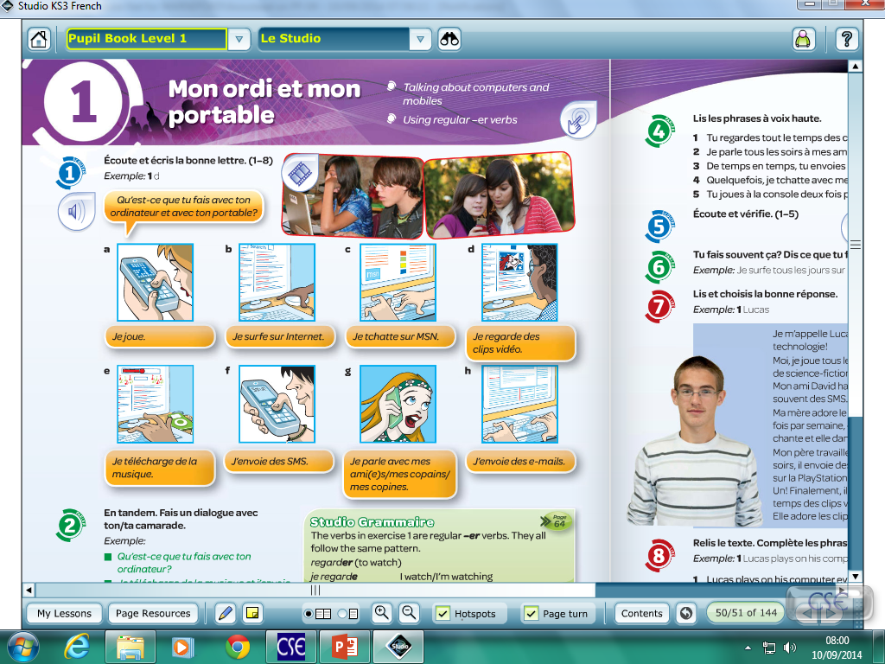
Click on the icon to listen to the clip and write the correct letter:
Week 1

Slide 5
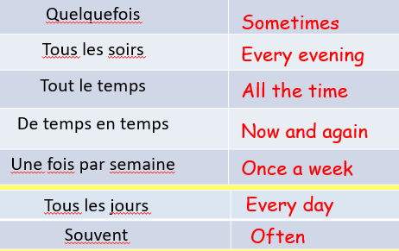
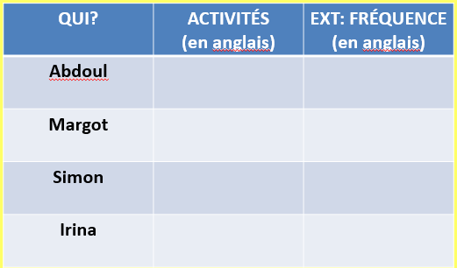
Copy the frequency vocab into your book then click on the icon to listen to the recording. Write down in English what activities they do and how often they do it.

Slide 6
“I send emails everyday,it’s fun”.
“Qu’est-ce que tu fais avec ton ordinateur?”
Translate the expressions in the speech bubbles. Then, click the link to practice the vocab on quizlet.
“Je regarde des clips vidéos tout le temps parce que c’est drôle”
“Sometimes I surf the internet, it’s entertaining”.
“Often I download music”.
“From time to time I speak to my friends, it’s interesting”
“Qu’est-ce que tu fais avec ton portable?”
“Je tchatte sur Facebook tous les soirs”.
https://quizlet.com/_quizlet games

Slide 7
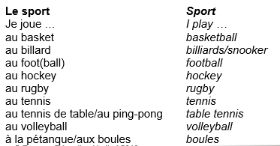
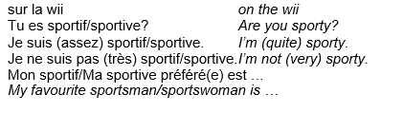
Week 2 – w/c 7th March
vocab
Read through the vocabulary for this week and spend a good amount of time trying to learn it. You will need these words to complete the tasks on the next few slides.

Slide 8
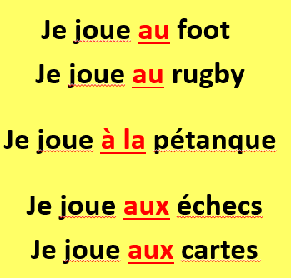
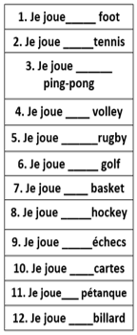
Week 2
The verb ‘jouer’ (to play) is always followed by the word ‘à’ when talking about sports. This word changes when the next word is masculine, feminine and plural. Copy this down:
masculine
feminine
plural
Can you use this rule to fill in the blanks here? Make sure you check whether the word is masculine, feminine or plural first.

Slide 9
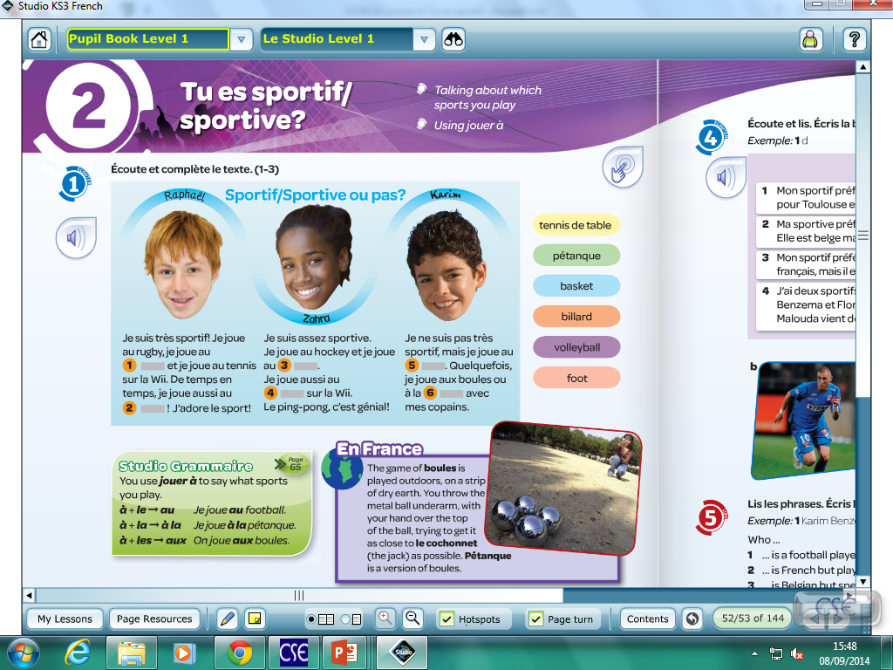
Do the listening activity and fill in the missing words.

Slide 10
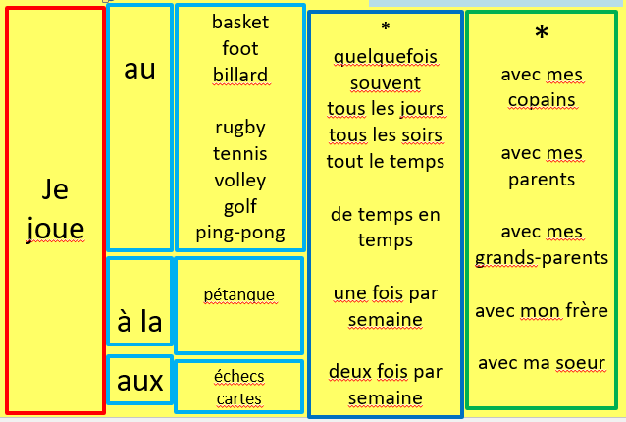
Make 6 sentences using the grid. Write your sentences in French and English.

Slide 11
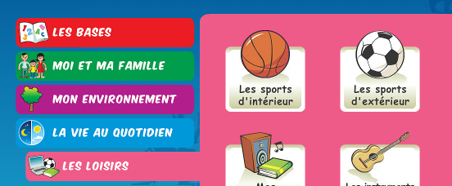
Log on to Linguascope and practise sports words (they are in the beginner section). Make a list of any new words:
Username – kingshill password – mfl123*

Slide 12
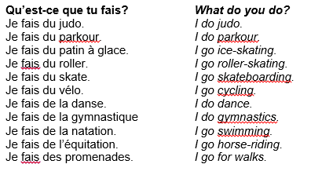
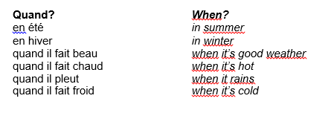
Week 3 – w/c – 14th March
vocab
Read through the vocabulary for this week and spend a good amount of time trying to learn it. You will need these words to complete the tasks on the next few slides.

Slide 13
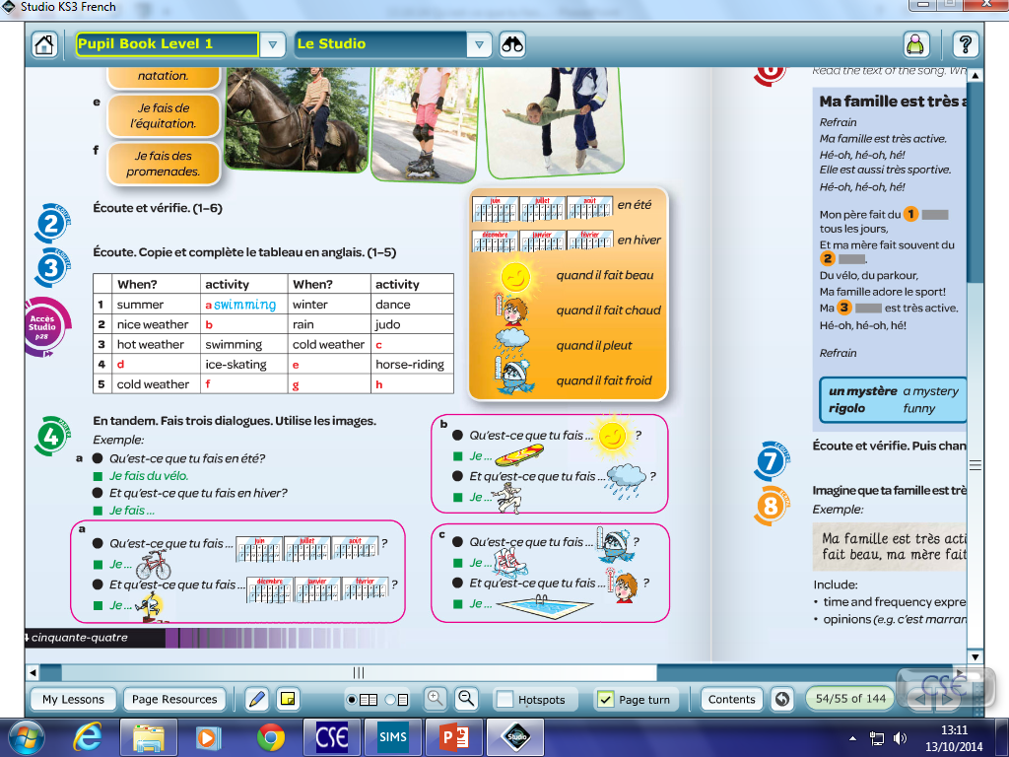
Week 3
Listen to the recording and fill out the relevant information in the grid.

Slide 14
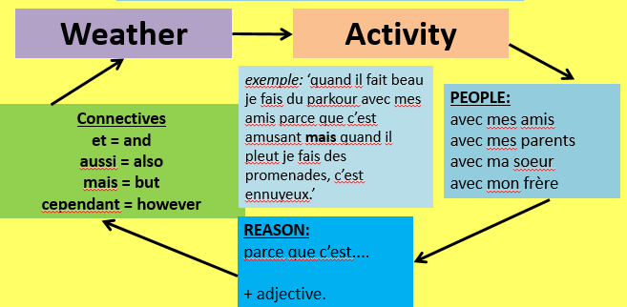
Try to write 3 sentences of 25 words each using the information here. Read the example to help you.

Slide 15
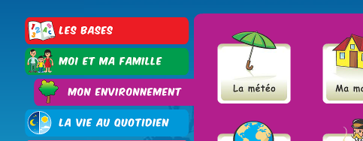
Log on to Linguascope and practise the weather words (they are in the beginner section). Make a list of any new words:
Username – kingshill password – mfl123*

Slide 16
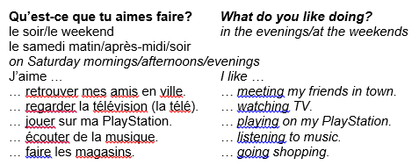
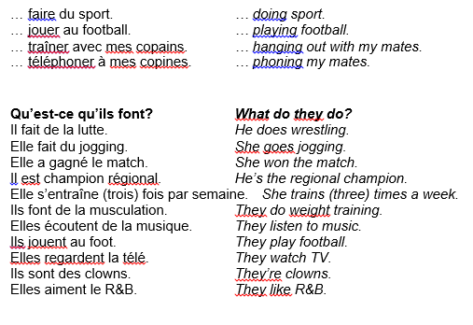
Week 4 – w/c 21st March
vocab
Read through the vocabulary for this week and spend a good amount of time trying to learn it. You will need these words to complete the tasks on the next few slides.

Slide 17
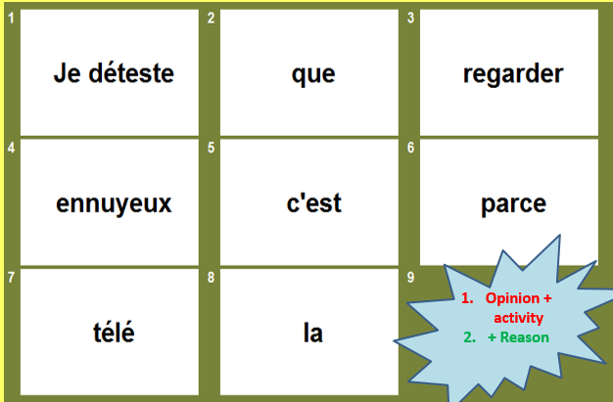
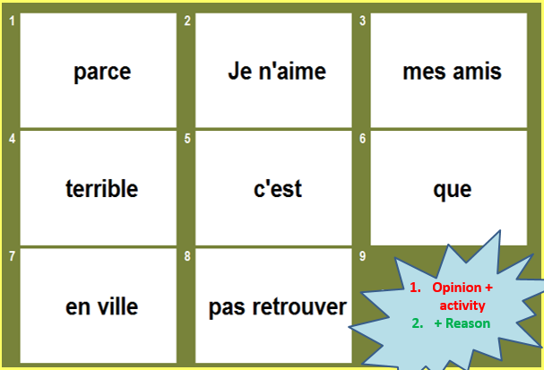
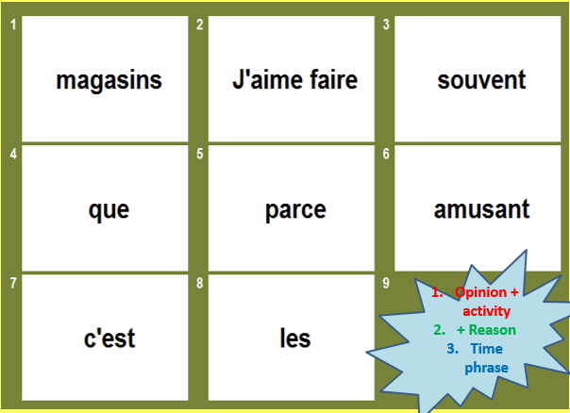
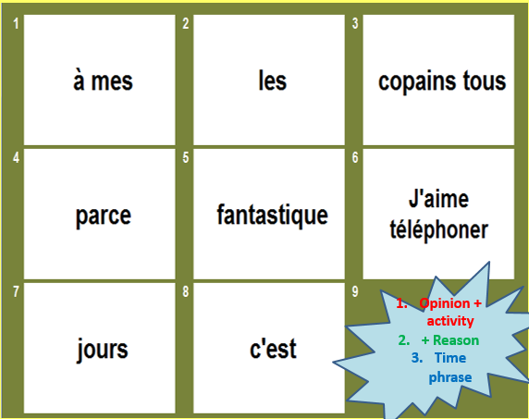
Put the words in the correct order in each box and translate into English.
Week 4

Slide 18
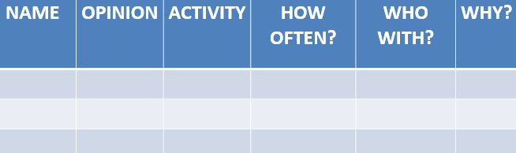
Read the texts and fill in the grid with the appropriate information
Bonjour je m’appelle Rowan.
J’aime jouer au basket tout le temps avec mes amis parce que c’est super et aussi j’adore écouter de la musique tous les soirs avec mon chien parce que c’est génial !
Bonjour je m’appelle Aban.
Je déteste jouer sur ma PlayStation avec mon frère parce que c’est terrible, aussi je n’aime pas regarder la télé avec mon chat tous les soirs parce que c’est ennuyeux.
Bonjour je m’appelle Hollie.
Je déteste traîner avec mes amis souvent parce que c’est ennuyeux mais de temps en temps j’adore regarder la télé avec mon chat parce que c’est amusant.
Bonjour je m’appelle Mia.
Je déteste faire du sport tous les jours avec mon frère parce que c’est fatigant, mais j’adore faire les magasins avec ma sœur tous les weekends parce que c’est amusant.
Bonjour je m’appelle Ross.
Je n’aime pas retrouver mes amis en ville souvent parce que c’est affreux, aussi je déteste jouer sur ma PlayStation le weekend avec mes parents parce que c’est ennuyeux.
Bonjour je m’appelle Morgan.
J’aime téléphoner à mes amis tous les soirs parce que c’est intéressant et aussi j’adore écouter de la musique avec mes parents, c’est fantastique !

Slide 19
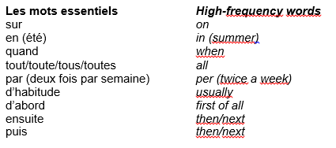
Week 5 – w/c 28th March
This week is revision week. Spend some time revising all of the vocab on these slides from the last 4 weeks and the high frequency words here. You could make revision flashcards/posters/ spider diagrams to help you learn.
There are also some revision exercises on the next few slides which you could work through.

Slide 20
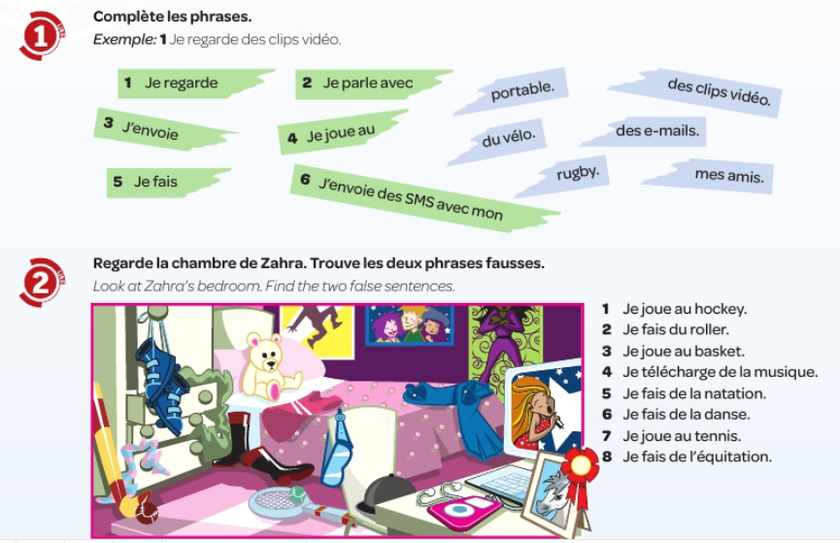


Slide 21
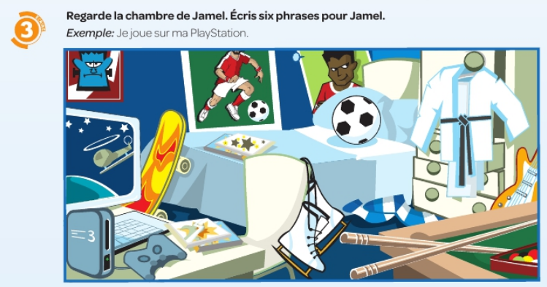

Slide 22
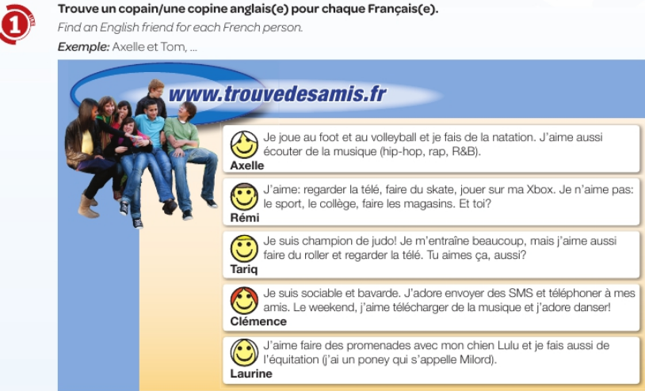
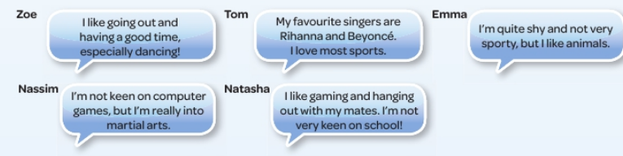

Slide 23
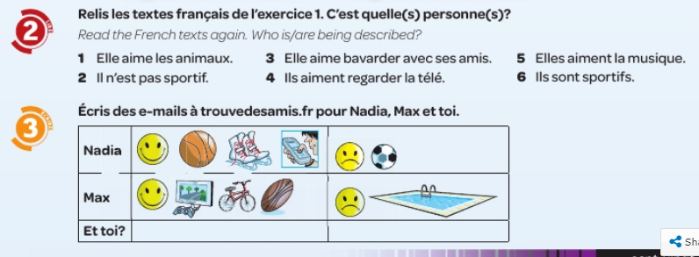

Slide 24

WEEK 6 – w/c 4th April
This week is assessment week. Contact Mrs Millar for the assessment papers. Spend some time revising all of the vocab on these slides.
You can then read about Easter in France and make your own powerpoint / poster about it.

Slide 25
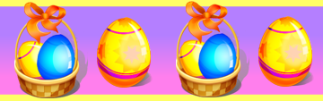
Pâques en France
Learning objective:
Today, we are learning about Easter in France

Slide 26
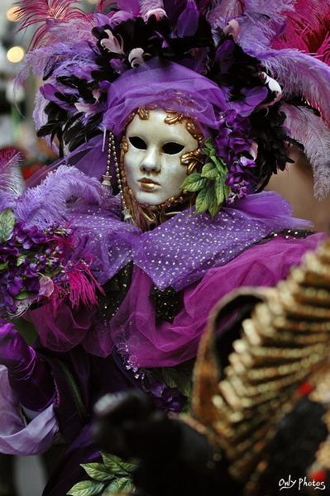
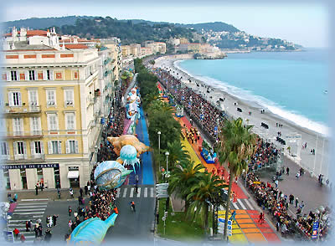
Le carnaval
Carnival is the festive season immediately before Lent.
During carnival, there are parades and street parties. People dress up.
Le Carnaval de Nice
In the city of Nice, in the south of France, there is a very famous carnival every year.
In fact, it is the original Mardi Gras carnival and the oldest in the world!

Slide 27
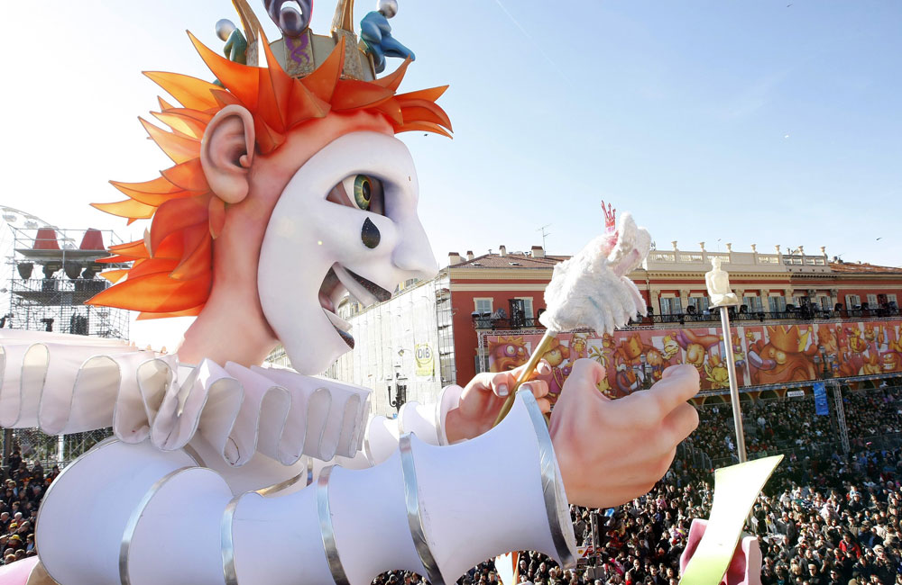
Le Carnaval de Nice
During the two weeks leading up to Mardi Gras, there are street parties, parades, shows, concerts, fireworks and general merry-making!
People wear fancy-dress.

Slide 28

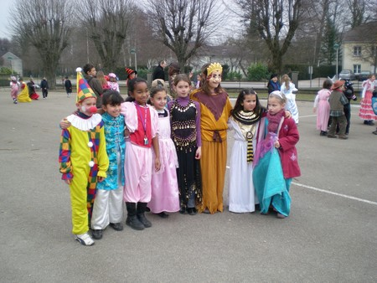
Mardi Gras
The carnival period finishes with Mardi Gras. It actually means ‘Fat Tuesday' and it is known as Shrove Tuesday in English.
It is the last day when you can eat everything you like before the fasting period of Lent.
Children often celebrate Carnaval and Mardi Gras together.
They can dress up to go to school or wear a mask.

Slide 29
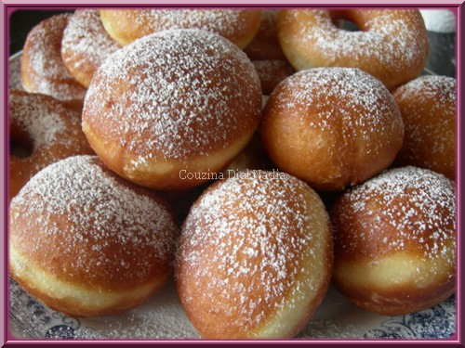
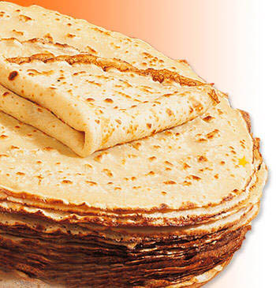
Mardi Gras
On Mardi Gras, French people traditionally eat doughnuts (les beignets) or pancakes (les crêpes).
These are the traditional food of Mardi Gras because they are a good way to use up all the extra flour, eggs and butter that should not be eaten during Lent.

Slide 30
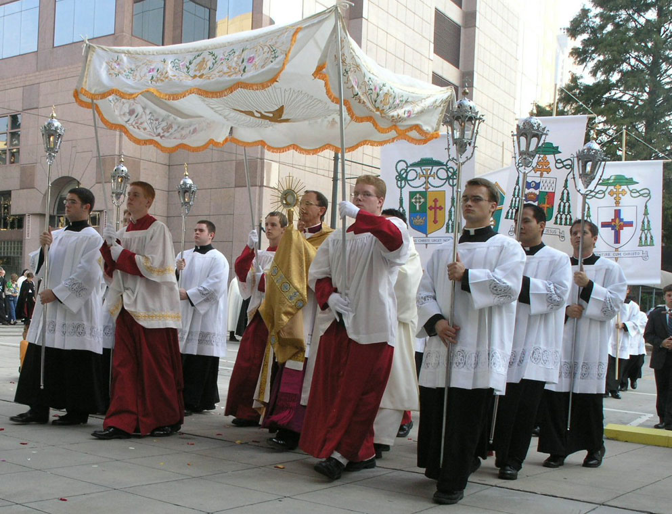
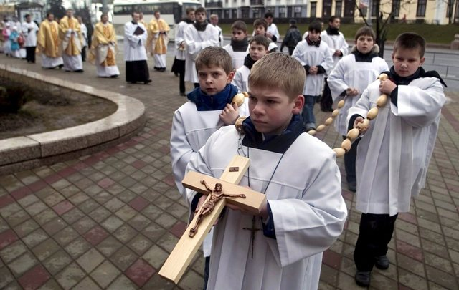
Les processions
There are lots of processions and religious parades in towns.

Slide 31
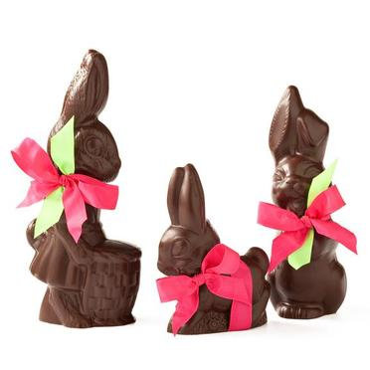
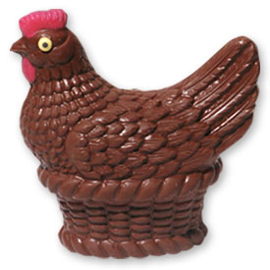
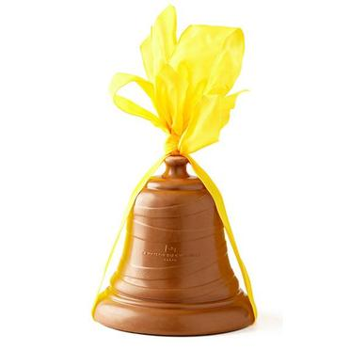
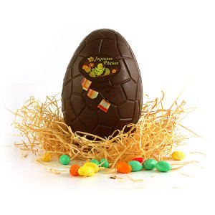
Le dimanche de Pâques
Early on the morning of Easter Sunday , the Easter bells (les cloches de Pâques) fly back to France!
They drop chocolate eggs, chickens, bells and bunnies in the gardens of the French towns.

Slide 32
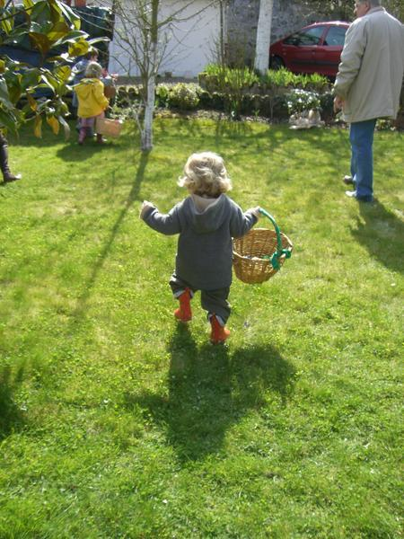
La chasse aux œufs
In the morning, the children awake very excited because it is time to search for the chocolate egg hunt (la chasse aux œufs).

Slide 33
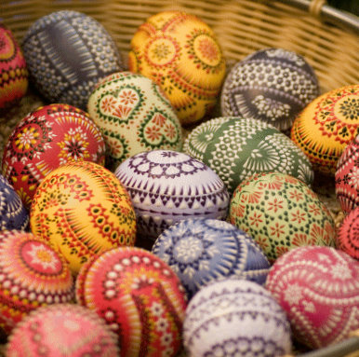
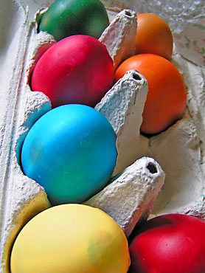
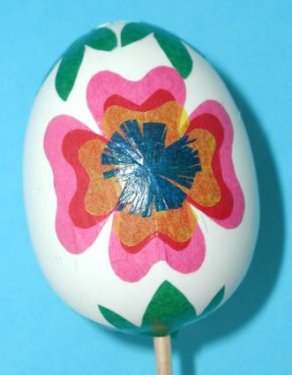
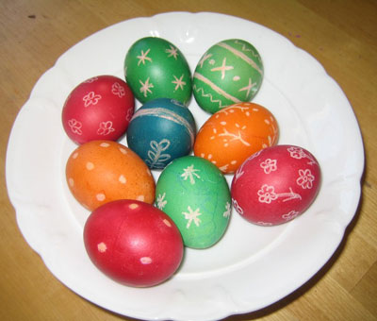
Les œufs de Pâques
The tradition of the Easter eggs dates back from the 4th century.
The eggs which were not eaten during Lent used to be decorated and then offered for Easter.

Slide 34
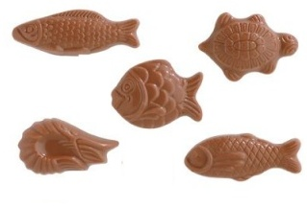
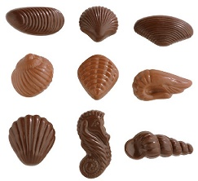
Les chocolats
In France, April fish are also an Easter symbol and that is why you will find chocolate fish (la friture) in the shops too!
You can buy chocolates goodies in sweet shops (les confiseries) or in shops specialising in chocolate (les chocolateries).

Slide 35

Le repas
There is generally an enormous amount of delicious food to eat.
French people spend a lot of the day eating with the whole family altogether.
It is a very special and happy day.
Bon appétit!

Slide 36


Le repas
People traditionally eat roast lamb (l'agneau).
There are lots of vegetables, for example, potatoes (les pommes de terre).
In the Alsace region, the traditional dessert is a biscuit in the shape of the Easter lamb (l’agneau pascal or Osterlamala).

Slide 37

Le repas
In the Vendée region, the traditional cake is called Pacaude or la Gâche de Pâques.
It is a very rich bread mixture, like a brioche - containing bread flour, sugar, milk, yeast, butter and eggs.

Slide 38

Information
If a baby is born around Easter-time, the name chosen for the baby might be Pascal, meaning 'belonging to Easter'.

