Slide 1


Year 7 Spanish rotation 2 – for 7C, 7D an 7F only
If pupils are absent from lessons they should spend time revising and learning vocabulary. All of the vocabulary for this term is on the following slides. First of all, they should recap the vocabulary which they learned the previous week. Then they should start to learn the next section of vocabulary which they have not yet covered in class. This could be done by using the look, cover, write, check method or by making flashcards etc. It should also be written in their orange book. There are also a few tasks to complete. A plan for the term is on the next slide.
Pupils can also revise vocabulary on Linguascope-
Username is kingshill password is mfl123*
Any new vocabulary they learn can be written in their orange books or on paper.
If pupils wish to do extension work they can access free MFL lessons on the Oak National Academy website:
https://classroom.thenational.academy/subjects-by-key-stage

Slide 2
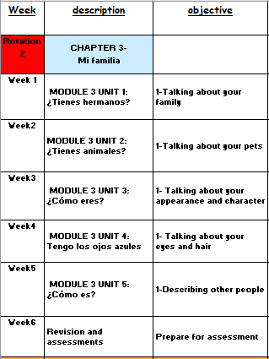

Slide 3
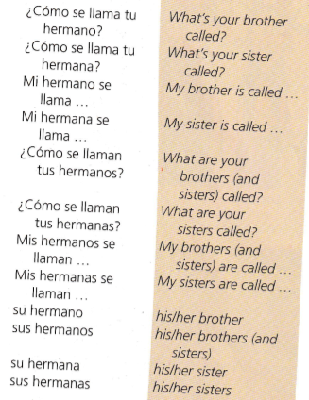
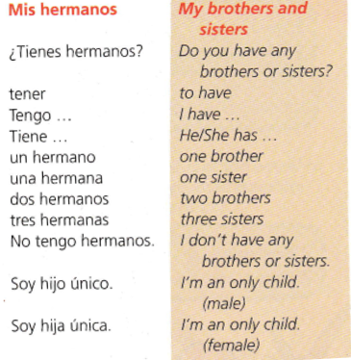
WEEK 1 – w/c 28th February
Read through the vocabulary for this week and spend a good amount of time trying to learn it. There are more words on the next slide too.

Slide 4

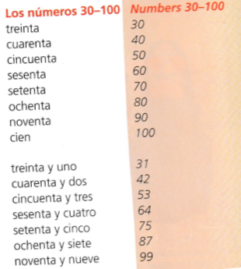
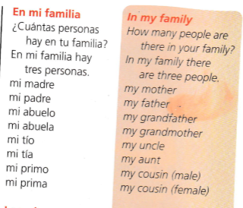

Slide 5

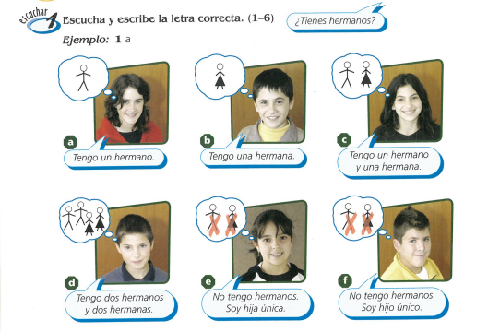
Listen to the recording. Write down 1-6 and say who is talking a,b,c,d,e or f?

Slide 6
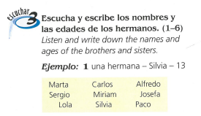
Listen to the recording. Write down 1-6. Write down how many brothers and sisters they have along with their names and ages.

Slide 7
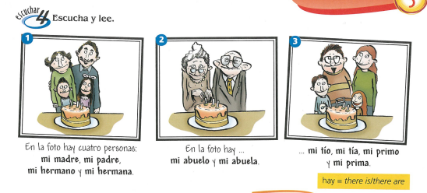
Listen to the recording as the pictures are being described. Read along.

Slide 8
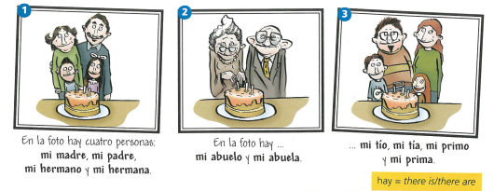
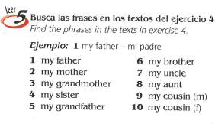
Look at the photos again of the family members. Then find the Spanish for the 10 people in exercise 5.

Slide 9
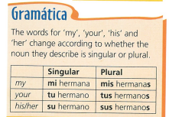
Copy down the following grammar:

Slide 10
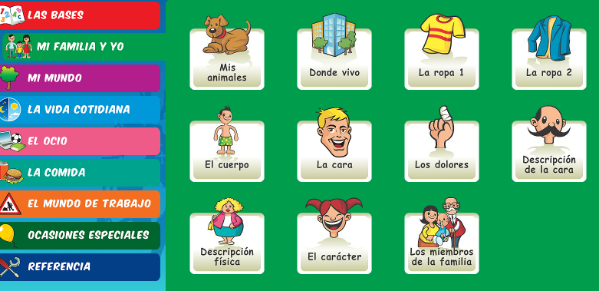
Log on to Linguascope and practise the family member words (they are in the beginner section):
Username – kingshill password – mfl123*

Slide 11

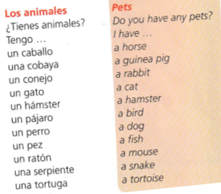
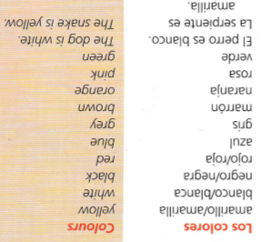
WEEK 2 – w/c 7th March
Read through the vocabulary for this week and spend a good amount of time trying to learn it.

Slide 12
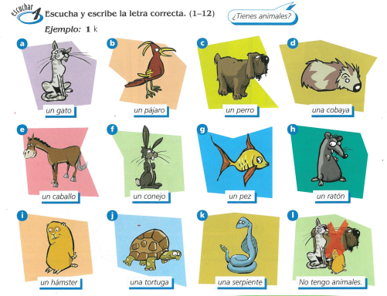
Listen to the recording. Write down 1-12 and write the letter (a-k) of which animal is being mentioned.
Remember ‘No tengo animales’ means ‘I don’t have any pets’.

Slide 13

Copy down the grammar about how to make plurals.
Copy down the question:
¿Tienes anmales: - Do you have any pets?

Slide 14
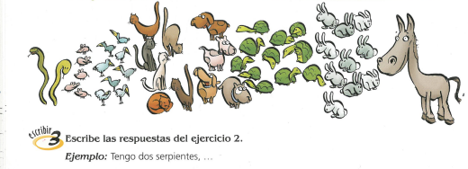
Pretend the pets in the picture are your pets. Write a list of what you have:
Tengo dos serpientes…

Slide 15
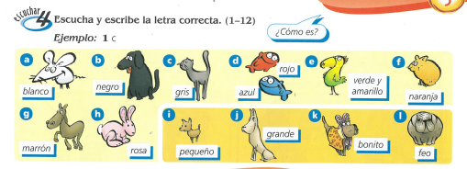
Listen to the recording. Write down 1-12 and write the letter (a-l) of which adjectives is mentioned.
¿Cómo es? = What is it like?

Slide 16
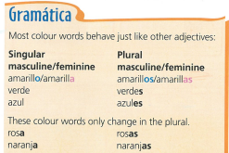
Copy down the following grammar:

Slide 17
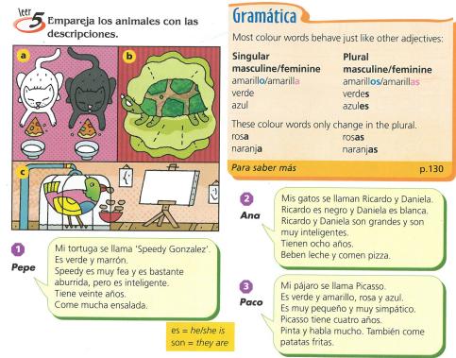
Match the animal descriptions with the pictures.

Slide 18
Log on to Linguascope and practise the pet words (they are in the beginner section):
Username – kingshill password – mfl123*

Slide 19
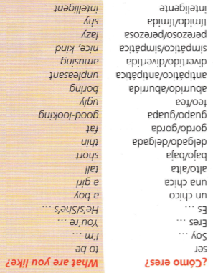
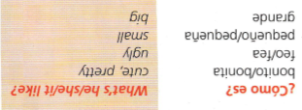
WEEK 3 – w/c 14th March
Read through the vocabulary for this week and spend a good amount of time trying to learn it.

Slide 20
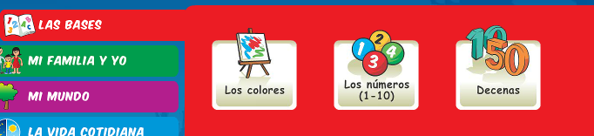
Log on to Linguascope and practise the colours words from last week (they are in the beginner section):
Username – kingshill password – mfl123*

Slide 21
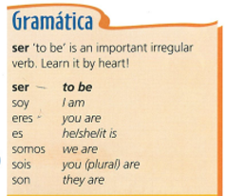
Copy down the following grammar:

Slide 22
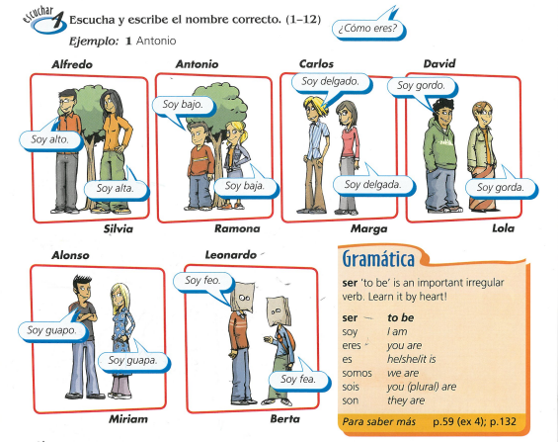
Listen to the recording. Write down 1-12. Which person is talking? Write down the person’s name.
E.g. 1) Antonio

Slide 23


Slide 24
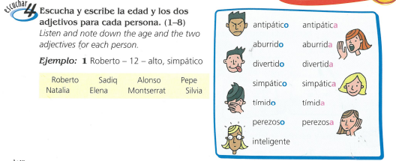

Slide 25
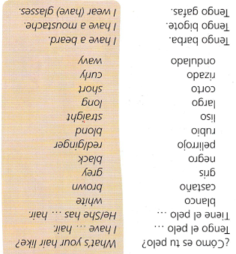
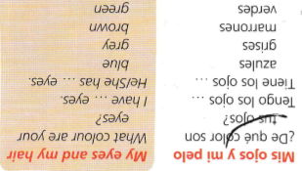
WEEK 4 – w/c 21st March
Read through the vocabulary for this week and spend a good amount of time trying to learn it.

Slide 26
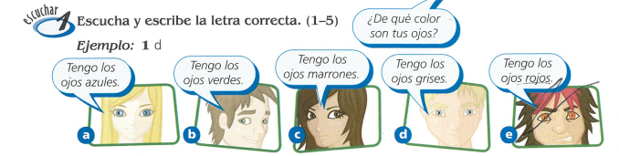
Listen to the recording. Write down 1-5. Which person is being described? a,b,c,d or e?

Slide 27
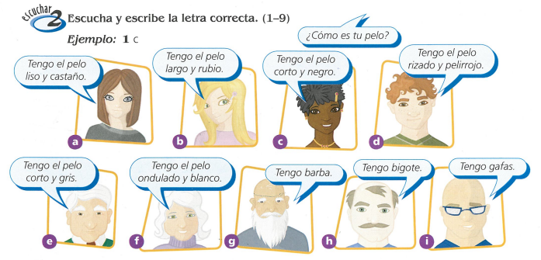
Listen to the recording. Write down 1-9. Which person is being described? Write the letter a-i

Slide 28


Slide 29
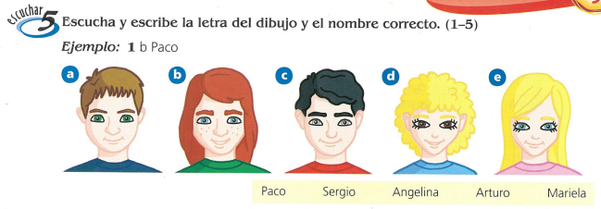
Listen to the recording. Write down 1-5. Which person is being described? Write a,b,c,d or e and their name

Slide 30
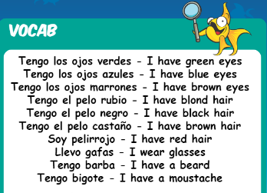
Log on to Linguascope and practise the hair and eye words (they are in the beginner section). The words are below:
Username – kingshill password – mfl123*

Slide 31
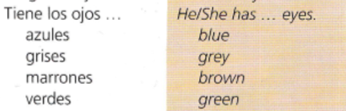
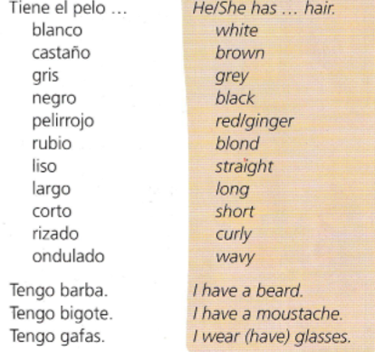
WEEK 5 – w/c 28th March
There is no new vocab this week, but you will need
the vocab from previous weeks for this week’s tasks.

Slide 32
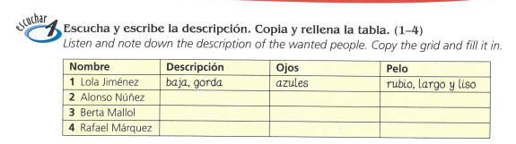
Copy the table. Listen to the track and fill in the descriptions of the people – in the 1st column you need to put a description of their appearance e.g. height or weight, in the 2nd column you describe their eyes and in the 3rd column you describe their hair.
Remember:
‘tiene’ means he/she has
‘es’ means he/she is

Slide 33
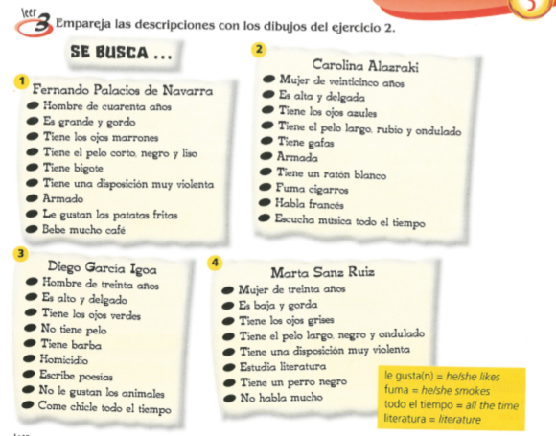
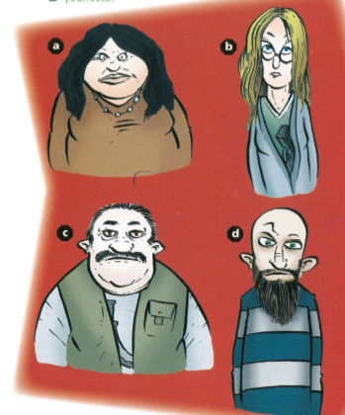
Read the 4 descriptions and then match them up with the pictures a-d

Slide 34
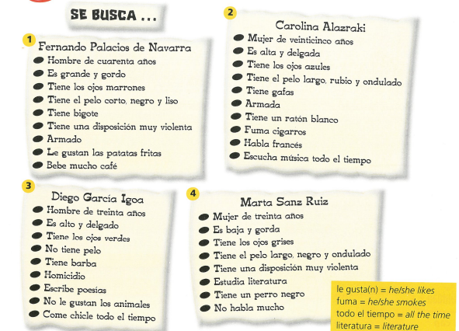


Read the descriptions again and then find the 6 phrases below in Spanish in the texts.

Slide 35

Using the picture below and the texts on the previous slide for ideas, design a wanted poster. Draw a picture of the wanted person and write a short description.

Slide 36
WEEK 6 – w/c 7th April
This week is assessment week. Spend some time revising all of the vocab on these slides so far (or on your vocab sheet which is in your orange book) and then email your teacher for the test papers.
There is also some information about Easter in Spain to read through.

Slide 37
The Spanish word for 'Easter' is Pascua.
The seven days leading up to Easter Sunday are called Holy Week, or La Semana Santa in Spanish.
All over Spain, it is a week of spectacular street processions (procesiones).

Slide 38
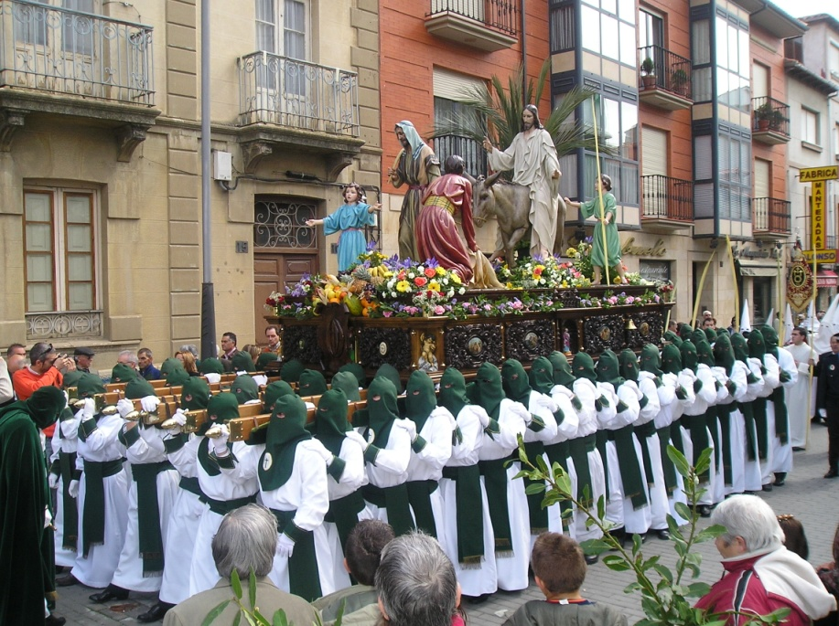
During La Semana Santa, starting on el Domingo de Ramos, Spanish towns have street parades every day.
In the processions, people carry and follow floats,
known as pasos.
On the floats, there are statues of Jesús and La Virgen María. The floats are beautifully decorated with flowers, gold, silver, candles and fine fabrics.

Slide 39


Easter week in Spain is a time of serious processions and remembering the events leading up to and including the death of Jesus.
But, on Easter Day (El Domingo de Resurrección) it is a day of happiness and celebration because on this day the Resurrection of Jesus is remembered.
In recent years the tradition of giving Easter Eggs has really taken off.

Slide 40
The most exciting place to visit during La Semana Santa is probably the city of Sevilla in the south of Spain.
Its processions are the most impressive and famous, attracting hundreds of thousands of visitors.
As a result, the city becomes overcrowded, but it is a very exciting and interesting time to be there!

Slide 41
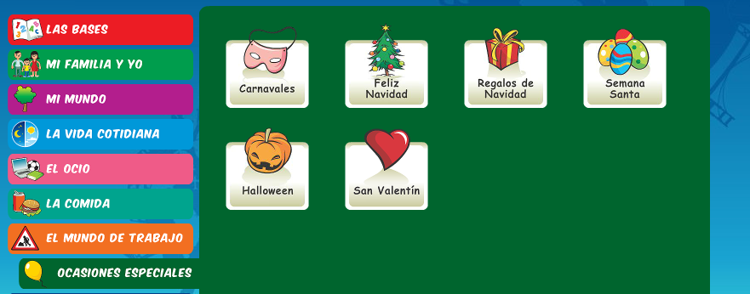
There is an Easter section on Linguascope in the beginner section too.
username – kingshill password – mfl123*

