Slide 1
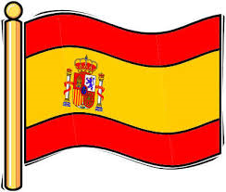

Year 7 Spanish rotation 2 - for 7B and 7G only
If pupils are absent from lessons they should spend time revising and learning vocabulary. All of the vocabulary for this term is on the following slides. First of all, they should recap the vocabulary which they learned the previous week. Then they should start to learn the next section of vocabulary which they have not yet covered in class. This could be done by using the look, cover, write, check method or by making flashcards etc. It should also be written in their orange book. There are also a few tasks to complete. A plan for the term is on the next slide.
Pupils can also revise vocabulary on Linguascope-
Username is kingshill password is mfl123*
Any new vocabulary they learn can be written in their orange books or on paper.
If pupils wish to do extension work they can access free MFL lessons on the Oak National Academy website:
https://classroom.thenational.academy/subjects-by-key-stage

Slide 2
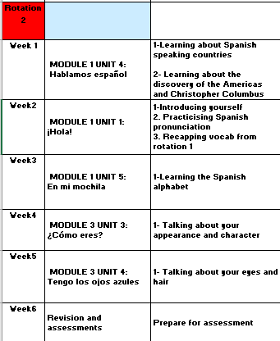

Slide 3
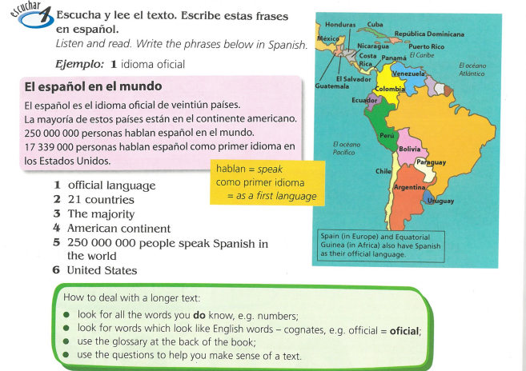

WEEK 1 – w/c 28th February
This week we are learning about some other Spanish speaking countries. Look at the map below and try and copy it. You will also learn about the discovery of the Americas on the next slides.

Slide 4
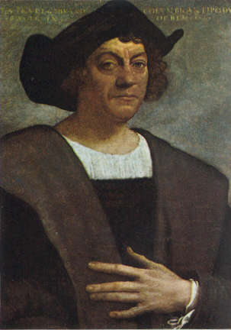
The discovery of the Americas
Today we are going to be looking at a cultural topic. We have looked at Spanish speaking countries in class and this week you are going to learn about the discovery of the Americas by Christopher Columbus.

Slide 5
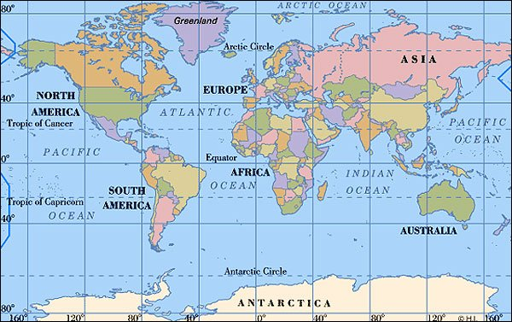
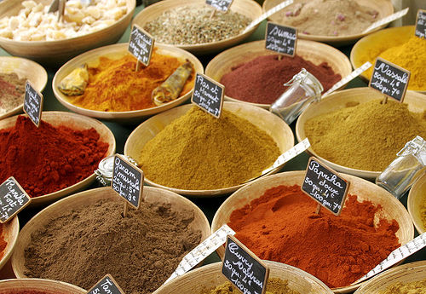
Christopher Columbus was born in 1451. He was Italian. When he grew up he became a great explorer who sailed across the Atlantic Ocean, hoping to find a route to India. He moved to Spain in 1491.
Italy
U.S.A
India was very important because many of the spices that people in Europe wanted grew there. They used these spices in cooking, for medicine, to dye their clothes and lots of other things.
India

Slide 6
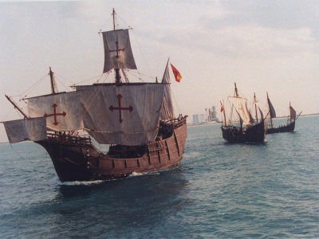
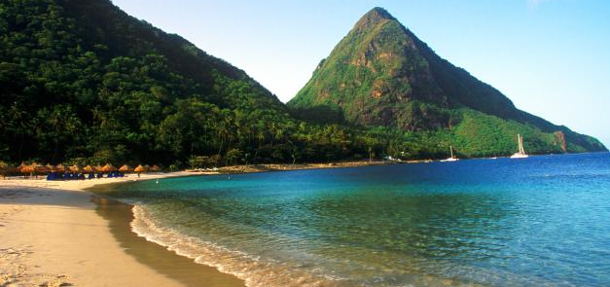
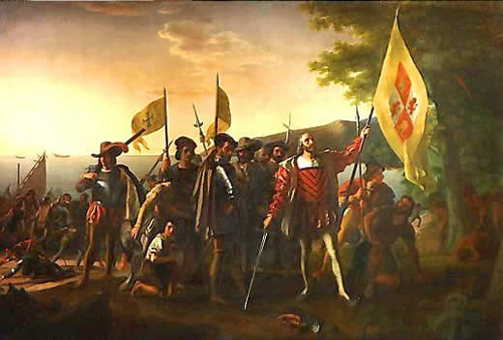
Columbus sailed for King Ferdinand the second and Queen Isabella of Spain. Columbus sailed with three ships, the Niña, the Pinta and the Santa Maria, and about 90 crew members. They set sail in August 1492 from Spain.
In October 1492 they spotted the Caribbean islands off the coast of America. They landed on an island they named it San Salvador. They were met by the native people. Many of these people were captured by Columbus' men and later sold as slaves. Columbus thought he had made it to India, and called this area the Indies, and called the people who lived there Indians.
Columbus didn’t know it at the time but he had discovered a new part of the world. Many people moved to the Americas after his great discovery. It became known as The New World.

Slide 7
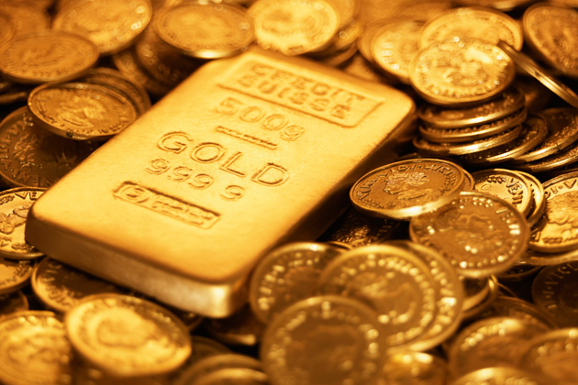
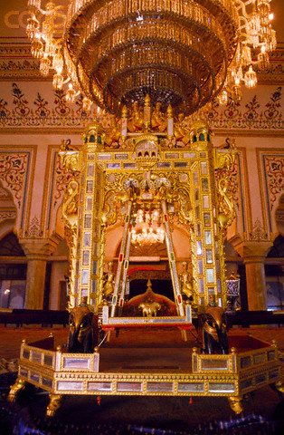
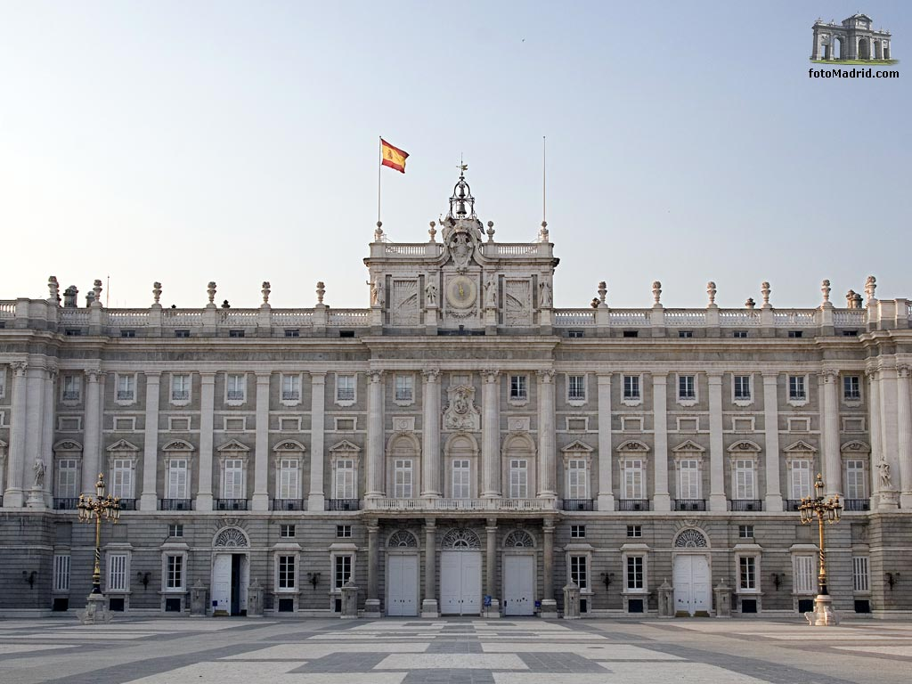
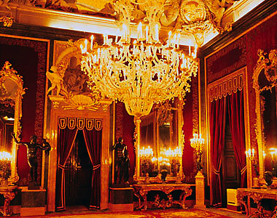
Columbus made four more trips to the Americas. Each time he and other explorers stole gold and new foods from the people already living on the land
Columbus and his other conquerors brought misery to many Native Americans. The Europeans stole their land. Many Native Americans were killed from diseases brought by Columbus and his men or by being forced to work in mines instead of growing food to eat.
The gold was taken back to the King and Queen in Spain.
Inside the royal palace
The royal palace in Madrid.

Slide 8
Write an extract from the ship’s log (diary) as though you were a sailor / Christopher Columbus on the first voyage
(Remember they hadn’t seen land for 6 weeks and were living in cramped conditions. Food and fresh water supplies would have been very low)

Slide 9
Choose from one of the following tasks:
Produce an information poster/booklet about the discovery of the Americas. You could use the internet to find even more facts too.
OR
2)Write an extract from the ship’s log (diary) as though you were a sailor / Christopher Columbus on the first voyage
(Remember they hadn’t seen land for 6 weeks and were living in cramped conditions. Food and fresh water supplies would have been very low)

Slide 10
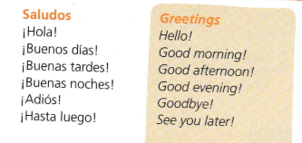
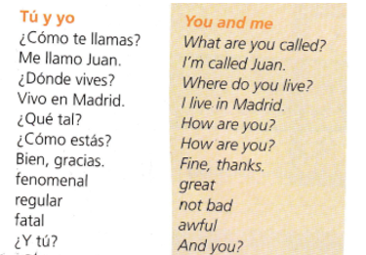
WEEK 2 – w/c 7th March
Read through the vocabulary for this week and spend a good amount of time trying to learn it.

Slide 11
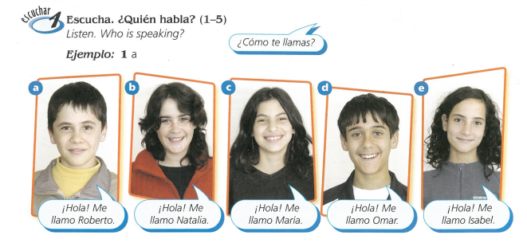

Slide 12
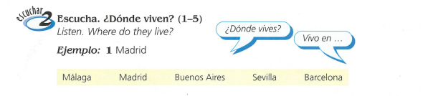

Slide 13
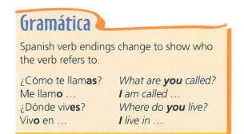
Copy this in to your book.

Slide 14
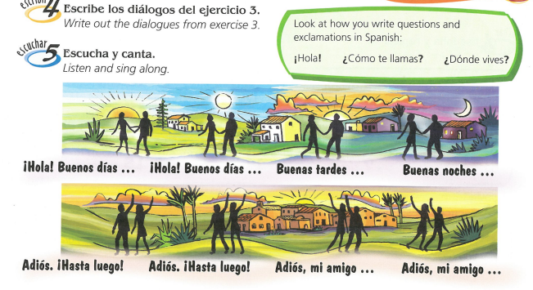

Slide 15
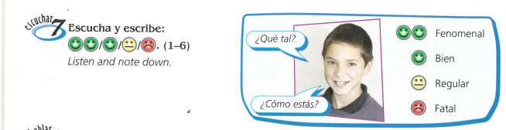
How are they feeling? Listen to the recording

Slide 16
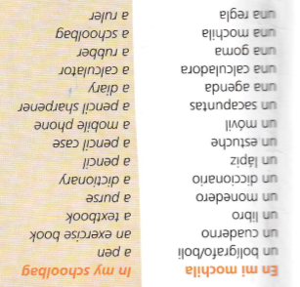
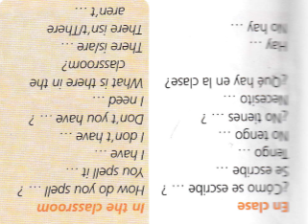
WEEK 3 – w/c 14th March
Read through the vocabulary for this week and spend a good amount of time trying to learn it.

Slide 17
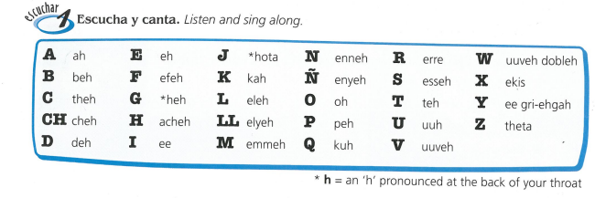

Slide 18
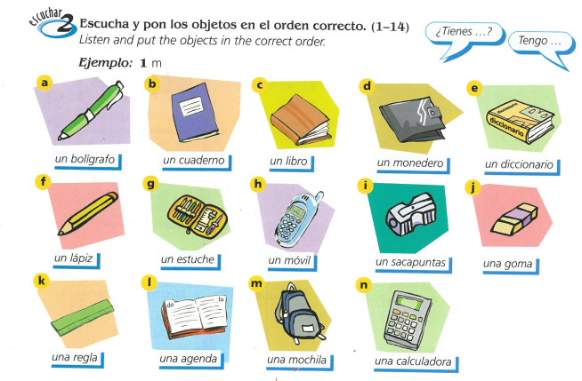
You could also make a poster of stationery items in your book

Slide 19
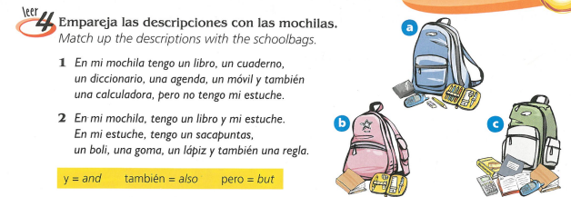

Slide 20
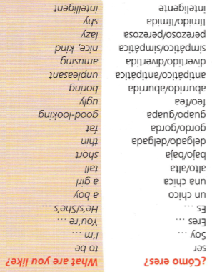
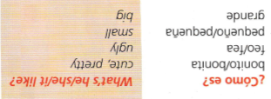
WEEK 4 – w/c 21st March
Read through the vocabulary for this week and spend a good amount of time trying to learn it.

Slide 21
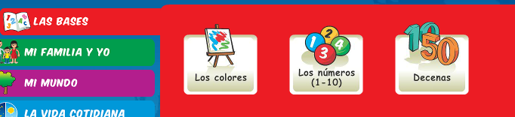
Log on to Linguascope and practise the colours words from last week (they are in the beginner section):
Username – kingshill password – mfl123*

Slide 22
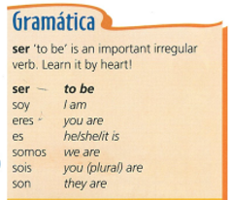
Copy down the following grammar:

Slide 23
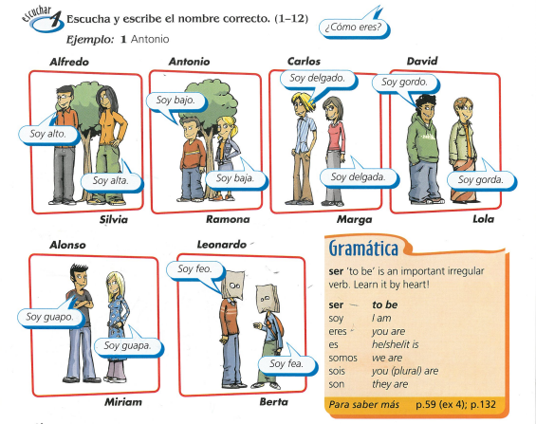
Listen to the recording. Write down 1-12. Which person is talking? Write down the person’s name.
E.g. 1) Antonio

Slide 24


Slide 25
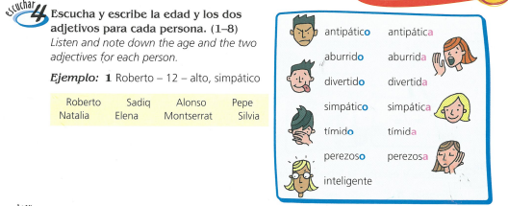

Slide 26
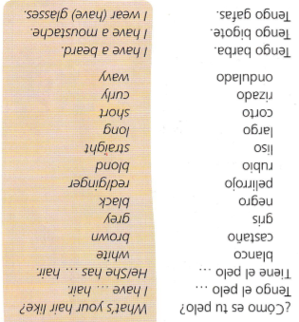
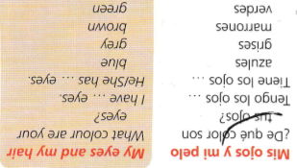
WEEK 5 – w/c 28th March
There is no new vocab this week, but you will need
the vocab from previous weeks for this week’s tasks.

Slide 27
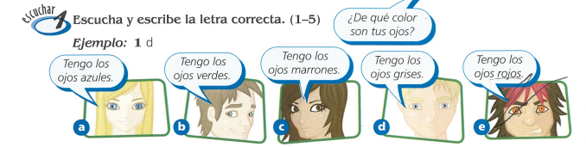
Listen to the recording. Write down 1-5. Which person is being described? a,b,c,d or e?

Slide 28
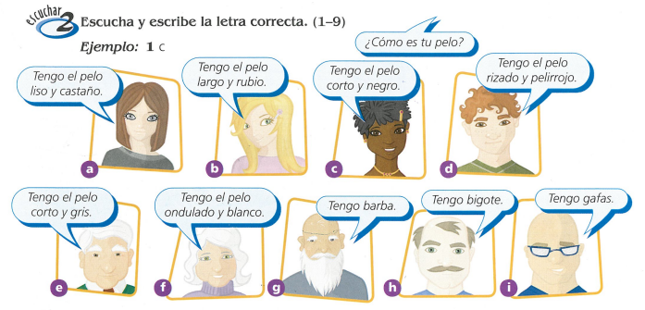
Listen to the recording. Write down 1-9. Which person is being described? Write the letter a-i

Slide 29


Slide 30
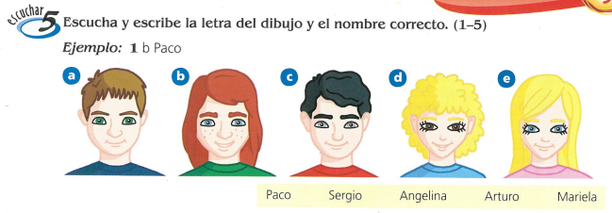
Listen to the recording. Write down 1-5. Which person is being described? Write a,b,c,d or e and their name

Slide 31
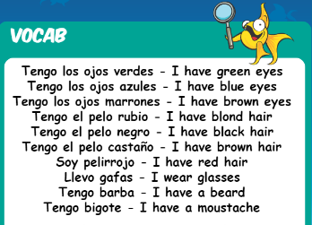
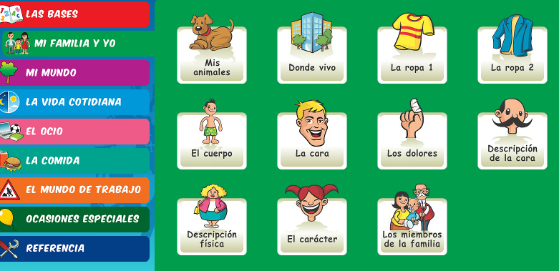
Log on to Linguascope and practise the hair and eye words (they are in the beginner section). The words are below:
Username – kingshill password – mfl123*

Slide 32
WEEK 6 – w/c 7th April
This week is assessment week. Spend some time revising all of the vocab on these slides so far (or on your vocab sheet which is in your orange book) and then email your teacher for the test papers.
There is also some information about Easter in Spain to read through.

Slide 33
The Spanish word for 'Easter' is Pascua.
The seven days leading up to Easter Sunday are called Holy Week, or La Semana Santa in Spanish.
All over Spain, it is a week of spectacular street processions (procesiones).

Slide 34
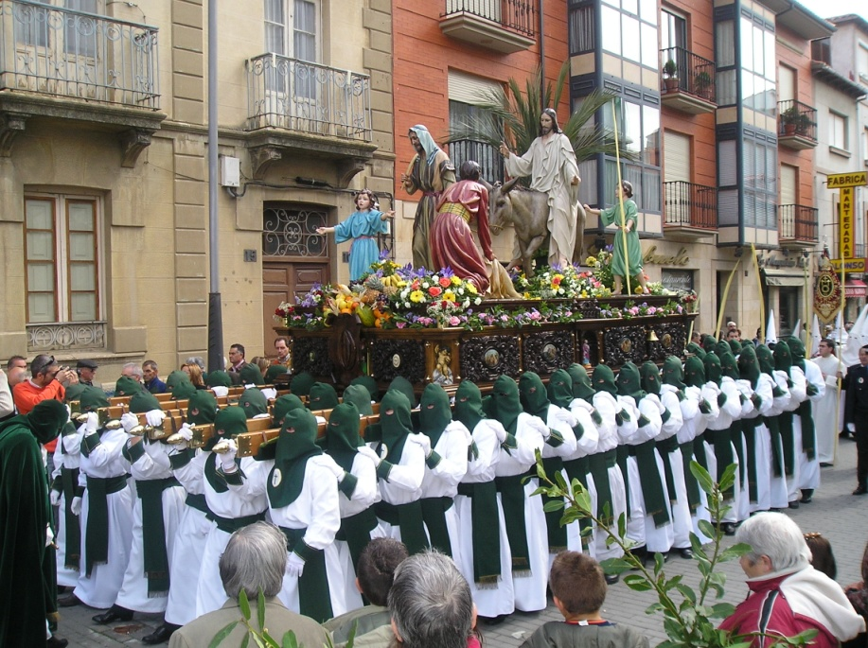
During La Semana Santa, starting on el Domingo de Ramos, Spanish towns have street parades every day.
In the processions, people carry and follow floats,
known as pasos.
On the floats, there are statues of Jesús and La Virgen María. The floats are beautifully decorated with flowers, gold, silver, candles and fine fabrics.

Slide 35


Easter week in Spain is a time of serious processions and remembering the events leading up to and including the death of Jesus.
But, on Easter Day (El Domingo de Resurrección) it is a day of happiness and celebration because on this day the Resurrection of Jesus is remembered.
In recent years the tradition of giving Easter Eggs has really taken off.

Slide 36
The most exciting place to visit during La Semana Santa is probably the city of Sevilla in the south of Spain.
Its processions are the most impressive and famous, attracting hundreds of thousands of visitors.
As a result, the city becomes overcrowded, but it is a very exciting and interesting time to be there!

Slide 37
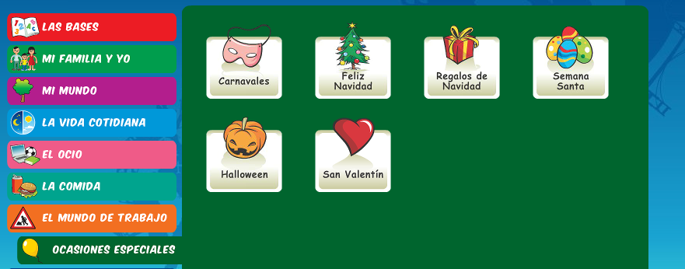
There is an Easter section on Linguascope in the beginner section too.
username – kingshill password – mfl123*

