Slide 1
Year 7 German rotation 2:
If pupils are absent from lessons they should spend time revising and learning vocabulary. All of the vocabulary for this term is on the following slides. First of all, they should recap the vocabulary which they learned the previous week. Then they should start to learn the next section of vocabulary which they have not yet covered in class. This could be done by using the look, cover, write, check method or by making flashcards etc. It should also be written in their orange book. There are also a few tasks to complete. A plan for the term is on the next slide.
Pupils can also revise vocabulary on Linguascope-
Username is kingshill password is mfl123*
Any new vocabulary they learn can be written in their orange books or on paper.
If pupils wish to do extension work they can access free MFL lessons on the Oak National Academy website:
https://classroom.thenational.academy/subjects-by-key-stage

Slide 2
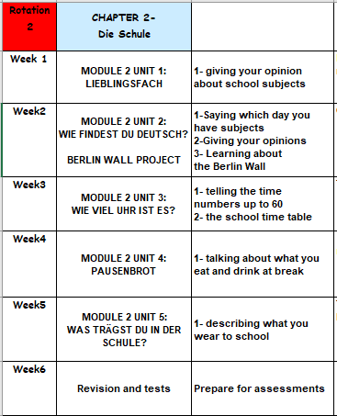

Slide 3
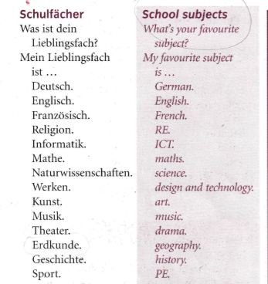
WEEK 1 – w/c 28th February
Read through the vocabulary for this week and spend a good amount of time trying to learn it. You will need these words to complete the tasks on the next few slides.

Slide 4
Copy the title in to your orange book ‘Was ist dein Lieblingsfach?’ What is your favourite subject?
This term you will be learning about school in Germany. Things are a little different in German schools, for example they usually finish about 1.30pm! They do start earlier than English schools though. They also do not have a school uniform. Before you all decide to move to Germany though, it is worth knowing that if you do not pass your end of year exams you are made to repeat the year! How would you feel about that?

Slide 5
Copy down the following:
Was ist dein Lieblingsfach? – What is your favourite subject?
Mein Lieblingsfach ist Mathe – My favourite subject is maths.
Now write a sentence in German saying what your favourite subject is.

Slide 6
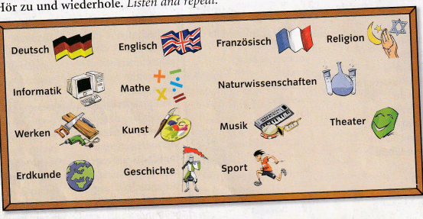
Copy down the school subjects in to your orange books. Draw a little picture for each one. Remember, all nouns in German need a capital letter.
German
English
French
RS/RE
Note-
You can shorten Naturwissenschaften to Naturwiss.
Computing/IT
maths
Science
DT
art
music
Drama
Geography
History
PE
Listen to the recording at how the subjects are pronounced and repeat.

Slide 7
Listen to the recording. Write 1-12. Which subject do they mention?
E.g. Musik

Slide 8
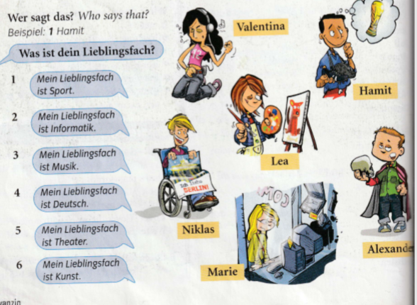
Look at the pictures of the 6 children – Valentina, Hamit, Lea, Niklas, Marie and Alexander.
Then look at the 6 sentences saying what their favourite subject is. Match them up.
Example –
1= Hamit
(because the sentence says my favourite subject is PE and he is dreaming of the world cup)

Slide 9
Look at the 6 pictures below. Write down what they are in German
Unscramble these school subjects. Example is done for you.
Example – tuksn = Kunst
1. hsedctu 2.kendurde 3. kiofrnmita 4. iksmu 5. tahme

Slide 10
Log on to Linguascope and practise the school subjects in German. You will find them in the pale blue part of the beginner section (die Schulfächer). There is a worksheet you can print out and a test you can do if you would like to. Listen carefully to how they are pronounced and repeat the words.
username = kingshill password= mfl123*

Slide 11
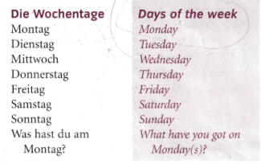
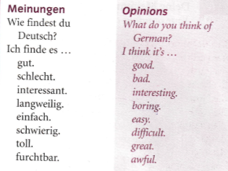
WEEK 2 – w/c 7th March
Read through the vocabulary for this week and spend a good amount of time trying to learn it. You will need these words to complete the tasks on the next few slides.

Slide 12
Copy down the days of the week in to your orange books (make sure they have a capital letter just like in English)
Montag-Monday Dienstag-Tuesday Mittwoch-Wednesday Donnerstag-Thursday
Freitag-Friday Samstag-Saturday Sonntag-Sunday
Did you notice that Thursday is very different to the other days? This is because it translates as ‘midweek’ as Wednesday is half way through the working week.

Slide 13
Listen to the recording. Write down 1-7. Which day do they say?
Example 1) e

Slide 14
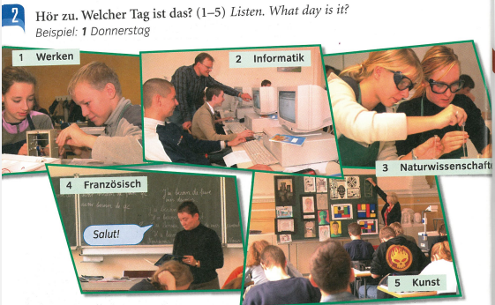
Listen to the recording. Write down 1-5. Which day do they say it is?
Example 1) Donnerstag

Slide 15
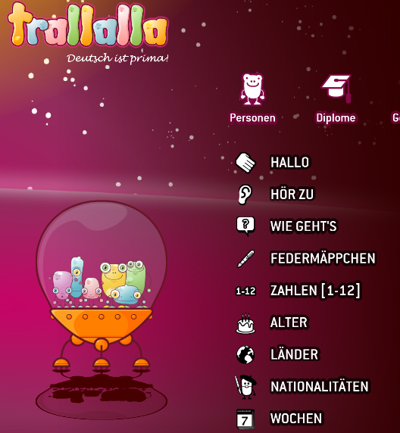
Log on to Linguascope and practise the German days of the week (Wochen) in the elementary section. Listen carefully to how they are pronounced and repeat the words.
username = kingshill password= mfl123*

Slide 16
Listen to the recording. Write down 1-8. What do they think of the subjects?
Remember:
Wie findest du? Means ‘What do you think of…?’
Ich finde es… means ‘I find it …’
Example = 1)a

Slide 17
Make a poster in German about your opinions of school subjects and draw some pictures.
For example:
Ich finde Deutsch gut
Ich finde Mathe schwierig

Slide 18
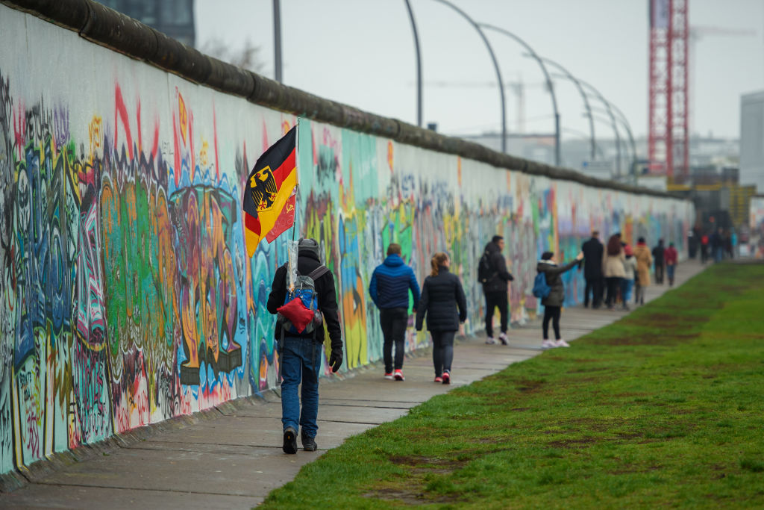
Look at the slides about the Berlin Wall. This is an important part of German history.

Slide 19
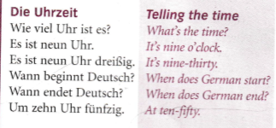
WEEK 3 – w/c 14th March
Read through the vocabulary for this week and spend a good amount of time trying to learn it. You will need these words to complete the tasks on the next few slides.

Slide 20
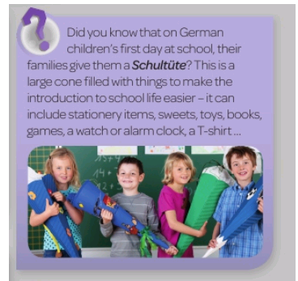
Year 7 German work Term 6 week 2 – w/c 8th June 2020
This week we are going to learn how to tell the time in German. You will need to recap numbers first on the following slide.
What do you think of this?

Slide 21
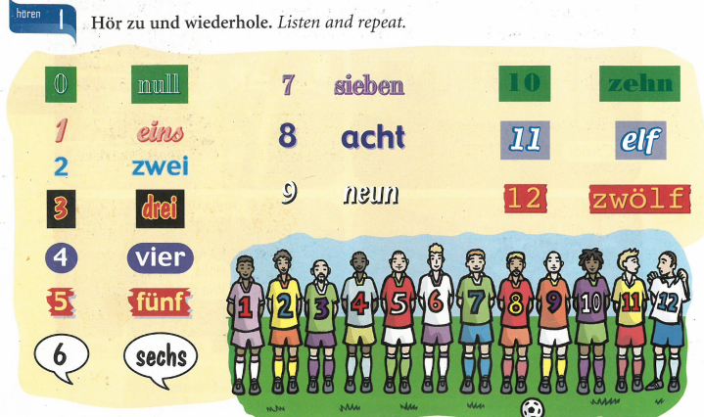
We are going to learn some big numbers this week. First let’s recap the numbers 1-12. Click on the listening track

Slide 22
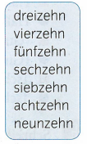
The numbers 1-9 are very important and we will see those again later when we count from 20-100 so I would like you to say them in your head a few times now.
Now let’s look at 13-19. What do you notice?
1- eins
2- zwei
3- drei
4- vier
5-fünf
6-sechs
7-sieben
8-acht
9- neun
Notice the s is missing off sechs and the en is missing of sieben,

Slide 23
You are now well on the way to learning all of your numbers. Lets look at the following. Make a note of these in your books:
20 -zwanzig
30- dreißig
40 – vierzig
50 – fünfzig
60 – sechzig
70 – siebzig
80 – achtzig
90- neunzig
Be careful not to muddle up zehn and zig, especially when listening to numbers.
fünfzehn = 15
fünfzig = 50
Notice the s is missing off sechs and the en is missing of sieben, just like with 16 and 17
Also, dreißig isn’t written with a z but it sounds the same

Slide 24
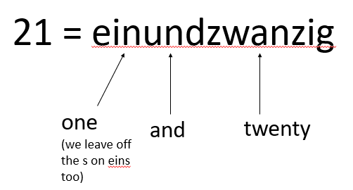
We now have everything we need to put the numbers together. Let’s look at how it works. For all numbers 21-99 we say the second number first in German. For example…
22=zweiundzwanzig 87=siebenundachtzig
35 = fünfunddreißig 49=neunundvierzig

Slide 25
Wie viel Uhr ist es?- What time is it? This is how you do the o’clock times in the 24hr clock. Make a note of a couple of examples.
08:00
17:00
Es ist acht Uhr.
Es ist siebzehn Uhr.
03:00
20:00
Es ist zwanzig Uhr.
Es ist drei Uhr.
14:00
23:00
Es ist vierzehn Uhr.
Es ist dreiundzwanzig Uhr.

Slide 26
This is how you do other times. You say the o’clock time first and then just say the minutes. Write down a couple of examples.
08:05
17:40
Es ist acht Uhr fünf.
Es ist siebzehn Uhr vierzig.
03:10
20:45
Es ist drei Uhr zehn.
Es ist zwanzig Uhr
fünfundvierzig.
14:25
23:58
Es ist vierzehn Uhr
fünfundzwanzig.
Es ist dreiundzwanzig Uhr
achtundfünfzig.

Slide 27
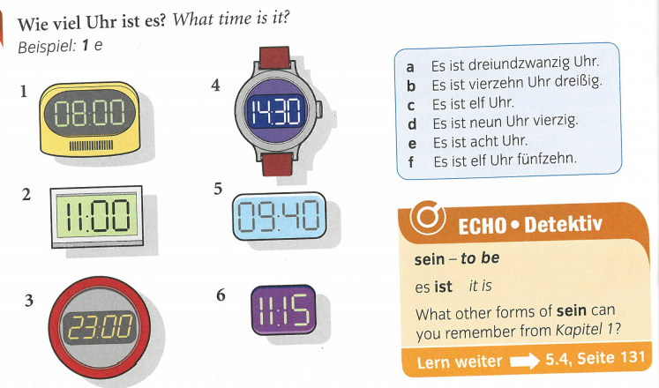
Echo 1 text book page 28 ex1
Match up the watches and clocks 1-6 with the times on the right a-f

Slide 28
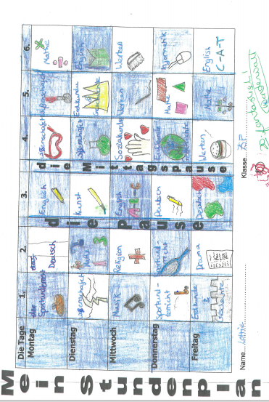
You are now going to make your timetable (Stundenplan) in German. Fill in the spaces with
the subjects (don’t forget capital letters). Then draw a picture to represent each one. There is
a printable version on the next slide
Mein Studenplan = my timetable
Die Pause = break
Lesen-reading
Die Mittagspause = lunch
Sozialkunde=PSHE
Alphabetisierung = literacy
Geisteswissenschaften = humanities
✓
✓

Slide 29
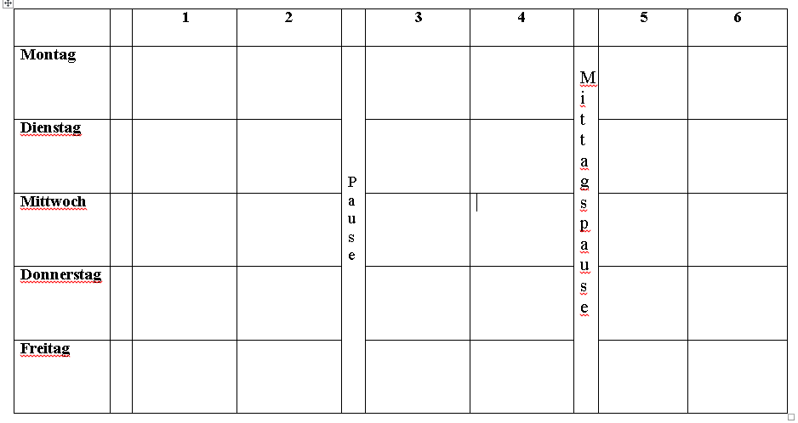
Try and write out your timetable in German. Print out the one below or copy it on to paper.)
Pause=break Mittagspause=lunch (I have put this after period 4 otherwise it would have been difficult to write in the subject)

Slide 30
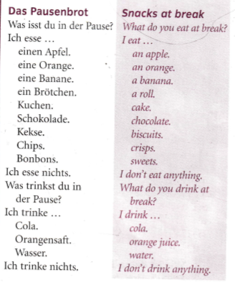
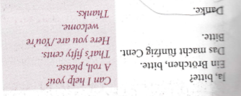
WEEK 4 – w/c 21st March
Read through the vocabulary for this week and spend a good amount of time trying to learn it. You will need these words to complete the tasks on the next few slides.

Slide 31
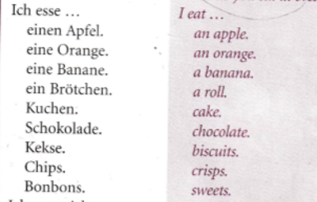
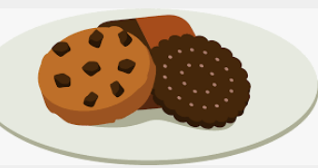
Make a poster in your books of these food and drink items. Draw a picture and label the items in German and English – Don’t forget the capital letters in German.

Slide 32
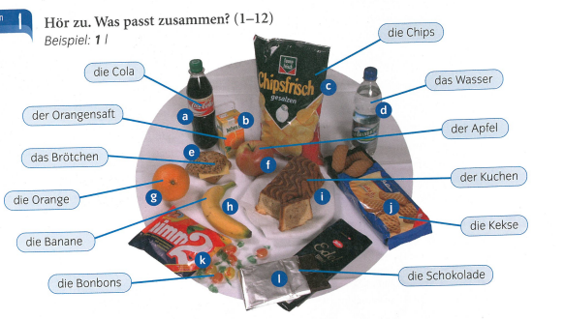
Listen to the recording. Which food or drink item is mentioned? Write down 1-12 and the correct letter. Example 1) l

Slide 33
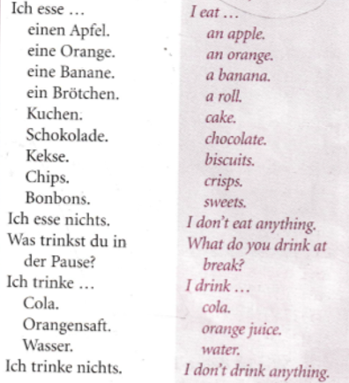
Listen to the recording. What does each
person say they eat and drink?
Example:
Peter – a sandwich, an apple

Slide 34
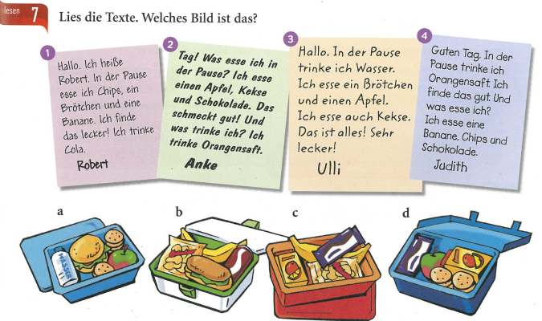
Read the descriptions and match them to the lunchboxes

Slide 35
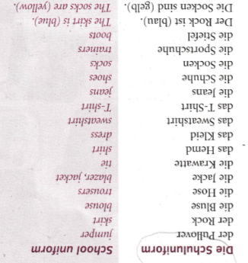
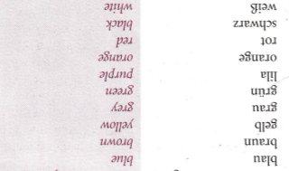
WEEK 5 – w/c 28th March
Read through the vocabulary for this week and spend a good amount of time trying to learn it. You will need these words to complete the tasks on the next few slides. There are more words on the next slide too.

Slide 36
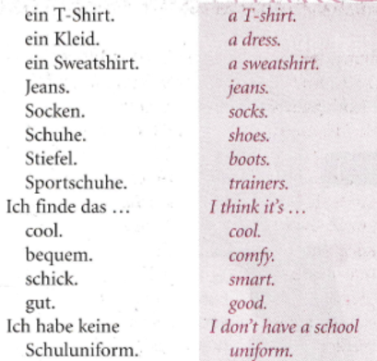
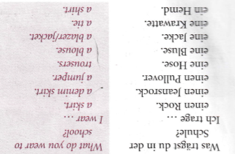

Slide 37
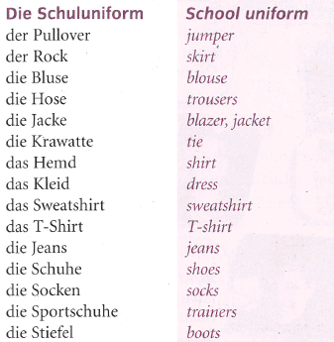
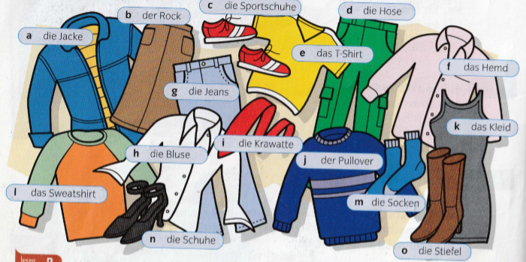
Did you know that in Germany pupils don’t wear a school uniform?
Look at the picture below. Copy the pictures and label them in your book. Remember der/die/das are the German words for ‘the’. Title ‘die Kleider – clothes’

Slide 38
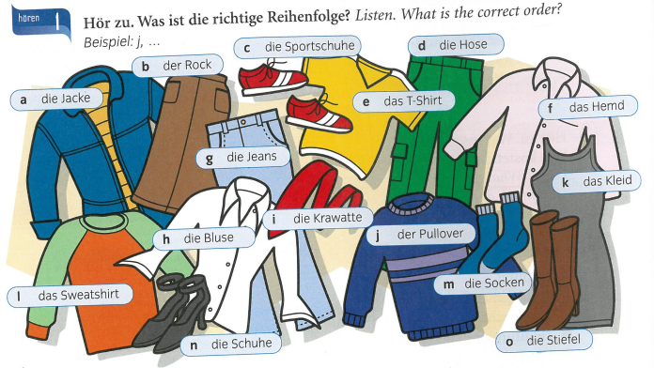
Listen to the recording. What order do they mention the items? Write down the letters in the correct order.
Example, j, …

Slide 39
Look at the picture. Are the 6 statements true or false?
Remember ‘ist’ means ‘is’ and ‘sind’ means ‘are’

Slide 40
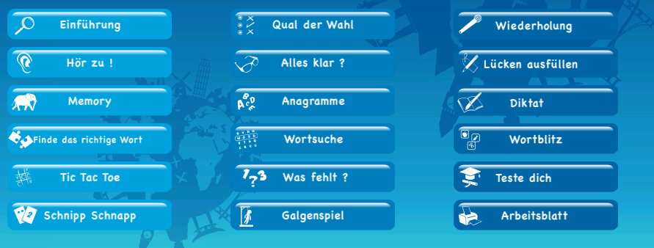
Log on to the beginner’s section of Linguascope and practise the clothes vocabulary (Die Kleidung 1 and 2). You will find this in the green section as seen below. Make a note of the new vocabulary that is introduced (shorts/suit/dungarees etc).
username = kingshill password= mfl123*
Optional task-
If you would like to print out a worksheet or take a quick test you will find that here:

Slide 41
WEEK 6 – w/c 7th April
This week is assessment week. Spend some time revising all of the vocab on these slides so far (or revise the chapter 3 vocab sheet in your exercise book) and then email your teacher for the test papers. There are also revision activities on the next slide.
There is also some information about Easter in Germany to read through.

Slide 43
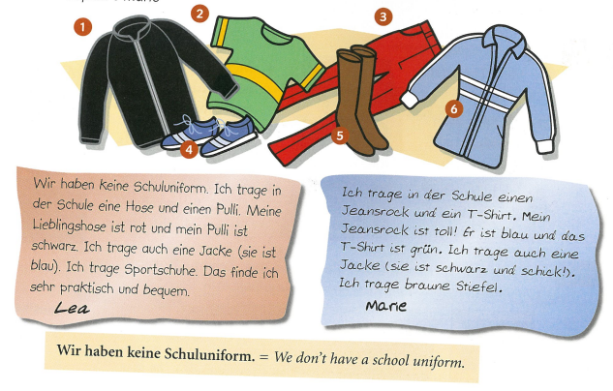
Read the descriptions of what Lea and Marie wear. Write down 1-6 and then say if Lea or Marie wears the item. Remember ‘Ich trage…’ means ‘I wear…’
Example – 1) Marie

Slide 47
There is an Easter section on Linguascope in the beginner section too.
username – kingshill password – mfl123*

