Slide 1

Analysis and Evaluation Task
Cirencester Kingshill School PE Department – GCSE PE
Coursework

Slide 2

Mark Allocation …
Analysis is worth
15 marks
Identify strengths and weakness MUST JUSTIFY!!!
Evaluation is worth 10 marks
Devise a session combating a weakness. Comment on a different part of the spec.

Slide 3
Identify Strengths
STRENGTH
My strength is ­­­­­­­­­­­­­­­­­­­­­______________ (refer to a Component of Fitness and give a clear definition)
STRENGTH
My strength is _______________ (refer to a specific skill/technique on the spec or tactic/strategy/aspect of choreography)
Speed
Agility
Muscular strength
Endurance …
Shooting
Tackling
Ins and Out when shooting in Netball

Slide 4
Identify Weakness
WEAKNESS
My weakness is ­­­­­­­­­­­­­­­­­­­­­______________ (refer to a Component of Fitness and give a clear definition)
WEAKNESS
My weakness is _______________ (refer to a specific skill/technique on the spec or tactic/strategy/aspect of choreography)
Speed
Agility
Muscular strength
Endurance …
Shooting
Tackling
Ins and Out when shooting in Netball

Slide 5
Evaluations
CREATE A SESSION PLAN THAT COVERS YOUR WEAKNESS
Clearly identify and describe training method have you selected that will improve both your weaknesses.
The method of training that I have chosen is Circuit Training. Circuit training involves performing a series of exercises in a special order called a circuit. Each activity takes place at a 'station'. It can be manipulated to improve a range of components of fitness such as; speed, agility and coordination.
Justify why you have selected that training method to combat both your identified weaknesses.
I have chosen this method as I am able to focus my session on improving my agility which is my first weakness and it can also combat my second weakness of dodging away from my defender. By creating a range of different stations I avoid any form of tedium as each station is different. I also have made some of the stations sports specific. This means that I will be able to target my weakness and relate it directly to my sport. Circuit training is also easy to progress, therefore as I complete my training programme over a series of 6 weeks I am able to change the frequency of the stations, the time spent on the stations and change the type of station. This will cause my body to overload and ultimately progress.

Slide 6
Evaluations
Outline and describe one session of your chosen training type focusing on the weaknesses. Include a Warm Up and Cool Down
Explain how your training programme will help improve your weaknesses.
Include teaching points
Station | Description and teaching points | Image | Time spent on station
Zig Zag Shuttles
Squat and side step
Pole weave
Hurdles
Ladders

Slide 7
Evaluations
COMMENT ON A DIFFERENT ELEMENT OF THE SPEC
Identify another part of the specification in relation to the weakness and your training programme.
Justify how knowledge of this area could improve performance (provide detail).
How can we use this knowledge in our future performances?
Diet
Arousal
Training thresholds
Injury
Oxygen Debt
Recovery after exercise
Somatotypes
Mechanical advantage
Training Seasons
Skill Classification
Goal Setting
Information Processing
Guidance and Feedback
Aggression
Personality types

Slide 8
Theory for weakness one: Arousal control
My chosen area of the course that I think can help my rugby performance is arousal control.
Arousal is defined as a physical and mental (physiological & psychological) state of alertness/ readiness varying from deep sleep to intense excitement/ alertness. In my case my arousal often shows in how focused, excited, aggressive and alert I am. Every skill in rugby (or any other sport) has a perfect level of arousal – called the optimal point. You can be over or under aroused depending on the arousal level needed to do the skill. The perfect arousal level is known as the optimal point as shown in the Inverted U theory below.
With specific reference to my mauling, I do believe that I am often over aroused when entering a maul, particularly as a supporting player. I tend to approach a maul with very high arousal, knowing that I must try to help our player keep possession. In the weakness I gave in my analysis, I was aggressive in my approach to the maul and lost focus, entering the maul from the side and being penalised. By working on how to control my arousal I think I can improve my performance in mauls (and other areas of my game) in future.
I am going to use two arousal control techniques:
deep breathing
mental rehearsal
Deep breathing involves taking slow, deep breaths so that the body can relax. In my case, I will aim to do this in between ‘phases of play’, trying to relax my muscles and focus on my breathing. If for example a penalty is given, I will take the chance to slow my breathing rate and take deeper breaths. If a maul then follows as play starts, hopefully my arousal will be closer to what is needed. For a maul, a fairly high level is needed, but if it is too high and not controlled, you can end up doing something wrong – like I did in my weakness. This is shown in the diagram below- marked as an X. : 1205
Mental rehearsal is a technique, which involves picturing the perfect performance in your head. For a weakness like mauling, I could do this when looking at mauls I am not involved in- picturing mentally how I would enter the maul if I needed to. As a winger I get lots of time without the ball and can picture the correct technique in moments of not being involved. Picturing the correct technique will hopefully help me focus and control my arousal level so that I am at the correct level for each skill I do- particularly when mauling. I can also use mental rehearsal when approaching a maul, picturing how my technique will be perfect before actually joining as a player. My mental rehearsal can also be used in training drills when I train on a Tuesday night with my team. If I am the ball carrier, I can picture myself taking the hit and turning in between goes of the drill. This should focus my thoughts and control my arousal.

Slide 9
TOP TIPS:
Be really specific with your strengths and weaknesses.
Provide lots of detail.
Use sports specific terminology.
Use images to support the strengths and weakness / images of yourself are even better!!!

Slide 10
10 points to remember: Analysis and evaluation
DO NOT provide individual feedback on content. Generic process feedback can be given
Students can be told about the process
The work can be written or verbal
It is possible to do the analysis verbally and evaluation written (or vice versa)
Candidates chosen for moderation will also have to provide their A&E
Any verbal interviews must be recorded
For verbal interviews, it is ok for students to bring in brief notes to assist
Students can do their analysis and evaluation on any activity- including those within the specification out with the three assessed activities
Students can do their analysis and evaluation on another student
Teachers should avoid leading questions. Open-ended questions should be used.

Slide 11
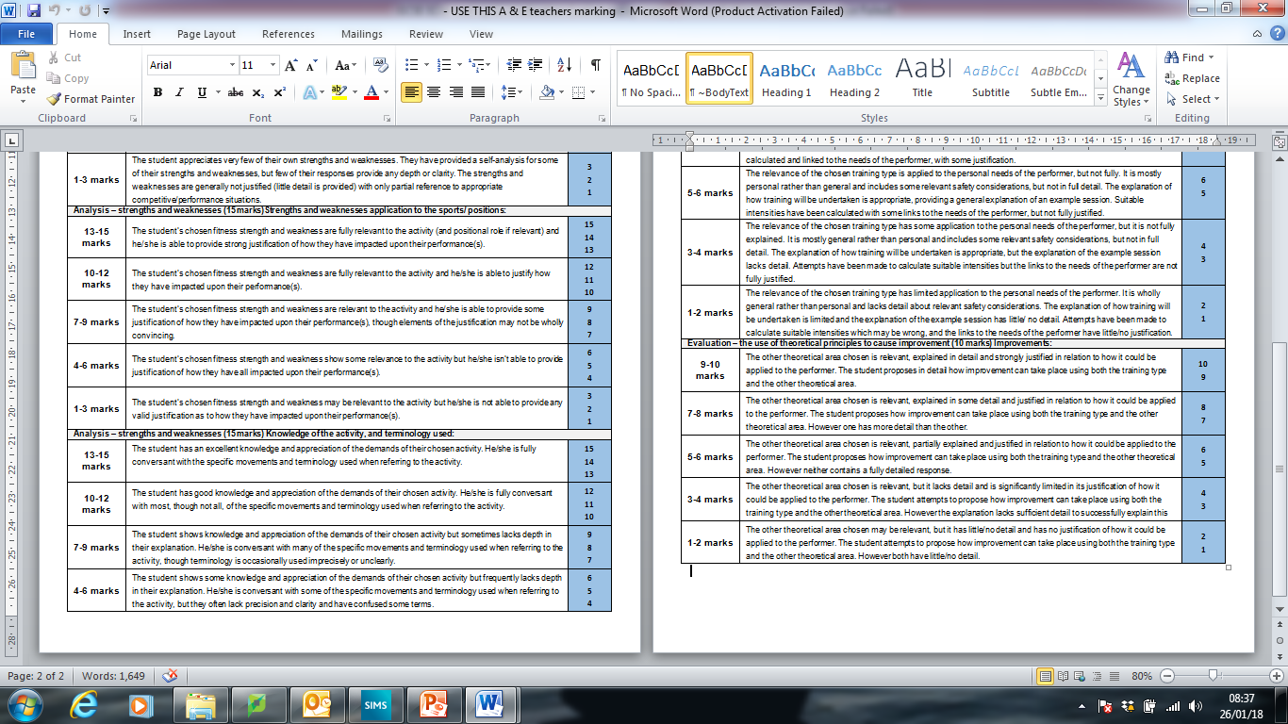
Mark Scheme

Slide 12
COURSE WORK REVIEW – Action points 2019
A1. Strengths and Weaknesses
Add detail – use coaching points, compare to a perfect model. Include images and use arrows to annotate.
Justify your strengths and weakness! Use at least 2/3 sporting examples! Why they are useful for you and your position.
Explain the ‘outcome’, why did / didn’t you achieve success?
Add depth – use clear / recognised terminology that identifies what you do / don’t do well. Definitions! Basic explanation what is a scrum?!
You do not need to do 2 strengths and 2 weaknesses. You can just do 1 in loads of depth.

Slide 13
A2. Evaluation – Action Plan
Provide a clear and detailed justification of your chosen weakness – why is it the most important one for you to improve?
Your weakness your improving needs to be a weakness you have already identified!!
Definition of method of training and strengths and weakness.
Add depth – include the energy system / training zone you plan to work in with a reason why! What is training zones? Which ones are important for you?
A3. Evaluation – Action plan / Description of Session
Add detail – Personalise the ‘Principles of Training’ (SPORT)
You will not add any marks by simply giving a generalised description of what the ‘PoT’s are!!!
Ensure this explanation is linked to your weakness!
Give more detail regarding your session. Coaching points…

Slide 14
A4. Evaluation – How can you improve over time?
Explain how ‘hard’ you are working.
Intensities are required, work it out …
  Maximal = Strength/Speed – anaerobic (85-95% of max H/R)?
  Sub Maximal = Muscular Endurance – on the threshold between an/aerobic (75-85% of max H/R)?
  Aerobic = C/V – continuous (60-80% of max H/R)?
A5. Evaluation - Link to ‘Theoretical’ principle
  Ensure your principle is explained.
  It must link to your weakness(s) and/or your chosen method of training!

Slide 15

Extended Writing
Explain and justify whether the different types of strength are required for a triple jumper. (9 marks)
 | I | D | E | A
 | IDENTIFY | DESCRIBE | EXPLAIN | APPLY

Slide 16
IDENTIFY | To begin with, identify what the question is asking you to do. Then identify the topic or point from the GCSE specification that you think links to the question.
Sentence starter: | What is this question asking me to do? Justify = support a case with evidence. “One type of strength that would be useful for a triple jumper is…”
DESCRIBE | Now, simply describe what this is / give a definition if possible. (Tip: keep away from ‘cause & effect’ connectives i.e. ‘because’ as this is the next stage!)
Sentence starter: | “The athlete would…” “This is when…”

Slide 17
EXPLAIN | Explain the definition/point in your own words. What does it mean? Show you fully understand the topic. How does your point relate to the question?
Connectives: | “because…” “ so…” “thus…” “consequently…” “therefore…”
ANALYSE/ APPLY | Link the points you have made to specific sporting example / what are positive and negative effects of the things you have identified in relation to the exam question? How will your performer use this point/topic?
Sentence starter: | “For example…”

Slide 18
Apply it – extended writing planning
Type of strength | Definition | Aspect of triple jump that it is/is NOT relevant | How that type of strength will be beneficial/NOT beneficial for a triple jumper

Slide 19
Apply it – extended writing planning
Type of strength | Definition | Aspect of triple jump that it is/is NOT relevant | How that type of strength will be beneficial/NOT beneficial for a triple jumper
Explosive strength

Slide 20
Apply it – extended writing planning
Type of strength | Definition | Aspect of triple jump that it is/is NOT relevant | How that type of strength will be beneficial/NOT beneficial for a triple jumper
Explosive strength | Amount of force exerted in one quick muscle contraction

Slide 21
Apply it – extended writing planning
Type of strength | Definition | Aspect of triple jump that it is/is NOT relevant | How that type of strength will be beneficial/NOT beneficial for a triple jumper
Explosive strength | Amount of force exerted in one quick muscle contraction | Used in the final phase; take off

Slide 22
Apply it – extended writing planning
Type of strength | Definition | Aspect of triple jump that it is/is NOT relevant | How that type of strength will be beneficial/NOT beneficial for a triple jumper
Explosive strength | Amount of force exerted in one quick muscle contraction | Used in the final phase; take off | It will give them more height; allowing them to jump higher and further; gaining a greater distance; more likely to win competition.

Slide 23
Apply it – extended writing planning
Type of strength | Definition | Aspect of triple jump that it is/is NOT relevant | How that type of strength will be beneficial/NOT beneficial for a triple jumper
Static strength | Amount of force exerted on an object you cannot move. | Not used in TJ. | TJ is a dynamic movement from beginning to end, therefore no stillness.

Slide 24
Apply it – extended writing planning
Type of strength | Definition | Aspect of triple jump that it is/is NOT relevant | How that type of strength will be beneficial/NOT beneficial for a triple jumper
Maximal strength | Greatest force possible in a single maximum muscle contraction. | Not used on it’s own in TJ. Perhaps used within take off. | Run up and take off interlinked, so the final movement could be maximal, along with explosive. Would give more height/distance.

Slide 25
Apply it – extended writing planning
Type of strength | Definition | Aspect of triple jump that it is/is NOT relevant | How that type of strength will be beneficial/NOT beneficial for a triple jumper
Dynamic strength | Amount of force that can be exerted repeatedly by a muscle. | Run up, leg momentum. In air, to gain distance. | Dynamic strength reduces onset of fatigue in legs, resulting in my force for take off, therefore height/ distance.

Slide 26
Application…
Explain and justify whether the different types of strength are
required for a triple jumper. (9 marks)
 | I | D | E | A
 | IDENTIFY | DESCRIBE | EXPLAIN | APPLY
REFLECTION & PROGRESSION

