Slide 1
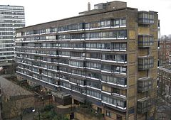
Sparkleshark – by PHILIP RIDLEY

Slide 3
Lesson 1 – Intro to the Script.
This play is about a group of teenagers who all end up on the top of a block of flats at 4.30 on a September afternoon. (10 mins)
Draw a picture / map of the roof top. Levels/ Entrances/ Exits/ Furniture/ Props (10 mins)
Make a list of typical playground stereotypes
Sporty one /–Confident one/ Bully and gang/ Swot/ Arrogant/ Geeky etc
Draw still images showing your pupils in Registration/ Break / Bus (20 mins)
Write a script for one of the images (ie Bring it to life!)
What do you learn about status

Slide 4
Lesson 2 : Sparkleshark Misfits
Mishapes by Blur
Misshapes, mistakes, misfits
Raised on a diet of broken biscuits, oh
We don't look the same as you
And we don't do the things you do
But we live around here, too, oh really
Misshapes, mistakes, misfits
We'd like to go to town but we can't risk it, oh
'Cause they just wanna keep us out
You could end up with a smack in the mouth
Just for standing out, now, really

Slide 5
Lesson 2
Task read page 3 – 6. What is life like for Jake at school?.
Write a diary for Jake - include Polly and Russell.

Slide 7
Lesson 3
Natasha and Carol’s entrance.
Task 1
Read p 6 – 11 as a class
Task 2
Make a list of 5 questions that you want to ask Natasha and Carol to find out more about them. Now answer those questions “as if” you were
Task 3
Design costumes/ make up / props for both Natasha and Carol.

Slide 15
Lesson 3
Natasha and Carol’s entrance.
Task 1
Read p 6 – 11 as a class
Task 2
Make a list of 5 questions that you want to ask Natasha and Carol to find out more about them. Now in pairs answer those questions “as if” you were
Task 3
Design costumes/ make up / props for both Natasha and Carol.

Slide 16
Costumes

Slide 17
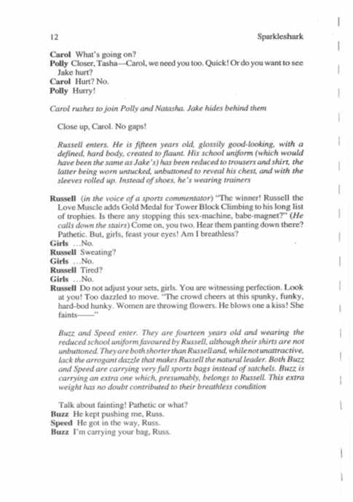
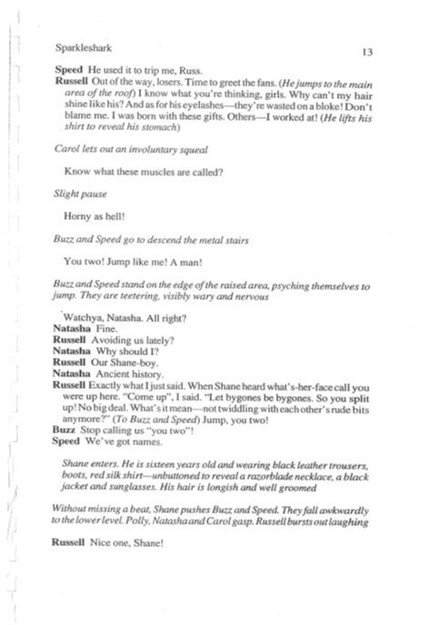
Lesson 4
Watch the first 15 minutes of this performance of Sparkleshark.
Imagine you are directing the entrance of Russell, Buzz and Speed. What would you get your actors to do?

Slide 19
Further Research: Watch video clips of this play using the links below: - JUST up to RUSSELL’S ENTRANCE
https://www.youtube.com/watch?v=lLGoL4kWV2w
https://www.youtube.com/watch?v=qKPRZ3M2AAM
https://www.youtube.com/watch?v=9LA46pD04Eo
Make notes on WWW/ EBI

Slide 20
Lesson 5 Choose ….
Either learn/ perform / costume film – Russells entrance on page 12 up to “Watchya Natasha”
Or – Create a Table Top film…… of Sparkleshark so far

Slide 21
Design Project
Table top scenes. Using what you can find and a table or tray try to re tell the story that we have explored so far.
So – TASK 1 – create the roof top. Then look for objects to map out (block) the action .
You will need to create:
Jakes entrance.
Polly’s entrance and their discussion.
Natasha’s entrance and their discussion.
Carol’s entrance and her argument with Natasha.
Russel’s entrance and the girls hiding Jake.
End when the boys find Jake!

Slide 22
Be creative ……
Stuff on the roof?
A matchbox / notebook for Jake? A pair of glasses?
Phones for Natasha and Carol?
A Pepper pot for Russell?
Small salt and peppers for Russell and Speed?
A Can you take photographs of each key moment?
Add emojis?
Add soundtrack? The Lyrics for Pulps “Misshapes” is on the next page. Sparkleshark has these lyrics at front of the script! Could you use the music? Especially -We won't use guns, we won't use bombs We'll use the one thing we've got more of That's our minds
Make a stop animation?

Slide 23
POLLY: It.... It was about this Princess, wasn’t it Jake? Am I right? Yes? This Princess. What happened, Jake? Right, yes, she lived in a Castle didn’t she Jake? With her father, yeah?
CAROL:The King...?
POLLY:Yes exactly. The Princess... lived with her father... the King...
RUSSELL:And don’t tell me, she had a mother the queen? Had enough of this... Let’s dangle him.
NATASHA:No no no... the Queen had been murdered.
CAROL:Very nasty..
POLLY:Horribly...
BUZZ:How?
POLLY: Well, one day, the Castle had been attacked, by the King’s enemies. The Kingdom had been at war for a long time.
SPEED:What a rubbish King –he should have been prepared.
CAROL:Well yes, he usually was a great soldier but he had the baby Princess...
NATASHA:Yes, and everyone was celebrating. The Castle was full of food and music and flowers.
BUZZ:A good ol’ knees up.
SPEED: Perfect time for an enemy to attack!
POLLY:And the battle was hard and bloody. But the King and his army defeated them.
BUZZ:So what about the Queen?
JAKE:...She was shot in the heart with a single arrow and then they chopped off her head and fed it to the pigs.
POLLY:After that day, the King never let his defences down again. He banned all things nice from the Castle and the Princess grew up with no pleasure.
CAROL:No entertainment or games..
POLLY: the King made the Princess wear a plain black dress. One day, the Princess heard a thumb against her window. She looked to see a dead bird on the sill with a broken neck. She hid it and took it out to the vast plain gardens to bury it. Little did she know, that a seed was inside that bird, and the following summer a flower started to grow from the ground.
POLLY: The Princess took a terrible risk and clipped the flower into her hair.

Slide 24
SCEENE 2:STILL IMA
SPEED:Don’t let the King see!
BUZZ:Too late!JAKE:Daughter –what is that I see in your hair! You’re banished!
POLLY: Princess leaves the Castle and wanders the Kingdom, lost, not knowing where to go. A wasteland.
CAROL:After walking and walking she finally comes upon a forest.
JAKE:Where she plants theflower which is full of seeds...
POLLY:And one year later, there are hundreds of flowers. And then the following year, thousands and then hundreds of thousands and then millions. As far as the eye could see. A blanket of yellow flowers.
NATASHA:And one day, a Prince arrives.
BUZZ:Me?
SPEED:No, me!
CAROL:Yes the most handsome manin all the Kingdom.
RUSSELL:That’d be me then
JAKE:The Princess looked out over her beautiful forest. A million yellow flowers. But the Prince thought that she was more beautiful than all the flowers.
POLLY:I know, a Prince like you who is strong and brave might not see the beauty I have created here.
JAKE:The Prince wanted the Princess to come with him and live in his enormous palace. NATASHA:But the Princess didn’t want to leave.CAROL:She loved her beautiful forest too much and never wanted to be stuck in a castle again.RUSSELL:Well if I’m not good enough for the Princess then... Look I’ve had enough. Let’s go.JAKE:Err.. so... umm...the Princess setthe Princean impossibly hard challenge.BUZZ:Challenge?SPEED:What challenge? I’ll do it.RUSSELL:No I’ll do it. POLLY:Find me something more beautiful than a million yellow flowers and I will come away with youand be your Princess.CAROL:So the Prince

